Slide 1
Circles After Nathanson
The Contemporary Psychology of Affect & Emotion
Courtney tobin

Slide 2
Agenda
Introduction
Biological Models of Emotions, 1960’s to Present
Cognitive Models of Emotions, 1990’to Present
Reconciling Restorative Practices & the Evolving Science of Emotions

Slide 3
Introduction
Courtney Tobin courtneytobin@iirp.edu
MA in General Psychology from Montclair State University (2017)
Thesis: Measurements of Emotional Attributional Biases: A Confirmatory Study of Infrahumanization
Graduate Certificate Student at the IIRP
Institutional Research, Senior Analyst at the IIRP

Slide 4
SCIENCE IS ITERATIVE

Slide 5
Simple Words, Complex Definitions
Cognition
Emotion
Affect

Slide 6
Biological Models of Emotions

Slide 7
Affect & Emotion: Biological Perspective
Affects
Emotions
Sometimes called basic, universal, or primary emotions
Present from infancy; physiological
Cross-culturally universal
Evolved; seen in other mammals
Many labs identify different lists of affects
Sometimes called complex or secondary emotions
Learned; have cognitive components
May vary by culture
Observed only in humans; “uniquely human”

Slide 8
Ekman’s Qualities of Basic Emotions (Affects)
Basic Emotions
Distinctive universal signs
Present in other primates
Distinctive physiology
Distinctive universals in antecedent events
Coherence among emotional response
Quick onset
Brief duration
Automatic appraisal
Unbidden occurrence

Slide 9
1960’s Infant Studies: Silvan Tomkins’ Affect Theory
Enjoyment / Joy
Interest / Excitement
Surprise / Startle
Anger / Rage
Disgust
Dissmell
Fear / Terror
Shame / Humiliation
Basic Affects
Distress / Anguish

Slide 10
1990’s Cross Cultural Studies: Paul Ekman’s 5 Basic Emotions

Slide 11
1980’s – 2010’s Neurological Affect
Fear
Seeking
Rage
Lust
Care
Panic
Play
Mammalian Neurological Affect

Slide 12
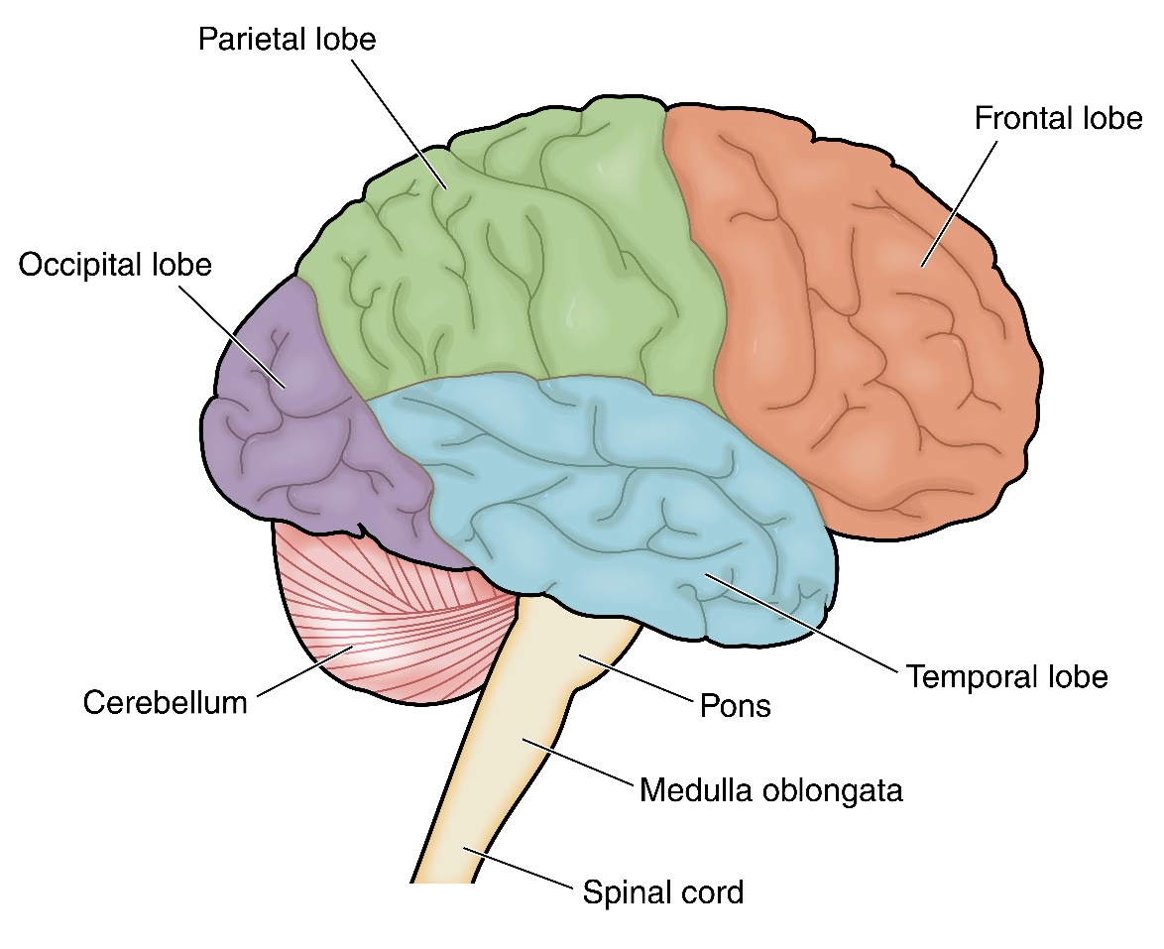
Neurological Overview: Affect & Emotion
Anatomically, affect is found in sub-neocortical areas of the brain, while emotions reside in neocortex.
Stabilized Affectivity: unconscious, in-born cognitive affective processes underlie conscious emotional reactions.

Slide 13
Cognitive Models of Emotion

Slide 14
2010’s: Theory of Constructed Emotion
Physiological Response & Affect
Experience
Emotion
Concepts
Stimuli / Context
The Theory of Constructed Emotion posits that emotions are complex reactions of the brain, created by synthesizing stimuli, psysiological responses, and experience.

Slide 15
Constructing an Emotion
Internal Stimuli (Affect)
Emotion Concepts
Interoception
Prediction Loop Constructs Emotion
External Stimuli (Optional)

Slide 16
2010’s: Appraisal Theories of Emotion
Emotion Episodes
Stimulus Change
Stimulus Evaluation/ Appraisal
Action Tendencies
Somatic Responses
Expressive Behavior
Emotion Experience
Instead of affect preceding cognitive & emotional response, appraisal theory posits that somatic responses (including hormonal and other unconscious response) are predicated by the cognitive appraisal of a stimulus change.

Slide 17
Biological vs. Cognitive Theories
Biological Theories of Emotion
Cognitive Theories
Affect is a biological (or neurological) process which produces emotion.
Emotions are seen as discrete phenomena
Specific, discrete affects are defined by each theory
Cognitive processes produce emotion, possibly while using the input of affect.
Emotion concepts are created as a result of heuristics, or categorical learning
Affect is a schematic model, explaining how some internal information may lead to emotions

Slide 18
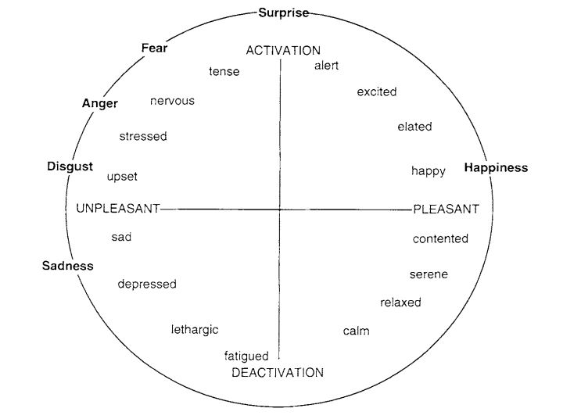
Affect Between Schools of Thought
Figure from Russell & Barrett, 1999, p. 808

Slide 19
Restorative Practices & the Evolving Science of Emotions

Slide 20
Donald Nathanson’s 1992 Compass of Shame
Shame
Withdrawal
Attack Self
Avoidance
Attack Other
The Compass of Shame describes behavioral reactions to adverse feelings, but are these reactions always triggered by the same affective or somatic responses?
How do we put the Compass of Shame to use if shame is not considered a universal affect?

Slide 21
Further Explorations in Practice
As an emerging social science, how do we further explore and test our theories and practice? How do we deal with the messy, iterative nature of science every day?
How do we integrate new information from other disciplines into our own theories?
How do the unanswered questions about the science of emotions inform our science? What answers might we provide? What assumptions do we have to make as practitioners?

Slide 22
Questions?

Slide 23
Suggested Readings
Barret, L. F. (2006). Are Emotions Natural Kinds? Perspectives On Psychological Science (Wiley- Blackwell), 1(1), 28-58. doi:10.1111/j.1745-6916.2006.00003.x
Barrett, L. F. (2017). How emotions are made: The secret life of the brain. Boston, MA: Houghton Mifflin Harcourt.
Moors, A. (2013). On the Causal Role of Appraisal in Emotion. Emotion Review, 5(2), 132. doi:10.1177/1754073912463601
Panksepp, J., Lane, R. D., Solms, M., & Smith, R. (2017). Reconciling cognitive and affective neuroscience perspectives on the brain basis of emotional experience. Neuroscience & Biobehavioral Reviews, 76, 187-215.

Slide 24
Additional References
Barrett, L. F. (2011). Constructing Emotion. Psihologijske Teme / Psychological Topics, 20(3), 359-380.
Elison J, Lennon R & Pulos S. (2006). Investigating the compass of shame: the development of the compass of shame scale. Social Behavior and Personality. 34, 221–238.
Ekman, P. (1999). Basic Emotions. In Dalgleish, T. & Power, M. J. (Eds.), Handbook of Cognition and Emotion (pp. 45-60). New York, NY: John Wiley & Sons Ltd.
Ekman, P. (n.d.). The Ekmans' Atlas of Emotion. Retrieved October 10, 2018, from http://atlasofemotions.org/#continents/
Haidt J. Elevation and the positive psychology of morality. In: Keyes CL, Haidt J, editors. Flourishing: Positive Psychology and the Life Well- Lived. Washington, DC: Am. Psychol. Assoc; 2003. pp. 275–289.
Leyens, J., Paladino, P. M., Rodriguez-Torres, R., Vaes, J., Demoulin, S., Rodriguez-Perez, A., & Gaunt, R. (2000). The emotional side of prejudice: The attribution of secondary emotions to ingroups and outgroups. Personality & Social Psychology Review, 4(2), 186-197.

Slide 25
Additional References
Moors, A. (2014). Flavors of Appraisal Theories of Emotion. Emotion Review, 6(4), 303. doi:10.1177/1754073914534477
Panksepp, J. (1998). Affective neuroscience: The foundations of human and animal emotions. London: Oxford University Press
Russell, J. A. (2003). Core affect and the psychological construction of emotion. Psychological Review, 110(1), 145-172. doi:10.1037/0033-295X.110.1.145
Russell, J.A.,& Barrett, L.F. (1999). Core affect, prototypical emotional episodes, and other things called emotion: Dissecting the elephant. Journal of Personality and Social Psychology, 76(5), 805-819.
Tangney, J. P., Stuewig, J., & Mashek, D. J. (2007). Moral Emotions and Moral Behavior. Annual Review of Psychology, 58, 345–372. http://doi.org/10.1146/annurev.psych.56.091103.070145

