Slide 1
Incorporating
Restorative Values
In Business
Practice

Slide 2
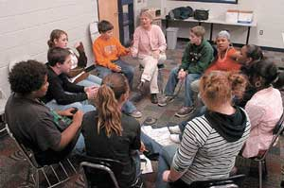
Restorative Practices
Business
© Govert van Ginkel 2016
Notes:
When we think about RP in business we may struggle with the concept because they seem so different

Slide 3
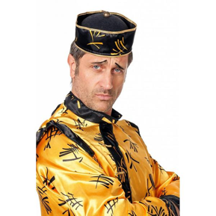
Gesundheit!
健 康？
© Govert van Ginkel 2016
Notes:
It could be compared to saying Gesundheit in China and even though you make it sound and look like Chinese it still doesn’t come across that well. The concept may just not translate that well in another culture and when you try and make it fit it may look both like a hybrid but also silly.

Slide 4
Embodiment – common sense
Community vs corporate identity
© Govert van Ginkel 2016
Notes:
Fluffy like community and translate that to something abstract like corporate identity. So maybe it works better if you do not try to make it look like a horse flower but let the seed carry you to the opportunity where it will take its own shape but still contains the idea. It is much like passing on a good idea without necessarily saying what that should look like. So it may not have that fluffyness when it finds fertile soil and grows.
So instead of using the words it is more about the embodiment of RP, a certain approach that we have to situations and choices that we make in how we want to be together.
I have heard one CEO describe this as looking for “common sense.” What binds us as human beings?

Slide 5
Business!
© Govert van Ginkel 2016
Notes:
Business is about providing a service to people. It can be food, housing, advice, care etc. It is something that people need and want. The core element for me is that it is about people doing something for other people. An element that in business certainly is not overlooked when it comes to the customer as we spend an awful lot of money on creating the right impression, the right “relationship” that will make people want to buy our product.

Slide 6
The business RELATIONSHIP!
© Govert van Ginkel 2016
Notes:
So this is what this looks like in a business environment but it is still about inter relatedness.

Slide 7
© Govert van Ginkel 2016
Notes:
And interrelatedness is an element that in business certainly is not overlooked when it comes to the customer as we spend an awful lot of money on creating the right impression, the right “relationship” that will make people want to buy our product.

Slide 8
The way in which we engage ….
© Govert van Ginkel 2016
Notes:
An element that in business certainly is not overlooked when it comes to the customer as we spend an awful lot of money on creating the right impression, the right “relationship” that will make people want to buy our product.
Certainly in the service industry it is clear that it is the relationship with the customer that will determine how well you do. For this reason the focus has mostly been on the customer whose money brings in the profit and less so on the workforce as this was mostly seen as a cost. This view created a different relationship between the company and its customers and the company and its employees: You need to woe the customer and control the (cost of the) employee. The business term for how we relate to each other is engagement.

Slide 9
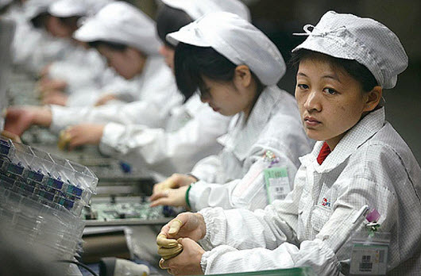
The way in which we engage ….
© Govert van Ginkel 2016
Notes:
Certainly in the service industry it is clear that it is the relationship with the customer that will determine how well you do. For this reason the focus has mostly been on the customer whose money brings in the profit and less so on the workforce as this was mostly seen as a cost. This view created a different relationship between the company and its customers and the company and its employees: You need to woe the customer and control the (cost of the) employee. The business term for how we relate to each other is engagement.

Slide 10
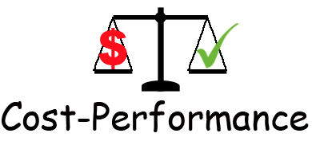
Highest outcome at the lowest cost = maximizing profit!
Limiting belief: workforce is a cost
© Govert van Ginkel 2016
Notes:
Over the last 50 years the topic of employee engagement has grown in importance as research made clear that seeing the workforce as a cost may not be the best way to keep the cost down and performance up. Research showed that the opposite was true. Dissatisfaction over wages and work conditions was detrimental to efficiency and productivity and were topics that needed to be taken care off to create a stable basis. However keeping a cost under control is measurable and easier to do than to inspire people and show leadership. So what has happened is increasing control and rewarding the book keepers.

Slide 11
Control – easy to
measure
Squeezing staff may not be the best way
to keep cost down and performance up.
© Govert van Ginkel 2016
Notes:
Over the last 50 years the topic of employee engagement has grown in importance as research made clear that seeing the workforce as a cost may not be the best way to keep the cost down and performance up. Research showed that the opposite was true. Dissatisfaction over wages and work conditions was detrimental to efficiency and productivity and were topics that needed to be taken care off to create a stable basis. However keeping a cost under control is measurable and easier to do than to inspire people and show leadership. So what has happened is increasing control and rewarding the book keepers.

Slide 12
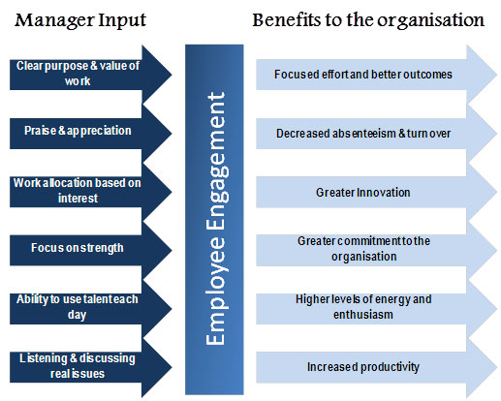
© Govert van Ginkel 2016
Notes:
Over the last 50 years the topic of employee engagement has grown in importance as research made clear that seeing the workforce as a cost may not be the best way to keep the cost down and performance up. Research showed that the opposite was true. Dissatisfaction over wages and work conditions was detrimental to efficiency and productivity and were topics that needed to be taken care off to create a stable basis

Slide 13
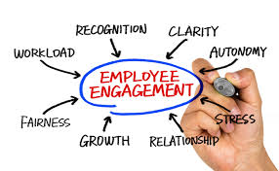
© Govert van Ginkel 2016
Notes:
So we became interested in the conditions that created engagement.

Slide 14
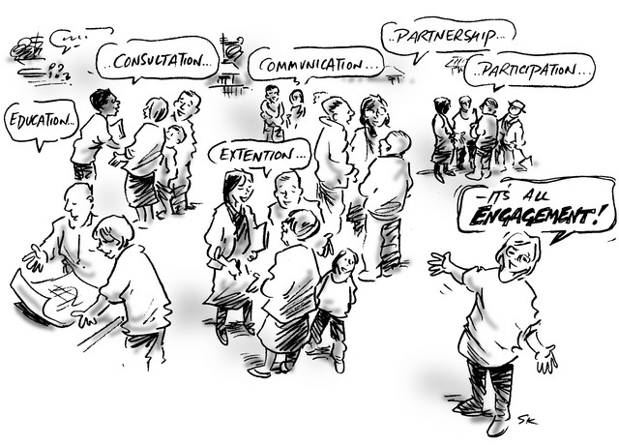
© Govert van Ginkel 2016
Notes:
And the started to see how that worked under many conditions and guises.

Slide 15
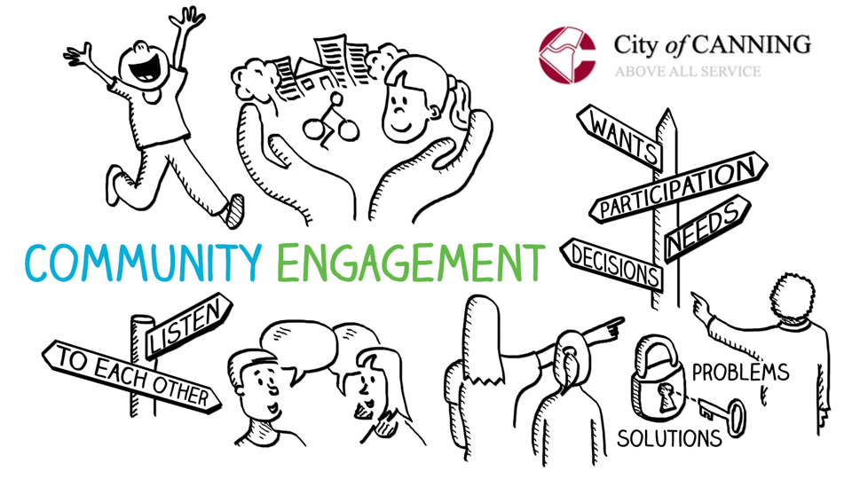
© Govert van Ginkel 2016

Slide 16
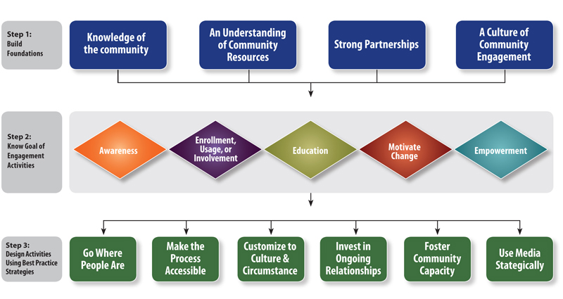
© Govert van Ginkel 2016
Notes:
It is all community engagement in different disguises and using different rules, agreements and power structures.

Slide 17
© Govert van Ginkel 2016

Slide 18
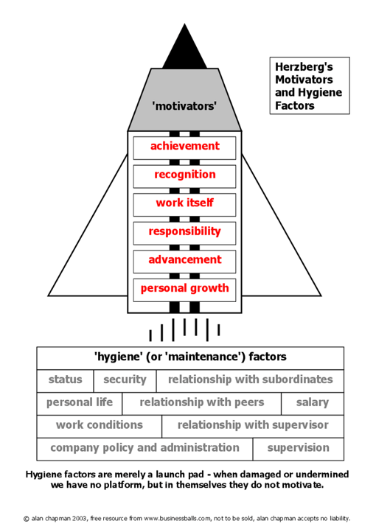
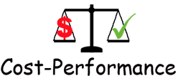
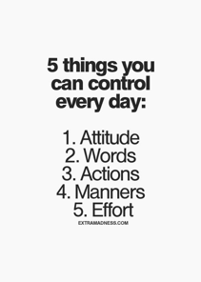
Highest outcome at
the lowest relative cost =
maximizing profit!
That positively
influence
performance
at no cost!
© Govert van Ginkel 2016
Notes:
Herzbergs research is an example of the development of our thinking. Topics as inspiration, opportunity for personal growth and promotion etc. were determined as factors that improved performance. An example of such research was done by Frederick Herzberg and became known as Motivation Hygiene Theory. (The Motivation to Work, Jan 1, 1993, by Frederick Herzberg and Bernard Mausner) Where the maintenance factors caused no lift at all but only prevented discontentment, the motivators really caused the lift.

Slide 19
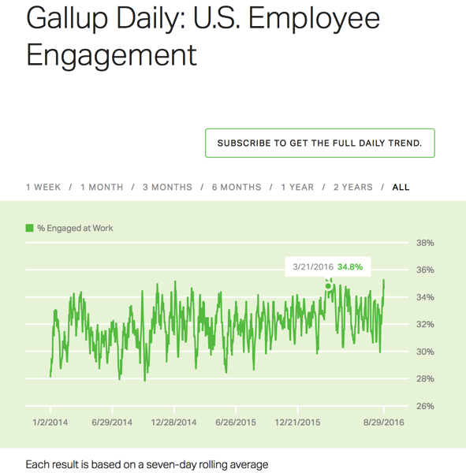
Not getting
The best for
Your buck!
© Govert van Ginkel 2016
Notes:
But even though research showed that investing in the employer-employee relationship improved performance, productivity and profit, little changed. Numerous articles offering advice on how to improve employee engagement were written and anyone reading this would probably cheer it on. When you read it, it all makes so much sense. Yet when we look at the everyday practice worldwide 70 to 90% of the workforce feels disengaged. This begs the question: If we know how this affects business, why is business shooting itself in the foot?

Slide 20
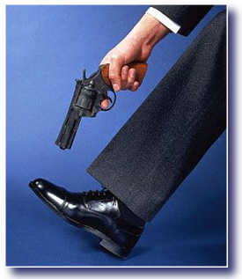
© Govert van Ginkel 2016
Notes:
This begs the question: If we know how this affects business, why is business shooting itself in the foot?

Slide 21
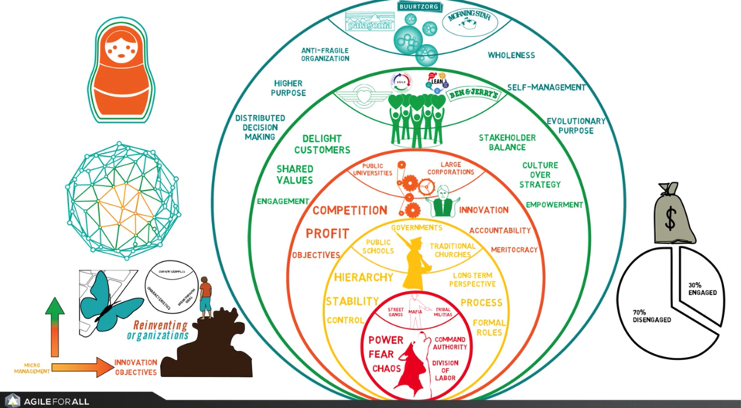
© Govert van Ginkel 2016
Notes:
The reasons for this we find in history. We have developed from a tribal power base to larger and larger communities that were held together by some form of guidance/leadership. The acceleration of societal and technological development has gone beyond our emotional and individual cognitive development when it comes to relationships. We often are working with outdated relationships models and may feel insecure when things change so fast. It also may affect our personal power base, jobs and self esteem. We like the benefits of the new ideas but look through a conservative lens and this makes it hard to change.

Slide 22
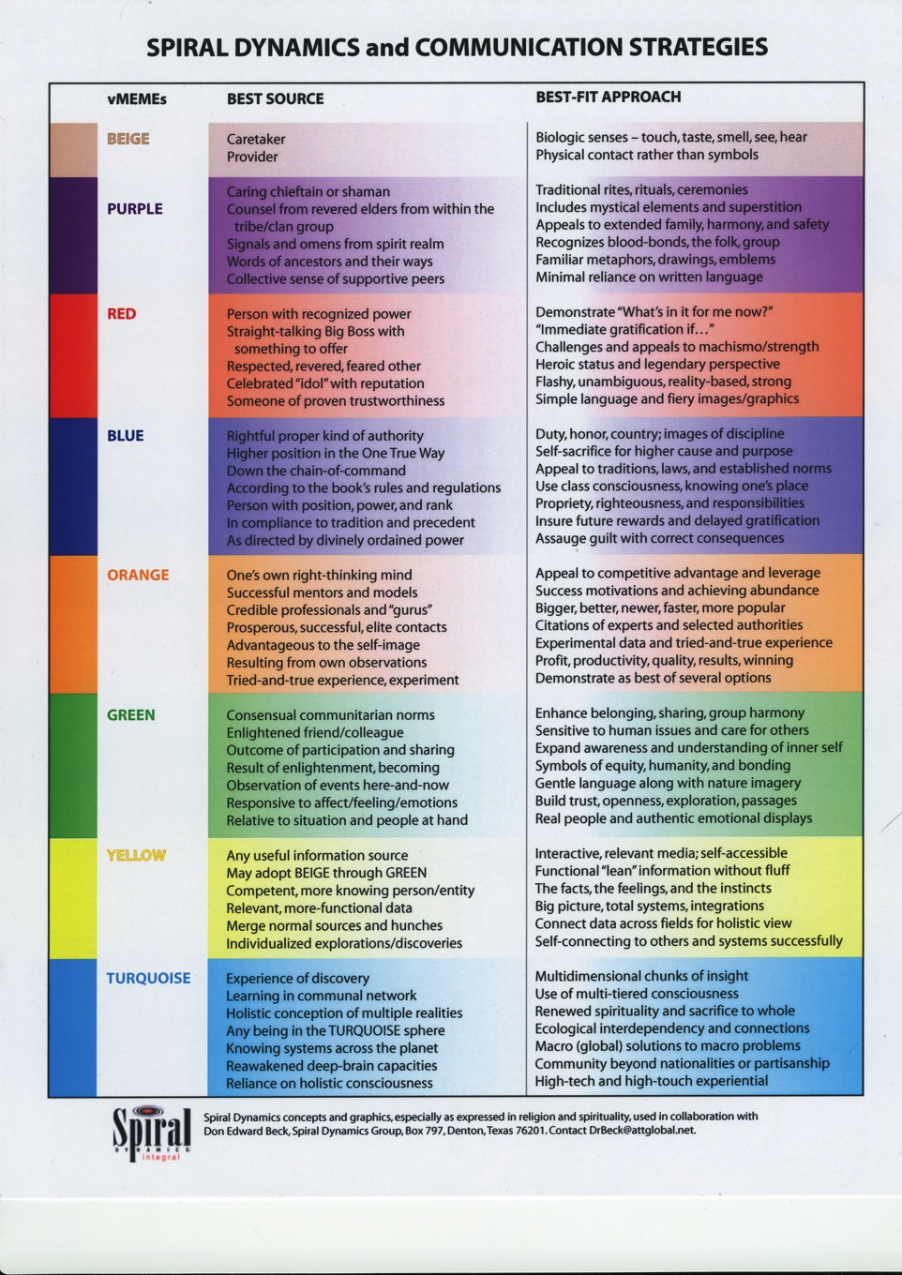
© Govert van Ginkel 2016
Notes:
So where do you think the community you live in is and where are your ideals?

Slide 23
Score as many points as you can!
© Govert van Ginkel 2016
Notes:
To demonstrate this development we’ll do an exercise. Score as many points as you can! You see given the choice you still work on the old model even though I just explained to could achieve more together.

Slide 24
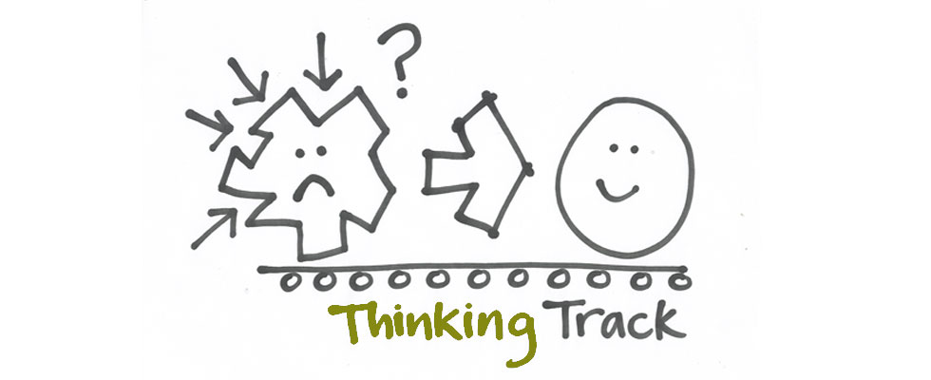
Revolution in thinking to deal with
the changing ways in which
we relate to each other
© Govert van Ginkel 2016
Notes:
Personally I came to the conclusion that it is necessary not just to change procedures but to change the relationship we have with each other. I think RP in schools are a great example. How is an RP school different from other schools? Is the difference just in procedures or do people have a different attitude towards each other? I think the latter is the case. Instead of punitive we think restorative. It is a difference in mindset.

Slide 25
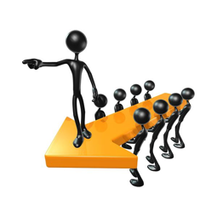
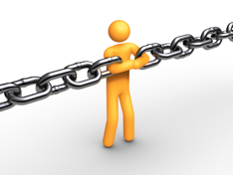
© Govert van Ginkel 2016
Notes:
Now when we think about business maybe a similar idea can apply. Most of our businesses are autocratic and still organized in hierarchies with management in control and employees kept in a subservient relationship. Some inspired leaders looked at this and wondered if this was the best they could do. They started to tinker with how the hierarchy works. Interesting ideas came out of this, which lead to new research that showed that if we would share control employees would be more motivated, feel more involved and empowered and as a result productivity and profit would rise

Slide 26
Exercise: Business Units
3 groups
In an Hospital
BU Intensive Care (IC) has a contract for internet with BU IT available between
8 am and 16 pm.
BU IT handles the contract with BU IC, services computers etc. and sends invoices.
Manager BU IC (group 1) receives an invoice for $ 7.500,- for internet instead of the expected $ 2500,- which was budgeted. Manager BU IC calls manager BU IT (group 2) to talk.
Adrian (group 3) works for the BU IT and BU IC is his account.
Appoint a spokesperson for your group.
3 minutes to strategize!
© Govert van Ginkel 2013

Slide 27
Exercise: Business Units
What did you see in responses from others?
What did you notice how you responded yourself?
© Govert van Ginkel 2013
Notes:
What this evolution of ideas and relationships shows to me is that how we relate to each other determines to what extent we can make full use of the potential of the relationship. And this is where it becomes very practical and common sense.

Slide 28
Exercise: Business Units
Each group defines its own goals/needs and those of the other(s).
1.
2.
3.
© Govert van Ginkel 2013
Notes:
What this evolution of ideas and relationships shows to me is that how we relate to each other determines to what extent we can make full use of the potential of the relationship. And this is where it becomes very practical and common sense.

Slide 29
Restorative Goals – Corporate Goals
Accountability
Community Safety
Social Competency development
Restoration
Inclusion
Voluntary participation
Informed consent
Collaborative process
Integration
Mutual respect
Empowerment
Fair Process
Increase profitability
Increase market share
Expand product lines
Reduce costs
Increase Performance
Increase productivity
Increase efficiency
Improve outcome/bottom line
Improving Employee Retention Rates
Customer service
Sustainability
Synergy
© Govert van Ginkel 2016
Notes:
So what made this exercise so hard? Why did we put our corporate cap on while we want to live restorative values and see our society change? It is seeing the relationship in different terms.

Slide 30
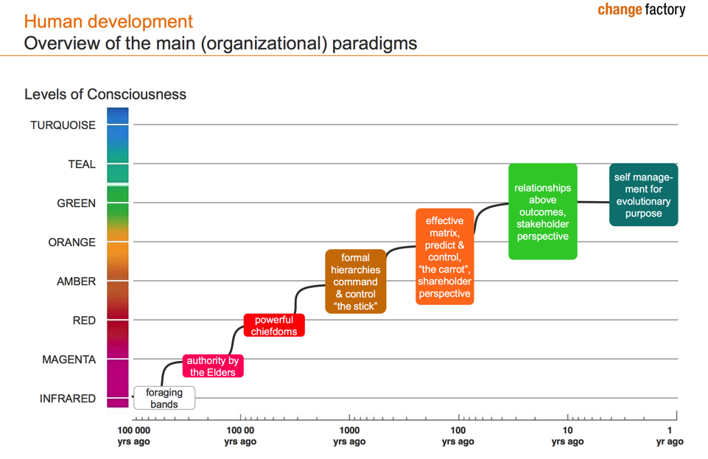
© Govert van Ginkel 2016
Notes:
When RP is in the green zone our business is still in the orange zone. It means different mindsets and creates a developmental gap that you need to bridge.

Slide 31
© Govert van Ginkel 2016
Notes:
Belonging and harmony becomes a result of using RP to create effectiveness and success in business.

Slide 32
Restorative Values
– Translation –
Corporate Customer’s
Needs
© Govert van Ginkel 2016
Notes:
I think it is hard because we use different thinking caps for one and the other and we have not learned how to translate our restorative values into corporate language. Literal translation doesn’t work, it is about an attitude that comes from living a certain value. But many of us are too busy to learn it and it requires a change of consciousness and that is hard even though the benefits are great!

Slide 33
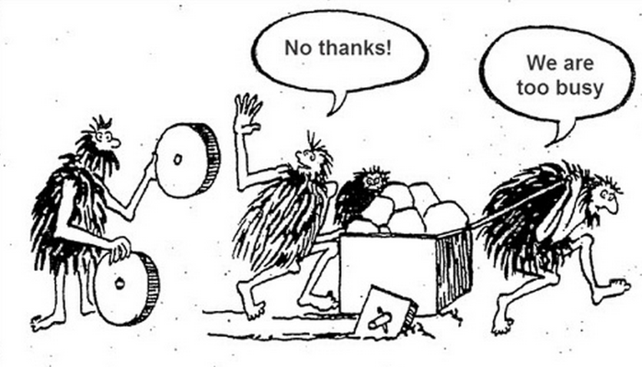
© Govert van Ginkel 2016
Notes:
Our relationships have evolved out of necessity and especially very rapidly over the last 100 years. The industrial revolution set a technological development in motion that has advanced far beyond our emotional and psychological growth. The complexity of our world is challenging in a way that is very different from how it was a century ago. We are faced with changing cultural structures and dynamics that demand a new way of engagement, while old structures of power try to stay in control. We are looking for new ways of being together while old structures stagnate and start to fall apart.

Slide 34
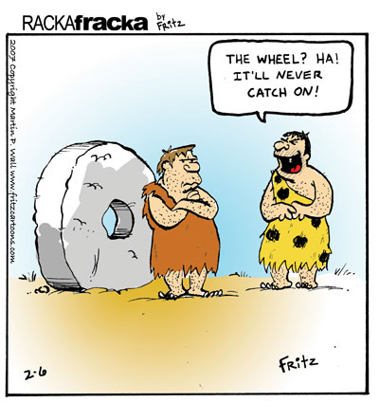
How to sell your wheel?
© Govert van Ginkel 2016
Notes:
Just because you think it is good doesn’t make your customer trust you.

Slide 35
Their problem/need or our solution?
© Govert van Ginkel 2016
Notes:
Do we know what our customers want or are we just offering our solution to the problem we imagine they have?

Slide 36
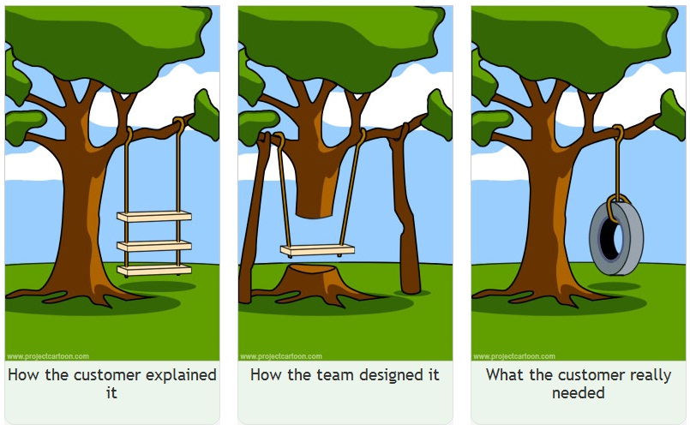
© Govert van Ginkel 2016
Notes:
Your customer may not be clear about what they need. So this is where empathy may go a long way: Imagining what it is like for your customer to arrive at a solution that will work for them ….

Slide 37
Gesundheit!
健 康？
© Govert van Ginkel 2016
Notes:
And explain this to them in a language that they understand

Slide 38
Customer Problems?
Who loves them?
© Govert van Ginkel 2016
Notes:
We live in a world in which nobody likes problems. And so you cannot see what you don’t want to look at and get rid off.

Slide 39
Are your business!
© Govert van Ginkel 2016
Notes:
Without customer problems why would anyone want to buy anything from you?

Slide 40
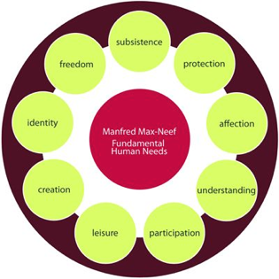
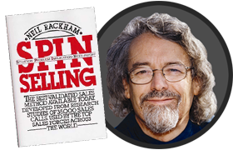
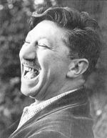
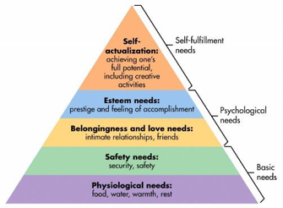
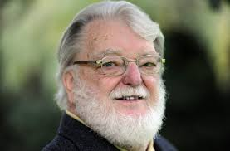
Rackham, Maslow, Max Neef
© Govert van Ginkel 2016
Notes:
Neil Rackham found in his research that knowing your customers needs is essential to making a sale. Before that we already had an understanding based on the findings of Abraham Maslow and Manfred Max Neef that human beings are driven by their needs.

Slide 41
Identifying (corporate) customer needs
Customer needs Restorative value
© Govert van Ginkel 2016
Notes:
Maybe use an example and ask the audience to identify the different business needs using the business needs list:
Think again of BU exercise, Now Vitras, Marieke Sumter school principal etc.

Slide 42
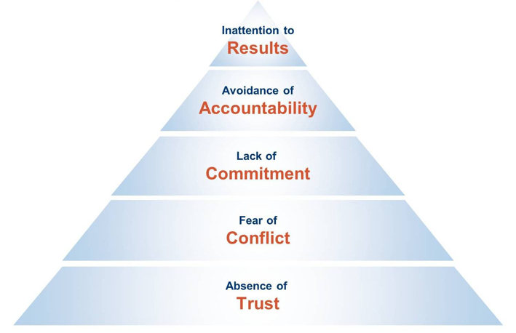
The corporate Issue
5 dysfunctions of teamwork
Patrick Lencioni
© Govert van Ginkel 2016

Slide 43
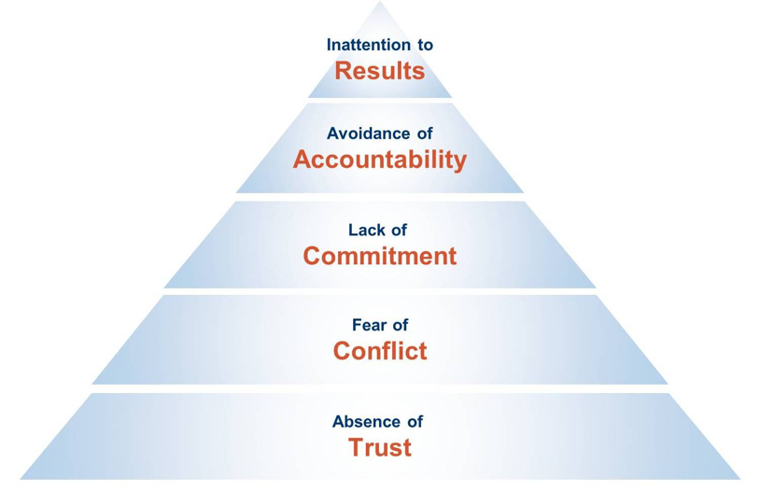
5 dysfunctions of teamwork
Patrick Lencioni
Status & Ego
Measure results, Evaluate & Feedback
Low Standards
100% buy-in
Ambiguity
Hear all, disagree, support outcome
Artificial Harmony
Open dialogue
Invulnerability
Share Vulnerability
© Govert van Ginkel 2014
Notes:
In zijn boek “De vijf frustraties van teamwork” beschrijft Patrick Lencioni de 5 disfuncties van een team en beoogt daarmee de vinger te leggen op de reden waarom teams vaak niet "werken" en wat er voor nodig is om dit alsnog te bereiken. Relaties komen niet zomaar tot stand. Daar is vertrouwen mee gemoeid. In zijn boek gebruikt Lencioni een verhaal over de wisseling van het management van een bedrijf in de IT sector om zijn idee te illustreren. De vijf gebreken die hij laat zien versterken elkaar en hebben daarmee een logische samenhang.
Het begint bij een gebrek aan onderling vertrouwen en daar is ook een goede reden voor. Teamleden die met elkaar om aandacht, waardering en beloning wedijveren, zullen hun best doen om elkaar te overtreffen. Dit gaat ten kosten van transparantie en kwetsbaarheid in het team. Het is dan moeizaam zo niet onmogelijk om een vertrouwensrelatie te kweken.
De angst voor conflicten is het tweede gebrek. Omdat er geen onderling vertrouwen is kan er niet openlijk worden gesproken over wat er misgaat in het bedrijf. Conflicten worden dus niet benut om problemen uit te spreken en op te lossen. In plaats daarvan wordt in de wandelgangen individueel met medestanders gesproken waardoor de onderlinge onrust groeit en het vertrouwen verder afneemt.
Dit leidt tot het derde gebrek: het gebrek aan commitment. Omdat meningen en ideeën niet openlijk met elkaar in het team besproken worden, ontbreekt het aan een gezamenlijke ontwikkeling waarbij iedereen werkelijk betrokken is en waardoor teamleden tot een betere afweging komen. Als dit wel gebeurt wil dit niet zeggen dat alle teamleden het eens zullen zijn, maar zij begrijpen dat het belangrijk is om tot een zo goed mogelijke beslissing te komen. Omdat zij zich uit hebben kunnen spreken hebben zij daaraan bij kunnen dragen en ontstaat de bereidheid om achter een beslissing te gaan staan. Als er geen commitment is heeft dit tot gevolg dat teamleden ongeacht de gemaakt afspraken hun eigen koers zullen blijven varen.
Een gebrek aan commitment heeft op zijn beurt weer tot gevolg dat niemand verantwoordelijkheid voor de gemaakt afspraken wil dragen. Dit is het vierde gebrek. Als teamleden verantwoordelijkheid vermijden zullen zij elkaar niet op activiteiten en handelingen die in strijd met de gemaakte afspraken zijn aanspreken.
Uiteindelijk heeft dit natuurlijk gevolgen voor het gezamenlijke resultaat. Teamleden zullen persoonlijk of eigen afdelingsresultaat nastreven en het bedrijfsresultaat daarbij achterstellen. Door het gebrek aan vertrouwen is er geen onderlinge samenhang en een ieder besluit dan naar eigen inzicht en eigen belang te handelen.
De les hieruit is dat het openlijk met elkaar kunnen spreken en het durven aangaan van het conflict zonder elkaar verwijten te maken, de sleutel is tot gezamenlijke groei. Daarvoor is het leren schakelen in de relatie een noodzaak.

Slide 44
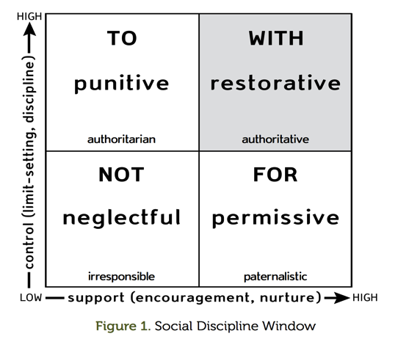
The Restorative Solution
© Govert van Ginkel 2016

Slide 45
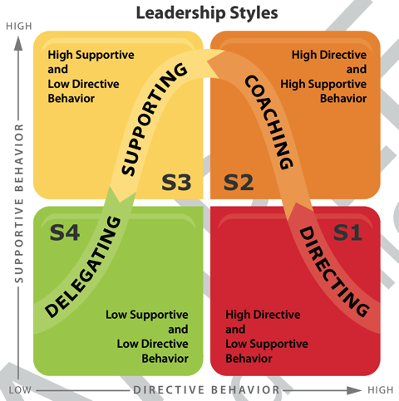
A leadership approach
Situational
Leadership:
Paul Hersey –
The Situational
Leader: The Other
Fifty-Nine Minutes
© Govert van Ginkel 2016

Slide 46
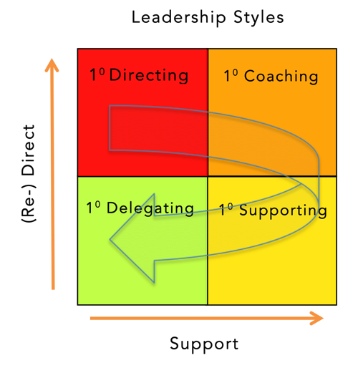
Adjusted perspective
© Govert van Ginkel 2016

Slide 47
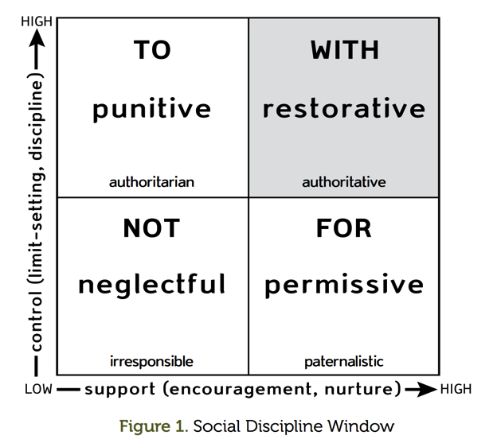
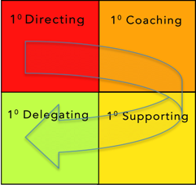
WITH
© Govert van Ginkel 2016

Slide 48
Fair
Process
People care about both the outcome and the process through which this was arrived at (to know that their point of view was considered.)
Individuals are most likely to trust and cooperate freely with systems—whether they themselves win or lose by those systems—when fair process is observed.
3 mutually reinforcing principles:
engagement
explanation
expectation clarity.
© Govert van Ginkel 2016

Slide 49
Thank you!
www.govertvanginkel.com
mail@govertvanginkel.nl
Calgary – Canada
Nieuwegein – The Netherlands
© Govert van Ginkel 2016

