Slide 1
More Voices, More Equity
RESTORATIVE PRACTICES IN
SCHOOLS
IIRP WORLD CONFERENCE
BETHLEHEM, PA
OCTOBER 25, 2018
Suzanne Petersen, MA- Supervisor Student Support Services
Mitchell Seipt, MT- Assistant Principal, Seneca Ridge Middle School
Loudoun County Public Schools
Department of Pupil Services

Slide 2
LCPS- AT A GLANCE
Loudoun County Public Schools (LCPS) is the third largest school division in the Commonwealth of Virginia. Each year, approximately 2,500 new students enroll in our schools, and one to three new school facilities are opened to accommodate them.
LCPS serves more than 78,000 students in 89 facilities. We operate 15 high schools, 15 middle schools, 57 elementary schools and three special purpose schools (Academy of Science, C.S. Monroe Technology Center and Douglass School).

Slide 3
MORE VOICES- MORE EQUITY
Incident: Cafeteria Fight over a slice of pizza
Students: 2 male high school students
Traditional Discipline: 10 day out of school suspension
School Administrator Recommended: RP in lieu of all but 3 days of Suspension- Saved 7 days of instructional time
What we learned from the RP Process and more voices:
*One of the boys had been experiencing racial bullying
*One of the boys had a history of trauma and exposure to violence.
*Both boys had single parent homes and no male role model.

Slide 4
Loudoun County Public Schools
Restorative Practices-Philosophy and Goals
​​Reduce the overall number of suspensions and expulsions. ​
​​​Address the disproportionate number of minority and special education students who are suspended.
Allow every student who is harmed to have a voice.​
​​Give students the opportunity to learn from the process without having their education interrupted. ​
​​Improved behavior, learning, and attendance​
​​​​​​​Accountability, school safety ​and building positive relationships

Slide 5
LCPS-IMPLEMENTATION TIMELINE
2012 - Discipline Task Force recommends implementation of Restorative Practices as a positive discipline alternative.
2013 -With limited resources and only Pupil Service staff trained as facilitators (Social Workers, Student Assistance Specialists and School Psychologists) in conferences the RP team was able to facilitate 17 conferences. In addition the same four staff became licensed IIRP RP Conference Trainers.

Slide 6
2014 - LCPS began training school based staff, including administrators, counselors, and teachers in Restorative Conferencing. Developed on-line referral site for RP cases and RP brochures for schools and parents.
2015 -By 2015 the team had facilitated 57 cases and trained 45 staff to be RP Conference Facilitators. One hundred twenty four students and 142 parents participated in completed RP cases.

Slide 7
2016 - Awarded a JJDP Restorative Practices Expansion Grant. Twelve staff become licensed IIRP Restorative Language and Circle Trainers. LCPS began implementing RP Circles in schools.
2017 - Wrote RP Guide for Administrators, RP added to the Discipline Handbook, Developed Fidelity Check for Circles, Developed RP Website.

Slide 8
Multi-Tiered Systems of Support
PBIS with Restorative Practices
MTSS- Targeted-Intensive
RP- Restorative Conference
Re-entry Conference
Reduces out of school suspensions and addresses discipline disproportionality
MTSS- Selected
RP-Conflict and Responsive Circles
Restorative Dialogue
Teaches conflict resolution skills and addresses issues before they go to suspension
MTSS-Universal
RP-Classroom and School -Wide Circles
Restorative Language
Builds School Community and Positive Relationships

Slide 9
Tier 3
Restorative Conferencing- Where we began…….

Slide 10
RESTORATATIVE CONFERENCING
To be used as a positive discipline alternative in lieu of suspensions of expulsions
School administrator makes recommendation for RP and receives parent permission
School administrators enter referral in to central office on-line data base
RP case is assigned to RP Regional Leader
Case is assigned to school based staff if they are RP trained
RP outcome data is entered into central office database

Slide 11
Historical Program Summary – 2013 -2017
RESTORATIVE CONFERENCING
Facilitated 252 Restorative Practices Cases
Total of 481students participated in the program
Total of 343 – General Ed, 138 – Special Education
Total of 648 parents participated in program (all services for a case)
Sharepoint Site
*Cases = pre-conferences, conferences, conflict circles, attendance circles, and re-entry circles
*Data for 16-17 as of July 10, 2017

Slide 12
RP Training/Success – Increases Growth
128% increase in the number of cases from 14-15 to 15-16
16-17 data as of July 10, 2017

Slide 13
Ethnicity of Students Participating in RP
2013-2017

Slide 14
Types of Incidents
2013-2017

Slide 15
RP Keeps Students in Class
Instructional Days Saved
(2013-2017)
In many cases the severity of discipline was reduced not the days – in lieu of suspension students received ISR

Slide 16
RP Students Follow-Up Evaluation
Students followed the agreement
Felt the issue was resolved
Felt safer at school
Had no further discipline issues related to the event
Changed their behavior at school
Would participate in a Restorative Conference again
97%
94%
87%
93%
80%
82%

Slide 17
“I didn’t realize that what I did affected so many people. I’m sorry, and I want to make things better” -LCPS Student

Slide 18
JJDP Title II – RP Expansion Grant Accomplishments – 2016-2017
Where we are now…….

Slide 19
Restorative Practices Circles Tier 1 & 2
Types of Circles
1. Community Building Circles – Builds connections between students within entire school community
2. Classroom Circles
  Assists with classroom management
  Builds positive relationships and cohesion between students
  Used to advance curriculum
3. Informal Conflict Circle - Proactive and preventative. Focuses on a specific topic of concern. Resolves or prevents conflicts/behavior issues.
Notes:
In the classroom: establish connections between students early on, review content, instruction, reflect on a topic, goals for the year, assess what students know, current events…Students are involved in coming up with solutions. Shared responsibility.

Slide 20
Trainings During Grant Period
(July 1, 2016-June 30, 2017)
Introduction to RP Language and Circles – Facilitated 26 trainings: 384 Staff
Two TOT trainings – which certified 24 trainers
  Introduction to all bus drivers
  Provided whole school training to- 1 high school, 2 middle school and 2 elementary schools
  Trained Peer students at 1 High School and 1 Middle School

Slide 21
Staff Trained in RP in 2016-2017
384 total staff trained in RP Language and circles - some of the staff trained were:
  69 school counselors, 1 Director of School Counseling
  19 school social workers, 6 Student Assistance Specialists
  10 School Psychologists, 3 interns, and 5 Diagnosticians
  13 Deans
  106 Gen Ed Teachers
  29 SPED Teachers
  14 Teacher Assistants
  14 Assistant Principals, 5 Principals
24 Staff trained and certified by IIRP as trainers of language and circles
47 Staff trained in conferences
Monthly Survey

Slide 22
Implementation of RP Circles
in Schools

Slide 23
Types of Circles
*Data Includes staff circles

Slide 24
SCHOOL SUCCESS STORIES
It was a bullying issue. Three boys were picking on another student. We talked about it and shared each other's perspective. It really worked...each person who bullies usually had a bad experience themselves at one time.
During a circle discussing an incident of conflict, a student voluntarily offered an apology to the other student as well as a handshake.
We were able to resolve a dispute between two sets of parents (who wanted to involve law enforcement) by using a restorative circle at one of my two schools.
Several students agreed to avoid conflict in January as of today they have complied.
I use RP in short conversations with students all the time. A longer conversation occurred with a student that had been suspended for his treatment of his teacher. The student ended up apologizing to the teacher and the relationship has improved.

Slide 25
CHALLENGES
FUNDING
LACK OF IDENTIFIED OR DESIGNATED RP POSITION
DIFFICULTY GETTING COVERAGE FOR STAFF TO ATTEND 2 DAY TRAINING
NO CLEAR DIRECTIVE TO USE RP FOR DISCIPLINE
THE LENGTH OF TIME NEEDED TO COMPLETE AN RP CONFERENCE

Slide 26
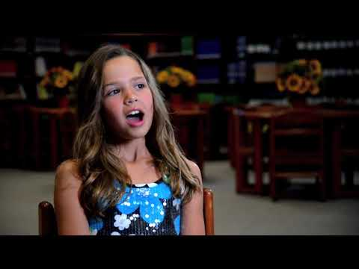
LCPS Restorative Practices Video

Slide 27
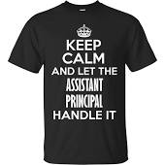

From the Bottom Up:
The Restorative Journey of
Seneca Ridge Middle School

Slide 28


Slide 29
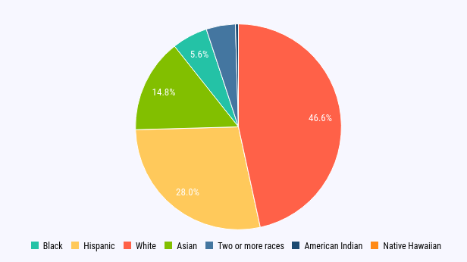

Slide 30
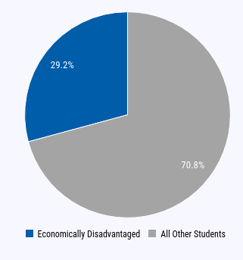
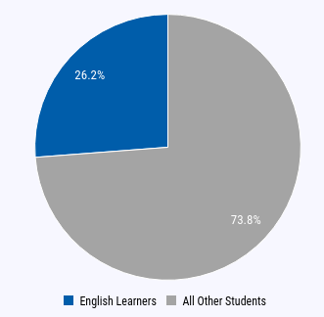

Slide 31
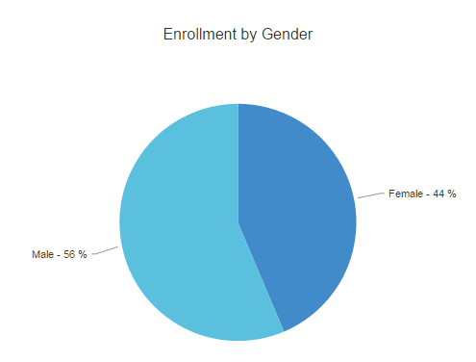

Slide 32
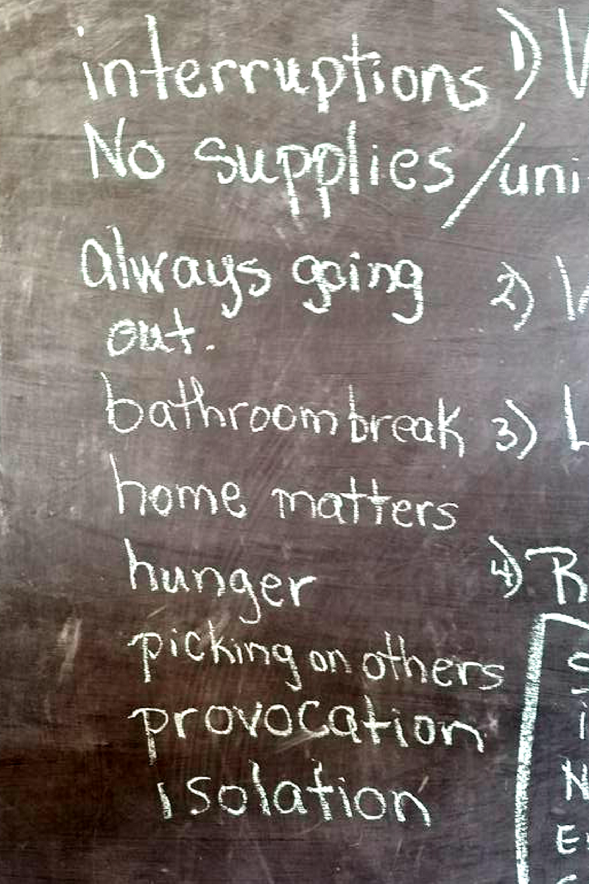
Discipline is not a verb.
Discipline is something that we need to teach, just like history, math, or science.

Slide 33
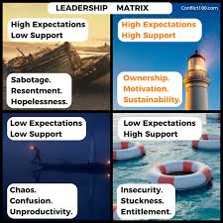
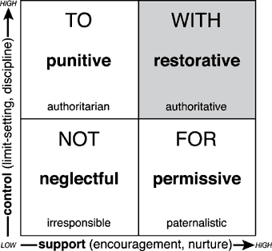
http://www.iirp.edu/media/socialdiscipline.gif

Slide 34
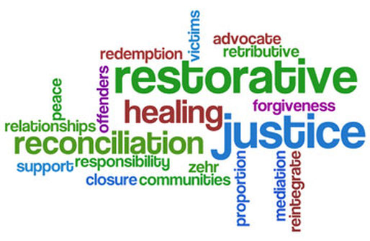
Steps Toward Building a Restorative Campus
PBIS Team
RP Facilitator Training
RP Language/Circle Training
Faculty Meeting
Introduction to Circles through Advisory lessons
PBIS Discipline Committee
http://www.cfschools.net/uploads/1/8/1/6/18163163/3630321.jpg?514

Slide 35

Steps Toward Building a Restorative Campus
Restorative Classroom Circles
Restorative Conferences
Temporary Removal
PM Detention/Ownership Time
Friday School
Re-Entry RP Conferences
District RP Support
Student Mediators
https://www.keepcalm-o-matic.co.uk/p/keep-calm-and-get-creative-24/

Slide 36
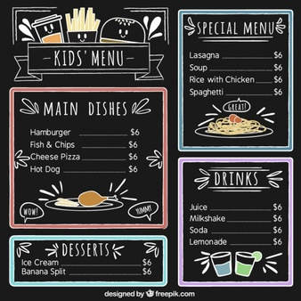
RP Professional Development - Menu Approach
Explore
Discuss
Experience
Sit and Listen

Slide 37
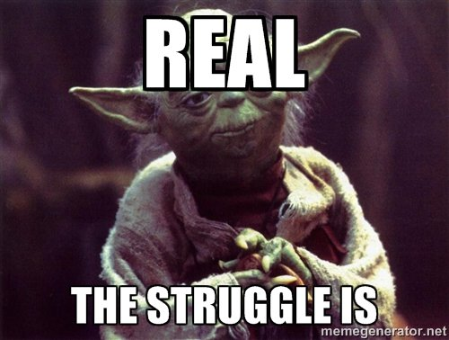
Challenges
Teachers
Kids
Parents
Administrators
http://images.guff.com/media/24163/millennialstrugglesrealstruggleisreal.jpg

Slide 38
Break-Out Groups
Implementing Across the School District or in your School
Introduce yourself - Where are you from? Where are you in the RP implementation process?
What have been your successes implementing RP across a school district or in your school?
What have been your challenges implementing RP across a school district or in your school?
What is one new strategy you can take back to your school or school district?

