Slide 1
How to Shift a School’s Culture from Traditional to Restorative
Presented by Jamie Berrien, Victoria Marie Soria Starr and Hugo R. Vazquez
IIRP World Conference in Bethlehem, Pennsylvania
Notes:
We introduce ourselves and roles.
Thank attendees for their stories and share outs.
SAY- We will be learning from each other!

Slide 2
Session Objectives
Get to know who we are
Share what we have done
Practice our protocols
Brainstorm solutions for a problem of practice
Notes:
Hugo- will share out the objectives

Slide 3
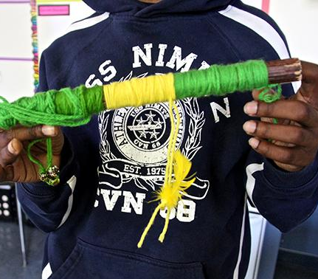
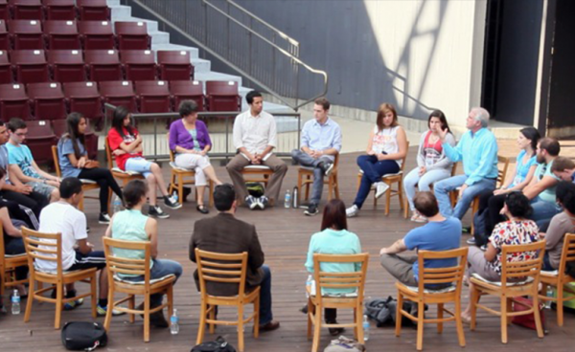
Community Circle
We sit in a circle where each member can see everyone.
Speak when you have the talking piece so that every voice is heard.
Share your name, job and hope for this session.
Notes:
Berrien- will lead our “getting to know you” circle

Slide 4
Brainstorm
What is your problem of practice?
Notes:
Soria-introduce the “problem of practice” protocol and have participants think of a problem of context in their practice relating to RP
SAY-We want to make sure this session is relevant to your needs. Take a moment to reflect with those around you on what brought you to this session and perhaps a problem of practice you are facing in your own context. We will be able to follow up with one problem of practice within the group later in our session an recognize the powerful opportunity we have to utilize the experts in the room.

Slide 5
Aspire Background
Mission & Vision
Organization Shift
Ownership
Data Review
Equity Statement
Notes:
Hugo- Quickly share out the Aspire story in the last 4 years…
AND
How Aspire was born from a vision to improve public education:
In 1998, longtime public school educator Don Shalvey joined forces with Silicon Valley entrepreneur Reed Hastings to launch Aspire Public Schools, one of the nation’s first charter management organizations.
Aspire now serves over 16,000 Students currently enrolled in Grades K – 12
in 40 schools!

Slide 6
Aspire Mission & Vision
Notes:
Soria
Our Vision Before: To enrich students’ lives and reshape local public school systems.
Our Mission Before: Aspire builds quality small schools that provide choice in underserved neighborhoods in order to: Increase the academic performance of California’s diverse students, Develop effective educators, Catalyze change in public schools, and Share successful practices with other forward-thinking educators.

Slide 7
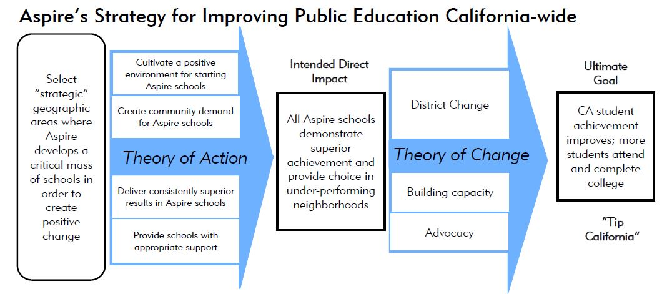
Organization Shift
Notes:
Soria
Standards changed.
Leadership changed.
Response to Behavior changed.

Slide 8
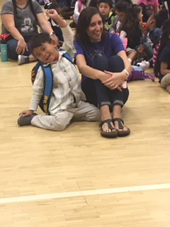
Ownership
​Purposefulness- Deliberate action, focused on the organization’s goals and priorities
​Collaboration- ​Working collectively to accomplish more than what is possible alone
​Ownership- ​Individual and group accountability for results, actions and decisions
​Quality- ​Commitment to excellence and the discipline to continually improve
​Customer Service- ​Responsiveness to the needs of external and internal customers
Notes:
Hugo
SAY While we looked at our Organizational Shift including our Equity work as Jamie will share in a few minutes. We deeply analyze our own practices, in that we realized there was an urgency for change. Data was the big catalyst to that shift.

Slide 9
Data Review
Suspension Over Representation: African American Students
Notes:
Hugo
SAY Our commitment to our Ownership to look deeper into our data specially our African American who then made up a 15% of our overall enrollment. When analyzed the data further we found that our AA students were over-represented in suspensions by more than 2x
African American suspension representation has decrease minimally in past 3 years (12/13=34%; 13/14=33.1%; 14-15=33%)
Nationally, African American students comprise ~26% of total suspensions

Slide 10
Data Review
Suspension Over Representation: African American Male Students
Notes:
Hugo
SAY We found that the vast majority of over representation lies with African American male students.
It was very difficult for us at Aspire to ignore the “brutal Facts” our discipline trend then was unfortunately in-line with what was being seen at the national level.
This is when our 13 school principals (then of 4 secondary schools and 9 elementary schools) began to explore our equity work more closely and looked at our very own discipline practices.
When we did we found the making of our very own implicit biases. Which the data indicated that we were suspending our AA Males 1 to 1.5 days for the exact Educational Code infraction.

Slide 11
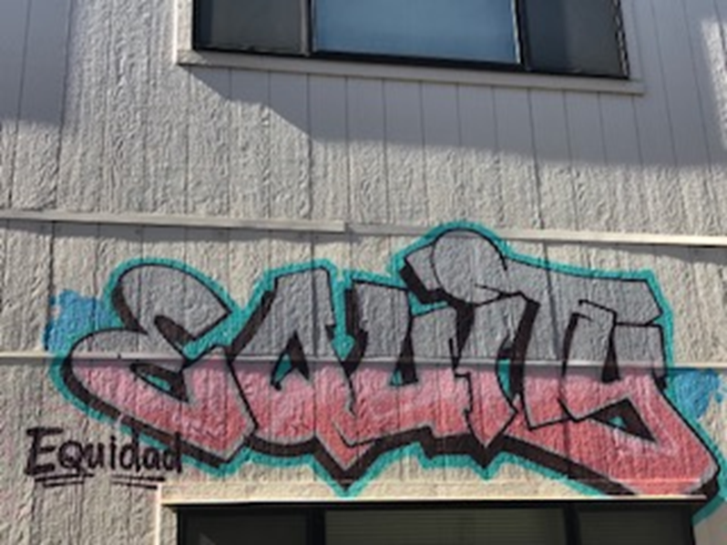
Equity Belief Statement
Notes:
Berrien-shares the journey that got us here…
Show video: https://vimeo.com/132266035
Creation of the CV-EWG,
Principal PD, etc.
Equity Drivers
Also our partnership with NEP
Share Equity Belief Statement

Slide 12
Systems Synopsis
PBIS / MTSS / Restorative
Sel / Mindfulness
Equity Consciousness
Notes:
Berrien- Share the journey ATCPA has taken when it comes to the services and supports offered to our students

Slide 13
PBIS / MTSS
Notes:
Soria
PBIS: Clear Expectations, Explicitly Taught, A System for Encouraging Appropriate Behavior, A System for Discouraging Inappropriate Behavior, A Data Collection System. Always ask if it is culturally responsive!
MTSS: A framework that aligns Response to Instruction and Intervention with the Common Core State Standards and the systems necessary for academic, behavior and social success. The focus is on aligning initiatives and resources within an educational organization to address the needs of all students. It offers the potential to create systematic change through intentional integration of services and supports to quickly identify and meet the needs of all students.

Slide 14
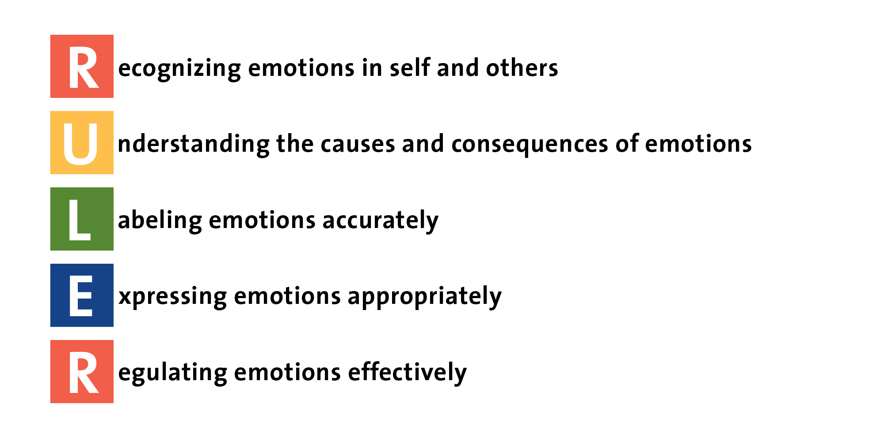
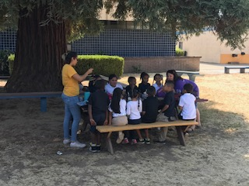
Social/Emotional Learning
Notes:
Berrien-We adopted a formal SEL curriculum 3 years ago, along with RP. This year we are adopting using RULER and supplementing with TRIBES.
Equity Study Groups-led with the RP framework, every staff member on campus is learning about:
Peace & Justice on campus—Teaching Tolerance
Family Engagement—Beyond the Bake sale
Culturally Responsive Teaching—Loretta Hammond

Slide 15
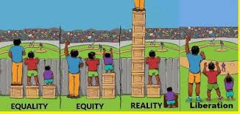
Equity Consciousness
ASPIRE’S EQUITY BELIEF STATEMENT
Notes:
Berrien
Equity Study Groups-led with the RP framework, every staff member on campus is learning about:
Peace & Justice on campus—Teaching Tolerance
Family Engagement—Beyond the Bake sale
Culturally Responsive Teaching—Loretta Hammond

Slide 16
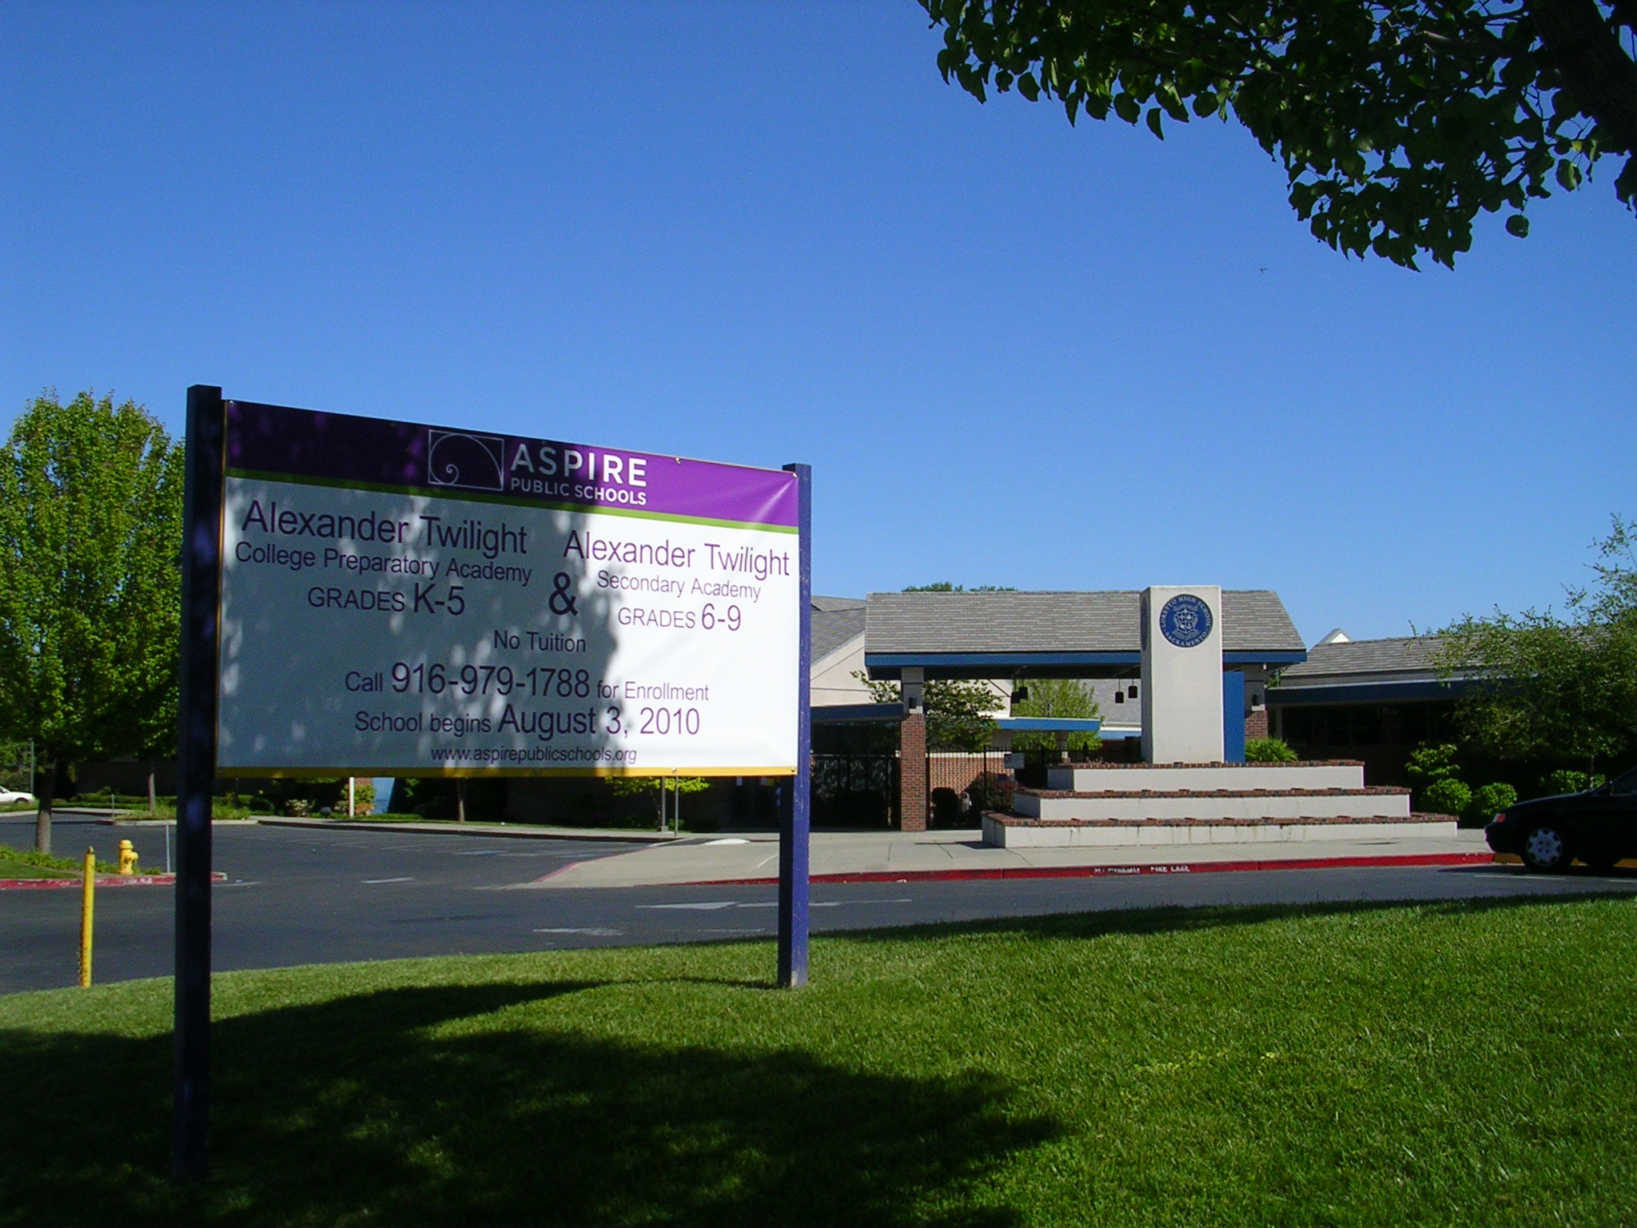
Our Story
Alexander Twilight College Prep Academy
Sacramento, California
Notes:
Hugo-
Say ATCPA was opened in 2009
Currently we serve 444 students
-AA 23%
-Latino 58%
-White 8%
-Asian 3%
-Other 8%
FRL-73%
ELL-36%
SPED-75
Contextual glimpse- refugee community, family deportations, police shooting, etc.

Slide 17
School History
Notes:
Soria
ATCPA opened in 2009 as the 2nd Aspire Charter in the Sacramento Area. We were a K-8 school.
2010 we split into Elementary and Secondary.
2012 we got an Elementary Principal.
2014-15 we had new leadership from our site up.

Slide 18
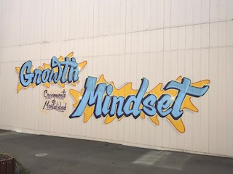
Staff Journey
Notes:
Berrien
Came to ATCPA in 2014
Staff was known as the dream team
Average of 8-10 Students missing class time and staying in the office all day, loss of instructional minutes
5 consequences system and once they were out of class, they were not allowed back in class
Saw the need to address the issues
Restorative Practices and SEL adoption
The year we implemented, we had 10 tier 3 students enter kindergarten. This tested our resolve and our foundation in RP. This made it difficult for staff to buy in. It was slow, painful at times, but allowed space for venting, frustration, and problem solving. We used fair process and allowed team members come up with solutions to the issues.

Slide 19
School Culture
Family
Students
Staff
Notes:
Berrien-
SAY-Where we ended up; where we are now and what we are doing
Families
Circles during monthly coffee with principal
Restorative with grown ups
Restorative circle with families and students around behavior issues
Students
Community circles each morning in the classroom
Agreements in the classrooms
Restorative with student to student; staff to student; student and families
Staff
Community circles to begin every staff meeting
Restorative between staff, specifically with equity issues
Fish bowls with staff
Gratitude circles
Fair process procedures and steps

Slide 20
Constructive Listening
Notes:
Berrien- Lead this activity

Slide 21
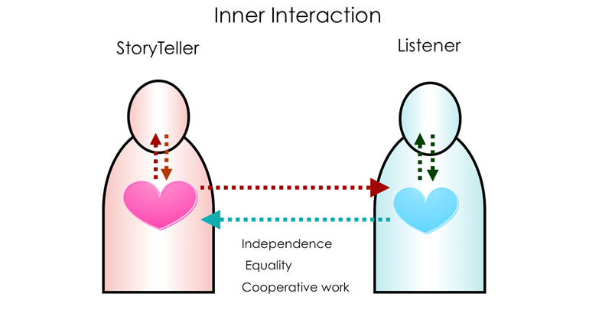
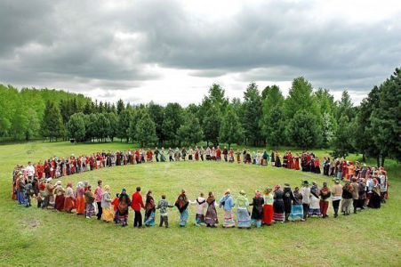
Dyad & Non-Sequential Circle
What have you Tried?
What are your wonderings?
What are your takeaways?
Notes:
Hugo- lead this activity

Slide 22
Fishbowl Protocol Restorative Problem Solving
Complex Problem of Practice
Protocol Set up: Inner Circle, Outer Circle, Open Chair.
Protocol Time: 7 Minute Share, 15 Minute Brainstorm, 3 Minute Take Away
Notes:
Soria-
Altered protocol times
Reference the social discipline window by doing things with people
As a RP community in this room lets help a colleague with a problem of practice
Every time we have ran fishbowls at our sites everyone always walks out with knowledge even if you did not participate.
Our offering to you all is the same today
This fishbowl activity supports the RP philosophy that persons are able to solve their own problems when giving the time and space…

Slide 23
Questions & Answers
Notes:
Hugo-offer and open up a space for Q and A

Slide 24
Gratitude Circle
Notes:
Berrien-
SAY-in one word mention something you are grateful for personally or professionally

Slide 25
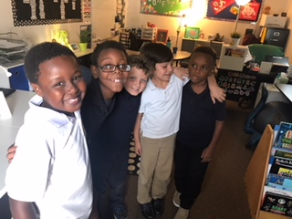
Connect: jamie.berrien, victoria.soria and hugo.vazquez @aspirepublicschools.org
www.aspirepublicschools.org
Jamie Berrien
Victoria Marie Starr Soria
Hugo R. Vazquez
Notes:
Gracias!
Our young people are waiting for the opportunity to make a difference...

