Slide 1

Healing a People:
How Restorative Practices Can Help Repair the Harm of the Past
Lynne A. Winfield BA, FCIS
Cordell W. Riley BSc, MSc, JP
Hashim Estwick BA, QCF

Slide 2
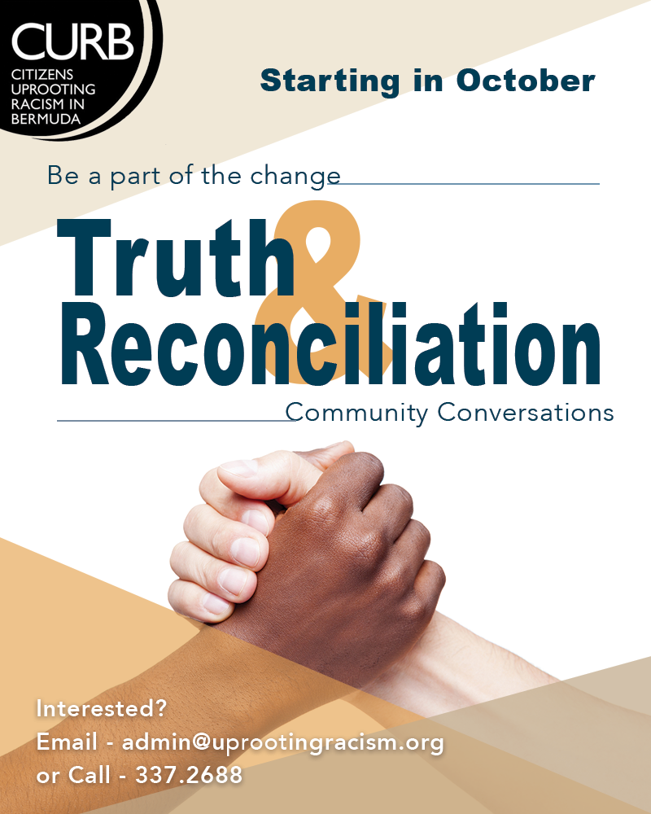
Bermuda Truth & Reconciliation Community Conversations (TRCC)
LW

Slide 3
Who and what is CURB?
Advocacy
Social Justice Mediation
Structural Racism Workshops
Dominant/Counter Narrative
Bermuda’s Hidden History
Restorative Practices Training
Educate/Challenge Racial Biases
Media Relations
Collaboration with Organisations
LW

Slide 4
Why TRCC?
The Need
Restorative Practice Response
Design and Implementation
Goals
The Process
The Outcomes
What now?
LW

Slide 5
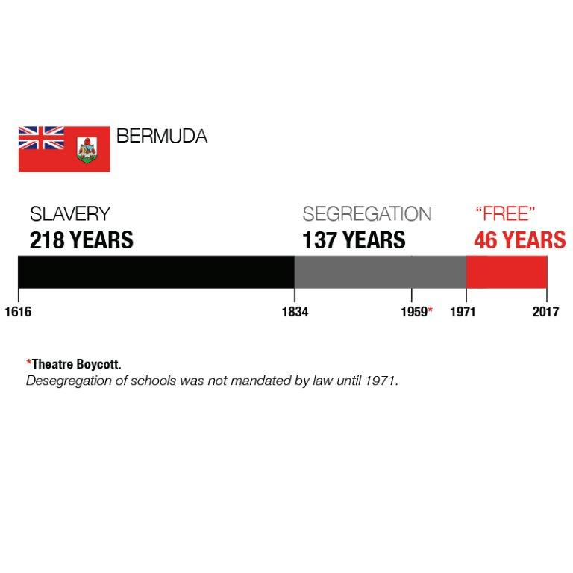
The Trauma
CWR

Slide 6

Bermuda was built and run on a belief in racial hierarchy [white supremacy] and colonialism, a collective national consciousness that has dominated the educational, economic, social and legal discourse for centuries. This way of doing and being became deeply embedded in our organizations, clubs, schools, justice system, government and education and today is known as systemic or structural racism.
Resistance and episodic movements through history have contributed to measurable progress, but to move to a racially just society a new narrative must be embraced: a fully inclusive telling of our history, and that of equal humanity.
CWR

Slide 7
The Need
When people are harmed, needs are created
The needs created by harms lead to obligations
The obligation is to heal and “repair” the harms
CWR

Slide 8
Why Restorative Practices?
Acknowledges the harm caused by wrongdoing (restoration/explanation)
Encourages appropriate responsibility for addressing needs and repairing the harm (accountability/reparation/expectation clarity)
Involves all those impacted, including the community, in the resolution (engagement)
CWR

Slide 9

Design & Implementation: Reaching the 1,000
Relationship Building
Respectful dialogue
Authentic discussions
Community involvement
Importance of each participant
When needs are met, change is possible
Facilitated conversation
Provide everyone with a voice
Use of fair process principles
HE
CWR

Slide 10
Design & Implementation
Skills
Communication – guidelines/ language/triggers/comfort zones
Listening skills
Safe space, fairness, confidentiality
Facilitator skills, manage-conflict, self-awareness
CWR

Slide 11
Design & Implementation: Reaching the 1,000
Facilitator Knowledge
Restorative Practices training
Cultural competency
Historical context
Legacy issues: internalized superiority/oppression, implicit bias, privilege, stereotypes, economic intimidation, discrimination, marginalization, prejudice, economic inequity
Intergenerational Trauma
Current systemic barriers
Psychological research
Our own experiences and biases
Model behaviour
CWR

Slide 12

TRCC Design & Implementation
Process
Circles, talking piece, large/small group dialogues, affective statements and affective questions
Historical Information / counter narrative
Storytelling / parallel truths
Seven weekly sessions of 2.5 hours each with same people/facilitators in the room
Note taking, reports, pre and post surveys
HE

Slide 13

TRCC Goals
Paradigm shift in society
Relationships, connectedness, community-building
Reparations: Repairing harm and its legacies
Research-based results for National Reconciliation Plan based on grassroots feedback
Bermuda Black history: create understanding and empathy around the counter narrative and its legacies
TRCC Participants sharing information within their own sphere of influence, e.g. churches, clubs, work, charities, etc.
Empower the voice of TRCC Participants to change their narrative and responses to racial inequality
Solution-focused
LW

Slide 14
The Process:
What happens in the room?
Facilitator scripts
A Lead Facilitator and two Assistant Facilitators
Restorative Practice Circles (Sequential/Non-sequential and Fishbowl)
Weekly themes
  Building Community
  Why do we need to heal?
  What happened?
  Who tells the story?
  Checking my privilege
  Telling our Stories
  What are we going to do?
LW

Slide 15
The Process:
What happens in the room?
Activities
Film clips
Story Telling
Powerpoint
Conversation, conversation, conversation
LW

Slide 16
The Process:
Participants’ feedback
Epiphanies
Stories told
Powerful moments
Triggering moments
Individual agendas
Managing conflict
LW

Slide 17
The Outcomes (so far)
10 TRCC groups since February 2017 (one starts this May)
Participant feedback
Pre-Surveys
Post-Surveys
Reports
LW

Slide 18
Transformational Stories
Changing perspectives
Book club
Apology
Esme’s story
The privilege walk
The MLK walk
All

Slide 19
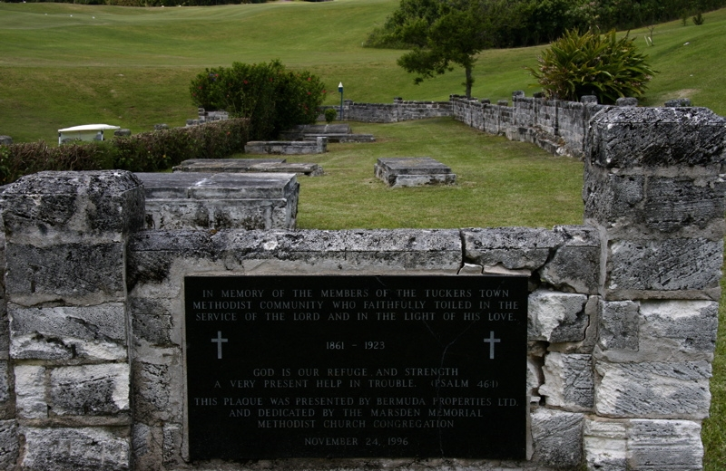
The Tucker’s Town Story
Linking the past to the present
CWR

Slide 20
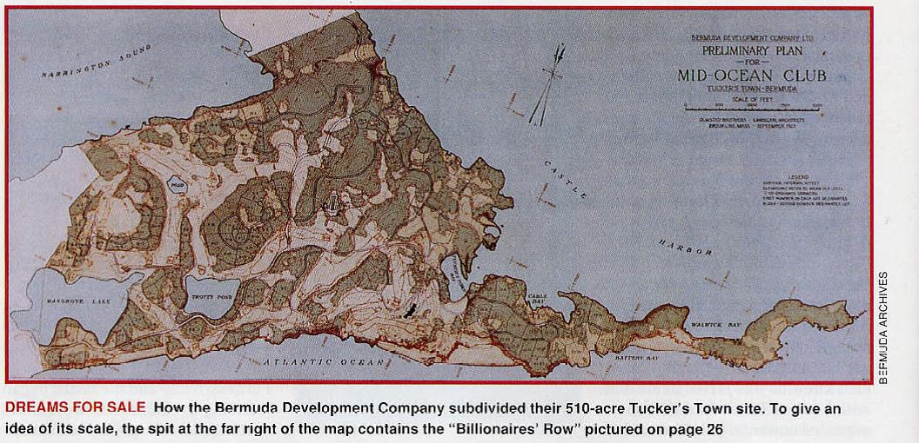

TUCKER’S TOWN
CWR

Slide 21
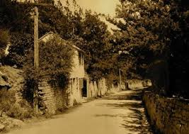
Earliest known free Black community in Bermuda late 1790s - 1921
CWR

Slide 22
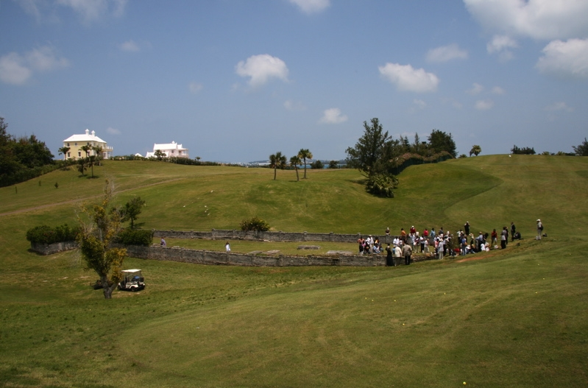
The Driving Range
CWR

Slide 23
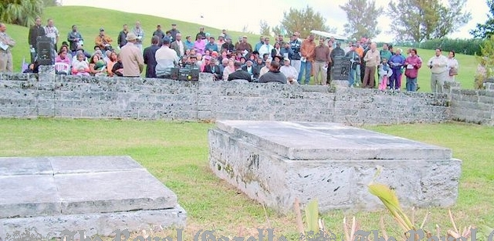
Tucker’s Town – prayers and gathering 2007
CWR

Slide 24
TUCKER’S TOWN
CWR

Slide 25
Dominant Narrative
“In Tucker’s Town, famed from the earliest days yet still undeveloped, the Company [Furness Withy] were permitted to buy a large area, and to build the splendid Mid-Ocean Golf Course.” - Bermuda: Today & Yesterday 1503 – 1980s; Terry Tucker
“Slavery in Bermuda was benign.”-Terry Tucker/Royal Gazette interview
LW

Slide 26
What Now?
Acknowledgement
Reparations / Restitution
Legislative changes
A new, inclusive history
Restorative Practices Society
Restorative Practices in schools
Restorative Justice in our criminal justice system
LW

Slide 27
Any Questions?
All

