Slide 1
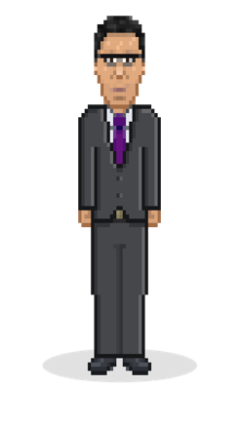

Slide 2
Discussion
Is this RP?
Is it almost RP which could be improved by adopting RP?
Is it better than RP?

Slide 3
RecoRa – guiding principles
Individuals lead change more than plans or models.
Energy is a key predictor of effective human enterprise
Empowering influential individuals to achieve change through relationships and tools for success is the best way to sustain individual change and create the desire to change in others.
Divergent thinking solves more problems than conventional treatment.
Sharing narratives aimed at influencing individuals to challenge their violence is more effective than informing people of the impact of their crime.
Motivating the internal desire to change within individuals is more effective than confronting their ideologies head on.
Actions speak louder than words

Slide 4
.
Foundations for achieving results
Self-help
The best way for people and groups to solve problems is to take the initiative and build on their own resources.
Entrepreneurial Capacity
Effective enterprise to deal with critical social problems is based less on long term plans and studies than on talented individuals with energy and perseverance.
Divergent Thinking
Many problems cannot be solved by incremental adjustments to current practice. Fresh and distinct innovations are needed as much in social and organisational settings as in technology.
Results focus
Non–profit and public sector groups should be held accountable not for activity and procedural compliance but for tangible outcomes. Return on investment is as relevant for activists as it is to the private sector.
Story Telling
Stories are the vein of life, the stories we tell ourselves and others are the growth of our personalities and being. Everyone has a story to tell – all we have to do is listen. New stories have to be nurtured
See the promise not the risk

Slide 5
The strength of education is our ability to
see the promise in children rather than the
risk.
That means viewing children and young
people as filled with capacity, realised or
unrealised, for healthy transformation and
change.

Slide 6
Power of the Story
Powerful stories can divide us
Stories to inspire connectivity

Slide 7
The Power Of Stories

Slide 8
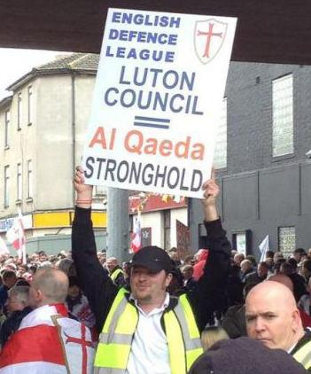
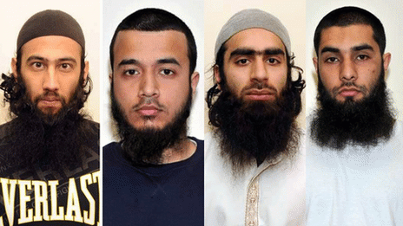
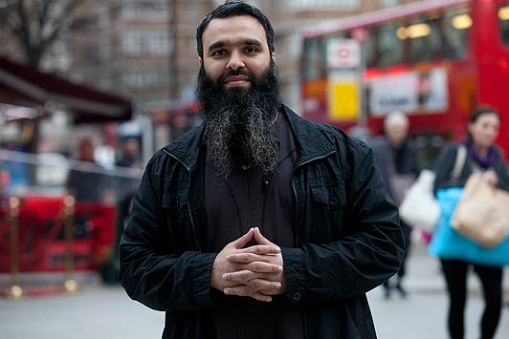
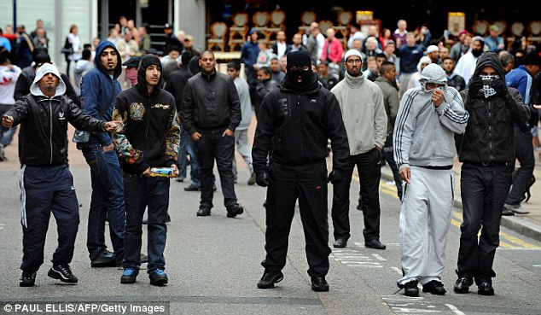
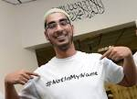
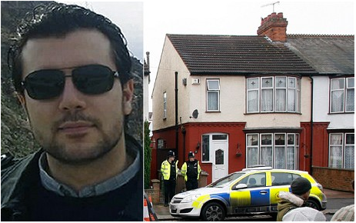
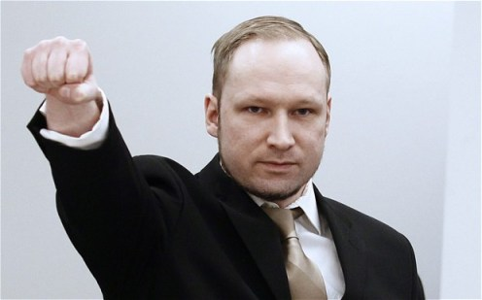
Understanding Luton in pictures

Slide 9
Luton has been a priority area since the launch of Prevent. There has been significant investment in projects and initiatives on tackling extremism and reducing vulnerability but extremism remains a substantive and enduring problem in the town. An apparent tolerance of extremists, tacit support for parts of extremist narratives, and an incoherent response from mainstream community groups who avoid engaging in Prevent were identified in a deep dive analysis by the Home Office in 2011 as promoting a conducive environment for extremism in Luton.
In some respects, this remains the case. There is significant hostility towards the Prevent agenda from parts of the community and a reluctance to acknowledge that extremism is a problem in the town. This hostility has coalesced around a vociferous anti-Prevent lobby, whose members pose as representative of the wider community. The anti-Prevent lobby has also co-opted several community organisations who are longstanding community partners.

Slide 10
How to tell your story
We are more alike than unalike

Slide 11
https://youtu.be/ztMfBZvZF_Y
Poem : we are more alike than unalike

Slide 12
" Stories are the veins of life, The stories we tell ourselves and others are the growth of our personalities and being.
I believe everyone has a story to tell and all we have to do is listen.”
new stories have to be nurtured

Slide 15
Be students, be teachers
Be politicians, be preachers
Be believers, be leaders,
Be astronauts, be champions
Be truth seekers.
I choose this song because its lyrics say you can be anything you want and should never give up even in the toughest of situations. You can be whoever you want to be and will succeed if you keep trying and keep holding on strong.

Slide 16
Your Best
If you try your best
Then you will never have to wonder
About what you have done
If you realise all your thunder.
If your best
Was not as good
As you hoped it would be
You still could say,
“I gave today all I had in me”

Slide 17
Make your own path
Don’t listen to what everyone wants you to be,
make your own path.
This is your life,
So make the most of it.
Your parents want you to become what they want, but if you don’t want it tell them or
You’ll miss out on your dreams.

Slide 18
So make your own path,
Choose what you want you want to be,
Make the most of your life
Because you only live once.
Remember this is your life, not your parents,
So make your own choices,
And live the life of your dreams.

Slide 19
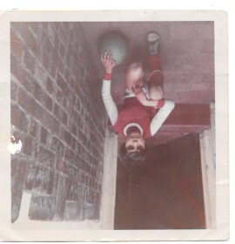
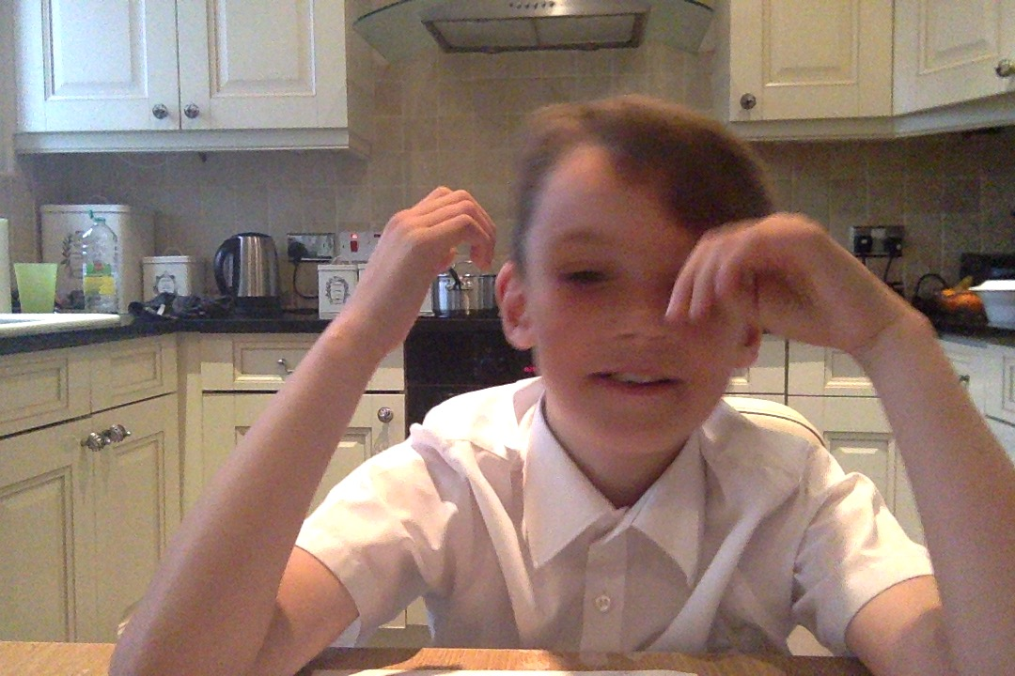
Making personal connections through sharing our own lives

Slide 20
Micro-level :the individual level
Meso-level: the wider social melieu
Macro-level : role of government and society at home and abroad
Identity, failed integration, alienation, discrimination, humiliation, stigmatization and rejection, moral outrage
supportive or complicit social surround, mediatisation, supportive family or friends; radicalizers
Foreign policy, party politics tense majority-minority relationships, social-economic opportunities; radicalisation of public opinion.

Slide 21
Creating and alternative narrative of our town

Slide 22
https://youtu.be/fW8amMCVAJQ
Leadership – dancing guy

