Slide 1

The Disengagement Crisis
Anne Martin
Centre for Workplace Engagement
Shalem Mental Health Network
Leading and Sustaining Change
IIRP Conference, Toronto
May 1, 2018

Slide 2
What does the disengagement crisis look like?

Slide 3
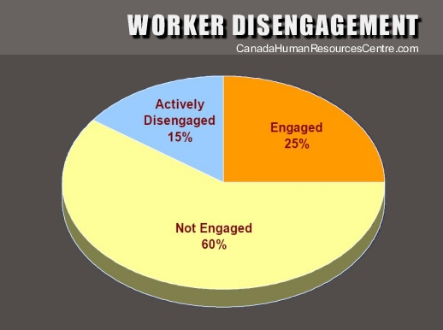
Canada Human Resources Centre

Slide 5
Engagement: what is it?
The concept of employee engagement is often confused with satisfaction or happiness. However, the true definition is deeper in meaning. Employee engagement is defined as “the level of an employee’s psychological investment in their organization.”
(2017 Trends in Global Employee Engagement: Global anxiety erodes engagement)

Slide 6
Canada Human Resources Centre
Notes:
Consistent with the annual Gallup report on workplace health

Slide 7

The crisis

Slide 8
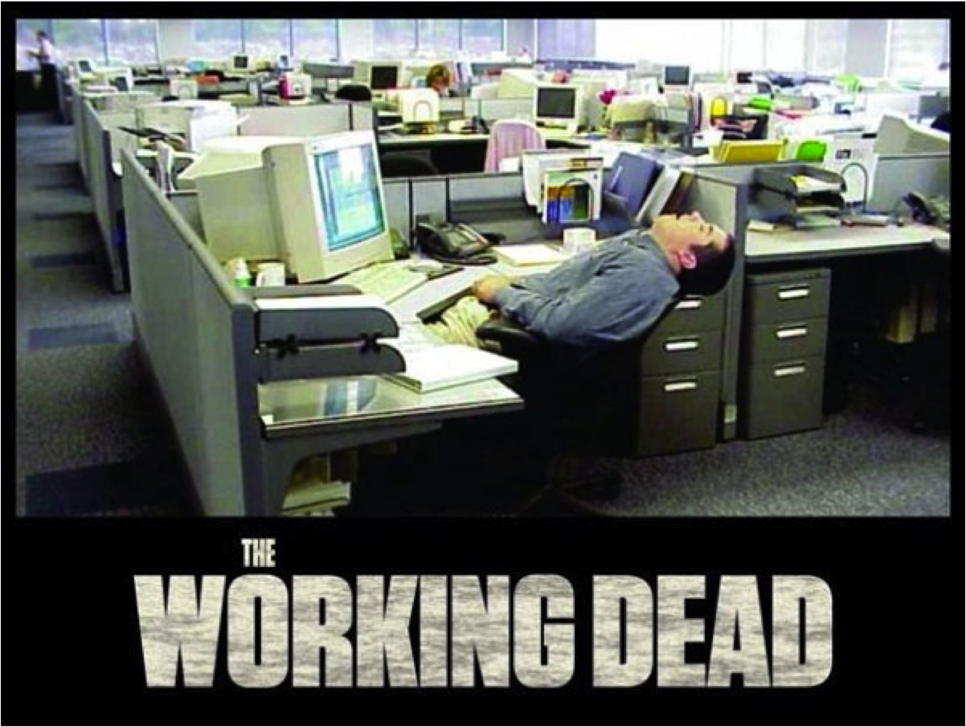

Slide 9
What fuels the crisis?

Slide 10
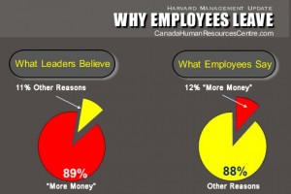

Slide 11
Reasons employees say they leave:
1. Poor management
2. Lack of career growth
3. Poor communication
5. Lack of recognition
6. Poor senior leadership
7. Lack of training
8. Excessive workload
9. Lack of tools and resources
10. Lack of teamwork

Slide 12
CWE: its beginnings
Our work experiences: restorative responses in churches and schools were often workplace issues
  Staff conflicts
  Dismissals
Invited to provide services to workplaces
Inquiry from a Union about working together
Knew of others doing workplace RP
Shalem strives to be a restorative workplace

Slide 13
Responding to the crisis
What? A crisis?

Slide 14
The data was out there
Gallup Employee Engagement reports
Canada Human Resources Centre
Mental Health Commission of Canada
Notes:
Gallup reports
Human Resources Canada
Mental Health Commission of Canada

Slide 15

Notes:
Gallup reports
Human Resources Canada
Mental Health Canada

Slide 16
Canadian Standards Association:
A Psychologically Safe and Healthy Workplace
Employers have a duty to take all reasonable steps to protect workers from being injured in the workplace, both physically and mentally. So they must ensure that the workplace is “psychologically safe” – that is, free from hazards such as harassment, discrimination, bullying, violence and mental stress that could cause harm to workers’ mental health. (2013)

Slide 17
13 factors affecting psychological health and safety
1) Organizational culture
2) Psychological and social support
3) Clear leadership and expectations
4) Civility and respect
5) Psychological demands
6) Growth and development
7) Recognition and reward
8) Involvement and influence
9) Workload management
10) Engagement
11) Balance
12) Psychological protection
13) Protection of physical safety

Slide 18
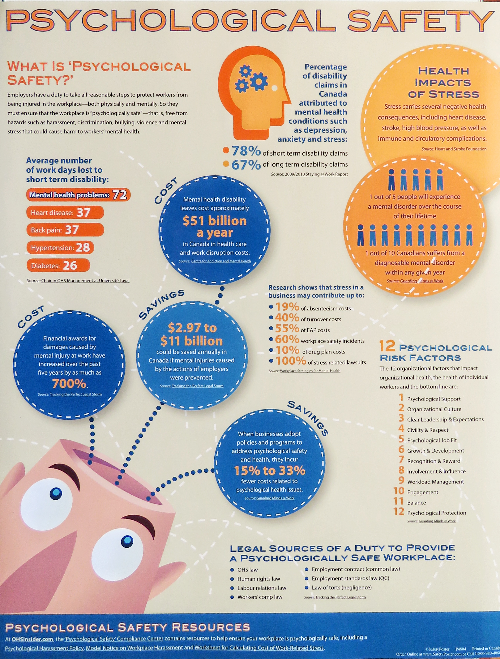

Slide 19
Talking about engagement
Identifying disengagement

Slide 20


Slide 21
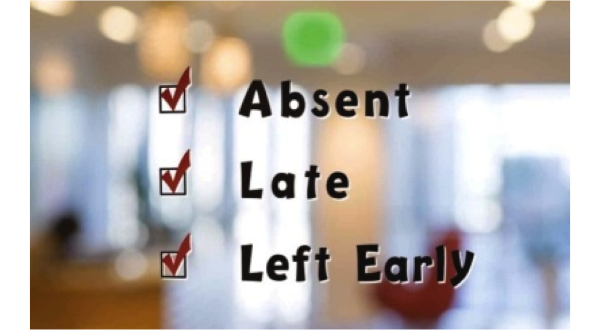
Absenteeism

Slide 22



Presenteeism

Slide 23

Low morale

Slide 24

High turn over

Slide 25
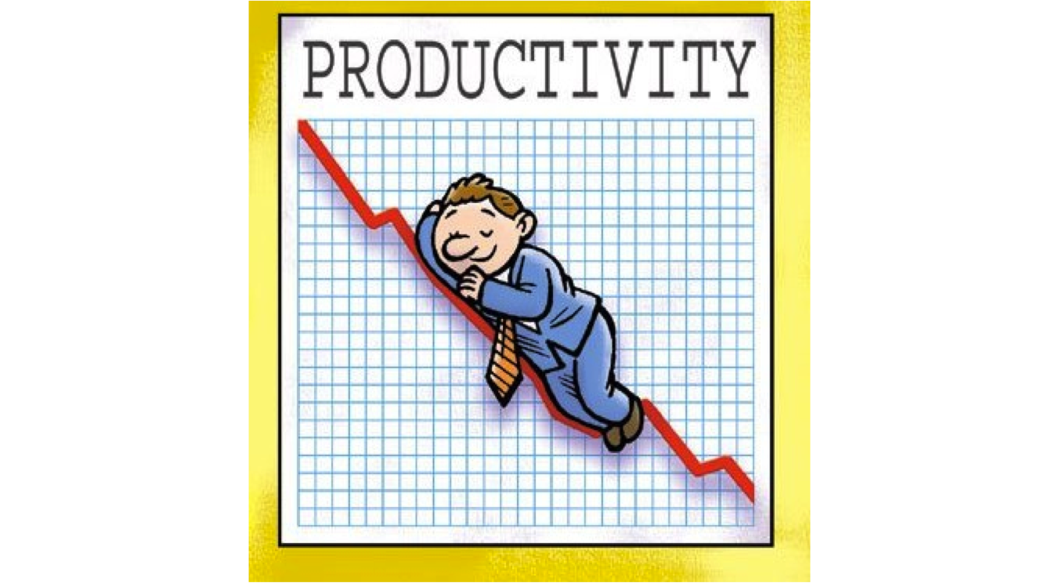
Low productivity

Slide 26
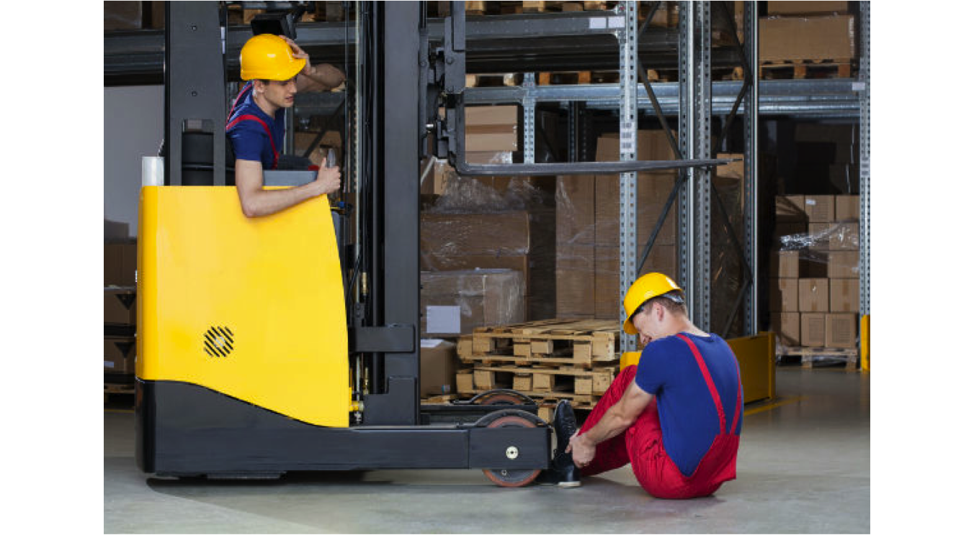
High number of on-the-job accidents

Slide 27

Gossip and other divisive behaviour

Slide 28

Unresolved conflict

Slide 29
In the meantime…..
    We were providing workplaces with engagement services.
    We were learning about our practice and ways to respond to disengagement

Slide 30
    CWE has worked with workplaces to:
    Identify what’s going well
    Identify disengagement
    Develop explicit practices to shift the culture from disengaged to engaged
    Address conflict
    Build relational capacity

Slide 31
CWE responses are grounded in the Restorative framework:
    The framework includes:
    Social discipline window
    Relationship styles
    Fair process
    The restorative questions
    A Socratic approach to dialogue
    The impact of shame on relationships
    The primacy of healthy relationships
    It’s all about relationships

Slide 32
The framework provides
    A common understanding of relationship health
    Common language for people to engage each other, to practice good relationships
    The basis for conversations that enhance the workplace experience
    An explicit way to build relationships, challenge each other and enhance creativity

Slide 33
Challenges we face
Developing a viable business model

Slide 34
Challenges we face
Developing our practice:
  How do we speak with workplaces about our services in light of:
    the workplace’s needs and capacity?
    the disengagement crisis?
    the CSA standard?
  How do we speak to:
    Management?
    HR departments?
    Staff?
  How do we talk about engagement?
    How do we understand what we have to offer?
    How do we make our practice explicit to ourselves and others?

Slide 35
Challenges we face
Developing an explicit practice

Slide 36
A few things to consider:
CWE - Developing
our Practice
Preparing for CWE project proposals?
How to gather and consolidate real-world experience?
Legitimate practice expansions?
Change approval procedure?
Creating RP guidelines for specific workplace types?
Recognizing legitimate CWE one-off custom services?
Respect for union environments?
Coordination with the IIRP
CSA recommendations
hiring practices
employee evaluation
workflows
follow-up
knowing CWE boundaries
grievance procedures
assessment
proactive & responsive
continuum
customer relations
legal boundaries
fair process
circles
restorative questions
relationship styles
restorative conferences
RP framework
core practice
leadership styles
healthy relationships
HR policies
restorative language
issues of shame
training
CWE extended services
team building
project planning
evaluation
reference group
staff surveys
levels of conflict
unions
staff meetings
workplace mental health
project status meeting guidelines

Slide 37
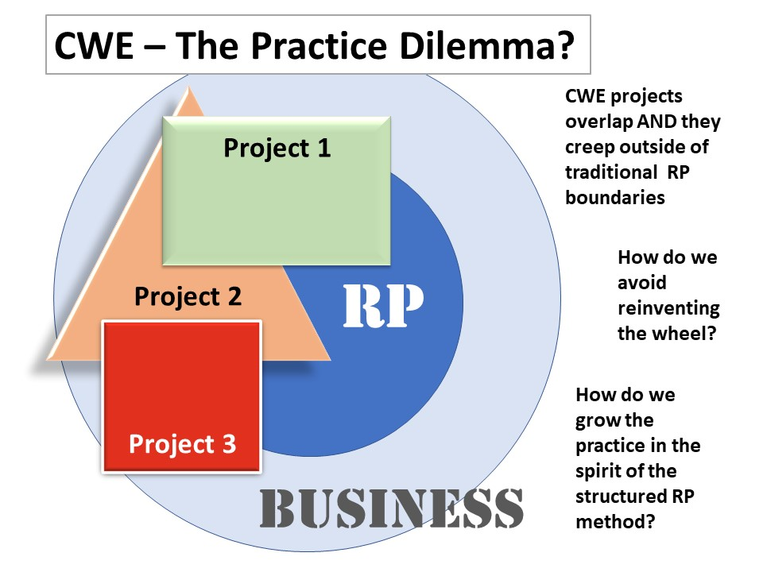
Developing an Explicit Practice

Slide 38
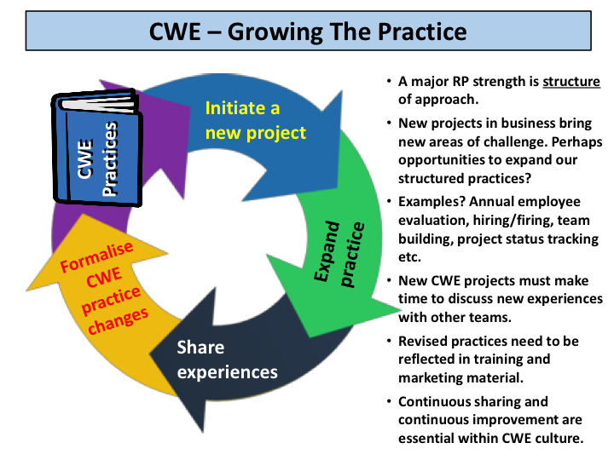
Developing an Explicit Practice

Slide 39
A CWE story
Reintegrating a staff member after sick leave

Slide 40
A CWE story: a union rep commented on the process
It was SO refreshing to engage members and management in a context other than a grievance meeting. Although we have systems in place (Labour-Management, Membership meetings, etc) to have member contact outside of conflict and grievances, I’m often frustrated with the outcome of these things in advancing positive relations. This process also served to accelerate the level of trust between our union and the management team. I really value that as the representative at this facility.
The restorative process was a success: they worked together to identify the issues and created their own goals towards resolving them. In that way, the facilitation was excellent – the conversation was guided just enough that they were forced to create their own solutions.

Slide 41
Although it’s just a first step, the process has left the staff, and management, with some very specific issues identified, and more importantly, specific next steps to work to solve them. There is a lot of energy around moving in a positive direction.
As a healthcare rep, low morale is the #1 dilemma I constantly face in my bargaining units. Arguably, it may not be my role as a union rep to improve workplace morale, but if I can play a role in that, then I feel I’ve accomplished more for my members than if I successfully settle all of their issues and grievances.
Understanding the basics of restorative practice is a skill that all reps should have a base knowledge of so that we can incorporate it into our language and daily practices when relating to members and employers.

Slide 42
We’re looking for connections!
We’d be pleased to hear from you and
learn with you!

Slide 43

The Disengagement Crisis
Anne Martin
Director of Consulting Services
Centre for Workplace Engagement
May 1, 2018

