Slide 1
Scott Milner Regional Executive Director of Education
Taking Restorative Practice into the Workplace: Learnings and Challenges

Slide 2
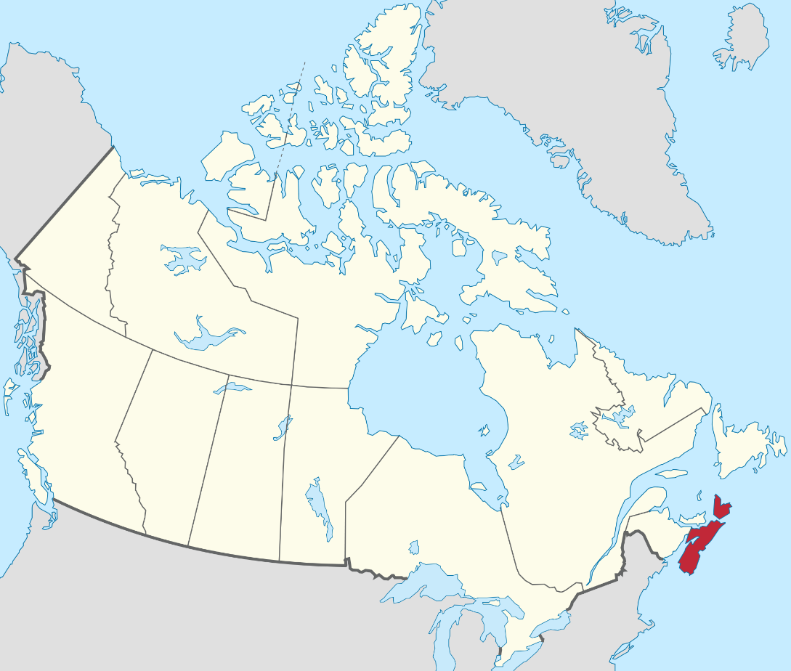
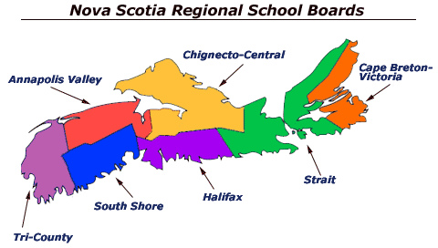
Notes:
For those of you who may not know, Nova Scotia is located on the east coast of Canada. It is a small province with a population of approximately one million people. Nova Scotia is known for its seafood, Celtic music (fiddling and bagpipes abound) and the hospitality of its people — but I want to suggest to you that it should also be known for its restorative justice program, which is the most developed and comprehensive program in Canada and among the leaders in the world.

Slide 3
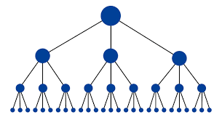
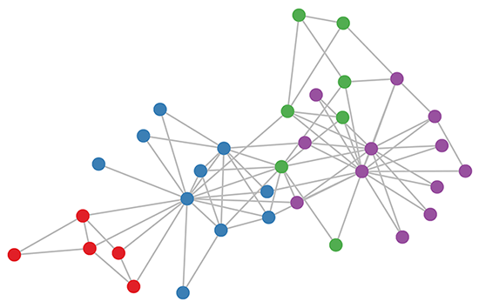
RA in 2011 / 2012
22 000 students
75 schools
Started at the school lead-team
4 Families of Schools
4 year implementation
Dedicated RA staff
RA in 2017 / 2018
6500 students
25 schools
Started across all divisions with volunteers
Early adopter lead guiding coalition
Start when ready, organic

Slide 4
Start with…… WHY?
“The implementation of a restorative approach forces alignment of the system and processes in order to be congruent with what we say we do and what actually happens in practice. To work restoratively means that we value relationships and connectedness across the school community (organization).”
Overcoming Resistance to Whole-School Uptake of Restorative Approaches
Peta Blood and Margaret Thorsborne, 2006
The quality of learning / working / growth / well-being that takes place in our day depends on healthy relationships between and among all adults and students in our school community.
WHY? To development a healthy and positive school / work community.
Transform culture / Optimize conditions for teaching and working / Build collective efficacy

Slide 5
Then describe….. WHAT?
Over time, incorporate Restorative Practices at the governing board level, classroom, school, office and worksite that will lead to effective vertical and horizontal capacity building and overall sustainability in SSRSB.
Develop a network of staff within all areas of the organization that will support Restorative Practice as part of the fabric their daily lives.

Slide 6
Umbrella Concept
Restorative Approach =
A Relational Approach
Practices
Strategies
Policies/Procedures
Processes
What is our goal?
Who will be affected and how by the way in which we go about achieving that goal?
If we want to do things differently, we must also think differently about what we are doing.
Notes:
6

Slide 7
Structural Change
Cultural Change
What we believe and think.
Our behaviours and actions.
Common set of beliefs
Shared vision for teaching and working
Growth mindset
High expectations for all
Participatory decision making
Cultural competency
Relational thinking

Slide 8
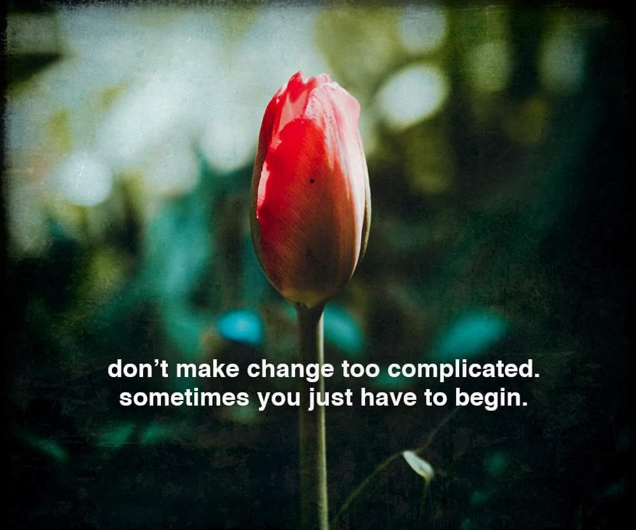

Slide 9
Thank you
English
Merci
French
Wela’lioq
Mi’kmaq
Danke
German
Asante
Swahili

