Slide 1
Artful Questions
Needs/Values/Respect

Slide 2
Co-Creating Cooperative Community
How can I learn to respect another?
How similar /dissimilar are our needs?
How do I understand the values that are driven by those needs?

Slide 3
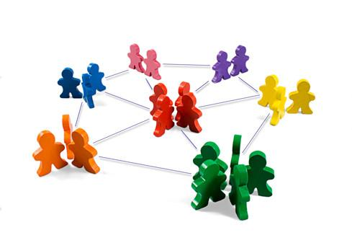
Bringing us together
What do the individuals in this room need in order to feel comfortable, safe, and supported?

Slide 4
Restorative Practices
“Restorative practices are processes that proactively build healthy relationships and a sense of community to prevent and address conflict and wrong doing.”
Http://www.iirp.edu/what-is-estorative-practices.hph

Slide 5
What does this mean?
What is a healthy relationship?
How does one define a community?
What is ‘wrong doing’?

Slide 6
The Mind vs. the Heart
Share something that you’ve noticed people in healthy relationships do.
What makes you feel like you are connected to a community?
Talk about a time when you felt connected to your community. Share one thing that connected you to that community.
Talk about a time when you felt wronged. What did you need?

Slide 7
Core Assumptions
Needs are universal
Values are driven by needs and experience
Experience shapes individual emotional scripts
Emotional scripts affect individual choices and reactions

Slide 8
Write a sentence or two about what these values mean to you.
True Love
Adultery
Apathy- Not my problem
Capitalism-buyer beware
Loyalty
Violence

Slide 9
Sam and Laura
Listen to the story and then rate the characters from 1 to 5.
Number 1 is the best.
Sam and Laura are deeply in love and engaged.
Susan is a friend of Laura.
Mathew owns the ferry
David is a mutual friend of both Sam and Laura.

Slide 10
The Story
Sam and Laura are deeply in love.
They live on opposite sides of a wide river.
A devastating storm destroys the bridge that connects their villages.
Laura is worried about Sam. She looks for him thinking that he will come to the side of the river if he is uninjured.

Slide 11
Now Rate the Characters
1 is the best 5 is the worst
  Sam- In love with Laura
  Laura is in love with Sam
  Susan- Friend of Laura
  Mathew- Ferry owner
  David- beats up Sam

Slide 12
Values
Look at what you wrote for your values and see if there are places where what you ‘thought’ about the value and how you rated a character differ.

Slide 13
Circle Question
Share a value that is central to your life. From whom did you learn this value or what happened that made this value important to you?

Slide 14
Conflict
Our values are meant to ensure that our needs are met both individually and collectively.
Conflict occurs when an individual is unable to get one or more of his or her needs met.
Sometimes the fear of not getting our needs met fuels conflict.

Slide 15
Developing Empathy
Intellectual arguments about fairness or right and wrong bypass personal experience and limit the personal response.
Sharing personal needs and concerns changes the direction of that conversation and promotes empathy.

Slide 16
Building the future
What do you need from your community?
What do we need from each other?
    Needs
    Values
    Experiences
    Preferences

Slide 17
Question Activity
After watching the video, use the reflection portion of the questions handout to analyze the exchanges in the video.
What did you learn about the participants in the circle?
What did they learn about each other?
How might you have changed the question asked by the facilitator in order to create more connections in the class?

Slide 18
Kindness
First be kind to yourself.
  Share how you feel
  Ask for what you need
Second be kind to others
  Listen to what the other feels
  Listen to the need that was expressed, and, if possible meet that need

