Slide 1

‘Creating a culture of conflict resolution’
_________________
A Policing Perspective
Sgt Martin Moloney

Slide 2
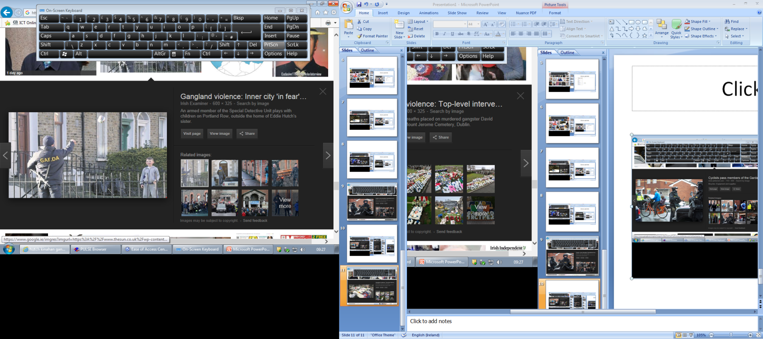
in the north inner city february 2016
‘gangland feud starts’
5th February 2016 – 1st murder
8th February 2016 – 2nd murder
14th April 2016 – 3rd murder
25th April 2016 – 4th murder
24th May 2016 – 5th murder

Slide 3
high end conflict
______________
conflict resolution

Slide 4
we had used the balanced model after a major incident in 2015
_________________
this was the approach

Slide 5
this approach didn’t work:- yet
To Feel Safe
To understanding why
Vindication
Acknowledgment of hurt
Opportunity to express anger, pain, to ‘tell their story.’
The restoration of control
Assurance that mechanisms in place to prevent reoccurrence
Acknowledgement of the hurt caused to the community
Assurance that the victims needs are being met
Encouragement of a sense of community ownership of and responsibility towards justice
The focus of the meeting is made clear.
Brought through a scripted conference, dealing with past, present and future.
Facilitator will look to the group for ways to repair their community (this will include input from local services, Gardai etc.)
It is hoped that the ‘relationship’ will be healed in some way.
UNIQUE OPPORTUNITY
☹
We are aiming to bring the community from the affected areas together and give them an opportunity to tell their story.
This will be a restorative meeting (without wrongdoers) looking to ‘restore’ the community in some way.
This process is the same as any restorative process.
☹
Provide a ‘safe space for free expression of emotion’.
Allow community to tell their story
Acknowledge their story
Look for ways to make things better
Rebuild Relationships/Community
Restore
☹
didn’t work ☹ for number of reasons

Slide 6
next approach
____________
‘be creative’

Slide 7
Gardai using RP in communities:
Trained Gardai to engage with children in schools/youth projects
If opportunity arises – Garda will bring children through RP conversation:
- Allow them to tell their story
- Acknowledge their story
- Look for ways to repair
This model can be used for any instance informally or formally (feud related or other)

Slide 8
Gardai using RP in communities:
RP Workshops to students on conflict resolution.
4th Years/5th Years –
3. Garda Youth Diversion Programme – Juvenile Offenders RP Approach.
Garda Youth Diversion Projects Working Group.
All projects in north inner city -
Major incident Community Assessment. Detective Units.
RP Training …residential care units in city centre
Case Management - ‘Re-integration of repeat offenders’
Community of Practice
1st Approach revisited
Anywhere else where it is deemed
appropriate to use…..

Slide 9
from fear
________________
to surprise

Slide 10
Interest - Excitement
Enjoyment - Joy
Positive
Neutral
Surprise - Startle
Fear - Terror
Distress - Anguish
Anger - Rage
Disgust
Dismell
Shame - Humiliation
Negative
Kelly, Vernon C., 2009

Slide 11
‘ease with difference’
____________
Derick Wilson

Slide 12
The RP model “creates environments and groups where young people feel safe and valued (equity), where their different abilities and vulnerabilities can be expressed and safely acknowledged (diversity) and where all grow, experiencing the excitement of belonging together (interdependence)(Eyben et al.1997)

Slide 13
promote this idea of being ‘easy with difference’
________________
thank you

