Slide 1
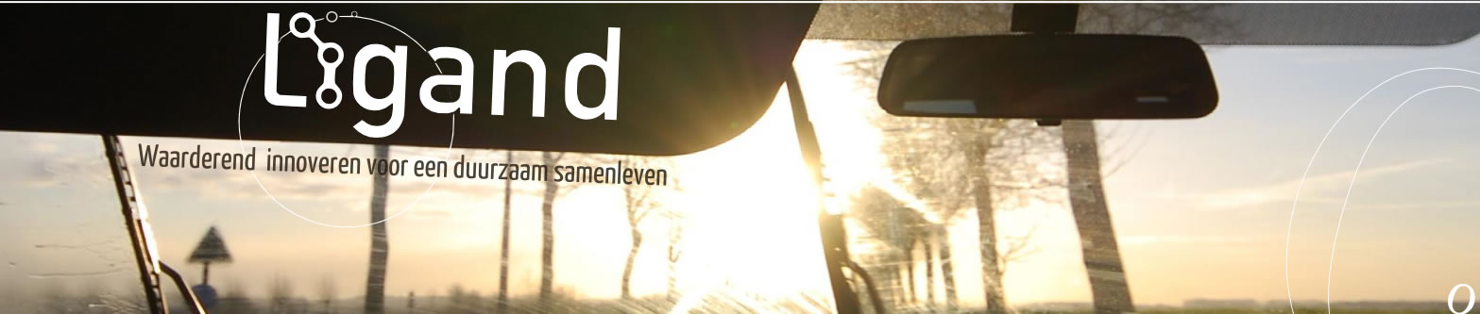
REORIENTATING ORGANIZATIONS
Stijn Deprez Ligand
2017

Slide 2
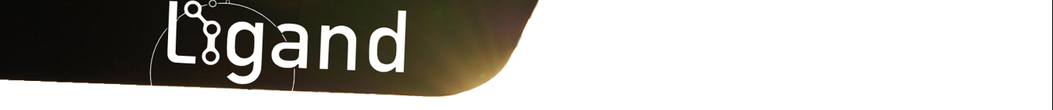
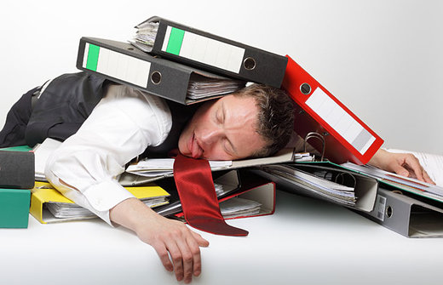
The state of Stijn Deprez

Slide 3
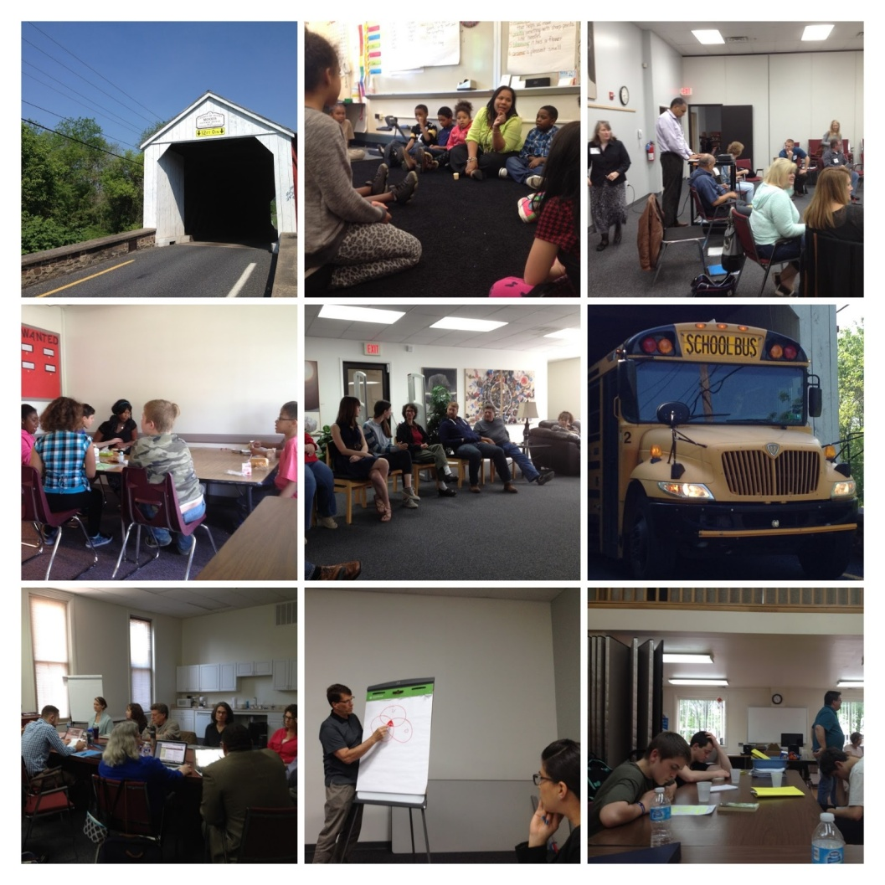
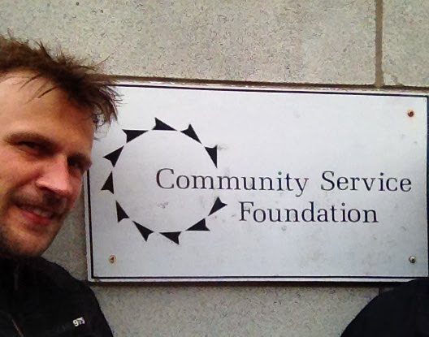

May 2016

Slide 4

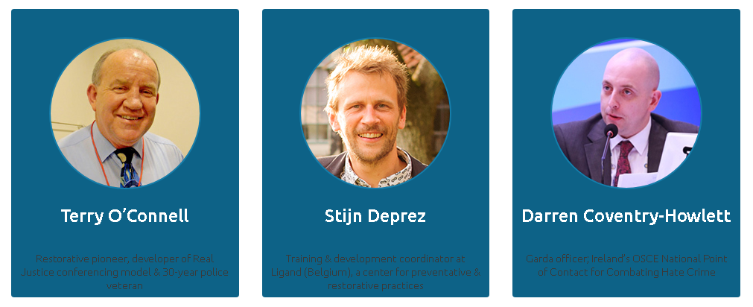
September 2016

Slide 5
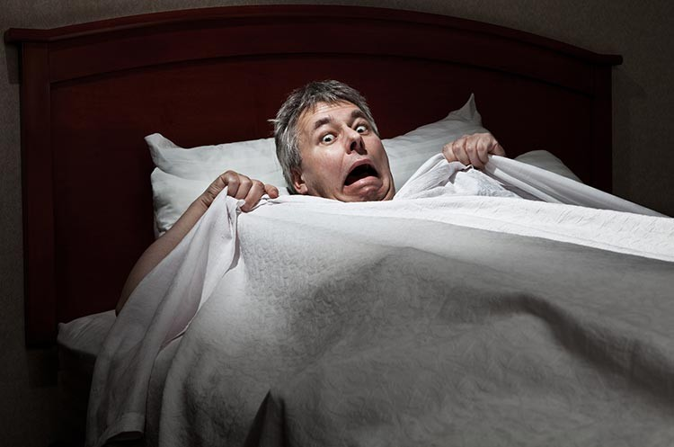
Two weeks ago

Slide 6


Two weeks ago

Slide 7
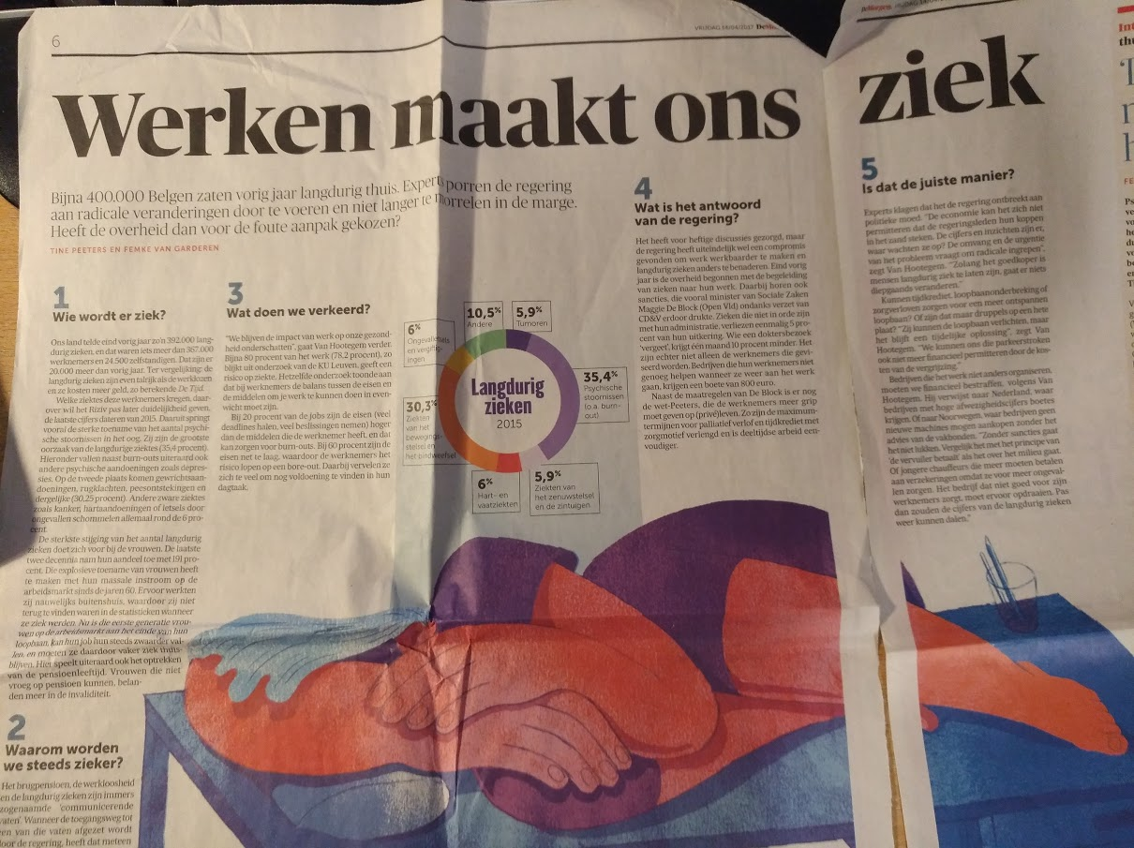
Why reorientating organizations?
Work makes
us sick

Slide 8
Why reorientating organizations?
"If everyone had to think outside the box, maybe it was the box that needed fixing“
Malcolm Gladwell, What the Dog Saw

Slide 9
Why reorientating organizations?
Reflection

Slide 10
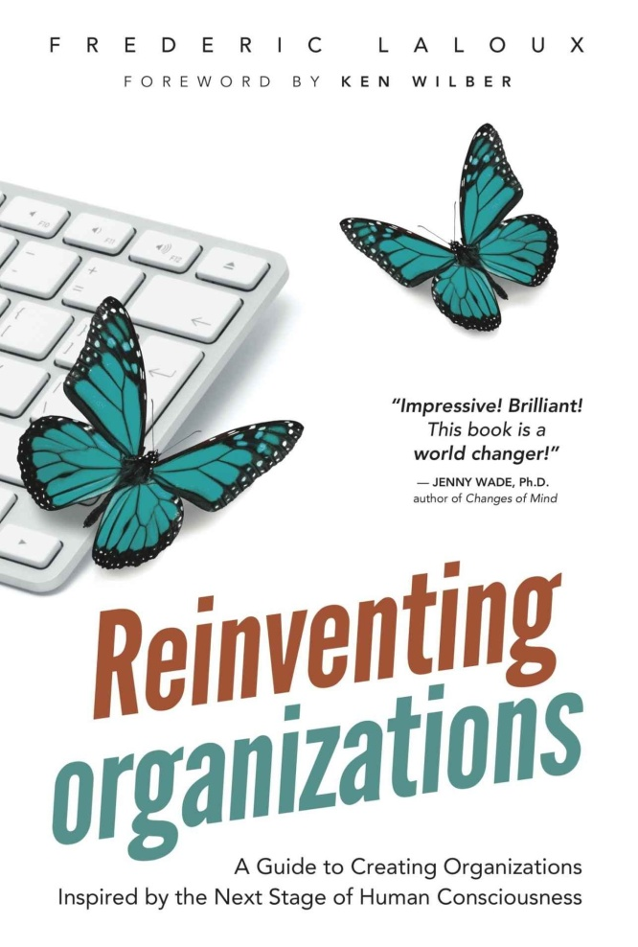
Why reorientating organizations?
Frederic Laloux: Reinventing organizations
Belgian consultant
Researched management systems worldwide

Slide 11
Why reorientating organizations?
“We have turned schools, almost everywhere, into soulless factories that process students in batches of 25 per class, one year at a time. Children are viewed essentially as interchangeable units that need to be channeled through a pre-defined curriculum. At the end of the cycle, those that fit the mold are graduated; castoffs are discarded along the way. Learning happens best, this system seems to believe, when students sit quietly for hours in front of all-knowing teachers who fill their heads with information.”
Laloux.

Slide 12
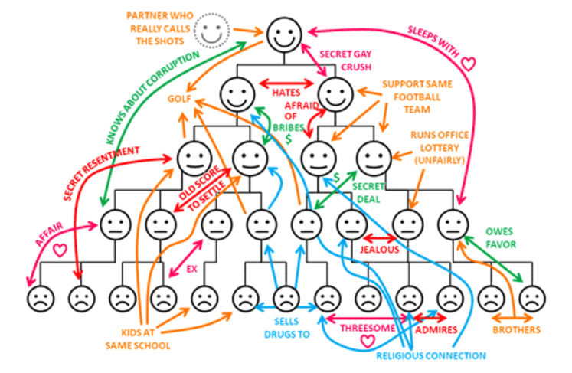
Why reorientating organizations?

Slide 13
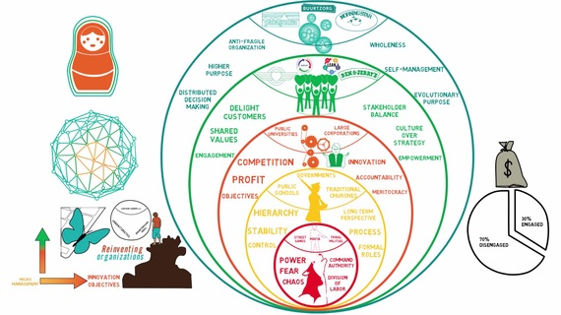
Historical and developmental perspective
An overview in colors
https://www.youtube.com/watch?v=g0Jc5aAJu9g&t=452s

Slide 14
Historical and developmental perspective
Teal organization <-> Restorative organization

Slide 15
3 breakthroughs in teal organizations
Self-management
Wholeness
Listening to evolutionary purpose

Slide 16
1. Self-management
Leaders are overworked
Self-management is not new
3 misunderstandings
  Self-management = no stucture
  Endless meetings
  Still in experimental phase
Selfmanagement needs an upgrade of most of the elementary management practices: structure of the organization, budgets, functions, targets, meetings, investments, resignation,…

Slide 17
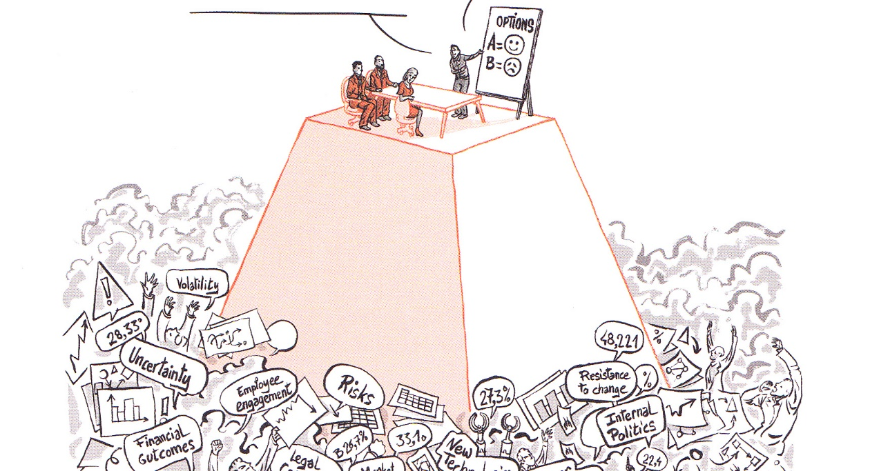
1. Self-management - structures
1.No pyramid
  Buurtzorg: “Nobody is the boss
  of somebody else.”
Traditional pyramidal structures demand too much of too few and not enough of everyone else (Gary Hamel)
New organogram
A new assumption
  “all colleagues have the obligation to do something about an issue they sense,…”

Slide 18
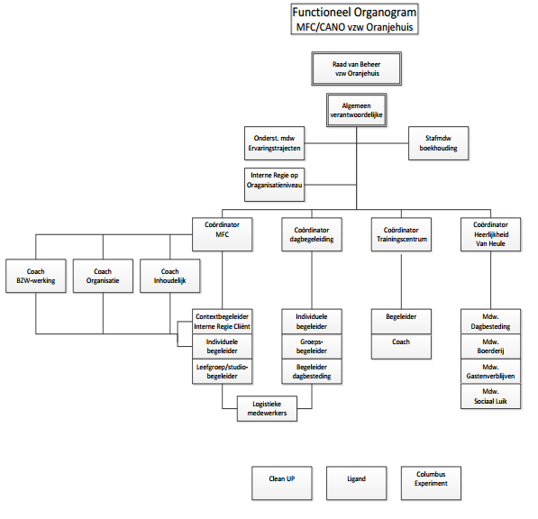
1. Self-management - old organogram

Slide 19
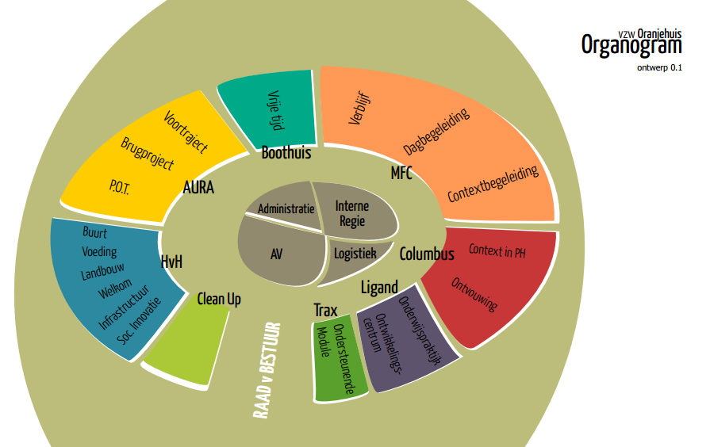
1. Self-management - new organogram

Slide 20
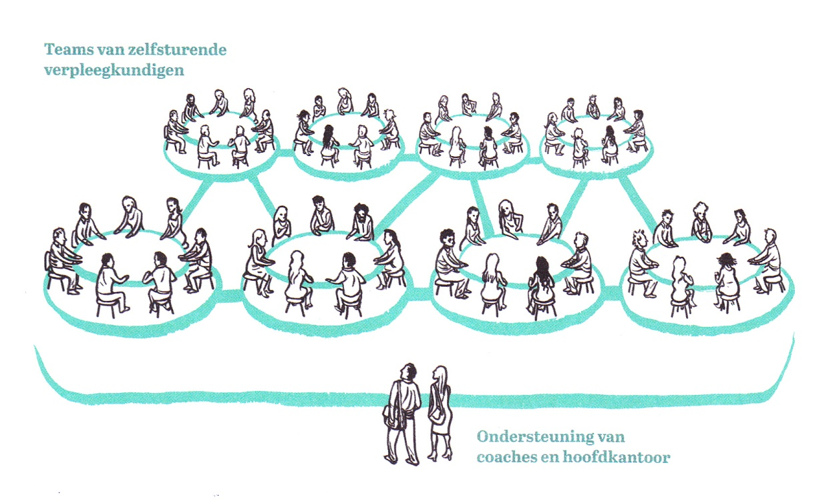
1. Self-management - structures
2. No middle-management
Bureaucracies are built by and for people who busy themselves proving they are necessary, especially when they suspect they aren’t (Ricardo Semler)

Slide 21
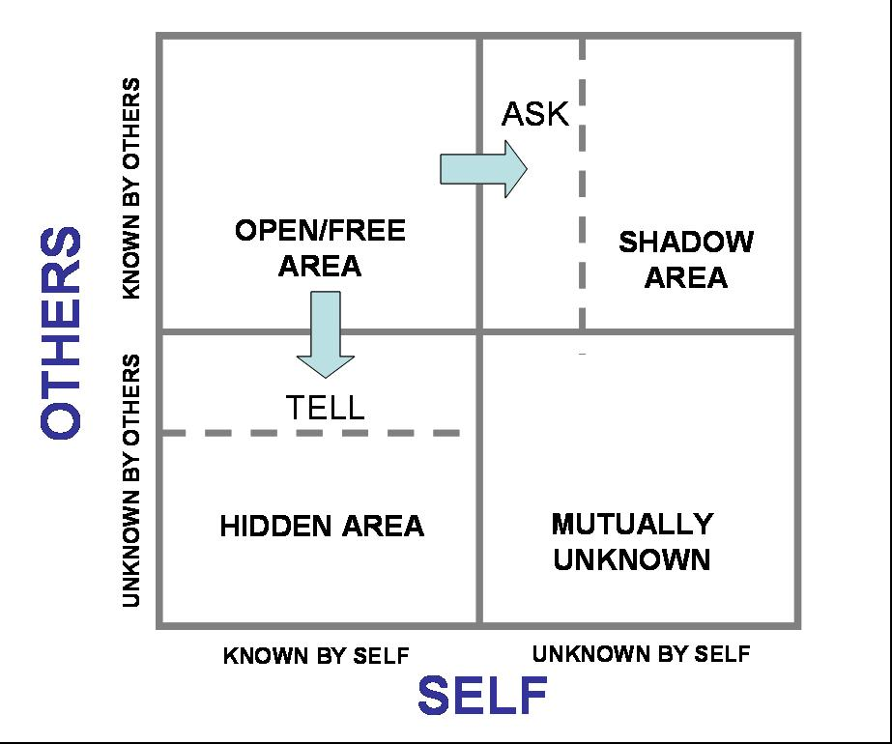
1. Self-management - structures
From control to trust
Self-management needs trust
and open communication
More and a bigger variety on
feedback
Johari-window
FEEDBACK
CIRCLES

Slide 22
1. Self-management - opportunities for RP
Shift from
avoiding conflicts to learn people how to deal with conflicts
How do people manage conflicts?
In a teal organization it is essential that every collegue is trained in conflict management (or Restorative Practices)

Slide 23
1. Self-management
Reflection:
Is self-management the future? What are your thoughts about this?
Opportunities for Restorative Practices?

Slide 24
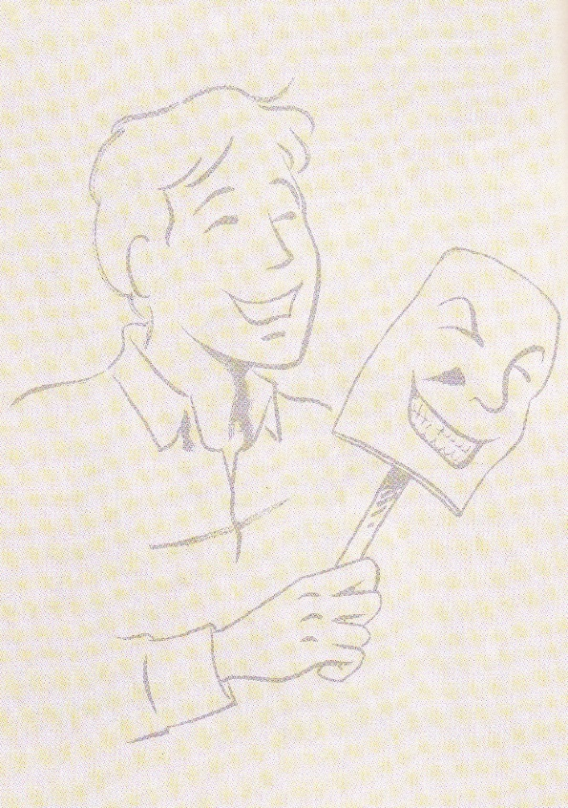
2. Breakthrough 2 Wholeness
If the soul is not welcome in the organization,
you get soulless organizations

Slide 25
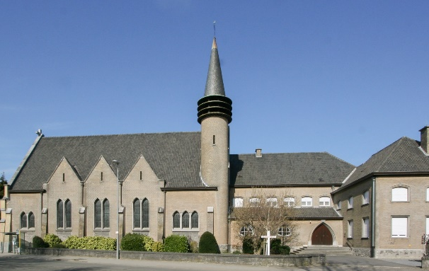
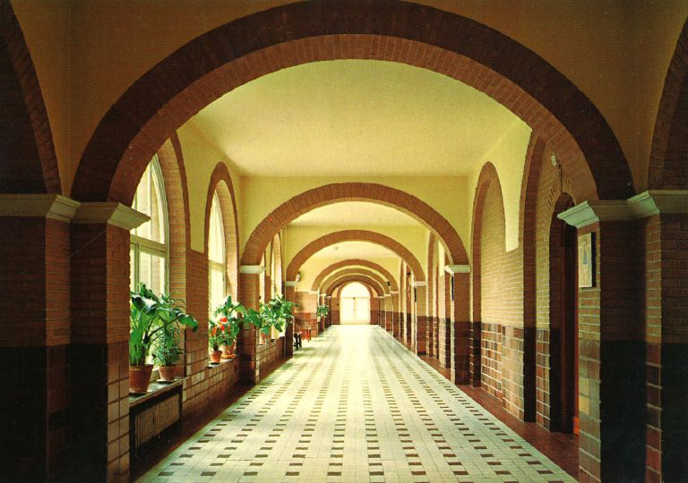
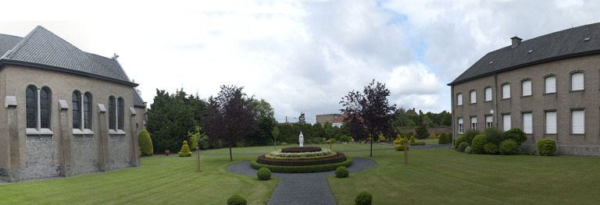
2. Wholeness in practice
Safe work environment where personal
interests meet organizational interests
Colleague principles
Circles
Time and space for reflection

Slide 26
2. Wholeness reflection
How is reflection build in in your organization?
Let’s share some good ideas.

Slide 27
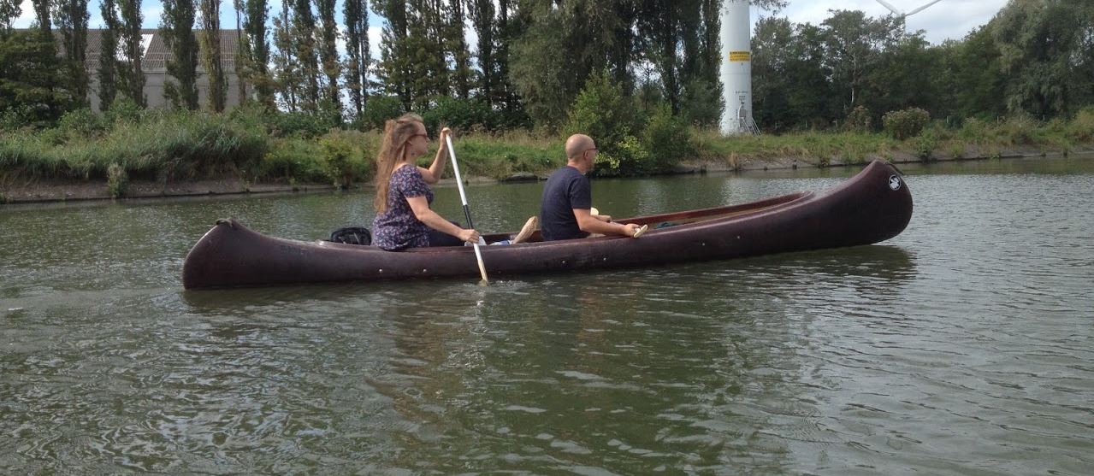
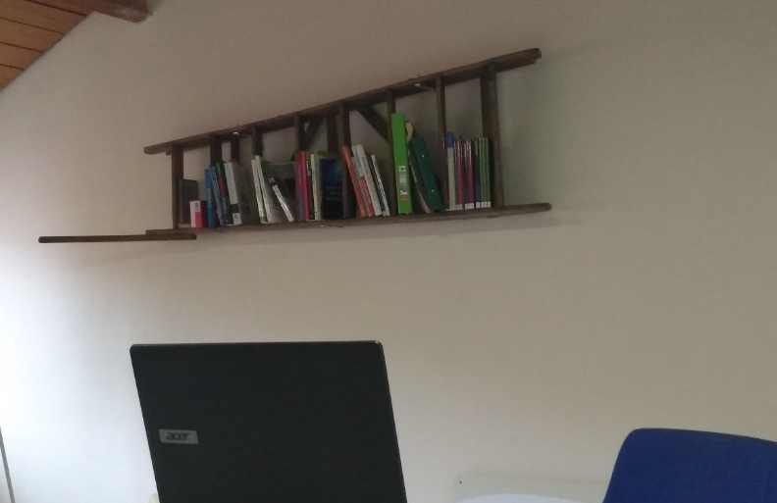
2. Wholeness in practice
Recrutement and start-up: where the lie starts
Meetings
Infrastructure
Churchill: “we shape our buildings
and then they shape us.”
Attention for climate and society

Slide 28
2. Wholeness in practice
Reflection:
How does your organization take responsibility for what happens in the world (socially, ecologically, …)?

Slide 29
3. Listening to evolutionary purpose
  No long term plans
  Listening to the deeper goal of the organization and to the people.
  Strategic plans, balances, targets. It is like machines. The new metaphor is living organisms.
  Fun

Slide 30
Conclusion
Thanks to Frederic Laloux

