Slide 1


The time’s they are a’ changin’
Restorative Practice in the Workplace
Anne Martin & Bill Bickle
May 2, 2018

Slide 2
Welcome

Slide 3

Centre
for
Workplace
Engagement
Anne Martin & Bill Bickle
Bill Bickle
Business person learning RP
Strategic Growth Planning
Anne Martin
RP person learning business
Director of CWE

Slide 4
What we do
Responsive processes
  When there’s conflict
  After a disciplinary process & termination
  Bullying on the staff team
  When sides have been taken on an issue
  Proactive processes
    When relationship building is critical
    In a structural re-org or merger
    New leader of a leadership team

Slide 5
What we have done
Offered services to 15 workplaces
  No segmentation or concentration
Putting practice into perspective
  services to other workplaces under FaithCARE & EduCARE
  Team and structural issues

Slide 6
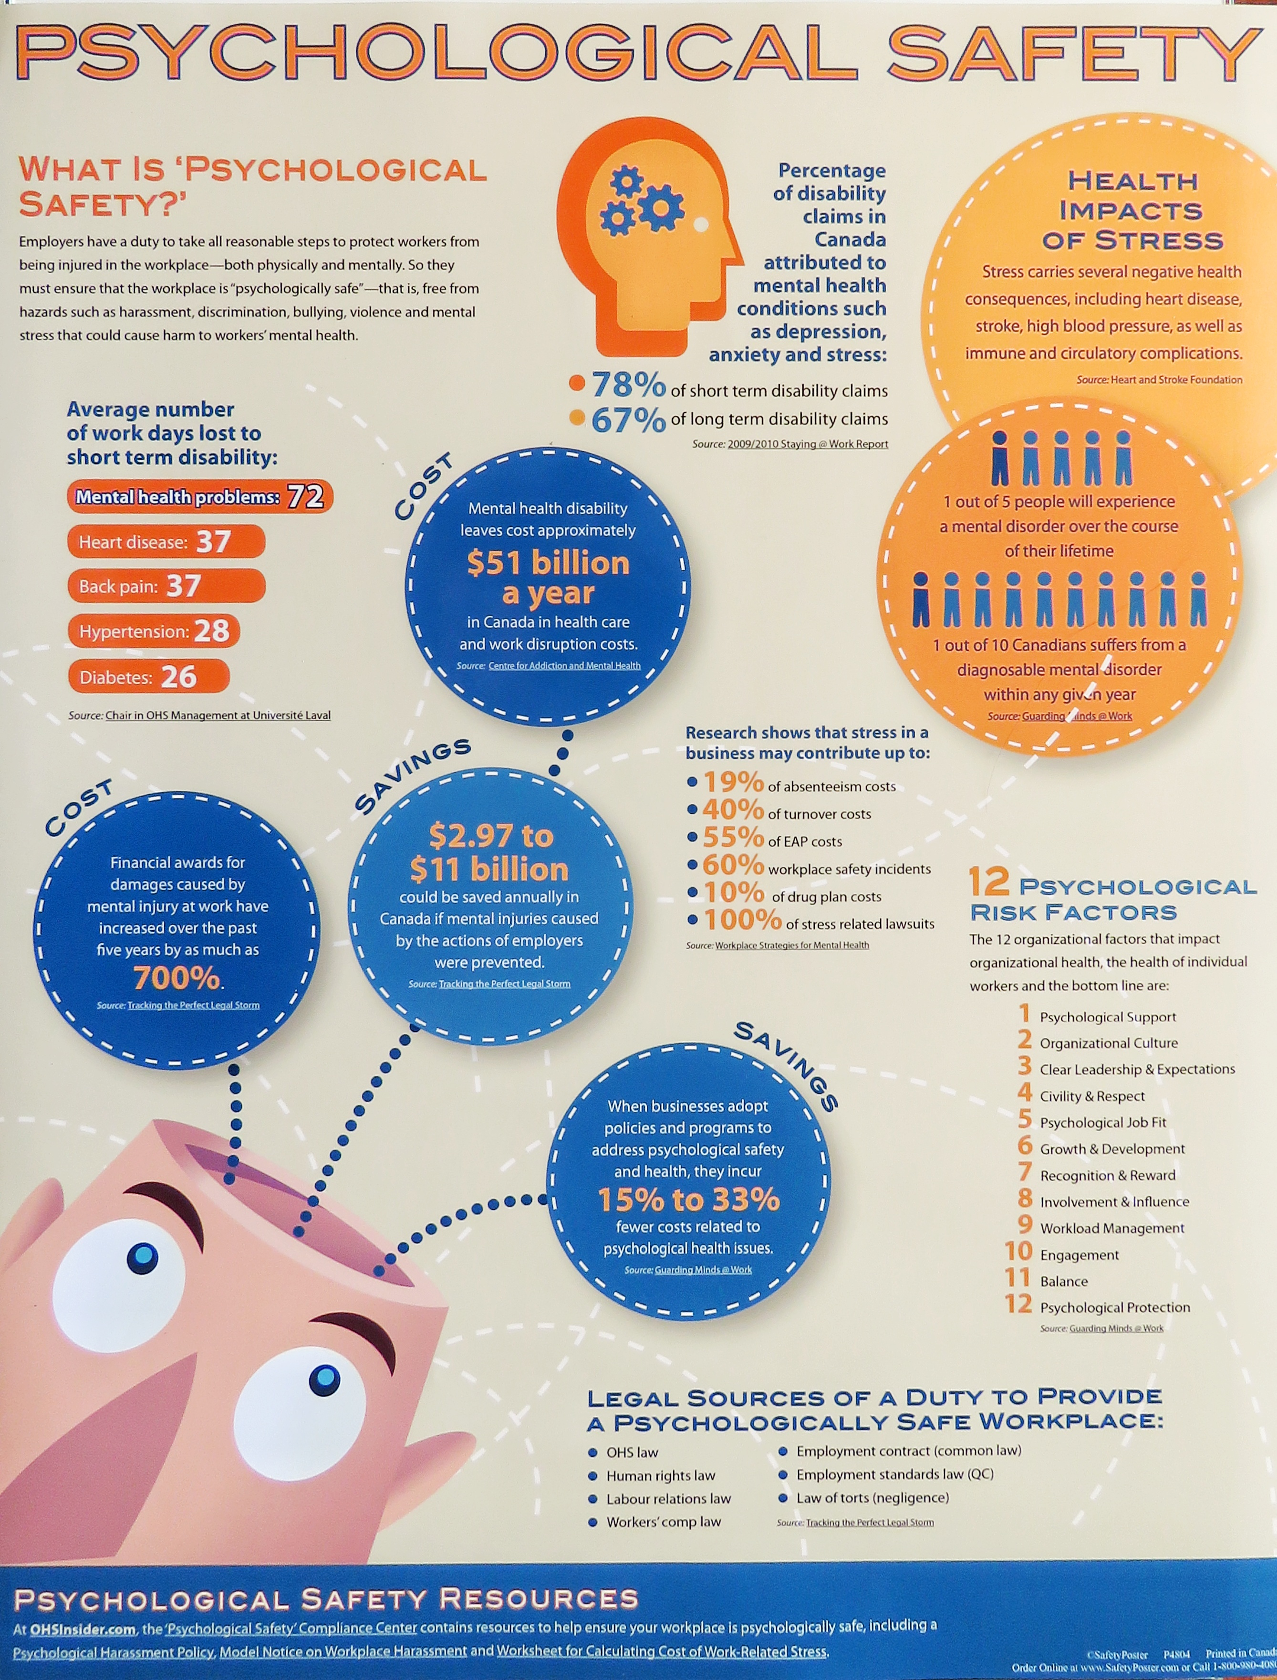

CSA workplace standard
How is it perceived by client: just another government intrusion into business?
Our work is validated by the standard
A turn-key solution if no HR Department or capacity
Bell Canada’s “Let’s Talk”

Slide 7
Adapting RP for the workplace
Language:
  from restorative to engagement
  Centre for Workplace Engagement
    Support for engagement language through Gallup
    Don’t get caught up in what “restorative” looks like
  Fits with Fair Practice language of engagement
  Can easily adapt the leadership styles quadrants using engagement language
  Can adjust the continuum accordingly

Slide 8
Relationship & Leadership Styles
HIGH
TO
WITH
Authoritarian
Engaged
Firm
Pressure
Expectations
Control
Controlling Punitive
Authoritative Respectful
CHALLENGE
NOT
FOR
Neglectful
Permissive
Protective
Easy/
Undemanding
Indifferent
Passive
LOW
SUPPORT
HIGH
Fair - Encouragement - Nurturing
Adapted from Social Discipline Window - Paul McCold and Ted Wachtel - 2000
Notes:
8
Simone

Slide 9
When People don’t get along
Two Approaches:
Adversarial
Engagement
Focus on the past
Preoccupied with blame Who? Why?
Deterrence linked to punishment
Focus on past, present and future “What?”
Emphasis: impact on group
Deterrence linked to relation-ships, personal accountability
Consequences:
Ways forward must be an outcome of an engagement approach. Through the integration of dialogue and respectful challenge, the team will determine the appropriate way forward.
Notes:
Anne

Slide 10
A Culture of Engagement
Our way of being
Our way of being together
Infiltrates all our interactions
Informal
Formal
Day to day conversations incorporating basic engagement principles and questions
Meetings:
Informal
response to
conflict
Policies & procedures:
Formal
response to conflict
Staff
Planning
Decision- making
Evaluation
Job- descriptions
Evaluations
Workplace- relationships
Notes:
Anne

Slide 11
Other Adaptations
Management training
Change Management
Organizational Design
Flatter Organizations and Structure

Slide 12
Relationship & Leadership Styles
HIGH
TO
WITH
Managed strategic change
Connecting personal & professional growth
Mandate Requirement
Top-down
Imposed change
Self-managed project matrix
Pressure
NOT
FOR
Cosmetic change (fadism)
Management Consultants
Avoiding/resisting change
Best Practice Emulation
LOW
SUPPORT
HIGH
Encouragement - Nurture
Adapted from Social Discipline Window - Paul McCold and Ted Wachtel - 2000
Notes:
12
Simone

Slide 13
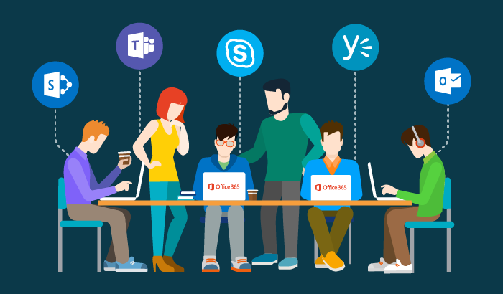


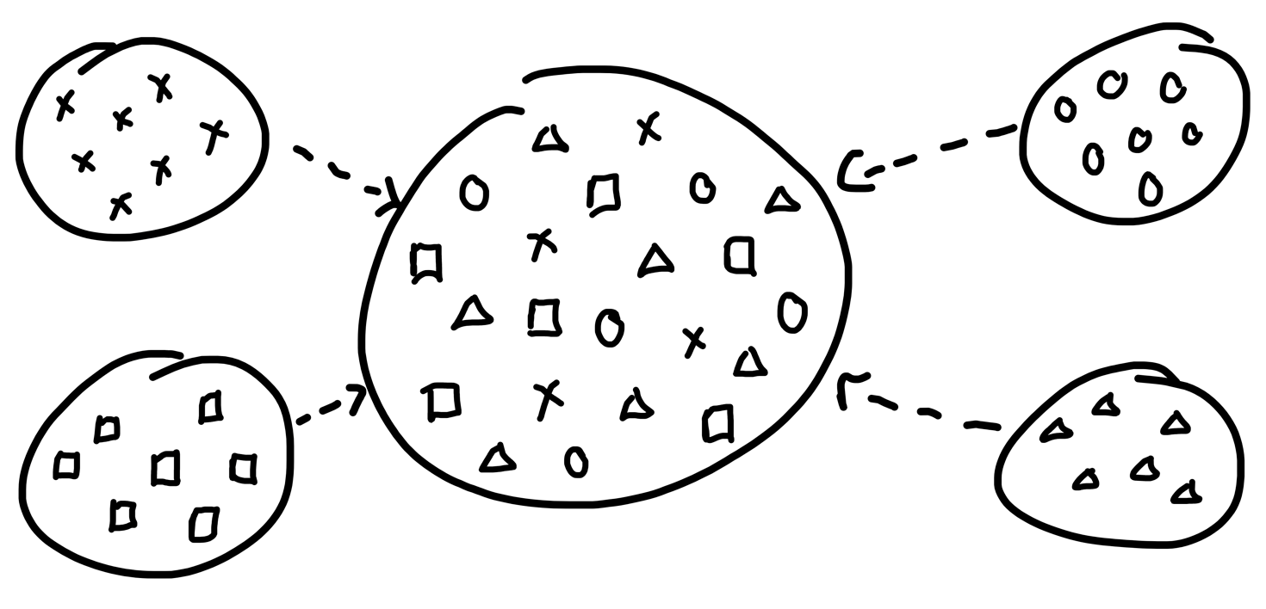


Alignment to Management Science
Engagement
Creativity
Collaboration
Cross-discipline

Slide 14


“The way forward, I’m suggesting, is not to stop collaborating face-to-face, but to refine the way we do it.”
“The most effective teams are composed of a healthy mix of introverts and extroverts, studies show, and so are many leadership structures.”
Susan Cain, author of Quiet – The Power of Introverts in a World that Can’t Stop Talking

Slide 15
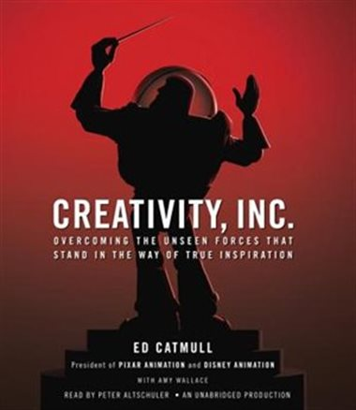
“To set up a healthy feedback system, you must remove power dynamics from the question – you must enable yourself, in other words, to focus on the problem, not the person.”
Ed Catmull, author of Creativity Inc. and head of Pixar/Disney

Slide 16
HR is really about relating
Reporting lines & accountability structures
Management receives less training & development, equipping for the role
Especially in the giving – and receiving – of feedback
Performance Management about outcomes or relationships, or both
Performance standards and outcomes vs face-time and being available 24/7
How Millennials want to be ‘managed’

Slide 17
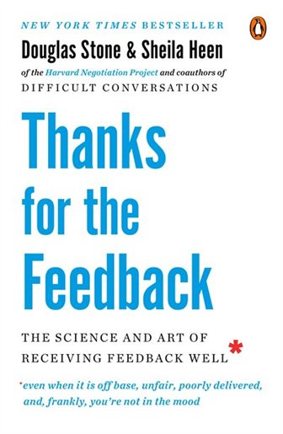
“Accidental adversaries are created by two things: role confusion and role clarity. It’s no longer clear where my position ends and yours begins. It’s impossible to overstate the extent to which role confusion exists, even in the most well-run organizations.”
Sheila Heen, author of Thanks for the Feedback – the Science and Art of Receiving Feedback Well

Slide 18

“When things fall apart, and chaos re-emerges, we can give structure to it, and re-establish order, through our speech. If we speak carefully and precisely, we can sort things out, and
put them in their proper place, and set a new goal, and navigate to it, often communally, if we negotiate; if we reach consensus. If we speak carelessly and imprecisely, however, things remain vague.”
Jordan Peterson, author of 12 Rules for Life – An Antidote to Chaos

Slide 19
Broader approach to change
Not change-management but building relationships
  From process & structural changes to growing relational capacity
  Ability to work through healthy conflict
  The challenge, and responsibility, is for leadership to set processes and practices in place to build healthy relationships
  People can adapt to change if they feel safe and secure, that someone is hearing them and cares for them

Slide 20
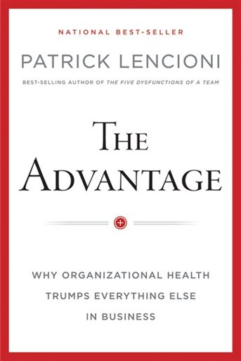
“Alignment and clarity cannot be a-chieved in one fell swoop with a series of generic buzzwords and aspirational phrases crammed together.
Leaders simply cannot inspire, inform, motivate, market, and position their companies in the context of a t-shirt or lucite tschotske. Clarity requires a much more rigorous and unpretentious approach.”
Patrick Lencioni, author of he Advantage: Why Organizational Health Trumps Everything Else in Business

Slide 21
Organizational Design
Structural change drives stress, strain and relational unsteadiness
Cross-disciplinary teams generate unique issues around clarity and accountability
Flatter organizations have less tolerance for structure and softer skills

Slide 22
Strategic Planning & Implementation
Strategic Planning often doesn’t ‘work’ because …
… because it’s not implemented
Implementation is really about focus
Alignment on the Leadership team
Articulate clarity
Over and over and over

Slide 23
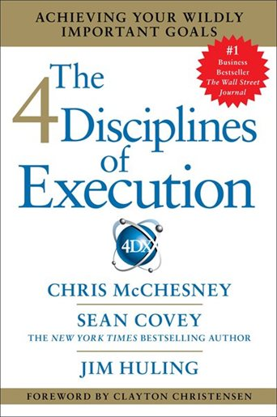
“This level of engagement seldom if ever comes from a command-and-control ap- proach – that is, one that relies exclusively on the formal authority of the leader. Authority alone at best yields only compli- ance from the team. By contrast, integrating the four disciplines produces results not from the exercise of authority but from the fundamental desire of each individual team member to feel significant, to do work that matters, and ultimately, to win. That kind of engagement yields true commitment.
Chris McChesney, Sean Covey and Jim Huling, authors of The 4 Disciplines of Execution

Slide 24
Challenges we face
Relevancy (they have to invest time & money)
Connecting, getting known
Not just another consultant, something more, really is about culture change (culture
Education: engagement facts and principles

Slide 25
Expanding your RP practice
How can you talk to a client so they can embrace the idea of relational change?
  Introduce an engagement approach from the time we start talking
Expect a healthy relational approach

Slide 26


There are people doing some of this already
Questions
Other learning
Other best practices
Other resources available

Slide 27
Centre
for
Workplace
Engagement
Anne Martin & Bill Bickle

