Slide 1


Restorative Practices, Relationships and Child Development
Nicola Preston
IIRP Graduate School
nicolapreston@iirp.edu

Slide 2

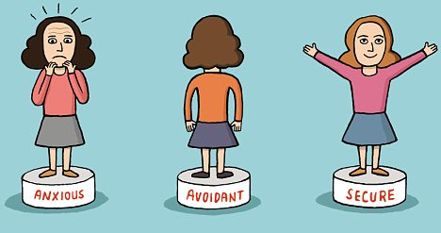
When relationships are reliably responsive and supportive, they can actually buffer young children from the adverse effects of other stressors.
Under optimal circumstances, language development occurs in the context of early attachment experiences and is paralleled by emotional attunement and the development of empathy.
Cohen, 2001

Slide 3

SPEECH, LANGUAGE & COMMUNICATION
Language Makes Us Human
Babies have thoughts before they have the ability to express them, but it is language that enables us to work together.
Steven Pinker marshals an impressive body of evidence that violence has steadily declined throughout human history, and that ours is therefore the most peaceable chapter in our several million years of existence. If we are a more cooperative species than when we began, language has played an enormous role in this evolution.
Steven Pinker, Professor of Psychology, Harvard University

Slide 4

More than 60% of young people in the criminal justice system have speech, language and communication needs
Royal College of Speech & Language Therapists
Children aged 10 to 17 in care are more than five times as likely to end up in the criminal justice system than others.
The Prison Reform Trust

Slide 5
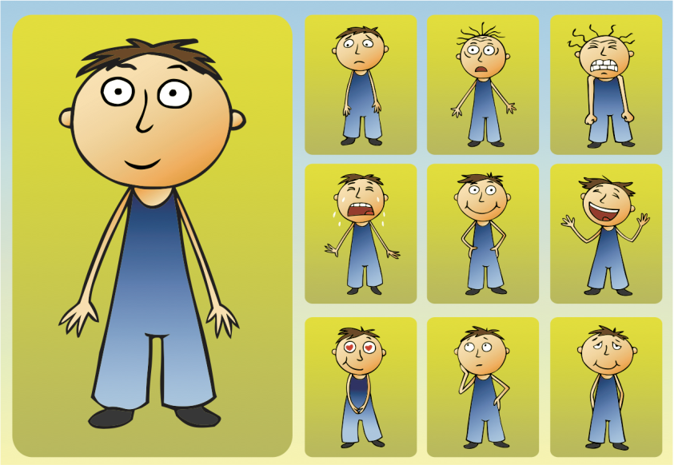
The foundations of social competence that are developed in the first five years are linked to emotional well-being and affect a child’s later ability to functionally adapt in school and to form successful relationships throughout life
National Scientific Council on the Developing Child (2004). Children’s Emotional Development Is Built into the Architecture of Their Brains: Working Paper No. 2. http://www.developingchild.net

Slide 6
CHILD DEVELOPMENT
Toxic stress in early childhood is associated with persistent effects on the nervous system and stress
hormone systems that can damage developing brain architecture and lead to lifelong problems in
learning, behaviour, and both physical and mental health
Negative emotions are adaptive in the short term (fight or flight response).
Positive emotions, however, are adaptive over the long haul
Creating the right conditions for early childhood development is likely to be more effective and less
costly than addressing problems at a later age
The Science of Early Childhood Development. (2007)
National Scientific Council on the Developing Child. http://www.developingchild.net

Slide 7
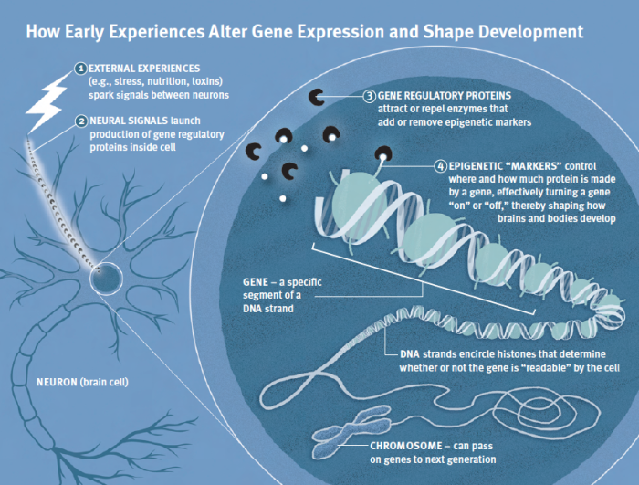
NATURE AND NURTURE
Genes are not set in stone.
Research shows that early experiences can determine how genes are turned on and off — and even whether some are expressed at all.
Ensuring that children have appropriate, growth-promoting early experiences is an investment in their ability to become healthy, productive members of society.
National Scientific Council on the Developing Child (2010). Early Experiences Can Alter Gene Expression and Affect Long-Term Development: Working Paper No. 10. Retrieved from www.developingchild.harvard.edu.

Slide 8

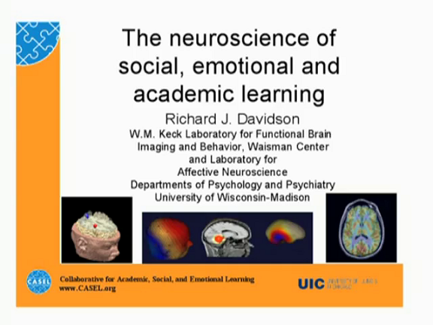
NEUROSCIENCE
The brain is “plastic,” or capable of generating new cells and pathways, and it is possible to train the circuitry in the brain to promote more positive responses. Neuroplasticity means that a person can learn to be more positive by practicing certain skills that foster positivity.
Recent developments in neuroimaging data have identified of circuits underlying positive and negative emotion in the human brain. Emphasis is placed on the prefrontal cortex (PFC) and the amygdala as two key components of this circuitry. Emotion guides action and organizes behavior towards salient goals. It is also proposed that the PFC plays a crucial role in affective working memory.
Dr. Richard J. Davidson, a neuroscientist and founder of the Center for Healthy Minds at the University of Wisconsin

Slide 9
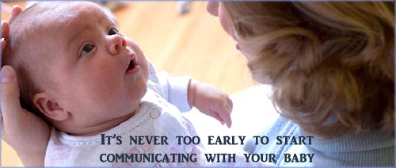
CHILD DEVELOPMENT
When parents, informal community programs, and professionally
staffed early childhood services pay attention to young children’s
emotional and social needs, as well as to their mastery of literacy and
cognitive skills, they have maximum impact on the development of
sturdy brain architecture and preparation for success in school.
Policy initiatives that promote supportive relationships and rich
learning opportunities for young children create a strong foundation
for higher school achievement followed by greater productivity
in the workplace and solid citizenship in the community.
The Science of Early Childhood Development. (2007)
National Scientific Council on the Developing Child. http://www.developingchild.net

Slide 10

RELATIONSHIPS
Good relationships are the basis for life long learning.
Anything that affects relationships (such as inappropriate or harmful behaviour) impacts on learning.
Challenging inappropriate behaviour needs to be experienced as an opportunity for reflection, learning and growth.
Terry O’Connell (2016)
“In order to flourish, we need to get essential daily ‘nutrients’ which include positive feedback from people who care about us.”
Barbara Fredrickson states that experiencing positive emotions broadens people's minds and builds their resourcefulness in ways that help them become more resilient to adversity and effortlessly achieve what they once could only imagine.
Barbara Fredrickson (2009)

Slide 11

Restorative Practices
provide a consistent explicit framework to build, maintain and repair relationships
The International Institute for Restorative Practices state that for Restorative Practice to be ‘explicit’, it must actively integrate:
Social Discipline Window
Fair Process
Restorative Questions
Free Expression of Emotions
©IIRP, 2010

Slide 12
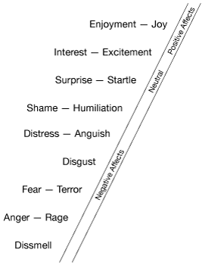
AFFECT SCRIPT PSYCHOLOGY
Tomkin’s Blueprint
We are ‘hard-wired’ to want to:
increase positive affect,
decrease negative affect;
We live best when we can accomplish these two goals;
Anything that increases our power to do this favours life.

Slide 13
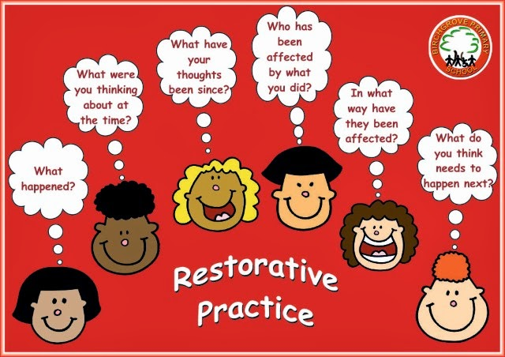
QUESTIONS AND SCRIPTS

Slide 14

University of
Northampton
Speech, Language and Communication needs
Restorative
Dialogue
PhD
Restorative
Practices
Boys at Risk
Early
Intervention
Neuroscience and Affect Script Psychology

