Slide 1
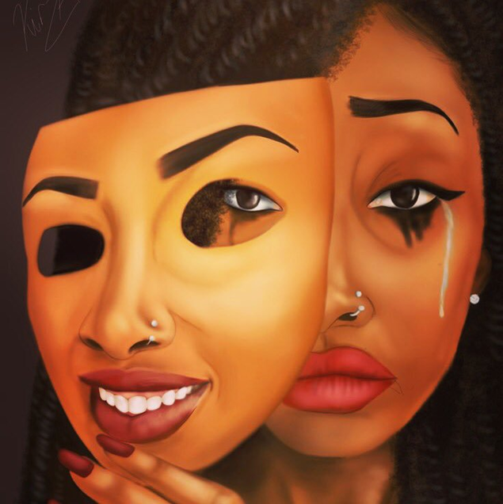
WE WEAR THE MASK:
CAN RESTORATIVE PRACTICES
REALISTICALLY
HELP MARGINALIZED COMMUNITIES HEAL FROM SYSTEMIC OPPRESSION

Slide 2
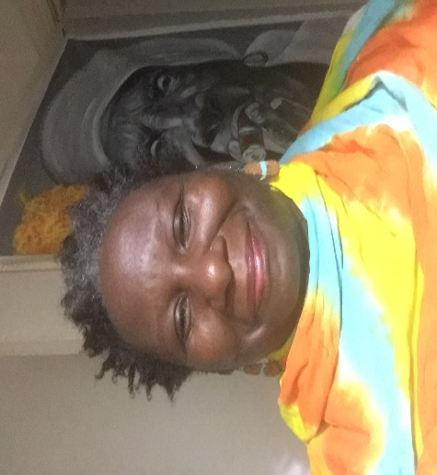
WHO AM I?
THE INVITATION:
YOU ARE HEREBY INVITED TO BE NO ONE BUT YOURSELF
FEEL FREE TO ALLOW YOURSELF TO BE OPEN AND PRESENT TO THIS EXPERIENCE.
FEEL FREE TO EXPRESS YOUR FEELINGS OPENLY, HONESTLY AND RESPONSIBLY; AND TO LET OTHERS DO THE SAME.
FEEL FREE TO DECIDE HOW AND WHEN TO ENGAGE IN THIS CHALLENGING DIALOGUE, UNDERSTANDING THAT EACH OF US BRINGS DIFFERENT LEVELS OF KNOWLEDGE AND EXPERIENCE TO THIS CIRCLE.
FEEL FREE TO BE SUPPORTIVE AND COMPASSIONATE OF OTHERS IN THIS SPACE, SUSPENDING JUDGMENT.
FEEL FREE TO TAKE CARE OF YOURSELF.

Slide 3
SESSION Circle Guide:
BE RESPECTFUL – You may not agree or like what is being said but- listen, allowing yourself to hear the stories, experiences, feelings and needs of others.
Respect the talking piece.
The person holding the talking piece is the ONLY one talking. Everyone else is listening.
Let the circle help you explore these issues on a deeper level.
Let the circle help you learn about each other and build stronger relationships.
Be Respect, Honest, Trust, Open, Courageous
Let this circle help with healing and transformation

Slide 4
THE MASK Maya Angelou “We wear the mask & For old black men”
Maya Angelou "We wear the mask"/"For old black men“ https://www.youtube.com/watch?v=syGGVZ_ILAI,

Slide 5
PONDERINGS
DOES CULTURE HAVE A PLACE IN RESTORATIVE JUSTICE/PRACTICES?
WHAT EFFECT DOES HISTORICAL AND SYSTEMIC OPPRESSION (EMBEDDED IN THE ECONOMIC, POLITICAL AND SOCIAL INSTITUTIONS) HAVE ON RESTORATIVE PRACTICES (ESPECIALLY IN MARGINALIZED COMMUNITIES)?
WHAT ARE SOME IDEAS AND STRATEGIES FOR HEALING/TRANSFORMATION?
WHAT IS SOMETHING YOU CAN DO IN YOUR COMMUNITY?

Slide 6
QUESTIONS
WHAT IS RESTORATIVE?
WHAT IS CULTURE?
WHAT IS SYSTEMIC OPPESSION?

Slide 7
ANSWERS
RESTORATIVE PRACTICES -
Relationship, respect, responsibility, repair, reintegration
The act of Humanizing
CULTURE –
The ideas, customs, and social behavior of a particular people or society.
The attitudes and behavior characteristic of a particular social group.
SYSTEMIC OPPESSION –
Institutional (within the system) mistreatment of people within a social identity group, supported and enforced by the society and its institutions, solely based on the person’s membership in the social identity

Slide 8
SOMETHING TO THINK ABOUT
“….the future depends so much on the past, and we must heal our memories. We must open the wounds to cleanse them, because if we just close them up and pretend they’re not there, they will fester.”
Archbishop Desmond Tutu

Slide 9
COLORIZING RESTORATIVE JUSTICE
Living Justice Press (LJP)
A book project that privileges restorative justice practitioners, trainers, or generalists of color to write about what they believe will make restorative justice and restorative practices relevant and effective in their communities.
Practitioners can use this book in trainings, their work, and their communities
Accepted articles, essays or transcribed and edited interviews or dialogues 3,000–8,000 words in length
The manuscripts of those selected are due next week
Great resources for and by Indigenous and POC practitioners
Website: http://www.livingjusticepress.org/

Slide 10
FROM THIS SESSION
SOMETHING YOU LEARNED
OR
SOMETHING YOU REALIZED
OR
SOMETHING YOU WERE SURPRISED BY

Slide 11
RESOURCES
Maya Angelou "We wear the mask"/"For old black men” https://www.youtube.com/watch?v=syGGVZ_ILAI
Title, B. (2011). Teaching peace: A restorative justice framework for strengthening relationships. Allen, TX: Homestead Press.
Oxford Online Dictionary https://en.oxforddictionaries.com/definition/culture
https://www.pcc.edu/resources/illumination/documents/institutionalized-oppression-definitions.pdf
Our Hope for the Future, by Archbishop Desmond Tutu. Brendtro, L.K., Brokenleg, M., & Van Bockern, S. (2001). Reclaiming youth at risk. Our hope for the future (Rev.ed.). Bloomington, Indiana: National Educational Service.
Colorizing Restorative Justice Call for Contributors, https://www.academia.edu/34530394/COLORIZING_RESTORATIVE_JUSTICE_Call_for_Contributors
Living Justice Press, http://www.livingjusticepress.org/

