Slide 1
Dynamic CBO/School District Partnerships
Effective Collaboration Transforming Schools to Restorative Communities
You are invited to share your experiences on the two posters titled:
Positive Collaboration Experiences, and
Challenges of Collaboration

Slide 2
Lucille Rivin
Senior Director, Curriculum and Resource Development
The Leadership Program
Lucille@tlpnyc.com
Matthew Guldin
Director, Restorative Justice Pilot Schools
Office of Safety and Youth Development
New York City Department of Education
Matthew.guldin@crossculturalconsult.com

Slide 3
A little about us…
The Leadership Program (TLP)
Community Based Organization (CBO) with over 20 years in Youth Development (YD)
Over a dozen original YD SEL curricula
Our Violence Prevention Program (VPP) OJJDP and SAMSHA national model programs lists
Lucille
19 years at TLP; Oversaw development of TLP’s National Model Program VPP
RJ Coordinator in NYC HS; Oversaw team of 15 RJ Coordinators in 17 schools at 6 sites
Facilitator of RJ trainings for in-house and school staff
Restorative Justice Initiative Advisory Board http://www.restorativejustice.nyc/
NYC Dept. of Education (DoE)
Largest school district in USA with 1800 public schools, 1.1 million students, and 75,000 teachers
RJ Pilot initiatives in over 100 schools over the past 3 years
Matthew
Former NYC Classroom teacher, MS/HS Dean, and Assistant Principal
Oversaw transformation in NYC high school from punitive discipline to RJ approach
Teachers Unite Organizing Council www.teachersunite.net
Director of Restorative Justice Programming at Cross-Cultural Consulting Services
Notes:
SAMSHA=Substance Abuse and Mental Health Services Administration; NREPP=National Registry of Evidence-based Programs & Practices; ----
Explain RJI: Restorative Justice Initiative is a Partner Project of the Fund for the City of New York dedicated to promoting restorative principles, practices and programs throughout New York City. We serve as a hub and a clearinghouse, distributing information about upcoming events, trainings, resources, employment and funding opportunities via email and social media to a growing network of restorative practitioners and supporters. We also organize and host events intended to build relationships across sectors and raise awareness of restorative practices and their broad applications and efficacy.

Slide 4
EQ:
How can a school/district and community based organization collaborate effectively to support a transformation from a retributive to restorative school culture?

Slide 5
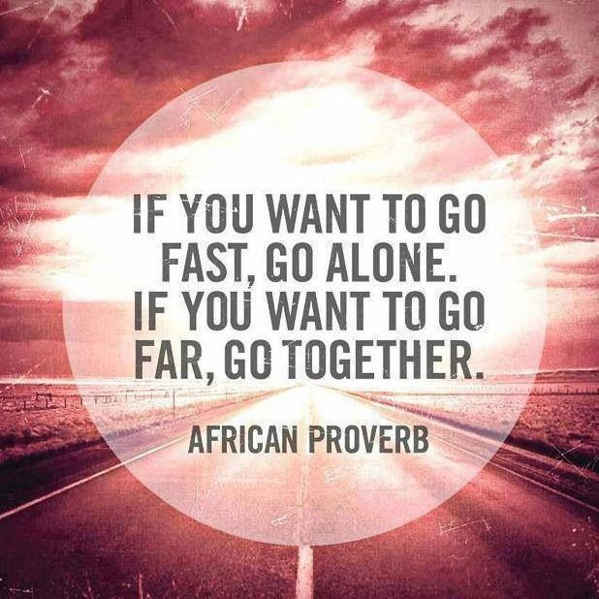
Quote:

Slide 6
1: Initial Expectations
NYCDOE
Leadership Program
CBO will staff each school with one RJ Coordinator versed in RJ Practices
Consistent CBO staffing
Principals and administrators well-informed about RJ approach and level of commitment needed
Enthusiastic Principal cooperation
25 schools committed to transforming culture.
Schools open to and clear about full collaboration with CBO RJ Coordinators
RJC would have access to all school staff to deliver RJ Professional development (PD)
Consistent cooperation and eager participation from school staff and leaders—across the board buy-in.
Notes:
Ask them what their expectations were or would be first—small group work at tables? Then groups share. Then we share our story.

Slide 7
2: What Worked from the Outset
NYCDOE
Leadership Program
Developing cohort/working unit among RJCs from various CBOs
Holding cohort skills workshops and sharing circles to build camaraderie and equalize skill levels among RJCs
CBO commitment to problem solving and finding effective solutions to challenging issues
Developing good relationship with CBO staff.
Building relationships between CBO staff and school staff and students
Two or more CBO RJCs in each school
RJCs Modeling community building circles with staff and students
Creating school RJ Action Teams of school staff (to varying degrees in different schools)
Building on restorative-aligned practices already in place in schools.
Notes:
Invite them to ask questions & comment;
RJ-aligned practices in schools like Advisory circles on topics, then working with SW or GC who help develop circles questions and working with most committed teachers; etc.

Slide 8
3: Challenges Encountered
NYCDOE
Leadership Program
School leaders’ lack of understanding of program requirements
Receiving full commitment to action from school leadership
Getting to know 6 CBOs and 20 RJCs
CBOs’ different contracts with NYCDOE affecting placement of personnel and organizing model*
Getting to know 25 school Principals and getting them together for workshops on leading cultural change
Obtaining regular progress reports from CBO RJCs
Training “discipline” personnel in each school.
Given February start, low availability of trained CBO staff, which necessitated hiring and training
Matching CBO staff to school personnel and culture
Working with 13 schools on 2 sites that did not request program or RJC
Getting to know Principals and staff in 17 schools, and approximately 500 students in each school
Lack of CBO clout with school leaders
Bureaucracy protocols to document services provided causing delays in payment for services.*
Notes:
Ask them what challenges they may have encountered or imagine they might encounter—small group work at tables? Then groups share. Then we share our story. * Entries with asterisk are applicable with large school district and will probably not be applicable

Slide 9
4: Addressing Challenges
NYCDOE
Leadership Program
Create report and action plan templates, and site visit guidelines
Cohort of multi-CBO staff working together to solve common problems: develop RJ tracking system, etc.
Ongoing site visits involving DoE, CBO staff, and school leadership
Trainings offered for deans, counselors, principals
Regular communication with school leadership and with DoE RJ Directors
Two or more CBO-based RJ Coordinators at each school site
Delivery of RJ Professional Development services adapted to particularities of each school
Collaboration with DoE RJ director to create cohesive Principal group at multi-school sites
Manage expectations when schools expected transformation overnight
Notes:
Invite participants to ask questions or comment

Slide 10
5: Lessons Learned so far
Make no assumptions!
Have clear agreements between District/School/CBO with well-defined expectations for all stakeholders.
Be flexible over time with ebb and flow of how things work.
Mandate principals’ workshop to ensure understanding of RJ program structure and timeline for implementing real culture change in a school.
Walk the talk! Role-model restorative responses to challenges that arise.
Adapt to changes in personnel and other changes/unexpected events.
Change/progress is more easily recognized over time—it’s hard to see it when you’re in it!
Agree on restorative consequences if stakeholder obligations unmet.
Notes:
Ask participants what are the lessons we could take away from our story ….?

Slide 11
RJ Partnership Planning Form
For CBOs page: questions to ask school/district leaders
For School/District page: questions to ask CBO program directors
What other questions do you need to ask to set up a Restorative Justice Partnership for success…?

Slide 12
Folders with…
Setting Up School/CBO Partnership for Success/Formula for RJ Success!
Partnership Planning form (2 two-sided pages)
RJ Action Plan template
Hallmarks of RJ
RJ site visit sample agenda

Slide 13
Questions…
The Leadership Program
NYC Department of Education
Lucille Rivin
lucille@tlpnyc.com
212-625-8001
www.tlpnyc.com
Matthew Guldin
Matthew.guldin@crossculturalconsult.com
347-678-8585
http://schools.nyc.gov

