Slide 1
Change the Conversation-
Change the Culture
2018 IIRP Canada Conference
Toronto, ON
April 30, 2018
Lee Rush, M.Ed.

Slide 2
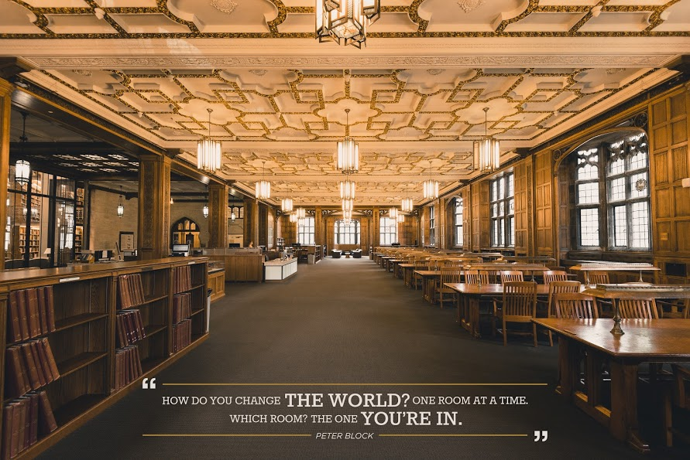

Slide 3
What happened on
December 24, 1968?

Slide 6
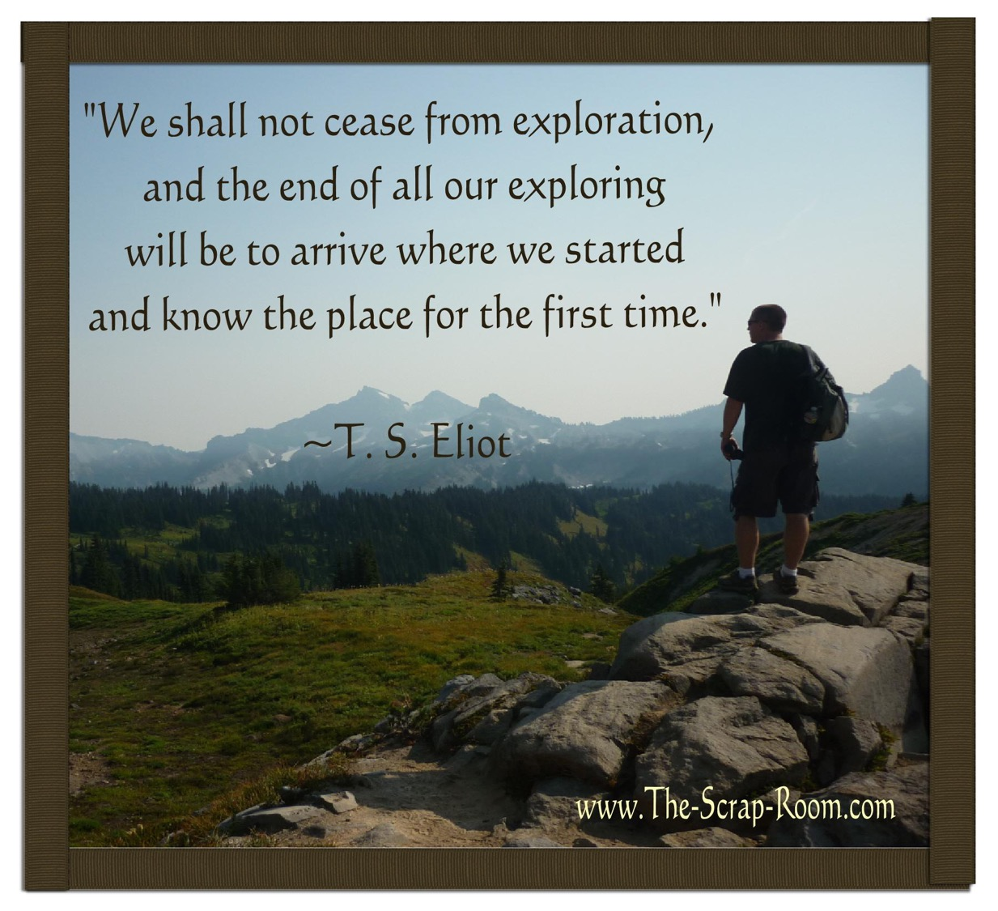

Slide 7
Who was I in
1968?

Slide 8
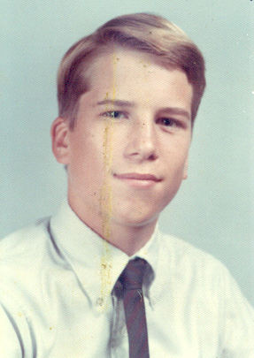

Slide 9
What crossroad
was I at?

Slide 10
Where were you on
April 20, 1999?

Slide 11
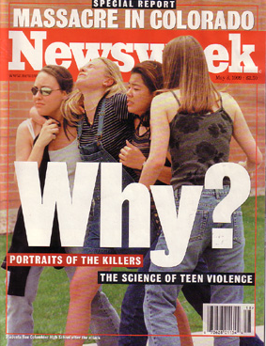

Slide 13
Sam Keen

Slide 19
“A man must ask himself two questions in life.”

Slide 20
“Where am I going?” and “Who will go with me?”

Slide 21
“…and if he gets them in the wrong order…..he’s in big trouble.” Howard Thurman to Sam Keen to Lee Rush

Slide 26
Peter Block

Slide 27
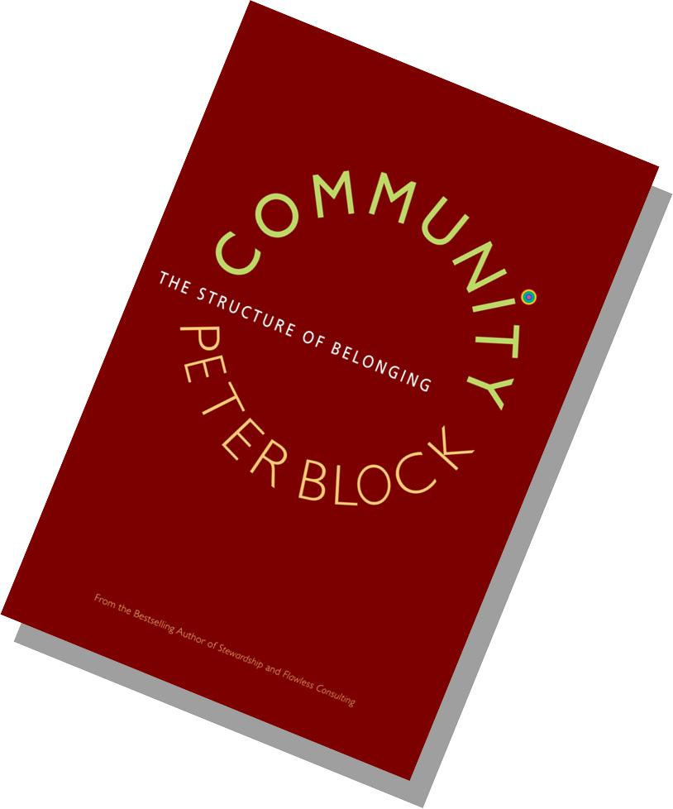

Slide 29
Connection over Content

Slide 30
Depth over Speed

Slide 31
Effectiveness over Efficiency

Slide 32
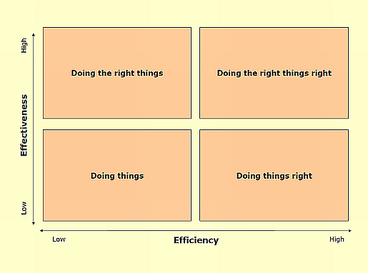

Slide 33
“All transformation is based in linguistics” Peter Block

Slide 34
Myths of the Default/Dominate Culture
People need more training
Rewards make a lasting difference
What worked elsewhere can work here
Future problems can be fixed by better planing
Source: Community: The Structure of Belonging, Peter Block

Slide 35
Questions With Little Power
How do we get other people to show up?
How do we hold others to be accountable?
How much will this cost?
How much time will this take?

Slide 36
Questions With Little Power
When will (fill in the blank) support us and this effort?
Who has done something about this issue?
Where else is this happening?
Can we get them to come here and share how they did it?
Source: Community: The Structure of Belonging, Peter Block

Slide 37
The Six Conversations
From
To
Mandate
Problem Solving
Blame
Lip Service
Barter
Deficiencies
Invitation
Possibility
Ownership
Dissent
Commitment
Gifts

Slide 38
Invitation over Mandate

Slide 39
Possibility over Problem Solving

Slide 40
Ownership over Blame

Slide 41
Dissent over Lip Service

Slide 42
Gifts over Deficiencies

Slide 43
Qualities of Powerful Questions
They are ambiguous
They are anxiety-producing
They are personal
They make you think

Slide 44
Questions With Great Power
What declaration of possibility is alive in me?
What story do I keep telling myself about (fill in the blank)?
What is the crossroads I face at this point in the game?

Slide 45
Questions With Great Power
What is the commitment that I have brought into the room?
What is the price that I and others have paid for being here?
How valuable do I plan for this (fill in the blank) to be?

Slide 46
Questions With Great Power
How do I contribute to the thing I complain about the most?
Why do I not speak up when my inner voice tells me to?
Am I afraid to be judged by others?
What resentments am I still holding on to?

Slide 47
Questions With Great Power
What gift have I just received from another in this room?
What gifts have do I continue to hold in exile?
What am I grateful for that goes unspoken?

Slide 48
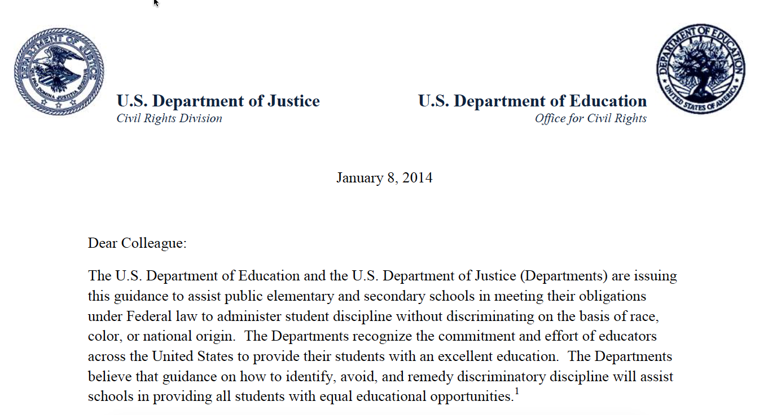

Slide 50
Punitive-Permissive Continuum
punitive permissive

Slide 51
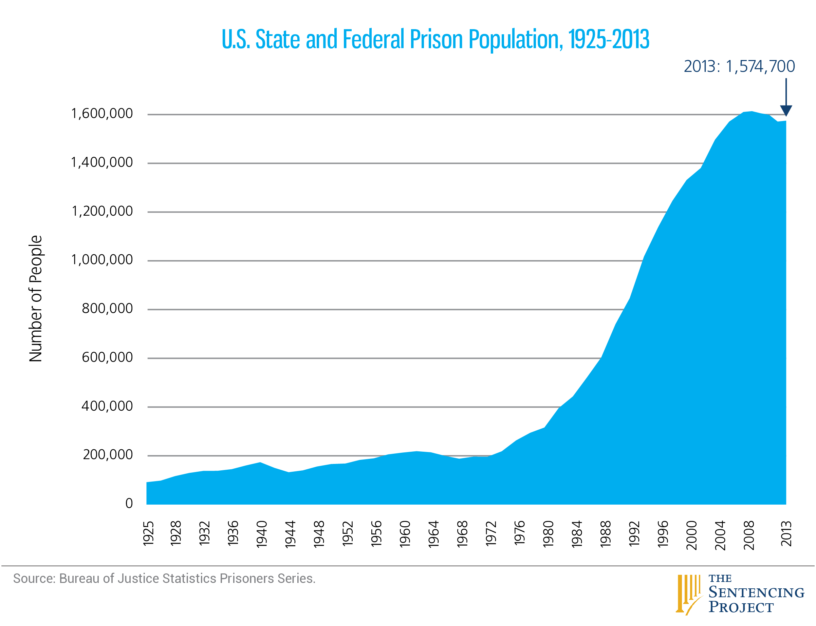

Slide 52
Social Discipline Window
HIGH
punitive
TO
control (limit-setting, discipline)
permissive
FOR
LOW
support (encouragement, nurture)
HIGH
Adapted by Paul McCold and Ted Wachtel from Glaser, 1969.

Slide 53
Social Discipline Window
HIGH
punitive
TO
control (limit-setting, discipline)
neglectful
permissive
NOT
FOR
LOW
support (encouragement, nurture)
HIGH
Adapted by Paul McCold and Ted Wachtel from Glaser, 1969.

Slide 54
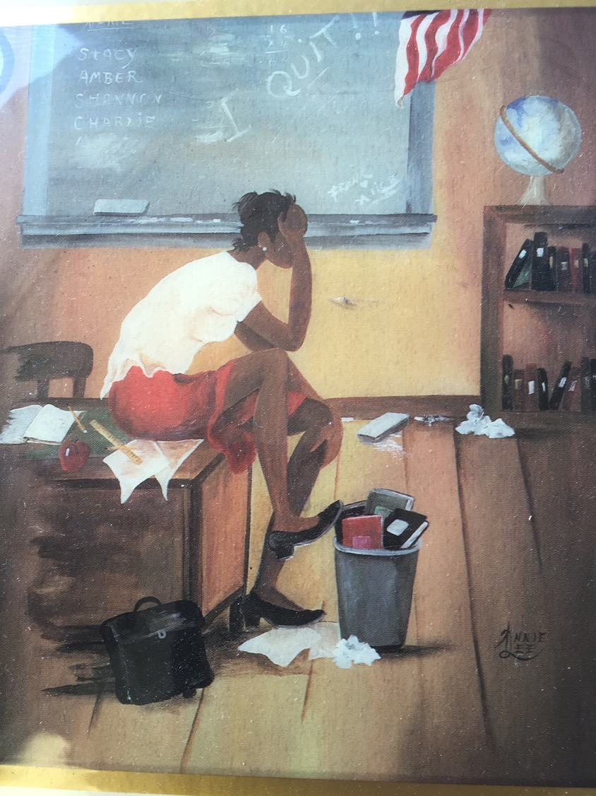

Slide 55
Social Discipline Window
HIGH
punitive
restorative
TO
WITH
control (limit-setting, discipline)
neglectful
permissive
NOT
FOR
LOW
support (encouragement, nurture)
HIGH
Adapted by Paul McCold and Ted Wachtel from Glaser, 1969.

Slide 56
Source: International Institute for Restorative Practices, Bethlehem, PA

Slide 57
Source: International Institute for Restorative Practices, Bethlehem, PA

Slide 58
Source: International Institute for Restorative Practices, Bethlehem, PA

Slide 59
Defining Restorative Practices
Restorative practices is a social science that studies how to build social capital and achieve social discipline
through participatory learning and decision-making.
Incorporates the use of informal and formal processes that precede wrongdoing, those that proactively build relationships and a sense of community to prevent conflict and wrongdoing.
Supporting Framework: Social Discipline Window, Restorative Justice Typology, Restorative Practices Continuum, Nine Affects, Compass of Shame and Fair Process, Essential Elements.
(Wachtel, 2012)
Source: International Institute for Restorative Practices
Notes:
Today we will explore the framweork and the how to actualize this framework

Slide 60
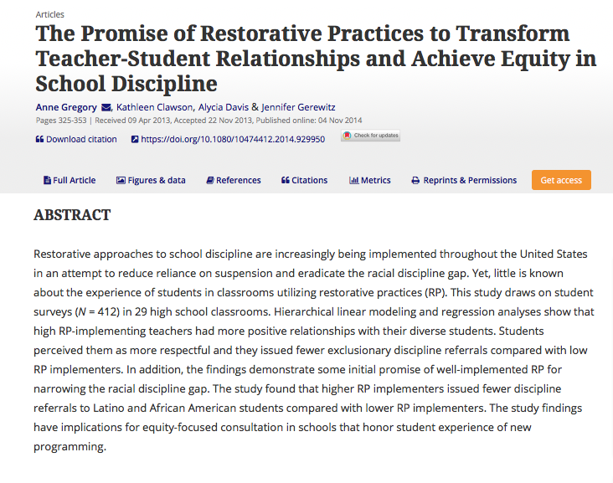
Critical Research

Slide 61
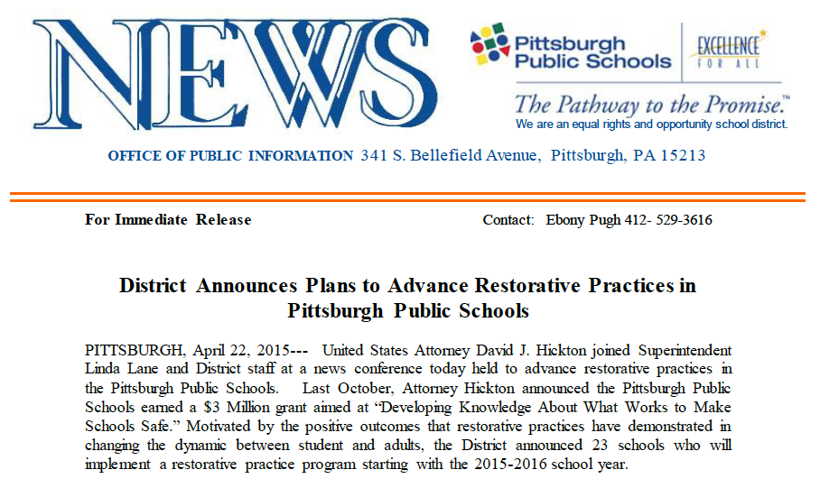
Critical Research

Slide 63
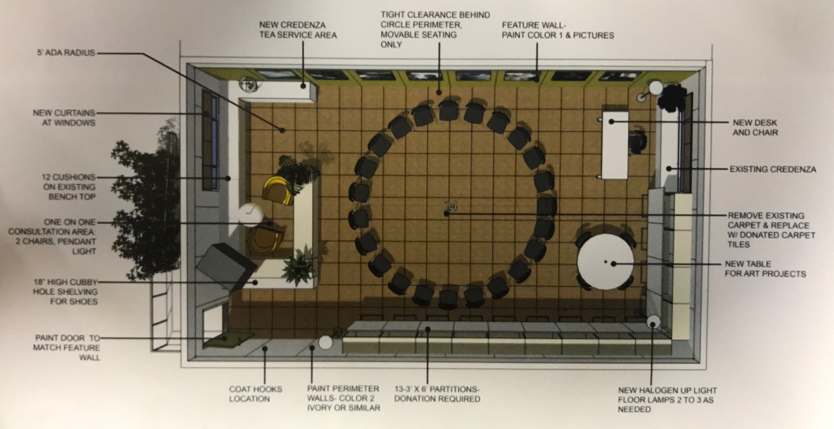

Slide 64
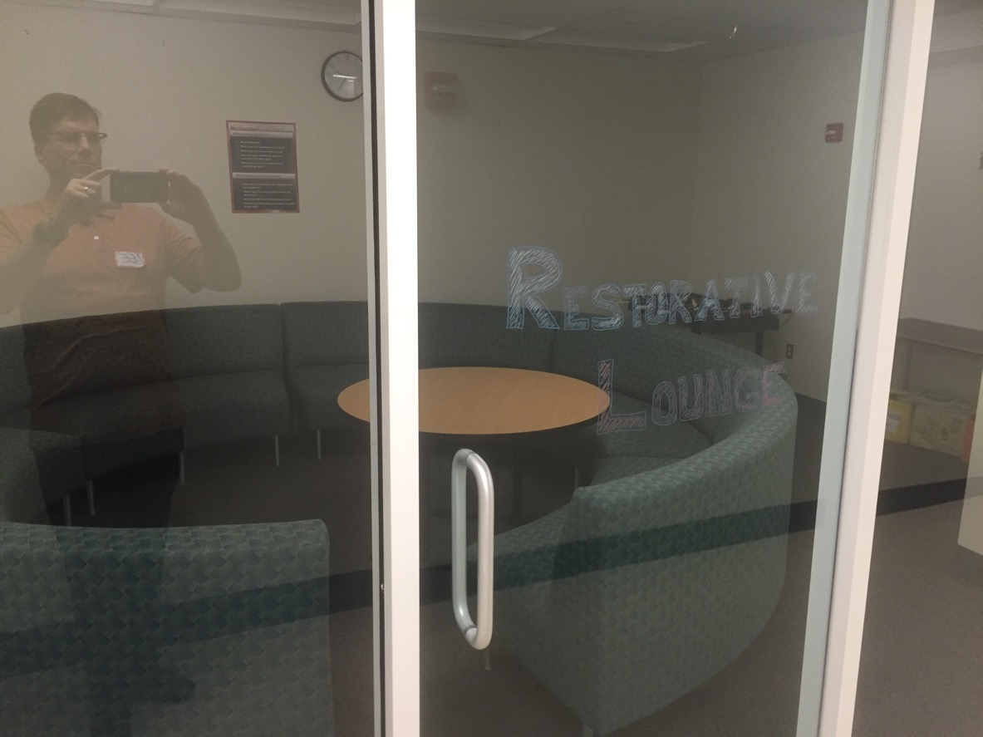

Slide 66
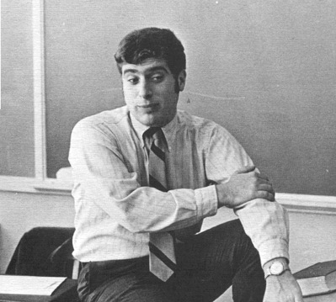
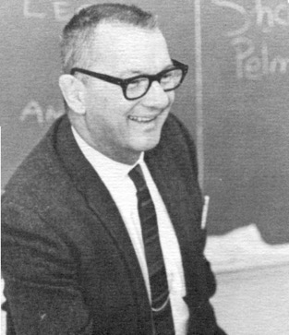
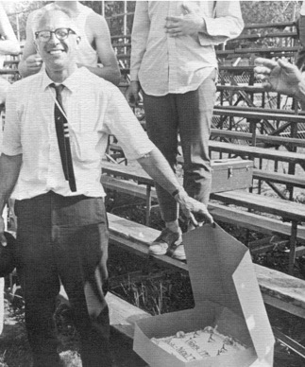
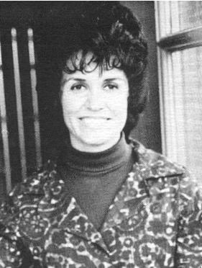
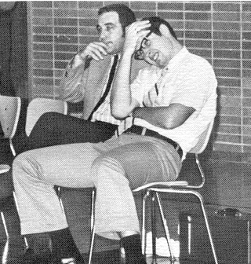
Ted Wachtel
Lou Pirnik
Wayne “Pud” Helman
Carol Bradley
Willis Frank and Fred Schwenk

Slide 67
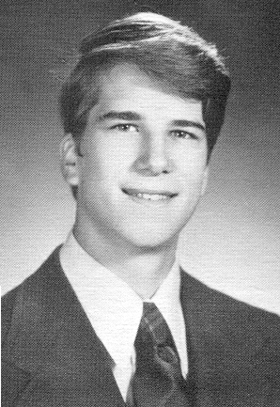

Slide 70
Optimism
Versus
Hope

Slide 71
The 21st Century- A Century of Peace?

Slide 72
The Restoration of
Community Booklet
https://www.dcjs.virginia.gov/2017-strengthening-connections-climate-forum-resources

Slide 73
For more information:
Lee Rush
lrush@justcommunity.com

