Slide 1
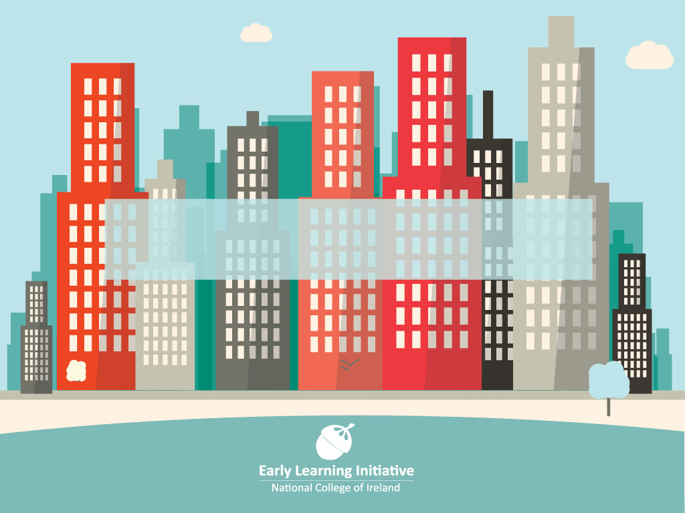
Brighter Futures: A Vision for a Restorative Learning Community in Dublin, Ireland.

Slide 2
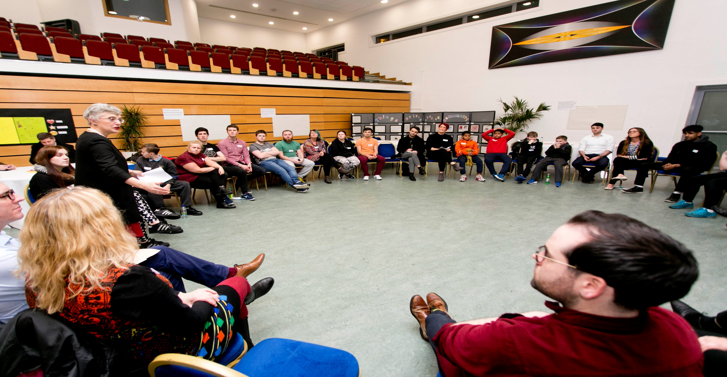
Are our communities fit for the purpose of giving all community members a fulfilling life?

Slide 3
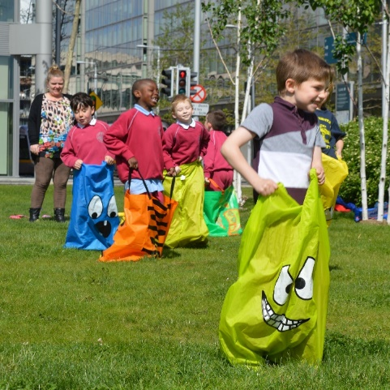
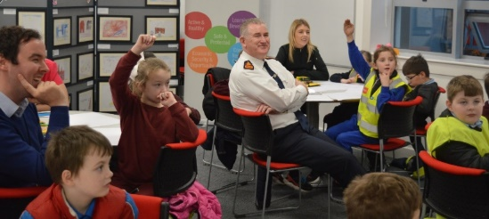
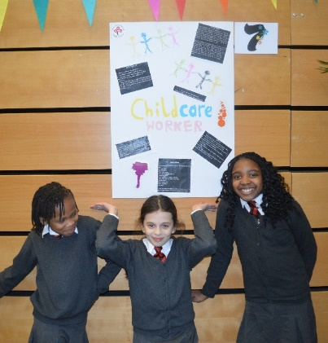
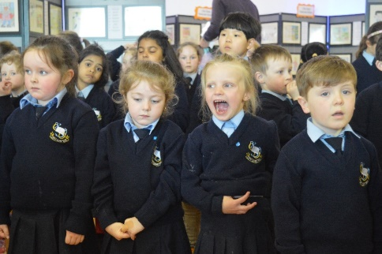
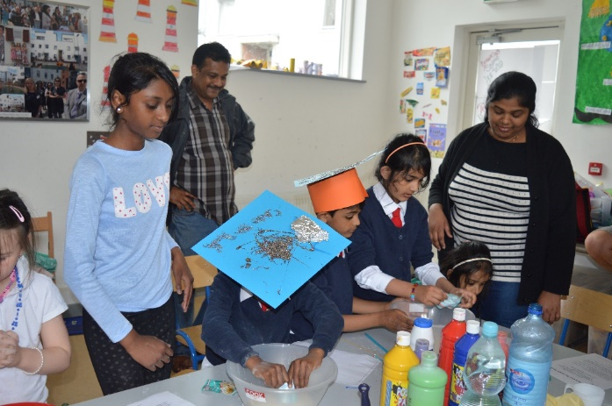
Our Community, Our Project
If our community members are expected to participate as citizens in an equitable, democratic society – they need to have the right skills, knowledge and attitudes to work with people from diverse groups, on a local, national and global level.

Slide 4
Our Community, Our Project
This initiative is located within four evolving strands of future-oriented best restorative practices outside criminal justice which will enable participants to:
1. Promote restorative processes within various public and civic institutions that value citizen voice and prioritise securing a safe local environment e.g. schools, youth & community projects.
2. Establish restorative principles in organisational and societal cultures e.g. public bodies, charities, schools, colleges.
3. Embed restorative processes in handling conflict in various institutional settings e.g. local councils, health agencies.
4. Secure restorative economic practices with inward investment,
social inclusion and economic development programmes
e.g. public & private bodies promoting restorative practices though
government policy and corporate responsibility.

Slide 5
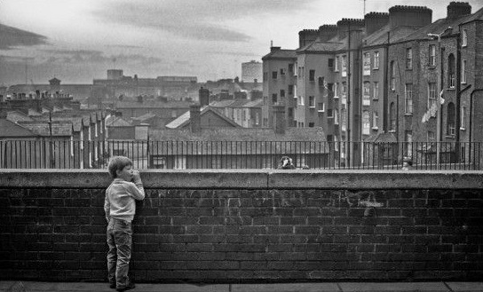
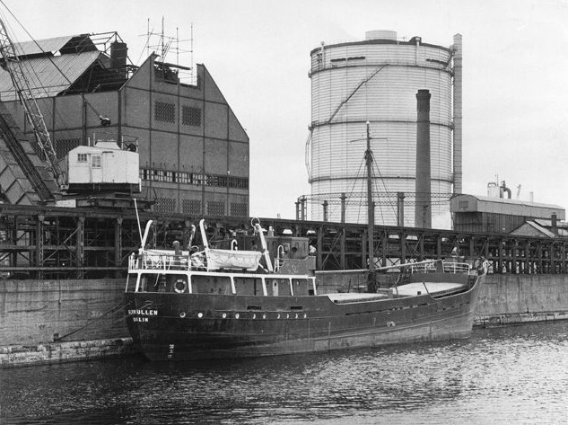
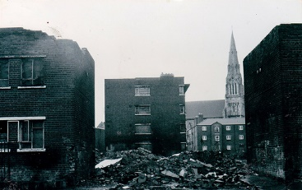
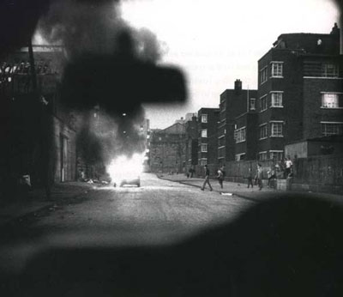
History of Dublin’s North Inner City
Over the past four decades Dublin’s North Inner City has experienced significant socio-economic decline.

Slide 6
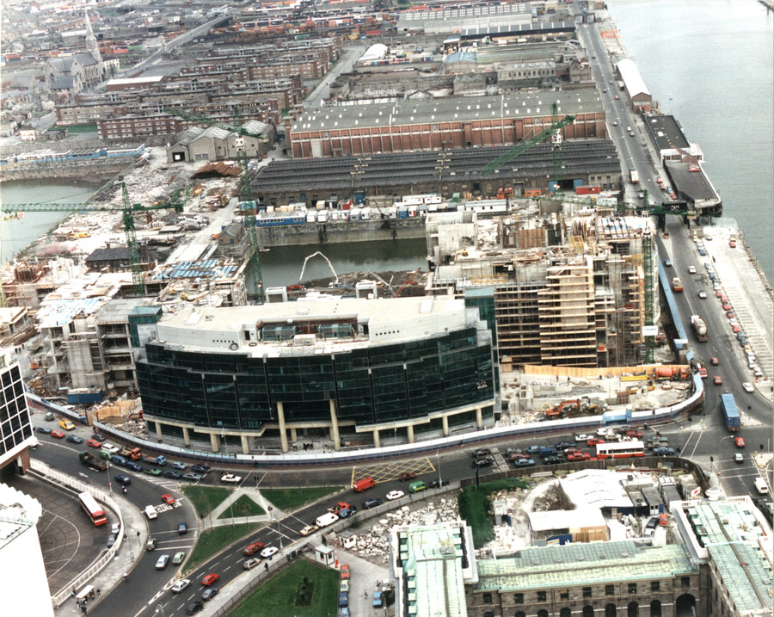
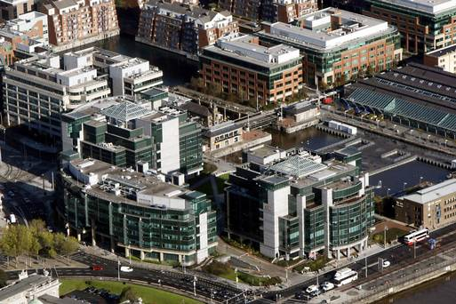
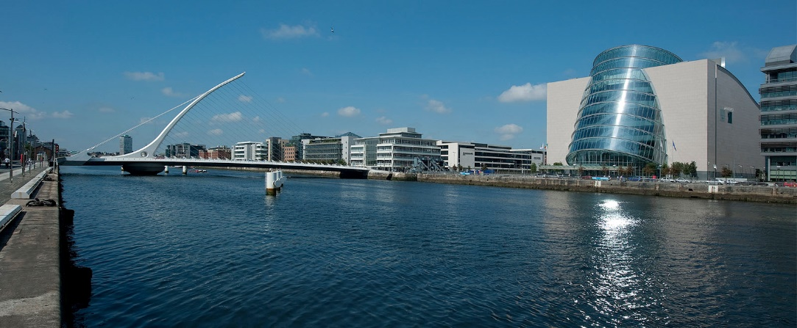
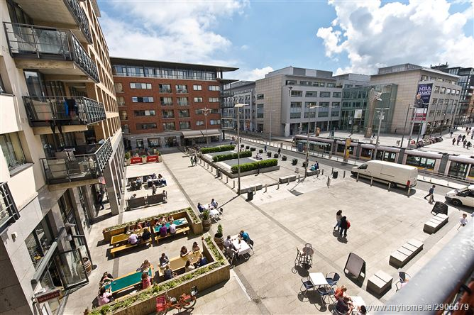
History of Dublin’s North Inner City
By the mid-2000s the area was transformed, while the community remained socially and economically very disadvantaged.

Slide 7
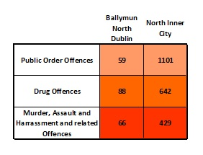
North Inner City – Current Climate
North Inner City Population 51,704
Ballymun North Dublin Population 61,051

Slide 8
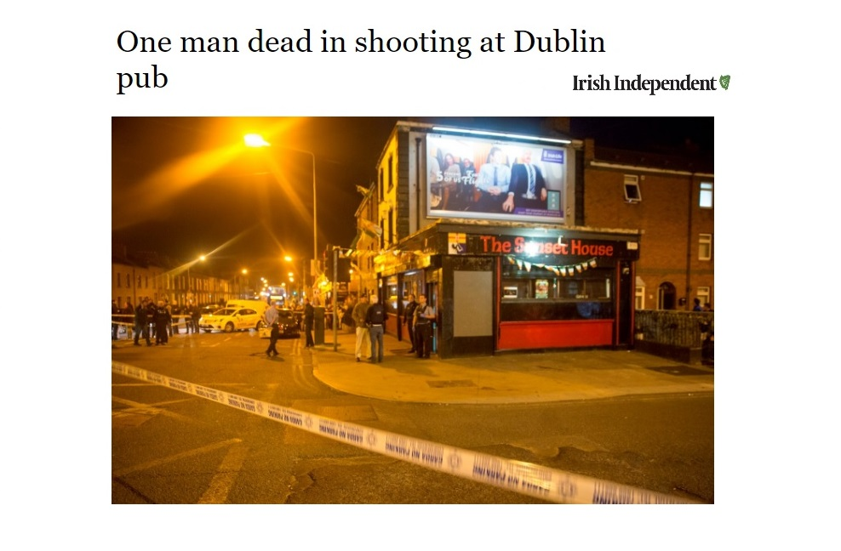
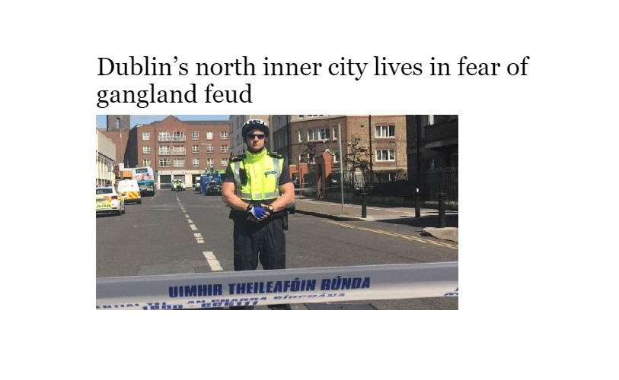
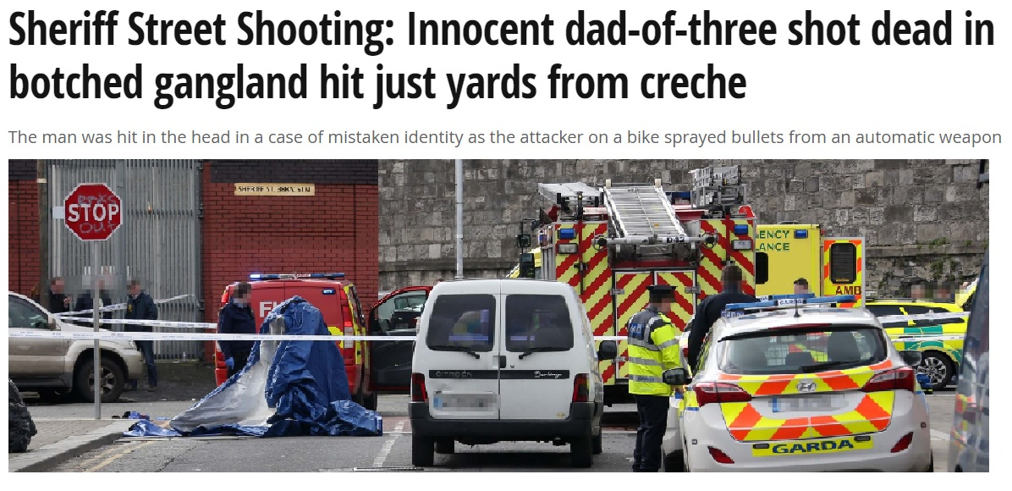
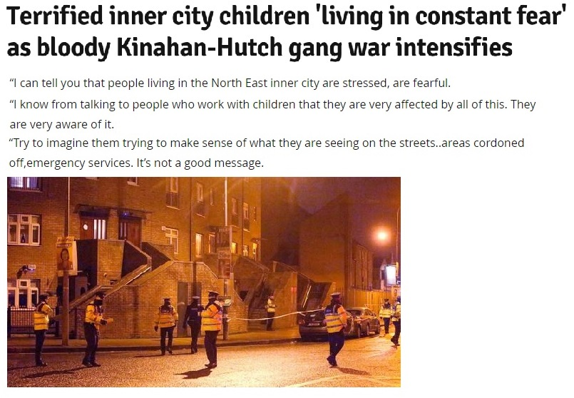

Slide 9
Promoting Restorative Practices
ELI’s Restorative Practices Initiative seeks to enable restorative engagements – in a divided, often alienated, inner city community – while cultivating mutually respectful and collaborative relationships. ​Our emphasis is:
To focus on strengths and assets, rather than deficits and problems and to nurture the strengths and assets acquired through positive relationships and capacity for empathy especially with pro-social and caring adults​
To support the development and acquisition of (children and) youth assets, which occur in multiple contexts and environments​
To encourage individual and community resilience​
To reflect sustainability principles, social justice ​principles
and have a focus on strengthening ​social capital.

Slide 10
Promoting Restorative Practices
According to Dr. Derick Wilson, “this is a project with ground-breaking significance in restorative practices nationally and internationally. This is the case because of the potential to include diverse ‘locality based’ community organisations in a collaboration with public, civic, corporate and Higher Education partners for the benefits of local children, young people and their families. ​
Wilson, 2017.

Slide 11
Promoting Restorative Practices
This initiative will be “supporting a visionary project around developing cohorts of diverse local children and young people, parents, carers and professionals to incorporate a more restorative understanding in their relations with families and colleagues, their work and in the culture of local organisations. This programme is in the vanguard of what internationally is called ‘a restorative learning region’ or ‘a restorative society approach’.”​
Wilson, 2017.

Slide 12
enquiry
engagement
embedding
Phase One: The core developmental task is to establish the potential of securing major community and institutional buy-in to what we would call a ‘restorative neighbourhood programme’ (12 – 18 months)
Phase Two: The long term intention of this programme is to engage deeply with the various stakeholders living and working locally, and develop an integrated restorative practices programme (18 months – 3 years)
Phase Three: Based on the envisioned new ways of working this
phase will seek to establish a number of locally-run integrated restorative practice hubs that embed a neighbourhood social and economic regeneration initiative
between diverse local, city and national
partners (3 years and beyond)
Guided by Dr. Derick Wilson 2017

Slide 13
Establishing Restorative Approaches
Beyond a theoretical framework, this initiative will practically support communities to engage in restorative approaches themselves and in their organisations, and to take action. Our goal is to create a tool and a process that is as encouraging as possible, so that we:
Lay the foundations of a restorative practices neighbourhood approach​
Support mutually respectful relationships while building community cohesion​
Improve people’s ability to resolve conflict and restore ​relationships encourage happy, positive and supportive communities​
Strengthen civil society​
Address generational, long-term problems of ​social deprivation,
poverty, poor educational attainment ​
and mass unemployment.

Slide 14
Interventions
- Training of Trainers
A Tiered System
of Supports
Universal/Prevention Focus
Social and Emotional Development
Problem-Solving and Conflict Resolution
Building Relationships and Community Resilience
Intensive Interventions
Interventions
- Upskilling Training on
Restorative Conferencing
- Upskilling Training on
Restorative Meetings
- Upskilling Training on
Restorative Circles.
Targeted Interventions
Interventions
- Restorative Practice training sessions with community practitioners
- Restorative Practice interactive activity sessions with children and young people
- RP Community of Practice

Slide 15
Establishing Restorative Approaches
Let’s Talk Research suggests significant associations between measured social-emotional skills in early years development and key young adult outcomes across multiple domains – education, employment, criminal activity, substance use, and mental health.
Children who had “trouble cooperating, listening, and resolving conflict were less likely to finish high school – let alone college.” These results demonstrate the relevance of non-cognitive skills in development for personal and public health outcomes and determining community resilience.
(Early Social-Emotional Functioning and Public Health: The Relationship Between Kindergarten Social Competence and Future Wellness, 2015)

Slide 16
Establishing Restorative Approaches
Beyond communities, local and national actors are recently committing to organisational change at council, government and policy level.
Department of Justice and Equality
Department of Education
Department of Children and Youth Affairs
Department of An Taoiseach
Tusla (Child and Family Agency)
Children and Young Peoples’ Services Committee
North East Inner City (NEIC)

Slide 18
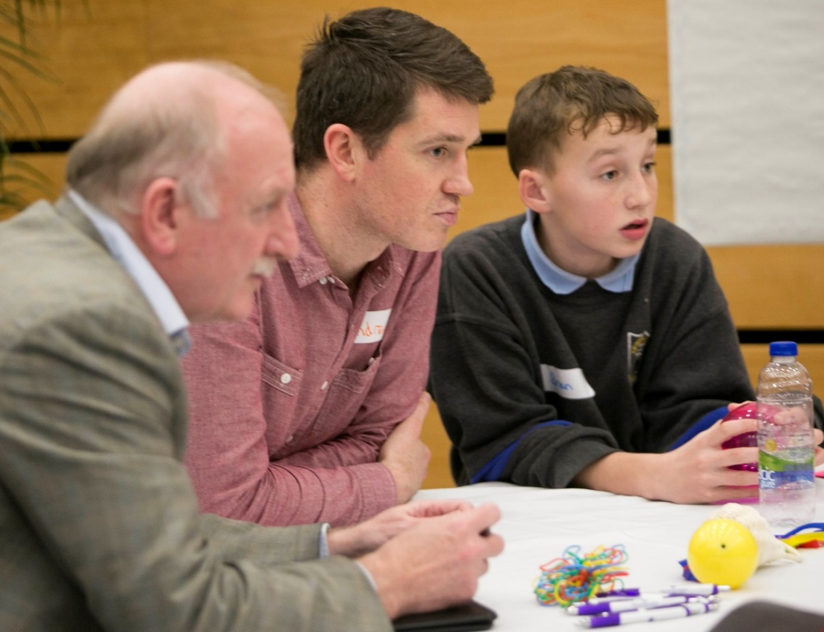
Embedding Restorative Principles
275+ local community professionals received Restorative Practice training in addition to CPD opportunities and sharing experiences through restorative COPs.
400+ children and young people (aged 4-24) directly engaging with RP initiatives
2300 primary school and 750 secondary school students indirectly benefitting from RP approaches
40+ organisations actively engaging in restorative initiatives

Slide 19
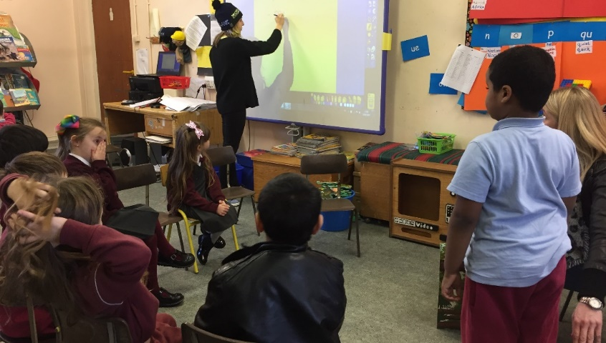
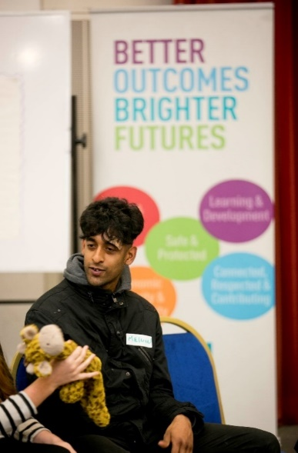
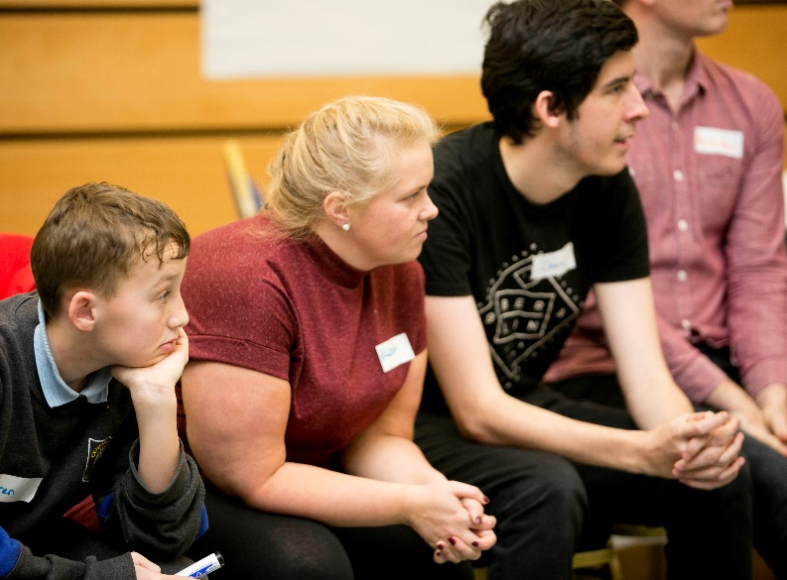
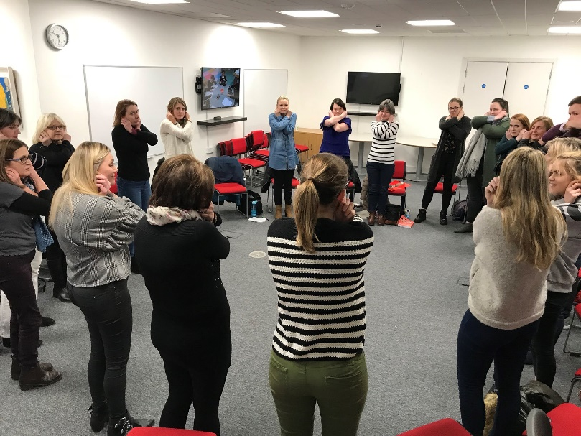
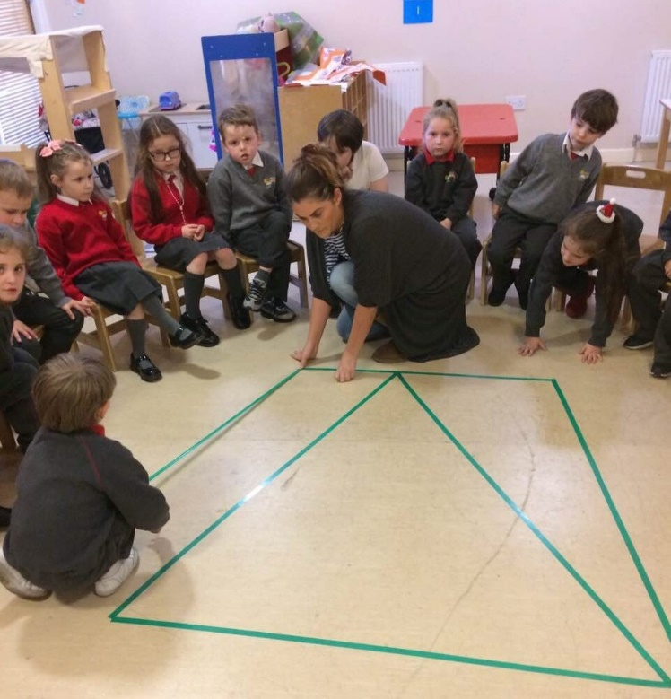
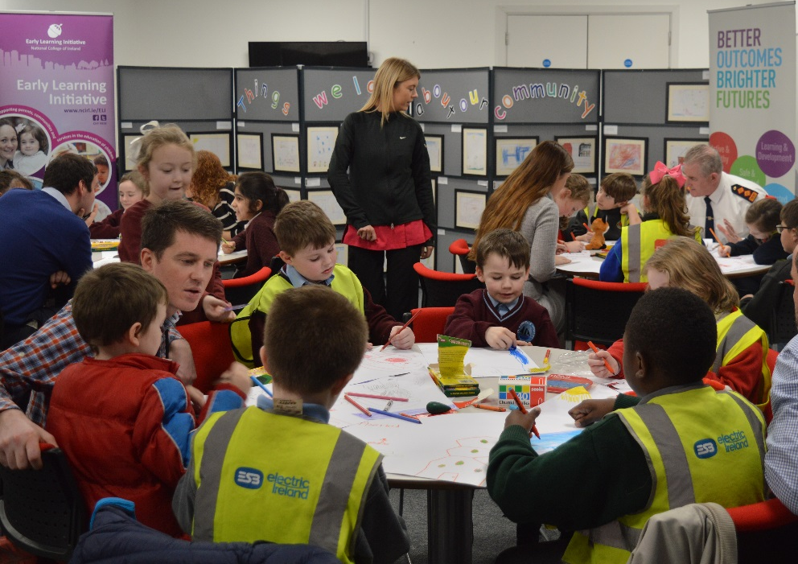
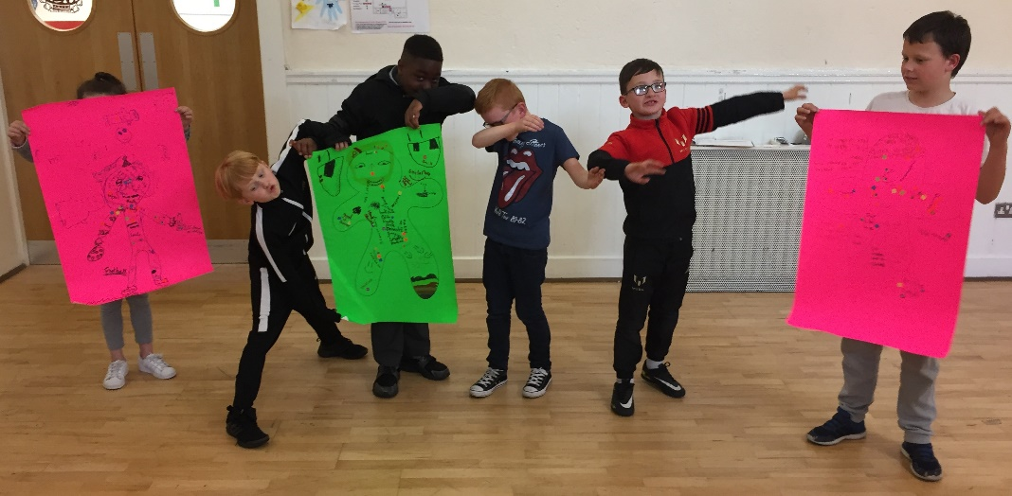
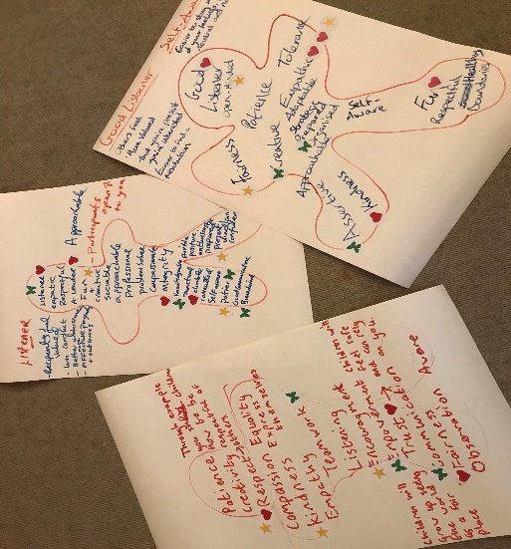
Embedding Restorative Principles

Slide 20
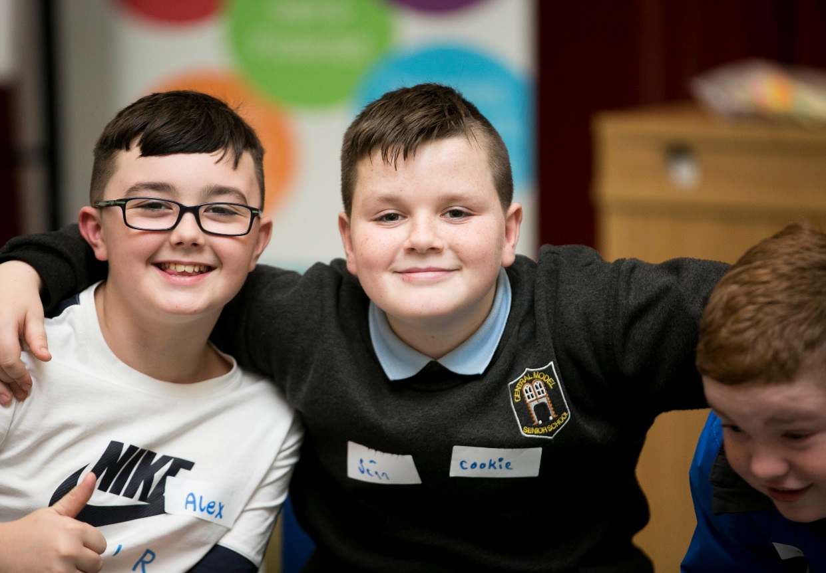
Embedding Restorative Principles
Children and Young People
– Initial Outcomes
Participating young people show a deep attachment to their area and their community, as well as the people within it. We are seeing that they are more consistently and consciously thinking about their communities and how their actions and the actions of others affect everyone.

Slide 21
Embedding Restorative Principles
“Restorative practice is about family, friends and loyalty.”
Greater Sense of Community
51%

Slide 22
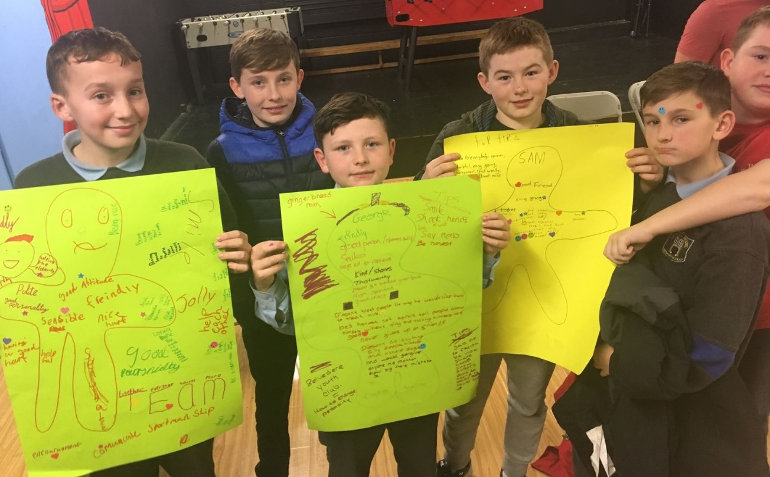
Embedding Restorative Principles
“Restorative values provide motivation.”
Awareness of Restorative Values
76%

Slide 23
Embedding Restorative Principles
“Restorative practice teaches us to be non-judgemental and treat everyone with respect.”
Improvements
in
Emotional Intelligence
54%
Improvements
in
Attitudes
51%

Slide 24
Embedding Restorative Principles
“Sitting in a circle is normal for us.”
Growth in Learning Dispositions
56%
Growth in Learning
Skills
72%

Slide 25
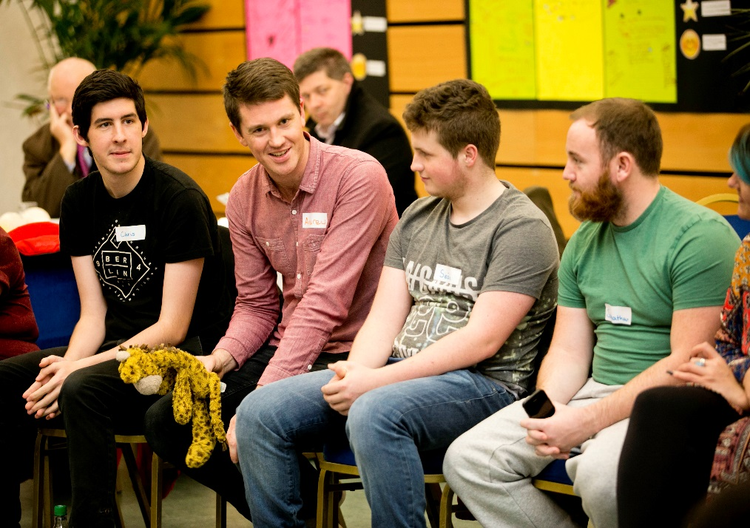
Embedding Restorative Principles
“Restorative practice is about self-worth, honesty and self discipline.”
Improvements in
Self-efficacy 71%

Slide 26
Embedding Restorative Principles
Adults – Initial Outcomes
Relationship Between a Person’s Knowledge of Restorative Practices and the Ability of That Person to Manage Conflict.

Slide 27
“Restorative Practice allows people to be reflective, more empowered…RP makes people see the impact of their actions, (and) it is making the workplace safe.”

Slide 28
Restorative Practices and Effective Communication and Relationship Building

Slide 29
“(Restorative Practice) is helping to develop effective and helpful relationships.”
“Restorative Practices will support the community in bringing lasting change.”

Slide 30
Social injustices and other conditions that cause harm or create unsafe conditions are in part the responsibility of families, communities and larger society.
Securing Restorative Sustainability
Putting right requires that we…
…address harm
…address causes
Zehr et al, 2015

Slide 31
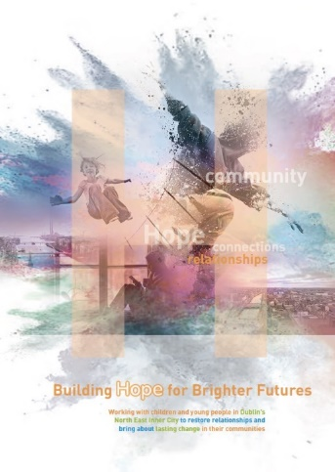
Securing Restorative Sustainability
ABC/NEIC Programme continuation
Dissemination at RP events/conferences/publications nationally and internationally
Dissemination at ELI/NCI conferences and symposiums
ELI Centre of Excellence
Corporate Partner engagement
EU Partner engagement
National and International Network Partners: Ireland (North and South) – RPI, RPF NI, Worldwide – IIRP
RP Mentors: Ireland, Europe, Australia and New Zealand

Slide 32
Securing Restorative Sustainability
Community
Corporate
College
Creating restorative learning communities…through restorative society approaches.
C

Slide 33
Securing Restorative Sustainability
An Increasingly Integrated Way of Working
Based on the envisioned new ways of working, the long-term vision of this initiative will seek to establish a number of locally-run, integrated, restorative practice hubs that embed:
A neighbourhood-based social and economic regeneration initiative between diverse local, city and national partners
A restorative learning hub that underpins support for the long term development of early years services, primary and secondary schooling, youth, community, sports and cultural developments
Innovative neighbourhood-based economic, career development and adult education initiatives based within and around the National College of Ireland.

Slide 34
“Through RP people might speak more about their feelings and that will build more empathy.”
Why our restorative practices programme works…
“There are better relationships, better flows of communication among adults as well as children.”
“RP might give a teenager support and understanding about the impact their behaviour has on wider community.”
“It brings cooperation and change for the better (a better community) and understanding of other people and their feelings.”
“RP allows people to be reflective, more empowered.”

Slide 35
For the first ten minutes the young boys were edgy, giggly, uneasy, even a little disruptive. To be together in a circle, to be invited to speak for themselves and give others their turn, was new and a challenge.​​
Within the hour engagement had become total, insights about trust, friendship, being hurt, being included, being listened to, caring for one another, keeping one another safe, were shared with clarity and honesty.​​
Their capacity to be open and to share deep experiences was done in a manner that adults often find too challenging. Their voice was strong and unexpectedly compassionate.”​
Derek Wilson, Dublin, 7th December 2016

Slide 36
If you have any questions or would like to contact us, please get in touch!
Emma Wheatley emma.wheatley@ncirl.ie
Karen Mooney
karen.mooney@ncirl.ie

