Slide 1
Family group conference for child welfare & youth justice:
A UK Perspective
shahed Chowdhury, United kingdom

Slide 2
What is Family group conference?
“A Family Group Conference (FGC) is a mediated formal meeting between family members and other officials such as social workers and police in regards to the care and protection or criminal offending of a child or adolescent” ("The Family Group Conference)".
Child, Youth & Family (New Zealand Journal). 20 July 2014).

Slide 3
MY WAY OF SEEING fgc model
(and Overall RESTORATIVE PRACTICEs) a process of
formalizing informals
Ancient tribe culture of family coming together to resolve conflict
Ponchaet (north india) I Shalish (south india)
To
Restorative practices (Fgc/fgdm)
Referral from local authorities or court
Informalizing formals
Punitive system
Adversarial or retributive policy
1960S, 1970S & 1980S
To
Restorative practices (FGC/ FGDM)
FAMILY LED MEETING

Slide 4
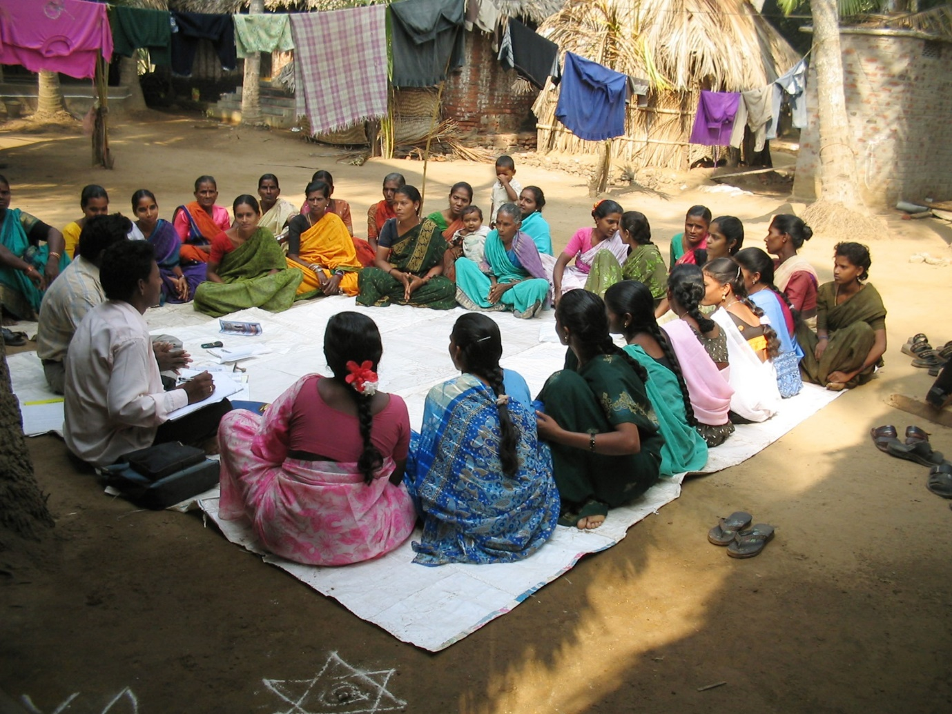
Shalish in a west bengal village in 1960s (informal)

Slide 5
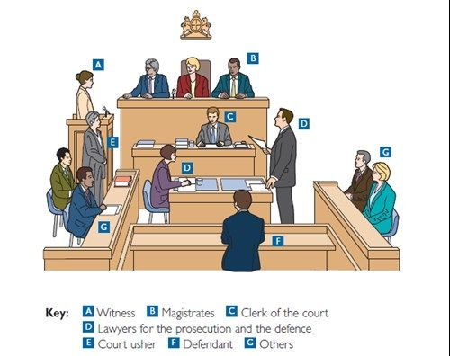
Retributive or adversarial (formal) system

Slide 6
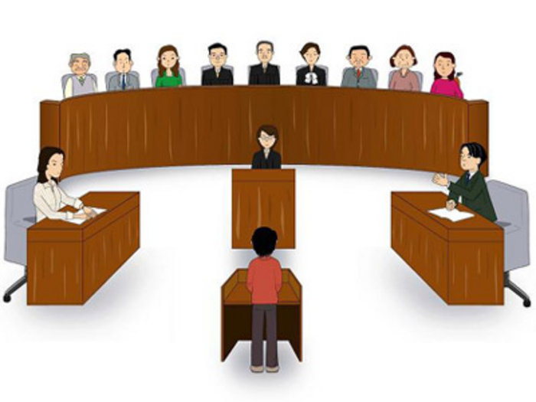
Adversarial punitive system

Slide 7

Families and other supporters (if allowed to come in)

Slide 8
I see fgc for child welfare or youth justice
AS
a family led decision making meeting, which is forward looking, solution focused and child centred

Slide 9
FGC – key components
Philosophy
Who is family?
decision-making process (formal/informal)
Family-led (Family group must take control)
Forward looking (must learn lessons from past)
Solution focused (child’s views & wishes)
Child centred (adults must set aside differences)
Child / young person
Parents/ carers
Extended family – maternal & paternal
Non-family members - connected people (family friends, neighbours, etc.)

Slide 10
historical development
origin
UK Development
Moari (aboriginal tribe) in new Zealand
1989 children, young persons & their family act – federal legislation in N.Z.
Spread to Europe, Australia, Canada & USA (indifferent forms)
Daybreak, HAMPSHIRE DOVE PROJECT
Welcare
Golton
70 to 75% local authorities use fgc

Slide 11
Local authorities with an fgc service in the uk from 1993 to 2017 in percentage (source: sean haresnape, FRG)

Slide 12
Countries use family group conference (only for child welfare or combination of child welfare & youth justice)
(source: Family Right Group, may 2017)
Austria, Australia, Canada, Finland, Germany, Holland, Hungary, Ireland, Israel, Italy, Japan, New Zealand, Norway, Poland, Serbia, Slovakia, South Africa, Sri Lanka, South Africa, the USA, England, Wales, Scotland and Northern Ireland.

Slide 13


Slide 14


Slide 15
principles
The Child’s interests are paramount
resources need to make available for the child’s wishes, feelings and views to be heard.
Children are best looked after within the family. Services need to promote this ideal.
Professionals Working in partnership with families beneficial for children.
Families have the ability to make rational and sound decision about their & children’s future.
Families know what is the best for their children .

Slide 16
Key elements
(five defining feature of fgc process)
Fgc is primary decision making forum for child.
Fgc is made up of as wide as family network members possible.
An independent coordinator facilitates the fgc.
Family should always have private family time to device family plan.
Family plan should be agreed & resourced (unless it places the child at the risk of significant harm).

Slide 17
Fgc process
Preparation stage
(a) Information giving, (b) private family time (C) plan sharing / agreeing the plan
Coordinator will type up plan & circulate
Review or Follow up meeting after 8 to 12 weeks

