Slide 1
Leading and Sustaining Restorative Practices in Schools:
The Journey of Administrators and Teachers in Toronto
Judith Kramer
Dovercourt Public School
Fiona Brougham
Dovercourt Public School
Christina Parker
University of Waterloo
May 1, 2018
Notes:
TO bring on day of:
Judith – computer
Each of us introduce ourselves and our role.

Slide 2
Session Objectives
Gain insight into the challenges and opportunities faced by administrators and teachers on a daily basis when implementing restorative practices
Explore practical strategies for how to build a whole-school approach to restorative practices, at classroom and school levels
Discuss various approaches and challenges to conducting research on restorative practices in diverse school contexts
Notes:
Judith to share

Slide 3
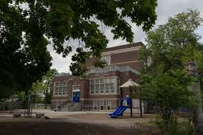
Dovercourt School: Whole School Approach to Restorative Practices
Notes:
Overview of Dovercourt – Judith
Overview of partnership – Fiona
-whole school training, sat beside Christina, formed a partnership
Whole school approach framework – Christina
(Fiona – I’m looking for another Photo)

Slide 4
Administrator Strategies, Perspectives, and Experiences
Preparing for restorative practices through professional development, guided practice and leadership
Walking the talk
Focusing on building strong relationships between staff members
Focusing on building strong relationships between students and staff
Restorative Practices is not only about conflict between students / staff / community members – can be embedded into curriculum
Notes:
Why whole school is important
Setting it up
What has worked
What is challenging

Slide 5
Administrator Challenges
Time
Buy-in and Sustainability
Monitoring Implementation

Slide 6
Teacher Strategies, Perspectives, and Experiences
There are many benefits to implementing Restorative Practices in classrooms;
1. Delivering and assessing curriculum: Language and Health examples
2. Community and Relationship building: student to student; student to teacher
3. Conflict resolution / classroom management
Notes:
Fiona
I have organized the benefits of restorative circles into 3 different areas:
Delivering and assessing curriculum – student voice, increase girl participation
Relationship building – student to student; student to teacher
Conflict management / classroom management
Challenges

Slide 7
Teacher Challenges
Teachers’ comfort with facilitating circles
Logistics: time and place
Student participation
Supportive administration
Notes:
Fiona

Slide 8
Key Learnings from our Research: Invite elicitive, restorative pedagogies to engage and transform conflicts
Conversations about equity, justice, and social issues—both interpersonal and broader scale—need to take place in (diverse, inner-city) school classrooms
Such dialogue practices are integral to creating restorative, peaceful classrooms
Proactive attention to conflict (guided practice), when implemented, clearly helps to prepare young people to address conflict
Notes:
Christina

Slide 9
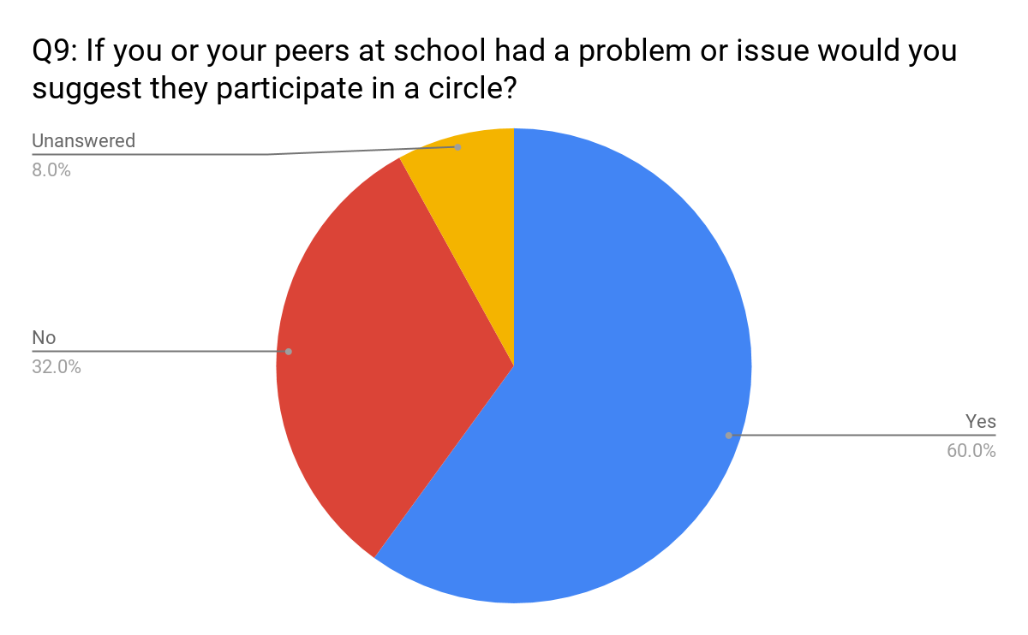
Student Perspectives on Using Peacemaking Circles
Notes:
Analyze by gender, ethnicity

Slide 10
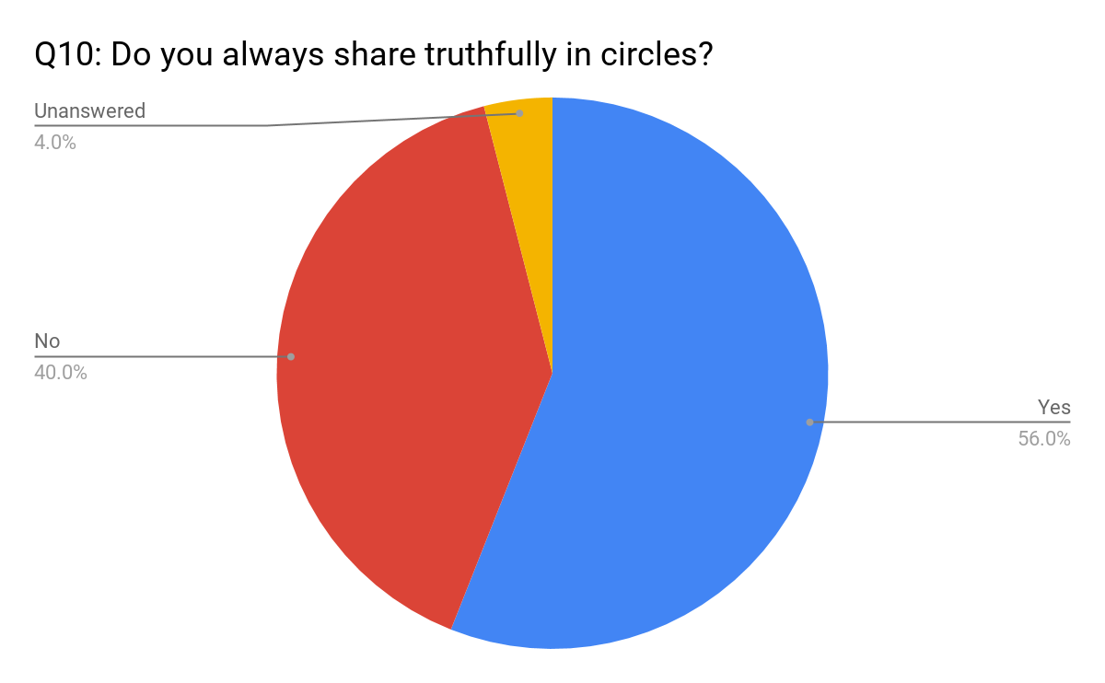
Student Perspectives on Speaking Truthfully in Circles

Slide 11
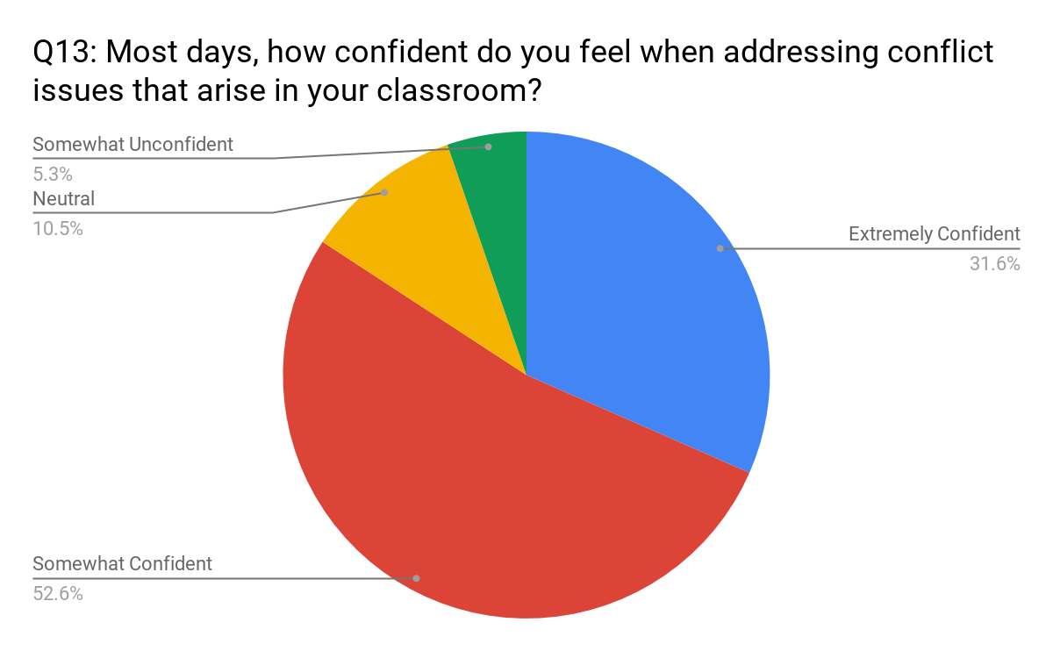
Teachers’ Confidence to Address Conflict

Slide 12
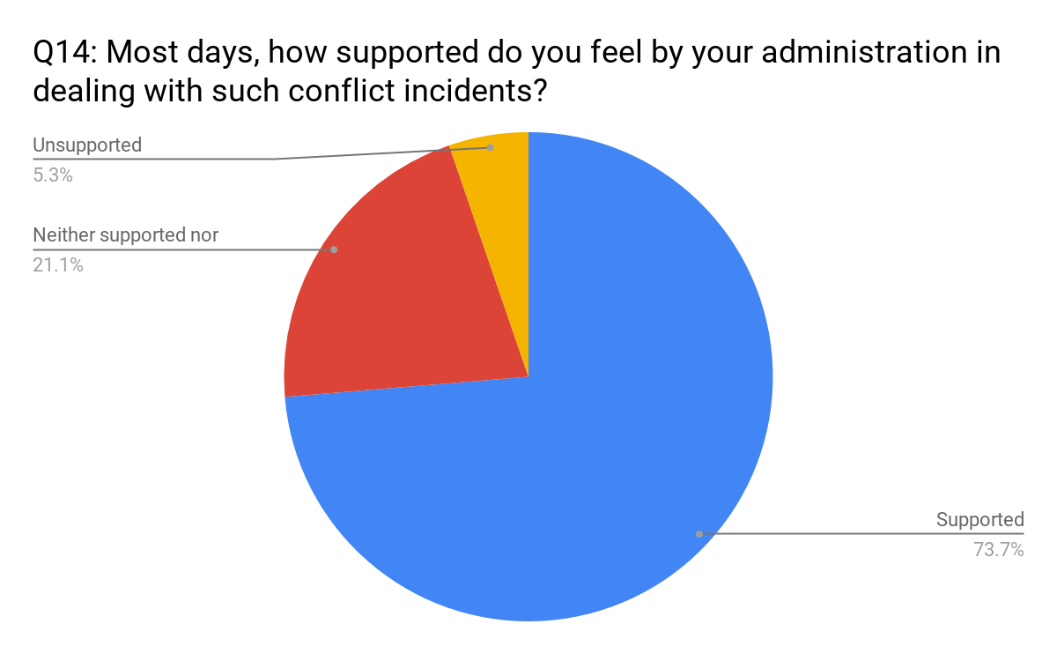
Teacher Perspectives on Administrator Support

Slide 13
Now it’s your turn…Questions?
Notes:
K&C

Slide 14
Why Restorative Practices and Constructive Conflict Talk in Diverse Classrooms?
Conflicts can be opportunities to build strong, just community and society
Proactive dialogue about conflict can contribute to sustainable, equitable peace
Dialogic pedagogies provide inclusive academic and social learning opportunities for diverse students

Slide 15
Teachers’ Professional roles and learning for responding to conflict
Conflicts may arise or escalate when handled in various ways: within, beyond or against teacher/student role expectations
Most teaching professionals seem to be socialized to respond to conflicts in particular ways — restorative dialogue PD resists prior normative/ prescriptive schooling and professional training

Slide 16
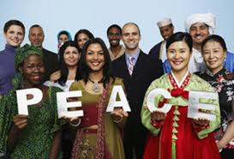
So what?
Dialogue is a necessary component of peacebuilding, particularly in conflictual contexts
Conflict dialogue is part of educating for and about peace, democracy, equity and social justice
Pedagogies can model and guide critical, reflexive peacebuilding talk and action (Dialogue, Case Studies, Team-building, Role-play, Circles, Reflective writing)

