Slide 1


Whose Religion Matters?
Exploring Emotional and Cognitive Responses to Boosting an Interfaith Restorative Community
Rasheeda Ahmad, Lisa Ratmansky
& Alia Sheety
Cabrini University & IIRP Bethlehem, PA
April 30-May 2, 2018
IIRP Canada Conference

Slide 2
TIBES
OBJECTIVES
Explore emotional responses to inequality as they relate to different beliefs, faiths, traditions and/or religions within any community.
Enhance understanding of how offering structured opportunity for engaging emotionally and cognitively with differences can lead to a more deliberate, restorative actions.
Empower participants to recognize how commonalities and differences impact their communities’ capacities to build relationships and thus enhance their communal strength.

Slide 3
Muslim Women Standing in Solidarity with Jewish Women—take note of the head coverings

Slide 4
Check In
Please share:
What is your name?
Where is home for you?
When you think of building an interfaith community, what word or phrase comes to mind?

Slide 5
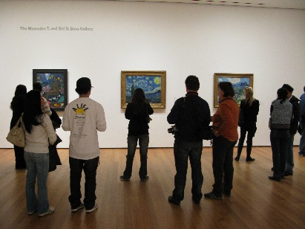


Agenda
Check In
Leading and Sustaining
Gallery Walk
  Small Group Discussion
  Large Group Discussion
Counternarrative Storytelling
  Individual Narrative
  Group Reflection
Facilitators’ Counternarratives
Debrief

Slide 6
Strategies for Leading and Sustaining Change
Gallery Walk
As you walk around and reflect on the various images and quotes,
please leave a comment on the sheet next to each.
How does each display make you feel and/or think about building
interfaith community?

Slide 7
Small Group Discussion
Make a list of key emotions you experienced in the Gallery Walk.
2. Which image or quote had the most emotional energy for you?
3. In what ways has faith and/or interfaith played a role in the
world(s) in which you live?
4. In what ways might the Gallery Walk experience challenge
perceptions about building Interfaith community?

Slide 8
Large Group Discussion
Please share key moments from your group’s discussion.
In what ways might any of your emotional and cognitive responses feel specifically related to the fact that this experience was located around faith and interfaith?
In what everyone has been sharing, what are some of the connections you are noticing to Restorative Practices?

Slide 9
Strategies for Leading and Sustaining Change: Counternarrative Storytelling
Challenge stereotypical assumptions and illustrate the diversity and complexity of our world.
Helps to explore and analyze experiences and perspectives that differ from traditional/dominant narratives.
(Solorzano & Yosso, 2002)

Slide 10
Please reflect on an experience that has elements of faith and/or
interfaith that you feel is a counternarrative to common stereotypes.
Take three minutes to reflect on and make some notes.
Share with your small group using the PLG structure.
  Allow time for each speaker to share their story uninterrupted.
  Create a safe environment by listening respectfully without judgment.
When each person in your group has had an opportunity to share his/her story, please respond to the following two-part prompt:
In what ways do these counternarrative stories help you imagine building
a sustainable Interfaith community?
Share something that challenged your own thinking in hearing your group
members’ stories.

Slide 11
Large Group Debrief
Share some key moments of your small group conversations.

Slide 12
THANK YOU

