Slide 1
Shifting Educator Mindsets Toward Restorative Practices Engage Session
George Sirrakos, PhD
Mark Wolfmeyer, PhD
Kutztown University
October 24, 2017
Notes:
George welcomes.

Slide 2
Session Goals
Goals:
Share experiences in shifting educator mindsets away from classroom management and towards Restorative Practices
Detail the developmental shifts educators make and what steps to take along this development
Discuss new approaches and directions of Restorative Practices
Notes:
George

Slide 3
Session Agenda
Introductions (15 minutes)
Opening Vignette (10 minutes)
Features of Restorative Practice in the Classroom (20 minutes)
Case #1 (15 minutes)
New Directions of Restorative Practices (10 minutes)
Case #2 (15 minutes)
Final Discussion (15 minutes)
Notes:
George

Slide 4
Introductions
Who are we?
What brings us to this work? this conference? this session?
Turn & Talk
Your name?
Your role as an educator (if any)?
Your experience with Restorative Practices (if any)?
Notes:
Mark leads…

Slide 5
Opening Vignette
Something to think about…
Mason’s Story
Close your eyes and try to envision the situation.
Notes:
George

Slide 6
Questions to Consider…
Were Mason’s actions enough of a threat to warrant the police officers shoving him to the ground and placing him in handcuffs?
Was Mason, a tall, muscular Black boy, considered a threat because of his physical characteristics or because of an objective interpretation of his actions?
Did anyone, at any point, inquire about Mason’s emotional welfare, specifically with regard to his traumatic experience earlier that morning?
Notes:
George

Slide 7
Some Background…
Restorative Practice has its roots in Restorative Justice, a way of looking at criminal justice that emphasizes repairing the harm done to people and relationships rather than only punishing offenders (Zehr, 1990).
Restorative Practice identifies both proactive (building relationships and developing community) and reactive (repairing harm and restoring relationships) approaches (Davey, 2007).
Restorative Practices aim to flatten the hierarchical power dynamic within schools and move towards equitable stakeholdership between youth, families, and institutions.
Notes:
George

Slide 8
Restorative Practice in the Classroom
Classroom Environment
Domain 2 of Danielson’s Teacher Effectiveness Framework
Restorative Practice Concepts:
Social Discipline Window
Restorative Justice Typology
Restorative Practices Continuum
Compass of Shame
Restorative Practice Processes:
Circles
Conferencing
Informal Practices
Notes:
Mark

Slide 9
Classroom Environment Policy
From Danielson’s Domain 2:
“An essential skills of teaching is that of managing relationships with students and ensuring that those among students are positive and supportive. Teachers create an environment of respect and rapport in their classrooms by the ways they interact with students and by the interaction they encourage and cultivate among students.”
Notes:
Mark
As we review the associated concepts processes, think about how these can be put to practice by educators (teachers, administrators, staff members).
We will put these into conversation with Domain 2.

Slide 10
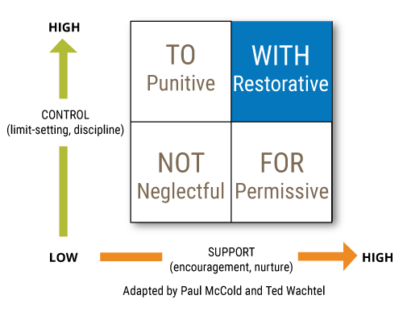
Social Discipline Window
Notes:
Mark

Slide 11
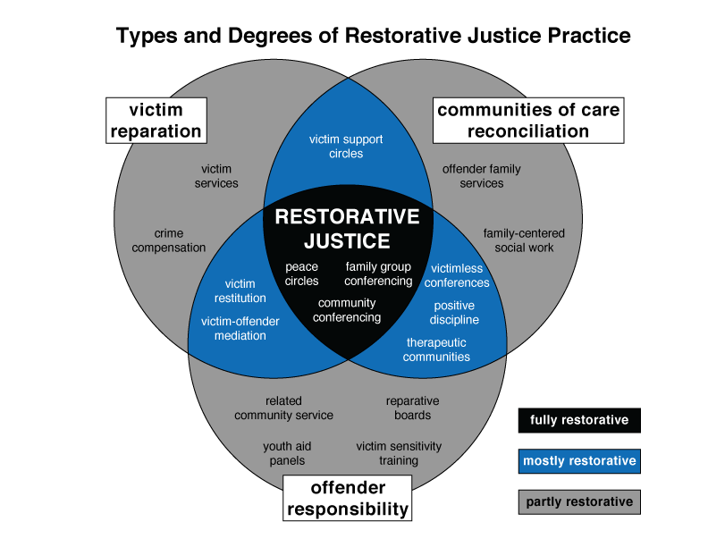
Restorative Justice Typology
Notes:
Mark

Slide 12
Restorative Practices Continuum
Notes:
Mark

Slide 13
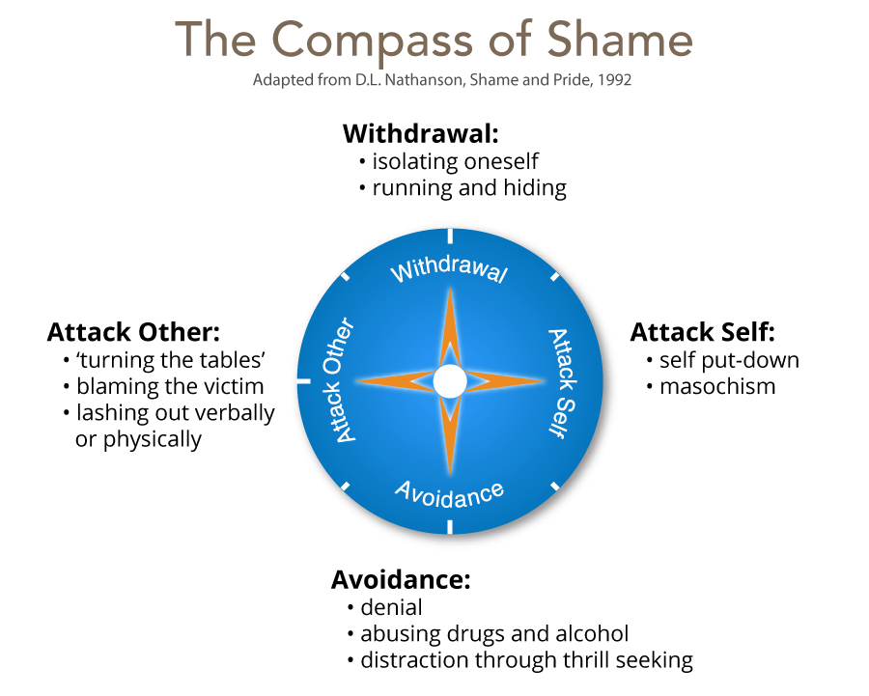
Compass of Shame
Notes:
Mark

Slide 14
Conferencing
What happened?
What were you thinking about the time?
What have you thought about since?
Who has been affected by what you have done?
What do you need to do to make things right?
What did you think when you realized what happened?
What impact has the incident had on you and others?
What has been the hardest thing for you?
What do you think needs to happen to make things right?
Notes:
Mark

Slide 15
Circles
Sequential participation (taking turns)
Purposes:
conflict resolution
healing
support
decision making
information exchange
relationship development
Notes:
Mark

Slide 16
Informal practices
Encourage affective statements within the community
Examples:
“When you disrupt the class, I feel sad.”
Notes:
Mark

Slide 17
Danielson Revisited
Turn & Talk: How do these Restorative Practice concepts and processes relate to:
“An essential skills of teaching is that of managing relationships with students and ensuring that those among students are positive and supportive. Teachers create an environment of respect and rapport in their classrooms by the ways they interact with students and by the interaction they encourage and cultivate among students.”
Notes:
Mark

Slide 18
Case #1
Read the case and respond to the following questions:
What are some things that Joanna is doing well?
How would you characterize Joanna’s use of restorative practices?
What did the case make you think about with respect to social identities and the use of restorative practices in schools?
If you were the principal, what would your next actions be for this teacher and/or the school?
Small group discussion
Whole group discussion
Notes:
Mark

Slide 19
Case #2
Read the case and respond to the following questions:
What are some things that the school is doing well?
How would you characterize the school’s use of restorative practices?
What did the case make you think about with respect to social identities and the use of restorative practices in schools?
Small group discussion
Whole group discussion
Notes:
George

Slide 20
New Directions
Move beyond viewing students as being in need of ‘restoration’.
Shift the focus of discipline to address school and community contexts rather than student pathology.
Focus on practices that are rooted in community building and shared ownership of decision making.
Restorative Practices need to move beyond the individual and instead, aid in the holistic transformation of the school. For example, typical restorative practices are situated to help students successfully navigate school, yet do not provide opportunities to influence the tapestry in which dominant culture adjusts itself to student context.
Notes:
George

Slide 21
Connecting Case 1 and Case 2
How do the two cases propose a developmental sequence of shifting educator mindsets?
What are essential features for teaching educators to integrate RP concepts and processes more fully into their practice?
Notes:
George then Mark

Slide 22
Conclusion
Revisiting Mason’s story
Recap of the session
Final thoughts and questions
Contact information:
George: sirrakos@kutztown.edu
Mark: wolfmeyer@kutztown.edu
Notes:
George then Mark

