Slide 1
KEYS TO SUCCESSFUL IMPLEMENTATION OF THE RESTORATIVE FRAMEWORK APPROACH
Pam Buttery & Pat Lewis
How we will know whether we have made the shift to a restorative school culture and provided the infrastructure for sustainability?
.
.

Slide 2
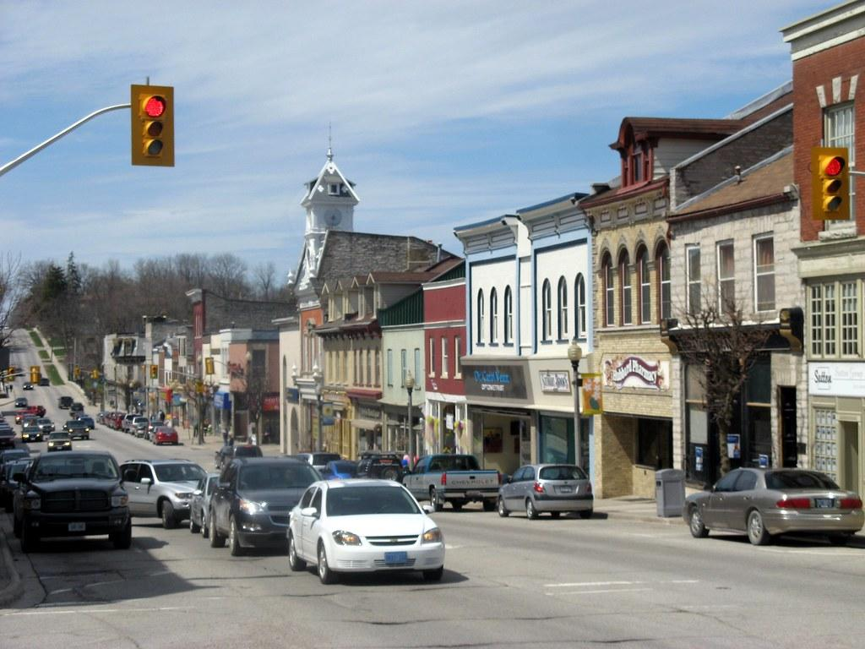
Peel Region Kawartha Pine Ridge Region
Population: 1.382 million Population: 179 thousand
Language: 49% Languages: 4.6%
Schools: 253 Schools: 88
Notes:
Pat & Pam tell stories about each school board - bit of history, personnel etc.
Data is from Stats Canada 2016 Census.

Slide 3
Training/Implementation Strategy
Peel District School Board
Kawartha Pine Ridge District School Board
Notes:
Snapshots;
Last year the Peel District School Board spent $100,000 on restorative practices training. The training was delivered to school teams that consisted of an administrator (mandatory) + 4-5 staff members. Staff could be teachers, Teaching Assistants, the Social Worker - left up to the Principal’s discretion. This delivery model has been used over the past 7 years. Schools that had not received training previously were prioritized. 3 days of training was delivered over a 2-4 week period. Teams received Framework, Circles in the Classroom and an introduction to Conferencing training.
Climate for Learning & Working staff (3 individuals working at regional level) supported school implementation planning and offered additional resources to support school-based initiatives.
Last year, the Kawartha Pine Ridge Board spent $12 000 on restorative practices training. Four “PILOT” schools were selected by the superintendent to receive 3 days of whole-school training. Framework, Circles in the Classroom and an introduction to Conferencing. Day 1 of the training took place in September, Day 2 in November. Each school was provided with ongoing coaching and resources over the course of 2 years.

Slide 4
FIVE LEARNINGS FROM OUR PRACTICE
Start with an End in Mind.
Nurture Local Champions.
Share Stories
Make Connections.
Use Data to Inform Conversations and Decision-making.

Slide 5
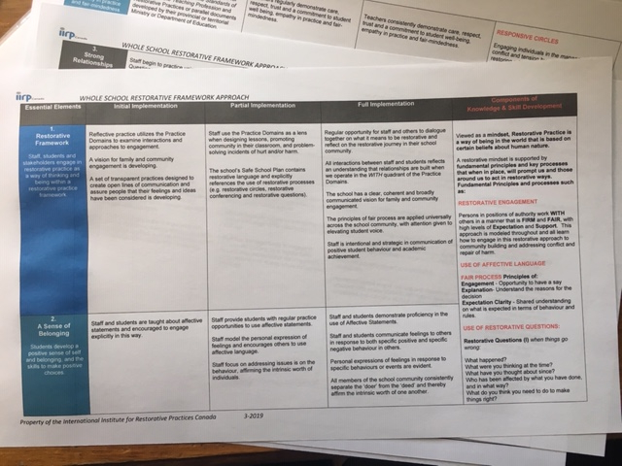
STARTING WITH THE END IN MIND
A Restorative School looks like ...
10 Essential Elements
Stages of Implementation
Knowledge & Skills
Notes:
For us it became increasingly evident that we needed to paint an accurate picture of what a restorative school ‘looks like’. We knew it was not about how many people were trained in what practices, it was more about what does a restorative school look and feel like from the perspective of different stakeholders - students, staff, leaders, families, larger Ontario education perspective.
Activity : Working in groups of 3 review the matrix document, identify 1 point that resonates with your experience.

Slide 6
STARTING WITH THE
END IN MIND
.
Notes:
For us it became increasingly evident that we needed to paint an accurate picture of what a restorative school ‘looks like’. We knew it was not about how many people were trained in what practices, it was more about what does a restorative school look and feel like from the perspective of different stakeholders - students, staff, leaders, families, larger Ontario education perspective.
Activity : Working in groups of 3 review the matrix document, identify 1 point that resonates with your experience.

Slide 7
STARTING WITH THE END IN MIND
In your group, review your assigned ‘element’. Identify something that resonates with your experience.
Notes:
For us it became increasingly evident that we needed to paint an accurate picture of what a restorative school ‘looks like’. We knew it was not about how many people were trained in what practices, it was more about what does a restorative school look and feel like from the perspective of different stakeholders - students, staff, leaders, families, larger Ontario education perspective.
Activity : Working in groups of 3 review the matrix document, identify 1 point that resonates with your experience.

Slide 8
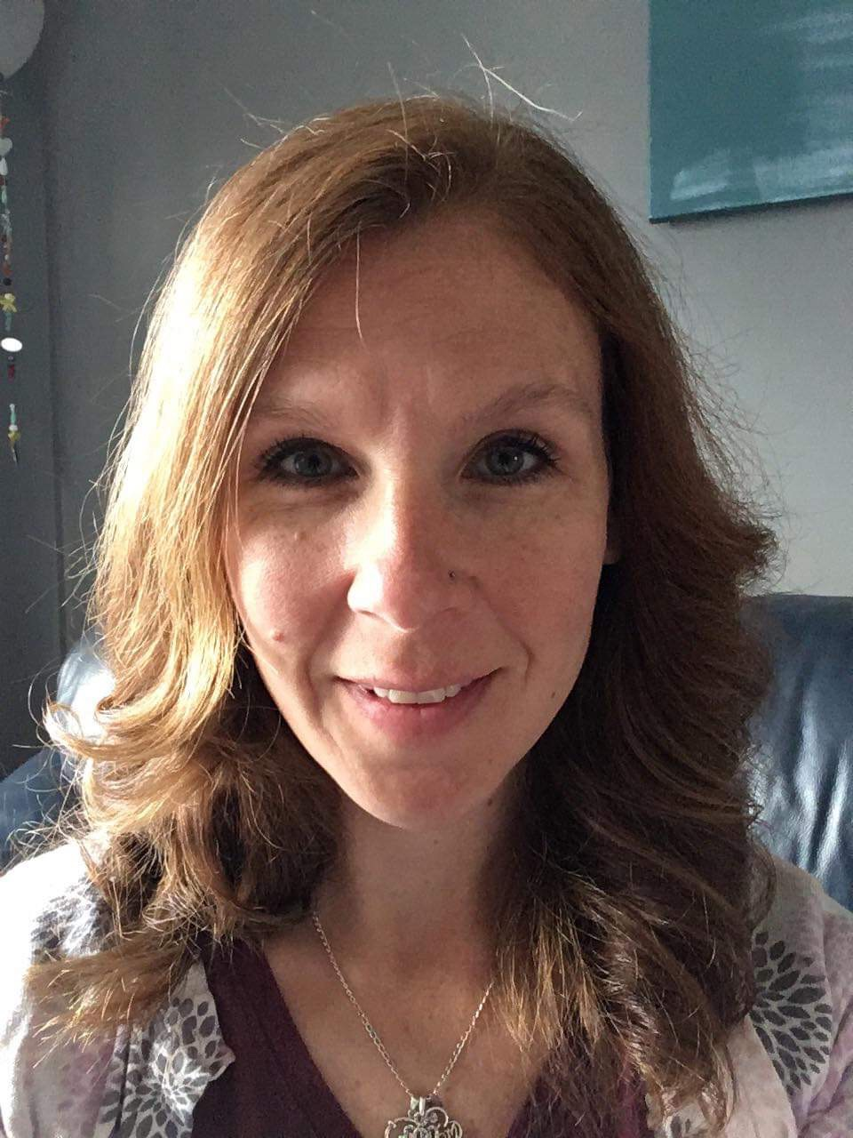
NURTURE LOCAL CHAMPIONS
Josie
“I have the privilege to be part of the Health and Well-being Team at my school. This is a group of people who all have a growth mindset. We discuss issues, look at data, compare best practices and make plans to move forward. Everyone on the team has a strong relationships with both staff and students at the school, which has led to the successful implementation of restorative practices”.
Key ingredients: Regular Meetings
Voice & Agency Shared
Diverse Voices
Reflective Practitioners
Notes:
Pam- Student Well-being Team i.e.) how often they meet- once a month after school, the coaching work that you have done with them-facilitating meetings- sharing best practices and coaching them sharing resources , supporting their on-going efforts to get space on staff meeting agendas (last year Mary Ellen promised this)-generally the admin are responsive- Circle
Format each member of the team acts as a facilitator and their is a recorder in the group, feedback is then sent back to the team for further reflection and action plans are devised etc.

Slide 9
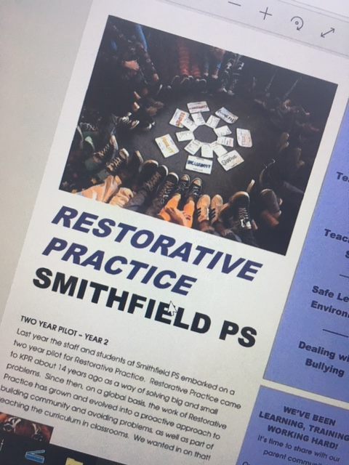
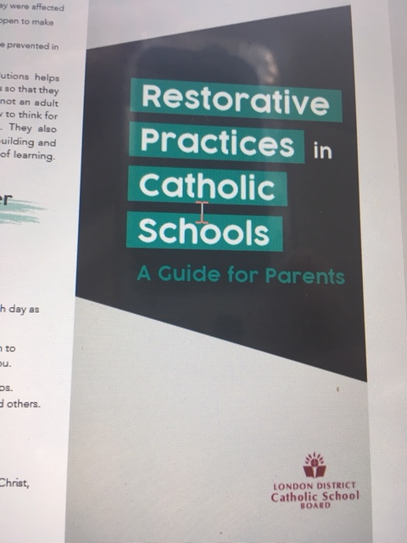
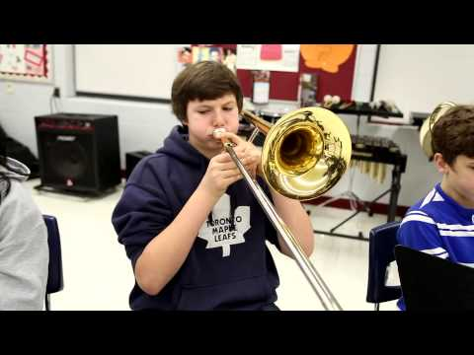
SHARE STORIES & RESOURCES
School Board Video
Parent/Family
Engagement
Notes:
Pam

Slide 10
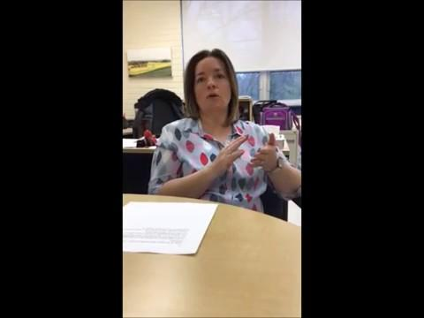
SHARE STORIES

Slide 11
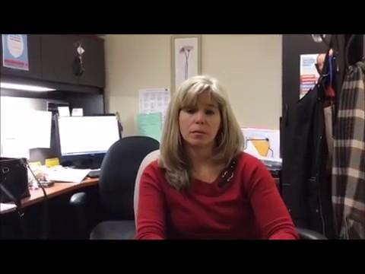
SHARE STORIES

Slide 12
MAKING CONNECTIONS: EDUCATION POLICY LANDSCAPE
Education Policy/Practices
Brain-Based Learning Theory
Equity & Inclusion
Our School Story
Notes:
OCT Ethical Standards: CARE: includes compassion, acceptance, interest and insight for developing students’ potential. Members express their commitment to students’ well-being and learning through positive influence, professional judgement and empathy in practice.
RESPECT: includes trust and fair-mindedness. Members honour human dignity, emotional wellness and cognitive development.
2. OCT Standards of Practice for the Teaching Profession:
COMMITMENT TO STUDENTS AND STUDENT LEARNING: Members are dedicated in their care and commitment to students. They treat students equitably and with respect and are sensitive to factors that influence individual student learning. Members facilitate the development of students as contributing citizens of Canadian society. LEADERSHIP IN LEARNING COMMUNITIES: Members promote and participate in the creation of collaborative, safe and supportive learning communities.
3. Achieving Excellence explicitly acknowledges the significant role that relationships with others and a sense of belonging contributes to the health and success of our students and the role that this play in helping students reach their full potential in the future. Relationships and well-being as an overarching educational goal brings into greater focus the need for strong school communities and encourages educators to implement holistic practices that focus on building relationships and nurturing a sense of belonging for students.
Ontario Mental Health Strategy (2011), Canada’s National Mental Health Strategy (2012)
Both strategies contend that greater attention to health and well-being of our young people will contribute to enduring benefits to individuals and families as well as longer-term economic benefits to larger sectors such as health, social services and justice systems within our communities. The onset of many mental health disorders occurs during puberty or young adulthood so schools are seen to be well positioned as gatekeepers and providers of early interventions that might address mental health in their initial stages (Open Minds, Healthy Minds: Ontario Mental Health Strategy, 2011, p.8 ).
PPM 119: Developing and Implementing Equity and Inclusive Education Policies in Ontario Schools (2013)
Identifies that students who feel connected to teachers, to other students, and to the school itself do better academically than students who do not feel the same connections (p.2).
Finding Common Ground: Character Development in Ontario Schools K-12 (2008)
The Ministry’s character development initiative direct teachers to "assist in creating a school culture that values caring relationships between teachers and students, fosters a sense of belonging, nurtures democratic principles and encourages student voice in decision-making” (, p. 29). Character must be developed through active participation and supported by dialogue, reflection and action. The Character Development Initiative is grounded in the vision of an education system in which students play a pivotal role, and are actively engaged in their own learning, in the life of the school, and in their communities.
urriculum Documents
Direction for educators to build positive relationships with students can be found in most curriculum documents such as the Social Studies, Grades 1-6 (2013) which states: ‘It is important that teachers create an environment that will foster a sense of community, where all students feel included and appreciated and where their perspectives are treated with respect’ (p. 3). In a 2013 CBS series edition entitled Student Voice: Transforming Relationships discusses at length the importance of creating classroom and school-wide environments and that this is best achieved when “the principles and values of pupil voice and participation are threaded through the daily interactions and communications of school life and reflect a coherent and widely supported set of values and principles”.
Caring and Safe Schools in Ontario (2010)
Treating students with equity, dignity and respect and ensuring they feel supported and accepted at school and the emphasis on the important role that feelings of belonging play in enhancing student self-esteem and contributing to their success at school (p. 4) are clearly articulated. Fair treatment and a call for all members to participate in decision-making to promote the well-being of all is also identified as contributing to a positive school climate (p.11).
Supporting Bias Free Progressive Discipline in Schools, Ontario Ministry of Education, 2013
“There is an increasing body of research showing that students who feel connected to school – to teachers, to other students, and to the school itself – do better academically.” (Ontario Ministry of Education, 2009b, p. 12)
School leaders practise progressive discipline as part of a whole-school approach that involves a continuum of prevention programs, strategies for fostering and reinforcing positive behaviour and helping students make good choices, and age-appropriate interventions, supports, and consequences used to address inappropriate student behaviour. The disciplinary measures used in response to inappropriate behaviour are applied within a framework that shifts the focus from one that is solely punitive to one that is both corrective and supportive. (Ontario Ministry of Education, 2012).
A bias-free approach is one that respects all people and groups, and reflects the human rights principles described in the following pages. A bias-free approach helps build and foster a positive, safe, accepting, and respectful school culture and climate and helps students and their families, school staff, and other members of the school community: • respect individuals’ dignity and diversity; • ensure that every person receives fair and equitable treatment based on individual strengths and needs; • consider the root causes of student behaviour; • improve strategies that focus on prevention and early intervention to resolve behavioural issues; • enhance the school’s approach to student discipline; • support student achievement and prepare students for their role as engaged, productive, and responsible citizens. (p.12)

Slide 13
MAKING CONNECTIONS: OUR SCHOOL STORY
How would you describe what you are about as a school? (Mission, Vision, Values)
How would your parent community describe what you are about as a school?
How does restorative practices resonate with your existing practice/beliefs as a school?
What do you see being the benefits of this RP initiative for your school?
Notes:
These questions are used in the initial planning stages for RP training in schools. As part of our whole school pilot, these questions were the focus of the first planning session with their school-based teams (including the school administrator).
In our Day 1 Framework Training we pose the questions: What does it look like when things are going well in your school? What do you see, hear students, teachers, families & staff doing when things are going well.
Both these activities help participants see that RP can be woven throughout and support good practice that is already happening in their school communities. These connections are important to building sustainable mindset and practices.

Slide 14
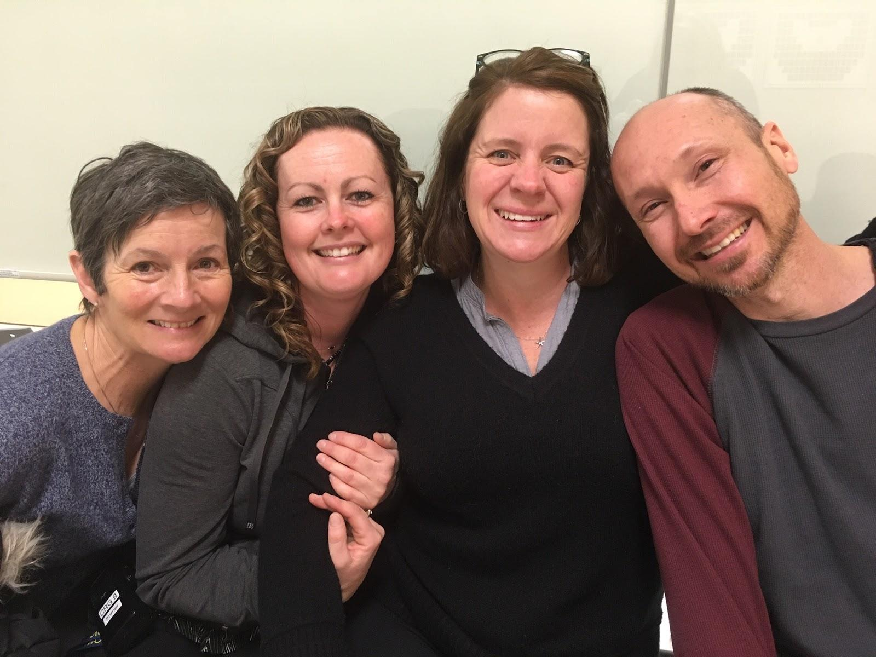
USING DATA
Types of data that may be collected- suspension rates, office referrals, surveys, Student Climate Surveys, staff reflection tools, interviews, anecdotal records, sharing stories and best practices.
Notes:
As we began this work in schools we realized that it was difficult to measure the impact of restorative practices because the concepts are hard to measure- relationships, fair process, positive school climate etc and there are so many factors that may needed to be considered.Even the most seasoned researchers are currently struggling with this.
Staff Data
At the school level, we honoured the belief that those that are closest to the challenge will come up with the best solutions. The Health and Well-being team received regular feedback from the staff and set goals and next steps based on that information. (quarterly). Teachers conducted circles in their classrooms to gain student voice and the administration checked in with the School Council.

Slide 15
USING DATA – KAWARTHA PINE RIDGE BOARD
Tell Them from Me - Student Climate Survey (Yearly/Mandated)
Staff Surveys/Feedback
Notes:
http://thelearningbar.com/about/learningbar/

Slide 16
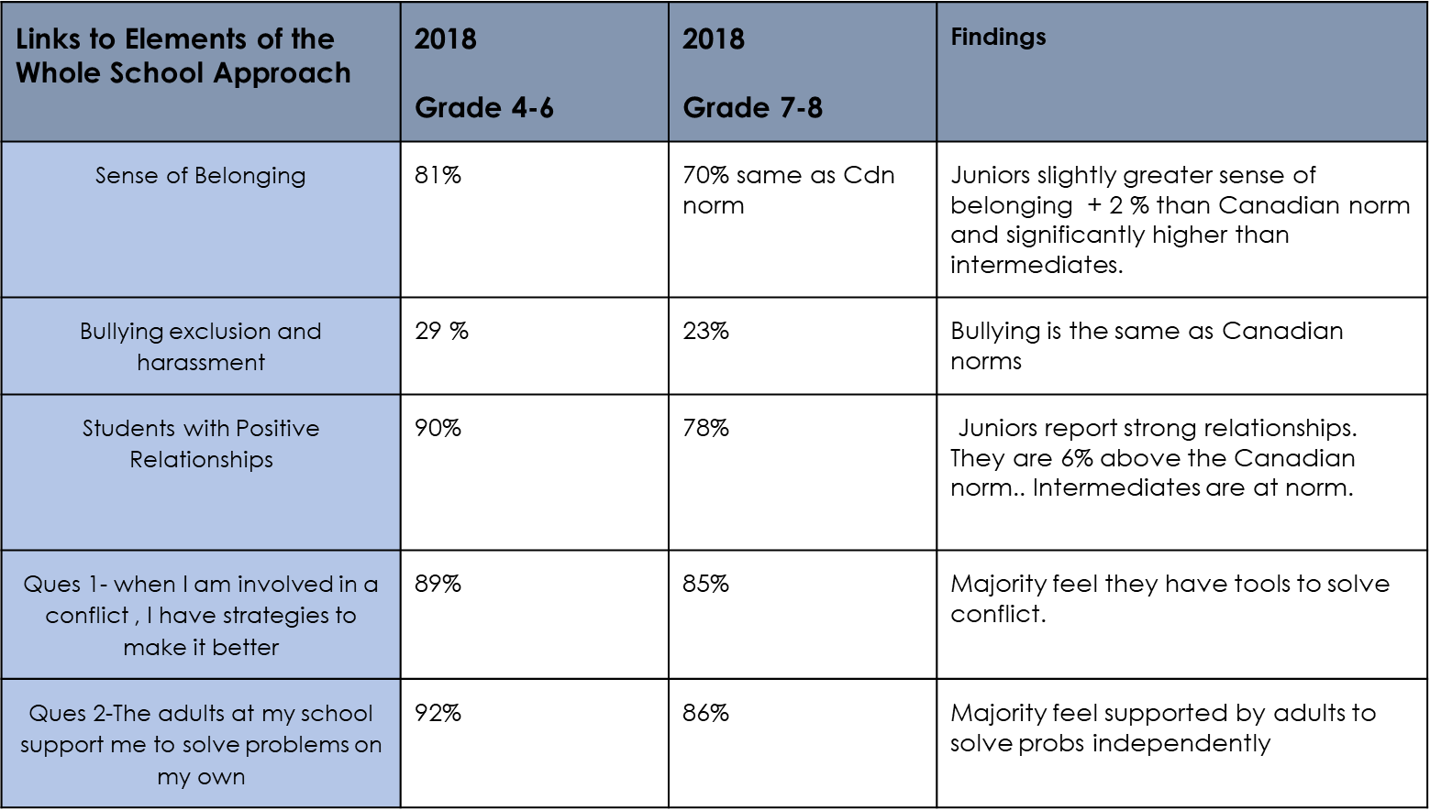
Notes:
We used this student climate survey (Canadian students in schools across the country) produced by the Learning Bar a to collect information. This survey gathers information for schools about school climate, student engagement, bullying and belonging. This chart is a snapshot of some of the questions that the Student Well Being Team. There are specific questions and layers of info that you can analyse to get more specific information when working on your action plan.

Slide 17
USING DATA - PEEL DISTRICT SCHOOL BOARD

Slide 18
FIVE LEARNINGS FROM OUR PRACTICE
Start with an End in Mind.
Nurture Local Champions.
Share Stories
Make Connections.
Use Data to Inform Conversations and Decision-making.
Notes:
Pat

Slide 19
CHECK OUT QUESTION
How we will know whether we have made the shift to a restorative school culture and provided the infrastructure for sustainability?
Notes:
Pat

