Slide 1
A Science of human Dignity
Belonging, Voice, and Agency as Universal Human Needs
John W. Bailie, Ph.D., www.iirp.edu
Download the full paper on the conference app

Slide 2
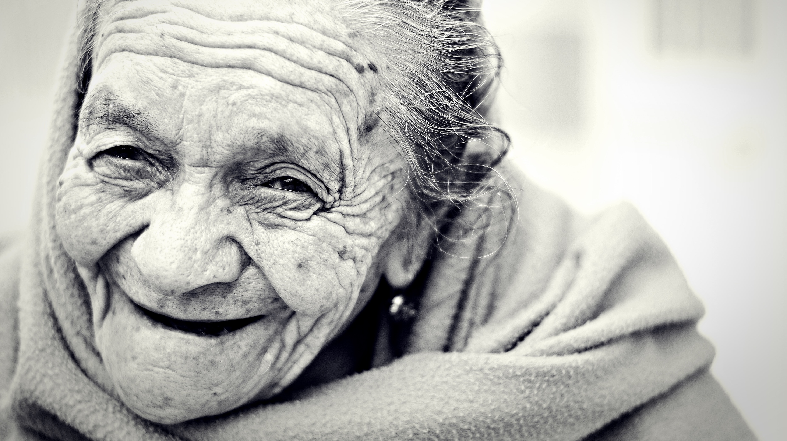
Like a Human being

Slide 3
I Am A Man
Civil rights marchers and earlier abolitionists rightly reasoned that they would not likely see justice unless they were first seen as equal in dignity and worth in the eyes of their oppressors.
“That hand is not the color of yours, but if I pierce it, I shall feel pain. If you pierce your hand, you also feel pain. The blood that will flow from mine will be the same color as yours. I am a man. God made us both.” – Ponca Chief Standing Bear, asserting his right to habeas corpus (Starita, 2008).
The entire modern concept of “universal human rights” is predicated on the inviolability of individual dignity (Rhodes, 2018). This philosophical and moral framework holds that one’s inherent worth is not rooted in one’s race, class, cognitive ability, or even in one’s relative capacity to contribute materially to society.

Slide 4
The experience of Justness
Communal and social arrangements will be experienced as just, and should be judged so, according to the extent to which they are aligned with and promote the experience of individual dignity.
This does not juxtapose the individual with the communal.
Although they often exist in tension, these ideas are not in zero-sum competition with one another. It is not a matter of individual or communal dignity, but instead a matter of individual and communal dignity.

Slide 5
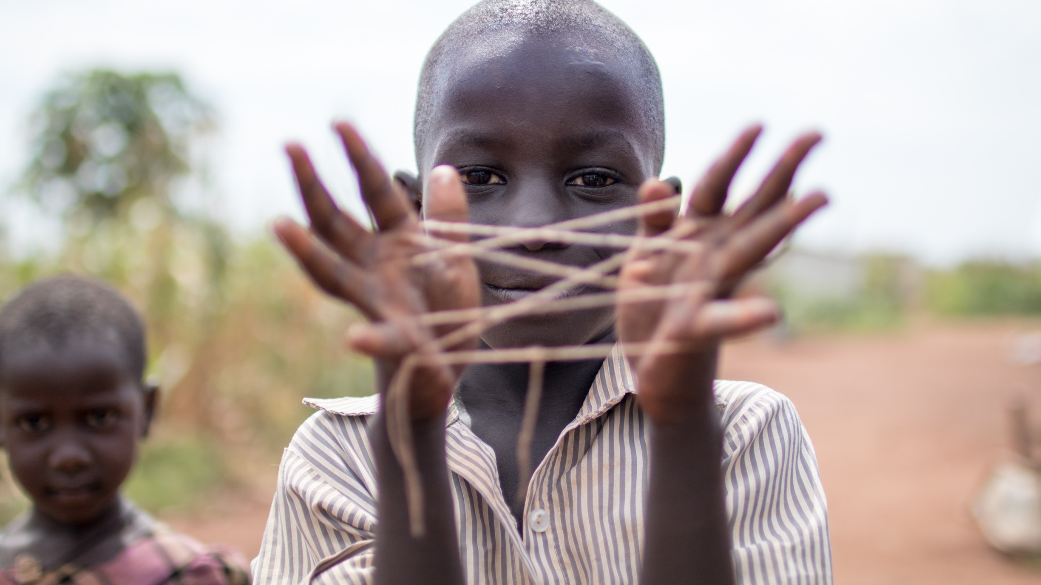
Ubuntu
Individual dignity might be ultimately rooted in one’s individual existence, but it is only truly possible to experience and express it via a just community that encourages its flourishing.
“…links individuality – the essence of “one’s being” to the humanity of others, to a collectivity that is interdependent. Ubuntu is grounded in relationships, a communitarian ethics where individuality and collectivity are symbiotic.” (Moyo, 2016, p. 75)

Slide 6
Circle of courage
Belonging, mastery, independence, and generosity (Brendtro, Brokenleg, and Van Bockern, 2002).
Mastery and independence are not developed for their own sake, but so that one can more fully practice generosity and experience belonging. Conversely, the task of community is to encourage its members to master both themselves as well as skills that will serve the community.
The goal is the development of strong and independent individuals who put their skills and lives at the service of the community. Only then can a person be made whole.

Slide 7
Scholasticism
“The ultimate source of human rights is not found in the mere will of human beings, in the reality of the state, in public powers, but in man himself and in God his Creator.” (Pontifical Council for Justice and Peace, 2004, p. 67)
All just political and social structures must, by definition, encourage and protect the natural dignity of the individual.

Slide 8
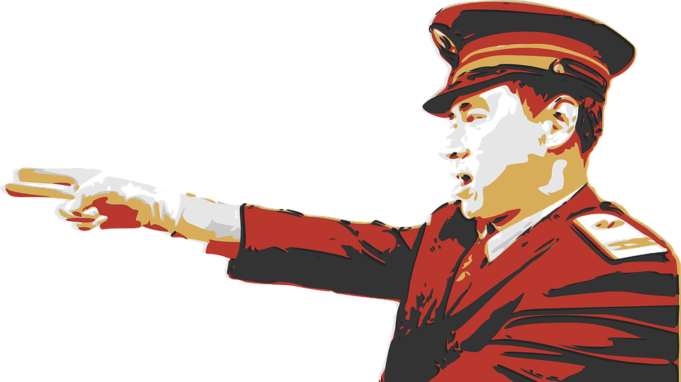
20th century horrors
In the 20th century, the radical collectivism of communism and fascism denied the necessity of individual dignity and thus the existence of natural rights (Applebaum, 2012; Payne, 1995). It is no accident that each produced monstrous regimes that dehumanized, violated, and murdered their fellow human beings with horrifying brutality and efficiency.

Slide 9
Hyper-individualism
Hyper-individualistic global capitalism also poses dangers to the experience of dignity as communal identities and entire layers of civil society are dissolved and commoditized to enable an ever-greater flow of international capital and labor.

Slide 10
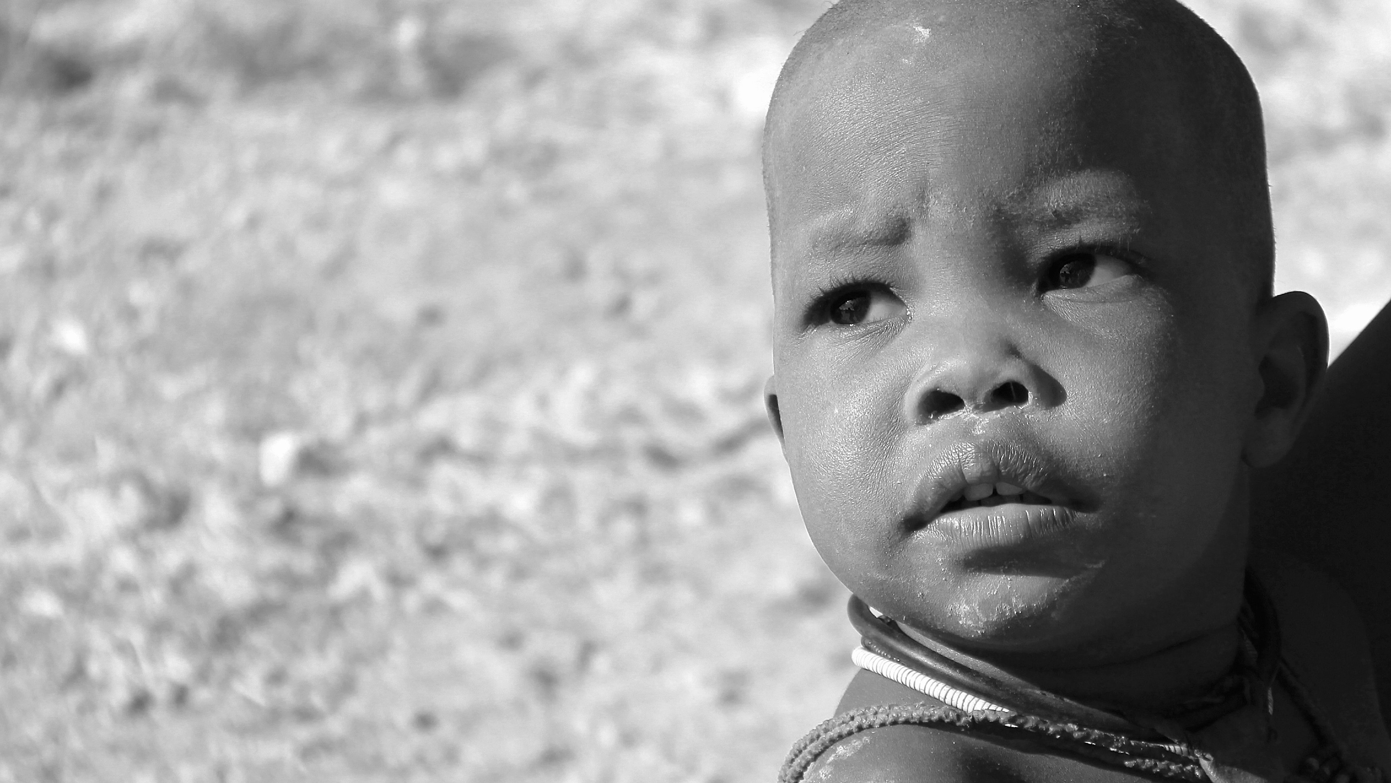
Universal human Needs
Belonging
Voice
Agency

Slide 11
The Need to Belong
While dignity is inherently rooted in the individual, it is only truly meaningful and apparent when we are in close relationships with others.
Harvard-trained social psychologist Matthew Lieberman argues that deep investigation into the social nature of humans began only in the past fifteen years or so. We are only at the beginning of our social-scientific understanding of how humans relate in groups (Lieberman, 2013).
Yet, says Lieberman (2013), every institution or social system is constructed according an implicit or explicit theory of human function.
Inevitably, some these theories are partial at best and erroneous at worst. Many of the institutions these imperfect theories have spawned are, to some degree, harmful to human relationships.

Slide 12
The Shape of Human Dignity
New fields of study such as restorative practices, expand our understanding of the human need to belong, how we function in groups, and the forms of social organization most conducive to human dignity and flourishing.
The “shape” and dimensions of human dignity matter (Bailie, 2016, in Restorative Practice Meets Social Justice).
Organizations, systems, or societies not aligned with the human need for belonging will always cause dysfunction and harm to individuals, families, and communities. They will be experienced as "unjust." People will sense the wrongness of these systems – even if they cannot quite describe the why of it.

Slide 13
Belonging as Survival
Deprivation of meaningful relationships is as painful as hunger or exposure to the elements. At a neurological level, brain scans have demonstrated that the experiences of social and physical pain are nearly identical (Lieberman, 2013, p. 5).
For humans, the need to belong is nearly as strong a motivator as the need for food and shelter.
Any effort to improve civil society must pay close attention to how our families, organizations, and systems impact, promote, or impede our ability to form strong and effective bonds with others.

Slide 14
The need to have voice
The assertion that humans have an innate need to be heard, to be understood, and to share emotions with others was one of the most salient features of early restorative justice literature (Zehr, 2002).
The need to be heard and have one’s experience acknowledged is central to the experience of personal dignity.
One of the great contributions being made by restorative practices as a field is the bringing to full consciousness how personal narratives impact our daily lives, relationships, and work.
Research into adult learners in programs utilizing restorative practices has even found that the sharing of personal narratives helped to reconcile past conflicts, hardships, and trauma (Bailie, 2012).

Slide 15
The need to exercise agency
In his famous work “Conflicts as Property,” justice theorist and philosopher Nils Christie (1977) argues that direct stakeholders “own” their relational conflicts .
Each of us has a realm of activity and decision making over which we are the rightful judge of what is best and desired for us.
“Deliberately developmental organizations” (DDOs) tend to have cultures that encourage radically honest self-reflection and taking of responsibility – not only for one’s work, but also for one’s relationships and personal growth (Kegan and Lisa Lahey, 2016).
Restorative practice restores belonging, encourages voice, and provides a means to exercise agency at the lowest possible level of social organization.

Slide 16
Human dignity in the 21st century
The emerging social science of restorative practices is beginning to provide a framework to communicate the dimensions of human dignity across cultures and disciplines via the language of the social sciences that is testable through experimentation and research. These insights will be essential to the restoration of a just community and civil society in the 21st century.

Slide 17
A Science of human Dignity
Belonging, Voice, and Agency as Universal Human Needs
John W. Bailie, Ph.D., www.iirp.edu
Download the full paper on the conference app

