Slide 1
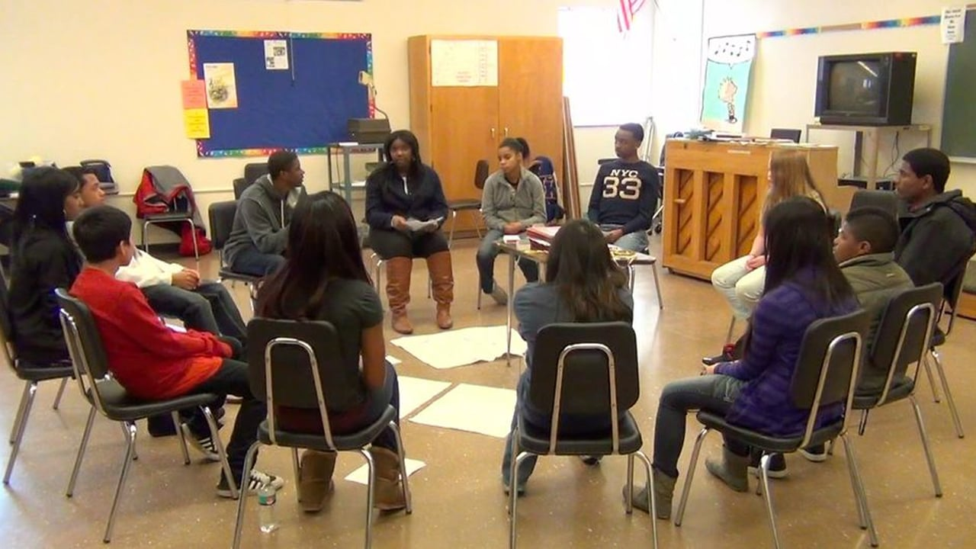
Baltimore City School Police Disrupting the School-to-Prison Pipeline
Karen Webber & Chief Akil Hamm

Slide 2
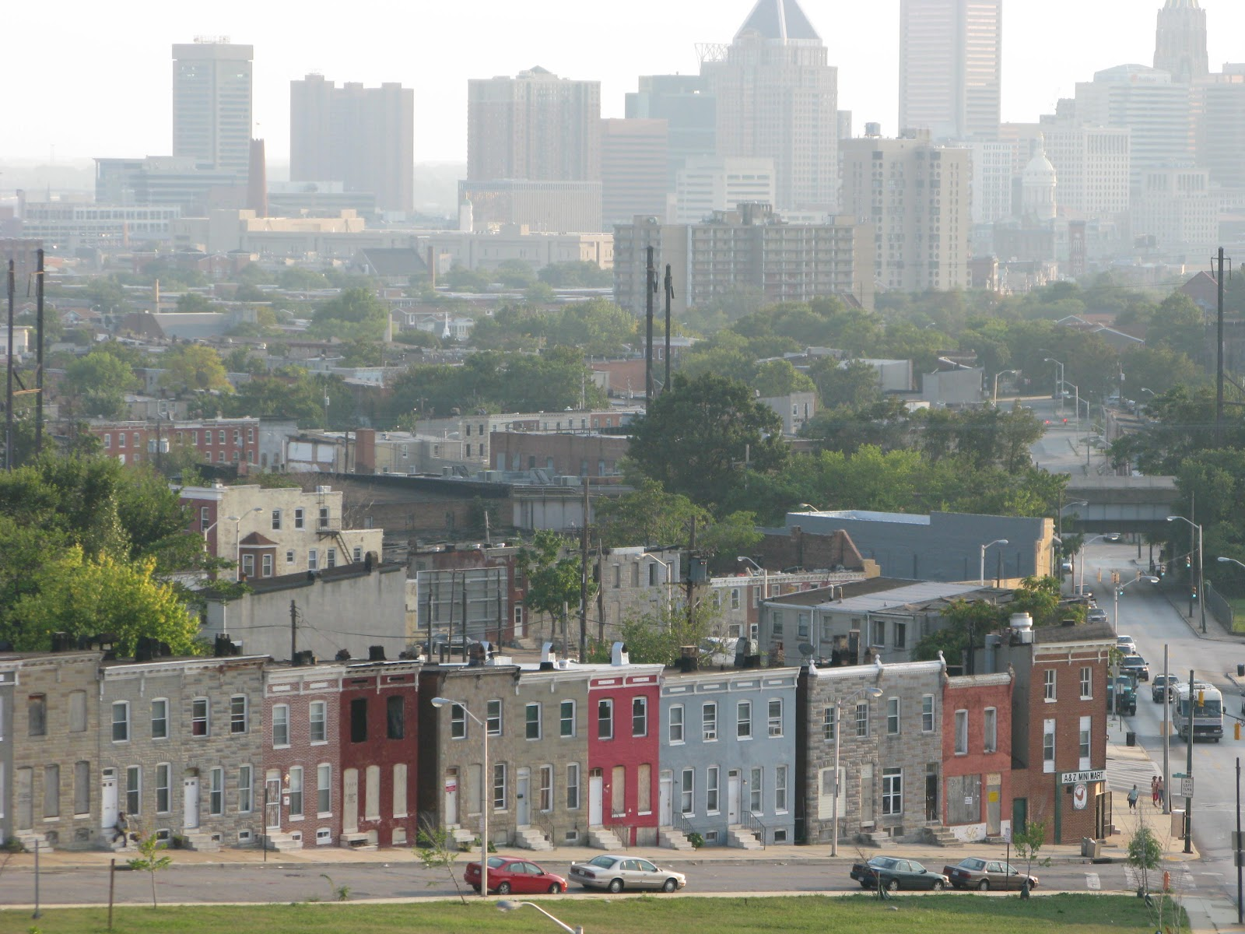
Why Baltimore?
Effects of Racism
Predominantly African American City (63%)
Poverty level twice the national average (24%)
Historically segregated schools and neighborhoods
Over-policing (DOJ consent decree) and mass incarceration of black communities
Criminalization of drug use and possession – especially among AAs
Over-use of suspensions and expulsions - feed the school to prison pipeline
Notes:
12% of U.S. residents live in poverty
24% of Baltimore Resident live in poverty
Segregated, concentrated poverty
Education = bridge to inclusive society
From DOJ report: “After engaging in a thorough investigation, initiated at the request of the City of Baltimore and BPD, the Department of Justice concludes that there is reasonable cause to believe that BPD engages in a pattern or practice of conduct that violates the Constitution or federal law. BPD engages in a pattern or practice of: (1) making unconstitutional stops, searches, and arrests; (2) using enforcement strategies that produce severe and unjustified disparities in the rates of stops, searches and arrests of African Americans; (3) using excessive force; and (4) retaliating against people engaging in constitutionally-protected expression. This pattern or practice is driven by systemic deficiencies in BPD’s policies, training, supervision, and accountability structures that fail to equip officers with the tools they need to police effectively and within the bounds of the federal law.”

Slide 3
Baltimore City Public Schools Demographics
Notes:
Despite the economic diversity throughout Baltimore, our schools are heavily concentrated by students living in poverty
(51% of all public school children in the US are low income)

Slide 4
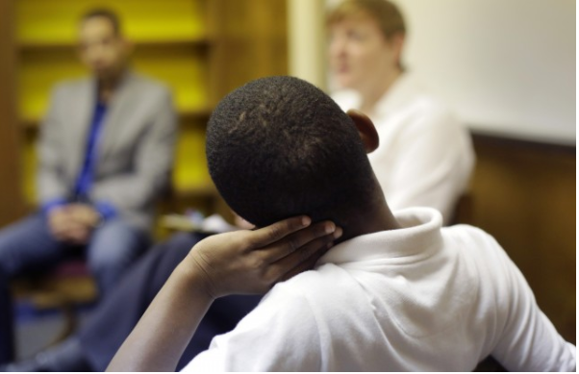
U.S. Urban poverty: exposure and effects
Exposure
Effects
  Trauma
  Mass incarceration
  Violence
  Drug addiction
  Environmental toxins
  Homelessness
  Poor Health/Nutrition
  Anxiety
  Attention Deficit
  Depression
  Impulse Control
  Aggression
Notes:
Concerning behavioral issues

Slide 5
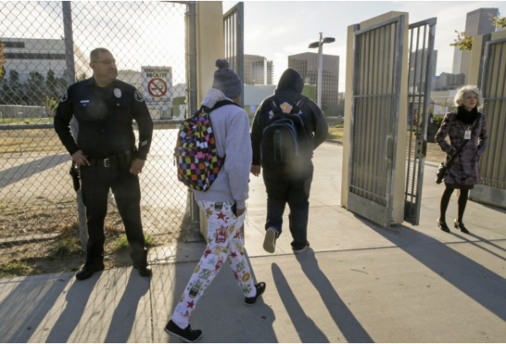
Influence of Race on Punishment in American Education
What does it look like in schools?
Police in schools
Metal detectors at entrances
Walkie-talkies
Overly punitive discipline
Suspension/Expulsion
Racial Threat:
Correlation between racial composition of student body and severity of discipline.
Majority Black Schools = Harsh Discipline.
Notes:
African American Students 3x more likely to be suspended than white counterparts for same/similar behaviors

Slide 6
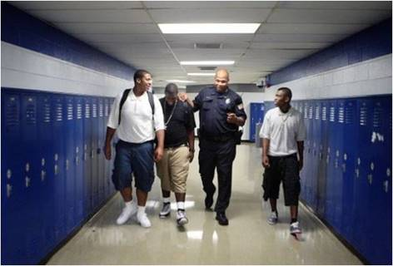

Slide 7
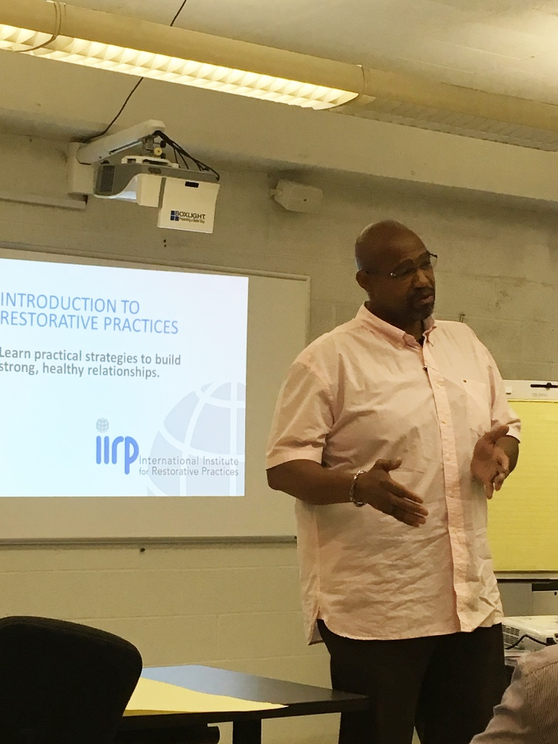

Slide 8
School Police Arrest Data

Slide 9
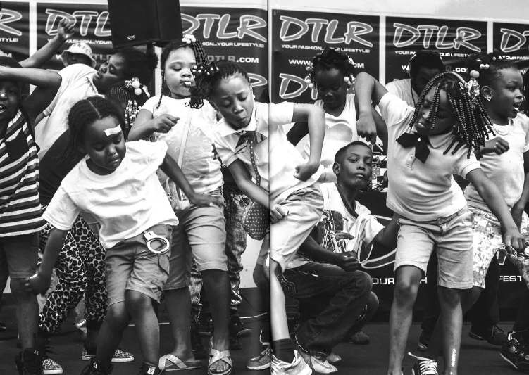
Questions?
Devin Allen, A Beautiful Ghetto

Slide 10
Quotes
“Students and even adults need an outlet to be able to decompress from what they have experienced over the weekend or even on the journey to and from school. Having a morning circle gives them that space and lets everyone see each other as humans, not teacher and student, not student and officer, just real people.”
“We have kids coming up to us outside on the sidewalks requesting circles…yes 17, 18, 19 years during a beef asking for us to help them work it out. It is powerful, and it works.”

