Slide 1
BEYOND SCHOOLS The Role of Restorative Practices in Building Resilient Communities
Joie Acosta
May 15, 2019

Slide 2
Objectives of today’s presentation
1
Describe the challenges facing communities and the importance of building resilient communities
Identify opportunities for restorative practices to contribute to community resilience
Identify next steps for engaging restorative practitioners in community resilience-building efforts
2
3

Slide 3
Strengthening community resilience is critical in a changing world
DISASTERS ARE MORE COMMON
DISASTER COSTS ARE INCREASING
NEW DISASTERS ARE EMERGING
EQUITY IS A CHALLENGE
Notes:
Disasters more frequent and more costly. Not just natural but economic downturn, community violence, etc.
Climate change creating new types of disasters now and in the future – population migration
Coinciding with this demographic shift, the rate of climate change is accelerating, bringing rising temperatures; increased risk of floods, droughts, and wildfires; stronger tropical storms and hurricanes; rising sea levels; and other climate-related hazards
Inequities – top 1 percent own 40 percent of the nations wealth, bottom 80% own only 7 percent.
It is more important than ever to build resilient communities that can not only bounce back from adversity, but progress forward to becoming better prepared for future events.

Slide 4
Traditional models to address acute stresses have not worked well enough
RESILIENCE
VS
PREPAREDNESS
Relationship-based
Whole community
Long term
Ongoing
Based on strengths
Broadly defined
Sustainable
development
Plan-based
Government agencies
Short term
Disaster-centered
Risk-focused
Narrowly defined
Build back the same
Notes:
Review differences between

Slide 5
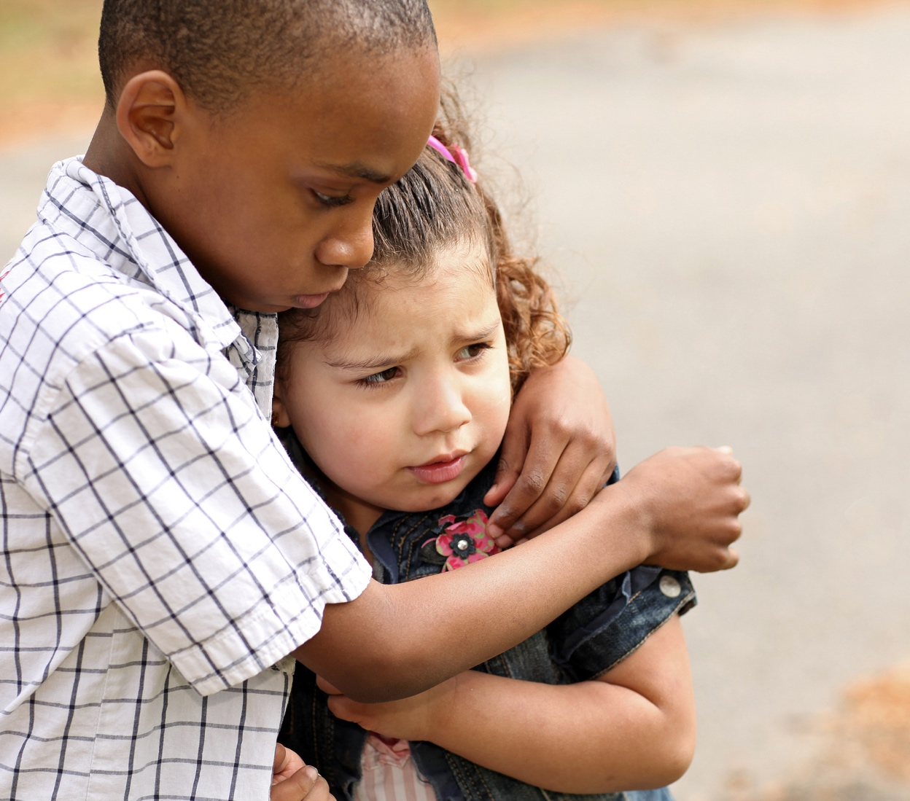
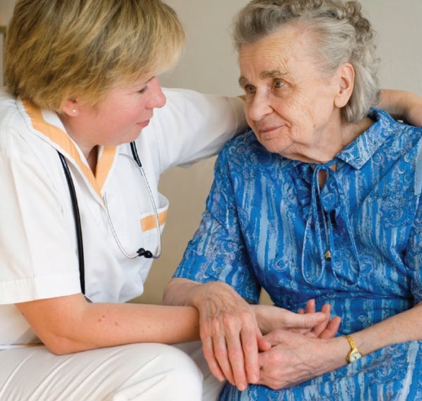
Traditional models view certain populations as vulnerabilities
Notes:
Older adults, children, immigrants, those with chronic health problems – all growing populations and all considered vulnerable by traditional models
Adults 65 years+ will account for over 20 percent of the U.S. population by 2050 (Census Bureau, 2014)
Vulnerability has been characterized in a few ways:
Having the highest prevalence rates for multiple chronic conditions, limitations in activities of daily living and instrumental activities of daily living, physical and cognitive disabilities, and sensory impairments makes older adults particularly vulnerable to physiological and psychological stresses during natural disasters .
2/3 older adults had no emergency plan, had never participated in any disaster preparedness educational program, and were not aware of the availability of relevant resources (Al-Rousan et al., 2014)
Live in areas more affected by climate change, including coastal zones and large metropolitan areas (Gamble 2013)
will require public health and prevention planning and programs to promote the resilience of older adults.

Slide 6
Building resilience can reduce the negative consequences of acute and chronic stress
Resilience is the capacity of a dynamic system, such as a community, to anticipate and adapt successfully to challenges.
Notes:
As a result, moving towards thinking about a more holistic strategy to managing disasters -- CR
There are lots of definitions of community resilience
Here’s RAND’s developed from our national work

Slide 7
Addressing resilience means considering a wide range of factors
ACUTE AND CHRONIC STRESSORS
ENVIRONMENTAL, SOCIAL AND ECONOMIC FACTORS
EQUITY so that all communities are resilient and adverse events do not disproportionately affect vulnerable communities
Notes:
As a result, moving towards thinking about a more holistic strategy to managing disasters -- CR
There are lots of definitions of community resilience
Here’s RAND’s developed from our national work

Slide 8
Community resilience has represented the intersection of Community Wellbeing Promotion and Emergency Preparedness
Community Wellbeing Promotion | Community Resilience | Emergency Preparedness
Routine surveillance | Assessment of population, structural vulnerabilities and assets | Emergency risk assessment
Community education | Education about ongoing mitigation | Risk communication
Provision of direct services (e.g., immunizations, home visiting, social services) | Ongoing assurance of health and social service access; skill building (e.g., PFA, economic supports) | Provision of shelters, evacuation plans, mass prophylaxis
Policy support re: community impact on health and wellbeing | Policies that prepare for routine and emergency conditions | Policy support re: disaster response and recovery
Notes:
Joie-I put this here, modify as you see fit

Slide 9
Resilience links other community efforts
Sustainability
Livability
Wellbeing
Restorative Practices
Focus of today’s presentation

Slide 10
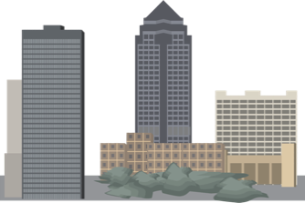
Community resilience requires building relationships between people and organizations
RESILIENT COMMUNITIES
RESILIENT COMMUNITIES
There are strong relationships between organizations
Organizations are ready and prepared to respond and recover from stress
There are enough volunteers to help in a time of stress
People can rely on each other (neighbor to neighbor)
Individuals/families have the knowledge to prepare for and respond to stress

Slide 11
Resilient communities drive residents toward a resilience mindset
“I have skills I can use to help others”
“If something unpredictable were to happen, I can count on my community”
“My community is not immune to stress”

Slide 12
Building community resilience takes the whole community
LAW ENFORCEMENT OFFICERS
EDUCATORS
RESTORATIVE PARTNERS
FAITH LEADERS
SERVICE PROVIDERS
COMMUNITY ORGANIZERS
STUDENTS
FAMILIES
Notes:
These are key partners in building a restorative school and community

Slide 13
Building community resilience takes the whole community
LAW ENFORCEMENT OFFICERS
EDUCATORS
FOOD AND NUTRITION
HOUSING
COMMUNITY PARTNERS
FAITH LEADERS
SERVICE PROVIDERS
COMMUNITY ORGANIZERS
STUDENTS
PUBLIC HEALTH
COMMUNITY DEVELOPMENT
FAMILIES
ARTS AND CULTURE
BUSINESS
Notes:
They are part of the whole community needed to be resilient
What we’ve learned through our work on the NHSS, NSS, and NDRF is that CR take multiple stakeholders and all sectors of a community
This is also reflected in national strategy that is recognizing this whole community approach
The restorative community is a networked system is
But older adults and their supporting organizations are still not adequately leveraged in these
strategy document, reflected only as a vulnerable pop,
which while important is not fully recognizing their
strengths

Slide 14
There are challenges to resilience building
CONFUSION over scope and intent
DIFFICULTY TRANSLATING FRAMEWORKS into action, even when definitions are clear
LIMITED MEASURES OF IMPACT

Slide 15
But we can rise to meet those challenges
Overload
Hurricane
Community Stress
Community violence
Economic decline
Time
Notes:
1. Apply resilience across multiple stresses
Community allostatic load example
2. Take a systems approach to building
resilience
3. Build more resilient community leadership, workers, and training programs
New skills in community engagement, asset identification, self-sufficiency
4. Use a diversity of measurement approaches across the system, organizational and individual levels that feed back findings frequently

Slide 16
But we can rise to meet those challenges
Overload
Hurricane
Stronger systems
Community Stress
Community violence
Economic decline
Time
Notes:
1. Apply resilience across multiple stresses
Community allostatic load example
2. Take a systems approach to building
resilience
3. Build more resilient community leadership, workers, and training programs
New skills in community engagement, asset identification, self-sufficiency
4. Use a diversity of measurement approaches across the system, organizational and individual levels that feed back findings frequently

Slide 17
But we can rise to meet those challenges
Overload
Hurricane
Stronger systems
Community Stress
Resilient leaders
Community violence
Economic decline
Time
Notes:
1. Apply resilience across multiple stresses
Community allostatic load example
2. Take a systems approach to building
resilience
3. Build more resilient community leadership, workers, and training programs
New skills in community engagement, asset identification, self-sufficiency
4. Use a diversity of measurement approaches across the system, organizational and individual levels that feed back findings frequently

Slide 18
But we can rise to meet those challenges
Overload
Hurricane
Stronger systems
Community Stress
Resilient leaders
Connected individuals
Community violence
Economic decline
Time
Notes:
1. Apply resilience across multiple stresses
Community allostatic load example
2. Take a systems approach to building
resilience
3. Build more resilient community leadership, workers, and training programs
New skills in community engagement, asset identification, self-sufficiency
4. Use a diversity of measurement approaches across the system, organizational and individual levels that feed back findings frequently

Slide 19
But we can rise to meet those challenges
Overload
Hurricane
Stronger systems
Community Stress
Resilient leaders
Connected individuals
Community violence
Measures that matter
Economic decline
Time
Notes:
1. Apply resilience across multiple stresses
Community allostatic load example
2. Take a systems approach to building
resilience
3. Build more resilient community leadership, workers, and training programs
New skills in community engagement, asset identification, self-sufficiency
4. Use a diversity of measurement approaches across the system, organizational and individual levels that feed back findings frequently

Slide 20
A whole community approach presents a unique opportunity for the restorative practices community
REQUIRES ‘ALL HANDS ON DECK’ to leverage community assets
Emphasizes building COMMUNITY CAPACITY
Reorients communities toward a STRENGTHS-BASED AND RELATIONSHIP-FOCUSED approach
Notes:
Requires ‘all hands on deck’ to leverage community assets
Transdisciplinary perspective
Emphasizes the building of community capacity
Including capacity of schools and other setting where RP is implemented, as well as school staff and other adults that touch youth, and youth themselves
Reorients communities towards a strengths-based and relationship-focused approach that can help change the norms or values needed to tackle systemic inequities (e.g., historical racism, entrenched poverty) and increase the supports and accountability (per the RP theory)

Slide 21
Road map toward a restorative school
Positive youth development
11 essential practices
Improved school environment
Notes:
How many people have seen this before? This shows the steps towards building a restorative school.
But what are the steps towards building a health community through restorative schools, and community practices?

Slide 22
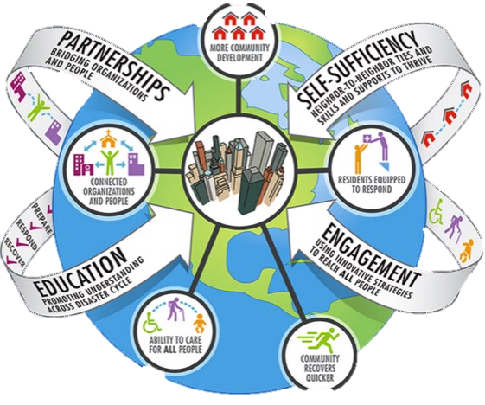
Road map toward a resilient community
Notes:
These are the steps towards building a health community. Restorative schools and community practices can play a role.

Slide 23
Partnerships across schools, families, and restorative community = Stronger systems
FAMILY
PEERS
SCHOOL
CHURCH
FAMILY
PROVIDER
FAMILY
PEERS
FAMILY
SCHOOL
SCHOOL
PROVIDER
PEERS
SCHOOL
CHURCH

Slide 24
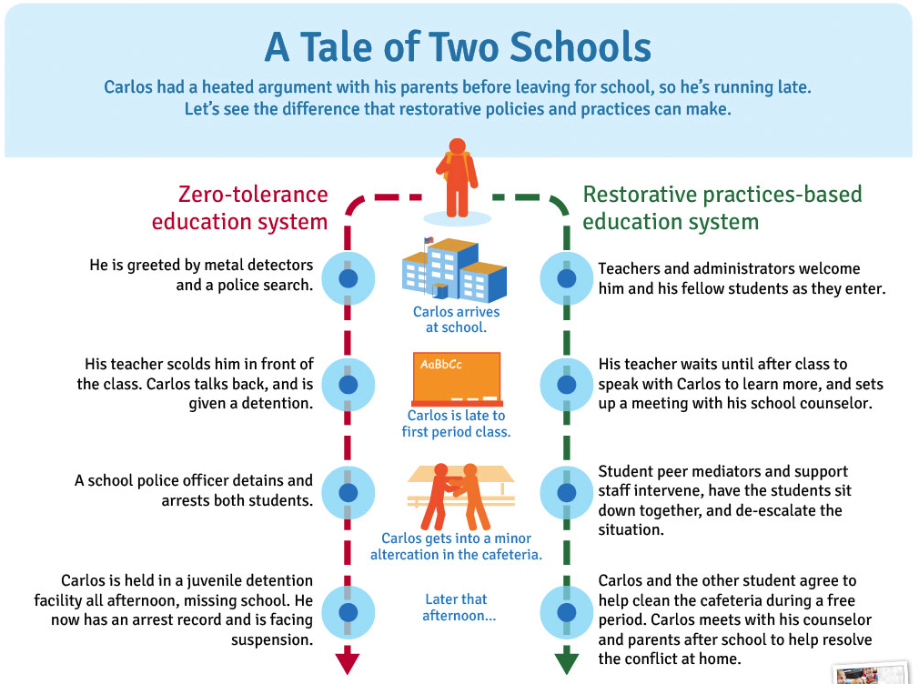
More connected individuals = Self sufficiency
Notes:
Restorative practices helps create connections between youth and between youth and adults

Slide 25
Dialogue promotes engagement and develops leadership skills = Resilient leaders

Slide 26
Restorative schools = Improve learning and the education environment

Slide 27
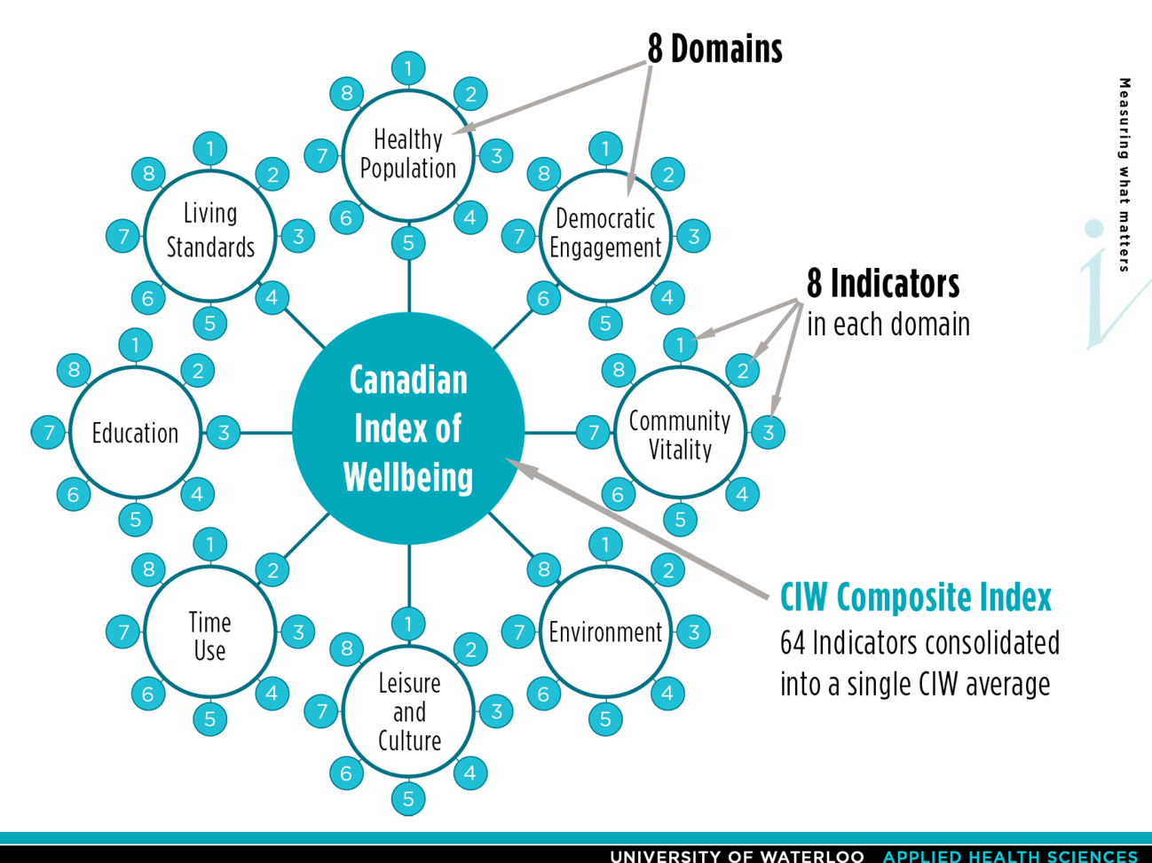
Outcomes align with community resilience and wellbeing outcomes = Measures that matter
U.S. Well-Being Index
Well-Being Index | 67.0
Life Evaluation | 50.5
Emotional Health | 79.7
Physical Health | 76.9
Healthy Behaviors | 64.4
Work Environment | 48.5
Basic Access | 82.3
Notes:
What has been missing?
Integration of the practice of government with science of wellbeing
Coordination around a common wellbeing agenda
Consideration of local resource allocation

Slide 28
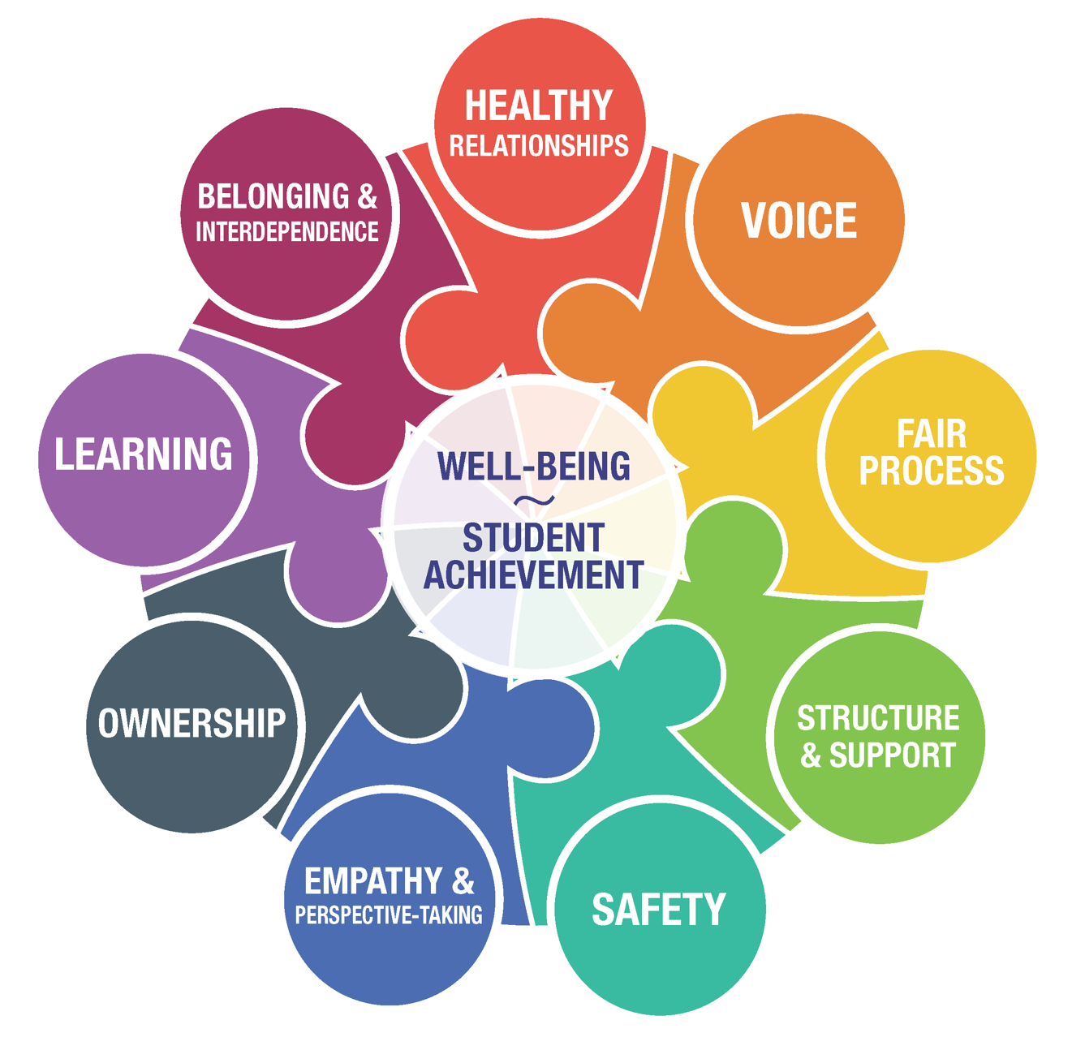
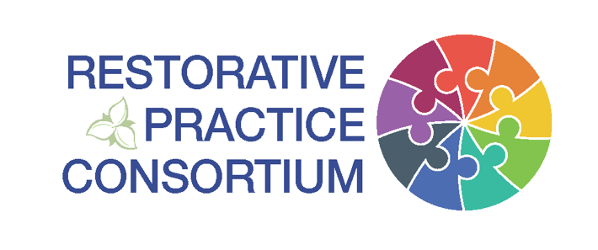
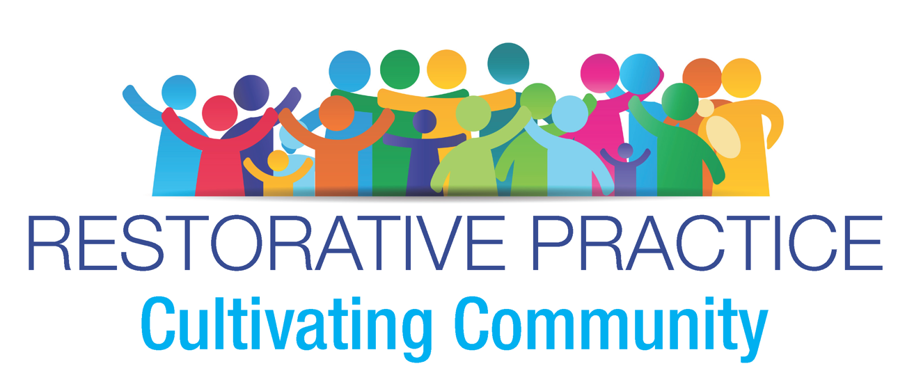
In action: Restorative Practices Consortium

Slide 29
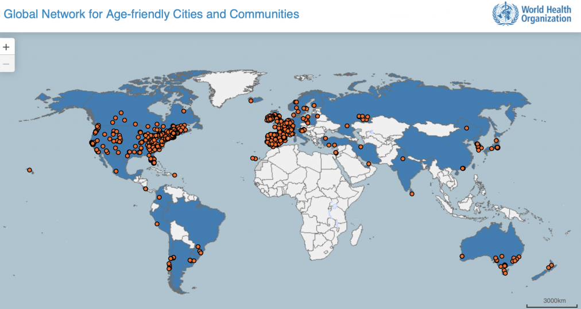
What can you do?
Capitalize on existing community resilience, sustainability, livability initiatives in your community
Notes:
These are efforts where youth can use their voice to make change in their community. You can amplify your work in schools by aligning with these community focused efforts which have brought together a range of disciplines to make a healthier community. You can also bring your expertise in relationship building to these efforts to help people work through differences, across the political spectrum, etc. to make change. Creating a respectful dialogue around needed community change is critical to bringing folks together.

Slide 30
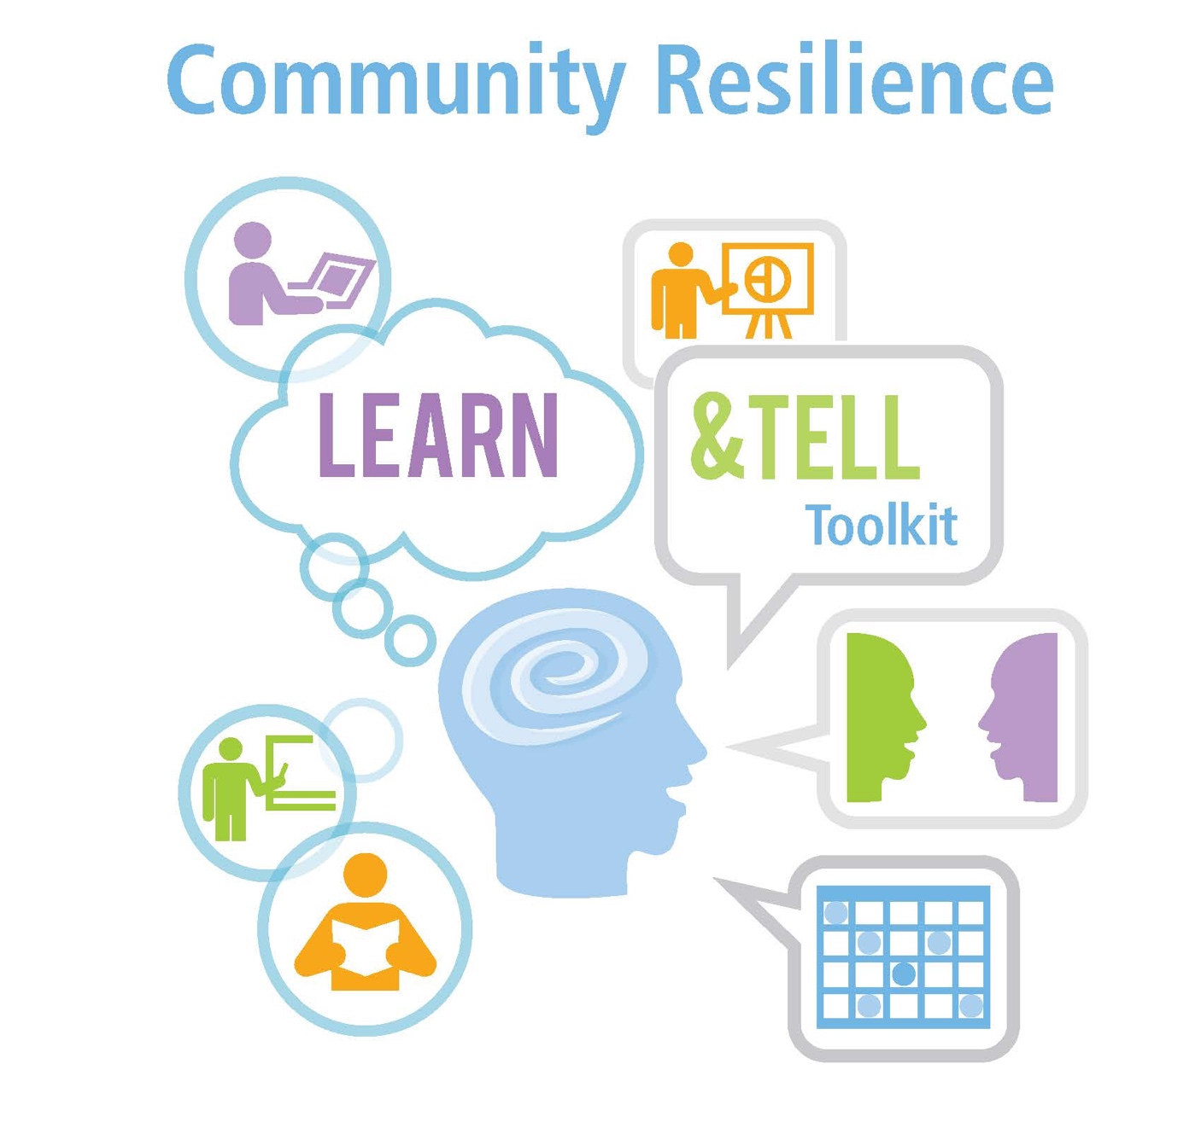
What can you do?
What’s your talent?
Bring resilience language and messages into your dialogue and circles
www.rand.org
Notes:
Building resilience is about action steps linked to things we do every day and working with what your community has. Communities with more connected people are more resilience to stress – connection is important. As is understanding your strengths and skills – if you can cook, drive, organize, use IT/social media you can help your community and your neighbors during a disaster. Use your proactive circles to have students think about their strengths/assets and the strengths/assets in their community they can rely on during a disaster.

Slide 31
What can you do?
Amplify other agencies’ existing programming and expanding dissemination
Notes:
You can help spread the word on available programs and resources available in the community. Family groups, diversion programs, resilience efforts, etc. These resources can benefit the youth you are working with and their families – and help them be better prepared to deal with stress.

Slide 32
What can you do?
Bolster restorative community’s ability to prepare itself and its consumers for stress
We are strong!
Notes:
Helping connect your youth with community resilience efforts that are planning and exercising for disaster and other community stressors. Youth can bring an important voice that can change the dialogue about them as a vulnerable population to viewing them as an asset.

Slide 33
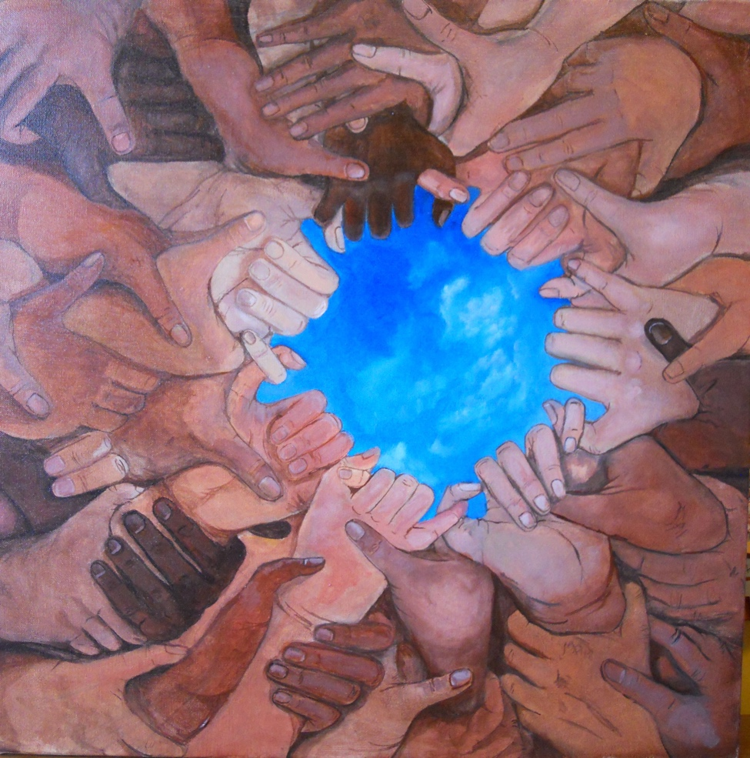
Moving the needle will take a collective effort
Coming together is a beginning. Keeping together is progress. Working together is success.
– Henry Ford
Notes:
Aging is not lost youth but a new stage of opportunity and strength.
-Betty Friedan

Slide 34
For more information
Joie Acosta, PhD
RAND Corporation
jacosta@rand.org
(703) 413-1100 Ext. 5324
www.rand.org/topics/community-resilience

