Slide 1
Restorative Storymapping
An Equity Tool Toward Designing Implementation Protocols
for Restorative Practices in Schools
Jacqueline Roebuck Sakho, Ed.D.
Assistant Professor of Educational Leadership
Program Director, Preliminary License Program

Slide 2
Restorative Justice
Restorative Justice is not…
Mediation
Forgiveness
Only about the individual
Closure
Reconciliation
A journey toward…

Slide 3

Developing a Critical Lens for Restorative Justice Work

Slide 5
The Historicity of Race

Slide 6
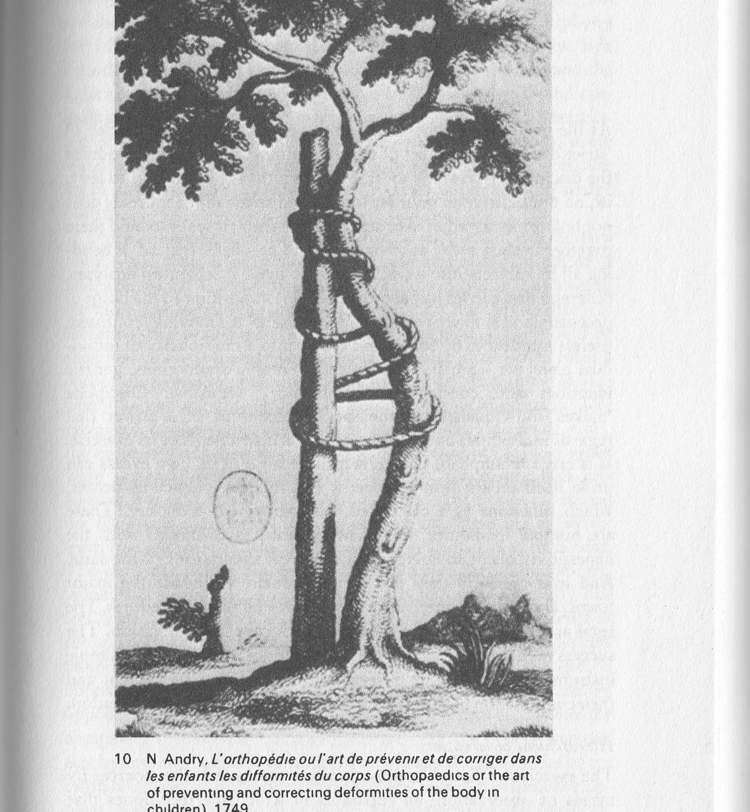
Eugenics
Stanford-Binet Intelligence Test
Anthropology
The Ties That Bind: Race, Education & Discipline
Notes:
The image was taken from an Orthopedic Surgery Manual. In this work by Foucault (1979) on discipline and punishment, is an illustrative symbol of the plight of African American students’ education journey. The stick, stable, strong and grounded, is representative of the organization of education to which the African American student as the uniquely bent tree enters the system of public education. Uniquely bent from their experiences; representing his/her own narratives and cultural lenses – as the counter-narrative to the straightness or normalized culture of the systems, beliefs, and structures. Therefore, the uniqueness of the African American student is thus defined in deficit discourse as defective and/or dysfunctional (Valencia, 2010; Ladson-Billings, 2012). Thus the rope, the bind, represents the corrective methodologies through education practices implemented to eradicate the uniqueness of the tree. In this process of normalization, the rope becomes symbolic of inequitable practices; the “education debt” (Ladson-Bilings, 2006, p. 3) accrued in serving African American students.
“a stratifying practice for providing or denying access to resources” (p. 116)
“a stratifying practice for providing or denying access to resources” (p. 116)
The field of Anthropology has produced key scholarship that “is so heavily implicated in forming our ideas and thinking about race [and]…in the formation of race as a worldview” (p. 117); that the American Anthropological Association launched a 4 million dollar re-education campaign “debunking prevailing thinking about race” (ibid).

Slide 7
Implementation Protocols

Slide 8
Implementation or…
Does your project/organization have an implementation protocol for Restorative Practices?
If yes, describe the planning phase?
Are you collecting data?
How are you measuring success?

Slide 9
Access
Achievement
Identity
Power
Equity Domains
Gutiérrez, R. (2002)
Notes:
Gutiérrez, R. (2002). Enabling the practice of mathematics teachers in context: Toward a new equity research agenda. Mathematical Thinking and Learning, 4(2-3), 145-187.
Chicago

Slide 10
Restorative Storymapping
Anecdote
Policy/Theory
Practice
“retrieve, reflect and infuse” (Richardson, 2015, p. 2071) experiences.
Notes:
This process is an attempt to crack the consciousness of the adult learning in order to move them toward activating their critical consciousness

Slide 11
Racial Order & Zones of Proximity
Nested Structures (Bronfenbrenner, 1979)
Hoare, Carol , "Models of Adult Development in Bronfenbrenner's Bioecological Theory and Erikson's Biopsychosocial Life Stage Theory" , in Handbook of Research on Adult Learning and Development ed. M Cecil Smith and Nancy DeFrates-Densch (Abingdon: Routledge, 07 Nov 2008 ), accessed 20 Oct 2018 , Routledge Handbooks Online.
Historicity of Racism
Notes:
Nested Harms: Bringing the Historicity of Race to the Circle
Zones of Proximal Development (Vogotsky) is a development theory taught in teacher preparation programs; however, not revisited during licensure or continuing adult development. Here, I am suggesting that by combining racialized institutional structures impact on students being served through Restorative Justice practices with educative justice work in order to create a type of Third Space where equitable practices like Restorative can serve to be vehicles of liberation for our most vulnerable and mistreated students, their families and communities.
Brian Stevenson’s notion of getting “proximate” to suffering and understand[ing] the nuanced experiences of those who suffer from and experience inequality”

Slide 12
Green, 2017, p. 17

Slide 13
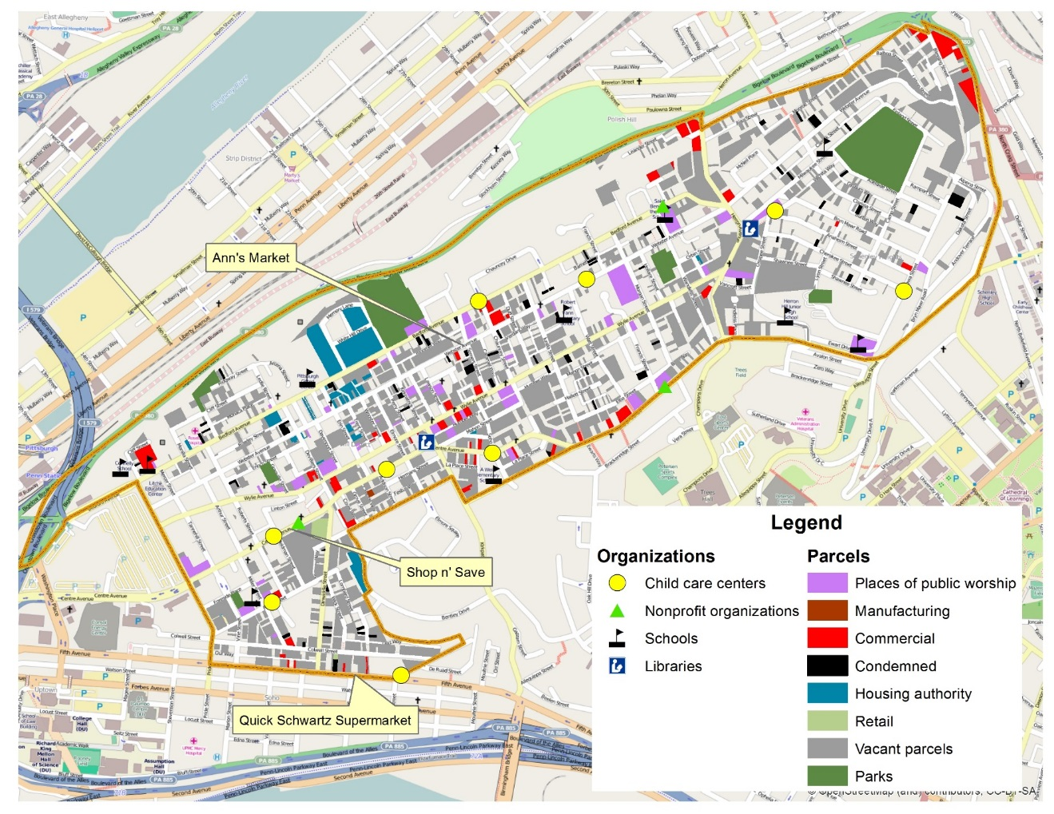
Restorative Storymapping
Sparks the agency of practitioners to:
Push against the racial order of institutions
Disrupt inequitable practices
Unearth Community Cultural Wealth (Yosso)
Notes:
What does it mean for educational leaders to walk a community, to know the geographical space; to map a community as professional development?
A geospatial image of the Hill District in Pittsburgh, PA.

Slide 14
http://corwin-connect.com/2016/03/decoding-the-rubric/
Notes:
An equity rubric used to assess the cultural proficiency of individuals and/or organizations. Corwin Press has multiple publications and tools for this work.

