Slide 1
The Art of Integration-
Primary Care and Collaborative School-Based Mental Health for Student Well-being
Marie Palumbo-Hayes, LICSW Vice President of Community Service

Slide 2

Our Mission
To improve the overall health and well-being of the communities we serve through high impact partnerships and high quality innovative programs.

Slide 3
Family Service of Rhode Island
Non-profit human services agency
Serving the community for over 125 years
Provide outpatient mental health, residential treatment, and case management for underserved/low income individuals and families
Programming for individuals from birth through adulthood
Trauma-informed & evidence-based practices
Culture of Restoration and provides Restorative Practices in urban school districts throughout Rhode Island

Slide 4

Providence Public School Department
Mission: To prepare all students to succeed in the nations' colleges and universities and in their chosen professions.

Slide 5
Historic Providence Demographics
Total # children living in poverty between 2012 – 2016: 15,068 37.5%
Total # children living in extreme poverty between 2012 - 2016: 6,770 16.8%
% of students who saw another student bring a weapon to school in 2014: 18%
% of students participated in a physical fight in 2014: 10%
2015 Rhode Island ranked 15th out of 32 states for self-reported weapon carrying on school property
# children of incarcerated parents in 2017: 983
% of domestic violence incidents reported in 2017 with children present 31%
# of child abuse/neglect victims per 100 youth in 2017 19.3
% of students in district English Learners in 2016-2017 29%

Slide 6
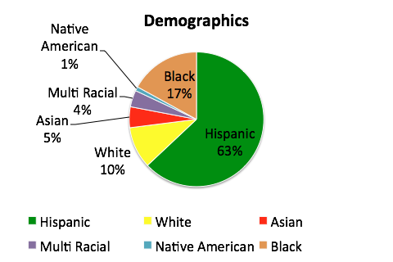
Current Demographics
Providence Public Schools
Student Population 24, 072
Total # Schools – 41
As of October 2018:
Special Education - 14%
ELL - 29%
Free & Reduced Lunch - 82%

Slide 7
Benefits of Social Emotional Learning
Social and emotional learning is defined as the process of acquiring the skills to recognize and manage emotions, set and achieve positive goals, appreciate the perspectives of others, establish and maintain positive relationships, make responsible decisions, and handle interpersonal situations effectively.
(SEL Research Group/ CASEL Update, 2011)
Students exposed to SEL performed better than peers in several areas:
Social behaviors and attitudes
Empathy and teamwork skills
Academics
And exhibited:
Fewer conduct problems
Less emotional distress
Lower drug use

Slide 8
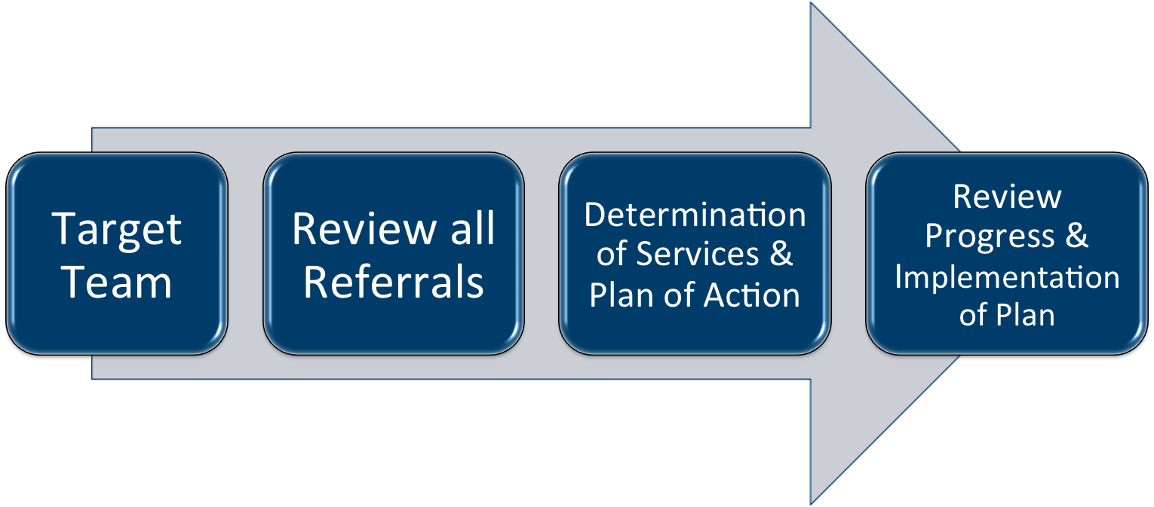
SEL: A Collaborative Process
Provided trainings & check-ins to all stakeholders & participating schools
Monitored process by attending Target Team Meetings
Created forms for systematic use
Quarterly meetings with Psychologists, Social Workers & participating schools
  review issues/concerns
  train new schools
  revise process as needed
Reviewed/Reported implementation to our School Board

Slide 9
Clinical Care
Collaboration
Weekly meetings
Team Members
Consultation
Screens & Assessments
Treatment Planning
Intervention
Family Involvement
PPSD Schools’ Wellness Teams
Linkages to community resources
Referrals to care
Integrate in school community
Training for school personnel
Parenting strategies
Sharing Expertise
Community

Slide 10
Community Health Team:
A Model of Integration in Pediatric Care
Primary Care Doctors, Nurses, Medical Assistants and Administrative staff
Behavioral Health Clinician
Community Health Worker

Slide 11
FSRI has the ability to treat the “whole child” by providing treatment integration in the school, medical clinic, and community.
The Behavioral Health Clinician collaborates with pediatric providers to coordinate care with the school nurses.
By expanding on the traditional office model, we are able to provide treatment without walls and increase wellness.

Slide 12

The Idea of Bringing Models Together
Expanding and complementing existing behavioral health and linkages to Primary Care supports within the schools by supplementing clinical and community health case management services in the school setting.

Slide 13
Key Advantages:
Easier and quicker access to services
Less barriers to services for students and families
Better coordination/integration with PPSD support systems for students
Better access to a continuum of services including Primary and Dental care
Utilizes best practice in addressing the continuum of care through an integrated system of tiered interventions and supports
Provides for an ongoing assessment and review at the school level utilizing progress monitoring and student outcome data
Improving family engagement
  Easy access to clinician and / or community health worker
  Fosters family voice and choice
  Cements a trusting relationship

Slide 14
Meeting Families Where They’re At
Emotionally
Physically
Developing Attainable Goals Together
Listening, Respecting, Exploring Strengths and Needs
Helping Families Use Strengths to Overcome Challenges
Offering Sessions at Convenient Locations and Times:
  School
  Home
  Community
  Office

Slide 15

Stepping Stones Toward Achieving Positive Engagement
School Personnel introducing the FSRI School Based Program to Families
Primary Care staff introducing the FSRI CHT to patients and their families
Removing the Stigma from Receiving Services
Being Mindful of Culture

Slide 16
Cultural Agility and Responsive Care
One Third of the FSRI School Based Clinical Team is Bilingual
Being Mindful and Inclusive of Cultural Traditions and Beliefs
Providing Documentation in Preferred Language
Utilizing Interpreter Services

Slide 17
2017-2018 Statistics

Slide 18
Screening Tools Utilized
Social Determinants of Health(SDOH)
Pediatric Symptom Checklist (PSC-17)

Slide 19
FSRI School Based 2017-2018
First Year
Serviced 101 students and families
7 Providence Public Schools: 4 Elementary, 1 Middle, and 2 High Schools
Social Determinants of Health (SDOH):
  20% of respondents who completed the screen stated that would like assistance with one or more identified needs
Pediatric Symptom Checklist (PSC-17):
60% of respondents who completed both an initial and follow-up screen reported improvement in symptoms
50 returning clients from last school year

Slide 20
Lessons Learned
Going Forward
Family
School Improving the experience and
District
Primary Care Paving the way for sustainability

Slide 21
Putting it all Together
10 year old client whose pediatrician wanted to refer her to a partial hospitalization program due to lack of school attendance for two months
Clinician met client in a warm handoff at her next pediatrician appointment
Client was stepped up to enhanced community treatment with the Community Health Worker added to her treatment team
The team closely coordinated services with school’s learning team and pediatrician
CHW followed behind school bus to support client, who was anxious to ride the bus to school
Attendance at school significantly improved, and partial and/or inpatient hospitalization was avoided

