Slide 1

Resilience Development as a Restorative Practice
©2019 Hello Driven Pty Ltd

Slide 2
Welcome!
Michael Piraino
Michael@resilienceforsuccess.com
©2019 Hello Driven Pty Ltd

Slide 3
Overview of the session
What is resilience?
The neuroscience of resilience
The six domains of resilience:
  Vision Health
  Composure Tenacity
  Reasoning Collaboration

Slide 4
Key Takeaways About Restorative Practices and Resilience
Goals, values and methods in common
Reinforce each other
Resolution of past incidents and preparation for future challenges
Resilience development based on neuroscience
Extend the impact of restorative practices
Microtasks over a period of time

Slide 5
15 Things Restorative Practices and Resiliency Development have in Common
Build better relationships
Engage a preventative skillset
The skills involved go beyond the current issue
Practitioners lead by example
Promote character development
Important for practitioners and teams, not just clients

Slide 6
15 Things Restorative Practices and Resiliency Development have in Common
Help people see how their behavior affects others, positively or negatively
Guide people to see themselves as caring, responsible and effective
Engage and teaches problem solving skills
Clarify personal values
Help people distinguish between right and wrong

Slide 7
15 Things Restorative Practices and Resiliency Development have in Common
Help participants look beyond immediate self gratification
Understand that all people make mistakes; resilient people admit and learn from them
Show how to consider the needs of others
Train people to use their smart brains

Slide 8
Some Projects with Both Resilience and Restorative Aspects
Principled policing (violence reduction)
Flow experiences (creativity and productivity)
Military toughness training
Better Angels (civil political discourse)
Fire Adapted Communities (wildfire prevention)

Slide 9

Self Efficacy
“how well one can execute courses of action required to deal with prospective situations.”
--Albert Bandura

Slide 10
The Language of Restorative Practice
Less Resilient Language More Resilient Language
Perpetrator, offender Responsible party;
Solution creator
Victim, sufferer Injured party
(or survivor in more
serious cases)

Slide 11
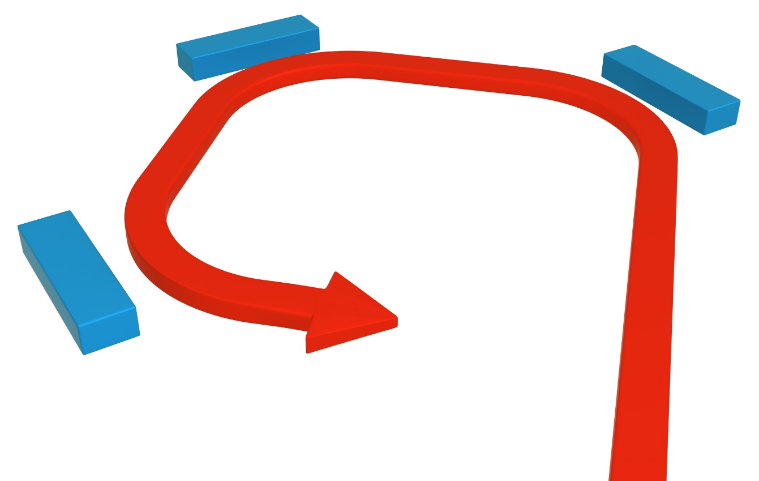
The Old Definition of Resilience
Bouncing Back
Status
quo

Slide 12

The New Definition

Slide 13
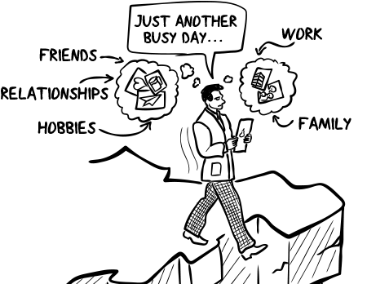
Resilience – important for:
Small things
  Work stress
  Traffic, delays, frustrations
  Everyday challenges
Big things
  Major illness
  Abuse
  Violence
  Tragedies, loss, heartbreak

Slide 14
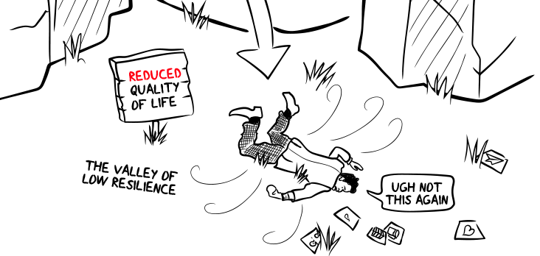
Low resilience:
Even small setbacks feel like disasters
Takes a while to get back on your feet

Slide 15
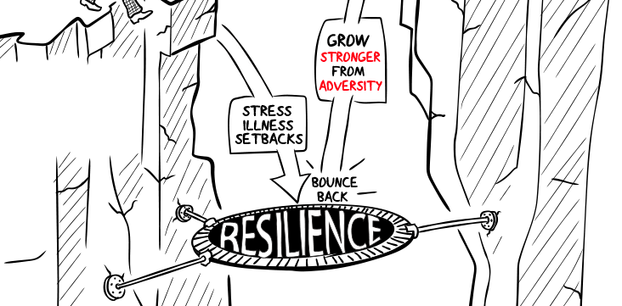
High resilience:
Bounce back from setbacks, then
Use adversity as an opportunity to grow

Slide 16
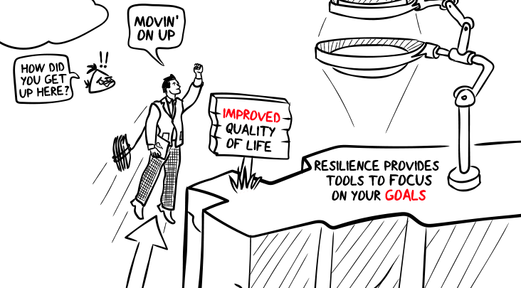
Resilience lets you...
Stay focused on your goals & what is most important
Allows you to always move forward

Slide 17
Important!
Resilience is a skill anyone can learn and develop
No matter your age and stage of life, you can always improve your resilience

Slide 18
Resilience exists across
6 Domains

Slide 19
The Six Domains of Resilience
We will look into each of these
Vision
Composure
Reasoning
Components:
Explore the Basic Needs
Set a Resilient Vision
Identify Goals
Smarter Goals
Components:
Calm Breathing
Mindfulness
Label Emotions
Reappraisal
Components:
Visualisation
Resourcefulness
Explore Beliefs
Embracing Change
Tenacity
Collaboration
Health
Components:
Realistic Optimism
Staying Motivated
Overcoming Mistakes
Time Management
Components:
Support Perceptions
Trust & Likeability
Mentor / Mirror
Better Communication
Components
Health Goals
Quality Sleep
Exercise
Nutrition

Slide 20
Wellbeing is ‘what’, Resilience is ‘how’

Slide 21
Stress and performance

Slide 22
How resilience helps performance

Slide 23
Resilience / Performance Matrix
Avoid burnout, being comfortable, or distress
High resilience allows you to sustain high performance
©2019 Hello Driven Pty Ltd

Slide 24

Neuroscience of Resilience
©2019 Hello Driven Pty Ltd

Slide 25
NEURO: MAIN POINTS
Location Which areas of the brain are involved?
Timing When should we build resilience?
Plasticity What helps for learning?

Slide 26
Location
Key points:
Smart brain and impulsive brain
Increase connection
We need holistic training to develop resilience – training that affects many relevant pathways and processing streams
Which areas of the brain are involved?

Slide 27
Timing
Key points:
Resilience is best developed in advance
Many only seek to build resilience after experiencing trauma – though at that point it is harder to overcome entrenched memories
Building resilience in advance primes the brain to be less emotionally reactive to adversity, promoting a calm and constructive response
When should we build resilience?

Slide 28
Small frequent tasks
= synaptic change
= better retention
A more effective way of learning
Applicable to all types of training

Slide 29
Plasticity
Key points:
Learning and behavioral change relies on physical changes to synapses and neurons in the brain
Small frequent tasks are better for neural change
Talking, writing and drawing activate more neural pathways and help embed learning
This
facilitates
change

Slide 30
More Science: Possible Selves
Imagine yourself as a successful adult
Imagine what you are afraid of becoming
Connect your success version to your present

Slide 31
More Science: Growth Mindsets:
The Tendency to Believe You Can Grow
Acknowledge your weaknesses
View challenges as opportunities
Understand the research on brain plasticity
Learn from failures
Nurture a sense of purpose
Reward actions, not traits
Redefine “genius”
Rely on effort before talent
Be tenacious

Slide 32
We Can Measure
Resilience
And we should
©2019 Hello Driven Pty Ltd

Slide 33
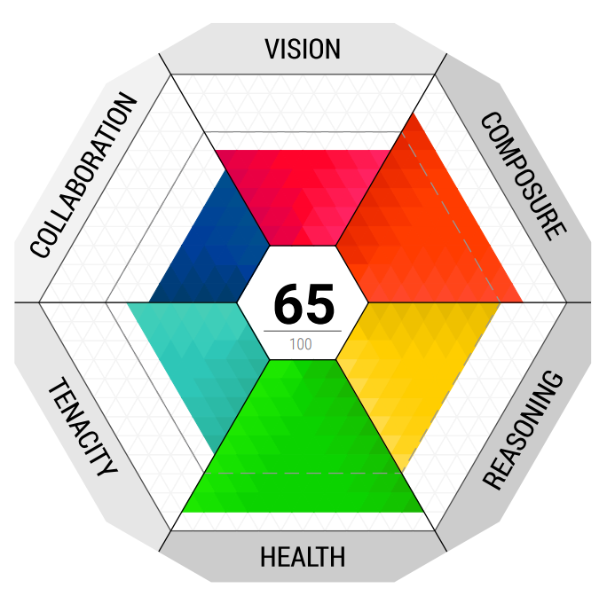
Measurement
Your resilience is measured across the six domains of resilience.
The filled-in area shows your score in that domain, while the middle shows your overall score out of 100.
Vision
Goal orientation, control, self worth, values
Composure
Emotion regulation, patience, stress as a welcome challenge
Reasoning
Problem solving, resourcefulness, ready for change
Health
Exercise, sleep, nutrition, brain health
Tenacity
Bounce back, optimism through adversity
Collaboration
Support networks, working in teams, managing perceptions
Predictive Indicator - Momentum
Indicator of future direction of wellbeing and engagement
©2019 Hello Driven Pty Ltd

Slide 34
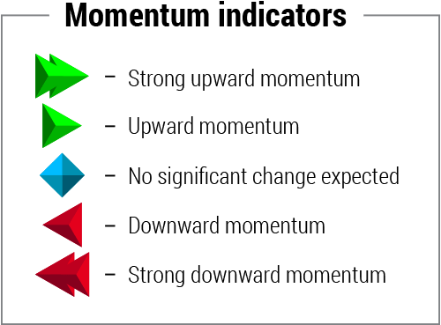
Indicators
A forward-looking measurement
An indicator of potential future resilience
Measures Approach and Avoidance motivation schemas
Affected by all areas of resilience

Slide 35
Resilience:
Vision

Slide 36
VISION
About purpose and meaning
Working towards clear goals
Ability to prioritise effectively between competing goals
Being committed & decisive
Vision motivates to action
The most important of the domains
Basic needs of the brain
Attachment
Control & Orientation
Motivation (pleasure & pain)
Congruence
Have goals, work towards them, see results & don’t have internal conflict

Slide 37
Resilience:
Composure
©2019 Hello Driven Pty Ltd

Slide 38
COMPOSURE
About regulating emotions
Effectively managing stress
Recognising the signs of stress
Increasing emotional granularity
Having strategies to regain composure when stressed or anxious
Interpretation bias
Awareness of own biases
Being open to challenge
Reappraisal
Learning how to reinterpret physical signals (anxiety » excitement)
Use proactively and retroactively

Slide 39
Resilience:
Reasoning
©2019 Hello Driven Pty Ltd

Slide 40
REASONING
About problem solving & critical thinking
Ability to think clearly when facing stress
Being resourceful
Seeing opportunity in change
Ability to challenge own beliefs
Anticipate and prevent
Visualise scenarios & plan for adverse outcomes
Take action to mitigate future problems
Reasoning bias
Recognise thinking style
Manage blind spots

Slide 41
Resilience:
Tenacity
©2019 Hello Driven Pty Ltd

Slide 42
TENACITY
About perseverance
Bouncing back from setbacks
Learn from own successes and experience
Perseverance is more important than intelligence in achieving success
Realistic optimism
Avoid being overly optimistic (impacts motivation)
Avoid pessimism (also impacts motivation)
Realistic sense of hope
Managing mistakes
Accurately analysing mistakes
Avoid self-judgement and focus on learning

Slide 43
Resilience:
Collaboration
©2019 Hello Driven Pty Ltd

Slide 44
COLLABORATION
About support networks
Secure attachment
Willingness to ask for help
Willingness to be support for others
Managing perceptions
Perceived support is more important than actual support
Investing in relationships
Building support networks
Mutually valuable relationships
Mentor relationships
Social context
Recognising behaviour for context
Using humour appropriately

Slide 45
Resilience:
Health
©2019 Hello Driven Pty Ltd

Slide 46
HEALTH
Health
About physical wellness
Foundational domain
Supports a healthy brain & ability to build resilience
Exercise
Promotes long-term brain health (neurodegeneration)
Plus short-term benefits
Promotes BDNF
Nutrition
Fat + sugar is potent producer of serotonin
Affects the brain (BDNF...)
Sleep
Lack of sleep releases cortisol, leads to being impulsive
Quality is more important than quantity

Slide 47
Other Science-Based Resilience Exercises
Storytelling
Language
Reframing
Visioning
Strengths and gifts analysis
Acts of kindness, volunteering, mentoring

Slide 48
Other Science-Based Resilience Exercises
Practice of Gratitude
Three good things
Humor
Silver lining
Mindfulness: body scan, deep breathing
Thought stopping

