Slide 1
RESTORE Building a European Restorative Practices Implementation Plan 16/05/2019

Slide 3
WHO?
Ligand (lead partner, Belgium), Cluj IDA (Romania), CRESM (Italy), Eigen Kracht Centrale (The Netherlands), IIRP Europe (UK), Le Souffle (Belgium), Mairie de Lille (France)
The different project activities are split up in work packages (WP) :
WP Management and coordination Ligand
WP Output 1a Compendium of existing RP Eigen Kracht
WP Output 1b Whole-school RP implementation plan IIRP UK
WP Dissemination CRESM
WP Exploitation of results Mairie de Lille
WP Project evaluation Cluj IDA

Slide 4
Six conversations (Peter Block – asmallgroup.net)
A powerful tool of civic possibility, civic accountability and civic commitment
Increases the power of associations to engage citizens (school staff, students, parents, neighbors, …)
“In order to change the nature of our community, we need to change the nature of our conversations.”
Smallest group of transformation = triad

Slide 5
Six conversations (Peter Block – asmallgroup.net)
Invitation
Possibility
Ownership
Dissent
Commitment
Gifts

Slide 6
Six conversations (Peter Block – asmallgroup.net)
The invitation conversation
What led you to accept the invitation?
Why are you here?

Slide 7
Six conversations (Peter Block – asmallgroup.net)
The ownership conversation
How valuable an experience do you plan this session to be?
What are you prepared to do for this?

Slide 8
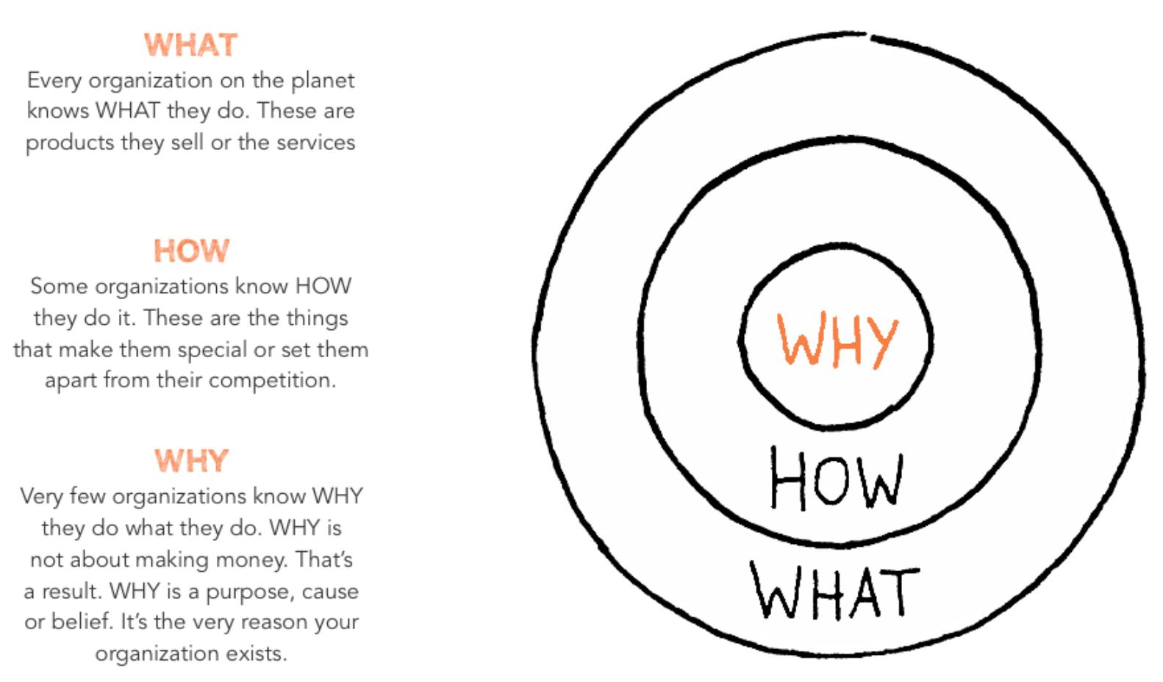
The Golden Circle
“People don’t buy what you’re doing, they buy why you’re doing it.” (Simon Sinek)

Slide 9
WHY?
Students and teachers work best in an environment in which they feel safe, supported and accepted. (…)
A healthy community with strong relationships is a conditio sine qua non for schools that want to tackle today’s and tomorrow’s challenges in an innovative and sustainable way. The use of restorative approaches is supportive to that process. By consistently giving people more voice, more choice and more responsibility, restorative approaches can realize a shift in the culture of an organization. (…)
But to be effective, restorative approaches must be in place across the entire school and till now however restorative practices have only been introduced fragmentarily in schools in Europe.

Slide 10
HOW?
36 month project
An innovative collaboration between training organizations and local authorities located in 6 different EU countries funded by Erasmus+.
Together we design, experiment and assess impact of a transnational “Restorative school change program” that will consist of:
A theoretical framework (vision) with a definition of a restorative school
Strategical implementation guidelines: an implementation model mapping how a school can evolve into a sustainable restorative school, including an ongoing assessment tool which can be used throughout this process
Training to utilization of restorative practices : methodologies and interventions which will be used to implement the theory, to create a restorative school
In other words RESTORE will develop a genuine European Restorative program for schools, inspiring from pioneer experiences (IIRP International Institute for restorative practices, USA) and some advanced countries (UK, BE, NL). It aims at demonstrating the positive impacts of restoratives approaches for improved school climate.

Slide 11
WHAT?
Each partner supports 1 local demonstration school that tests the implementation of the RESTORE program along 18 months.
Several transnational learning activities enable upskilling the partners trainers and leaders from demonstration schools.
Several multiplier events and numerous dissemination activities will engage potential users and beneficiaries and advocate for exploitation of this affordable, accessible and transferable model.

Slide 12
Project RESTORE - TIMELINE
 | YEAR 1
 | sep.-17 | okt.-17 | nov.-17 | dec.-17 | jan.-18 | feb.-18 | mrt.-18 | apr.-18 | mei-18 | jun.-18 | jul.-18 | aug.-18
PROJECTMEETING |  | 9-10 Oct Belgium (Oranjehuis-Ligand) |  |  |  |  | Progress-report 10 march | 26-27 Apr Italy
INTERNATIONAL TRAINING |  |  |  |  | 24-26 Jan Netherl Trainersmeeting C1 |  |  | 28-29-30 Apr Italy (Gibellina): Staff training by Le Souffle C5
LOCAL EVENTS |  |  |  |  |  | RAMPUP LOCAL SCHOOLS
MULTIPLIER EVENTS |  |  |  |  |  |  |  |  | 15 - 16 May France (Lille)

Slide 13
 | YEAR 2
 | sep.-18 | okt.-18 | nov.-18 | dec.-18 | jan.-19 | feb.-19 | mrt.-19 | apr.-19 | mei-19 | jun.-19 | jul.-19 | aug.-19
PROJECTMEETING |  |  |  | 5-6 Dec Romania |  |  | 10 March official interim report |  | 20-21May France (Lille)
INTERNATIONAL TRAINING | 25-26-27 Sept Belgium Leader-shiptraining C2 |  |  |  |  | 27-28 febr 1 march Feb Belgium Restorative conference training C3*
LOCAL EVENTS |  | TRAINING & COACHING SCHOOLS
MULTIPLIER EVENTS |  |  |  |  |  |  |  |  | Multiplier Event hosted by each partner
 |  |  |  |  |  |  |  |  | 15-16-17 Mai IIRP conference

Slide 14
 | YEAR 3
 | sep.-19 | okt.-19 | nov.-19 | dec.-19 | jan.-20 | feb.-20 | mrt.-20 | apr.-20 | mei-20 | jun.-20 | sep.-20
PROJECTMEETING |  |  | 14-15 Nov UK | 15 Dec internal interim report |  |  |  | ?? Apr Belgium (Le Souffle) |  |  | 15 Sept official final report
INTERNATIONAL TRAINING
LOCAL EVENTS | TRAINING & COACHING SCHOOLS
MULTIPLIER EVENTS |  |  |  |  |  |  |  |  |  | 15-16-17 May Belgium (Oranjehuis-Ligand) IIRP conference E2*

Slide 15
Six conversations (Peter Block – asmallgroup.net)
The possibility conversation
What opportunities do you see in this project?
What dreams may come true from this?

Slide 16
A definition
A restorative school is
a safe learning place where everyone involved is empowered to grow together, enjoy life and to feel ownership of themselves and the community, as an ongoing process.

Slide 17
The implementation pathway
Start-up meeting
Pre-loading school
Kick-off day (all staff)
2 day training
basics of RP
for the 'ambassadors'
Professional learning groups
leadership training

Slide 18
 | All staff | Students | Parents | Leadership team | Early adopters | Restorative facilitators
Social discipline window
Typology (simple version)
Conflict escalation
Prevention pyramid
Restorative continuum |  |  | Optional
Affective statements / NVC
Restorative questions
Compass of shame | (PLG)
Fair process
Restorative circles | as appropriate | as appropriate
Proactive circles
Bateson | (PLG) |  |  | more using the model than explaining it
Golden circle (why-how – what)
Attitude (being restorative)
The implementation matrix

Slide 19
Six conversations (Peter Block – asmallgroup.net)
The dissent conversation
What doubts and reservations do you have?

Slide 20
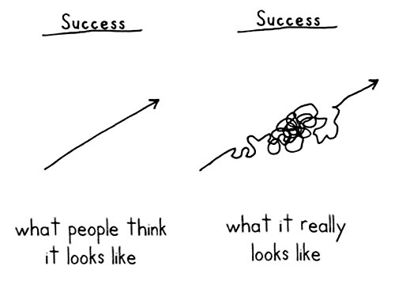
The real implementation pathway
Idea: Simon Sinek

Slide 21
Lessons learned
1 model is an illusion?
“You don’t debate about how noble it is to be a vegetarian with people who are starving.”
Leadership!
Get your hands dirty!
How to start a flywheel?
Climate change takes time
Resistance is natural

Slide 22
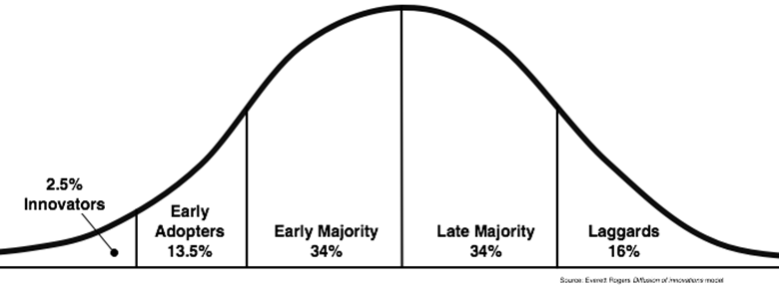
Diffusion of innovation Theory
Source: Everett Rogers
Idea: Simon Sinek

Slide 23
Everybody is a laggard
… it just depends on the subject
Where are you on the curve of diffusion of innovation?
Restorative practices
Smart phones
Instagram/twitter
Zero footprint
…
Think of area in which you are/were a laggard. How do/did you want to be treated? What do/did you need to be able to move?

Slide 24
How to deal with resistance?
Share the why
Listen to needs and concerns, explore people’s fears
Share success stories
Leave space for sceptical voices
Continue to create opportunities to participate
Get them to experience the spirit of RP
Recognize difficulties and failures
Give people time to get used to the new idea
Smooth sales pitches or good news shows result in the opposite
Clear expectations
Be thankful!

Slide 25
The future of RESTORE
From what you have heard …
What feedback can you give us?
Do you have ideas that could further strengthen our model?
How do you envision this implementation tool could look like?

Slide 26
Six conversations (Peter Block – asmallgroup.net)
The gifts conversation
What is a gift you received from someone in your group?

Slide 27
Thank you for being here!
www.restore-project.eu

