Slide 1
Teaching Empathy & Compassion Through the Use of Identity Wheels
Jordan Ferrick & Fabio A. Ayala-Bello
International Institute of Restorative Practices Community Well-Being & Resilience Conference
Kortrijk, Belgium - May 16, 2019
Notes:
Fabio

Slide 2
Agenda
Opening Reflection
Think/Pair/Share Exercise
Social Identity Wheel Facilitation
Training Context
Intro to Social Identity Wheels
Pair Share & Debrief Questions
Continuum Activity
Final Group Activity & Debrief
Closing Synthesis & Brainstorm Session
Notes:
Fabio

Slide 3
Opening Reflection
What is something that inspires hope in you?
SOMEONE IN THE ROOM GETS HOPE FROM…
Notes:
Jordan

Slide 4
Jordan Ferrick
Restorative Justice Outreach & Advocacy Coordinator
Greater Falls Community Justice Center
Bellows Falls, Vermont USA
EDUCATION: International Relations & Global Health (B.A.)
Sustainable Development & Peacebuilding & Conflict Transformation (M.A.)
BELIEF: Creating sustainable communities through restorative practices.
What wakes me up in the morning: there is nothing more exciting and motivating than the thought of a community where there are no police and systems of power, because everyone is supporting one another and holding each other accountable. While this is just a dream, my work is driven with this in mind.
Notes:
Jordan

Slide 5
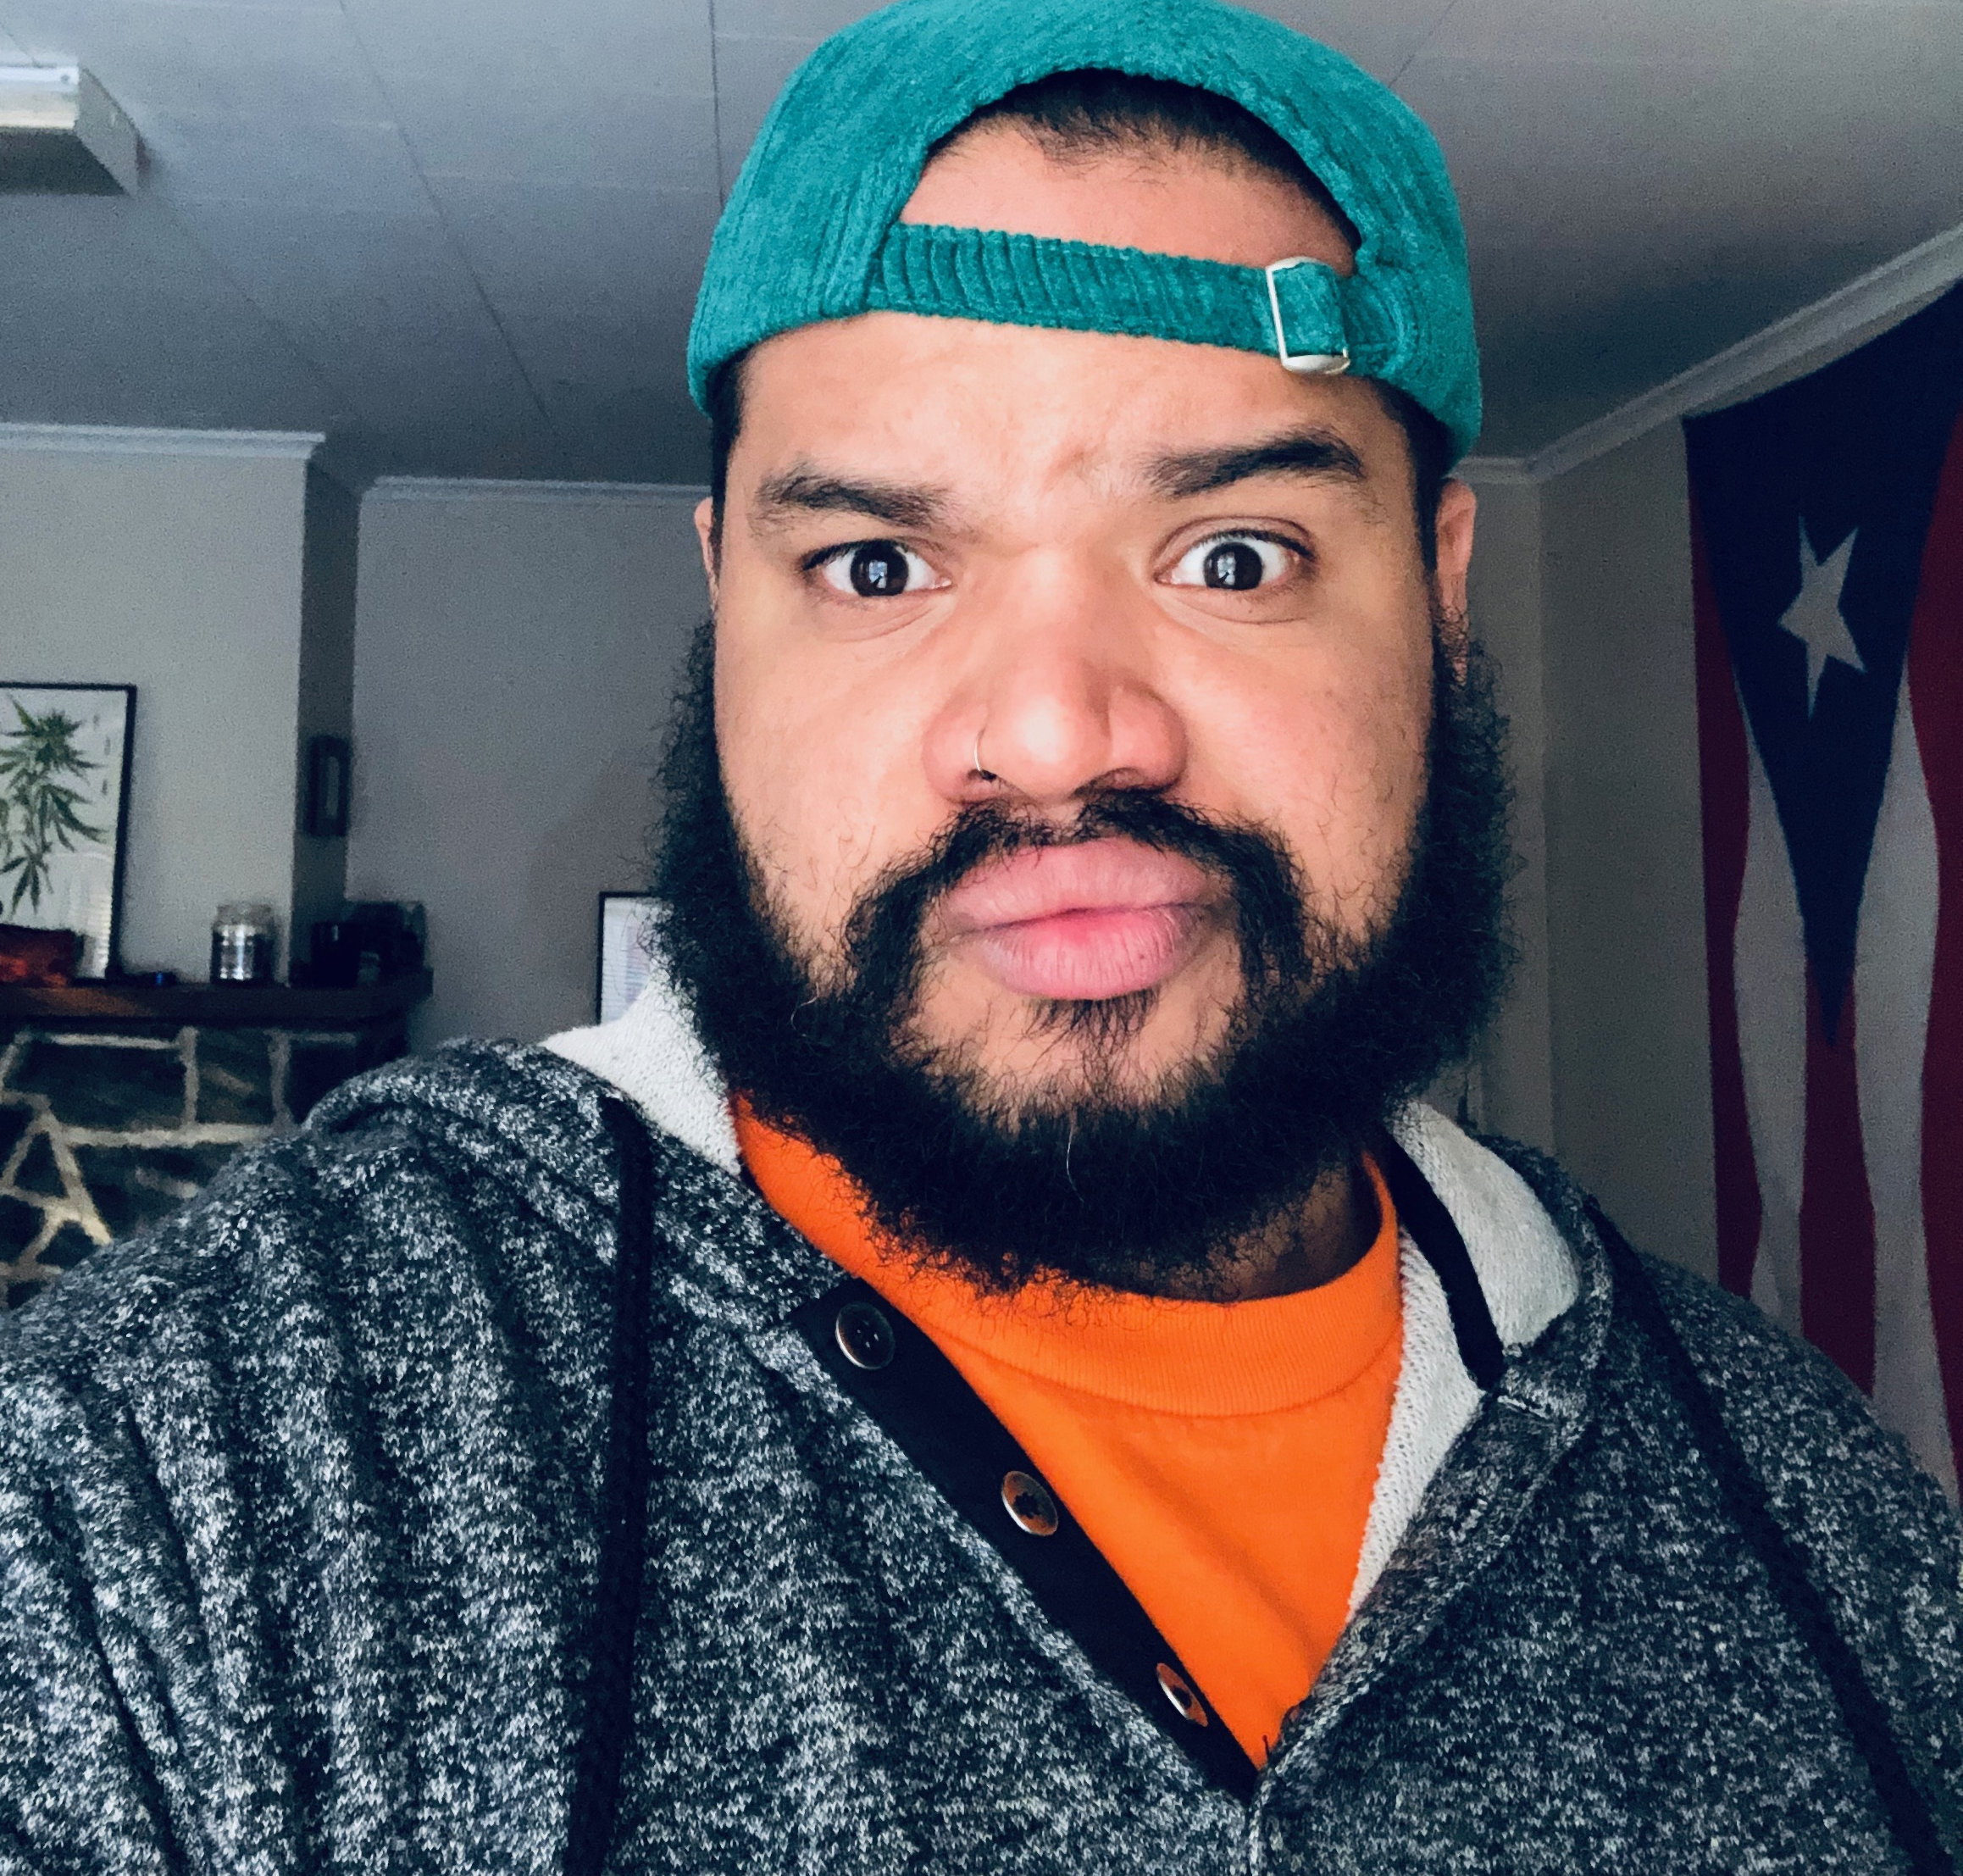
Fabio Arnaldo Ayala
Restorative Justice in Schools Consultant & Conflict Mediator
Greater Falls Community Justice Center
Bellows Falls, Vermont USA
EDUCATION: Spanish Studies (B.A.)
Religious Education (B.A)
Peacebuilding & Conflict Transformation (M.A.)
EXPERIENCE: High School Educator
K-12 School Chaplain
Youth Development Specialist
BELIEF: Restorative Justice & Practices will be effective when it acknowledges, and makes space for, the INTERECTIONALITY of people and communities.
What wakes me up in the morning: The belief that conflict is an opportunity to co-create something new
Notes:
Fabio

Slide 6
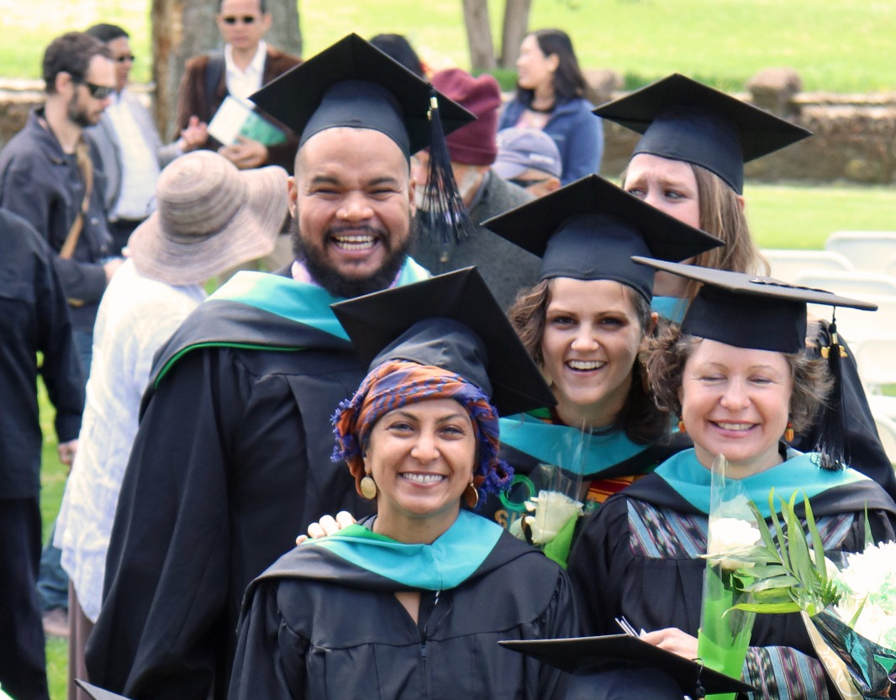
Sustainable Development
Critical Community Engagement
Peacebuilding & Conflict Transformation
Restorative Practices
Notes:
Fabio

Slide 7
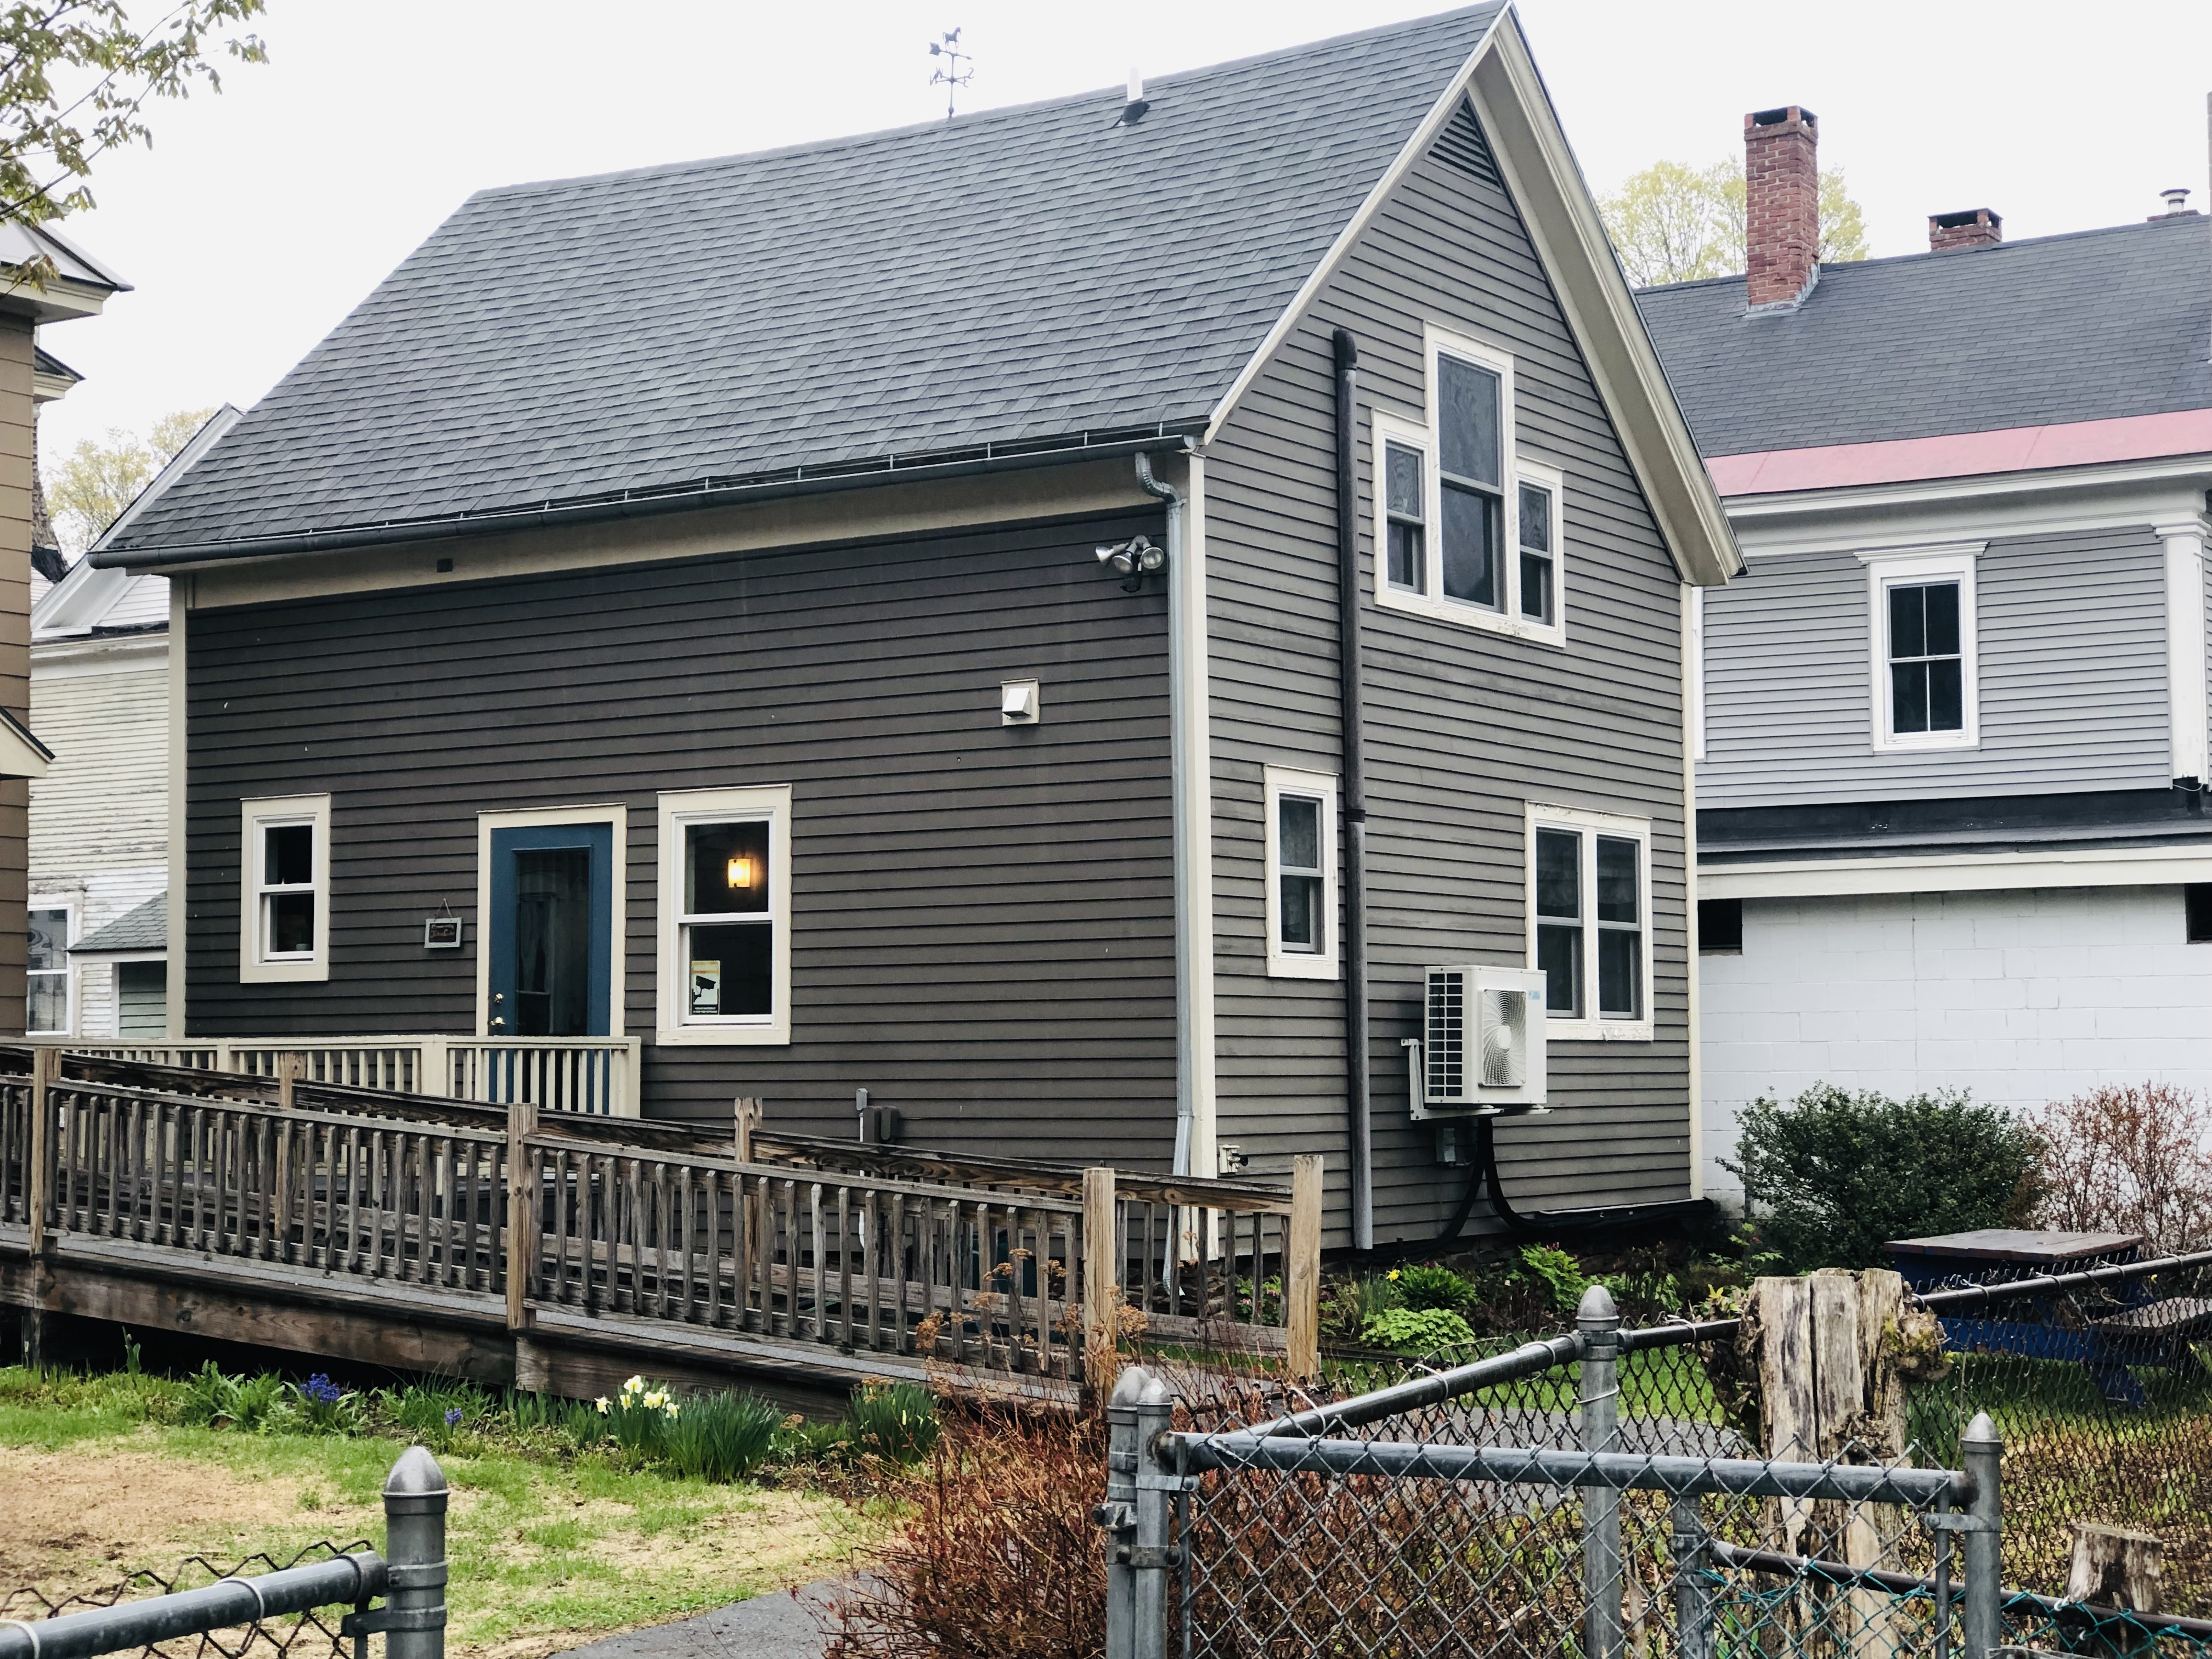
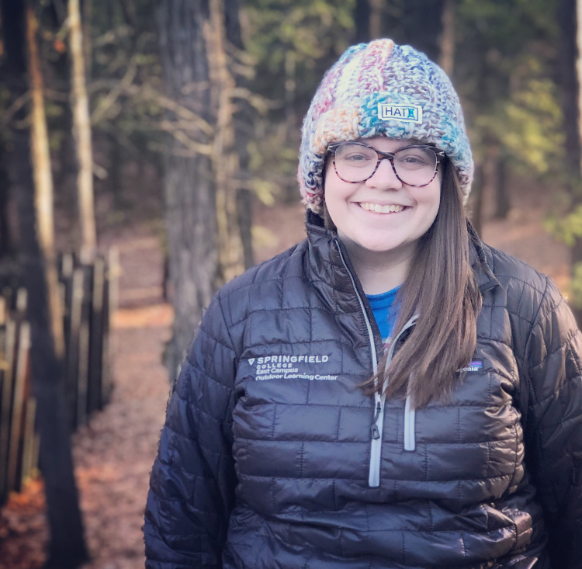
Samia Abbass
Jordan Ferrick
Fabio Ayala
REPARATIVE PANEL COORDNATOR
RJ OUTREACH & ADVOCACY COORDINATOR
RJ SCHOOLS CONSULTANT & CONFLICT MEDIATOR
Becca Jacobson
Mike Malick
Susie Belleci
OUTREACH & EDUCATION COORDINATOR
COSA CORDINATOR
CJC EXECUTIVE DIRECTOR
Notes:
Jordan

Slide 8
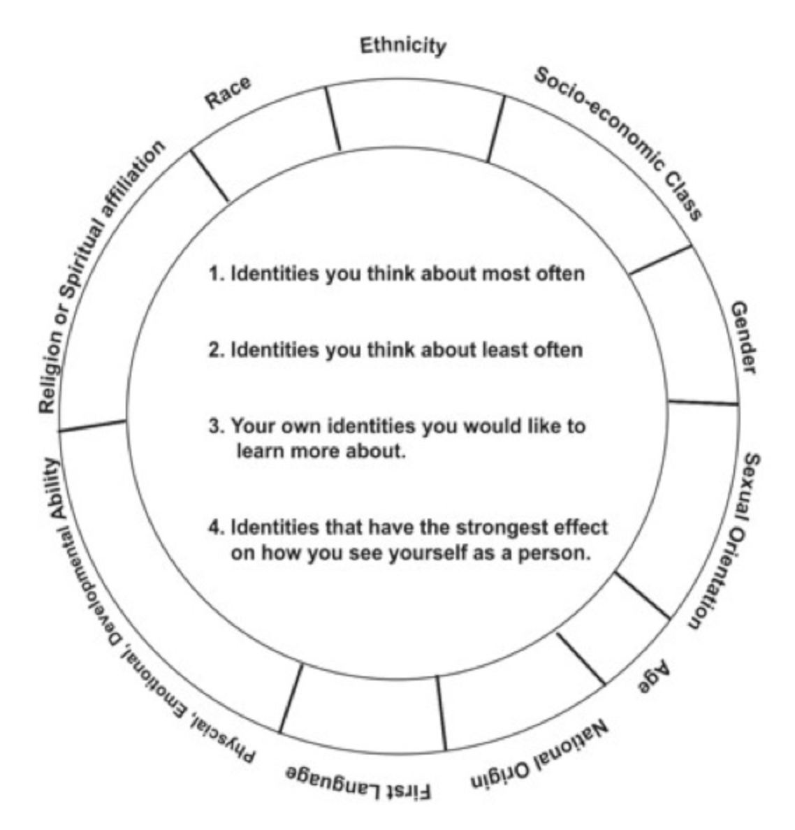
How are we impacted by these identities?
Social Identity Wheels
Race
Ethnicity
Socio-economic Class
Gender
Sexual Orientation
Age
National Origin
First Language
Physical, Emotional, Developmental Ability
Religion or Spiritual Affiliation
Ideologies
Family Roles
Education
Notes:
Fabio

Slide 9
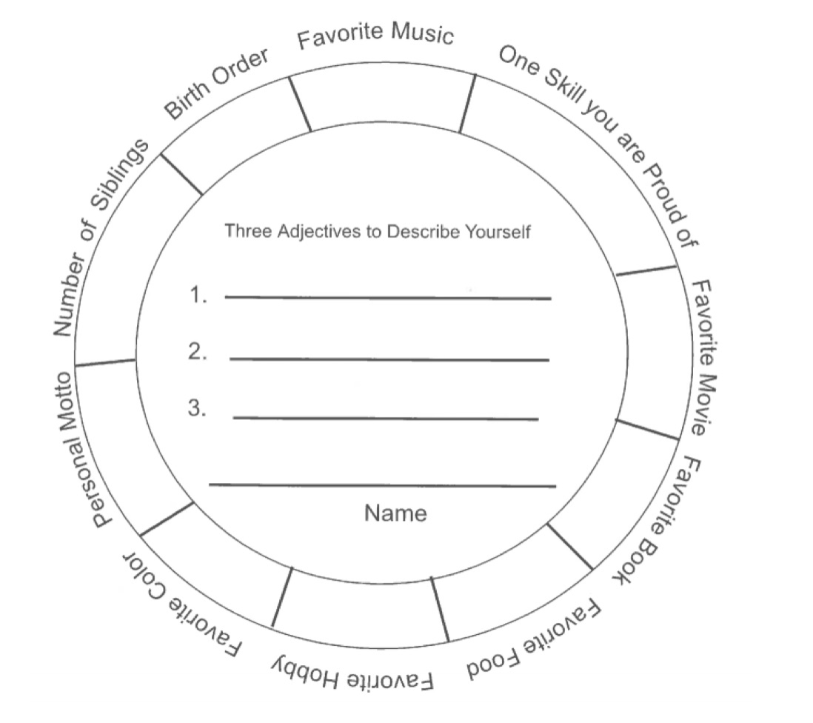
Identity Wheels
Notes:
Fabio

Slide 10
Continuum Exercise
That’s totally me!
That’s sometimes me!
That’s never me!
Notes:
Jordan

Slide 11
Think/Pair/Share
Impartial
Partial
Multi-partial
Conflicting Identities
Fluid Identities
Cross-Cutting Identities
Notes:
Jordan

Slide 12
M.A. Graduate
X
Brown
7th-day Adventist
Black
Feminist Ideology
Cis-Gender Male
Son & Brother
Queer
Middle Class
Fabio Arnaldo
U.S. Citizen
Puerto Rican
X
Spanish Speaker
32 Years Old
Self-Esteem & Depression
2nd Language Learner
Social Anxiety
Notes:
Fabio

Slide 13
Duel Parent Household
M.A. Graduate
White
Mid-Western
Temporarily Disabled
Feminist
Cis-Gender Female
Educated
Middle Class
Jordan
Urban Education
U.S. Citizen
Ambivert
Strong
Sister & Daughter
EBT User (Gov. Assistance)
X
Notes:
Jordan

Slide 14
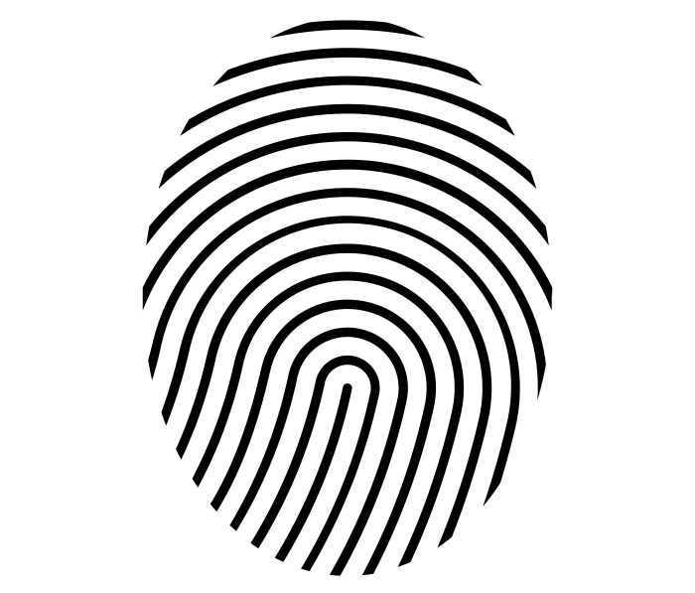
Social Identity Wheels
Now Its Your Turn!
Notes:
Jordan

Slide 15
?
?
?
?
?
?
?
YOU
?
?
?
?
?
?
?

Slide 16
Social Identity Wheels
Race
Ethnicity
Socio-economic Class
Gender
Sexual Orientation
Age
National Origin
First Language
Physical, Emotional, Developmental Ability
Religion or Spiritual Affiliation
Ideologies
Family Roles
Education

Slide 17
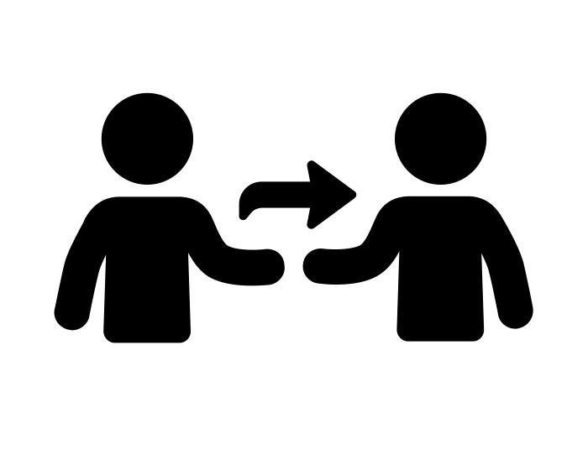
Pair Share
Share the parts of your S.I.W. your comfortable sharing
Discuss what came up for you during this process
Is there anything you forgot and want to add after talking with your partner?
Notes:
Fabio

Slide 18
Debrief Questions
What part or parts of your identity are you most proud of?
Which of your own identities you would like to learn more about and experiment more with?
Which of your identities do you think others quickly recognize?
Which of your identities are you most reluctant to share with other readily? Why?
Where are there any potentially or perceived conflicting identities?
Which of these identities have caused you some pain?
Notes:
Jordan

Slide 19
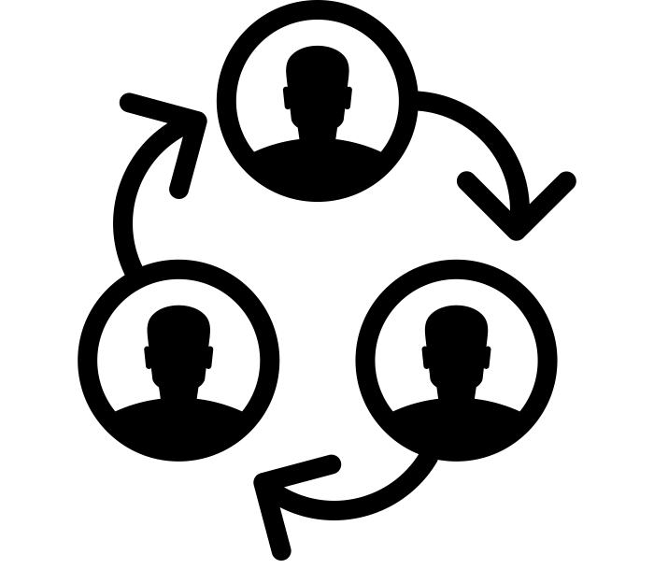
Group Share
Which of these questions were most impactful to your learning?
What were some main takeaways from your pair share?
Notes:
Fabio

Slide 20
Group Activity
Circle your three most salient identities
Put an X on two of these identities
Notes:
Jordan -
What would life be like if you had to conceal those identities from others, from your family, from your friends?
How would you go about hiding those identities from people in your daily life?

Slide 21
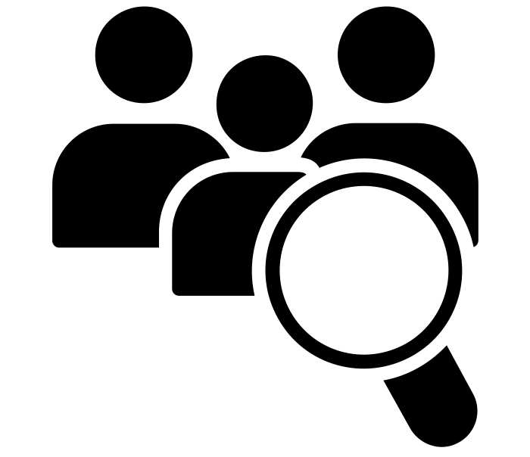
Group Debrief & Brainstorm
Question #1
Question #3
Can you think of any real world examples, from your communities, of people might have to hide a part/s of their identity?
How can making and debriefing identity wheels in groups increase empathy and compassion for others?
Question #2
In what contexts, would you all use this training, and how would you adopt it to meet the needs of the populations you work with?
How can making and debriefing identity wheels increase empathy and compassion for yourselves?
Notes:
Fabio

Slide 22
Closing Quote
The Wellspring lies in our moral imagination, which I will define as the capacity to imagine something rooted in the challenges of the real world yet capable of giving birth to that which does not yet exist.
(John Paul Lederach, Moral Imagination, 2005, p. ix)

Slide 23
THANK YOU!
Please don’t hesitate to contact us with any further questions at:
ferrick.jordan@gmail.com
fabioarnaldoayala@gmail.com

