Slide 1
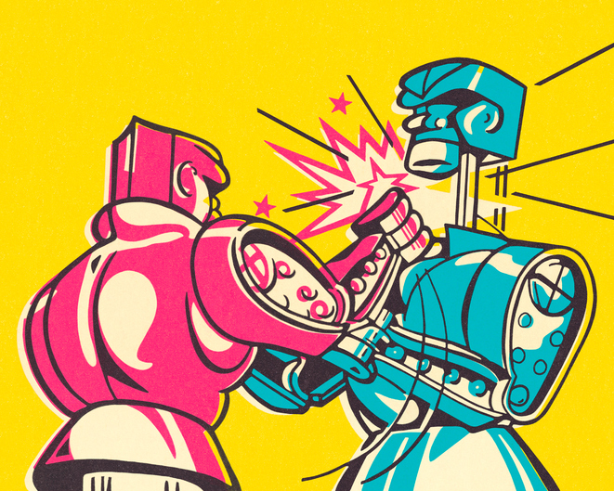
LEADING CONFLICT: HOW TO FIGHT AT WORK
Subscribe at:
WWW.LEADINGCONFLICT.COM
JOHN W BAILIE, PhD

Slide 2
CONFLICT: LOVE IT AND LEAD IT
“We generally want to keep the peace and seek to put out interpersonal fires – not walk into them or set them alight.”
“Real conflict, the truly useful kind, is messy, chaotic and can be scary. But within the roots of conflict lie the life blood of creativity, possibility, self-knowledge and group evolution.”

Slide 3
“The highest performing groups learn that they need group members who are willing to lead conflict – not just manage it or resolve it.” “Instead of settling for the immediate gratification of conflict avoidance, high-performing teams sacrifice short-term peace for long-term health and performance.” “Creative conflict is rooted in the dynamics between people.” “Toxic conflict, on the other hand, is typically rooted in the personalities of individual people.”
CREATIVE VS TOXIC CONFLICT AT WORK

Slide 4
WHY YOU NEED MORE FIGHTS AT WORK
“Learning how to “fight” at work is not about behaving badly, being hurtful or causing chaos for its own sake. It is about knowing how to lead others through the chaos of interpersonal conflict and find meaning, creativity and growth in the mess.”
“You need more “fights” at work because most conflicts are avoided when they are at the stage at which a mild treatment might prevent a nasty infection. You need more small conflicts that are effective, creative and short in duration.”

Slide 5
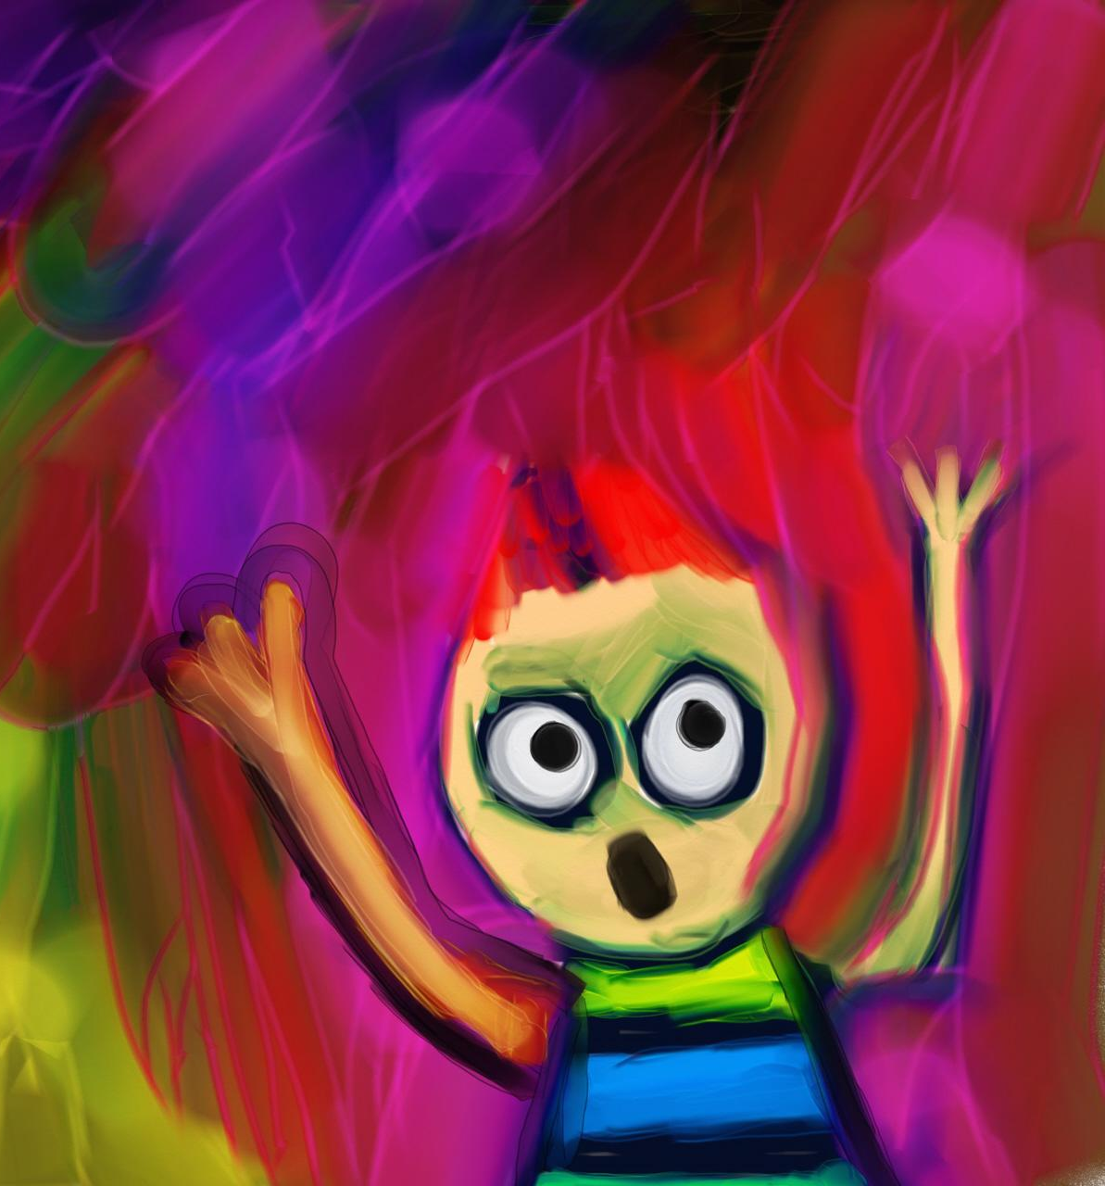
MOVE TOWARD FEAR: PRINCIPLE 1
“You must develop the unnatural habit of moving toward fear, not away from it.”
“The experience of conflict always involves some measure of fear and discomfort. It is learning how face and use that fear that, at a certain level of expertise, can provide meaningful positive experiences. You can’t eliminate the fear, but you can ensure that it is not your master.”
“Don’t fight fear. Make friends with it. Learn how it works in your body and what it is trying to tell you when it happens. Fear, properly utilized, is a wise advisor – not a dictator.”
”Perfect the small habit of pausing, reflecting and not running away from the fear. Then, take one or two immediate actions that take you closer to what happened instead of running from it. “

Slide 6
THERE’S NO NICE WAY TO POKE SOMEONE IN THE EYE: PRINCIPLE 2
“Its not supposed to feel good or comfortable.”
“Feedback often fails to make an impact or change behavior because its overly diluted.”
“Wrapping feedback in cautious niceties only helps the giver, not the receiver.”

Slide 7
EMBRACE THE SUCK: PRINCIPLE 3
“Whether on a road march, in an ultra-marathon, processing grief, or leading conflict, success begins with accepting that the process includes suffering. The more you can accept that and embrace it, the better you will do.”
“These things do not feel good. You don’t do them because they are pleasurable. You do them because they need to be done. And being the rare person who can do these things is very satisfying. That’s what you are working toward.”

Slide 8
TOXIC BEHAVIOR PROFILES: THE SUBMARINE
“The submarine lowers morale, undermines plans and decisions, and creates silent factions in the team.”
“Do not play the submarine’s game by going into the silent deep with them. They are better at fighting from the shadows than you are – and generally willing to play much dirtier.”
“Do… As soon as you suspect a submarine is at work, you must make its presence known publicly and keep it on your radar. Use team meeting time to talk about the responsibility to raise concerns openly and with the person who can do something about it.”

Slide 9
CREATIVE STRATEGIES: STAY IN THE PROBLEM
“The real danger is not that our relationships will completely fall apart. That is actually quite rare. The real danger is that, in response to the emotional tension surrounding conflict, we resolve things too soon.”

Slide 10
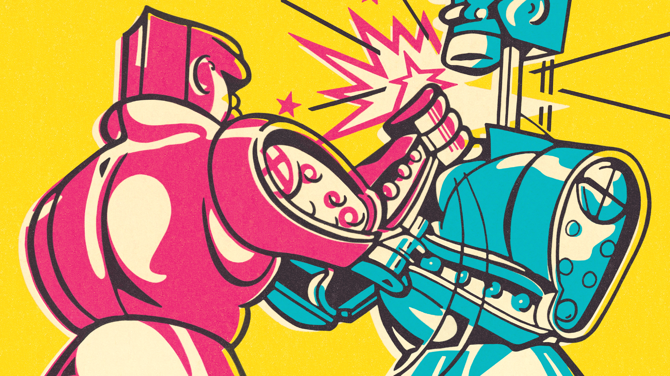
LEADING CONFLICT: HOW TO FIGHT AT WORK
Subscribe at:
WWW.LEADINGCONFLICT.COM
JOHN W BAILIE, PhD

