Slide 1
Promise and Pitfalls of Restorative Practices for Promoting Positive School Climate and Youth Development
Is everything OK?
What happened?
How did it happen?
Joie Acosta
May 15, 2019
1:10-2:00pm
How do you feel now?
Who got hurt?

Slide 2
Agenda for today’s presentation
Describe the unique features of IIRP’s Restorative Practices Intervention (RPI)
Report the design and findings from the first two randomized controlled trials of RPI
Share lessons learned and implications for practitioners and researchers

Slide 3
Flow for IIRP Restorative Practices Intervention
Year 1 reflection and Year 2 planning meetings with Leadership Teams
Monthly PLG meetings & consultation calls with Leadership Teams continue
Monthly PLG meetings & consultation calls with Leadership Teams
Summer │ │ │ │ │ │ Summer │ │ │ │ │ │ │
Initial RP training for schools and formation of Professional Learning Groups (PLGs)
Additional training for schools on balance of RP elements
Sustainability and data review with Leadership Teams
Mid-year review with Leadership Teams at schools
Mid-year review with Leadership Teams at schools
Actual tasks/timeline vary by school

Slide 4
Features of IIRP Restorative Practices Intervention
Encourages free expression of emotion through training in practices such as affective statements and questions to promote communication
Alternative to punitive approaches often used by schools (e.g., zero-tolerance disciplinary policy)
Minimizes negative affect through responsive practices to specific offenses to help youth take responsibility and reintegrate into community
Maximizes positive affect through proactive practices (e.g., restorative circles) to build closer bonds among youth

Slide 5
Conceptualization of IIRP Restorative Practices Intervention
Positive youth development
11 essential practices
Improved school environment

Slide 6
Study 1: Maine
Evaluation of a Whole-School Change Intervention
Two-Year Cluster Randomized Trial of the Restorative Practices Intervention
by Joie Acosta, Matthew Chinman, Patricia Ebener, Patrick S. Malone, Andrea Phillips, & Asa Wilks
May 2019, Volume 48, Issue 5, pp. 876-890

Slide 7
Randomized controlled study design
14 middle schools
7 treatment schools
RPI for 2 years
7 control schools
RPI after 3 years on wait list

Slide 8
Surveyed 416 staff and 2,834 students
Student characteristics
Staff characteristics
 | Control N=1,832 | Treatment N=1,002
Age [M(SD)] | 11.52 (0.70) | 11.47 (0.62)
Grade 6 | 48% | 49%
Grade 7 | 52% | 51%
Female | 50% | 48%
Hispanic | 3% | 4%
Non-white | 18%* | 20%*
 | Control N=210 | Treatment N=206
Classroom teacher | 69% | 70%
Administrative | 3% | 5%
MH professional | 5% | 7%
Ed tech | 17% | 15%
Student/teacher support staff | 3% | 2%
Non-teaching staff (e.g., nurse, librarian) | 3% | 2%
*significantly different at p<.05

Slide 9
Examined outcomes before and for two years after RPI was implemented
1
2
How well did schools
implement RPI ?
  Data Sources:
    Surveys of staff and students
    Fidelity observation data
Did RPI implementation influence the school environment?
  Data Sources:
    Observations using the Youth Program Quality Assessment

Slide 10
Examined outcomes before and for two years after RPI was implemented
3
4
Did RPI affect staff perceptions
of school climate?
  Data Source: Staff survey
    Student input
    Positive peer interactions
    Teacher support
    Safety problems
    Classroom control
Did RPI affect student
outcomes?
  Data Source: Student survey
    school climate
    school connectedness
    peer relationships
    social skills (assertion, empathy)
    bullying victimization (physical, verbal, cyber)
    academic achievement
    suspension rates

Slide 11
How well did schools implement RPI?
1
Fidelity varied by practice, but was generally high
Did not change from Y1 to Y2
But most circles failed to reach a successful resolution
Inter-rater reliability for observations ICC=.71.
Notes:
Need to check the overall success of resolution.

Slide 12
How well did schools implement RPI?
1
Teachers self-report showed significant improvement (Y1-Y2)* in their:
  Use of affective statement, discussion of restorative practice, informal use of restorative questions, and encouraging people beyond shame response (Past 60 day)
  How well they were using two specific practices: restorative questions and small impromptu conferences
But only about 1/3 of teachers reported using restorative practices more frequently over time
  29% for proactive circles
  32% for responsive circles
*Estimated probability of change from Y1 to Y2 P< 0.01

Slide 13
How well did schools implement RPI?
1
Wide variability in student experiences of restorative practices within treatment schools (i.e., some receiving RPI, some not)
Student self-reported experience of restorative practices (Year 2)
Treatment students
Number of students
Low RP
High RP

Slide 14
How well did schools implement RPI?
1
Student experiences of restorative practices did not significantly differ between treatment and control schools
Student self-reported experience of restorative practices (Year 2)
Control students
Treatment students
Number of students
Number of students
Low RP
High RP
Low RP
High RP
Notes:
Got our Restorative Practices in Maine collaborative that may have affected the control schools.

Slide 15
Did RPI implementation influence the school environment?
2
No significant impact on whole school environment
  No differences between treatment and control schools
  No change in whole school environment over time
School Level Environment (youth Program Quality Assessment Scores

Slide 16
Did RPI affect staff perceptions of school climate?
3
Staff Perceptions of School Climate
No significant differences

Slide 17
Did RPI affect staff perceptions of school climate?
Implementation
Restorative Staff Community
School Climate
3
Within treatment schools, SEM mediation* found that Restorative Staff Community mediated the influence of implementation on climate
Teachers who reported doing more restorative practices had significantly more positive perceptions of two domains of school climate: (1) clarity/consistency (p=.006); (2) teacher support (p=.046)
*Using delta method standard errors (aka the Sobel test) and accounting for clustering

Slide 18
Did RPI affect student outcomes?
4
Intent to treat analyses found no significant differences between students in control and treatment schools on:
  perceptions of school climate
  school connectedness
  peer relationships
  social skills (assertion, empathy)
  bullying victimization (physical, verbal, cyber)
  academic achievement
  suspension rates
Wide variability in student experiences (i.e., some receive RP, some not)
I deleted the last line because it’s on the next slide: Better outcomes observed among students who experienced more RP

Slide 19
Did RPI affect student outcomes?
4
Better outcomes for students who experienced more RP
 |  | Amt per SD | SE
School climate | Clarity/ consistency** | 0.33 | 0.04
 | Teacher support** | 0.42 | 0.03
 | Positive peer relations** | 0.23 | 0.01
 | Student input** | 0.38 | 0.02
School connectedness** |  | 0.39 | 0.03
Peer attachment** |  | 0.29 | 0.05
Social skills | Assertiveness** | 0.36 | 0.06
 | Empathy** | 0.24 | 0.03
Bullying | OR | CI (L,U) | Amt per SD
Physical | 0.87 | (0.74, 1.01) | -0.15
Verbal | 0.86 | (0.62, 1.20 | -0.15
Cyber** | 0.77 | (0.66, 0.91) | -0.26
**significant at p<.01

Slide 20

Study 2: Pittsburgh
Can Restorative Practices Improve School Climate and Curb Suspensions?
An Evaluation of the Impact of Restorative Practices in a Mid-Sized Urban School District
by Catherine H. Augustine, John Engberg, Geoffrey E. Grimm, Emma Lee, Elaine Lin Wang, Karen Christianson, Andrea A. Joseph
Available at www.rand.org/t/RR2840

Slide 21
Randomized controlled study design
44 schools (K-12)
22 treatment schools
RPI for 2 years
22 control schools
RPI after 2 years on wait list

Slide 22
Pursuing Equitable and Restorative Communities (PERC) study schools spanned all grade levels
Grade Configuration | Number of Treatment Schools
K–5 | 11
K–8 | 4
6–8 | 4
6–12 | 2
9–12 | 1
Total | 22

Slide 23
RAND surveyed more than 600 staff at treatment schools and got district data on 11,000 students across schools
Staff characteristics
Variable | Unweighted Respondents | Weighted Respondents | All PERC Staff | Standardized Difference
Female | 77% | 75% | 72% | -0.063
Male | 23% | 23% | 26% | 0.066
White | 82% | 76% | 72% | -0.073
Black | 15% | 20% | 23% | 0.080
Other race | 3% | 3% | 3% | 0.001
Years in district | 11.2 | 11.7 | 11.8 | 0.016
Classroom Teacher | 74% | 65% | 61% | -0.088
Direct student staff | 20% | 22% | 21% | -0.019
Indirect student staff | 6% | 12% | 17% | 0.123
Attended IIRP training | 88% | 83% | 80% | -0.079

Slide 24
Examined outcomes before and after PERC was implemented
1
2
How was PERC implemented?
  Data Sources:
    Surveys of staff (twice)
    Interviews of IIRP coaches and district leaders
    Four case study schools
      Observed 180 circles and conferences
      Interviewed 66 staff
2. Did PERC affect school climate?
  Data Sources:
    Surveys of staff (twice)
    Attendance records

Slide 25
Examined outcomes before and after PERC was implemented
3
5
Did PERC affect classroom
climate?
  Data Source: Student survey
    Overall classroom climate
    Teachers classroom management
    In-class peer support
Did PERC affect schools’ approach to suspension?
  Data Source: Disciplinary records
    Suspension rates by offense
    Repeat suspensions
    Race/income
    Transfers to alternative schools
    Arrests
4
Did PERC affect academic achievement?
  Data Source: Assessment scores

Slide 26
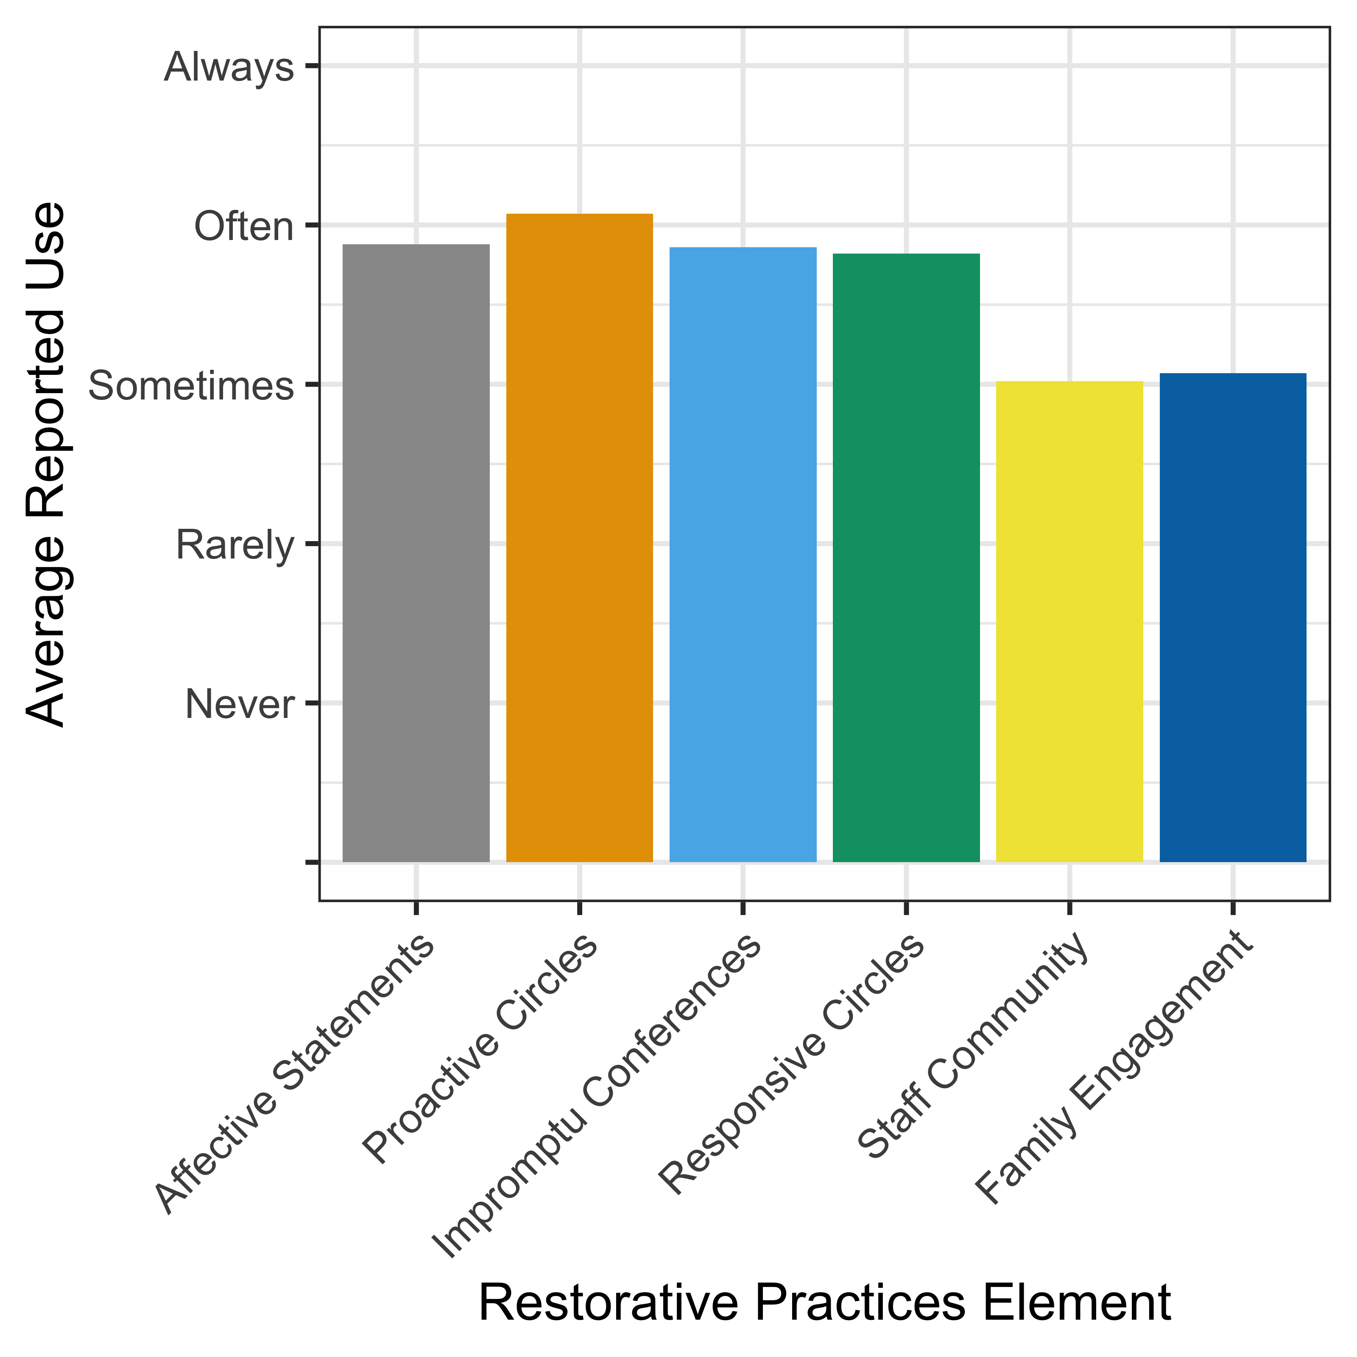
How was PERC implemented?
1
Most aspects of RPI were well implemented
Buy-in was relatively high overall (around 3.0 average both years)
Use was highest in elementary grades but increased significantly in middle and high schools from Year 1 to Year 2

Slide 27
Did PERC affect school climate?
2
Staff perceived a more positive climate in PERC schools than in control schools
PERC staff reported stronger relationships with students because of restorative practices
PERC reduced absences among elementary students

Slide 28
3. Did PERC affect classroom climate?
3
Students in PERC schools rated as worse:
  Overall classroom climate
  Teachers’ classroom management
  In-class peer support
But based on exploratory analyses, student survey results were no worse
if the teachers reported being ‘high users’ of restorative practices

Slide 29
Did PERC effect academic achievement?
4
The combined math/language arts/science assessment score for grades 7-8 worsened
Math scores for the state assessment in grades 3–8 worsened
PERC had a negative impact on achievement for both black and white students at schools that are predominantly black

Slide 30
Did PERC affect schools’ approach to suspension?
5
Overall, there was a 16% reduction in days of instruction lost to suspension
PERC schools had:
  Decreased days of suspension
  Reduced rates of repeat suspensions
  Reduced disparities by race and by income*
  Reduced transfers to alternative placement schools
Impacts were driven by elementary grades
  No decreases for grades 6-8
  No decreases in violent behavior/arrest for MS/HS students
  *But not by IEP status or by gender

Slide 31
Promises and Pitfalls?

Slide 32

Restorative practices, if used consistently, hold promise for improving both positive development and reducing problem behaviors

Slide 33
RPI can have positive impacts on school climate and suspension disparities, particularly at the elementary level

Slide 34
Implementation quality varied and teachers/staff wanted more support than RPI provided
Notes:
Unclear guidelines on what they should be doing and how
often
Limited implementation tools
Limited implementation support (based on established implementation theory)

Slide 35
RPI, as designed and supported, may not work for all schools
Notes:
Unclear guidelines on what they should be doing and how
often
Limited implementation tools
Limited implementation support (based on established implementation theory)

Slide 36
  Schools need more intentional implementation
Leadership needs to encourage adoption and hold teachers accountable (e.g., make training of leadership required)
  Consultation model could be more intensive and include more specific guidance on implementation (targets, tools, etc.)

Slide 37
  More research is needed
  Need more creative ways of capturing dose, given nature of interactional intervention
  Unclear what all the barriers were to diffusion and need to understand more on how to maximize uptake

Slide 38

We must teach our children to resolve their conflicts with words, not weapons.
President Bill Clinton

Slide 39
Acknowledgements
Staffing
  Maine: Pam Anderson, Margaret Micolichek, Chuck Saufler, Ansley Newton, Susan Savell
  IIRP: John Baile, Mary Jo Hebling, Sharon Mast, Keith Hickman
  Rutgers: Anne Gregory, Josh Korth
  Pittsburgh Public Schools
Funding
  National Institute on Child Health & Human Development: Reducing Problem Behaviors Through PYD: An RCT of Restorative School Practices (1R01HD072235-01A1). Acosta, PI
  National Institute of Justice

Slide 40
For more information
Joie Acosta, Ph.D.
Senior Behavioral Scientist
RAND Corporation
Email: jacosta@rand.org
Phone: 703-413-1100 x5324

