Slide 1


measuring & improving fidelity to restorative justice implementation: sharing a comprehensive tool dr. sonia jain principal/ceo at data in action, llc
October 26, 2018
IIRP, Strengthening the Spirit of Community
Notes:
This is last year of VRP. Need to show results.
Need for more Structure while being true to the process
Fidelity Tool – adds structure.

Slide 2
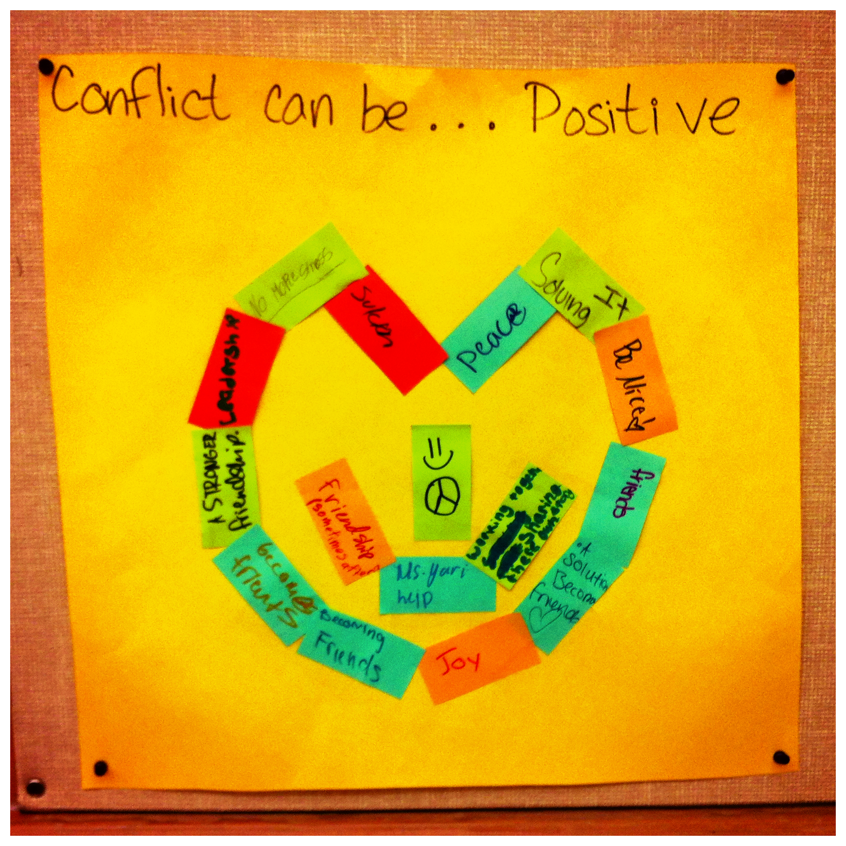
objectives
To define fidelity and why it’s important to measure
Name 3 key dimensions of RJ Fidelity to Implementation Checklist
How fidelity data can be used
Workplan template
Notes:
Why important to measure – continuous quality improvement, and accountability. Results-based accountability! Is the framework we’ll be using for RJ Evaluation.

Slide 3





Data is….
“Maybe stories are just data with a soul” - Brene Brown
Drag
Informative
Confusing
Empowering
Validating
Fun/Sexy
Notes:
A photograph! A video! Information!
Evaluation is the ability to use data to tell your story! Rigorous designs

Slide 4
Background
Disciplinary practices NOT working.
Disproportionality, School to Prison pipeline.
Growing recognition for RJ practices and policies as an alternative to suspension, school climate efforts and successful reentry
Evidence documenting implementation and effectiveness of still scarce.
  Tools, benchmarks and data around tier-specific practices are limited.
School wide implementation requires Professional Development, Leadership Support, referrals system, and IMPLEMENTING PRACTICES WITH HIGH FIDELITY AS INTENDED.

Slide 5
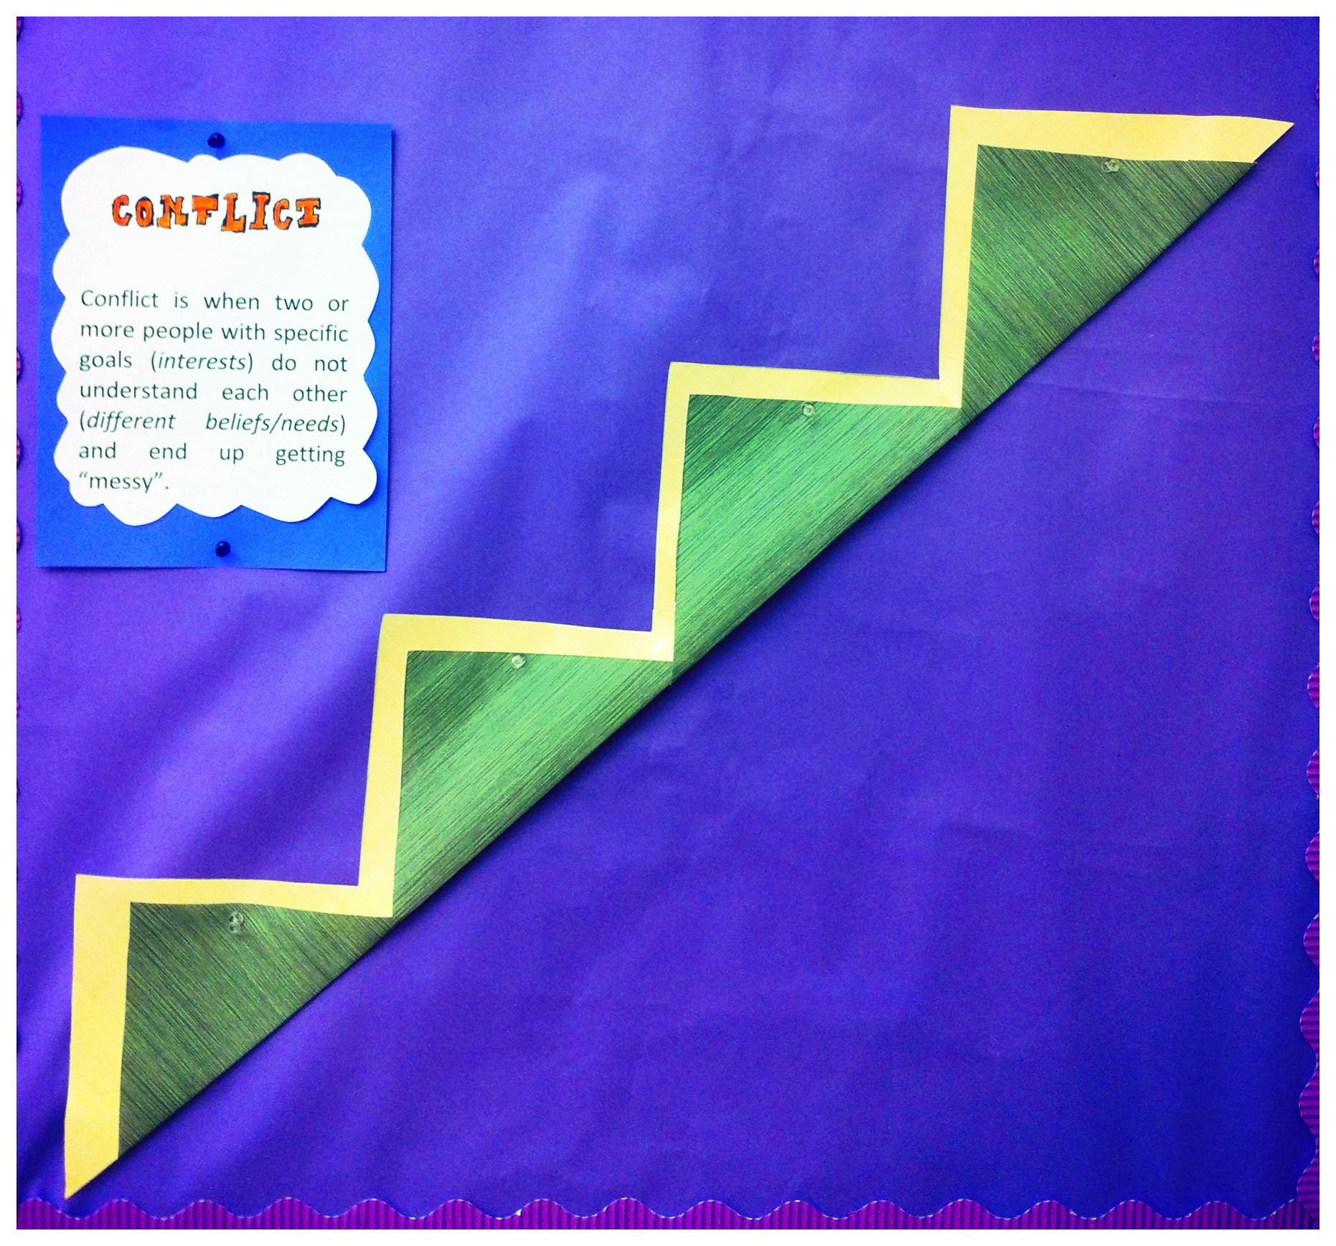
Have you reached your goals?
Restorative justice Goals
To build positive culture and climate
  Q. How do you know you are building caring community?
To reduce harms and conflicts
To re-integrate
To engage students, staff and parents
To reduce racial disproportionality in suspensions…
Notes:
Anything missing in these goals?
List year of the VRP. Can’t make excuses. Need to show results. Suspensions and disproportionality. Responsibility!
Performance measures… time

Slide 6
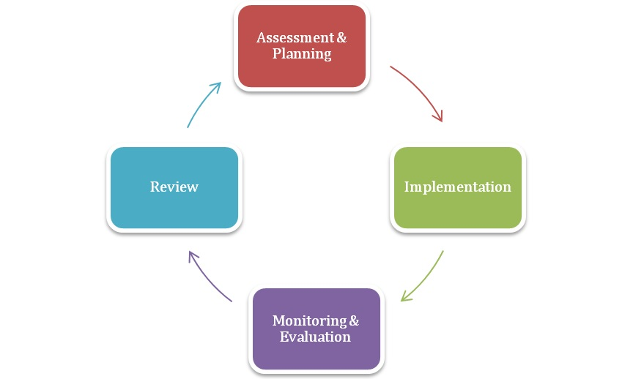
Program Planning Cycle

Slide 7
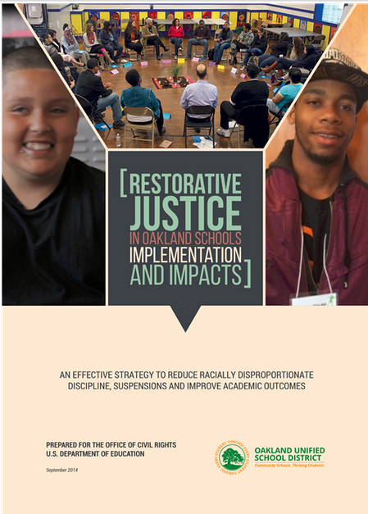
Purpose of RJ Evaluation – Oakland USD
To describe the students and staff served by RJ
Describe how participants experience and use RP
Determine outcomes of students served by multi-tier practices.
Examine the implementation and development of RJ in schools—to assess fidelity to core principles,
Measure effectiveness of program in reaching
the set goals and objectives.
Data are critical for sustainability!
Notes:
Could take out this slide
7

Slide 8
Examples of tools
Web-based data collection, scoring and reporting (dashboard)
Collection and reporting of monthly
Surveys
Fidelity of implementation measures
Observation
Objective measures (document reviews)
Self-report measures
Must be easy and quick to complete, Burden of data collection minimum, Prioritize meaningful outcomes

Slide 9
Results-based accountability framework
Q2. How WELL are you doing it?
Quality, Satisfaction, Knowledge/skills gained
RJ Fidelity to Implementation Checklist
Year-end Implementation Survey
Training Evaluation Forms…
Q1. How MUCH are you doing?
Counts, # Students
Source: RJ Dashboard, COST
Q3. IS ANYONE BETTER OFF?
OUTCOMES – SUSPENSIONS, ACADEMIC PERFORMANCE, RELATIONSHIPS
Aeries, California Healthy Kids Survey, California School Climate Survey, RJ Implementation survey …
Notes:
Data to evaluation
Larger evaluation framework
History – Fetterman from stanford. Not used in RJ much but a very simple powerful framework to show results.
Tries to answer 3 questions using qualitative and quantitative data

Slide 10
What is implementation Science?
“the study of the process of implementing evidence-based or promising programs and practices. It is not validation of EBP. “
“Most importantly, because even if the intervention or practice has been demonstrated to be effective by research, if it is not implemented properly or without sufficient fidelity to the established model… IT WILL LIKELY FAIL”
Adapted from Robert P. Frank, Connecticut Center for Effective Practice

Slide 11
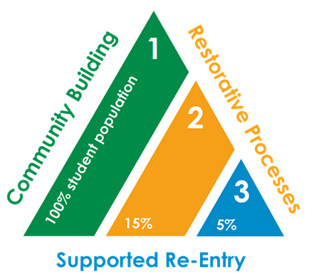
Six Stages of Implementation
(Fixsen et al, 2005)
Exploration
  Identify need, assess fit, prepare
Installation
  Resources used in prep
Initial Implémentation
  Change must occur at multiple levels (e.g., practice level, supervisory level, administrative level)
  Typically this change is met with much anxiety and at times, resistance
  Missteps may occur
  A supportive organizational environment key to success

Slide 12
Six Stages of Implementation con’d
4. Full Implementation
  New learning is integrated into practitioner, organizational, and community practices, policies, and procedures.
  Full staffing, full client loads, all realties of “doing business” in place.
  The destination (new program) should approximate that of the source (original program) with fidelity.
  Typically takes 2-4 years (3-5 years per RJ staff).
5. Innovation
  Sufficient fidelity to the model, but adapts to ecology of destination site to achieve successful implementation, not drift.

Slide 13
6. Sustainability
After initial implementation new program must be maintained with sufficient fidelity to the model
Turnover of staff must be successfully addressed
Policies must support sustainability of program including governance and funding
Must be adaptable to shifting ecology of the environment

Slide 14
Benefits Of Using Implementation Science
Possible to examine change over time
Possible to identify drivers of change and factors that influence outcomes
Research can have real value for “real world” application of best practices
Else researcher can draw erroneous conclusions, not conducted within the context of implementation (misinformed)

Slide 15
Challenges with operationalizing implementation science
Good validated measures do not exist
Stages may vary by type
Implementation factors often need to be measured repeatedly and continuously (not point A to B).
Researchers not adequately prepared

Slide 16
Rj School summaries
Purpose
Annually
Format
How does your school perform against district and program expectations? Specific changes to make?

Slide 17
Q1. How much are you doing?
COUNTS
WHO, WHAT, WHERE, WHEN
Source: RJ Dashboard, COST
Example Graph.
Notes:
David covered!

Slide 18
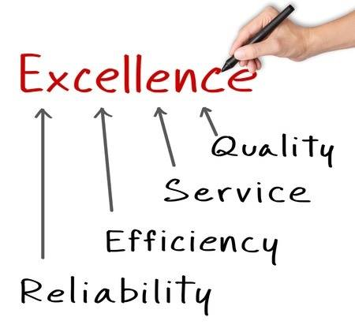
Q2. How well are you doing it?
Fidelity, Quality, Satisfaction, Knowledge/skills gained
Sources of Data: RJ Implementation Survey, Training Evaluation Forms…, Other tools: Fidelity Checklist, Observation Tool
Example: Did you sleep? How well? Quality of sleep…Result?
In RJ context, what else you would want to know the quality of?
"Quality is never an accident; it is always the result of high intention, sincere effort, intelligent direction, and skillful execution; it represents the wise choice among many alternatives." - William Foster
Notes:
Second Primary Evaluation Question!
Example
The term school culture generally refers to the beliefs, perceptions, relationships, attitudes, and written and unwritten rules that shape and influence every aspect of how a school functions, but the term also encompasses more concrete issues such as the physical and emotional safety of students, the orderliness of

Slide 19
Different ways of measuring: Perception. Observation. Checklist
Self-Observed or Participant opinion – satisfaction surveys.

Slide 20
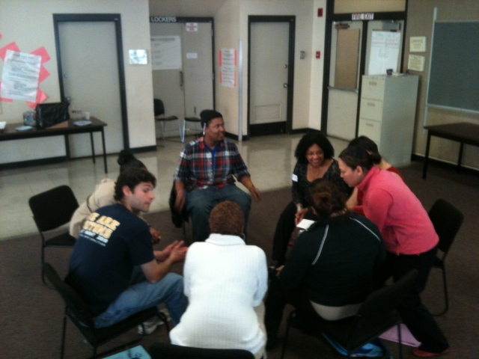
Fidelity To Implementation
What does FIDELITY mean to YOU in your work?
What is it?
Why you need it? Purpose
How and When to use it?

Slide 21
What is fidelity?
The Core elements of a program are implemented as designed: Accurately and consistently
    These could include Program structure, content and method of delivery
    National Center on Response to Intervention, n.d., online
The quality with which the practices are delivered.
Notes:
Are you doing what you set out to do
Now the core elements or steps are more clearly defined – via the guidebook !!! Yay!!!

Slide 22



How will you know you have implemented core steps successfully?
Need to measure it!
Core elements or 12 steps of implementation are more clearly defined now!
    “The more clearly the core components are defined, the more readily the program or practice can be implemented successfully”
    (Fixen, Naoom, Blasé, Friedman, & Wallace, 2005, p. 24).
How is this different than the counts?

Slide 23
why high Quality Implementation Matters ?
Fidelity is crucial to successful outcomes (Lipseyet al. (2010)
High Quality implementation is difficult to achieve
  Real world implementation takes place in complex ever-evolving settings. We often underestimate the number of steps involved, separate decisions to be made, or number of participants whose preferences have to be taken into account (Pressman & Wildavsky, 1973)
Notes:
Quality of food! Junk food/soda vs. healthy greens/vegetables/fruits
Fidelity: 5 veggies/fruits daily

Slide 24
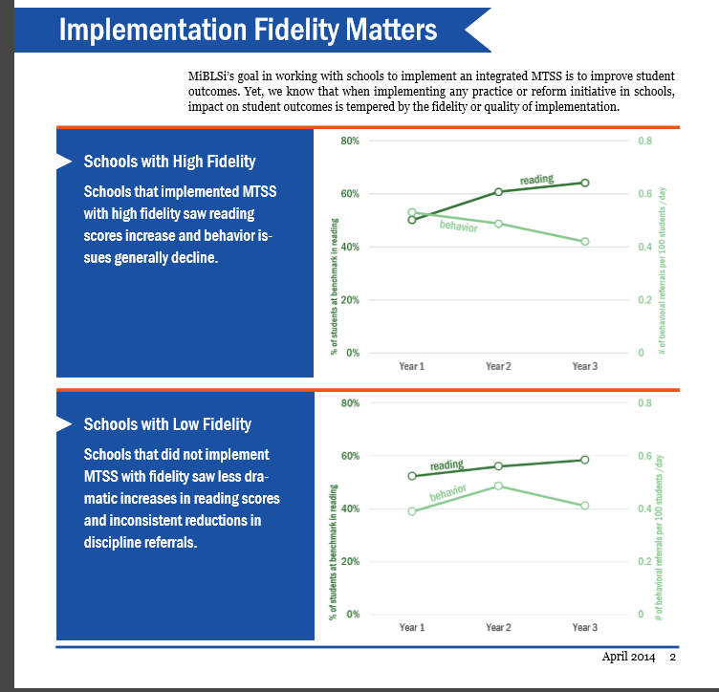
Implementation matters
Growing evidence of higher fidelity associated with
better student social-emotional, behavioral and academic outcomes.
School Climate and culture
LIMITED RJ FIDELITY DATA
Source: Michigan School Support System Report

Slide 25
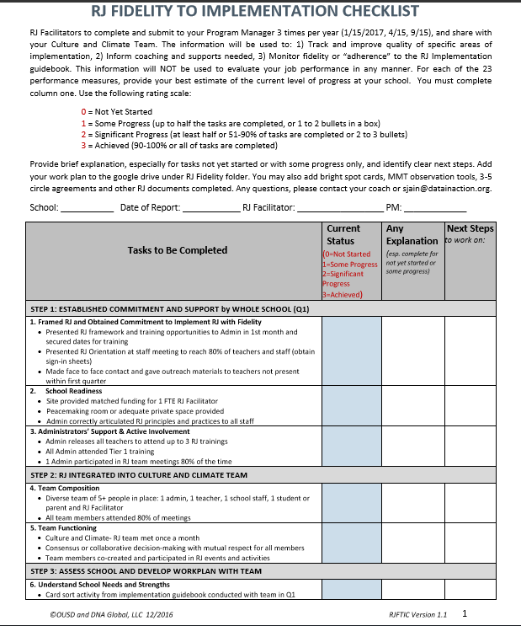
RJ Fidelity to implementation checklist
In collaboration with Oakland USD
EVIDENCE-BASED RTI FIDELITY TOOLS
  Minnesota, SWPBIS, MTSS and other tools
Aligns with 12 STEPS
PRACTICE INFORMED
MULTIDISCIPLINARY THEORY INFORMED
(YOUTH DEVELOPMENT, EQUITY, ECOLOGICAL-DEVELOPMENTAL)

Slide 26
TIPS TO COMPLETE THE CHECKLIST
11 steps and 23 components. Each component has some bullets or indicators that help us measure your progress at that school in implementing RJ component.
Fill out 0-3 based on current status of 3=achieved, 2=significant progress (at least 2 bullets), 1=some progress (1 or 2 bullets/half the bullets completed), 0=not yet started
Circle each bullet (or add a checkmark √) that your school is doing really well in, or has been achieved.
For components not yet started (0) or some progress (1), add a brief description explaining why (major issues) under EXPLANATION

Slide 27
TIPS TO COMPLETE the checklist con’t
2 questions at the end to complete - what’s working really well and any significant areas of improvement.
We also obtained WORKPLAN, MMT OBSERVATION FORMS, and other implementation documents to google drive.
Next Steps fill out briefly for action planning. The fidelity data will help inform school-specific future action plan.
COMPLETE THOROUGHLY (very important)

Slide 28
RJ Fidelity checklist: how to use it
Systematic, standard set of implementation indicators
First time, Pilot
Quarterly filled out by RJ Facilitators starting September 30th
Measure progress along specific steps/indicators (1-4)
Accurately, honestly, thoroughly, and consistently
To be used for coaching/PD support, monitor progress…
Back-end documents share copies with coaches in school folder

Slide 29
RJ Fidelity checklist results
Pilot phase
Quantitative results are presented as percentages, e.g., a status of 2 out of 3 = 66.7%
Graphs by Step = average of components within each step
Notes:
Calculation method: Each component had a maximum status of 3. The “percent implemented” is the status for that component divided by 3 and multiplied by 100. For example, if the status for Component 1 is 2 then the “percent implemented” would be 2/3 X 100 = 66.7%. Each step’s “percent implemented” is the average of the percent implemented for each of the step’s components. For example, Step 1 includes 3 components; if the components had “percent implemented” of 66.7%, 33.3%, and 33.3% then the “percent implemented” of Step 1 would be (66.7 + 33.3 + 33.3)/3 = 44.4%.

Slide 30
Overall strengths: Commitment and support, team integration, and T2 quality implementation
Overall challenges: Capacity building, reflect and refine, engagement and collaboration
Notes:
Overall strengths: Commitment and support, team integration, and T2 quality implementation
Overall challenges: Capacity building, reflect and refine, engagement and collaboration
It’s getting diluted out by high implementation and low implementation schools (since it is an average essentially)

Slide 31
Elementary strengths: Commitment and support, team integration, T2 quality implementation
Elementary challenges: Peer RJ, T3 quality implementation, T1 quality implementation
Notes:
Elementary strengths: Commitment and support, team integration, T2 quality implementation
Elementary challenges: Peer RJ, T3 quality implementation, T1 quality implementation

Slide 32
Middle school Strengths: T2 and T1 quality implementation, team integration
Middle school Challenges: Capacity building, reflect and refine, engagement and collaboration
Notes:
Middle school strengths: T2 and T1 quality implementation, team integration
Middle school challenges: Capacity building, reflect and refine, engagement and collaboration

Slide 33
Strengths: T2 quality implementation, team integration, T3 quality implementation
Challenges: Capacity building, engagement and collaboration, reflect and refine
Notes:
High school strengths: T2 quality implementation, team integration, T3 quality implementation
High school challenges: Capacity building, engagement and collaboration, reflect and refine

Slide 34
There is a lot of variation across schools, likely at least partially due to variation in school context (e.g., staff turnover, leadership support), when started/resources, as well as the subjective nature of filling out the checklist.
Notes:
There is a lot of variation between schools, likely at least partially attributable to variation in context (e.g., staff turnover, leadership support), as well as the subjective nature of filling out the checklist
Just completed year-end key participant interviews and year-end survey to better understand the stories behind the fidelity scores by school sites.
Interviewed high implementation, medium implementation and low implementation school staff/RJFs.

Slide 35

Qualitative results: what have we learned?
IMPLEMENTATION BARRIERS:
TRAINING –RELATED
LACK OF STUDENT AND PARENT INVOLVEMENT
COMPETING NEEDS
LOGISTICS
STAFF TURN 0VER
WHAT’S WORKING WELL?
COLLABORATION & COMMUNICATION
BUY-IN & SUPPORT
TIER 2 PRACTICES

Slide 36
HOW CAN YOU Use implementation data…?
To engage to inform to advocate

Slide 37
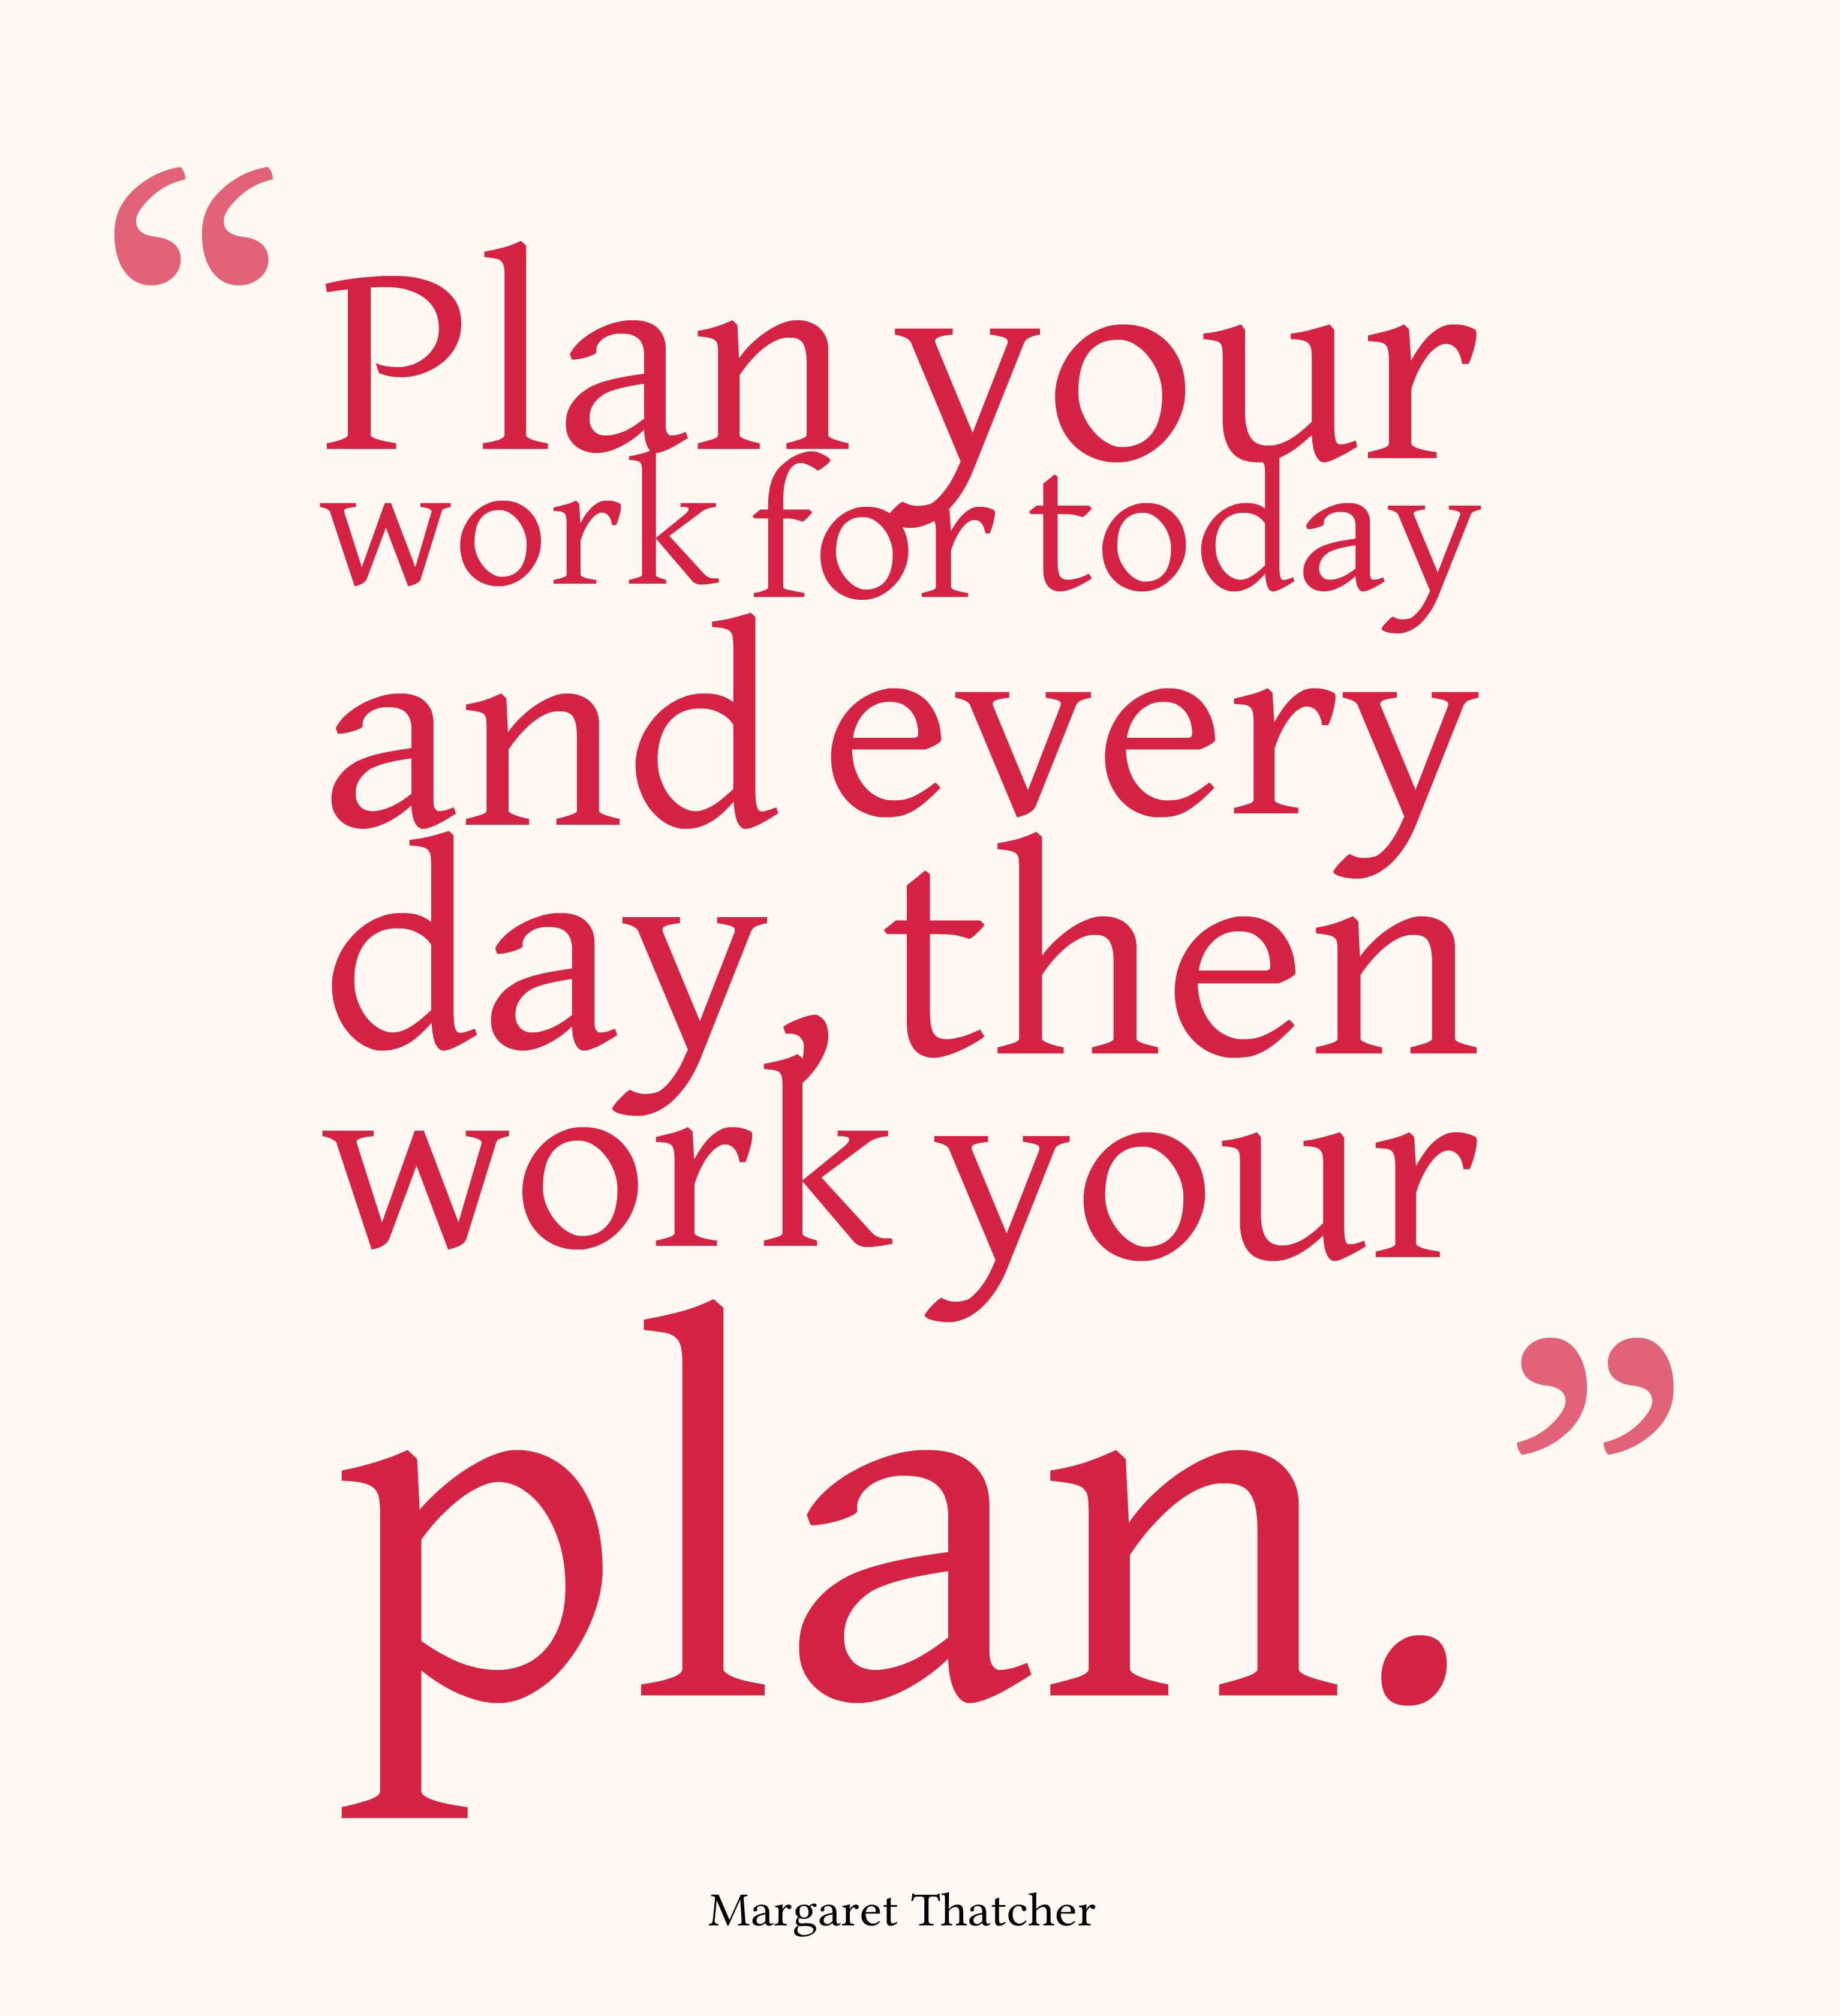
Uses of fidelity data
Inform Action Planning at School Sites
Continuous Quality Improvement Practices
Increase Accountability
Evaluation
Obtain Additional Funding for Implementation
Leadership Buy-in
Untangle impact of Specific Components
  “Service documentation is key to understand which aspects of the program lead to positive youth outcomes” – Harvard Family Research Project

Slide 38
Process of sharing and using fidelity data: School Summaries
What is the story behind the numbers?
  Numbers /scores change ongoingly, context changes.. Important to capture key implementers perspective on key challenges and strengths.
  Evaluation Team developed School Summaries with Fidelity scores, and RJFs added context/story
  Share with School (CCT, Principal/AP) to gain support to improve implementation for specific steps

Slide 39

Annual rj Workplan Development
RJ Workplan Template developed
  10 Implementation Goals, 23 Indicators
  Status, Challenges, Who, What, By When, Notes
Piloted Spring 2017 at learning community (PLC)
Aligned with Fidelity Checklist

Slide 40
WORK PLAN REFLECTION
PAIR UP
Q1. HOW MANY HAVE ANNUAL WORKPLANS?
Q2. DO YOU MONITOR ITS PROGRESS QUARTERLY?
Q3. HOW HELPFUL WOULD THAT BE?

Slide 41
STRENGTHS AND LIMITATIONS
LIMITATIONS
STRENGTHS
COMPLEX
PROCESS TO USE FIDELITY DATA NEEDS TO BUILT IN
NEED TO EXPAND ACCOUNTABILITY CULTURE
TO BE VALIDATED/PILOTED IN OTHER PLACES
ONE COMPREHENSIVE TOOL
ALIGNS WITH IMPLEMENTATION EASY TO USE/ ONE RESEARCHER
EVIDENCE-BASED
PRACTICE-INFORMED

Slide 42
Quotes of the Day!
“One of the great mistakes is to judge policies and programs by their intentions rather than their results.” - Milton Friedman
“Fear cannot be banished, but it can be calm and without panic; it can be mitigated by reason and evaluation.” -Vannevar Bush
“Everything that can be counted does not necessarily count; everything that counts cannot necessarily be counted.” - Albert Einstein
“The only man who behaves sensibly is my tailor; he takes my measurements anew every time he sees me, while all the rest go on with their old measurements and expect me to fit them.” - George Bernard Shaw

Slide 43

Questions & Answers!!!
For more information:
Sonia Jain, DrPH
Lead Evaluator ,OUSD RJ Program
Founder and Principal, DNA Global, LLC
www.datainaction.org
sjain@datainaction.org

