Slide 1
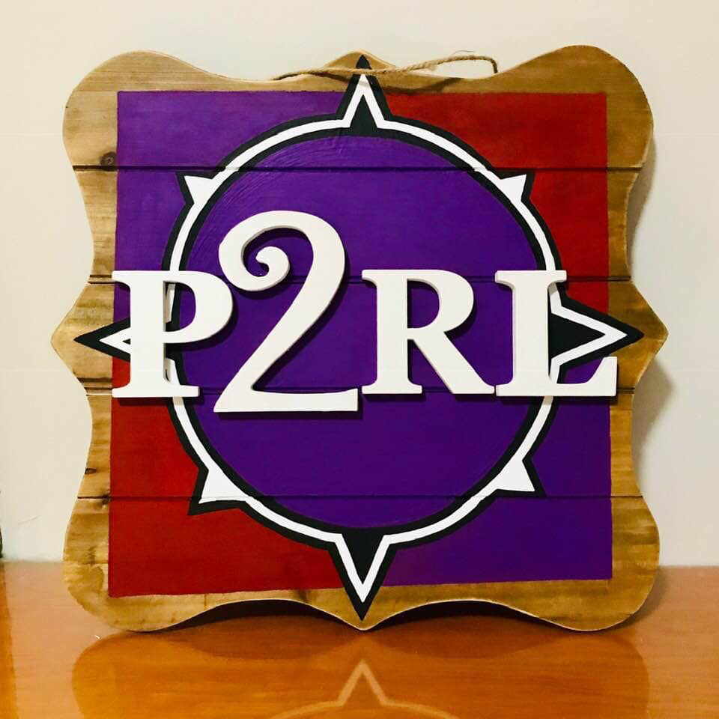
Pathways 2 Restorative Leadership WITH Restorative Conversations
Kevin Jones, MS
Licensed Trainer, Coach, Continuing Education Instructor, Lecturer
IIRP

Slide 2

Check in Circle: Let’s Get To Know Each Other

Slide 3
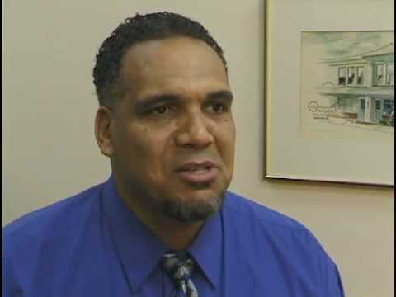
Steve Korr-Continuing Education Instructor
Restorative Practice as Leadership Model

Slide 4
Outcome Goals
By the end of the session participants’ will be able to:
Provided strategies to utilize intentional, explicit restorative practices to positively impact their current practices.
Reflect on how restorative practices may impact participants’ professional and personal lives.

Slide 5
Reflections
“He who thinks he leads and has no one following him is only taking a walk.” Anonymous
“There are many reasons for failure, but no excuses.” Anonymous
“If your actions inspire others to dream more, learn more, do more, and become more, you are a leader.” John Quincy Adams
“The key to successful leadership is influence, not authority.” Ken Blanchard

Slide 6
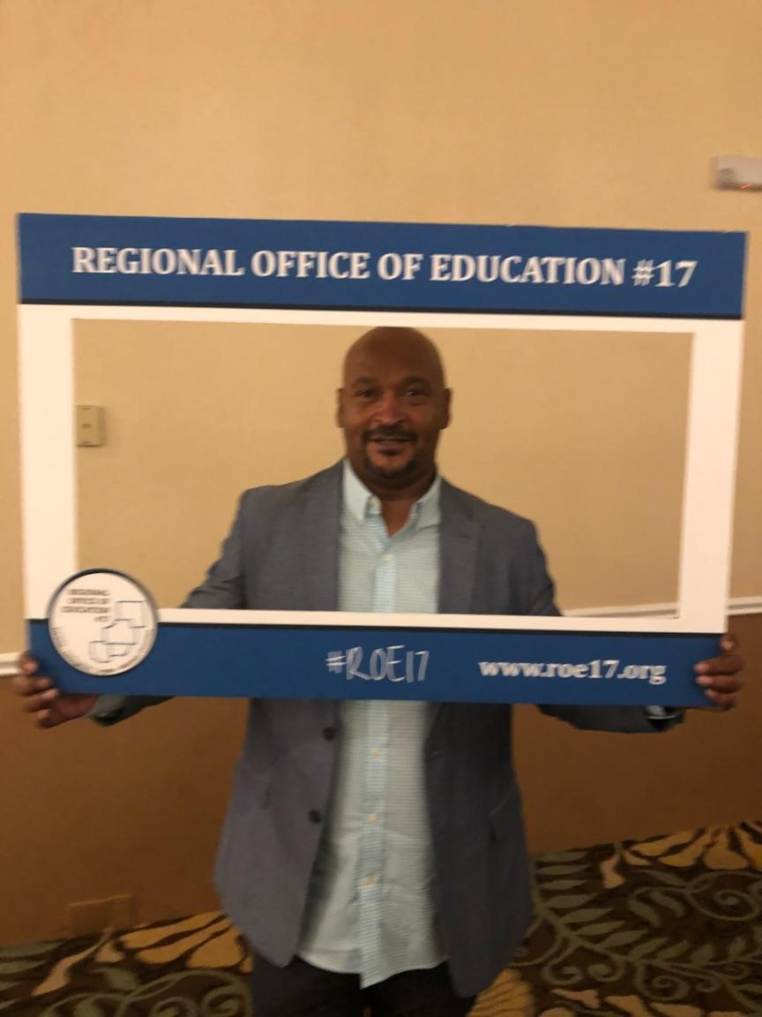
My Restorative Journey
The Restorative Continuum in Real Time

Slide 7
Impact of My Intentional and Explicit Restorative Journey
Director of Restorative Practice Leadership Team-Regional Office of Education
Trainer, Coach, Continuing Education Instructor, Adjunct Professor-IIRP
Founded Pathways 2 Restorative Leaderships
Developed and Coach 27 Restorative Leadership Teams within My Region
Impactful Restorative Work WITH My Community
Increased Self-Reflection

Slide 8
Integrating Explicit Restorative Practices into Everyday Life
Social Discipline Window
Fair Process
Psychology of Affect
Restorative Practice Continuum

Slide 9
Activity:Definition of Restorative Leadership
Write Your Personal Definition of Restorative Leadership
Letter of Commitment
Restorative Leadership Goals

Slide 10
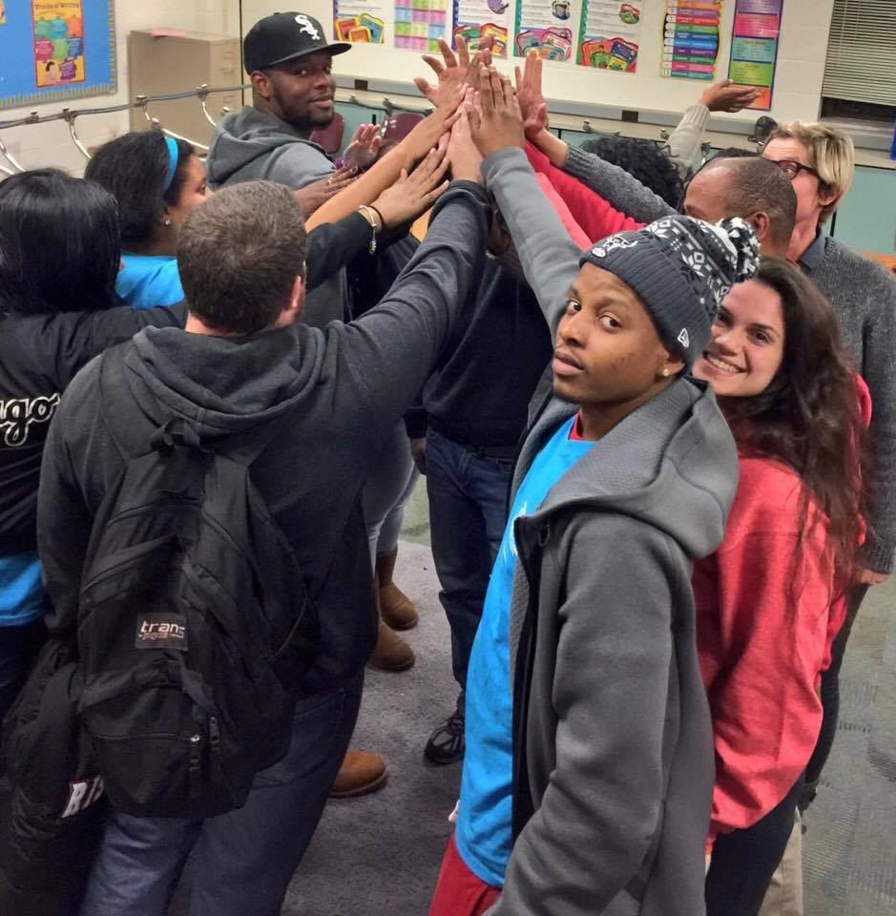
Checkout Circle
What Surprised you?
What did you Learn?
What was your take away?

Slide 11

Thank You!

