Slide 1
Using Restorative Practice and Mindfulness to Build Relationships and Heal Trauma
Sharing best practices, successes and learned lessons at ICARE, An Elementary Alternative Education Program in Pensacola Florida.

Slide 2
Objectives. Participants will…
Learn about the ICARE program Framework, routines and expectations. Examples of community and family activities.
Overview of the following topics:
Fight and Flight Response & Trauma
Social and Emotional Learning
Restorative Practice
Mindfulness and Yoga ( include short practice)
Learn about implementation and structure of Morning Meetings at the ICARE
Learn about Restorative Practices used at ICARE to build relationships, heal, reconnect and reintegrate.
Hear about success stories and challenges

Slide 3
ICARE Core Values:
Integrity
Community
Achievement
Resilience
Engagement

Slide 4
About the ICARE Program…
ICARE is an Alternative Education program at Escambia County School District, Pensacola, FL. We serve K-5 students who have displayed aggressive and unsafe behaviors at their school of residency and need an alternative setting to learn social skills and emotional regulation. Currently we serve 25 students and the family keeps growing!
Instructional Staff- There are 3 classrooms at ICARE. We have a teacher and a teacher's assistant in each class and 1 ESE teacher who comes to ICARE 2-3 times a week.
Structural and Behavioral Staff- 1 Teacher in Charge, 1 Behavior Analyst, 1 Mental Health Counselor, and 2 Behavior Tech.

Slide 5
ICARE Mission Statement
The mission of the ICARE program is to assist students to reach their fullest social, emotional, and academic potential. Through our REACCH Framework, Trauma Informed Care and a Multi-Tiered System of Supports, we educate, guide, inspire, and collaborate with each and every student to create a school community of kind, compassionate, productive, engaged, and cooperative individuals.

Slide 6
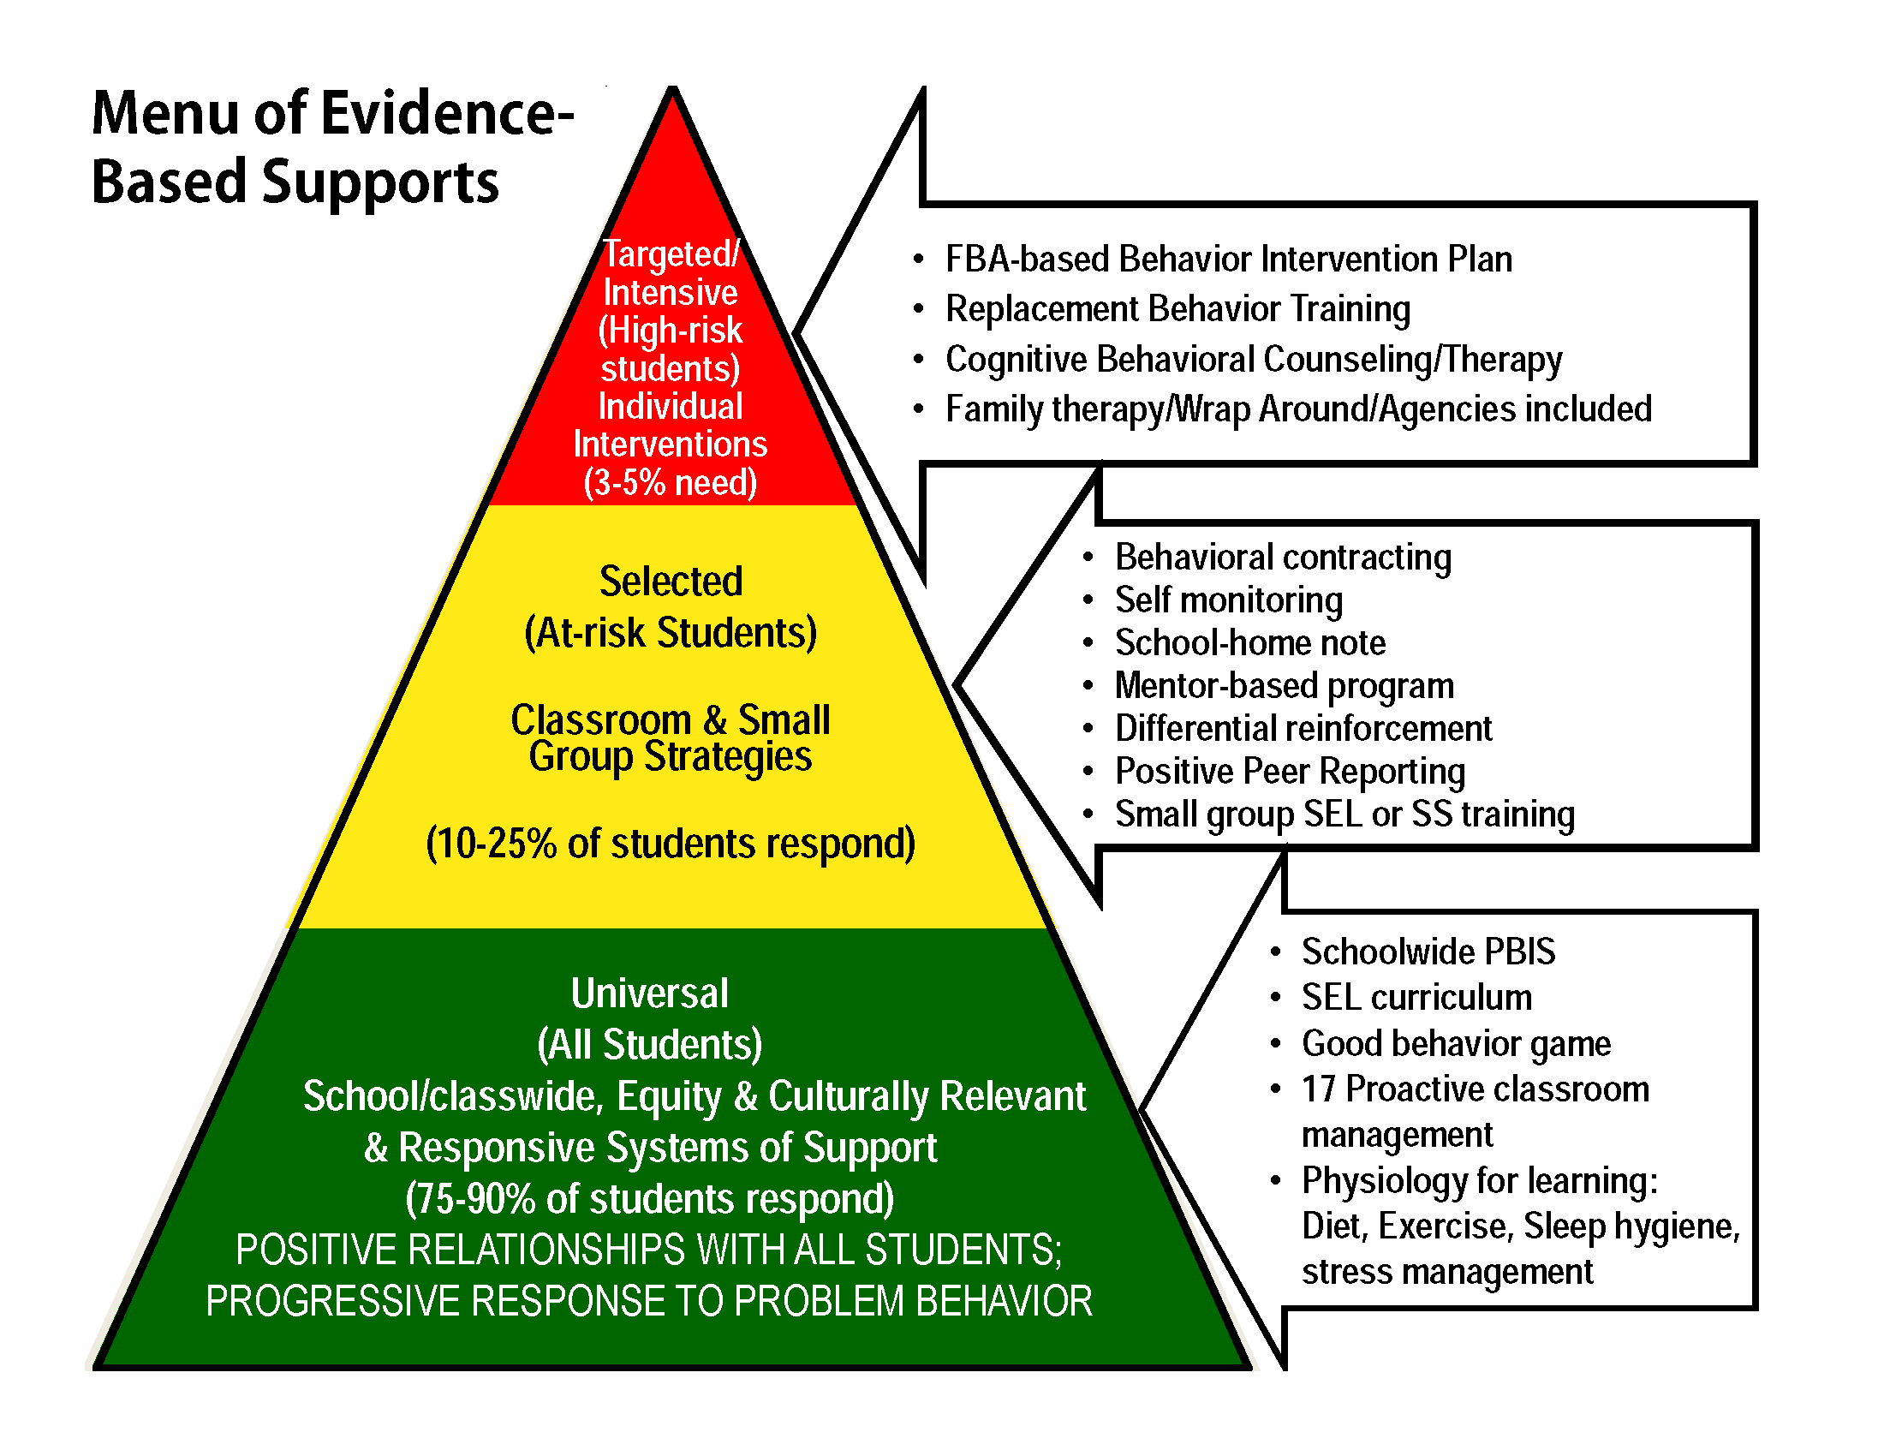
Who Attends ICARE?
Other schools in the district- 5% High Levels of support
ICARE
100 % High Levels of Support

Slide 7
Layers of Interventions- all students receive ALL TIERS

Slide 8
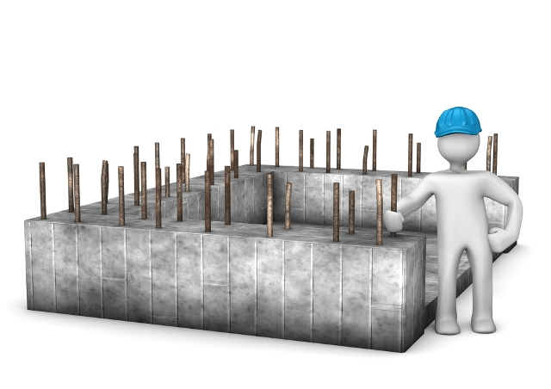
Our Program’s Foundation
The ICARE REACCH Framework and Expectations
Trauma Informed Care
PBIS and SEL
Restorative Practice

Slide 9

Through the
ICARE REACCH Framework…
Relationship Building
Engagement
Appreciation
Coaching
Community Connections
Healing

Slide 10
We Become…
Respectful
Optimistic
Appreciative
Responsible
Resourceful
Reflective
Safe

Slide 11
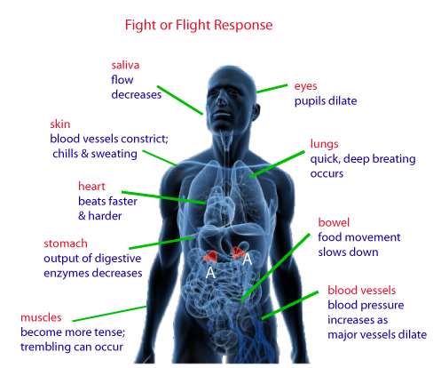
Fight or Flight Response what is trauma fight flight and freeze for kids - Yahoo Video Search Results

Slide 12
Trauma- What it is?
In general, trauma can be defined as a psychological, emotional response to an event or an experience that is deeply distressing or disturbing.
Complex trauma happens repetitively. It often results in direct harm to the individual. The effects of it are cumulative. The traumatic experience frequently transpires within a particular time frame or within a specific relationship, and often in a specific setting.
Developmental Trauma Disorder is a recent term in the study of psychology. This disorder forms during a child’s first three years of life. The result of abuse, neglect, and/or abandonment, developmental trauma interferes with the infant or child’s neurological, cognitive, and psychological development. It disrupts the victim’s ability to attach to an adult caregiver.

Slide 13
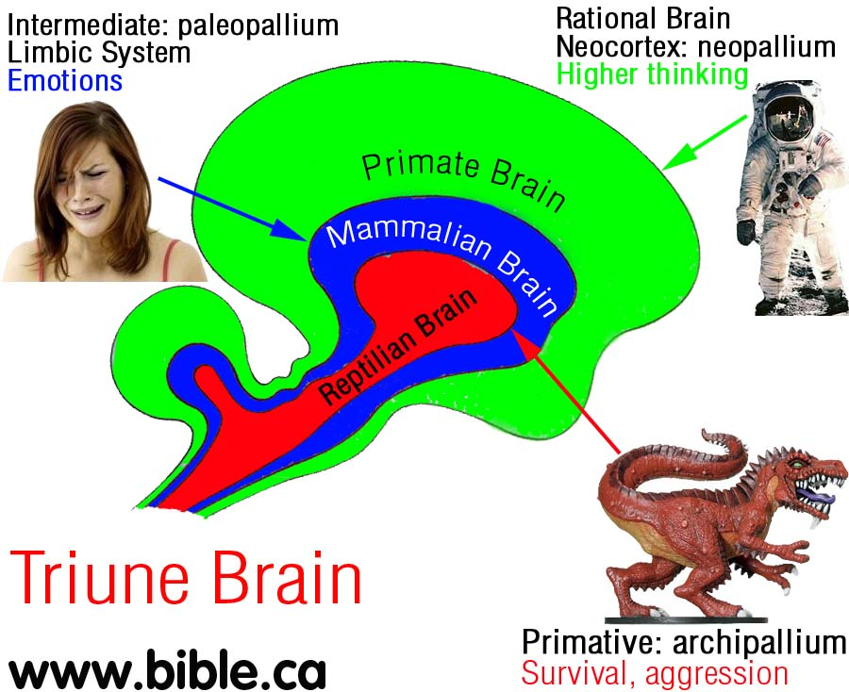
How Does the Brain Work?
Don’t Flip Your Lid
https://youtu.be/3bKuoH8CkFc
Mindfulness in Schools: Mindfulness and the Brain for Children – YouTube
https://youtu.be/a_hPelcPRTg

Slide 14
Trauma- Symptoms
Often, shock and denial are typical reactions to a traumatic event. Over time, these emotional responses may fade, but a survivor may also experience reactions long-term. These can include:
Anger
Persistent feelings of sadness and despair
Flashbacks
Unpredictable emotions
Physical symptoms, such as nausea and headaches
Intense feelings of guilt, as if they are somehow responsible for the event
An altered sense of shame
Feelings of isolation and hopelessness

Slide 15
Trauma- Treatments
Trauma therapy is not one-size-fits-all.
Currently, there are several trauma therapy modalities in place:
Cognitive Behavioral Therapy (CBT) teaches the person become more aware of their thoughts and beliefs about their trauma and gives them skills to help them react to emotional triggers in a healthier way.
Exposure therapy (also called In Vivo Exposure Therapy) is a form of cognitive behavior therapy that is used to reduce the fear associated with the emotional triggers caused by the trauma.
Talk therapy (psychodynamic psychotherapy) is a method of verbal communication that is used to help a person find relief from emotional pain and strengthen the adaptive ways of problem management that the individual already possesses.
Recent studies have found that body-oriented approaches such as mindfulness, yoga, and EMDR are powerful tools for helping the mind and body reconnect.

Slide 16
Understanding Relationship Building Components used at ICARE
Greet each student everyday with a smile. EXCEL(Engage, explore, Communicate, Empower and Launch
HEAT Model
Conscious Discipline
Restorative Practices/ Circles
Service Activities
PBIS Activities and Family Involvement

Slide 17
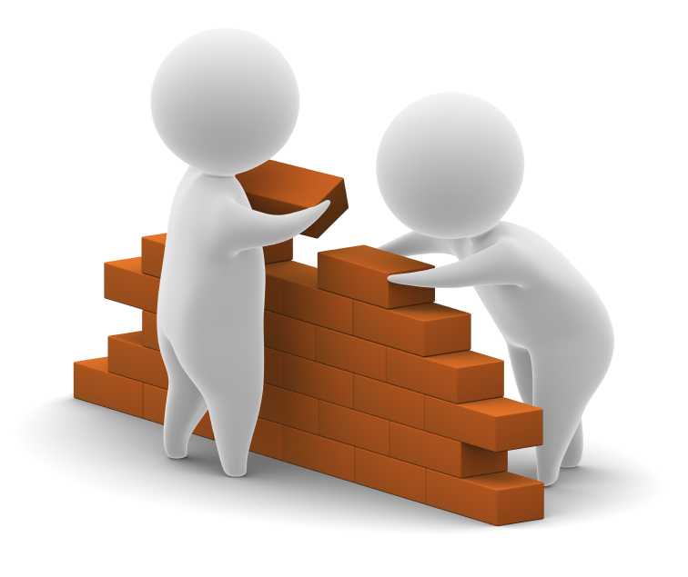
The Building Blocks. What do we do? How do we do it?

Slide 18
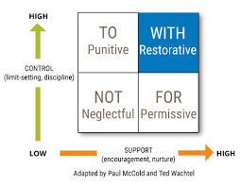
Guiding Principles of RP 5 R’s
Relationships
•Central to building an inclusive community
•Build systems that develop & strengthen healthy relationships
Respect
•Provide a voice for the victim
•Improve social behavior of staff & students
Responsibility
•Emphasis placed on the harm rather than the offense
•Understand the impact of the harm
Restoration
•Collaborative problem solving
•Empowers change & growth
Reintegration
•Offender is welcomed back into the environment
Eber, 2015; SFUSD; Gonsoulin, Schiff, and Hatheway2013; IIRP, 2012; Restorative Practices Workgroup, 2014

Slide 19
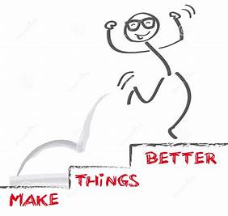
A restorative approach aims to…
Repair HARM
People respond best when you do things with them, not to or for them.

Slide 20
Types of Restorative Practices
Affective Statements-
Everyday usage
“I” statements ( Be cautious not to go into child’s voice)
Describes how something made you feel
Circles
Morning meetings
Social/emotional instruction (e.g. empathy)
Problem-solving class-wide issues
Restorative Conferences
Informal conference
Restorative meeting and chats
Restorative conferences
Reintegration Procedures
Restore relationship between offender & victim
Classroom and/ or office-managed offenses
Match to severity of incident

Slide 21
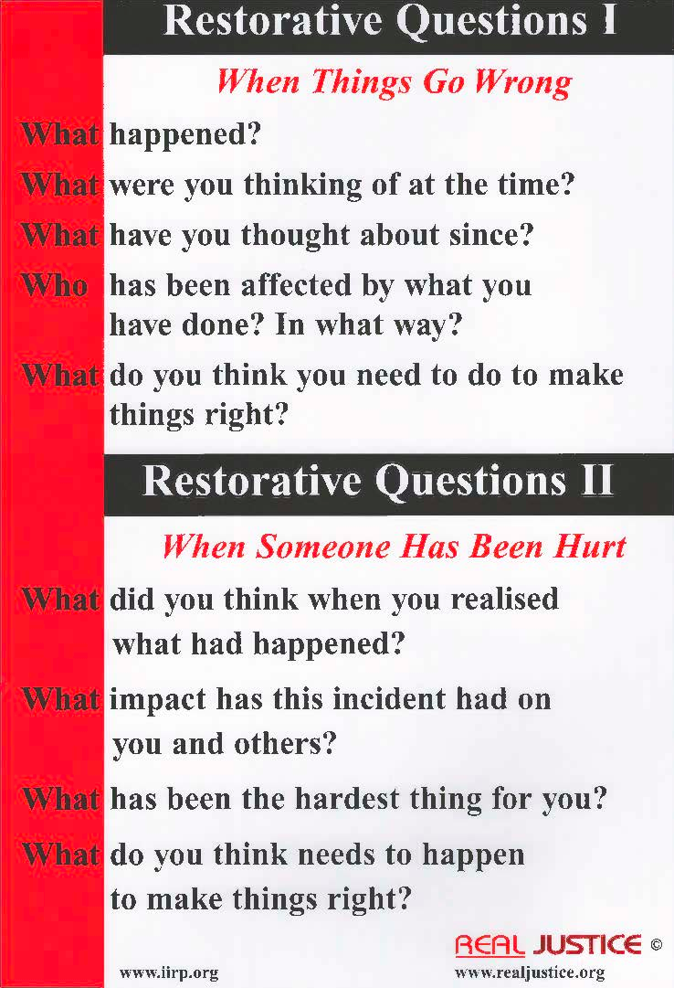

Slide 22
Understanding the ICARE
Coaching Components
SEL – Teaching through literature, language, external examples and illustrations and personal examples. (Zones of Regulation, Social Thinking
Mindfulness- Proactive practice and coaching during crisis.
Teaching Replacement Behaviors
Positive Praise, Affirmations and constructive feedback

Slide 23
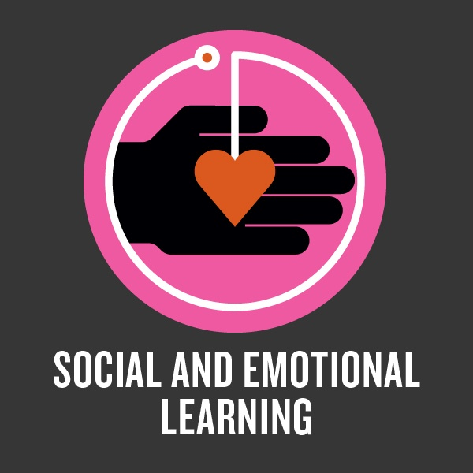
Social Emotional Learning (SEL)
“Social and emotional learning (SEL) is the process through which children and adults acquire and effectively apply the knowledge, attitudes, and skills necessary to understand and manage emotions, set and achieve positive goals, feel and show empathy for others, establish and maintain positive relationships, and make responsible decisions.”
Collaborative for Academic, Social, and Emotional Learning (CASEL) http://www.casel.org/what-is-sel/

Slide 24
Collaborative for Academic, Social, and Emotional Learning (CASEL) http://www.casel.org/what-is-sel/

Slide 25
Self Awareness and Self Management
Mindfulness
Mindfulness means maintaining a moment-by-moment awareness of our thoughts, feelings, bodily sensations, and surrounding environment, through a gentle, nurturing lens.
Mindfulness also involves acceptance, meaning that we pay attention to our thoughts and feelings without judging them—without believing, for instance, that there’s a “right” or “wrong” way to think or feel in a given moment. When we practice mindfulness, our thoughts tune into what we’re sensing in the present moment rather than rehashing the past or imagining the future.

Slide 26
Examples of Mindfulness Practices
Breathing Exercises
Body Scan
One Point Concentration Focus- (Smell, taste, tactile, visual, auditory)
Nature connect.
Arts

Slide 27
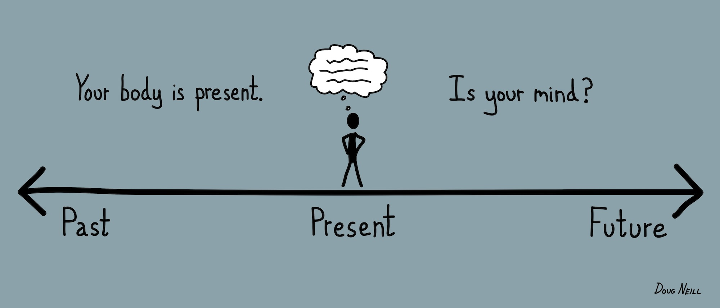
Let’s Practice!
Mindfulness

Slide 28
Self Awareness, Self Management, Regulation and Body and Mind Integration in Action-Yoga
The word “yoga” means “union” in Sanskrit, the ancient language of India. Quite simply, yoga is the “union” or coming together of mind (thoughts and feelings) and physical body.
There are many aspects to yoga. In short, yoga is a system of physical exercises or postures (called asanas). These asanas build strength, flexibility and confidence. Yoga is also about breathing (called pranayama), which helps calm and refresh the body and mind. These are basic two aspects of yoga, but there are many other parts to practicing yoga.

Slide 29
Why Yoga?
Yoga teaches us about our bodies.
Yoga teaches us how to breathe better and observe the energetic body.
Yoga teaches us how to use our energy more effectively.
Yoga teaches us how to quiet the mind.
Yoga teaches us about balance.
Yoga teaches us to concentrate, let go and live in the present moment.
Yoga teaches us about taking care of ourselves to be more open and available to others.

Slide 30
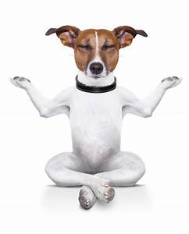
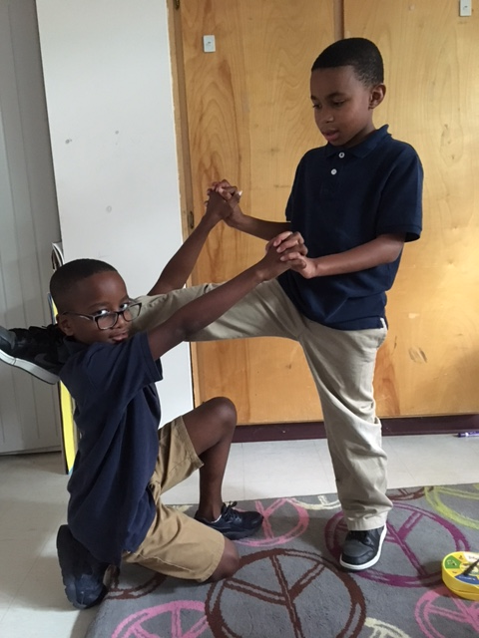
Let’s Practice!
Yoga

Slide 31
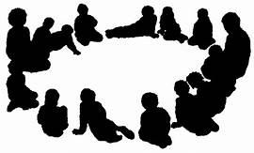
Relationship Skills- Circles
A structured process for bringing people together to:
Understand one another
Strengthen bonds
Share & understand feelings
Solve problems

Slide 32
ICARE Morning Meeting Circles Activities- Proactive
Mindfulness Activity
Zones of Regulation activities
Greeting
Sharing
Activity( SEL book)- with curriculum integration
Message/ Encouraging Quote/ Closing
Appreciation Statement & Positive Connection
Visualization
Yoga- group, after restorative conference, preventive
Special Guest Lesson
Focus Topic with Mental Health Counselor
Notes:
Show materials

Slide 33
The Morning Meeting Board Elements
Calendar
Schedule
Interactive Zones of Regulation Board
Breathing Strategies poster
ROARRRS Expectations
Feeling of the Week
Social Skill of the week
Posters created by teachers and students on ZOR, Morning Meeting Cards
Brain diagrams- Lizard Brain and Smart Brain
Mindful Games Cards
Calming Techniques visuals

Slide 34
SEL Common Language and Curriculum infused in Circles
ICARE Expectations
Zones of Regulation
Growth Mind Set
Trauma Informed Care- Learning about the brain and how to rewire
Social Detective and Super Flex
ICARE Social and Emotional Library

Slide 35
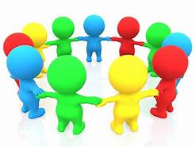
Let’s Practice!
Morning Meeting Circles

Slide 36

Understanding the ICARE
Healing Components

Slide 37
Healing Components
The ICARE REPAIR Process
Counseling
Partner Yoga- after regulation
Synchronize Breath
Holding Space
Using your senses and focus to regain control

Slide 38
Relationship Skills- ICARE REPAIR Steps
Regain physical control- comfort versus confront approach, breathing, muscle relaxation, quiet time, visualizations, motor activities, distractors. Adult shift the energy to his/her own mindfulness practice to be able to hold space
Express feelings in drawings or writing and eventually verbally. The narrative. Adults use HEAT (Hear, Empathize, Apologize, Take action with the student) Reflection activity.
Plan actions to maintain emotional and physical control. Examples, role play.
Act to make things better. Apologize for harm caused. Participate in restorative circle. Restitution, rebuilding.
Incomplete assignments are completed
Re-entering process- Ask for permission to return, focus on the replacement behavior/skill and repair of harm. Generalization. Using the new behaviors, creating new paths, new habits. Rewiring the brain restore the demage!

Slide 39
The Impacts of the ICARE Paradigm Shift
Since implementation of the REACCH Framework we have observed the following:
Decrease in the involvement of law enforcement on school campus.
Students are smiling more, spontaneously hugging or giving 5.
Increased Parental Involvement. Phone calls, written, positive calls.
Significant decrease in intensity, frequency and duration of behavior outbursts.
Students are more respectful of the physical environment.
The development of a positive School Culture. Where we support each other and stay focused.
We began the 2nd year of implementation with only 4 returning staff members out of 10. We began the 3rd school year with 9 out of 10 staff members returning.
Our students are now allowed in extra curriculum activities and fieldtrips because they can regulate emotions and use appropriate social skills.
Our staff members addresses conflict with a growth mind set. We meet formally at least 2 times a month and informally everyday to debrief and improve systems.
Students are generalizing self regulation and social skills to other settings.
Each year the number of students transitioning back to their schools of residency has increased.
The vast majority of students transitioning out of ICARE are succeeding in their school of residency.
More community involvement- guest speakers, community members involved and collaborating.

Slide 40
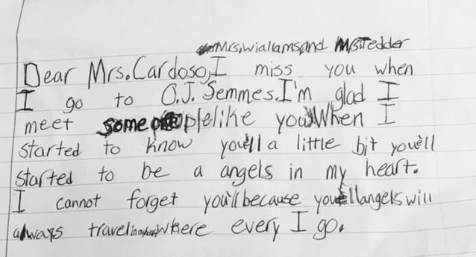

Slide 41

Questions?

Slide 42


