Slide 1

Healing a People:
How Restorative Practices Can Help Repair the Harm of an Island’s Dark Past
Presentation to the IIRP World Conference, "Strengthening the Spirit of Community," October 24-26, 2018, Detroit, Michigan.
Lynne A. Winfield BA, FCIS
Hashim Estwick BA, QCF

Slide 2
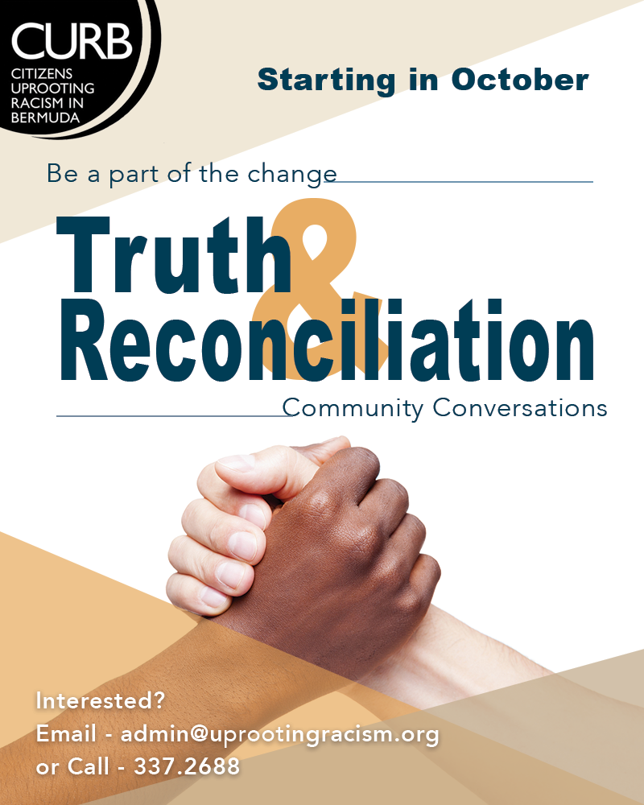
Bermuda Truth & Reconciliation Community Conversations (TRCC)

Slide 3
Who and what is CURB?
Advocacy
Social Justice Mediation
Structural Racism Workshops
Dominant/Counter Narrative
Bermuda’s Hidden History
Restorative Practices Training
Educate/Challenge Racial Biases
Media Relations
Collaboration with Organisations

Slide 4
Why TRCC?
The Need
Restorative Practice Response
Design and Implementation
Goals
The Process
The Outcomes
What now?

Slide 5
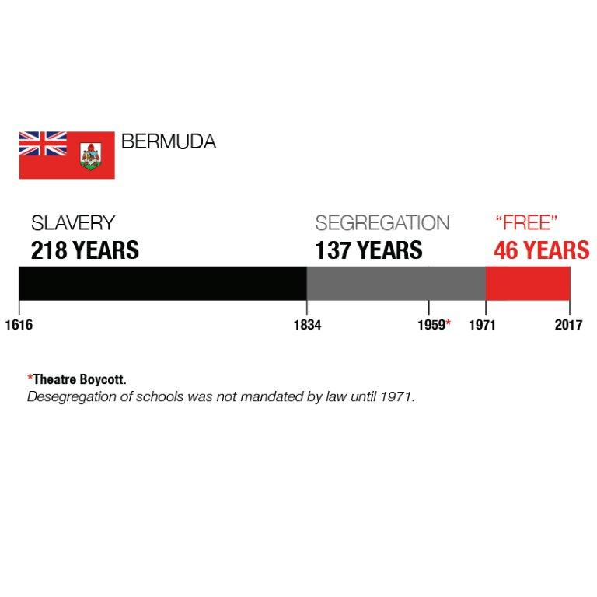
The Trauma

Slide 6

Bermuda was built and run on a belief in racial hierarchy [white supremacy], a collective national consciousness that has dominated the educational, economic, social and legal discourse for centuries. This way of doing and being became deeply embedded in our organizations, clubs, schools, justice system, government and education and today is known as systemic or structural racism.
Resistance and episodic movements through history have contributed to measurable progress, but to move to a racially just society a new narrative must be embraced: a fully inclusive telling of our history, and that of equal humanity.

Slide 7
The Need
When people are harmed, needs are created
The needs created by harms lead to obligations
The obligation is to heal and “repair” the harms

Slide 8
Why Restorative Practices?
Acknowledges the harm caused by wrongdoing (restoration/explanation)
Encourages appropriate responsibility for addressing needs and repairing the harm (accountability/reparation/expectation clarity)
Involves all those impacted, including the community, in the resolution (engagement)

Slide 9

Design & Implementation: Reaching the 1,000
Relationship Building
Respectful dialogue
Authentic discussions
Community involvement
Importance of each participant
When needs are met, change is possible
Facilitated conversation
Provide everyone with a voice
Use of fair process principles

Slide 10
Design & Implementation
Skills
Communication – guidelines/ language/triggers/comfort zones
Listening skills
Safe space, fairness, confidentiality
Facilitator skills, manage-conflict, self-awareness

Slide 11
Design & Implementation: Reaching the 1,000
Facilitator Knowledge
Restorative Practices training
Cultural competency
Historical context
Legacy issues: internalized superiority/oppression, implicit bias, privilege, stereotypes, economic intimidation, discrimination, marginalization, prejudice, economic inequity
Intergenerational Trauma
Current systemic barriers
Psychological research
Our own experiences and biases
Model behaviour

Slide 12

TRCC Design & Implementation
Process
Circles, talking piece, large/small group dialogues, affective statements and affective questions
Historical Information / counter narrative
Storytelling / parallel truths
Seven weekly sessions of 2.5 hours each with same people/facilitators in the room
Note taking, reports, pre and post surveys

Slide 13

TRCC Goals
Paradigm shift in society
Relationships, connectedness, community-building
Reparations: Repairing harm and its legacies
Research-based results for National Reconciliation Plan based on grassroots feedback
Bermuda Black history: create understanding and empathy around the counter narrative and its legacies
TRCC Participants sharing information within their own sphere of influence, e.g. churches, clubs, work, charities, etc.
Empower the voice of TRCC Participants to change their narrative and responses to racial inequality
Solution-focused

Slide 14
The Process:
What happens in the room?
Facilitator scripts
A Lead Facilitator and two Assistant Facilitators
Restorative Practice Circles (Sequential/Non-sequential and Fishbowl)
Weekly themes
  Building Community
  Why do we need to heal?
  What happened?
  Who tells the story?
  Checking my privilege
  Telling our Stories
  What are we going to do?

Slide 15
The Process:
What happens in the room?
Activities
Film clips
Story Telling
Powerpoint
Conversation, conversation, conversation

Slide 16
The Process:
Participants’ feedback
Epiphanies
Stories told
Powerful moments
Triggering moments
Individual agendas
Managing conflict

Slide 17
The Outcomes (so far)
10 TRCC groups since February 2017 (one starts this May)
Participant feedback
Pre-Surveys
Post-Surveys
Reports

Slide 18
Participant Feedback
Thank you team for the peaceful open way you allow discourse to unfold. For me this is a scary, uncomfortable journey that is stimulating and confirming. What I heard and experienced this week was also exhilarating. I appreciate most when we can share deeper personal struggles in a way that emotionally engages others.
Be encouraged as you continue to encourage others in ways you may never know. Kindest regards, Maxine
It [TRCC] brings people together from across divides and they hear each others’ personal experiences and feelings in a way that nothing else does. It has given me more confidence to point out and, where I can, act on inequalities and legacies of slavery – because when I think of the personal stories I have heard, I think of those people and I feel I am backed up by real people, real stories, concrete evidence and not just statistics that can be skewed.

Slide 19
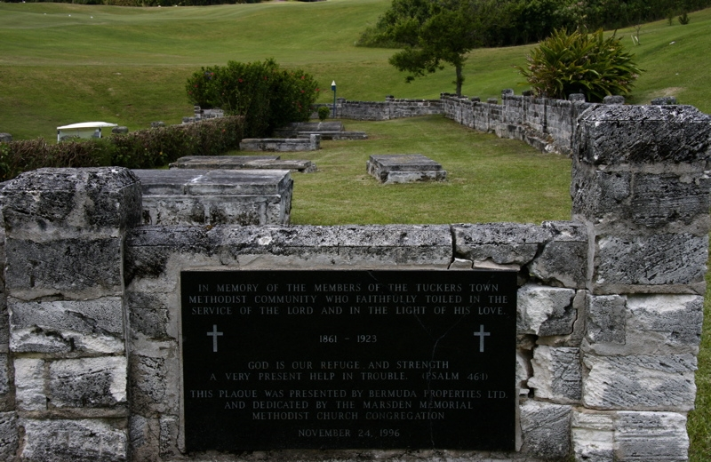
The Tucker’s Town Story
Linking the past to the present

Slide 20
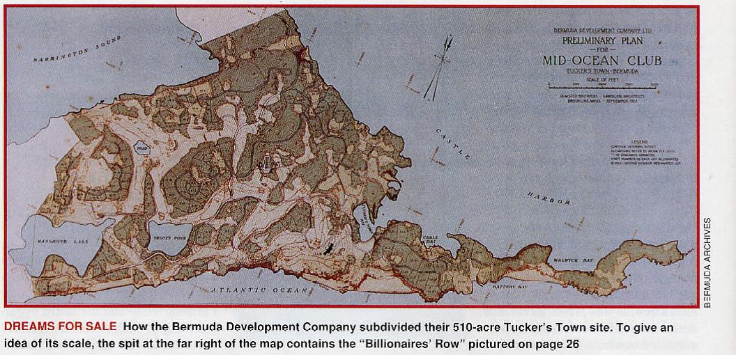

TUCKER’S TOWN

Slide 21
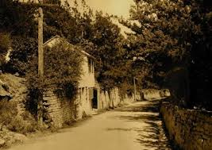
Earliest known free Black community in Bermuda late 1790s - 1921

Slide 22
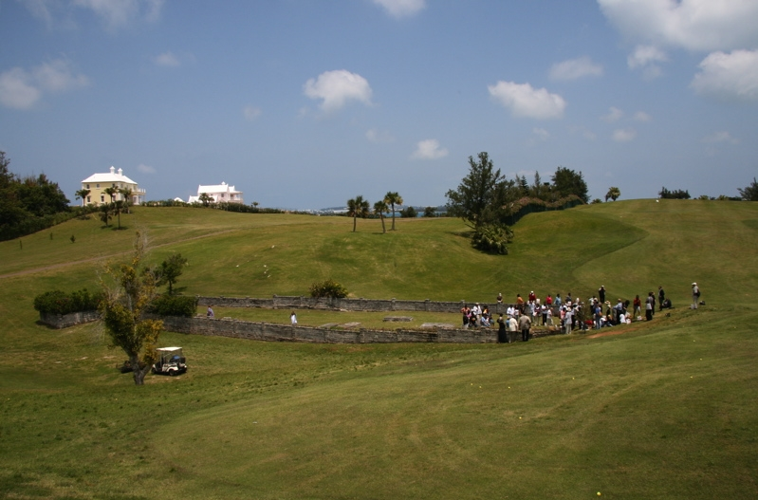
The Driving Range

Slide 23
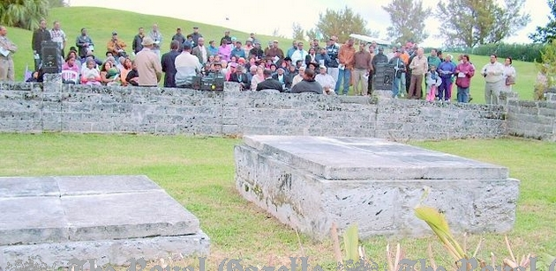
Tucker’s Town – prayers and gathering 2007

Slide 24
TUCKER’S TOWN

Slide 25
Dominant Narrative
“In Tucker’s Town, famed from the earliest days yet still undeveloped, the Company [Furness Withy] were permitted to buy a large area, and to build the splendid Mid-Ocean Golf Course.” - Bermuda: Today & Yesterday 1503 – 1980s; Terry Tucker
“Slavery in Bermuda was benign.”-Terry Tucker/Royal Gazette interview

Slide 26
What Now?
Acknowledgement
Reparations / Restitution
Legislative changes
A new, inclusive history
Restorative Practices Society
Restorative Practices in schools
Restorative Justice in our criminal justice system

Slide 27
Any Questions?

