Slide 1
Aligning & Integrating PBIS & Restorative Practices in a Large, Urban School District
Naomi Brahim, Saundra Hensel,
Sarah Hitchings, Chris Kolb
Jefferson County Public Schools, KY

Slide 2
objectives
Describe the need for alignment of initiatives and cautions for implementing without alignment
Identify critical stakeholders in alignment process
Identify contraindicated practices and systems that interfere with alignment
Describe one district’s example of aligning multiple initiatives

Slide 3


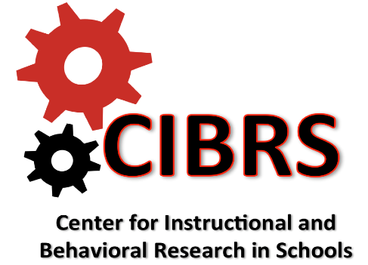
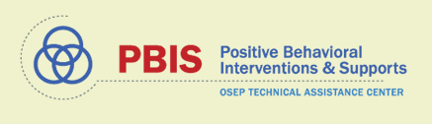
INTEGRATION/
ALIGNMENT PARTNERS
Notes:
Brahim
Behavior Support Systems Model
Integration of:
Positive Behavior Interventions and Supports (PBIS), Restorative Practices (RP), Classroom/Instructional Management, and Professional Growth and Effectiveness System/Danielson Framework
Key Players in Alignment Work
Keith Hickman, Director of Continuing Education, International Institute of Restorative Practices
Dr. Naomi Brahim, Positive Behavior Interventions and Supports/Restorative Practices Coordinator, Area 5, JCPS
Dr. Jessica Swain-Bradway, Research and Evaluation Director, Midwest PBIS Network
Dr. Terry Scott, Director, Center for Instructional and Behavioral Research in Schools, College of Education and Human Development, University of Louisville

Slide 4
Dr. Marty Pollio, Superintendent
Jefferson County Public Schools
Board of Education
Organizational Structure
Dr. Carmen Coleman, Chief Academic Officer
Dr. Katy Deferrari, Assistant Superintendent
School Culture And Climate

Slide 5
Dr. Naomi Brahim
Multi-Tiered Systems of Support Director
Dr. Katy Deferrari, Assistant Superintendent
School Culture And Climate
Organizational Structure
Saundra Hensel
Behavior Support Systems Coordinator
10 MTSS Behavior Resource Teachers
12 MTSS Academic Resource Teachers

Slide 6
Positive Behavior Interventions and Supports (PBIS)

Slide 7
Positive behavior interventions and supports (PBIS)
PBIS IS:
A framework to create a system to positively impact school climate and culture
Decision-making framework to maximize use of effectiveness of evidence-based classroom practices to
  Prevent and reduce problem behavior
  Increase learning time
  Boost academic achievement
At the core of PBIS is the interaction between teacher and student
PBIS is NOT:
Awards and cookies for all kids, all the time, no matter what
A club for a few teachers

Slide 8
Behavior Support Systems Framework
Social Competence &
Academic Achievement
Proactively Address Social Behavior Needs of All Students to Promote Social and Academic Success
OUTCOMES
Supporting
Decision
Making
Supporting
Staff Behavior
SYSTEMS
DATA
PRACTICES
Supporting
Student Behavior
Notes:
“Our Behavior Support Systems Framework asks us to consider:
“FIRST: Our valued OUTCOMES, what we hope to achieve with our students, what skills and qualities do we want them to possess when they move from grade to grade? When they graduate?”
“The PRACTICES we select and use at a high level of fidelity are directly related to the outcomes we want to achieve.”
“The SYSTEMS enable our adults to use those practices with high level of fluency (resources, professional development, planning time, PLCs).”
“And we use various sources of DATA to understand how we are doing - are we achieving our outcomes? For whom? Where do we “point” our resources for maximum achievement?”

Slide 9
Scope of pbis
Currently implemented in over 26,000 schools in the U.S.
National PBIS Technical Assistance Center, funded by Office of Special Education Programs (OSEP)
National data-base on school discipline and use of PBIS
In JCPS, PBIS is implemented in 113 out of 172 schools
Link to PBIS National Website

Slide 10
PBIS Tiered Framework
Intensive, individual interventions
1-5%
Tier 3
Few
Tier 2 Targeted Interventions
Some
Some students (at risk)
Group interventions
10-15%
All settings, all students
Proactive
80-90%
Tier 1 Universal Supports
All
Notes:
Make tier 1 at start

Slide 11
Pbis tier 1 key elements
Proactive Classroom Strategies
Positively Stated Expectations
  School-wide and common areas
  Taught and re-taught in appropriate settings
Defining Behavior
  Major (office-managed)
  Minor (classroom-managed)
Behavior Flowchart
Analyzing Data
  Share monthly with staff
  Use for data-based decision making
  Action plans

Slide 12
Foundational beliefs of pbis
We can effectively teach behavior to all children
Intervene early
Use a systematic, multi-tiered model of service delivery
Use research-based interventions
Monitor student progress and use data to make decisions
Best practices in instruction apply to both academic and social behaviors

Slide 13
A CONTINUUM OF RESTORATIVE PRACTICES
A CONTINUUM OF SWPBIS PRACTICES
If we are adding additional strategies to our continuum, we need to:
Expand Systems
Expand Data
Look out for contraindicated practices
Be worried about fidelity
Intensive Intervention
Return from suspension
Administrative transfer or school crime diversion:
Victim offender meetings
Family/community group conferences
Restitution
Intensive Intervention
Function-based support
Wraparound support
“Person-centered”
~5%
~15%
Early Intervention
Restorative Conferencing to develop alternatives to suspension:
Youth/peer court
Peer mediation
Conflict resolution training
Restitution
Early Intervention
Check-in/ Check-out
Social Skills Curricula
Prevention & Skill Building
Define and teach expectations
Establish consequence system
Collection and use of data
Prevention & Skill Building
PROACTIVE circles for:
Morning meetings
Social/emotional instruction
Staff meetings
~80% of Students

Slide 14
Contraindicated Strategies
In our classrooms and schools, we routinely use exclusion and shame as “discipline”
Effective classrooms and schools:
  Have a range of “high probability” strategies in place in the classroom
  Teachers can increase the dosage as needed to build student fluency social skills
  Eliminate contraindicated strategies

Slide 15
Jefferson County Public Schools
Highlights:
28th largest school district in U.S.
172 school sites
6 high schools on US News and World Report’s list of “Best U.S. High Schools”
41 National Merit semifinalists in 2018
415 National Board Certified Teachers
According to a 2018 survey, 91% of parents report that they are satisfied with their child’s school

Slide 16
Jefferson County Public Schools
DIVERSE COMMUNITY WITH DIVERSE CHALLENGES
  6% of JCPS students receive ELL services
  120 different languages spoken
  Approximately 12% of JCPS students receive Special Education services
  6% of JCPS students are homeless
  62% of students receive free/reduced lunch
BUS RIDERSHIP
  65,000 students (nearly 75%) ride the bus every day
MEALS
  JCPS provides 109,000 meals, including breakfast and lunch, every day
99,910 students
(2017-18)
(~81% of market share)
1/7 of all students in KY
47% White
37% African American
16% Other

Slide 17
Alignment

Slide 18
Updates to the District Leadership
New Superintendent along with multiple rounds of re-organization
Renamed/branded the department
  Now under umbrella of MTSS with 2 areas of focus: MTSS Academic, MTSS Behavior
Full support of the superintendent - opened the community event held in August 2017, and Spalding RP Education Summit in March 2018
Board member support with just under $3,000,000 invested solely in Restorative Practices
Notes:
All changes went through board approval process
April 2017 – 3 hour event approx. 100 participants
Overview of RP, PBIS, and classroom management work
August 2017 – 2 day event with approx. 50 participants
Overview of RP with data analysis of equity score card

Slide 19
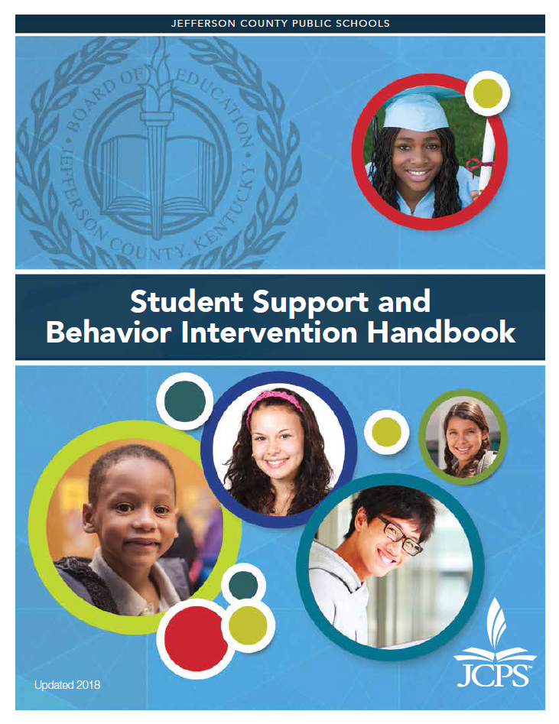
Updated Student Handbook
Student Support and Intervention Handbook

Slide 20
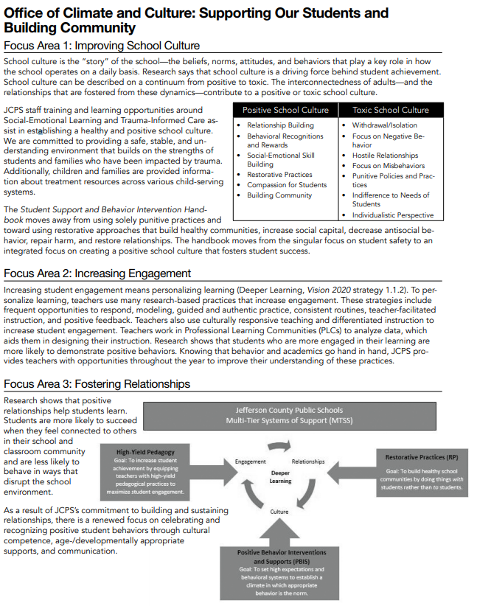
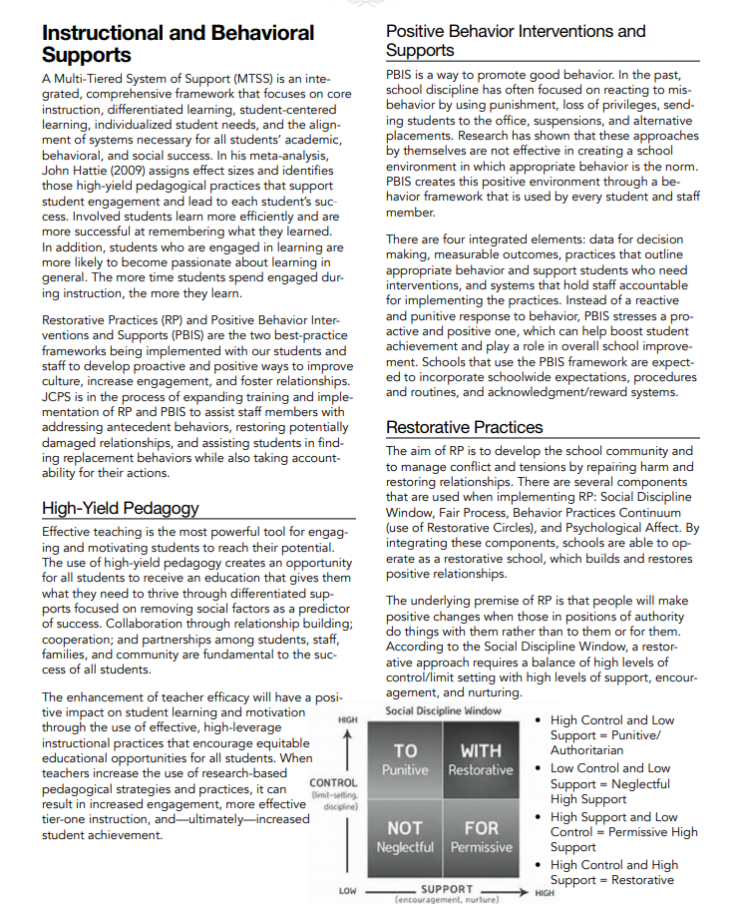

Slide 21
District leadership Team
COMPOSED OF:
Asst. Superintendent
Executive Administrator
MTSS Behavior Department (Coordinator + 10 Resource Teachers)
Principals (1 Elementary, 1 Middle, 1 High)
State PBIS Director
Special Education
Student Relations
YEAR 1-2 TRAININGS:
Introduction to Restorative Practice (and TOT)
Introduction to Circles (and TOT)
Facilitating Restorative Conferences (and TOT)
Restorative Responses to Adversity and Trauma
Basic School Climate (and TOT)
Notes:
Initial application presented to the school board – Feb. 2017
Presented to principals – March 2017
Applications due with SBDM approval – March 2017
First selection - April 2017
Map of schools shows that schools were chosen from all over the district including high and low achieving schools

Slide 22
Selection Process
COHORT 1
Initial application process – March 2017
Selected 18 schools for implementation - April 2017
  9 Elementary Schools
  9 Middle/High Schools (includes alternative and state agency schools)
COHORT 2
Revised application process – March 2018
Selected 12 schools for implementation - May 2018
  Includes youth detention facility, State Agency School, ESL Newcomer Academy
Added 2 additional schools
3 were trained early
Notes:
Initial application presented to the school board – Feb. 2017
Presented to principals – March 2017
Applications due with SBDM approval – March 2017
First selection - April 2017
Map of schools shows that schools were chosen from all over the district including high and low achieving schools

Slide 23
Training Plan
Whole school trainings include all staff members
Held on dates without student attendance
Staff paid their daily rate/PD credit
Total cost for training, consultation, and supports from national partner and to pay daily rate = approx. $3,000,000
Notes:
Whole school training included all staff
Certified = Teachers and Administrators
Classified = Clerks, Lunchroom Staff, Security, Mental Health Counselors, Social Workers, Bus Drivers
School board is paying for a contact with IIRP for training and coaching support
TOT with district personnel to sustain the training after three year contract ends
Three year coaching and training contract = $2,000,000
Total Cost for staff participation = $800,000

Slide 24
RP + PBIS + Classroom Management Alignment
The expansion of “PBIS” lens to a full behavioral frame and what that means: alignment of the classroom, RP, and SWPBIS
Alignment to Danielson Framework/Evaluation System
RP/PBIS Alignment Trainings
Notes:
Worked with national experts:
Jessica Swain-Bradway from Midwest PBIS
Keith Hickman – IIRP
Terry Scott – University of Louisville
Trained PBIS using school team model – does not always filter to the classroom
RP – whole school with all staff trained at the same time, digesting the content together
Classroom management – important because teachers need in classroom strategies to curb behavior
Kentucky using the Danielson framework as the evaluation system for teachers and administrators
Important to align the work to how teachers and principals are evaluated so they do not see this as another thing but as an integration of what they are already doing
Because we trained so many schools, we did not want schools to throw PBIS out. We know that you have to look at data, set and teacher expectations for students and staff, and hold people accountable. PBIS is a great foundation for the work of being more restorative.

Slide 25
Danielson | PBIS | RP
1B. Demo. Knowledge of Students |  | Community Circles, Welcoming Circles, Students “keeping” the circle
1E. Designing Coherent Instruction | Matching practice opportunities to student needs Ensuring re-teaching is part of classroom routines Professional development and coaching
2A. Creating an Environment of Respect & Rapport | School and Classroom Expectations Calm re-teaching Behavior problems treated like learning errors Professional development and coaching | Community Circles, Welcoming Circles, Students “keeping” the circle
Notes:
There is real strength in pulling from what works across these areas. We expand teachers and administrators tool kits. We include family and student voice, we create a stronger community of learners and teachers.
Systems and Data are really below the line work.

Slide 26
Danielson | PBIS | RP
2D. Managing Student Behaviors | Re-teaching, Reinforcing, Behavioral Team-based problem solving Data to guide interventions Professional development and coaching | Developing relationships Using informal and formal restorative questions
3C. Engaging Students in Learning | High rates of opportunities to practice High rates of reinforcement to encourage participation Professional development and coaching | Developing relationships Creating a safe, welcoming climate
3D. Using Assessment in Instruction | Using data on outcomes to drive how we teach Team based decision making Professional development and coaching

Slide 27

RP and PBIS Informal to Formal Practices
Tier 1: Proactive Classroom Strategies
Tier 1: Re-teach & Increase Classroom Strategies
Tier 2: Referral Process
Tier 3: Team Problem Solving
Classroom based, Explicit Instruction, Calm Corrections,
Praise (4:1)
Classroom based, Explicit Instruction, Calm Corrections,
Praise (4:1)
More Specific, Intense Instruction and Practice through T2 supports AND Classroom Support
Function-based, Person-Centered, Tier 3 plans AND Classroom Support
Included alignment slides and activities into 2 day IIRP training
Notes:
Restorative Practices and PBIS Continuum Alignment
[Start with “informal” and move to “formal: starting with Tier 1 Proactive:]
“Informal” practices in PBIS are:
- The foundational classroom practices that establish a positive, predictable environment.
- They are evidence-based.
They provide a bridge to more advanced interventions.
They are the high probability practices of (1)explicit instruction, calm error correction, and behavior specific praise.
We intensify these main practices, and if students are not responsive, the teacher increases the dosage of those practices.
“As teachers move from informal- classroom based- to more formal interventions they extend problem solving to other members of the school (Tier 2 team, SST, etc.).”
“If not successful, the formal problem solving continues with a person-centered plan, that still uses the high probability practices, but in a much more intense and specific manner with an individual student.”
“Problem solving happens with more people involved, with the main goal to intensify, and specify the use of the foundational practices.”
“It is important to note that the practices all link back to the classroom and the interactions between the teacher and the student.”

Slide 28
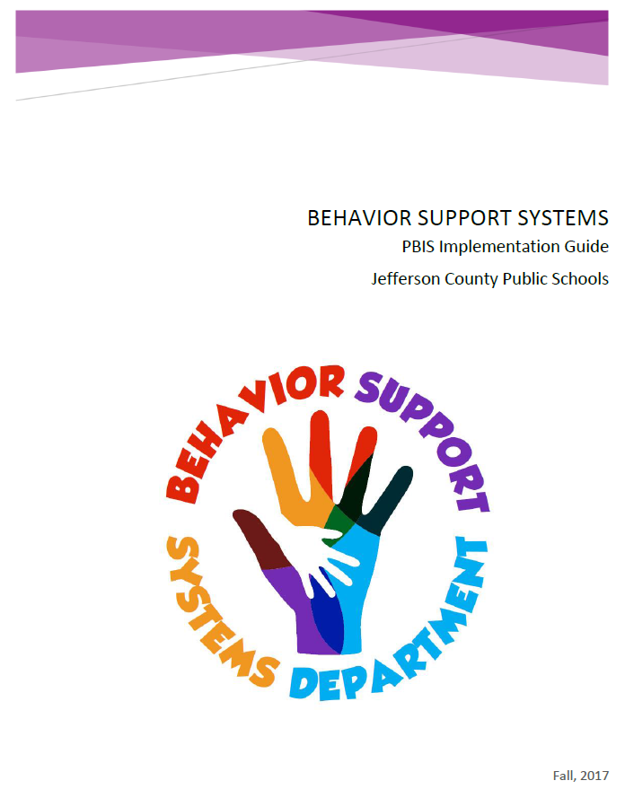
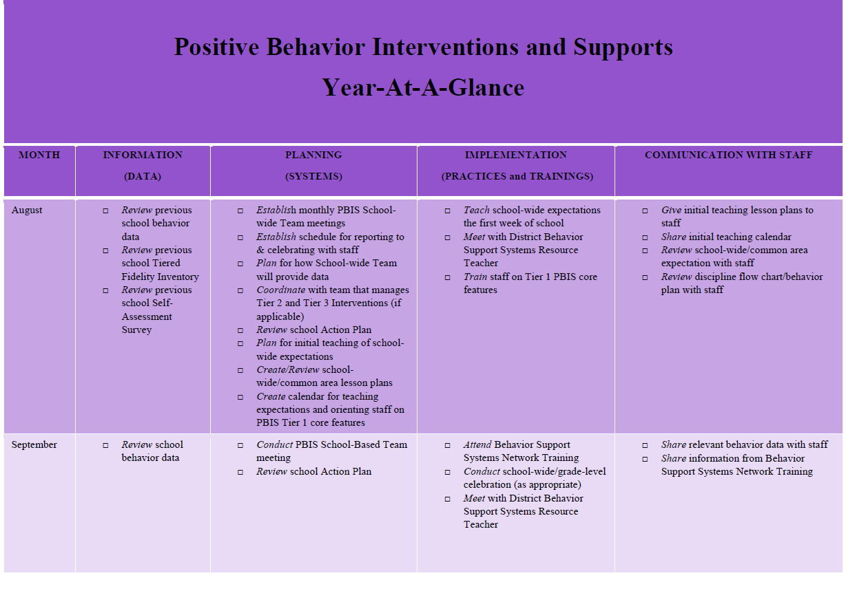
PBIS implementation support
Link to Documents: JCPS PBIS Implmentation Guide JCPS PBIS Year-at-a-Glance

Slide 29
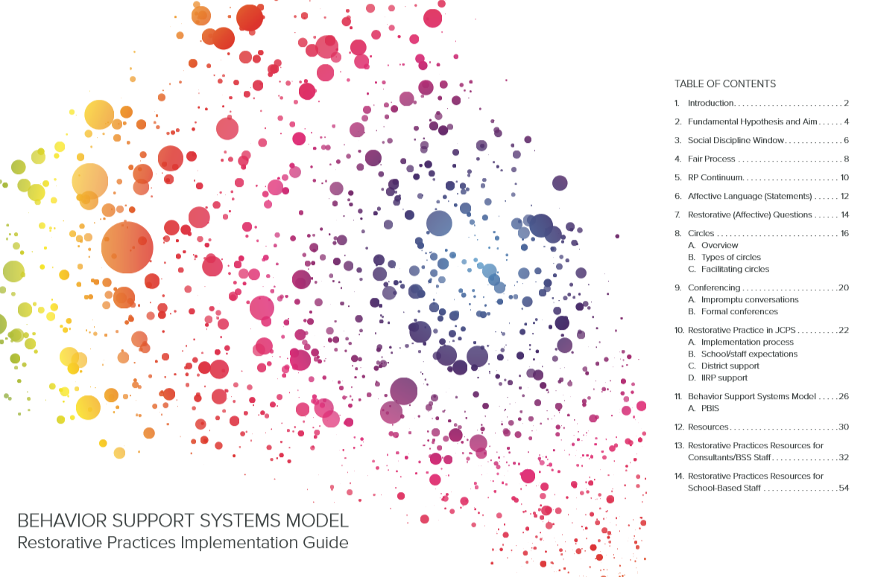
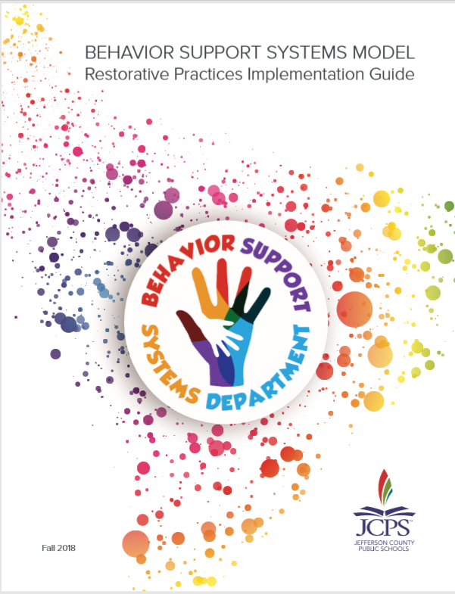
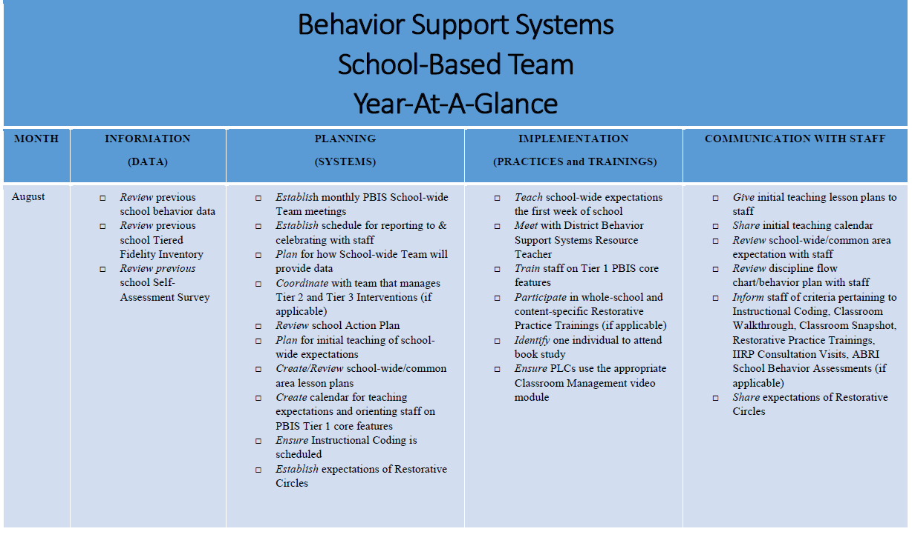
Behavior Support Systems Model implementation support
Link to Documents: JCPS RP Implementation Guide JCPS RP Year-at-a-Glance

Slide 30
Coaching Plan
District Resource Teachers (Coaches) have gone through trainings as RP coaches and are receiving on-site supports from IIRP: epitomize the behavior framework in place.
Extensive training from IIRP
- District team went through a series of trainings before school teams
- Trainer of Trainers for Intro to RP and Using Circles Effectively
Partnerships
- University - Partner with Dr. Terry Scott (University of Louisville CIBRS) to provide training for district resource teachers
- National – IIRP with Director of Continuing Education and Midwest PBIS Network
Coaching, Consultation, and Support for Schools
- Monthly On-Site Consultation for trained schools with national consultant
- Pre-call with national consultant, principal (designee), and district support
- Coaching plan customized for each school with a different focus each month
- District support for schools – weekly onsite coaching and support from district team
Notes:
- PBIS coaches becoming a behavior coach (expanding their knowledge of classroom, RP)
- Updates to the district offices / leadership
- involvement of the community and working with the board
- updates to the student handbook
- The data integration (in process is fine).

Slide 31
Community Events
Large Scale Community Event – August 2017
Invited prominent community leaders – Court System and DJJ, Faith Based Organizations, Teachers Union, Helping Professions, PTA
Three of seven board members attended
Reviewed the Theory of Aligned Contribution
Taught limited components of RP (Social Discipline Window and Fair Process)
Community building elements – model proactive and reactive circles
Data Walk – with data analysis of district specific data
Spalding University RP Education Summit
Invited all JCPS schools for 1 day summit
3 schools showcased their implementation
2-day School Resource Officer training in RP
Smaller Scale School-Based Community Events
One event per trained school
Invite parents, students, and community leaders for each school
Teach limited components of RP (Social Discipline Window)
Community building elements – model proactive and reactive circles
Notes:
Community leaders attended from all sorts of social services professions – juvenile justice, county attorney’s office, big brothers big sisters, human relations commission

Slide 32
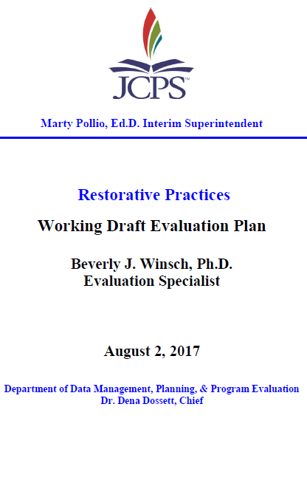
Evaluation Plan
Formative and summative data collection includes a Classroom Observation Tool and Circles Observation Tool
Major Outcome Variables
Climate
Student Behavior
Staff RP Skills and Engagement
Academics
Monthly implementation meetings between district support team and RP evaluator; additional meetings between national consultants, school and district staff
Quarterly Reports to schools and district staff will include data on trainings, coaching and support, as well as survey data
Link to Documents: JCPS RP Program Evaluation JCPS RP 2017-18 Program Evaluation Report
Notes:
RP will be implemented with high fidelity leading to measureable progress on the major outcome variables derived from the following domains:
Climate (i.e., relationship skills, self-awareness, social awareness, school engagement, school belonging, school discussion climate, caring environment, personal safety, overall satisfaction, personalization, collaboration, voice, perseverance, compassion, teaching, and site safety.)
Student Behavior (i.e., suspension events, attendance)
Staff RP skills and engagement (i.e., self-reported skills, attendance, retention, discipline disproportionality)
Academics (i.e., gap, growth, novice reduction)

Slide 33
Data Integration
CLIMATE
IMPACT | MEASURES
Relationship Skills, Self-awareness, Social Awareness, School Engagement, School Belonging, School Discussion Climate, Caring Environment, Personal Safety, Overall Satisfaction, Personalization, Collaboration, Voice, Perseverance, Compassion, Teaching, And Site Safety | Comprehensive School Survey Students Parents Teachers Staff Teacher TELL Survey Teacher Pre/Post Survey Teacher Retention School Observations Student Voice Survey Student Focus Groups

Slide 34
Data Integration
BEHAVIOR
IMPACT | MEASURES
Suspensions, Discipline Disproportionality, Absences | Suspension Events Suspension Duration Group Suspension Gaps Absences
ACADEMICS
IMPACT | MEASURES
Deeper Learning Opportunities (Caring, Thinking, Communicating Skills), Gap, Growth, Novice Reduction, Proficiency Rates | Comprehensive School Survey Student Focus Groups State Assessment Results Student Retention Rates

Slide 35

High School Exemplar:
Waggener

Slide 36
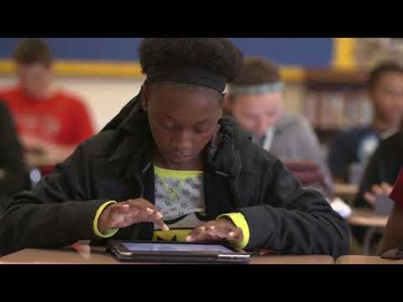
Welcome to Waggener
High School

Slide 37
Waggener Enrollment | 912
Freshman Academy Enrollment | 220

Slide 38
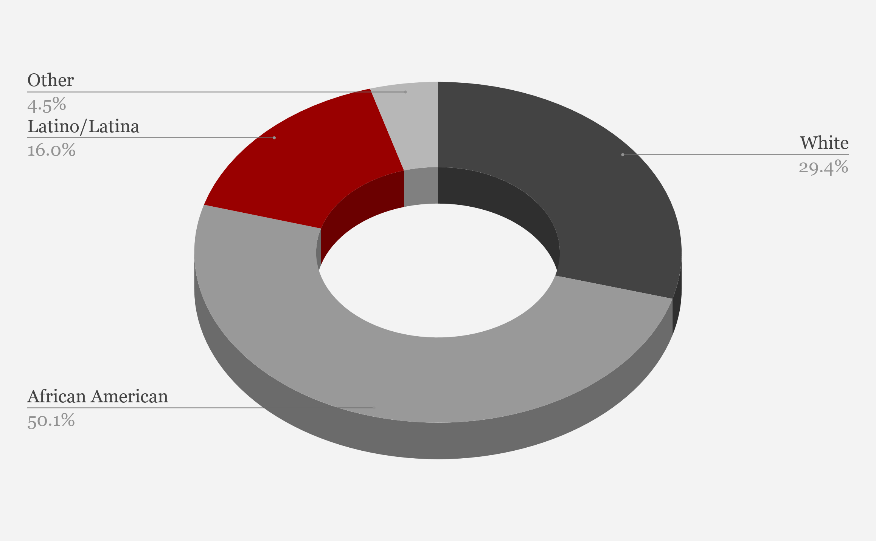
The Demographics of Waggener
Demographics

Slide 39
Free/Reduced Lunch | 76%
Attendance Rate | 88.3%
Retention Rate | 08.4%
Drop Out Rate | 02.4%

Slide 40
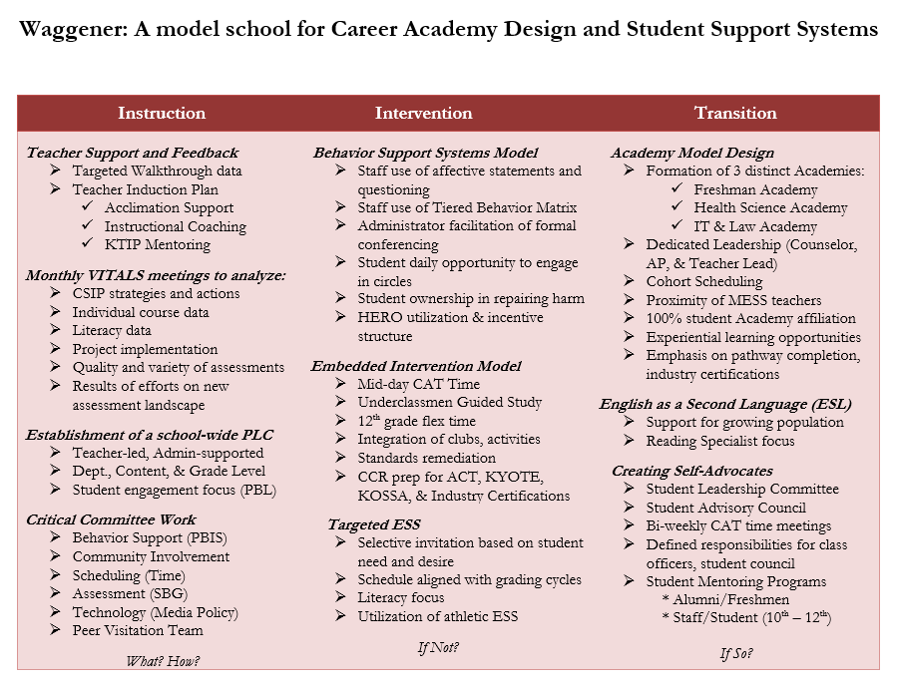

Slide 41
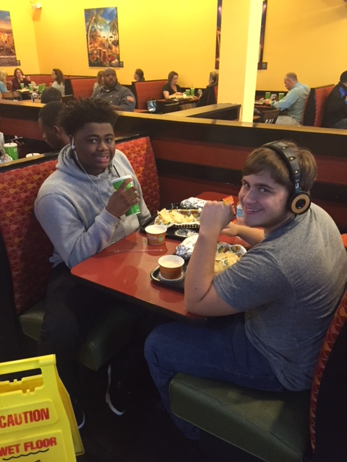
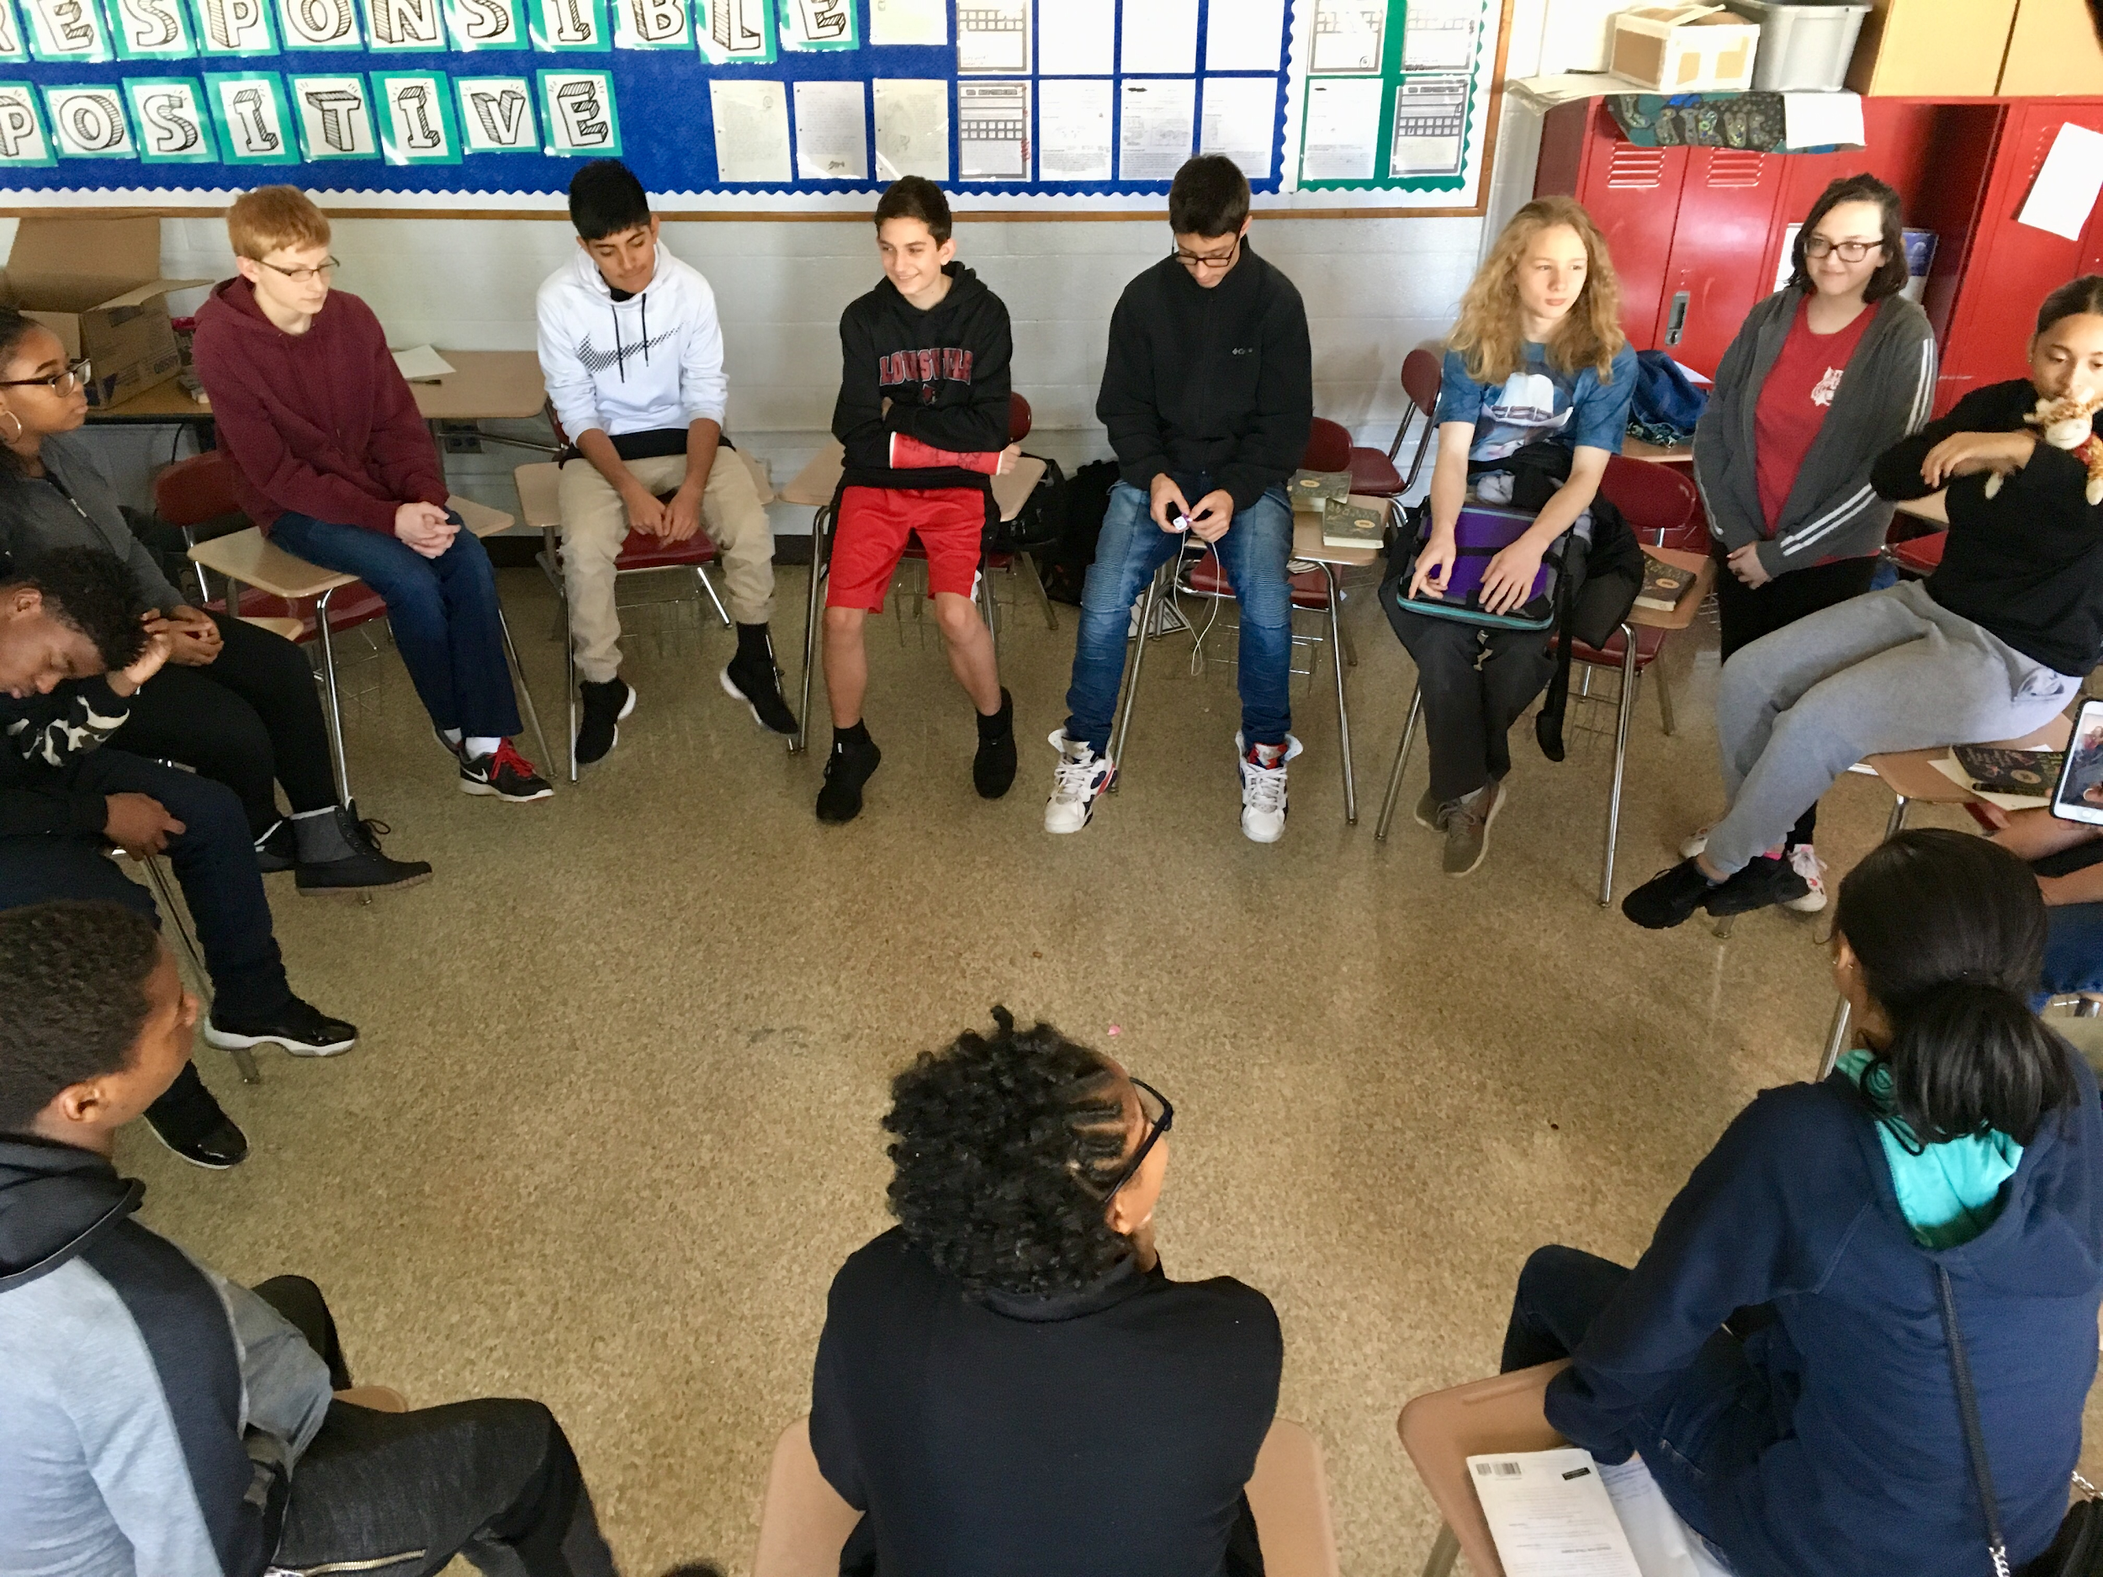
Behavior Support Systems
Daily opportunity to participate in Circles
Student & Staff use of affective statements and questioning
HERO positive behavior management system

Slide 42
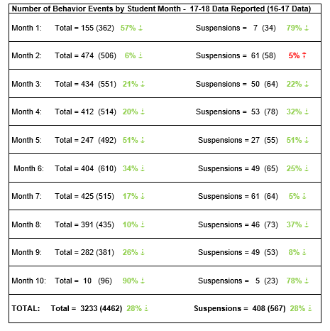
We are seeing discipline data results . . .

Slide 43
Behavior Data: Totals
Number of Behavior Events
16-17 4,462 total events
17-18 3,233 total events
1,229 FEWER events
28% overall reduction
Number of Suspensions
16-17 567 total suspensions
17-18 408 total suspensions
159 FEWER suspensions
28% overall reduction
Savings:
2000 instructional hours 307 instructional days
$6092 in state funding 9 administrator days ($3,600)

Slide 44
40 Day Discipline comparison
TOTAL SUSPENSIONS |  | TOTAL STUDENTS |  | TOTAL DAYS |  | AVERAGE LENGTH
2017 | 2018 | 2017 | 2018 | 2017 | 2018 | 2017 | 2018
76 | 82 | 63 | 54 | 200 | 141 | 2.6 | 1.7

Slide 45
Instructional coding
District contracted with University of Louisville (Dr. Terry Scott)
3 times during the year
Coders went in every classroom for 15 minutes
Coded teacher and student behavior

Slide 46
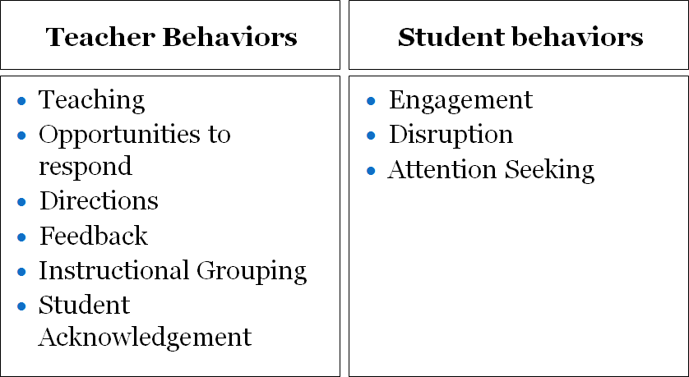
Student/Teacher Interactions

Slide 47
Questions/Responses
34:24
66:42
Notes:
Hands raised = Student raises hand or asks question in an appropriate manner to elicit an answer (academic or social) from the teacher.

Slide 48
Observed disruptions
Notes:
Disruption = Student is neither actively engaged AND displays behavior that does or potentially could disrupt the lesson (e.g., out of seat; noises, talking to peer, making comments). Behaviors can range from low intensity (out of seat to sharpen pencil) to high intensity (making derogatory statements or destroying property).
WHEN TO COUNT A NEW ONE:
Code new event if topography changes (ie talking and then tapping) or if talking changes to new person or if 5 sec of pause or if other speaker (teacher or peer) respond then target talks again.

Slide 49
Students are engaged in the classroom
Notes:
Downtime = There are no academic expectations of the target student or group target student is part of. Use down-time any time a reprimand or discussion with another student exceeds 5 sec without clear expectations. If student leaves class to go to the restroom/get a jacket/get her jacket, code Downtime.
Target student off-task = Student is neither actively engaged nor looking at the teacher but is not disrupting the class in any way (no negative behaviors).
Passive Engagement = Student is passively attending to instruction by orientation to teacher or peer if appropriate.
Active Engagement = Student is actively engaging with instructional content via choral response, raising hand, responding to teacher instruction, writing, reading, or otherwise completing assigned task.

Slide 50
Positive/Negative Feedback
1 per 8.33
mins
1 per 25
mins
1 per 12.50
mins
1 per 33.33
mins
Notes:
Positive feedback = Teacher gives the class or individual student feedback on an academic or social behavior that indicates the behavior/response is correct. Can be verbal or gestural.
Negative feedback = Teacher informs student that behavior/response is incorrect, but does not provide corrective feedback (e.g., “no” “stop that” “turn around” “quiet”). Can be verbal or gestural.

Slide 51

LESSON FRAME
Learning Target: We will…(learn today)
  Gives Students a direction for their learning
  Helps students make connections/ build upon their cognitive filters
Closing: I will…(demonstrate what I learned)
  Stretches the Rigor
  Shows proof of understanding
Frame the Lesson
Notes:
We understand the impact that childhood trauma (including living in poverty) has on student learning. Many of our learners have similar backgrounds due to familial circumstances or life circumstances. Our life experiences shape the way we learn. Those experiences help to establish cognitive filters that help us sort through, categorize, prioritize and retain/discard new information. Students who experience childhood trauma have shown significant delays in development of the frontal lobe of the brain. The frontal lobe is where a person’s capacity for self-regulation (executive function… goal setting) exists.
Lesson Frame: The effective lesson frame provides the class with a clear picture of critical concepts that will be addressed by the lesson (We will…..What are we going to learn today?) and the individual student with a clear picture of how he or she will demonstrate the understanding of the critical concepts (I will……What is the most critical element to understand?). The lesson frame is communicated consistently, both visually and verbally.
Eliminates “Guess what the teacher is thinking you should know and do”
Shifts responsibility to the student
Stretches the rigor when well-thought and well-written
Primes the brain
Leads to more effective lesson closure
Chunks the learning
Utlilizes the Primacy/Recency effect (The brain tends to retain what it hears first and last)
Increases student retention in the closing
Also assists the teacher with focus of the lesson, knowing that the lesson activities are leading the students to success in completion of the closure activity.

Slide 52
“CAT” Time
Students Earn
½ Credit Per Semester
“Leadership Dynamics”
Targeted Interventions/Supports
ACT, College & Career Ready (CCR), End of Course exams (EOC), KOSSA, Industry Certifications
Content Area Intervention/Enrichment
  Built into school day
  Increasing student autonomy

Slide 53
“CAT” Time
WHOLE-SCHOOL
Restorative Practices lessons on Mondays and Fridays
12th
Open CAT Time (Students’ choice) Tuesday-Thursday
Teachers offer different intervention/enrichment options
9th, 10th, 11th
Guided Study
Teachers Request Students

Slide 54
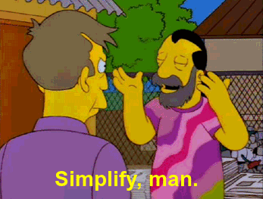
lesson Structure
Agenda
School-wide Structure for Circles
Check-in Question
Lesson Content
Discussion based with supplementary content presented in PowerPoint
Monday: Cover new content
Friday: Review and dig deeper on Friday

Slide 55
Additional Supports
Restorative Practices Coach
District Behavior Support Systems Lead
Waggener’s “Four Pillars of Success”
Be Prepared, Respectful, Responsible, and Safe
PAC “Positive Action Center” Room
Reflection sheet using Restorative Questions
Circle Schedule
Content Circles

Slide 56
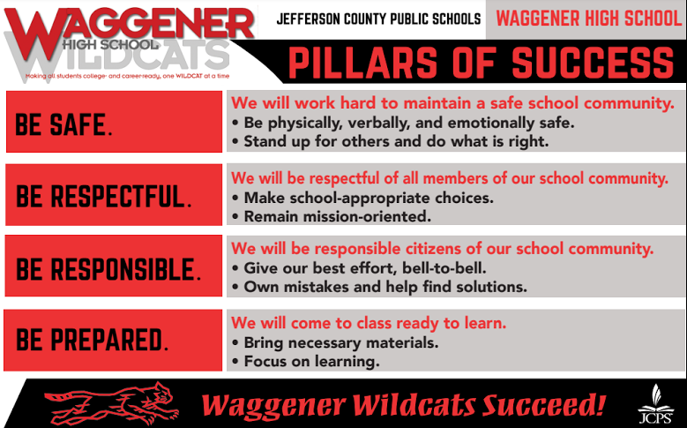
Additional Supports

Slide 57
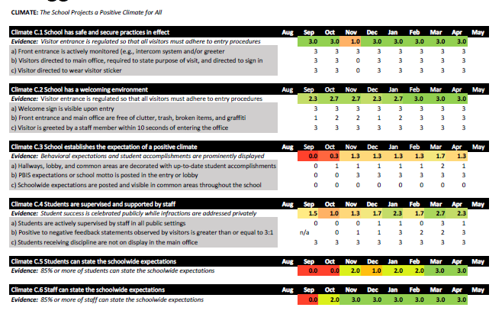
PBIS CLIMATE Walkthroughs

Slide 58
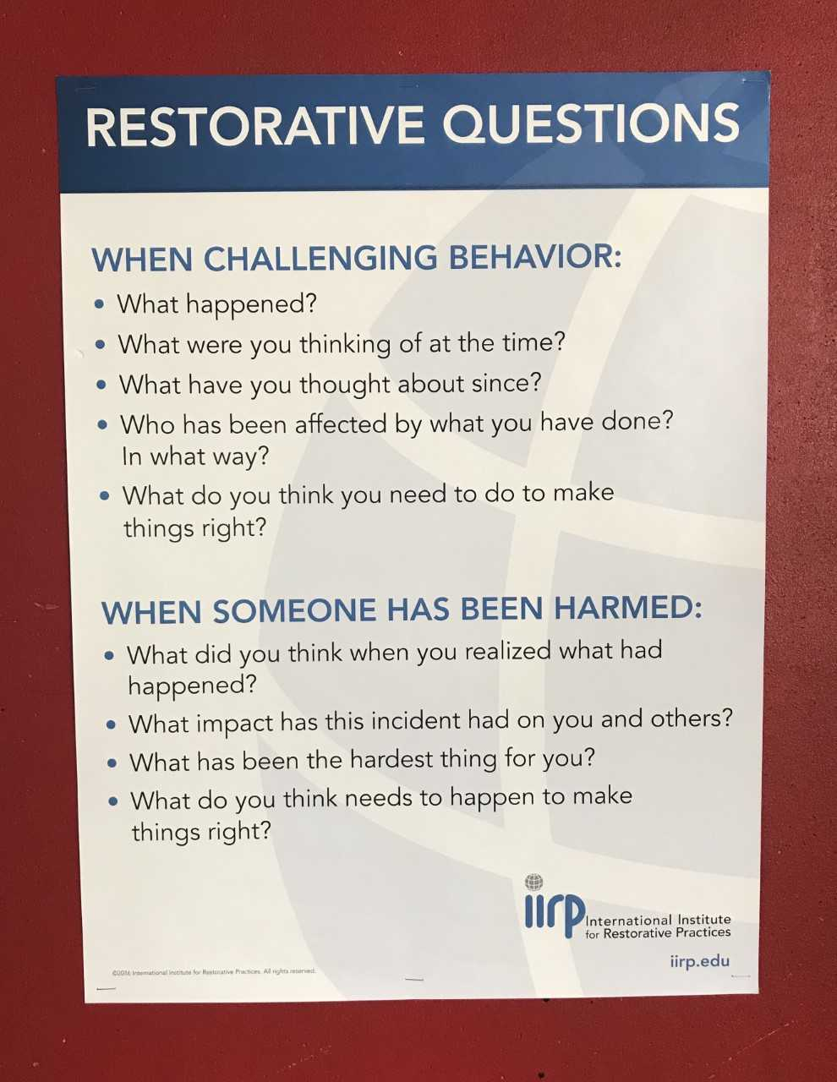
Additional Supports
“PAC” aka the Positive Action Center
In the words of one of our students…
  “It’s a place we can go to cool off and be more mindful of our actions.”
Reflection sheets in Google Drive
  Shared with teacher when complete

Slide 59
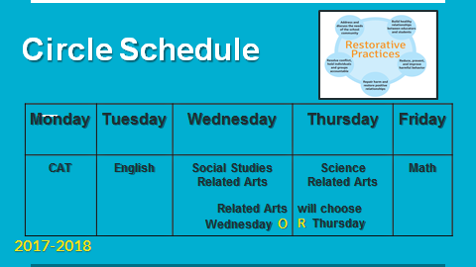
Additional Supports

Slide 60
Re-integration model
Re-integration circle facilitated by counselors for every student returning from a long-term suspension or placement at an alternative school
Eventually plan to scale to all suspensions and chronic absences
Collaboration with Student Relations at district
Designed to reinforce that the student is part of the Waggener community and foster a sense of belonging

Slide 61
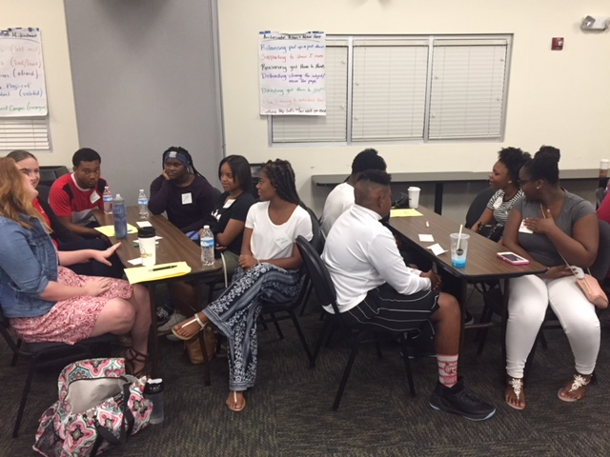
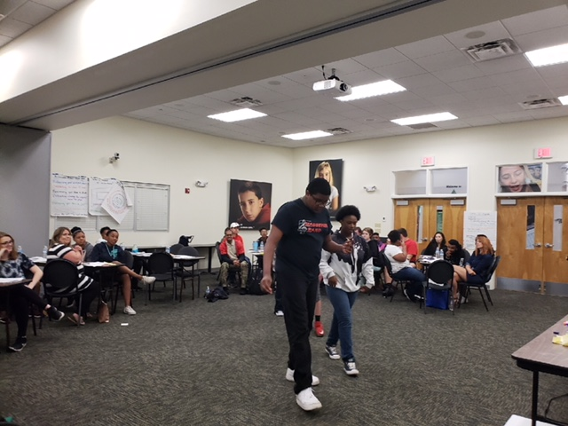
Safe School Ambassadors
Trained 37 students & 10 adults
Deployed students into various CAT Time groups
Facilitate circles, help teach RP lessons
Follow-up through family group meetings

Slide 62
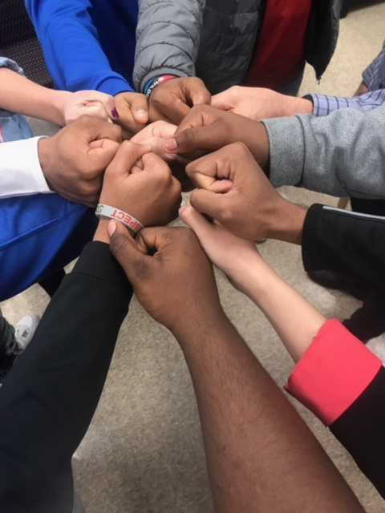
Lessons Learned - School
Change is HARD!
To get different results everything has to be done differently (systems, resource allocation, personnel)
Trust the process!
Frame the data around the ultimate goal – increased student achievement
Communication is vital!
Celebrate early & often, big & small

Slide 63
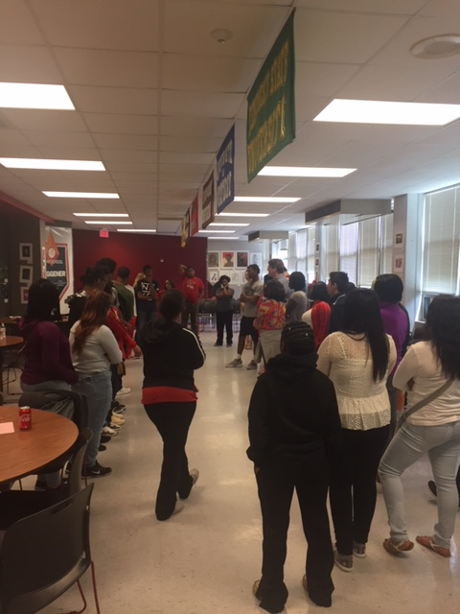
Moving forward- School
Get the work to the student level
    CAT time lessons
    Safe School Ambassador Program
Continual training
Intentional data tracking
  Discipline data
    Pull out disruptive vs. non-attendance
    Address non-attendance with RP
    Repeat offenders
  Classroom observational data
    Student voice
    Engagement
    Teacher responsiveness
  Culture & Climate (TELL & CSS survey data)
  Academic data

Slide 64
District Lessons Learned
Obstacles
Opportunities
Administrator and Teacher Support
District Support Personnel (Adequate FTE)
Funding = Daily Rate X Two Days X Total Staff X 18 Selected Schools
Scheduling Whole School Training Sessions
Integration of RP, PBIS, and Classroom Management
Committed Board Members
District Reorganization
Application Process versus Voluntold Schools
Coaching/Consultation Planning
Implementation Planning
Culture and climate integration (SEL/Trauma Informed Care)

Slide 65
Contact Information
Dr. Naomi Brahim naomi.brahim@jefferson.kyschools.us
Multi-Tiered Systems of Support (MTSS) Director
Ms. Saundra Hensel saundra.hensel@jefferson.kyschools.us
Behavior Support Systems Coordinator
Dr. Sarah Hitchings sarah.hitchings@jefferson.kyschools.us
Principal, Waggener HS
Dr. Chris Kolb chris@kolbforschoolboard.com
Jefferson County Board of Education Member

Slide 66
RP PBIS Brief –
Implementation of Comprehensive Behavior Support Systems Model
Brief created in collaboration between Dr. Naomi Brahim and Saundra Hensel of JCPS, and Dr. Jessica Swain-Bradway of Northwest PBIS Network
Link to MTSS Behavior website containing brief

Slide 67
Resources
PBIS Forum in Brief: Integration of RJP within SWPBIS https://www.pbis.org/Common/Cms/files/Forum15_Presentations/RDQ%2013%20Brief%20-%20Restorative%20Practices.pdf
Advancing Education Effectiveness: Interconnecting School Mental Health and School-wide Positive Behavior Support https://www.pbis.org/common/cms/files/Current%20Topics/Final-Monograph.pdf
PBIS Technical Guides (Technical Guide for Alignment of Initiatives, Programs and Practices in School Districts) https://www.pbis.org/training/technical-guide
The Transformation of West Philadelphia High School: A Story of Hope https://www.youtube.com/watch?v=hatsl1lu_pm
Restorative Justice in Oakland Schools, Tier 1 Community Building Circles https://www.youtube.com/watch?v=rdkhcqrld1w
International Institute for Restorative Practices www.iirp.edu
National Association of Community and Restorative Justice http://nacrj.org/

Slide 68
JCPS-Specific Resources
Student Support and Intervention Handbook
https://www.jefferson.kyschools.us/sites/default/files/forms/Student%20Support%20and%20Behavior%20Intervention%20Handbook.pdf
Multi-Tiered Systems of Support Department
https://www.jefferson.kyschools.us/department/academic-services-division/school-climate-and-culture/multi-tiered-systems-support
MTSS Behavior Department
https://www.jefferson.kyschools.us/academic-services-division/academic-support-programs/positive-behavior-intervention-and-supports
Classroom Management Modules - High-Yield Strategies to Support Classroom Management
https://www.jefferson.kyschools.us/classroom-management-modules
Article on Restorative Practices at Waggener HS
https://www.courier-journal.com/story/news/education/2018/08/13/jcps-restorative-practices-solution-disproportionate-school-suspensions/913411001/
Waggener High School
  District Profile Page: https://www.jefferson.kyschools.us/schools/profiles/waggener
  School Website: https://schools.jefferson.kyschools.us/High/Waggener/

Slide 69
References
Costello, Bob, Joshua Wachtel, And Ted Wachtel. The Restorative Practices Handbook: For Teachers, Disciplinarians and Administrators. Bethlehem, PA: International Institute for Restorative Practices, 2009. Print.
Costello, Bob, Joshua Wachtel, And Ted Wachtel. The Restorative Circles in Schools: Building Community and Enhancing Learning. Bethlehem, PA: International Institute for Restorative Practices, 2010. Print.
Wachtel, Ted, Terry O’Connell, And Ben Wachtel. Restorative Justice Conferencing: Real Justice & the Conferencing Handbook. Bethlehem, PA: International Institute for Restorative Practices, 2010. Print.
Vincent, C., Horner, R.H., & May, S. (2009). ODR Across Grade Levels: What are the Patterns of Office Discipline Referrals Across Grade Levels. Evaluation Brief. OSEP PBIS Technical Assistance Center. Retrieved July 7th, 2017 from http://www.pbis.org/blueprint/evaluation-briefs/odr-across-grade-levels

