Slide 1
Student Voice Improvement Paradox: Spreading & Sustaining Youth Court
Dr. Marc Brasof
Assistant Professor of Education
Arcadia University
October 25, 2018
TWITTER: @BRASOF

Slide 2
Some guiding questions
Am I seeing wider impacts of work across my organization? If not, how might the design of that work be a root cause?
How can my work sustain so it is not dependent solely on people?

Slide 3
Organizational Improvement Paradox
Positive benefits of a change strategy do not spread throughout an organization despite change agents’ intention/assumption for that to happen (Goodman, 2000)
Has this ever happened in your work? Why?

Slide 4
Organizational Improvement Paradox
Lack of spread/impact beyond immediate implementers, and ultimately sustainment, might actually be result of the design of the change strategy

Slide 5
Student Voice
the positionality of young people as students can provide important perspectives, solutions, and leadership for improving school across a wide-range of important indicators, and thus, should be involved in the formal management processes

Slide 6
Benefits of SV
School
Race/class
Curriculum
Community Involvement
Attendance
Discipline
Teachers
Responsive
Renewal
Reinforce
Students
Identity
ABCs
Motivation
Brasof (2016)
Student Voice and School Governance

Slide 7
Student Voice Improvement Paradox
SV initiatives tend not to spread beyond initial adult implementers nor involved students.
Instead, student voice initiatives often remain isolated—both in identity and inclusion with other established decision-making processes—which reduces educator buy-in and implementation throughout the organization.
Consequences: limited impacts & sustainment of initiatives

Slide 8
Youth Court
Maureen’s (5th Grader) case: How would the traditional discipline system handle this?
constant talking, roaming around the classroom, taking advantage of bathroom privileges, and overall defiance towards the teacher
progressive consequences would have been a detention, a letter sent home describing her behavior after numerous phone calls, and then suspension (NORMS).
What does such a system/response to misbehavior assume?

Slide 9
Youth Court
How did Youth Court handle it?
assigned a mentor (peer) who can help Maureen calm down when she gets angry.
Permitted to take a break and go to the bathroom for some alone time
Reflected in her journal about what she is angry about instead of taking it out on others
Moved her seat during Power Play so she is not distracted
What does such a system/response to misbehavior assume?

Slide 10
Surfaced Vital Information
Youth and Adult Conversations reveal Vital Information about
Students
Teachers
Wider school policies
Classroom
Does it get stuck in YC? Why and how?
Brasof, M. (submitted). Meeting the discipline challenge: Capacity-Building Youth-Adult Leadership.
Journal of Educational Change

Slide 11
Assumptions:
Interventions help address individual instances of misbehavior, a well-documented outcome (Butts & Buck, 2000; Butts, Buck & Coggeshall, 2002; Gase, Kuo, Lai, Stoll & Ponce, 2016; Povitsky, 2005)
Restoring students back to the class creates a more peaceful/productive environment.
Restorative approaches in classrooms will Improve school climate & culture; reduce disciplinary incidents
Improv Paradox: YC ability to influence the myriad forces engendering misbehavior was inconsistent or absent.

Slide 12
Resolving the Improvement Paradox: Why is YC not having greater impact across the school? How can information YC surfaced be leveraged to improve School?

Slide 13
Linkage Theory
Linkages are the connections in an organization between activities, events and outcomes within and across levels of an organization
What pathways exist, and where can/should new ones be built?

Slide 14
Linkage Analysis
Activities, Events, Levels & Outcomes
Political Arenas
Concept Maps
Logic Models
Coordinating Mechanisms
Twitter: @Brasof

Slide 15
Concept Maps
Concept maps visualize how change work is designed to solve important problems
Concept maps represent participants’ mental images/assumptions of the causes of a problem & what should be done about it;
Can help identify biases/assumptions
How do I get tenure?
YC: What influences/engenders misbehavior?
What are all the forces that cause (problem) and is your work addressing all of those forces?

Slide 16
Activities, Events, & Outcomes
Activity is a “definable unit of work produced by an individual…or things people do.”
referral; pre-hearing interviews/case building; prosecution; defense; deliberation; sentencing—surfaced vital information in each activity
Event is a “cycle of interrelated activities performed by two or more people.”
Conflict & discipline write-up; hearing; sentence completion—no other outcome planned—where is the feedback loop?

Slide 17
LEVELS
hierarchal locations in an organization; physical as well as conceptual space; horizontal (same level of the organizational flow chart) and vertical (up or down)
same floor of a building,
grade groupings,
teachers,
administrators,
support personnel
multi-layered, socially interactive organization requires more, not less coordination across and within levels
What are the activities/events that make up the whole?
What are outcomes measured/missed?
What levels are involved?

Slide 18
Logic Models
trace how the path of individuals, activity, events, and outcomes follow within an initiative and the organization
Individual- and organization-logic models allow for the examination of interventions when there are repeated cause-effect-cause-effect patterns, whereby a dependent variable (activity or event) at an earlier stage becomes the independent variable for the next stage.
What is the sequence(s) of activities/events/outcomes?
How does your program move through the organization?
How do individuals/groups move through the program?

Slide 19
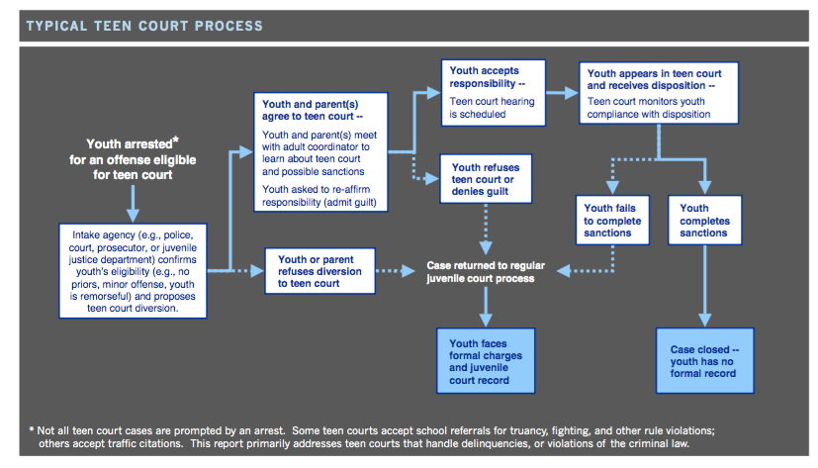
Youth Court: Individual-Logic Model

Slide 20
Outcomes at Each activity
Individual-logic
pre-hearing interviews/case building
prosecution
defense
Jury deliberation
Sentencing
Org logic model considers how activities, events, levels and outcomes are connected
Who triggers case?
Who is involved in the hearing?
Where does case file go? Who manages?
What happens after a case is closed? (nothing at most sites)

Slide 21
Political Arenas
Power: Top down vs. ‘wheeling and dealing’ that undermines hierarchy: Who is in control? Where/how are decisions made?
ARENAS: faculty-principal, faculty-student, faculty, and school-parent
Conflict over CIA, other policies/admin decisions, resources play out in arenas
stakeholders clash or coalesce over values, goals, strategies, and symbolic and material resources
YC surfaced information illustrated: conflict in arenas—inaccurate discipline referrals, disengaging CIA, poor classroom management skills (student-faculty); policy/ldrshp issues (faculty-principal)

Slide 22
Coordinating Mechanisms
meant to remove organizational barriers creating the organizational improvement paradox
Liaisons
coordinate time, interpersonal and goal orientations between groups, serving as an organizational nerve center with considerable informal power
Yet, liaisons do not necessarily have to be formally established, or carry any formal authority.
Task forces or standing committees
Process-oriented mechanisms
Checks & balances (ethnography on robust model in Student Voice and School Governance: Distributing Leadership to Youth and Adults)
How is policy created, implemented, and reviewed, and how can my work be interwoven into those processes?

Slide 23
Youth Court site That was addressing the Organizational improvement paradox
YC teacher/dean had a wider view of causes of misbehavior (concept mapping);
YC teacher acted as a liaison to other teachers by coordinating their visits into YC and asking for cases (org logic model)
When teachers were present at cases, feedback loop occurred (event connected to another level).
YC in 5th grade fed into the 7th grade YC, which was run by the dean of students (student volunteer outcomes; levels)
Dean of students brought findings into school leadership team (level; admin arena; org logic model)
Leadership team and 5th grade teachers pushed for PD around responsive classrooms (levels; faculty-admin arena)

