Slide 1
Jordan Ferrick
MY PHOTO, MY VOICE:
Reducing Self-Stigma of Felons & Addicts through the use of Storytelling & Photographs
Greater Falls Community Justice Center
Bellows Falls, Vermont USA

Slide 2
1
Introduction
2
Activity & Video
AGENDA
3
Photovoice
4
Findings
5
Application

Slide 3
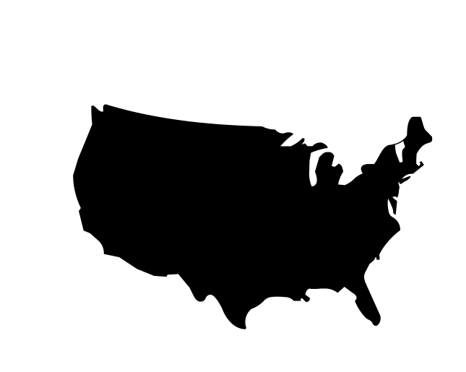
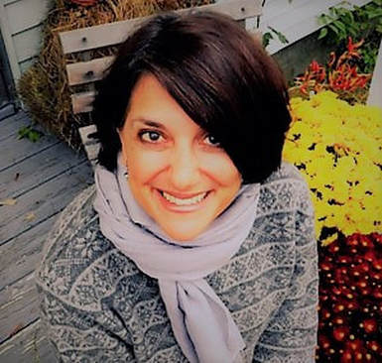
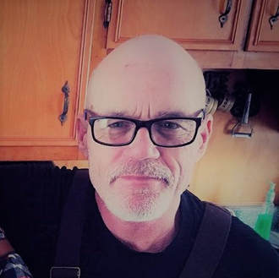
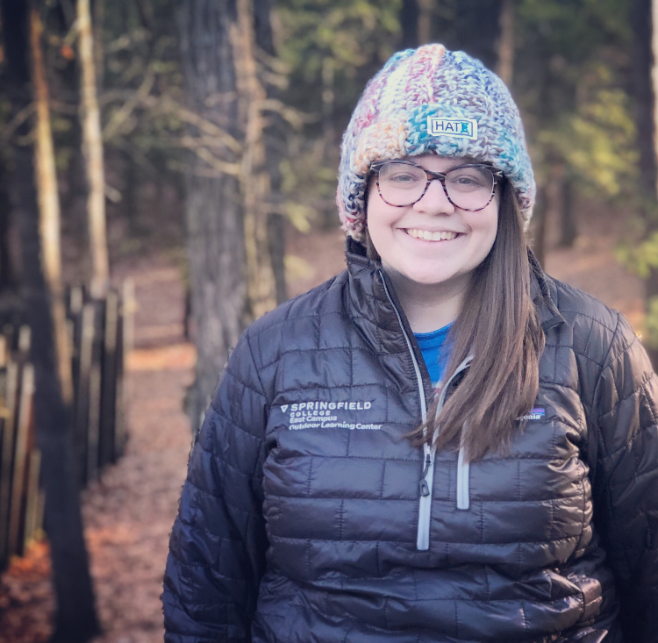
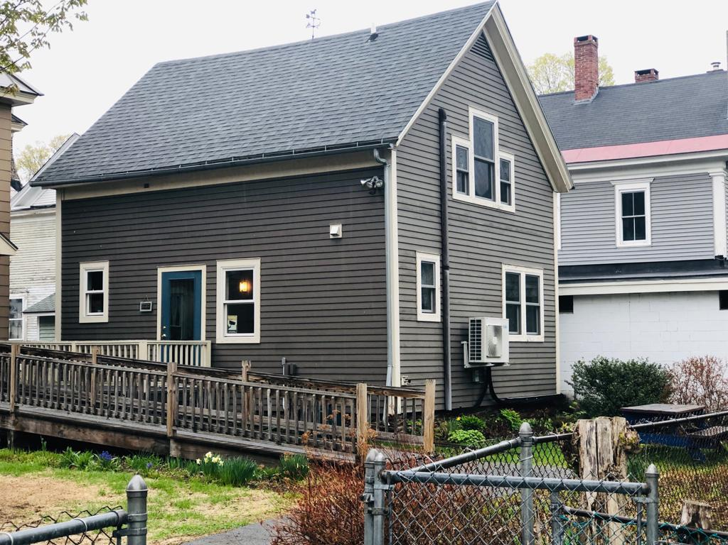
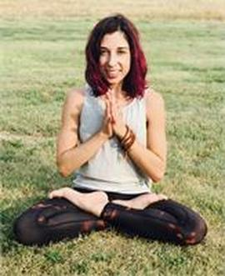
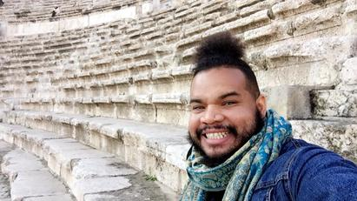
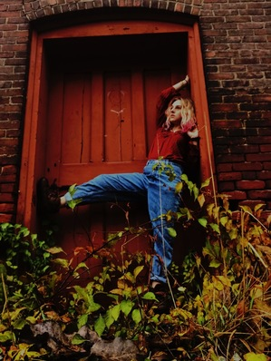
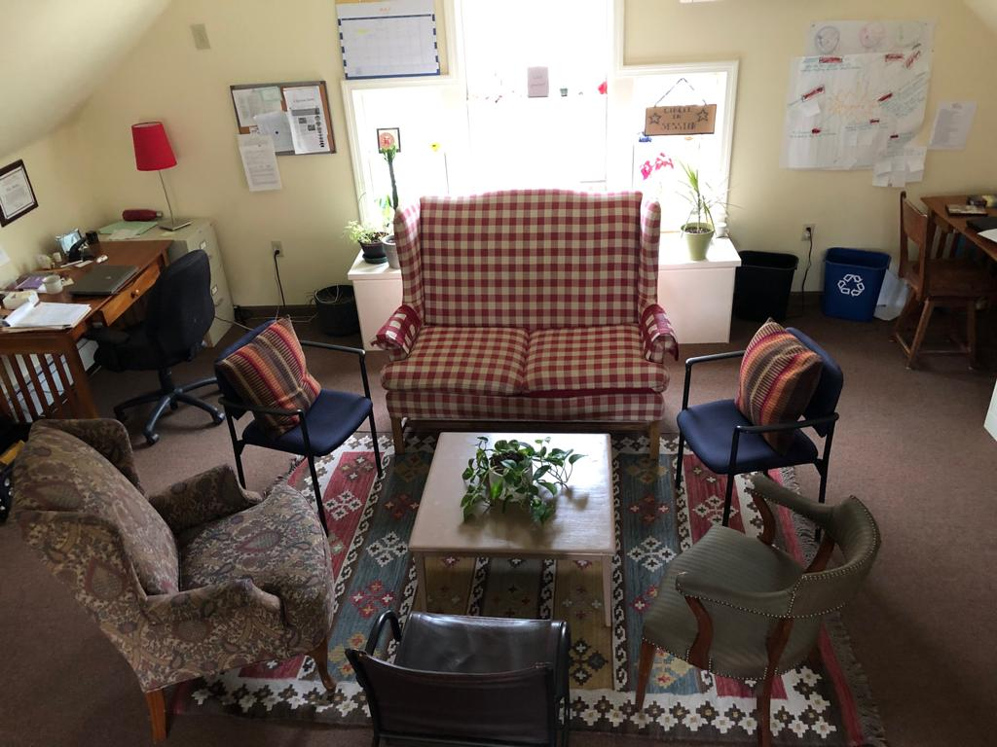
Introduction

Slide 4
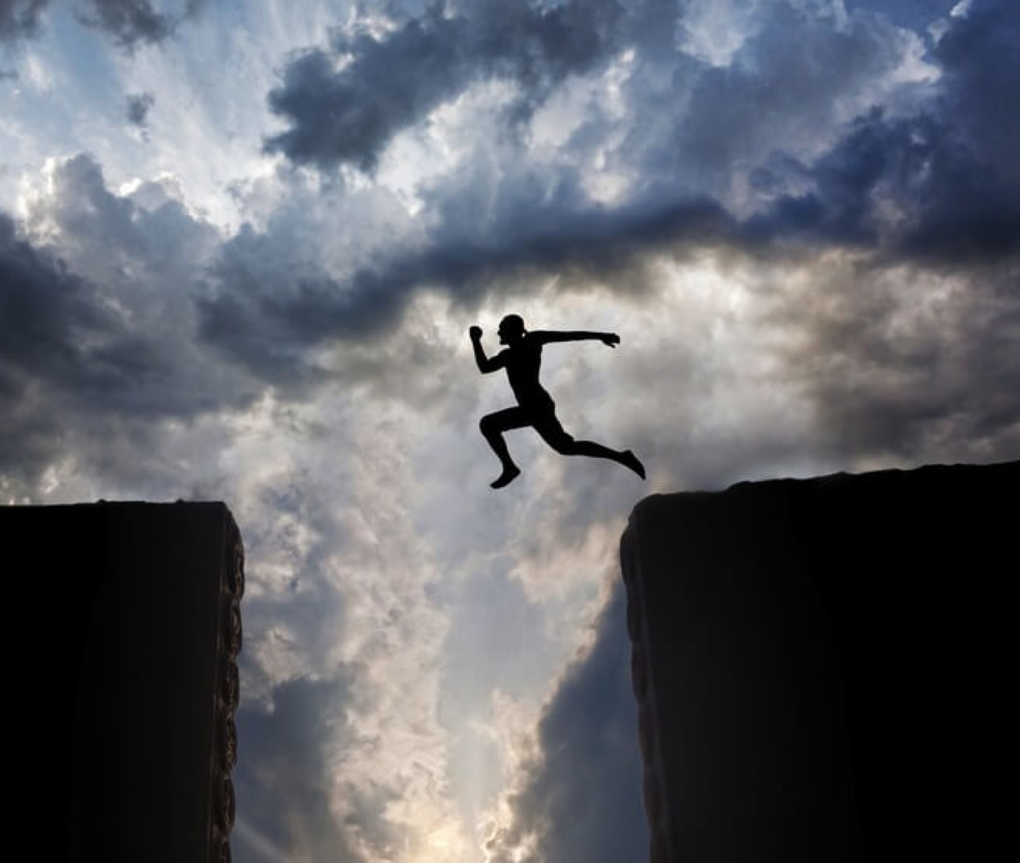
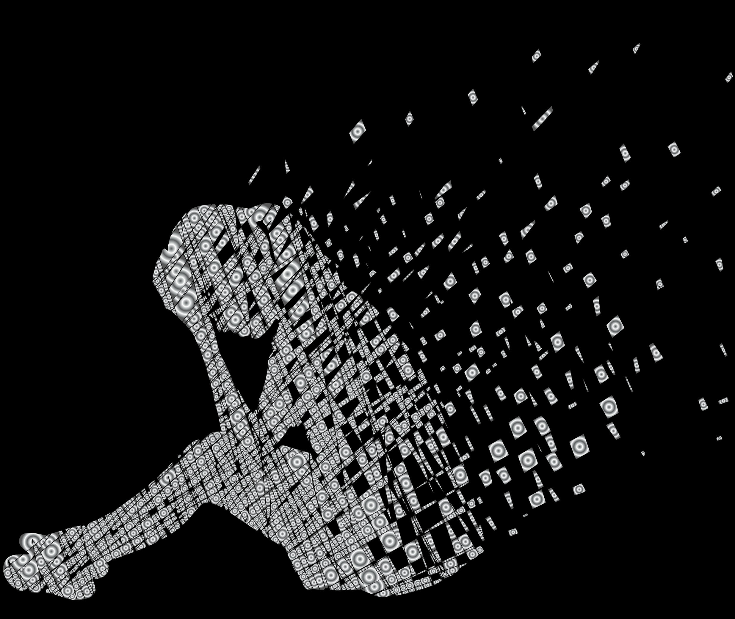
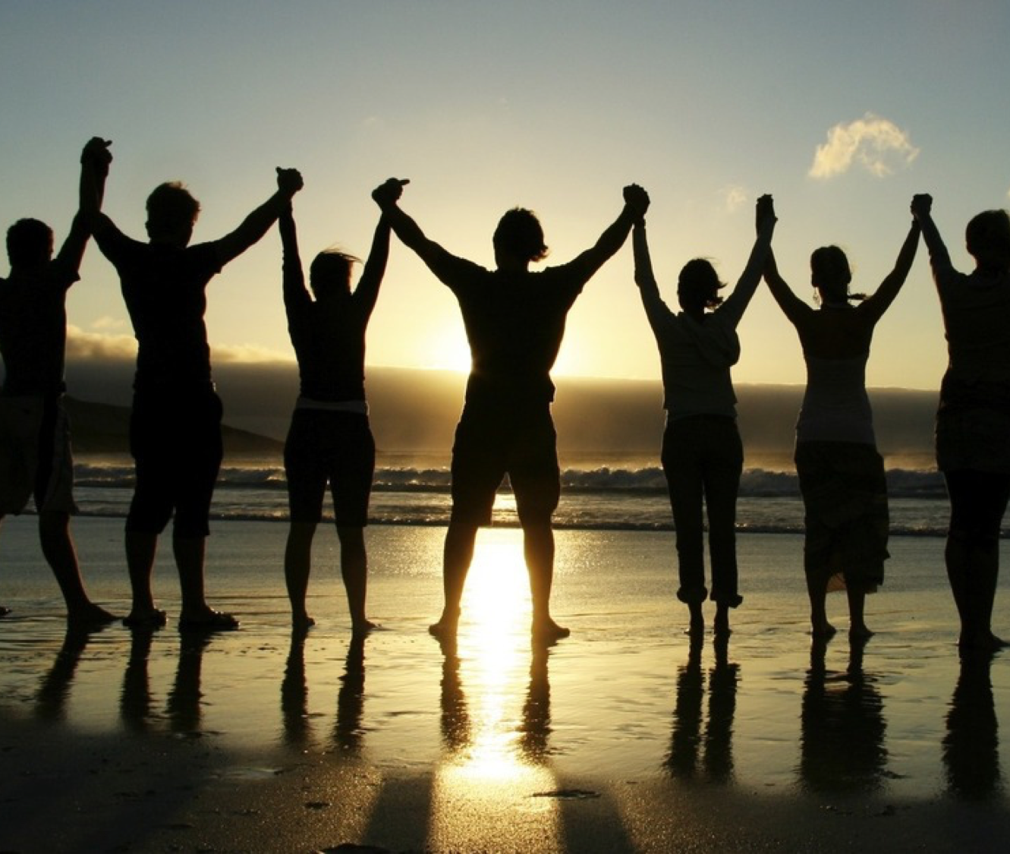
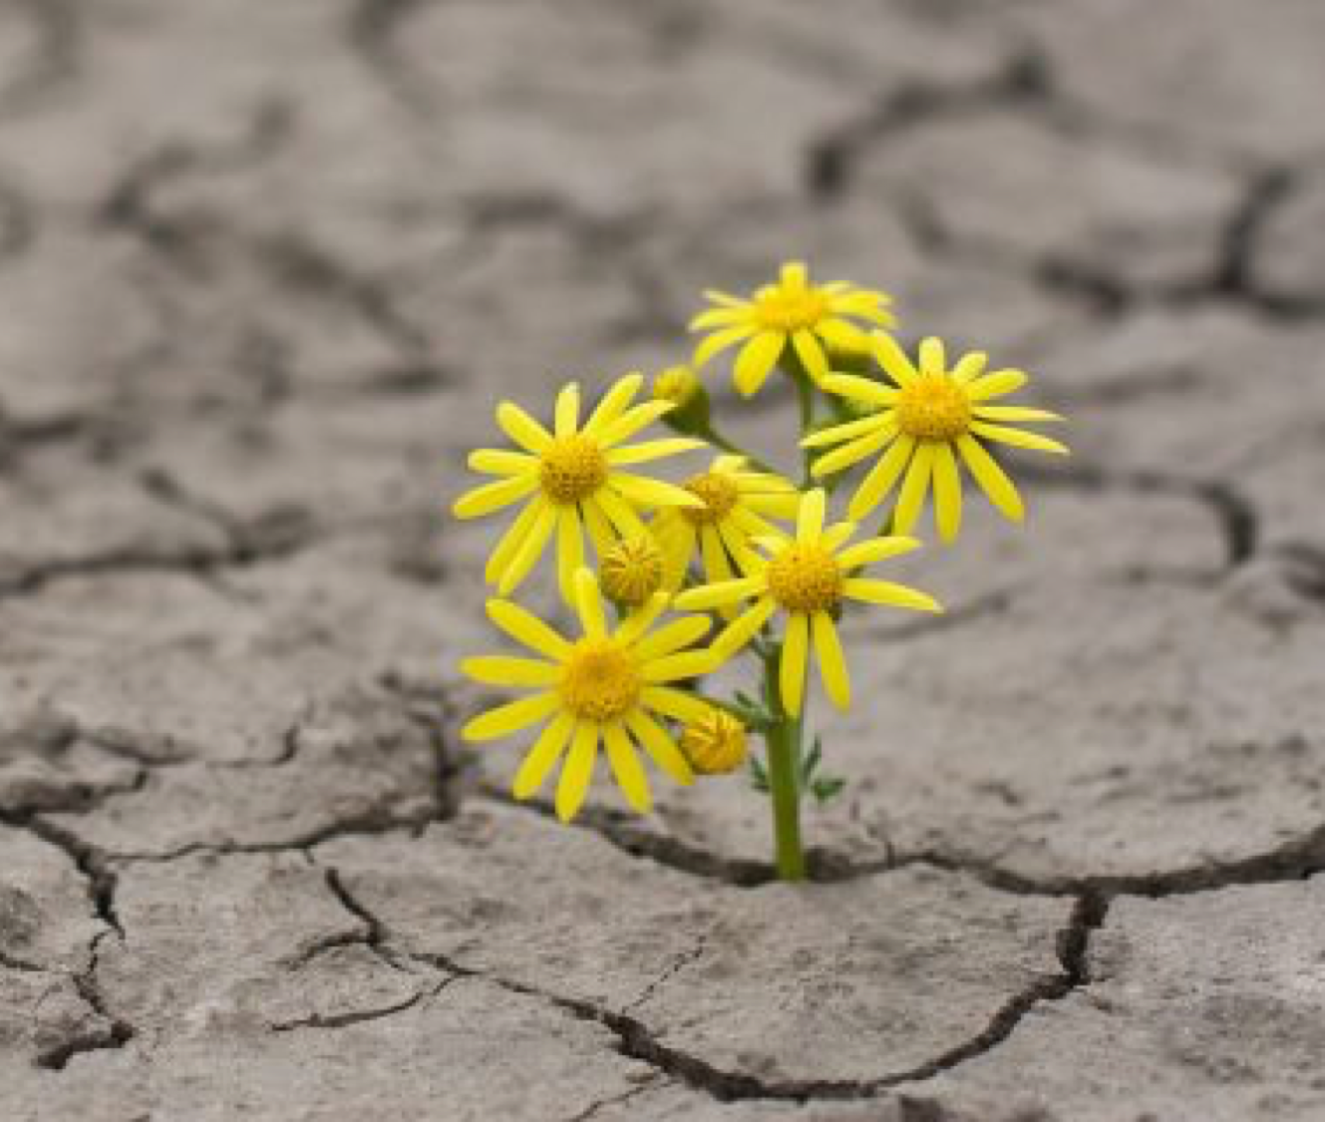
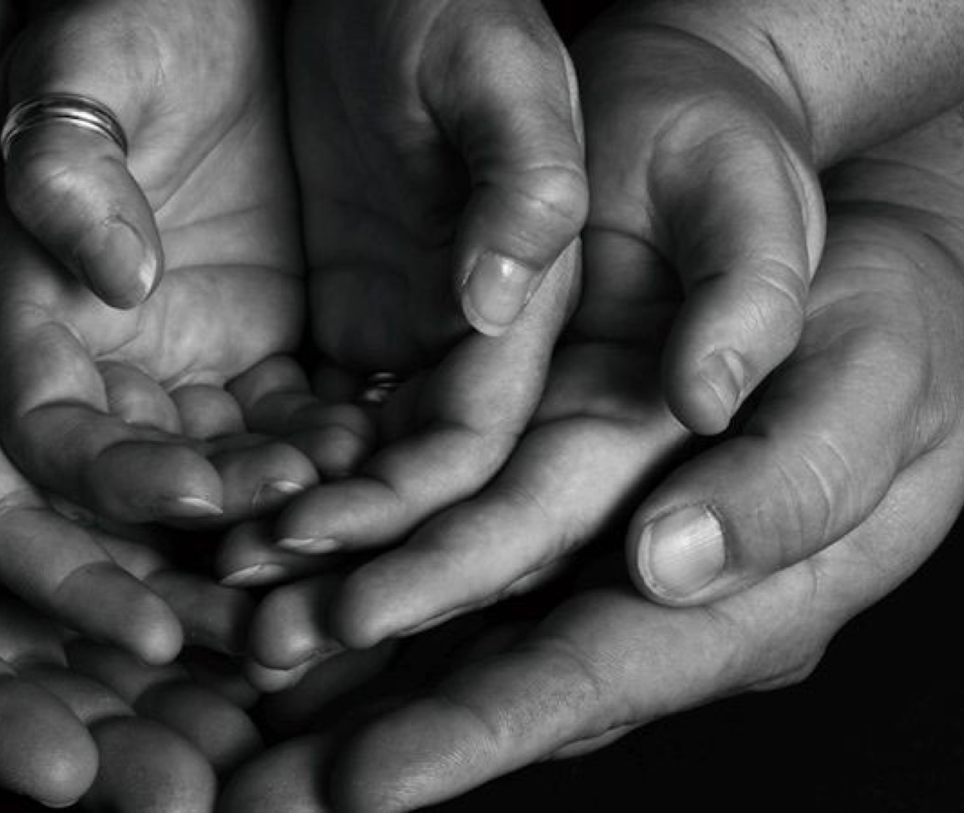
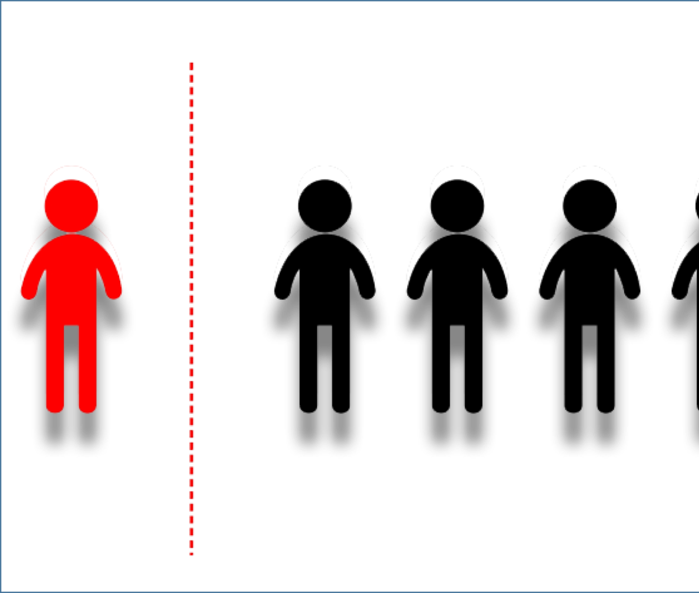

Slide 5
Grounding Question:
How can internalized stigma, of felons and addicts, be reduced with photo storytelling?
Sub Questions:
How does storytelling through circle processes create a space for healing?
In what ways do personal storytelling and photovoice provide an opportunity for participatory action research to be applied to the research process?

Slide 6
Video
Please click the link below to access a 6 minute video
https://youtu.be/_qClMjFPbeA

Slide 7
Photovoice
Showcase Photos
Reach policymakers through a final exhibition
Group Circle Sessions
Promote critical dialogue and knowledge about important issues through large and small group discussion of photographs
Taking Photos
Enable people to record and reflect their community’s strengths and concerns

Slide 8
Healing
Identity
Humanization
Relationships
Systemic Challenges
Findings

Slide 9
Systemic Challenges
Societal systems
Government systems
Educational systems
Department of Corrections
Probation & Parole
Economic Services
Rise House Requirements

Slide 10
Identity
The stigmas they live with are never ignored, but instead it is seen as just one part of how they see themselves
This project provided another way for participants to further explore the complexities of their overall identity and relate to others going through the same process.
The significance of their stigmas changed from day to day and situation to situation.
A person’s experience with his or her identity is more than just a set of particular beliefs about oneself, but instead is based on the connection between self and their experiences

Slide 11
Relationships
Family
Children
Friends
Co-Workers
Social Capital
Support Systems
Connections
Community
Causing Harm
Encouraging drug use
Isolation
Loneliness

Slide 12
Healing
“Getting it [my story] out definitely helps. When people know [what I’ve been through and what I’ve done] instead of keeping it hidden and then making up lies. The lies always make things worse and spiraling out of control becomes so much more likely.”
“It makes me feel better to talk to people about certain things. I just don't like talking to a bunch of people. If there's a lot of people around I can't talk. If it's just like one on one or with the guys here, I can, because I'm so used to these guys here.”
“If you open up to people, you have a better chance of making it, you know? Just because someone does stuff when they were a kid doesn't mean that they're a bad person now. So maybe I can help people see that. Not with just me. I mean with everybody that comes out of jail, there are people that can change.”
“I have a new understanding of how my actions and the things that happened in my life affect other people. I want to give back to other people, there's a desire in me to share my story because I think that it can help others.”

Slide 13
Humanization
Stigma
Identity 1
(Father)
Identity 2 (loyal)
Identity 3 (Friend)
Identity 4 (Kind)
Stigma

Slide 14
“Even if I can't identify [with their story], I can empathize. You know, and then I can pay it forward, because I'm not going to identify with everyone. But I can listen and try to feel what they are feeling or understand what they went through... I think [this process] has the potential to be nurturing and healing. And um, recuperative for guys like myself coming out of the institutions.”

Slide 15
New Research Question:
What was the impact of photovoice and narrative storytelling on the stigma of felons and addicts?

Slide 16
Challenges & Opportunities
This study could not possibly represent the experiences of everyone who has been attached to the labels of addict and felon and had to live with the stigma surrounding those labels. While this study has many strengths, there were also challenges along the way, and limitations that have left room, and need, for further research.
Phoenix Rise House
Healing Potential
Time
Photovoice
Demographics & Size
Space
Obligations
Informal Circles
Setting
Systems
Depth
Relationships
Trust
Guidelines
Policy Change
Community Event

Slide 17
Application
Turn to someone you don’t know
Share how you could apply the concept of a photovoice project to an area of work that you are doing in your respective community
How can you support one another?
What are things you need? What are questions you still have?

Slide 18
https://youtu.be/Fy2U4_hXbXM
Video
Please click the link below to access a 2 minute video

Slide 19
Thank You
If you have any further questions please feel free to talk to me in person or contact me.
My contact information is:
Jordan Ferrick
Restorative Justice Outreach & Advocacy Coordinator
Greater Falls Community Justice Center
Bellows Falls, VT USA
+1 (608) 628-3749
ferrick.jordan@gmail.com
outreach@gfcjc.org
https://www.linkedin.com/in/jordan-ferrick-445529b4/

