Slide 1
Using Restorative Practices
To Teach With Truth, Order, Balance, and Reciprocity.

Slide 2
Objectives
By the end of this session participants will have connected the major key features of Restorative Practices and Ma’at Principles and identify how together they can be used transform Student:Teacher relationships.
By the end of this session participants will have learned how the combination of these principles can lead to long-term positive effects on school culture, high school graduation rates and post graduate success.
Rationale: What we are doing Isn’t Working
Possible Long-Long term Outcomes
Cutting off the pipeline.
Healing communities that experience the greatest generational trauma.

Slide 3
Presentation Norms
Be Present
  Phones on Silent/Vibrant
Be Openminded
  Refrain from thinking in outliers
Be Reflective
  How can I apply/implement this pedagogy
Honor each others Truth
  Assume best intent, refrain from judging others.

Slide 4
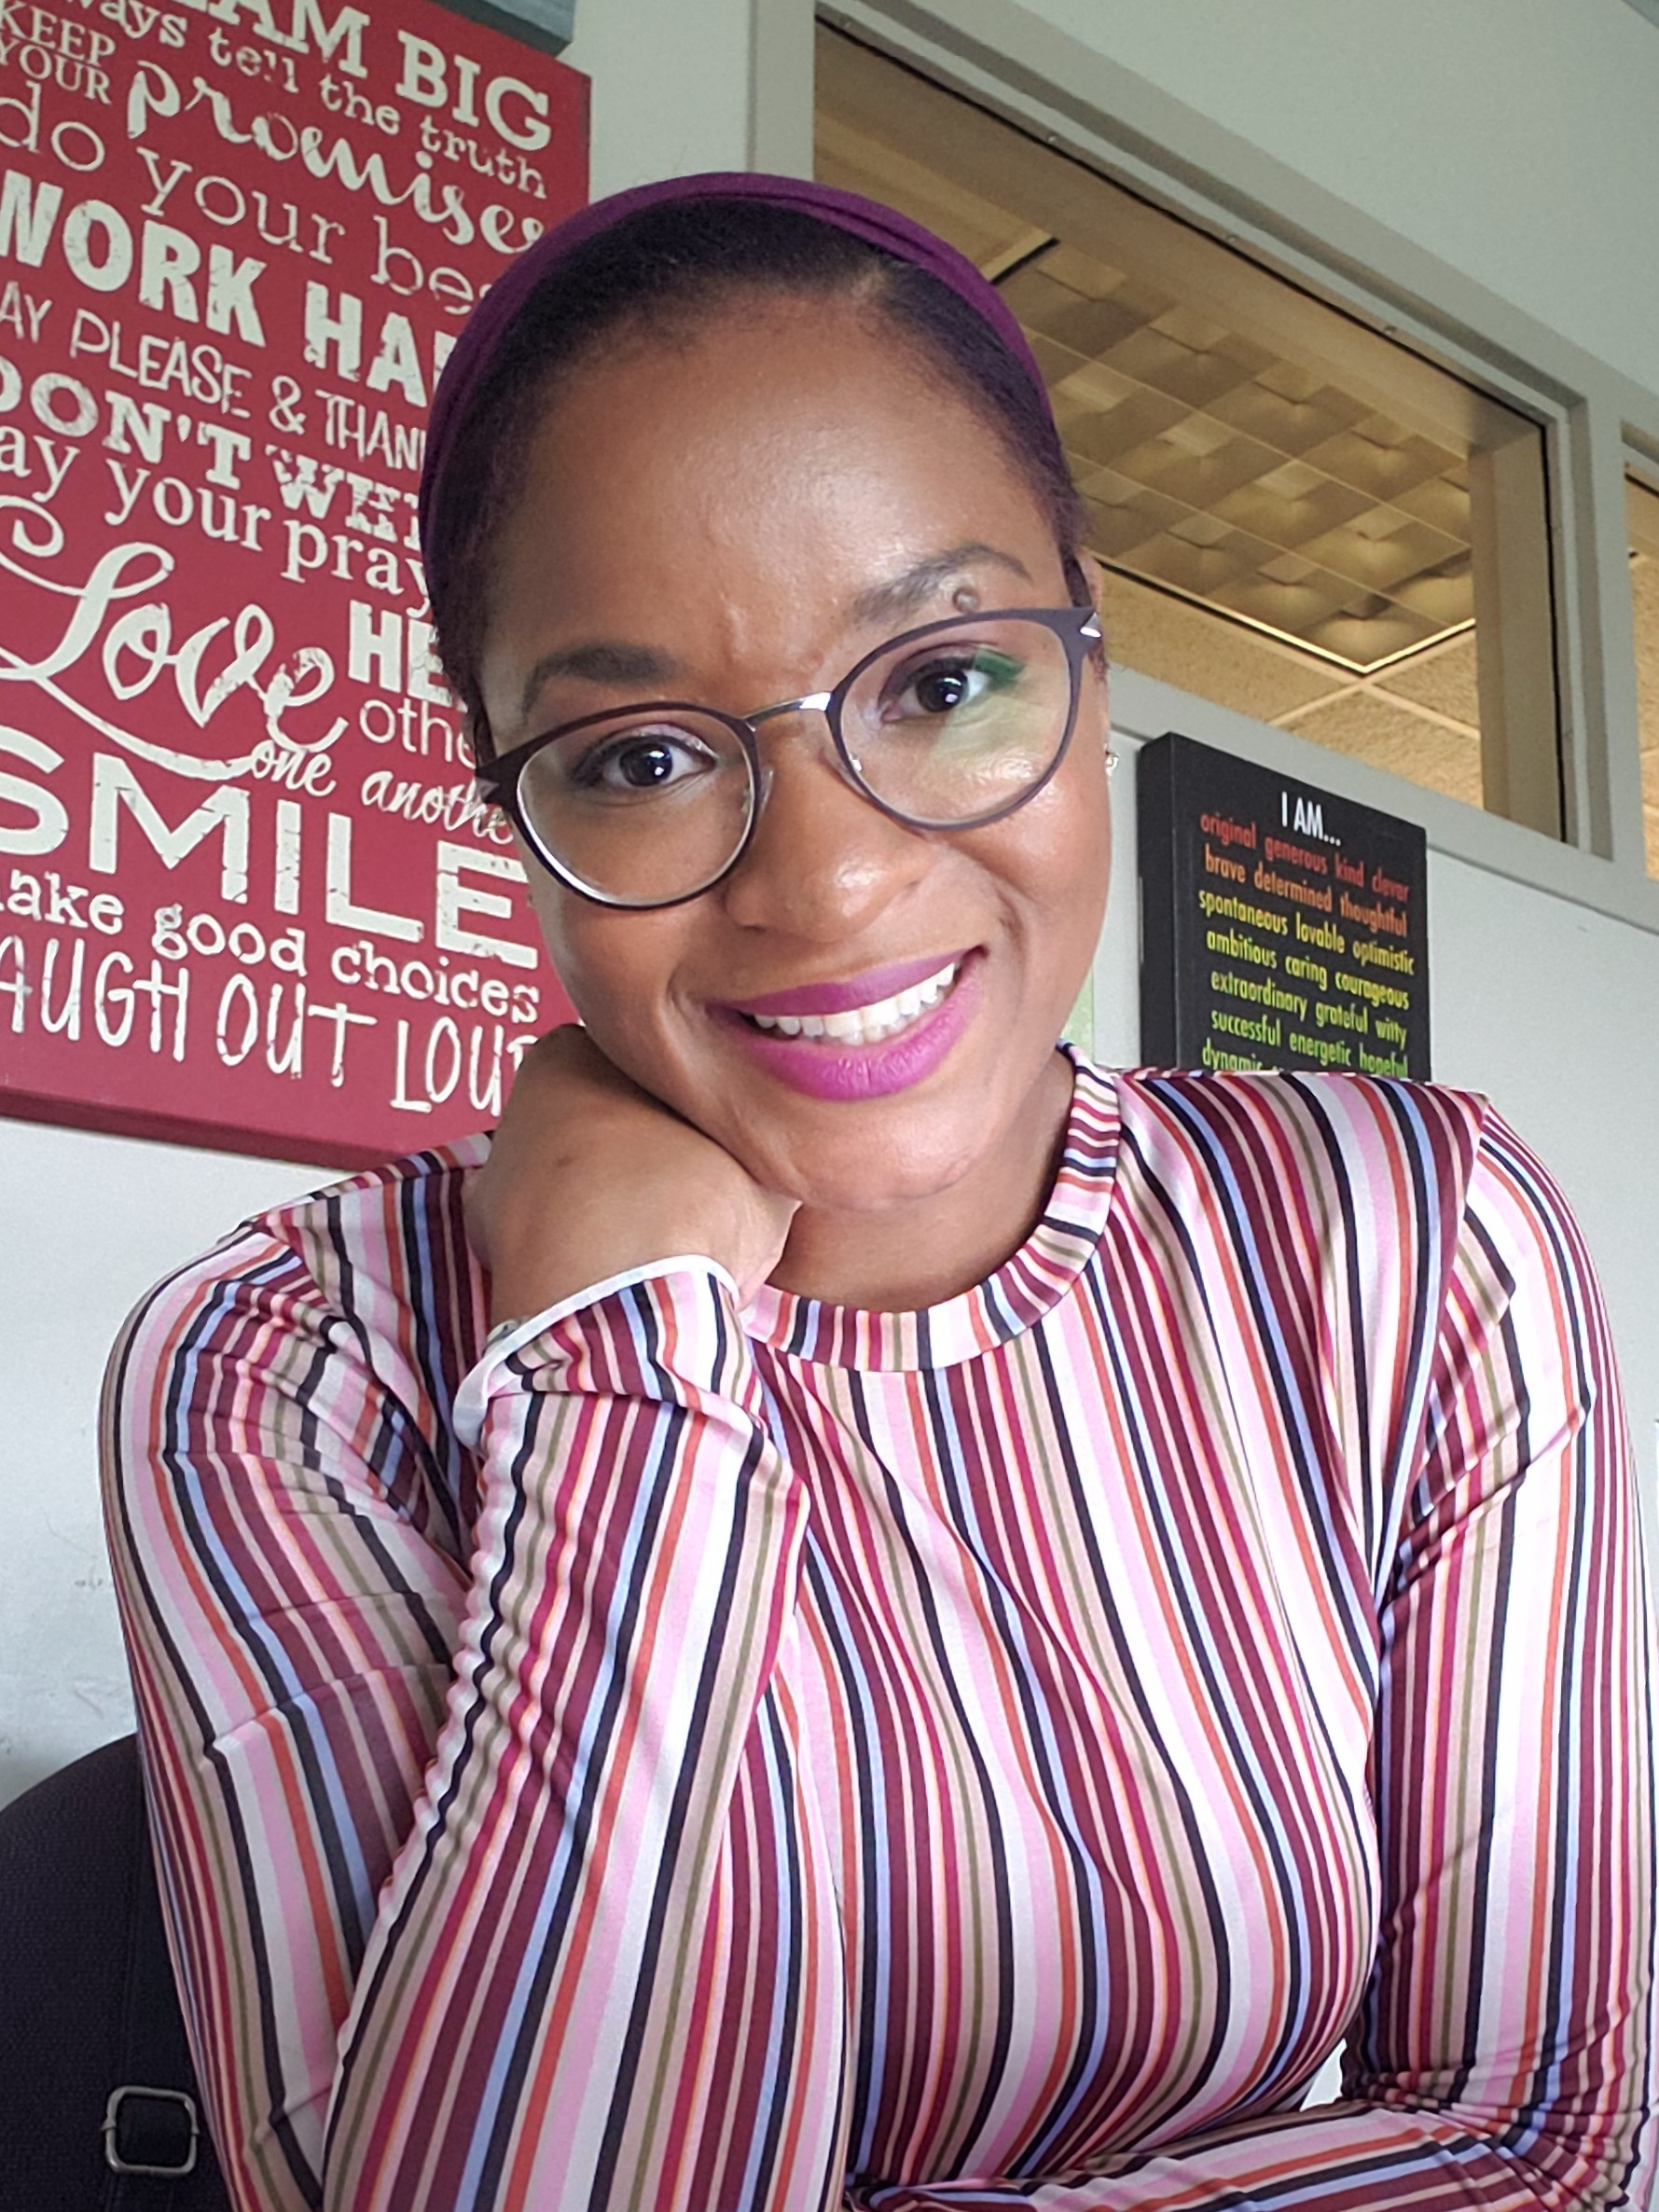

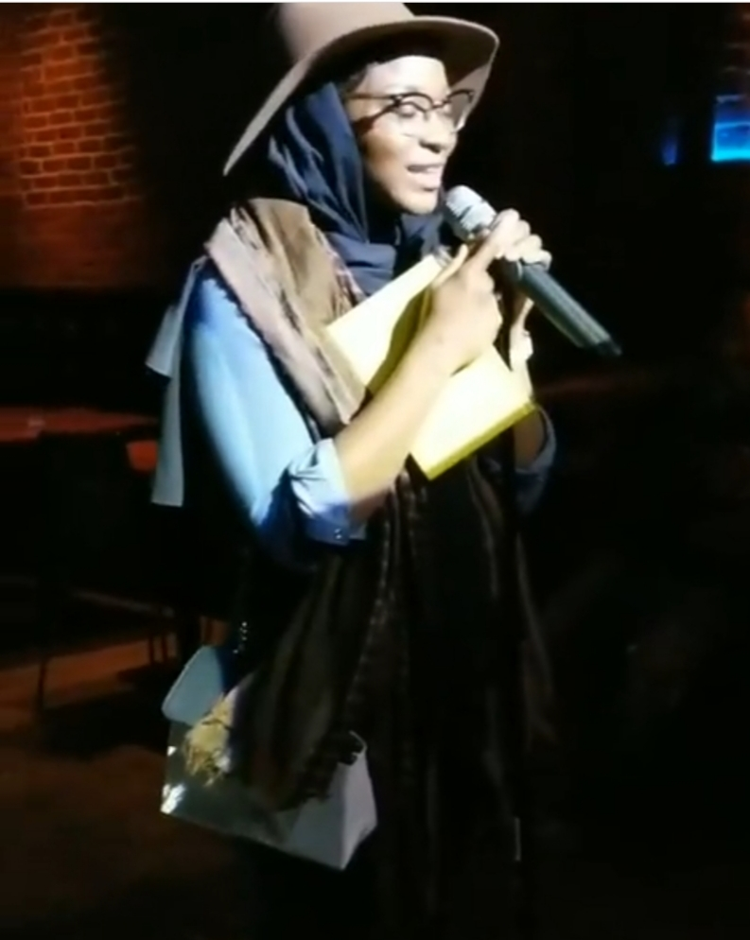

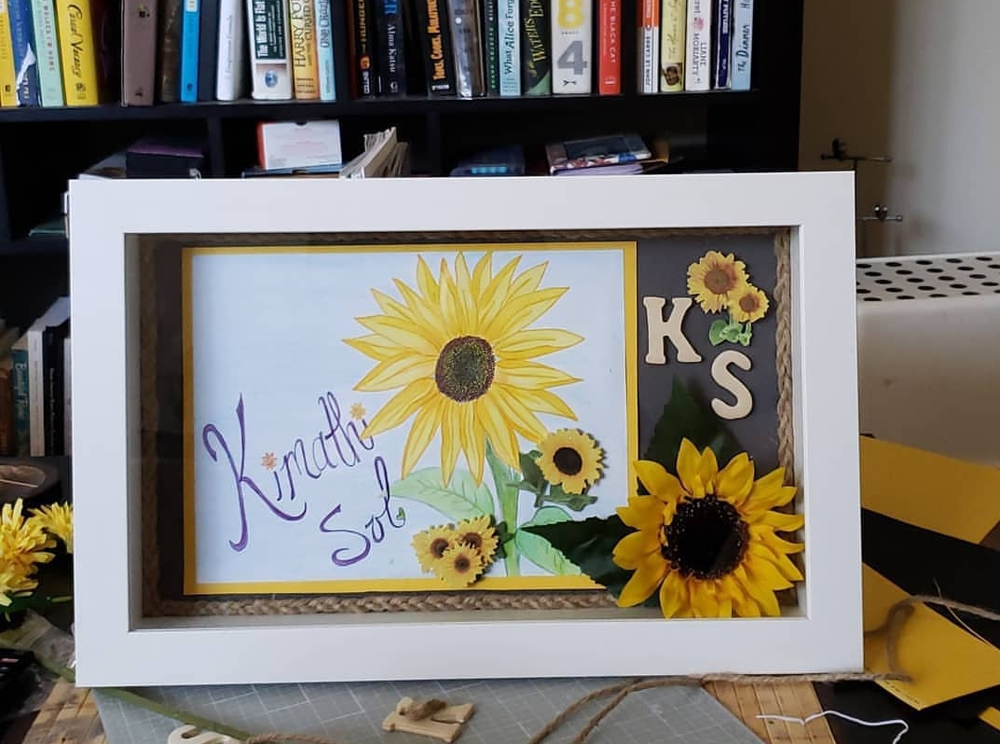
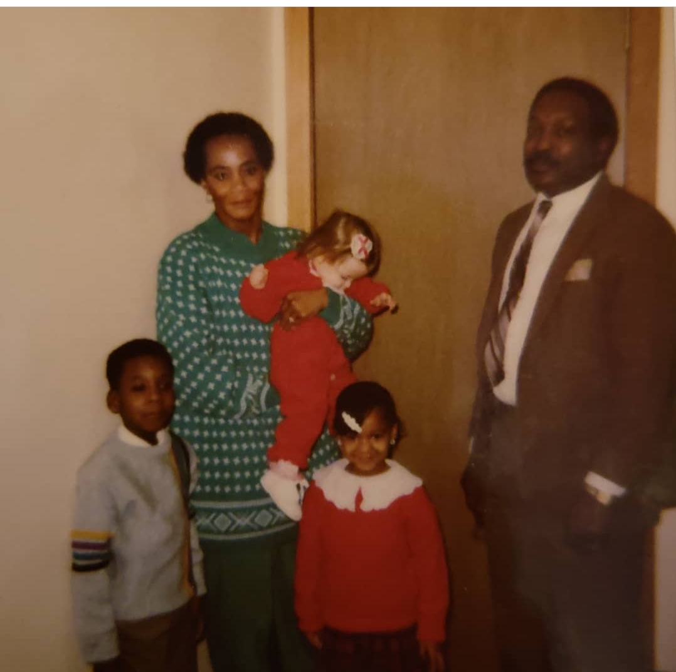
Proud Temple Owl! Class 2009
Book Worm: Children of Blood and Bone
Hobbies Include: Armature Artist,
Poet, Photographer, Fashion Enthusiast
Dream Job: TEACHING (10 year Anniversary!)

Slide 5
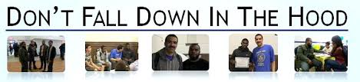

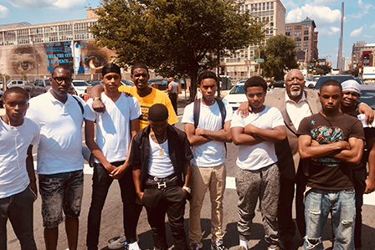
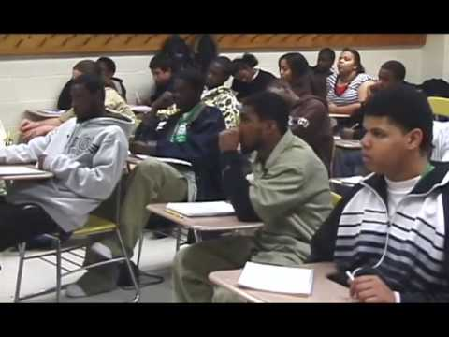
2009 Movie and Documentary
http://www.dontfalldownmovie.com/
I make a “cameo in this film”
https://youtu.be/ToVy9Z7usmg

Slide 6
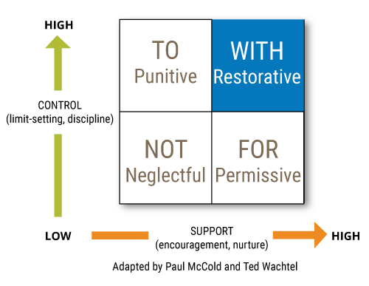
Using Restorative Practices to Teach with Truth, Order, Balance and Reciprocity
Restorative Practices
Ma’at Principles
Circles
Affective Questions
Restoration of Harm
Positive Relationships
Accountability
Safe Space
Truth
Order
Balance
Harmony
Justice

Slide 7
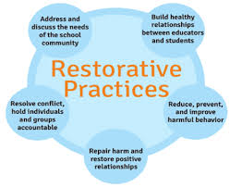
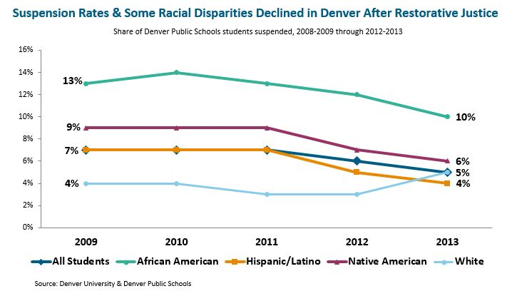
Restorative Practices
A Social Science aimed at:
  Reduce crime, violence and bullying
  Improve human behavior
  Strengthen civil society
  Provide effective leadership
  Restore relationships
  Repair harm.
Read More Here

Slide 8
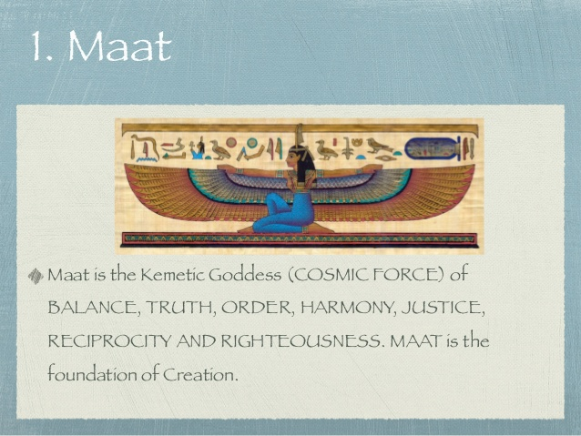
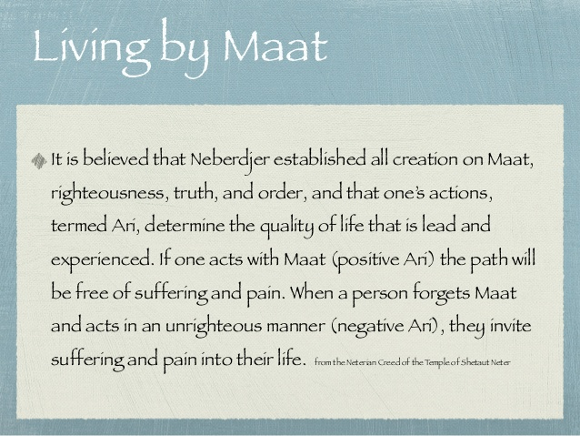

Slide 9
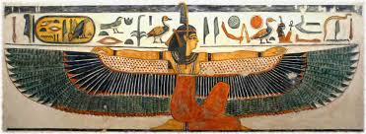
Ma’at Principles
Truth-
that which is in accordance
Order-
an arrangement that relates to safety, procedure and organization.
Balance-
ability to regulate one’s emotional response.
Time for Fun vs. Time for Bus.iness
Reciprocity-
a voluntary act of kindness not regulated by expectations to be returned instantaneously.
Safety
Honesty
Respect
Procedures Rountines Consitant Expectations
Belly Breathing Mindfullness
Teamwork Mentality

Slide 10
“In This Classroom We Will Honor the Truth,
Function with Order,
Keep Our Balance,
and Practice Reciprocity.”

Slide 11
Self Efficacy
Truth
Growth Mindset
Order
Social Awarenes
Reciprocity
Self Control
Balance
When students are able to establish trust between themselves and school they are more likely to take risk in their learning because they feel confident in their innate abilities to achieve.
Students who can more readily adapt, follow procedure and make plans to solve a problem will have a better chance of successfully facing challenges.
Regulating ones emotional responses and then communicating needs and wants can lead to healthy emotional relationships with oneself and others.
Students who are socially responsive to how they navigate the world around them have e

Slide 12
3 Step Approach for Implementation
Step 1 Trunk/Restorative Practices
Use of Restorative Practice as a Foundation for Problem Solving, Communication and Developing meaningful Relationships.
Step 2 Branches/ Teacher/Leader
Teachers and Leaders prioritize Community over Content through the establishment of relationships.
Step 3 Leaves/Our Babies
Students are given the ability to learn, develop, and demonstrate healthy social and emotional skills.
Truth, Order, Balance and Reciprocity guide the overall culture of the building and classrooms.
Leading to their ability to make successful life choices that breaks the cycle of generational trauma, violence and poverty.

Slide 13
Thank You!

Slide 14
Additional Resources
 | https://journalistsresource.org/studies/society/education/minority-teachers-students-same-race-research

Slide 15
Discussion Questions
What is a truth that you can honor about yourself or teaching practice that gets in the way of developing a connection between you and your students.
What is a truth that you can honor about your students that you can use to leverage meaningful instructional experiences?
What is a truth you can honor about the state or nature of your administration that gets in the way of you serving the needs of your students.

