Slide 1
New vision of mourning the DNA model (based on the book ‘DNA of mourning’ by Johan maes)
Mourning is searching for another form of loving

Slide 2
Classic mourning models
Mourning = negative
Linear proces: in phases, focused on an end point
Mourning is being experienced as a problem, medical model (about recovery of symptoms) → ex. emotional woman
Notes:
Linear proces: in phases, focused on an end point Medical model: recovery of symptoms (f.e. by taking medication). Mourning is being problematized → emotional woman with friends at the dinner table, 20 years after father's death
→ friends think she needs help because it’s not normal she feels like that after all these years.

Slide 3
expressing emotions = healthy
loss because of death
‘letting go’ is essential → ex. “over your mum"

Slide 4
DNA-model: 3 dimensions (loss/recovery/connection)
it’s a metaphor: DNA=unique, grieve = unique/ we give through our DNA, the same with grieving (ex.)
mourning = a normal response to an abnormal event
mourning = looking for another way of loving
living loss: divorse, loss of land, loss of job, loss of dreams,…
Notes:
→ actually any loss of person, place, goal or object that creates meaningful relationship

Slide 5
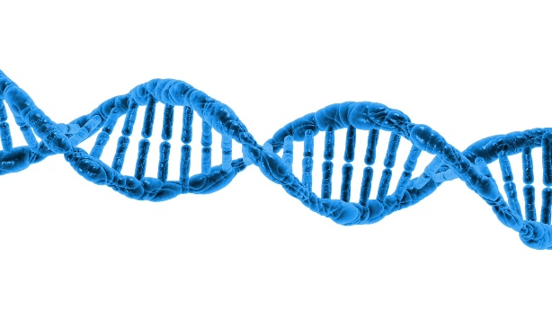
spiral: non-linear, no end point the 2 spirals = 2 poles, connection in between

Slide 6
1. Loss pool - Allowing emotions to flow, then they automatically disappear: no! → self-help groups
- Mourning never stops, the mourning pain becomes less
- Positive emotions make people dare to experience them
- Emotions have a function: it’s about regulate them ex: anger
Notes:
Searching for its meaning is regulating it.
f.e. a boy felt anger, even 6 years after the loss of his father. When we explore that anger, he realizes that he did’t know the story about his fathers death, what made him angry: searching together who or what could help him clear the story out, helped him, it gave him the feeling of piece.
Self-help groups can be harmful (emotions can become stronger), they only fill the social affective need. Self-help groups need someone who leads the process.
(f.e. feeling happy doesn’t mean ‘you are over it’, you can be happy and sad at the same time)

Slide 7
2. Recovery pool
life that goes on
integrate the loss, not getting over it
identity reconstruction: P-T-F
Notes:
searching for a new connection is necessary to be able to continue in a constructive way.
who was I before the loss, during and after and who do I want to be?

Slide 8
The frame of reference is also changing: values, norms, beliefs ...
Teenagers often mourn recovery-oriented and dare to allow loss only when they experience safety (delayed mourning) → ex girl
Notes:
: after 5 years she is overwhelmed by the death of her dad. All the time she looked after het brother and sister and 5 years later, she took care of herself
→ She felt not normal, she couldn’t talk about it with anyone because her context wouldn’t understand and would problematize the grieving (old model)

Slide 9
3. connection, relationship = essence - Redefining the relationship
→ the relationship doesn’t disappear but is transformed, a search that never ends
- From physical absence to symbolic presence
Ex. divorce
- loved ones are lost, but love is not
Notes:
f.e: when a child’s parents divorse, and misses dad with mom, a picture of dad can be enough to feel good.

Slide 10
- Attachment
Mourning and attachment are linked (the way we are attached to parents, influences the way we bond to others and how we grieve
Normal attachment: flexible movement between L&R (protective factor),
Fearful attachment: especially loss side (risk factor!)
Avoiding attachment: especially recovery side

Slide 11
- different dimensions: body, feeling, thinking, behavior, relations
Ex. Woman with pain in her stomach/ how does a father has to go on with his children after the loss of their mom when he thinks ‘a man can not show his emotions’?

Slide 12
As coach in mourning…
Make room for the loss by honoring what is being told, without judgment and tips. give back what someone says by reformulating
Search for power sources and network
Be present
Notes:
- When someone feels that it is ok to grief, it can be enough. But also: people has to take or give themselves that space

Slide 13
Being emotionally available for the other:
Missing = desire.
Carry ‘it’ together
Secondary loss: dominant loss story vs alternative story
Ex: boy lost father vs. identity
Notes:
searching for the pain, not being afraid of painful emotions, but giving them a reason to exist (it feels unnatural…) together not being able to "know“
Search for the desire and reformulate
When someone feels you carry it all together with him, it can help, because people are afraid to talk about their grieving because they think other people would not feel comfortable about it and want to get rid of the conversation.

Slide 14
“I have experienced terrible things in my childhood and they have made me deeply lonely. The fact that my coach not made it his story or got away with it, or get involved with it - emotionally or expertly - meant the most to me. My life has been left with me, but I have not been left alone with it. "

Slide 15
Important within mourning guidance: explore 6 w's and possible gaps
who loses - who or what is lost - what a loss - where - when - why
→ the story gives peace, control and meaning
→ it makes the loss story ‘alive’
→ brings clarity about L&R flexibility

Slide 16
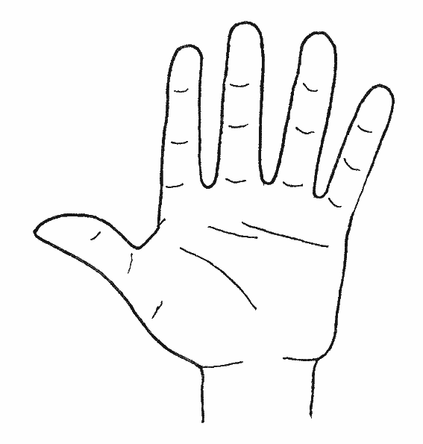
Possible exercises
Fingers (emotion regulation) Write reminders that can sometimes help you when it is a difficult day. The next time you have a hard time, you can recall the memories with emotions, sensations, linked to a finger, and it can be a little more bearable for you.

Slide 17
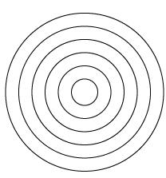
Help circles (network and power sources) Enter the people who can best help you. The closer they are to you in the circles, the better they help you. Can you say what exactly those people do to help you?

Slide 18
Letter (connection) In this letter you can write everything that you want to say to the person who died. For example, write how you are doing, what you are doing. What has changed since he / she is no longer there. Write down what you actually wanted to say but where you didn't get the chance. How do you feel now that the other person is no longer there? What are good memories of him / her? Tell about your plans, things you would like ...

Slide 20
Say hello (connection) Exercise to reconnect with who you are and are lost so that person becomes part of your life again. A photo or an object of the person can be brought

Slide 21
Thank you for listening and I hope the DNA-model can inspire you!
Questions?
Song Rudimental ‘waiting all night’

