Slide 1
School-Based Restorative Practices in the Middle East
One School’s Journey

Slide 2
The American School of Doha
Embassy School - 30 years old
2250 Students K-12
528 Middle School Students
11% Qatari, 82 other nationalities represented in student body.

Slide 3
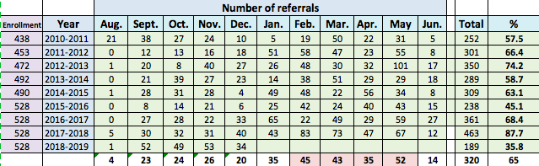
Discipline Incidents in a Yo-Yo Pattern
Month over month, data averages out, but specific months yield large numbers of incidents both on small disrespect/violation of ASD Values as well as larger incidents, such as bullying, fighting, social media harassment.

Slide 4
Using Peer Courts as Suspension Diversion
Model is a middle school in California - Davidson Middle School (hyperlink is an article from Edweek

Slide 5
Using the IIRP questions, students provide an alternative to suspension
What happened?
What were you thinking at the time?
What have you thought about since?
Who has been affected? How?
What needs to happen to make things right?

Slide 6
The power comes from the students
The court does not determine guilt or innocence, but rather helps the offender to reflect and repair harm
Parents are present, as are other adult supporters such as teachers or counselors.

Slide 7
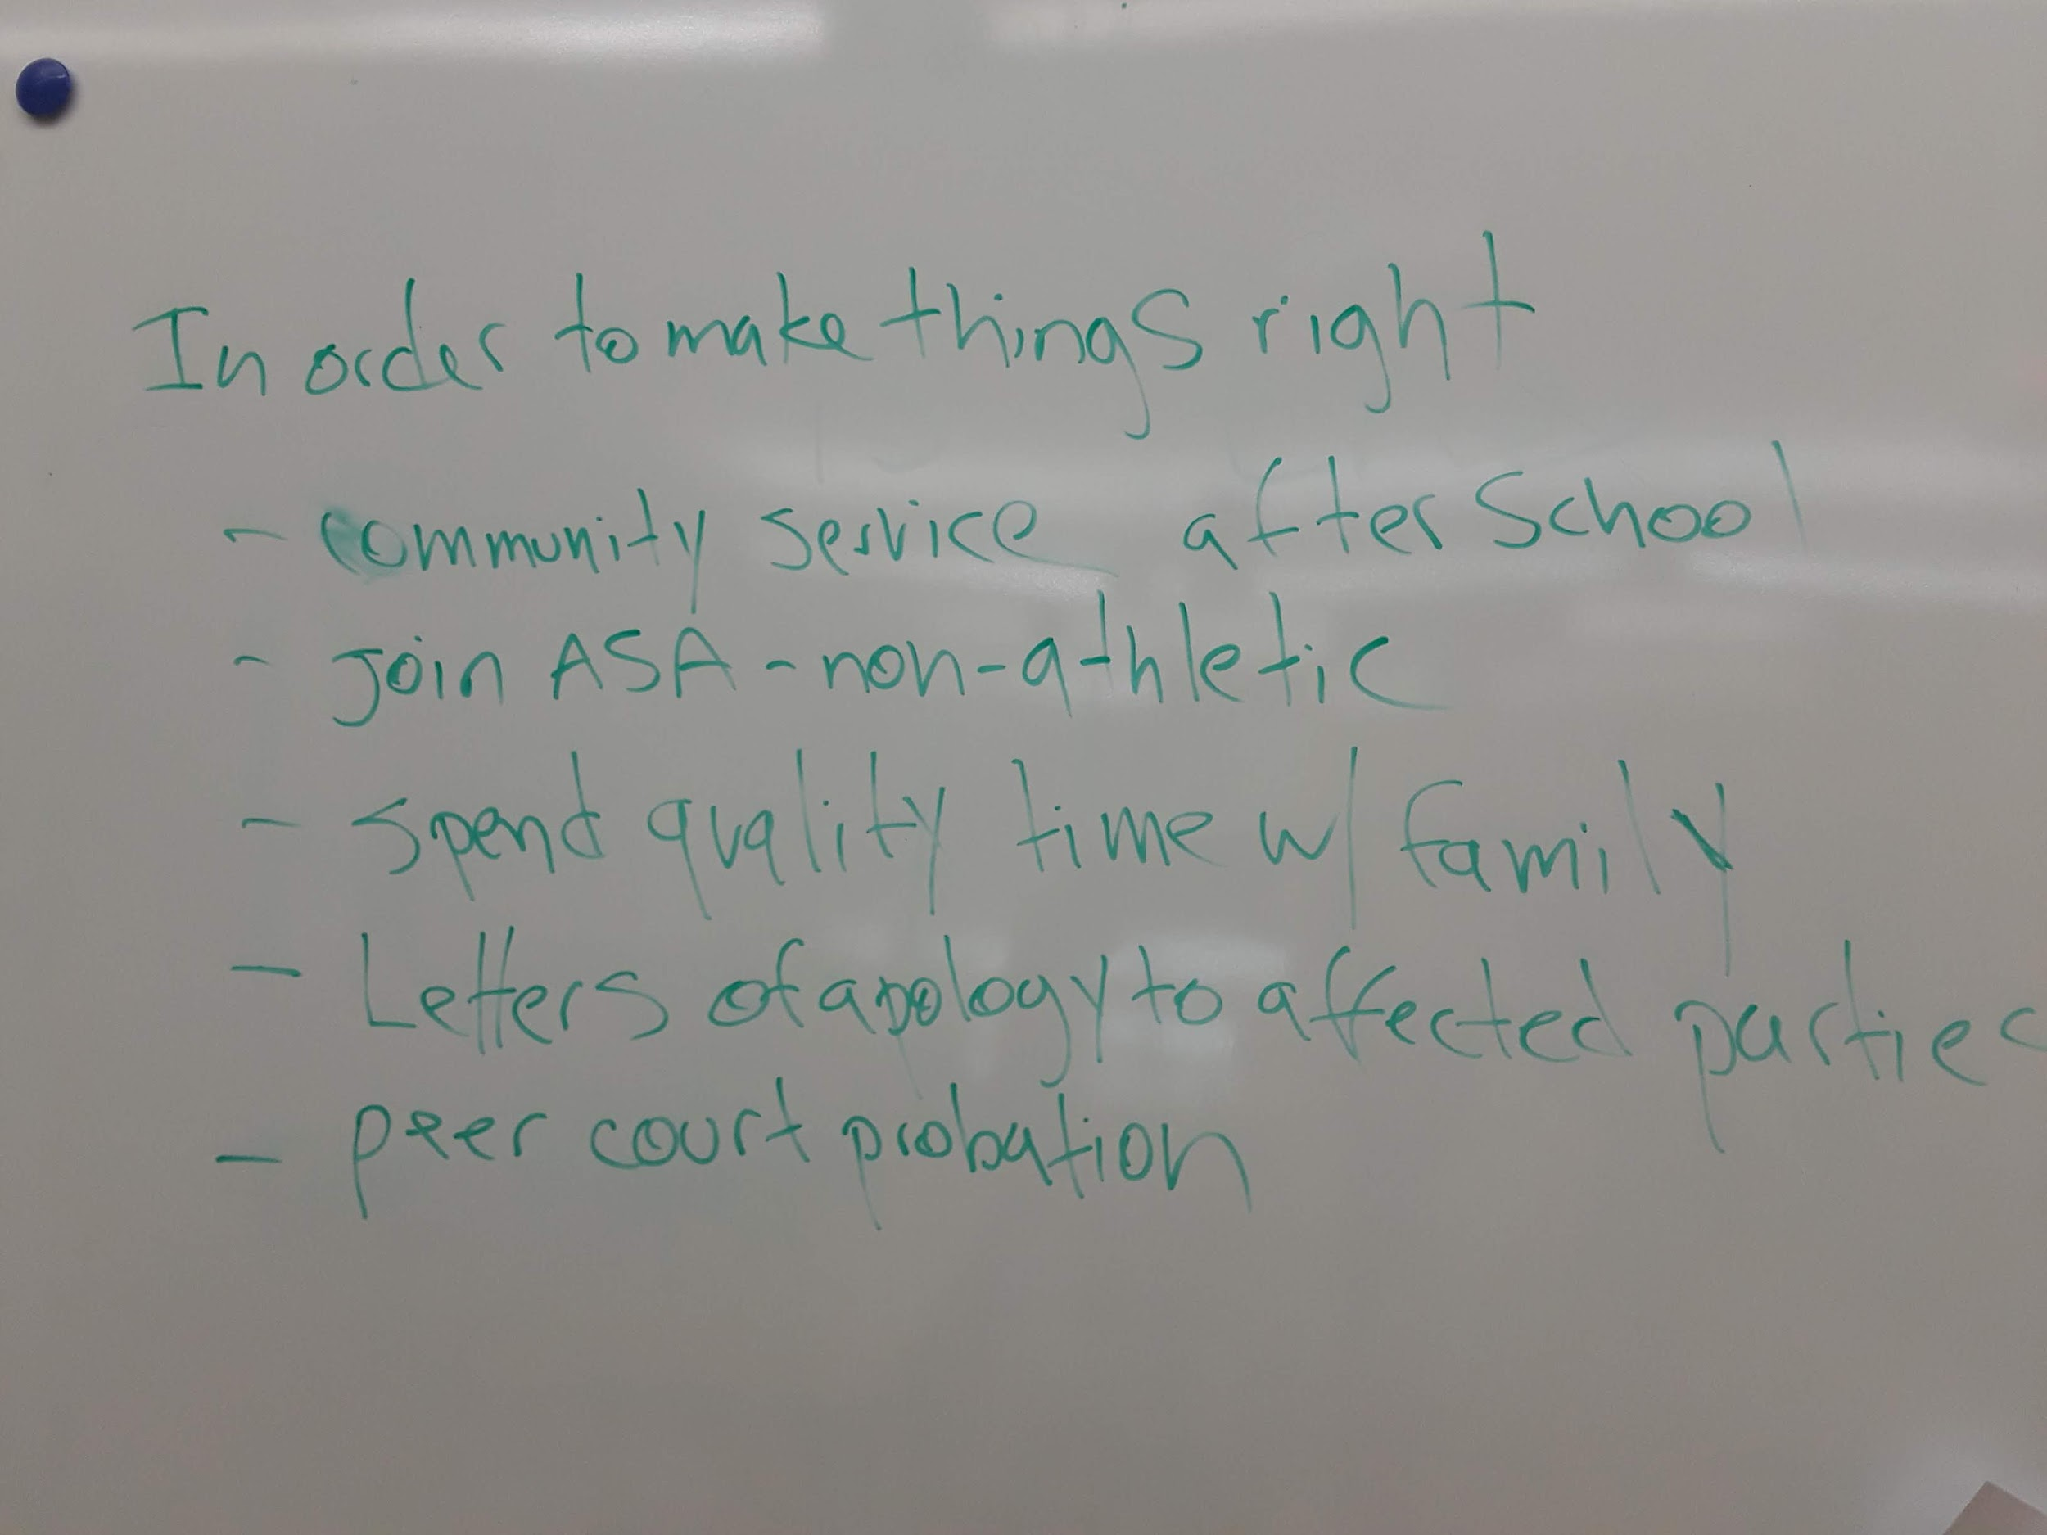
Based on information learned in court, students create a contract of restitution

Slide 8
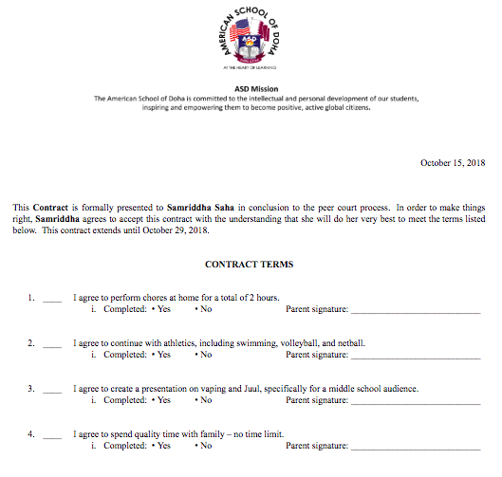
The student meets with an adult to check in during the contract period

Slide 9
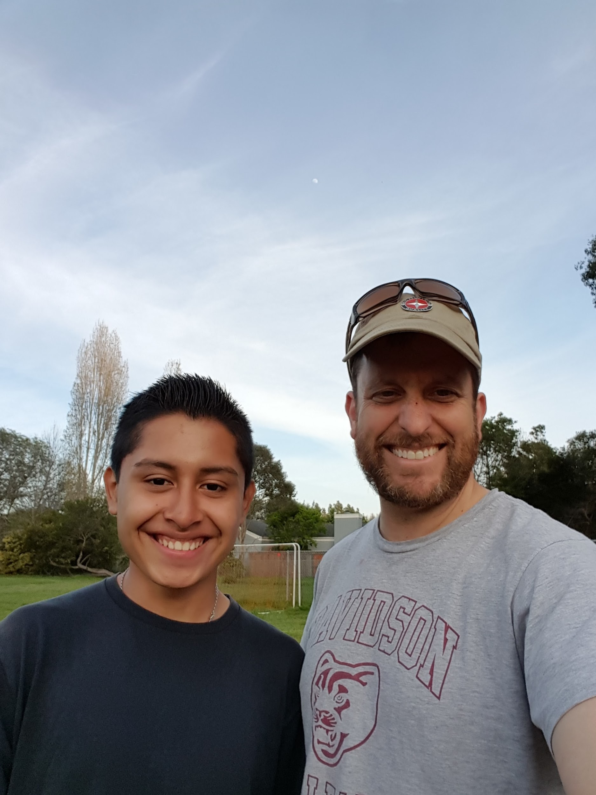
If the student completes the contract, the suspension is diverted!

Slide 10
We have also instituted Restorative Conferences
“Fight Club” and the meeting, which went very well, followed by the actual behavior on Week Without Walls, which did not.

Slide 11
Successes
Changing the paradigm around discipline and consequences/punishment
Giving students an opportunity to repair their harm
Incredible buy-in from teachers who are invited and show up to courts/conferences
Buy-in from parents who are grateful for the opportunity to repair harm and avoid stigma, ie, instead of being the “bad kid.” , students have an opportunity to take ownership of their behavior and rebuild their image.

Slide 12
Struggles
Efficacy of Restorative Conferences. Agreements are made but not held to.
Cultural Barriers: Locals are not used to being held accountable in this manner.
Teacher pushback, articulating that there needs to be a “punishment” when students make mistakes.
Teaching kids to demonstrate contrition about an incident.
Getting teachers to implement the continuum of Restorative Practices on the classroom level.

Slide 13
Next Steps
Instituting Affective Statements at the Classroom Level.
Expanding Court to the High School? We are sending trained students on to 9th grade, so it’s a good start.

