Slide 1
Washtenaw Alliance for Virtual Education
Creating Restorative Community in Alternative School Settings

Slide 2
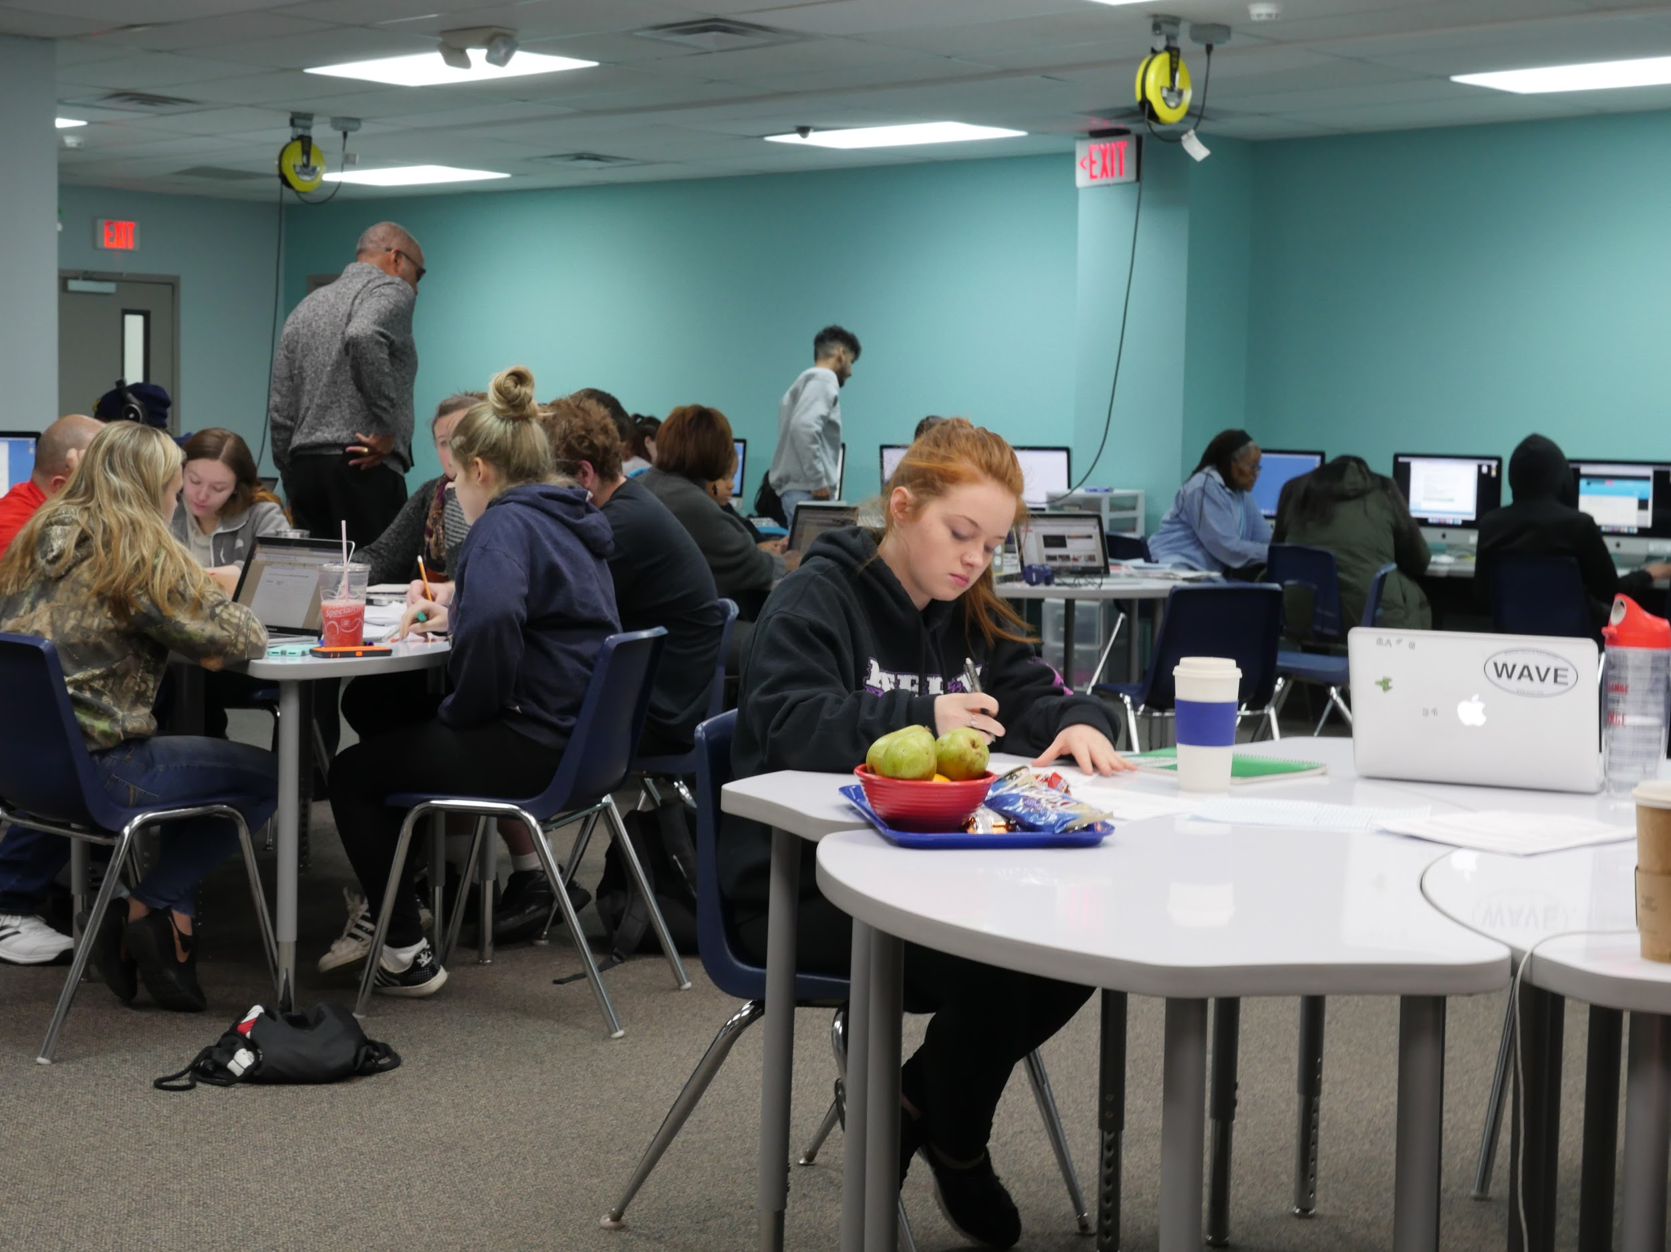
Introductions
Sarah Giddings, M.Ed NBCT
sgiddings@weocflex.org
@sarahyogidds
Jennifer Haines, M.A., M.Ed.
jhaines@weocflex.org
@jenshaines
Notes:
Sarah & Jen & Monique

Slide 3
Goals and Vision
Offer students, especially those with a history of non-engagement with schooling, an innovative, non-traditional path to earn their high school diploma.
Notes:
Sarah - intro.

Slide 4
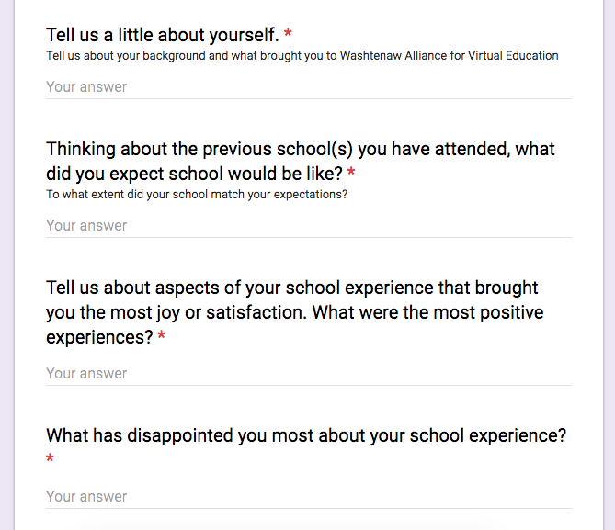
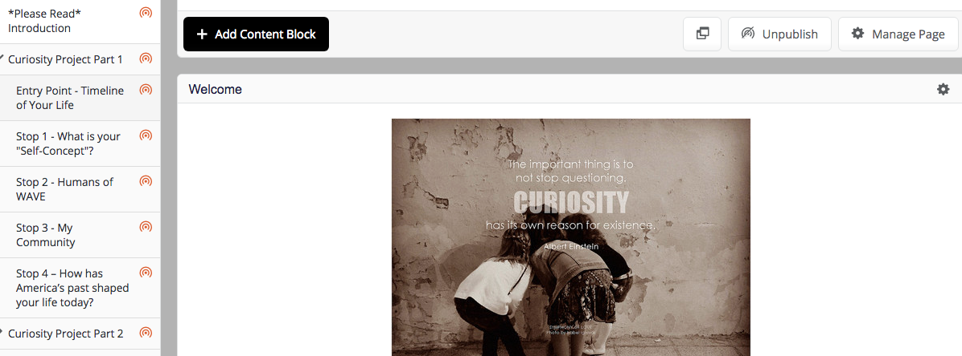
Restorative Community from the Outset
*Who are you?
*Who are we?
*What affects you?
Notes:
How do we build a community right from the first day? Orientation and here is how we interview the students - Sarah
What are community demographics are. Family & community survey with questions such as “Have there been any significant changes in family relationships or circumstances at home that may be affecting school performance?”, “What goals do you have for your son/daughter?”

Slide 5
Restorative Community
Meeting students where they are - learning styles, mental health needs, pacing
Curriculum development - different types of classes for different learning styles
Mental Health supports - Social Workers, Life Survival Skills, CBT, DBT
Restorative practices for class norms, daily check-ins, morning greetings
Restorative practices for disciplinary issues/community building
Notes:
Sarah - Meeting students/Curriculum / Monique - Mental Health Supports
Jen - Face2Face, Lab, morning greetings / Monique - Restorative practices for disciplinary issues/community building

Slide 6
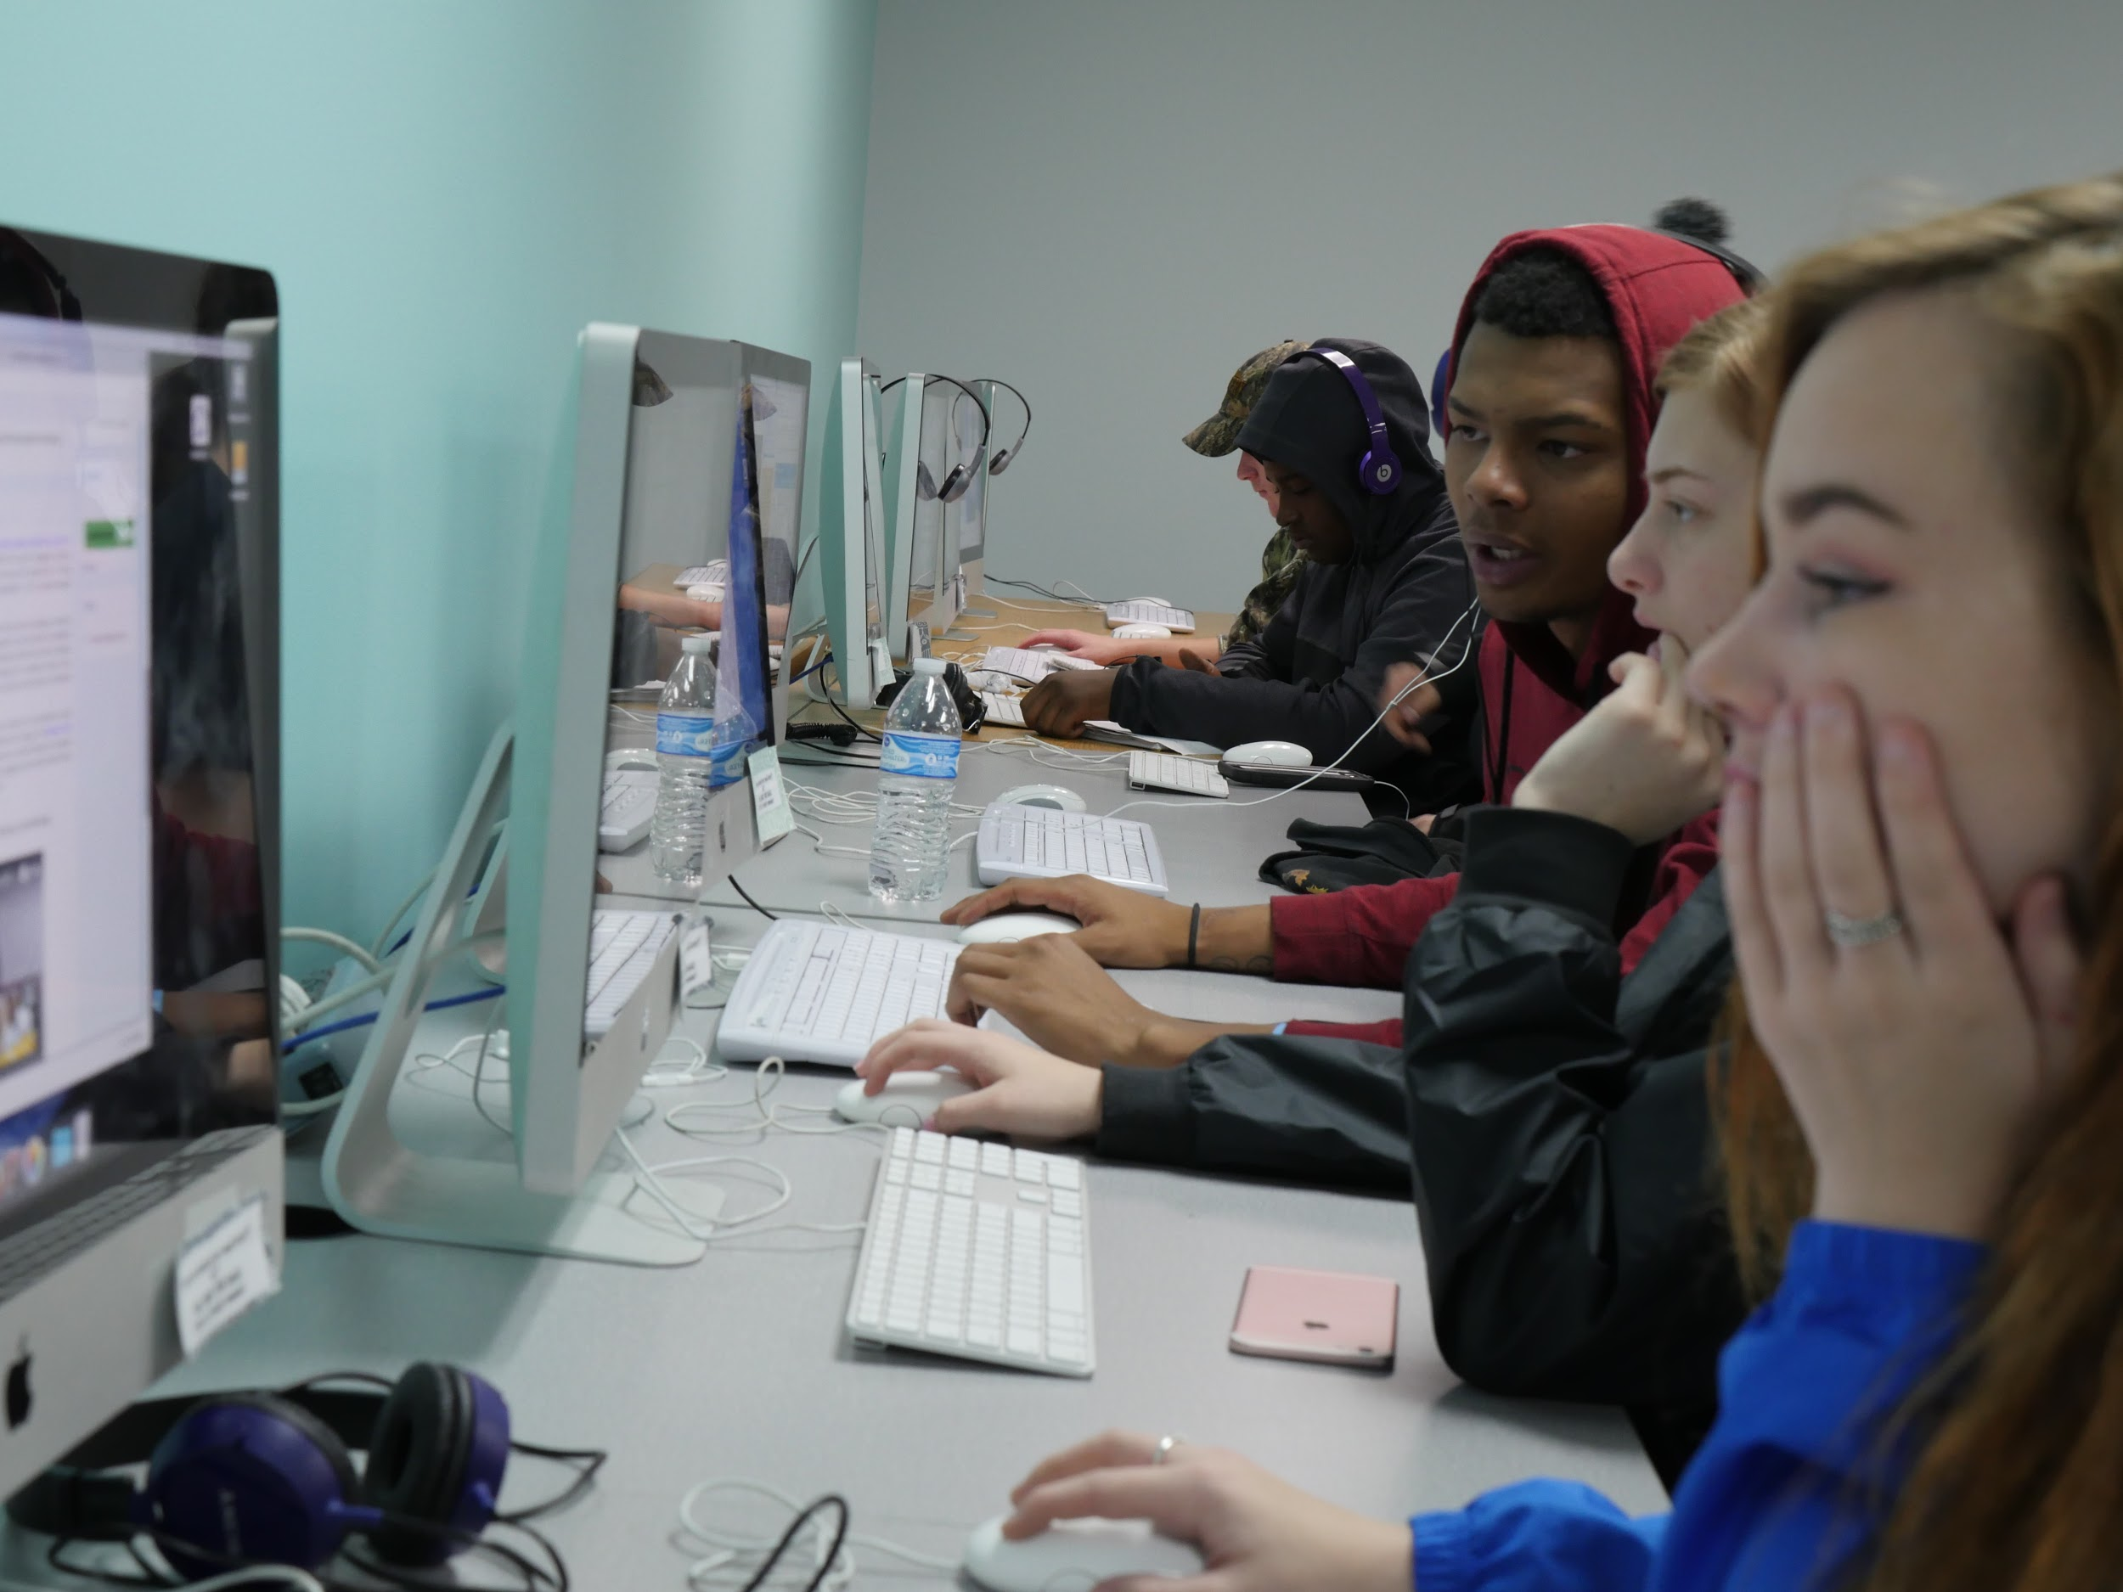
Support
and Structure
Year-round schedule
Highly individualized curriculum selection and pacing
Strong instructor and student relationships and culture
Online and face-to-face learning community
Scheduled learning lab and classroom times
Online content specialists
Home visits
Mental health training for teachers
Teacher-led training & teacherpowered leadership
Notes:
Monique - focus groups and what the students wanted
Sarah - Take the slide from there

Slide 7
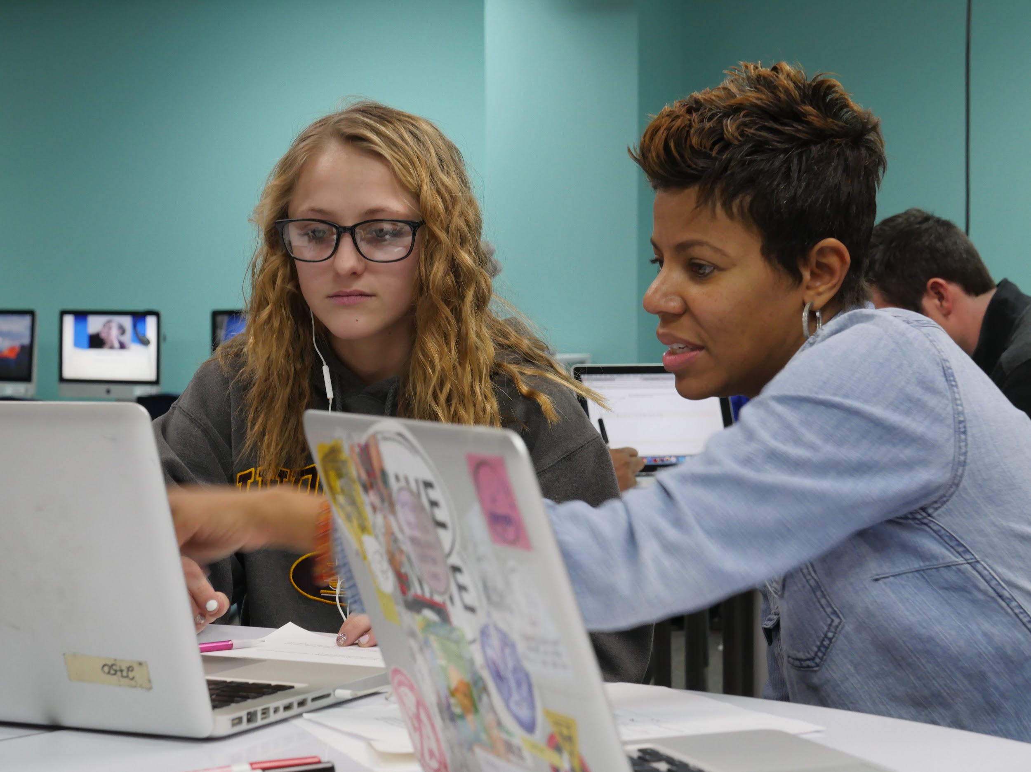
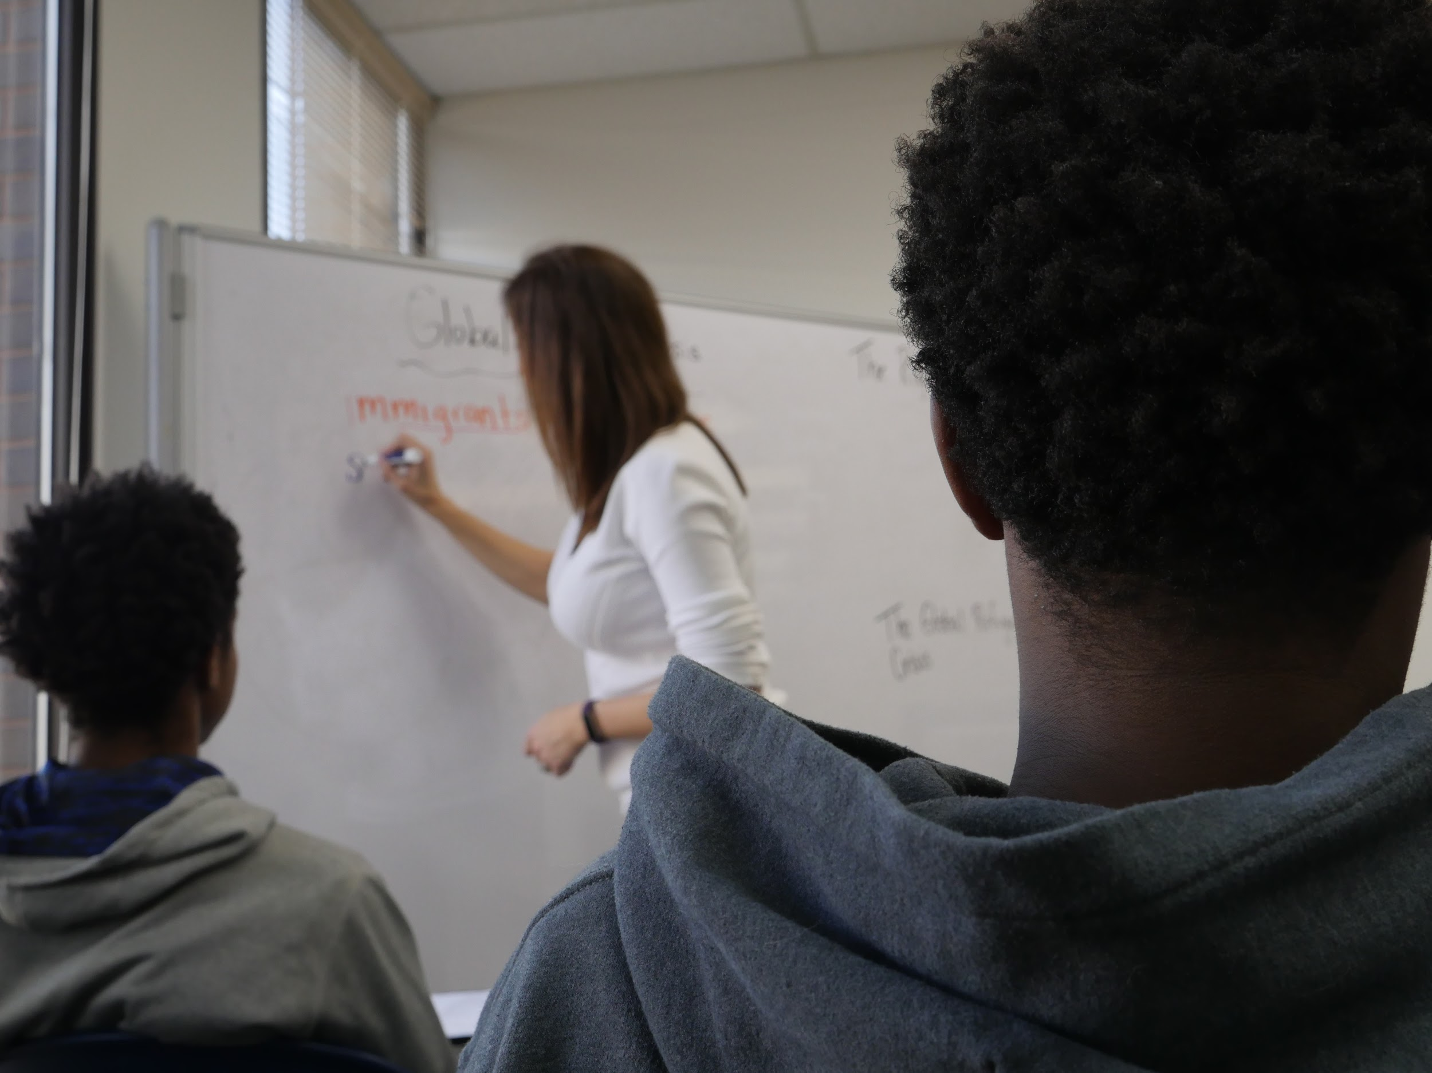
Advisors
Main point of contact for family with program
Develops individual learning plans
Home visits
Weekly contact
Quarterly student review meetings
Progress reporting, advisory data & collaborative teams
Notes:
Sarah - Discuss SEL teaming, advisory, co-leading classes, dean/counselor/social worker/outreach work

Slide 8
Partnerships - moving our students into the community
Dual Enrollment - WCC partnerships
  Construction trades/CNA program/Adult Transitions
Regional Alliance for Healthy Schools: School Based Health Centers
Washtenaw Health Plan
MI Works!
Washtenaw Area Council for Children / Washtenaw Literacy
Corner Health
Student Advocacy Center
SEL Training with UofM Depression Center
Curricular partnerships
Area community organizations: Rotary Club,Ozone House, Neutral Zone, others
Notes:
Monique

Slide 9
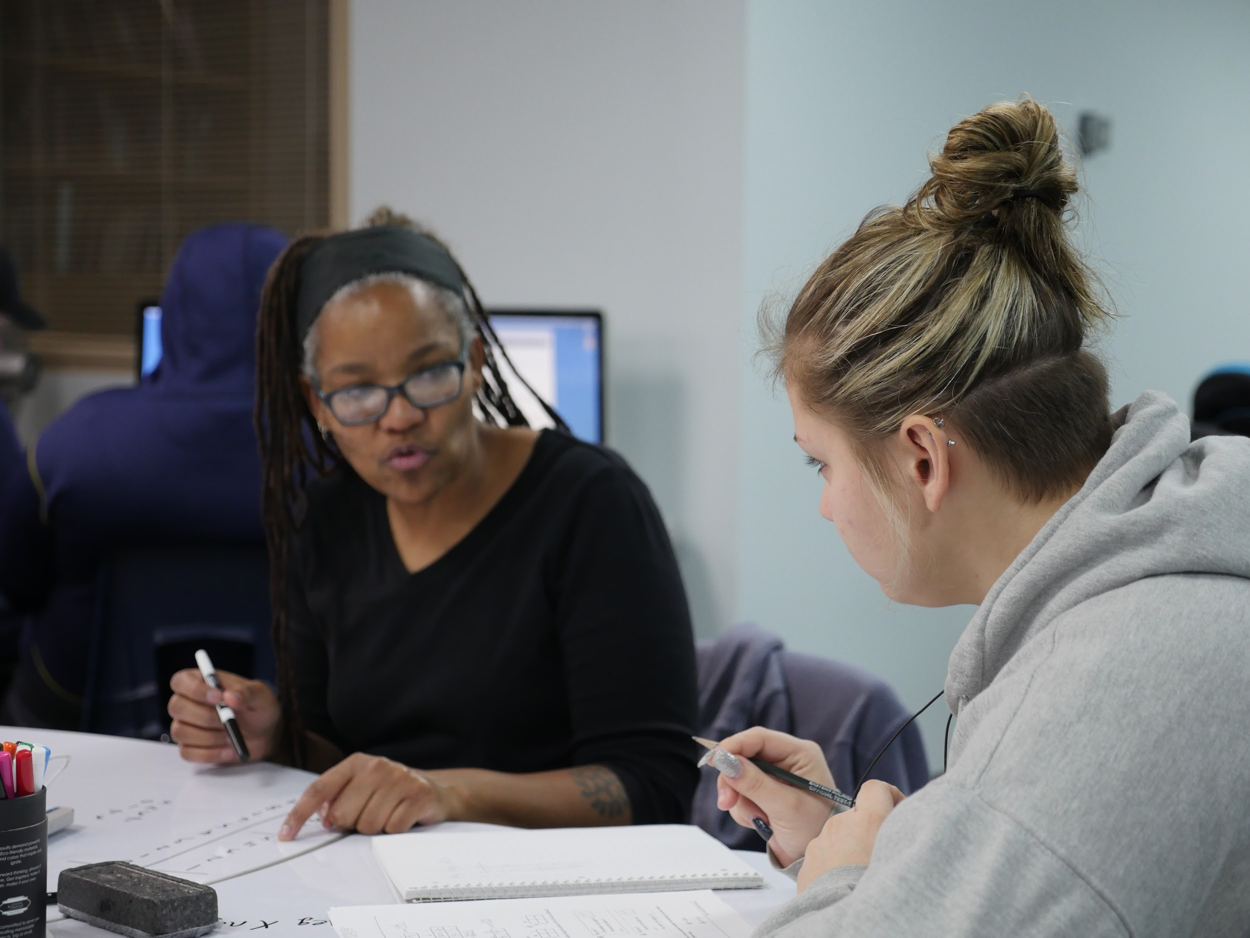
Hearing from the Students
Notes:
Student panel - 20 minutes
Thank students for their time.
Final part - Sarah and me

Slide 10
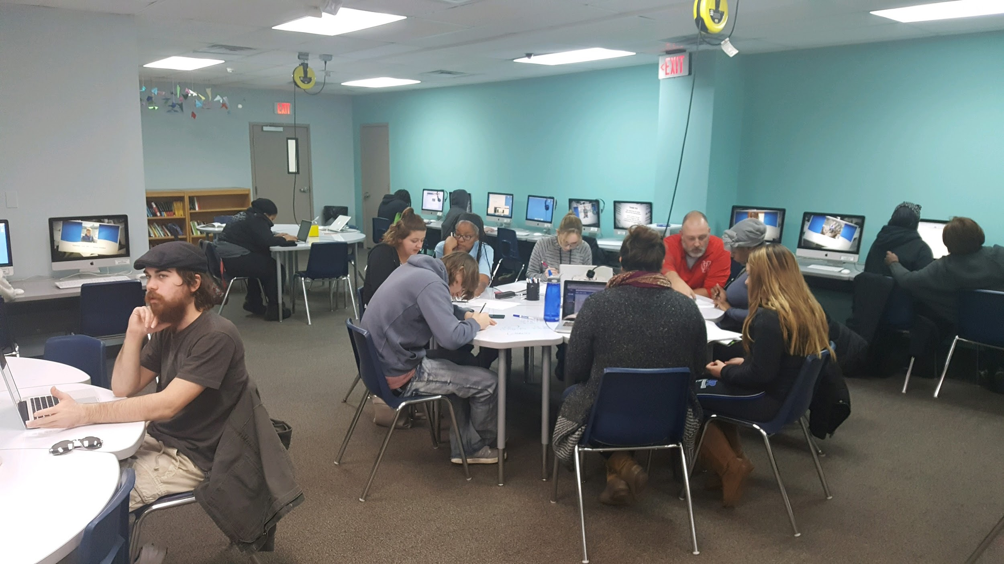
Questions?

