Slide 1

Bridging the Divide:
Partnership with Police
Kathleen McGoey, Sgt. James Brown & Abby Whipple

Slide 2
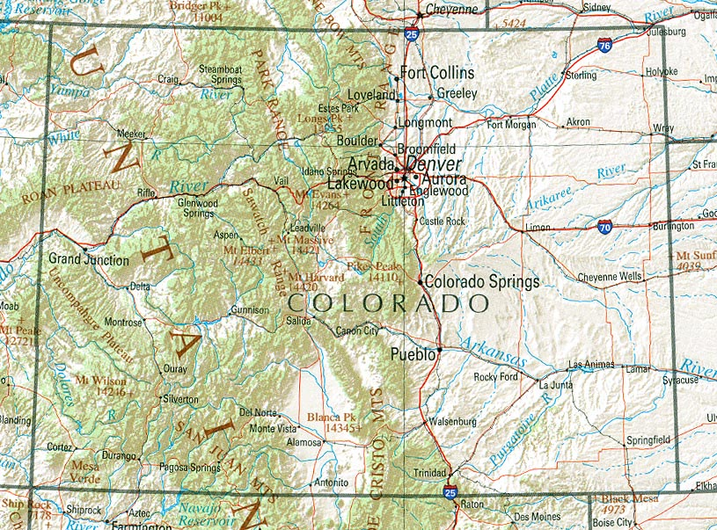

Longmont, Colorado
Population: 95,000
Demographics:
  67% White
  26% Hispanic/Latino
  7% All other race/ethnicities
Longmont Police Dept. (LPD): 155 sworn officers + Admin
1994: LCJP founded as Teaching Peace
LCJP: Staff of 5
Notes:
KM

Slide 3

Longmont Community Justice Partnership
LCJP builds community through collaborative and inclusive restorative practices and gives people the opportunity to heal and create justice in their community and the world.
Community Restorative Justice
Restorative Practices in Schools
Volunteers
&
Training
120 cases involving 200 offenders and 100 victims per year
90% of offenders complete their contracts
100% of victims report feeling the offender was held accountable
Notes:
KM

Slide 4
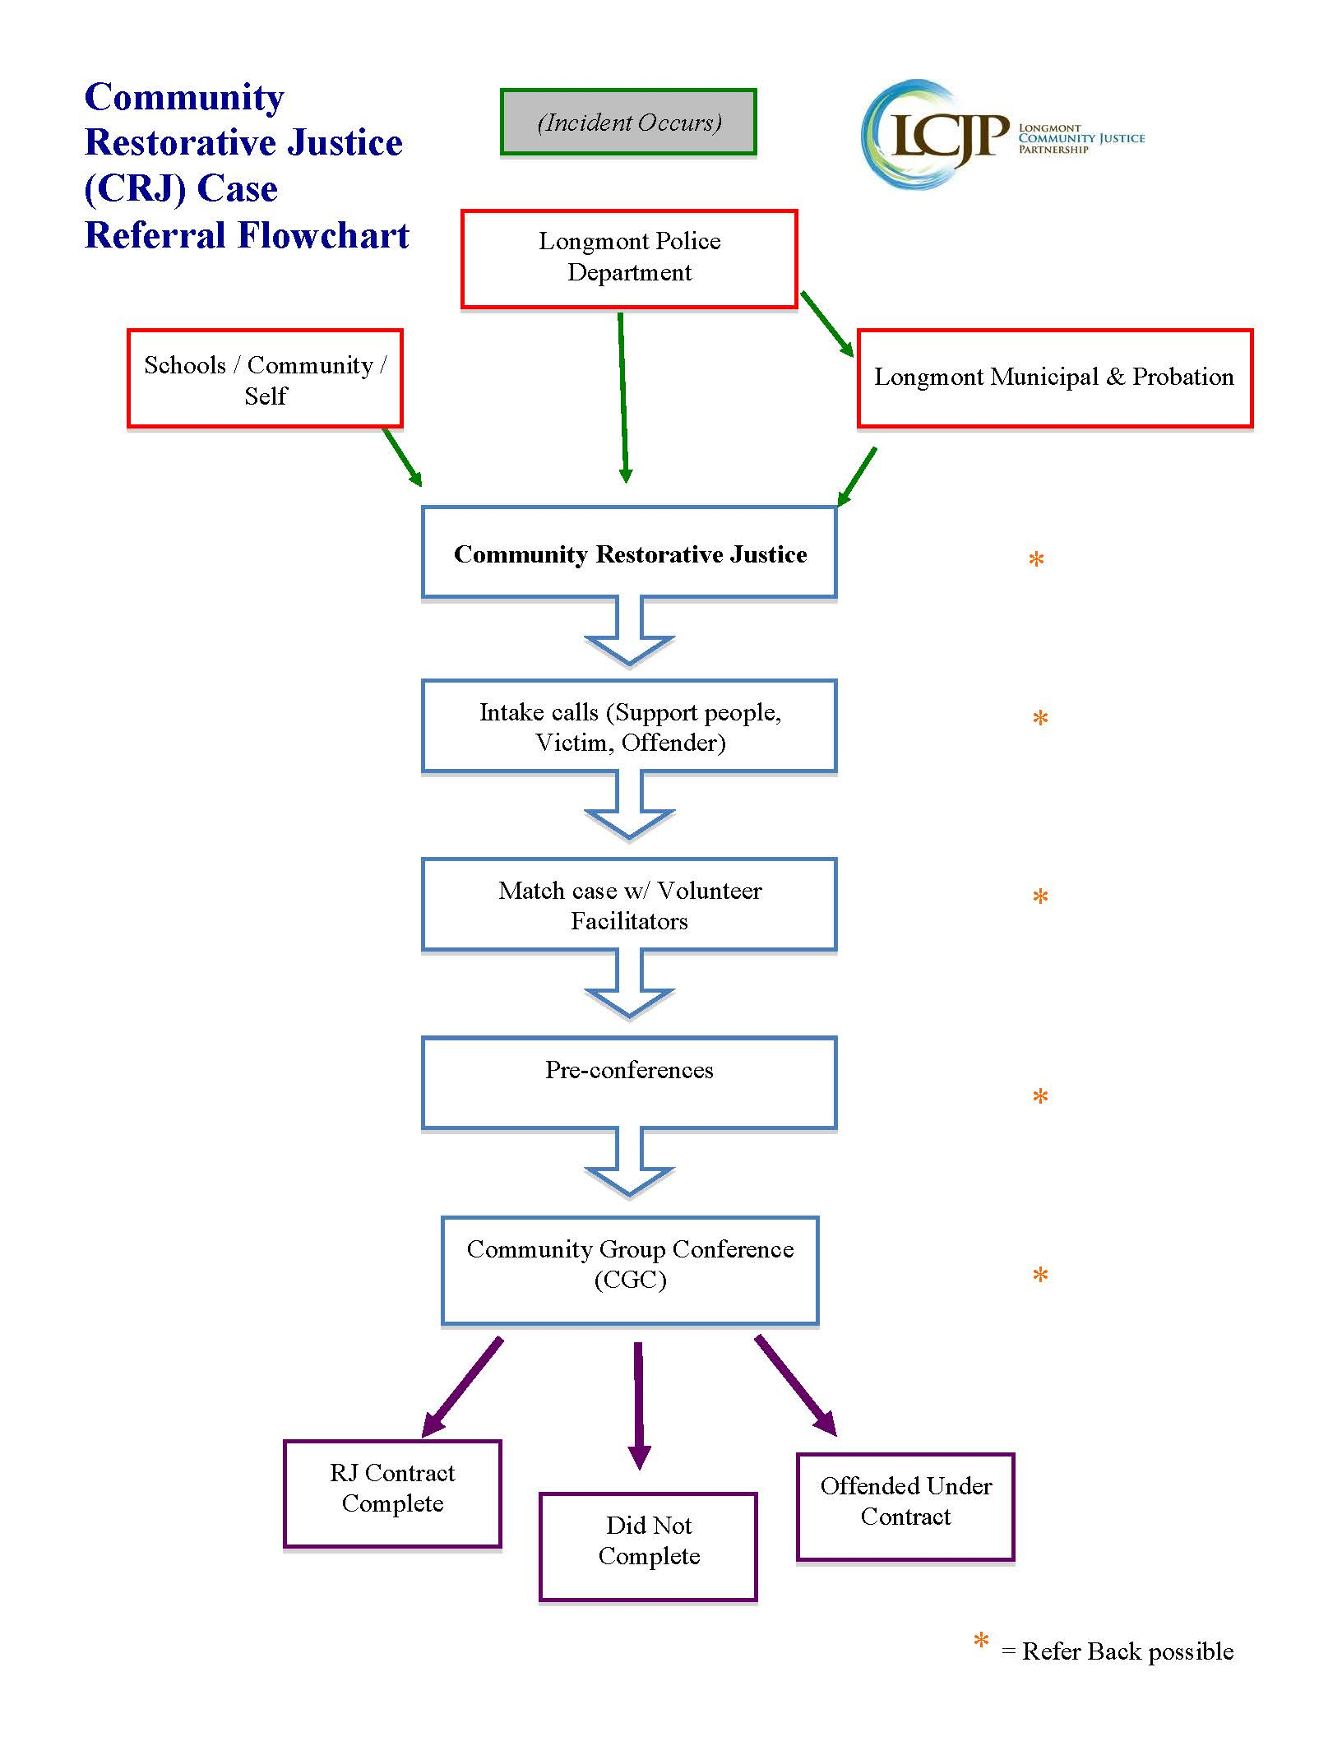
Notes:
KM

Slide 5
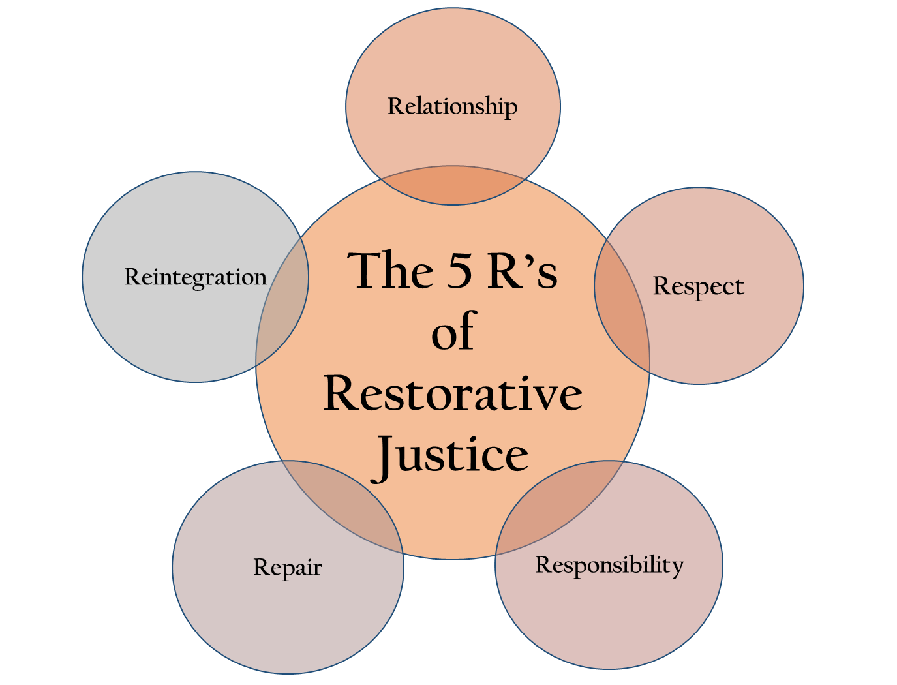
Key Concepts: Beverly Title’s 5 R’s

Slide 6
Community Restorative Justice:
Process & Numbers
On average, from 2014-17:
Cases referred to LCJP by LPD | 121
Offenders referred to LCJP by LPD | 174
Police officers who referred at least 1 case Police who participated in 1 circle | 59 36
Percent of RJ Conferences “circles” in which a Police Officer participated | 94%
Notes:
KM

Slide 7
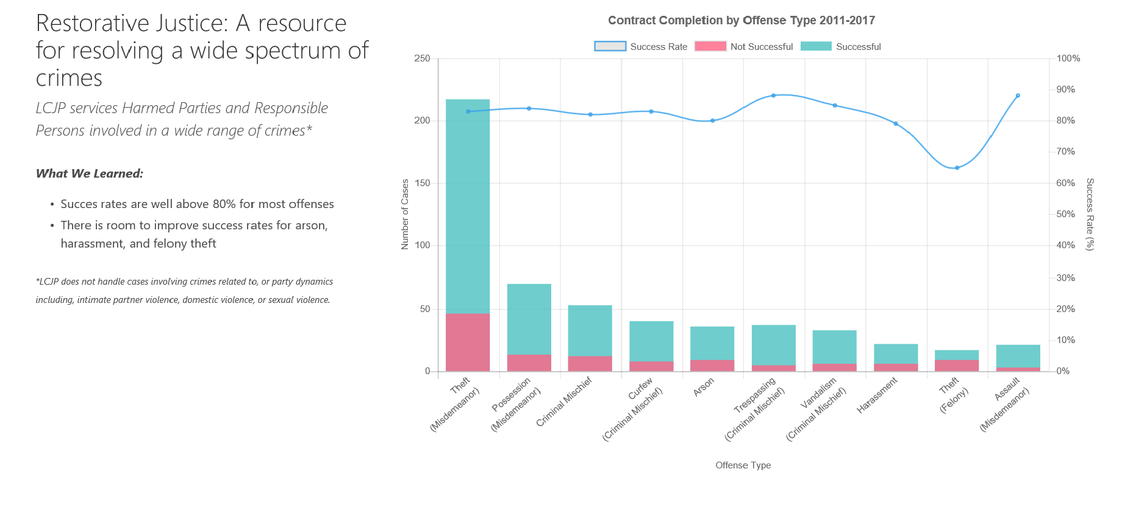
These graphs don’t lie!
Types of charges referred: Theft, Criminal Mischief, Arson, Trespassing, Vandalism, Harassment, Assault, Burglary, Reckless Use of a Firearm, Fraud
https://outreach.penlink.com/lcjp

Slide 8
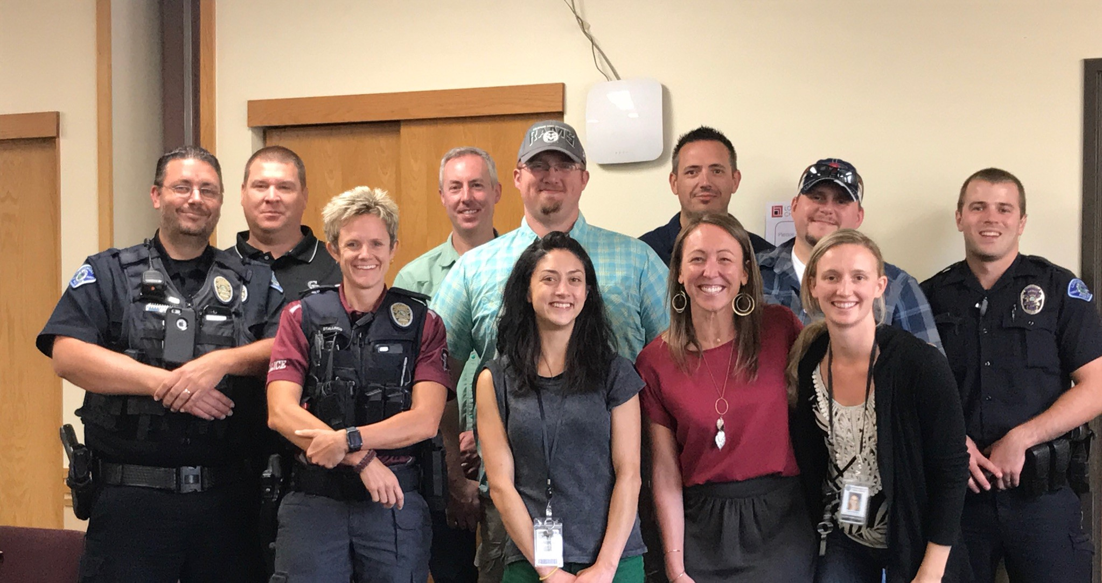
LPD- LCJP Liaisons
Notes:
How liaison program started
JB: What liaisons do
Participate in conferences if referring officer can’t/ doesn’t want to
Educate peers about what cases are good for RJ
Eyes and ears around the department – are there any negative impressions of RJ floating around?
Support staff on reviewing cases (AW example)

Slide 9

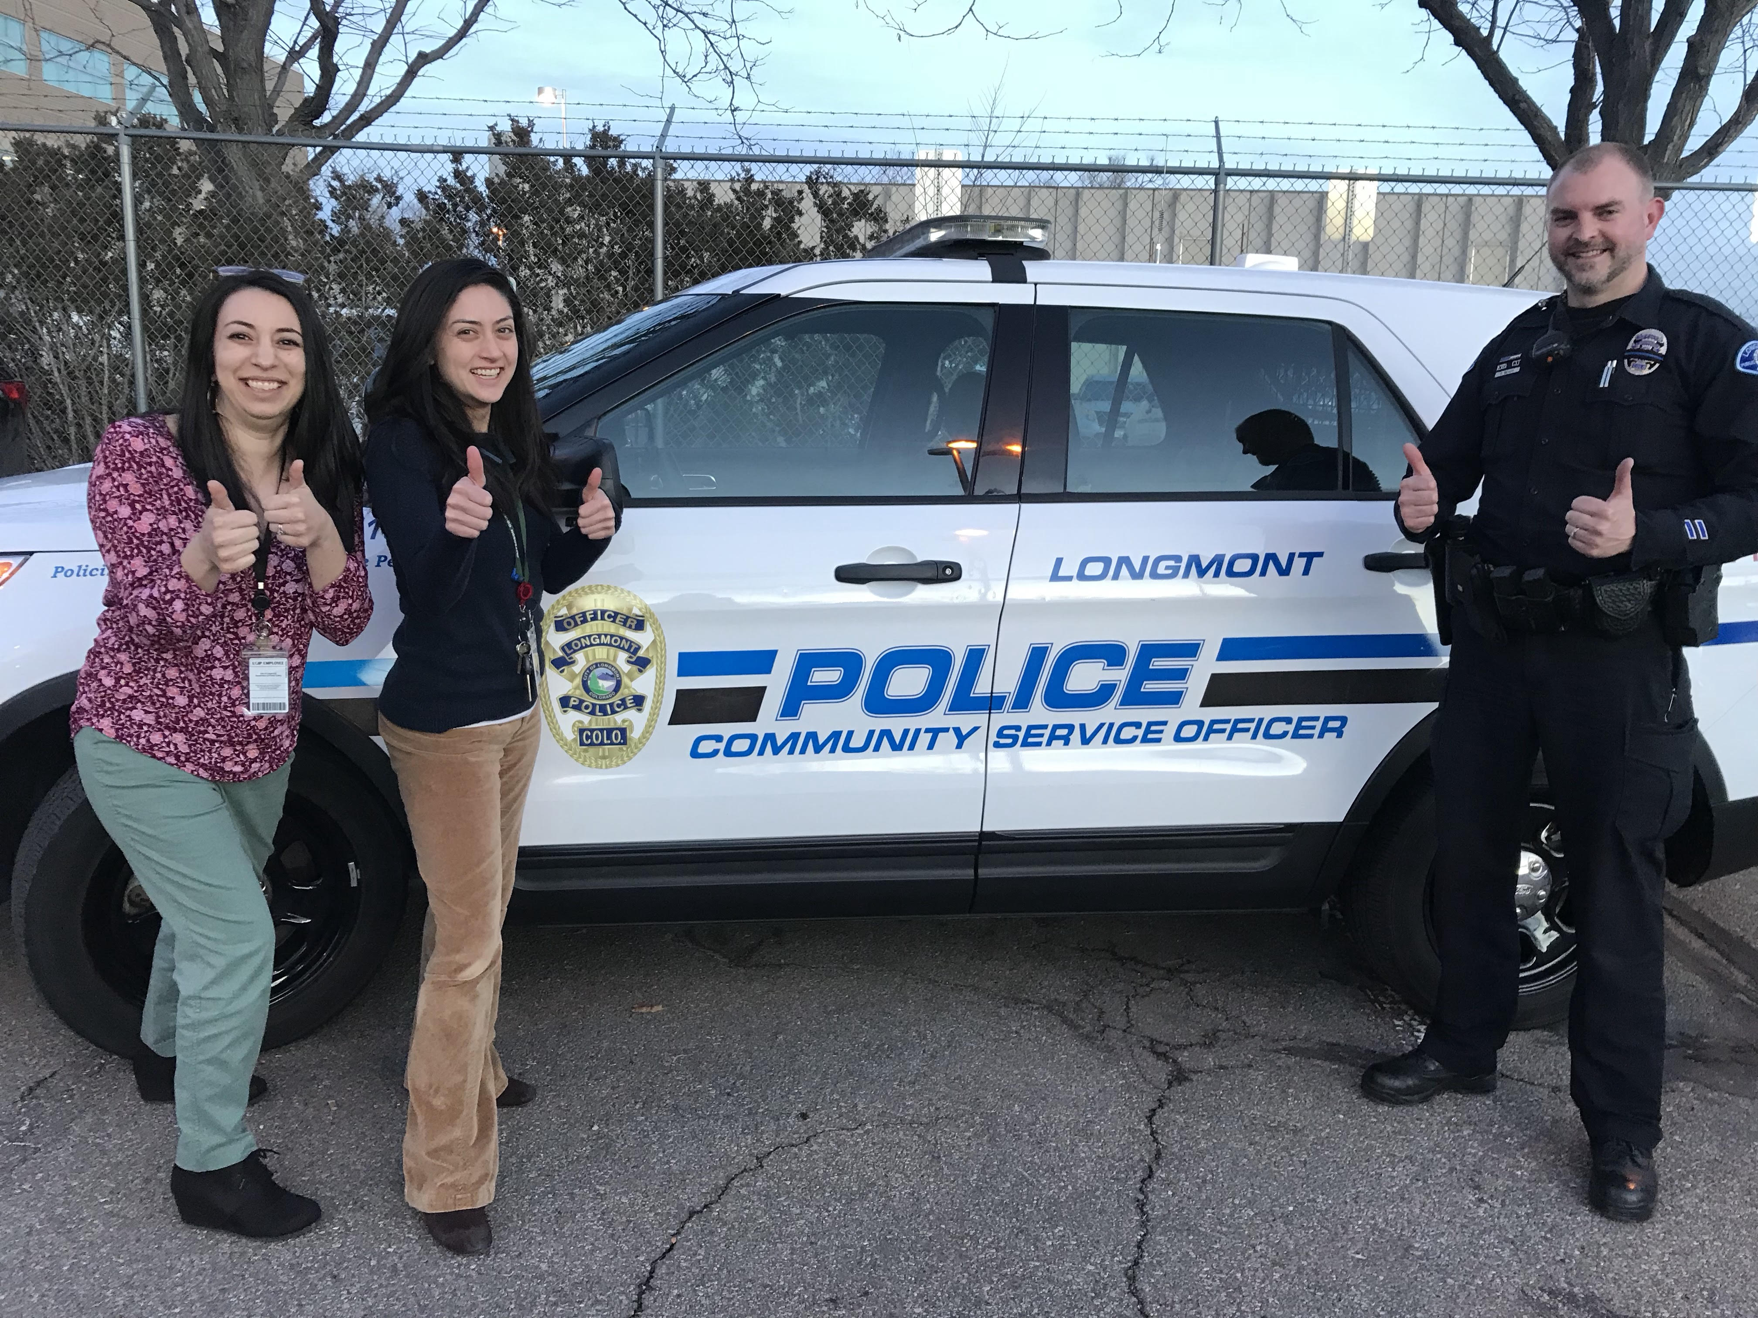
RJ-Police Partnership:
10 Do’s & Don’ts for RJ People
Notes:
KM

Slide 10
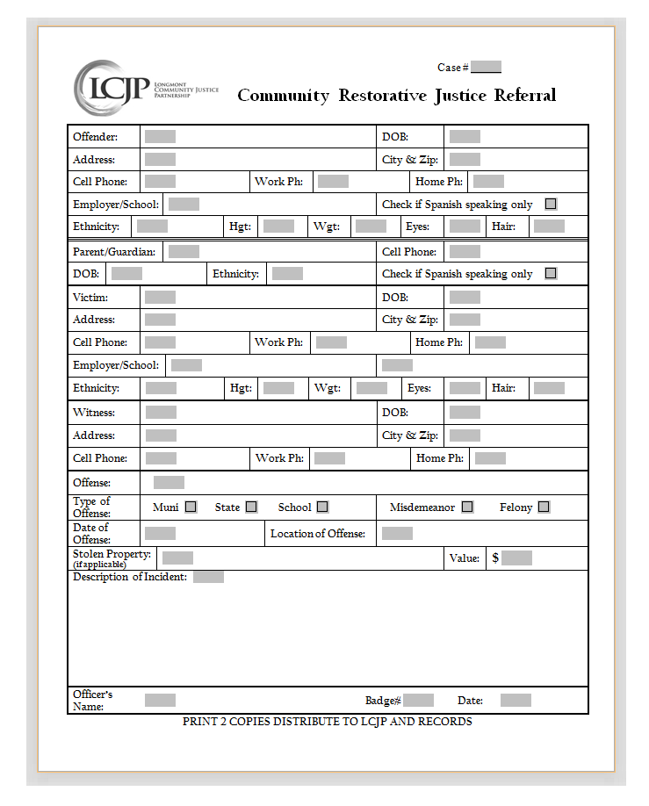
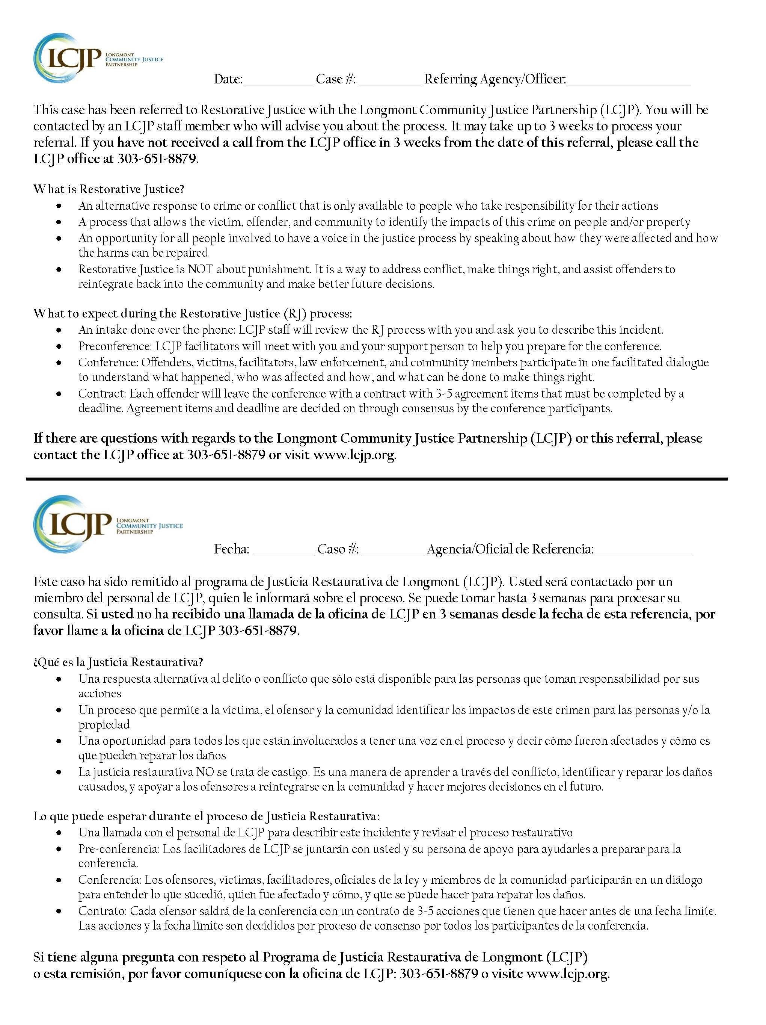
Do: Streamline the RJ referral process
Don’t: Create extra work for officers
1.
Stand-Alone Referral Form
Victim / Offender Half-Sheet
Notes:
JB: Referral process used to be more cumbersome than writing a ticket
Quota system= bad news
KM: Discuss forms

Slide 11
“Criteria for LCJP” Pocket Reminders
Notes:
KM

Slide 12


2. Don’t: Insist that ALL cases should go to RJ
Do: Explain how RJ is beneficial for certain types of cases and scenarios
Relationships
Notes:
KM start
JB: describe initial message from RJ people
KM: heard it was like RJ Cheerleaders
JB: What

Slide 13
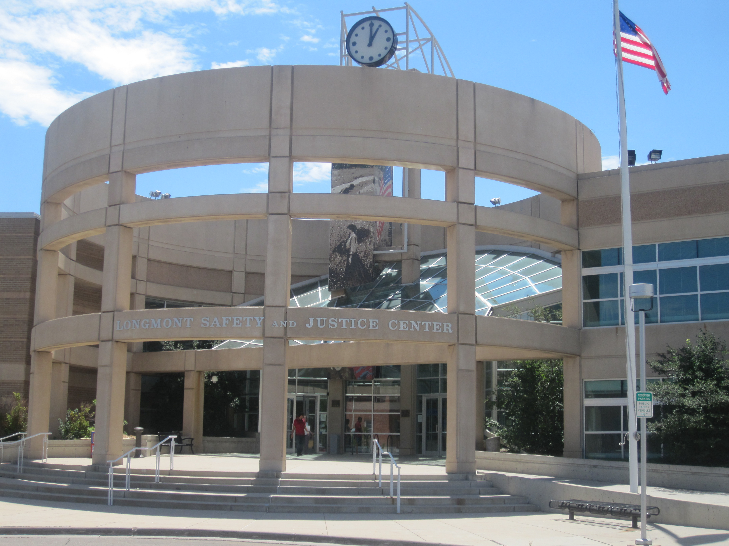
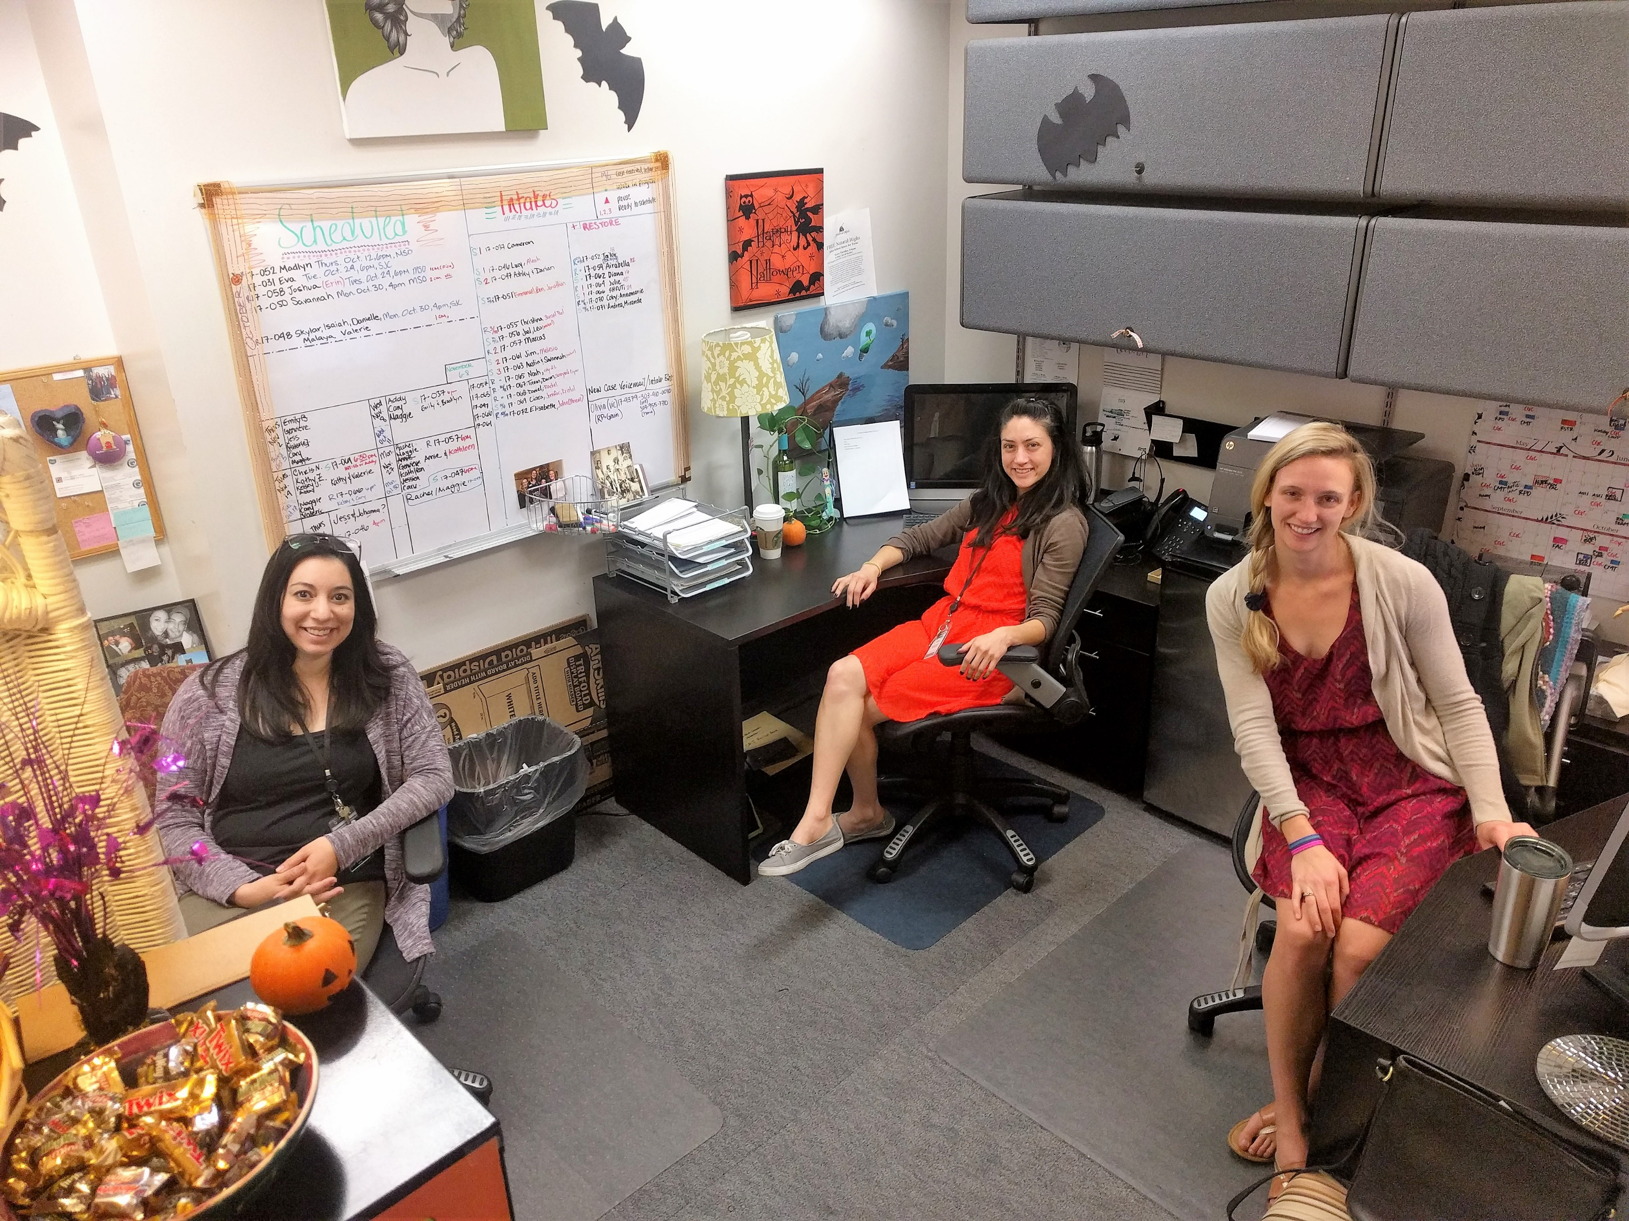
LCJP’s CRJ Program Office
Don’t: Introduce yourself once and call it good
Do: Maintain presence and establish trust
3.

Slide 14
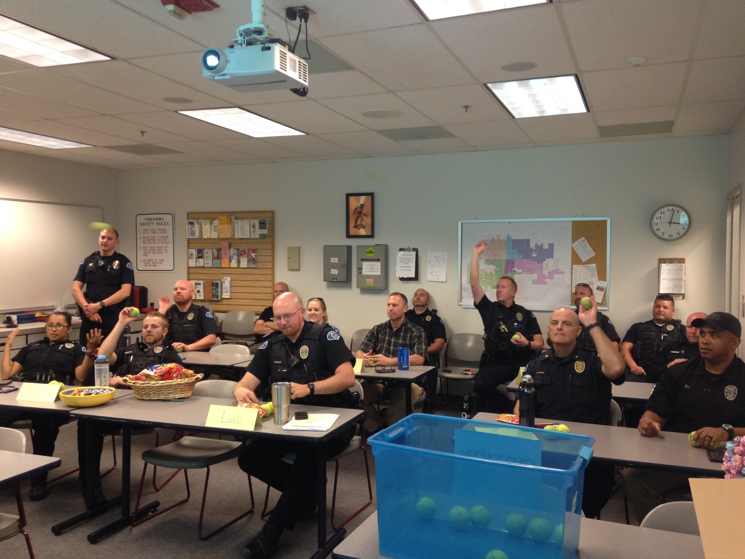
LPD Briefings

Slide 15
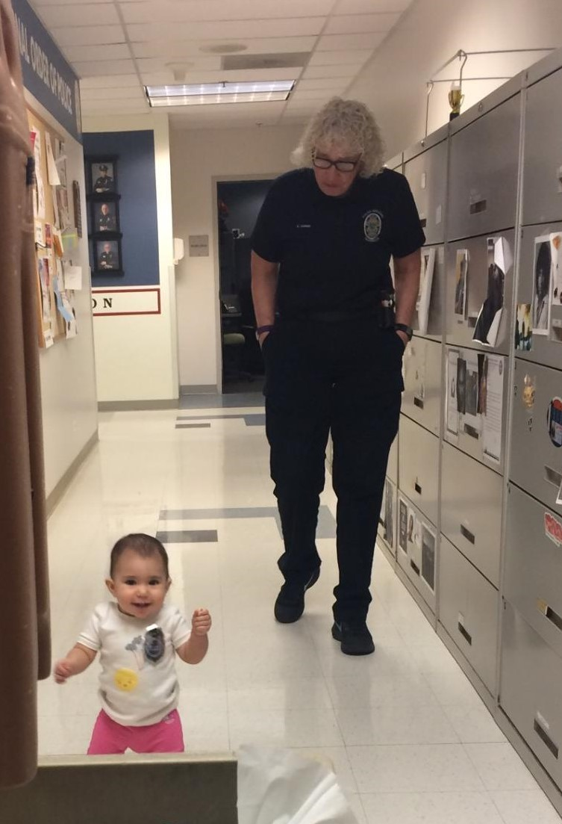
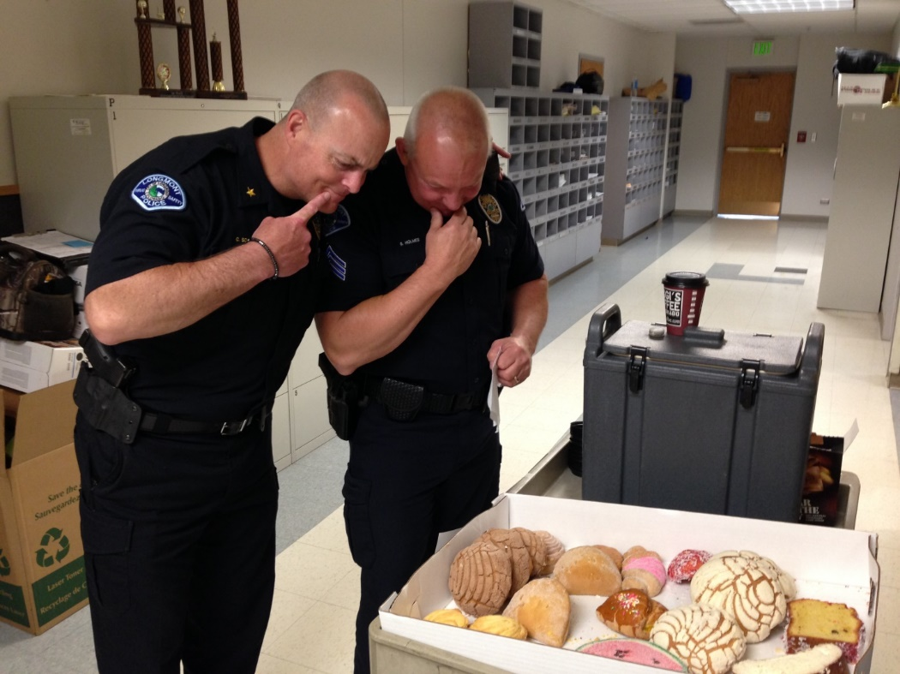
Officer Appreciation Day

Slide 16
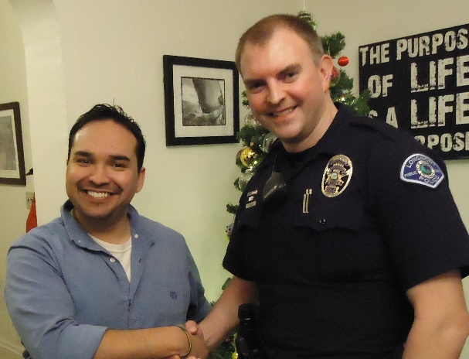
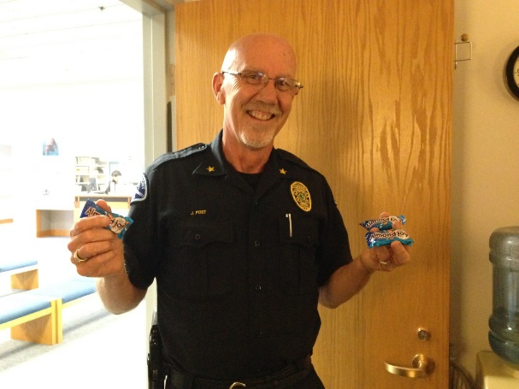

Don’t: Show up with unreasonable expectations. Do: Get to know your audience.
4.
5.
Do: Value police discretion.
Don’t: Compromise on fidelity to RJ practices & principles. Be consistent!

Slide 17
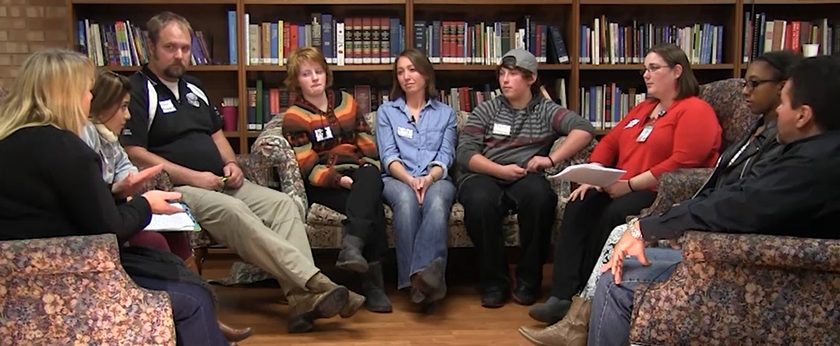
6.
Do: Get officers into well-facilitated RJ conferences ASAP.
Don’t: Try to get officers to be someone they’re not.
Notes:
Humanizing police
Everyone’s perspective changes, offender feels seen
Helps bring clarity and gravity to circumstances

Slide 18


Slide 19
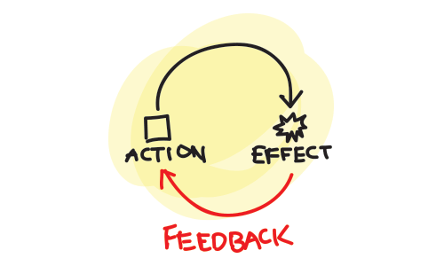
Do: Give & receive feedback.
Don’t: Blow it off.
7.
Notes:
officer feedback considered to maintain the quality of the process.
encourage appropriate participation (avoid lecturing, punitive language)- liaisons help.

Slide 20
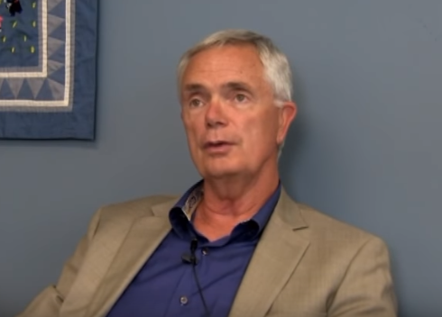
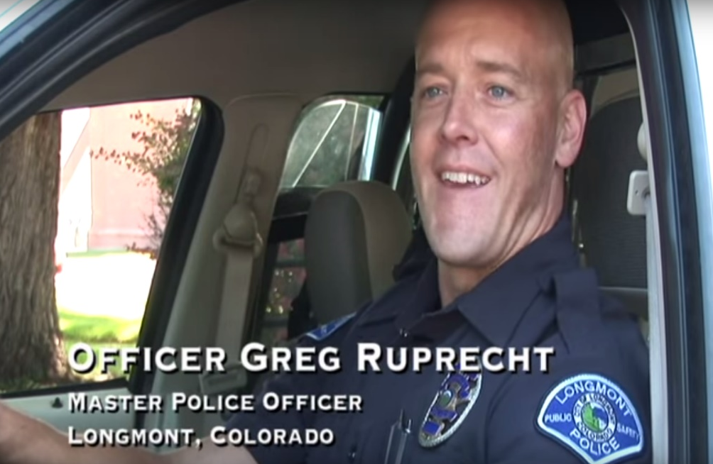
Don’t: Underestimate the voices of line officers.
8.
Do: Seek buy-in and support from police leadership.
Public Safety Chief Mike Butler

Slide 21
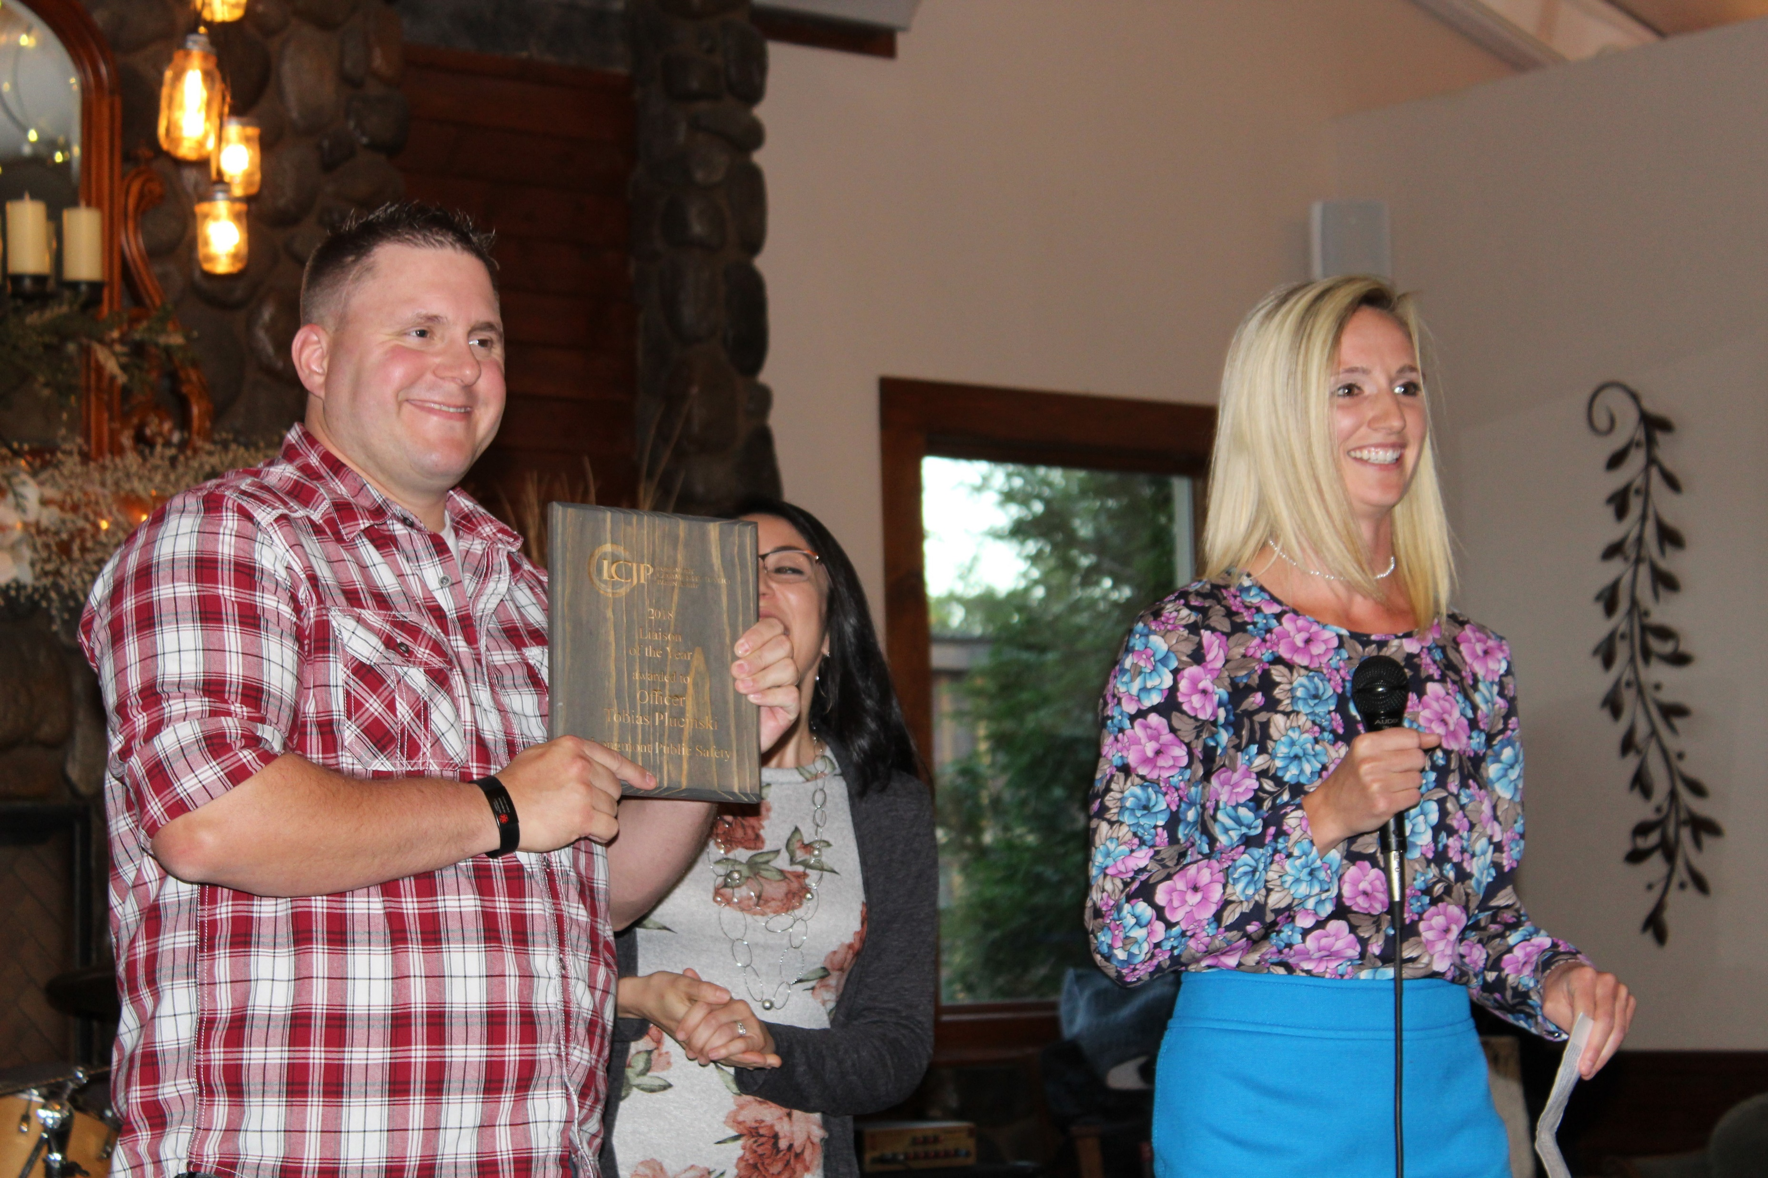
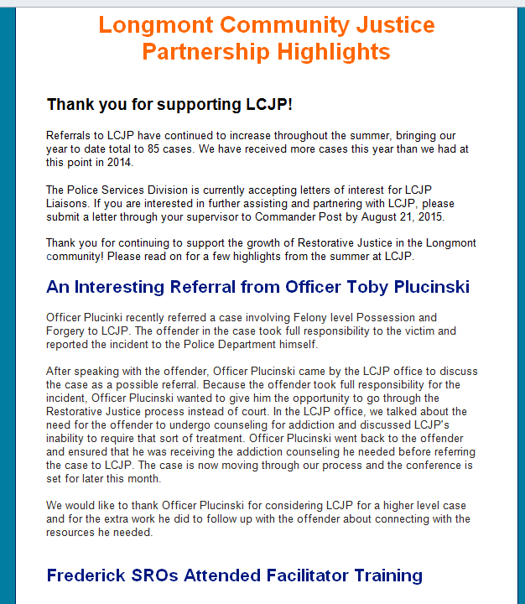
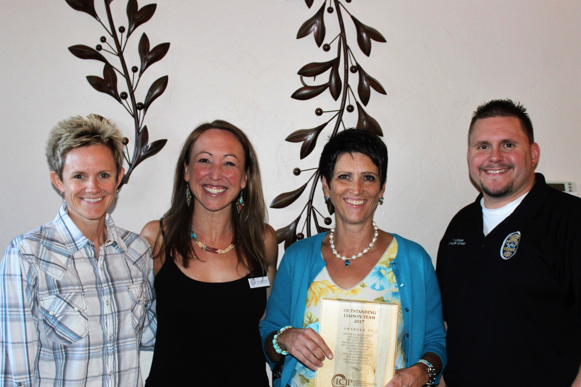
Do: Share success stories.
Don’t: Rely only on numbers.
9.
Notes:
Success stories cases
Positive recognition for Officers

Slide 22
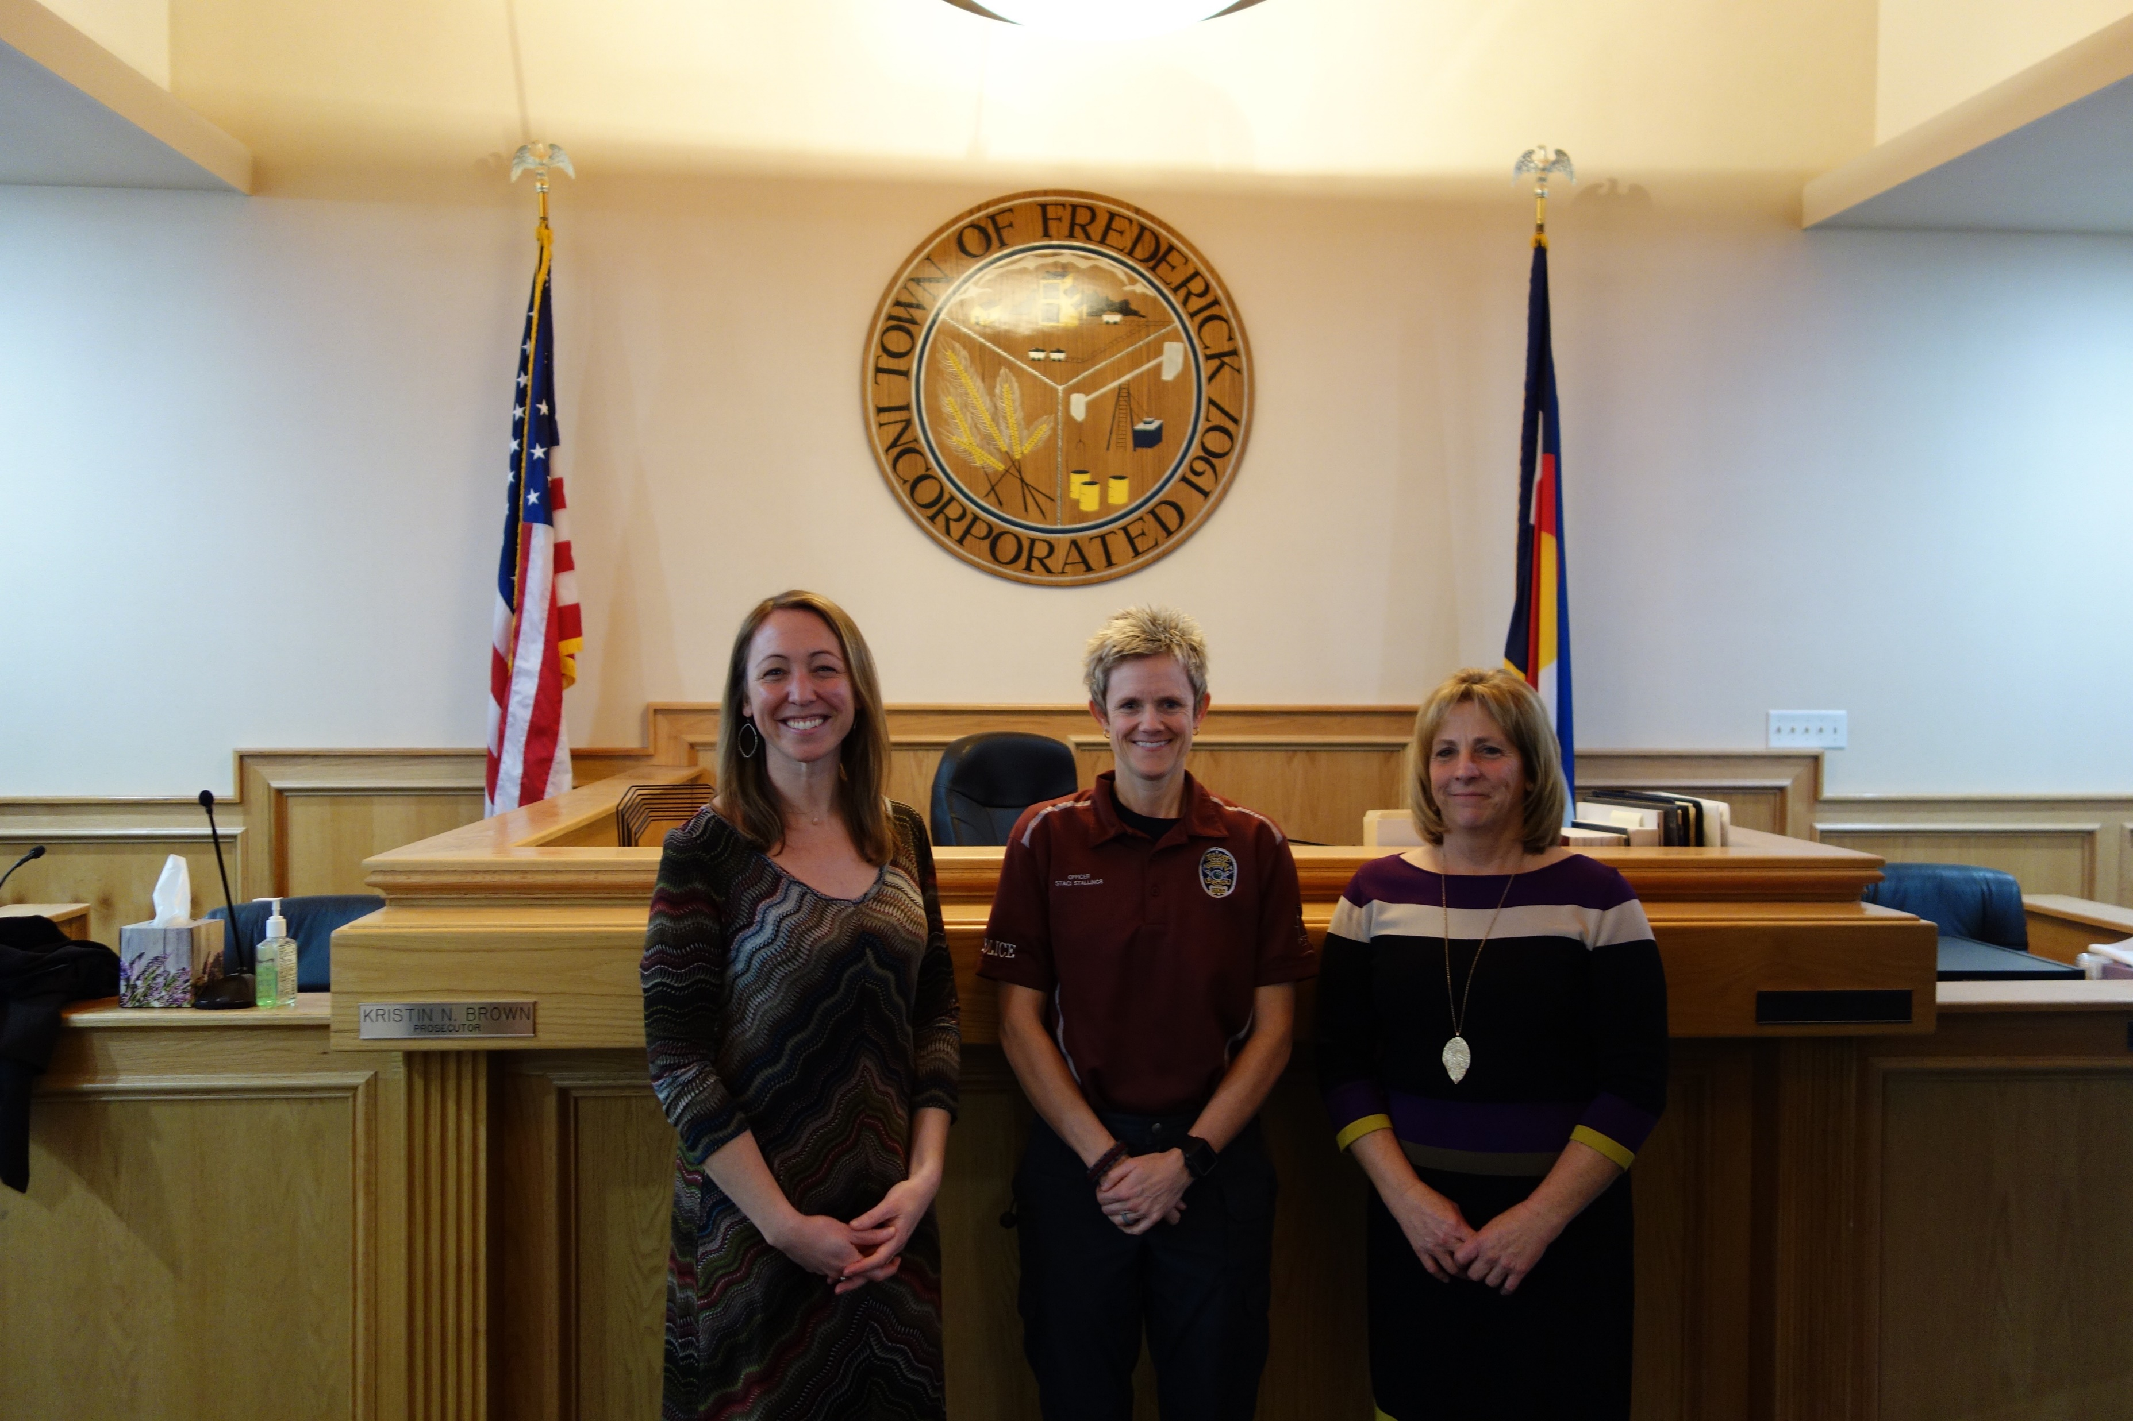
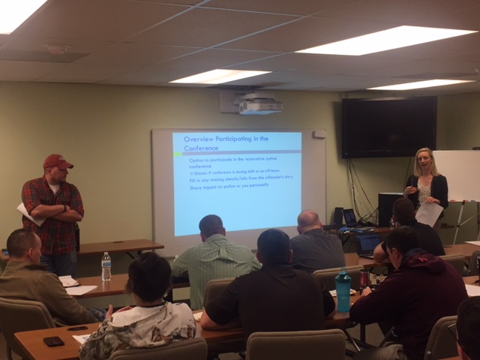
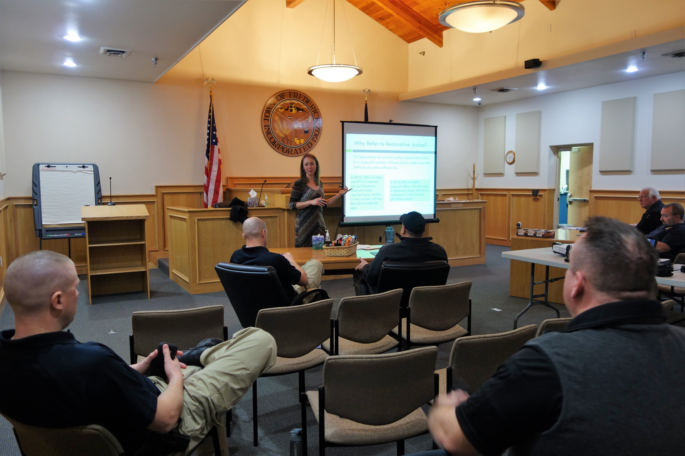
Frederick, Colorado
10.
Don’t: Give up.
Do: Seek advocates, allies, stakeholders.
Casper, Wyoming

Slide 23

Activity
Form groups of 3
Discuss: How does this presentation relate to your community/program?
Identify your/your program’s next step in involving police
  Who are the relevant stakeholders?
  What are the possible barriers?
  Who are your allies / advocates? Who has shared goals?
Come back together in large group
  Action steps?
  Questions

Slide 24
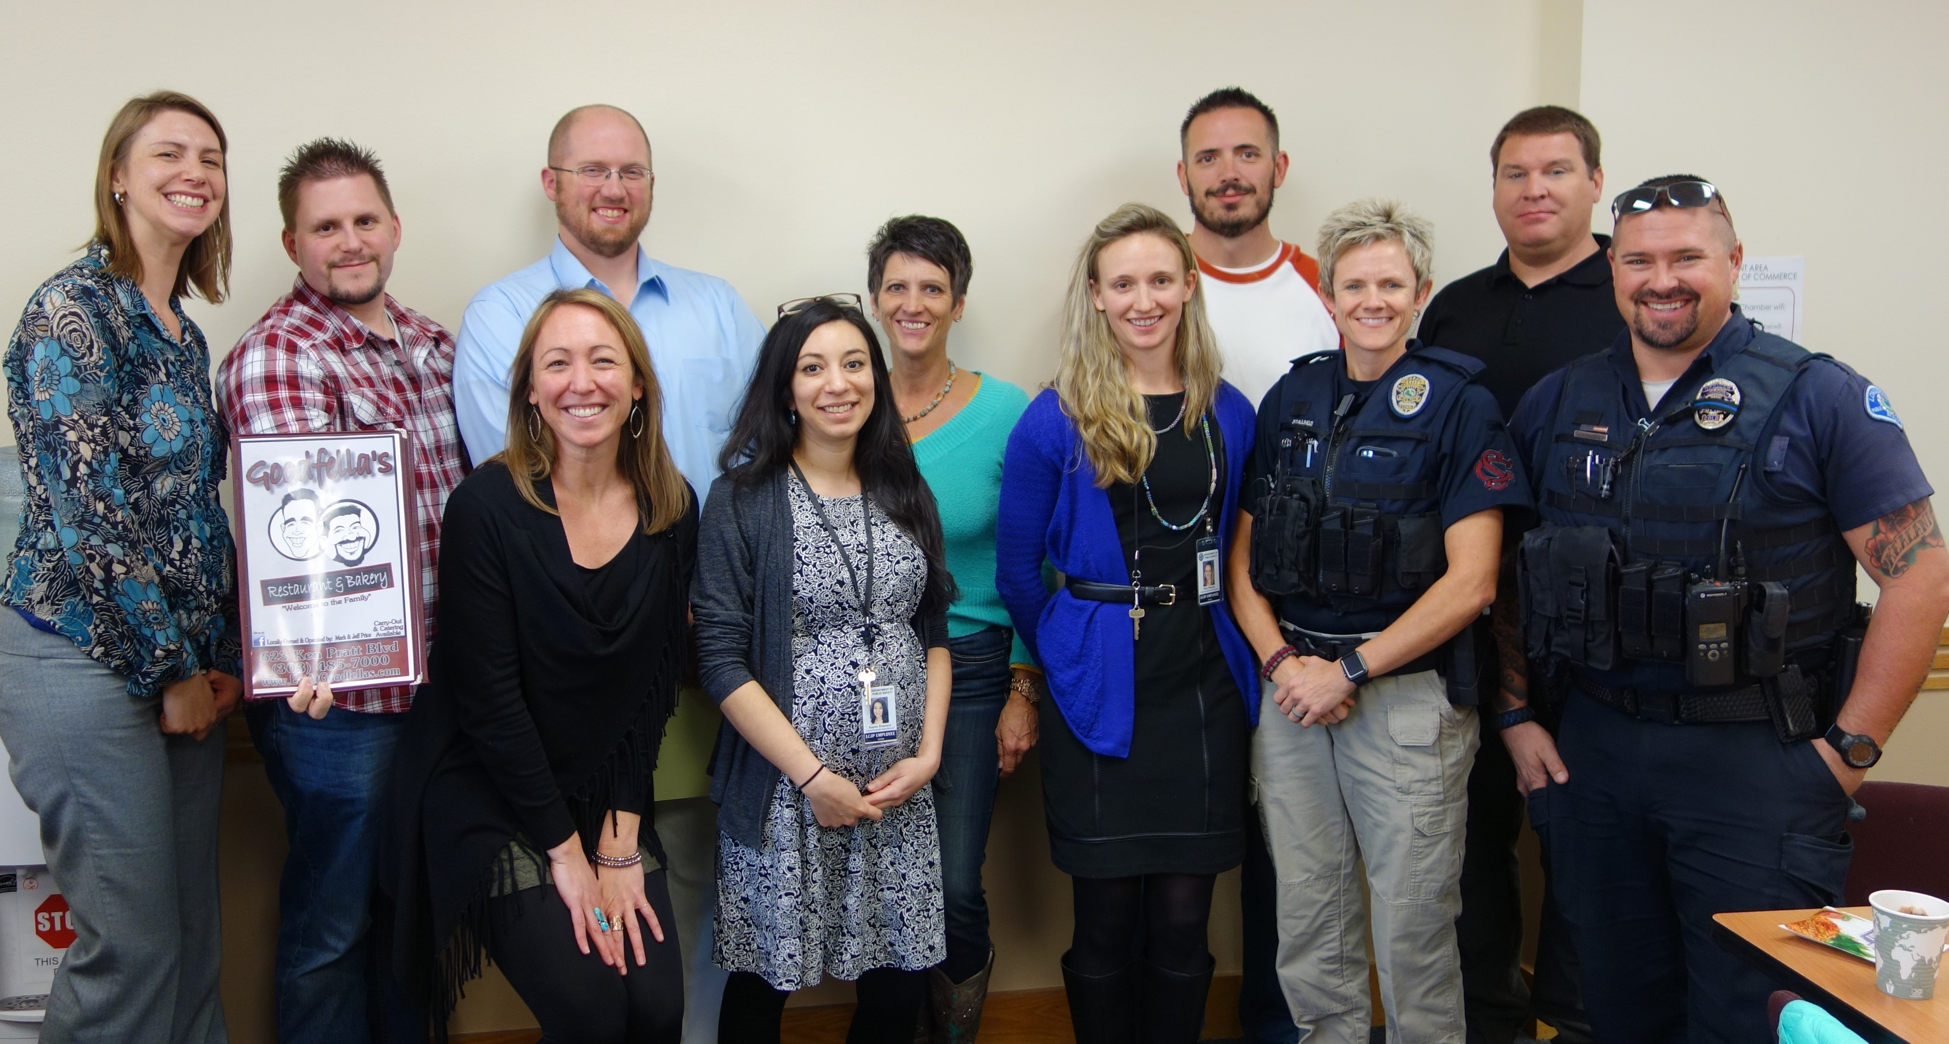
Thank you!
If you would like the slides emailed to you, please sign up or leave your business card
For more information about LCJP & partnering with police, please contact us!
  Kathleen@lcjp.org 303-776-1527

