Slide 1
trauma doulas
& critical yeast
A Role to Activate Resilience, Recovery, & Peace
Austin Averett, MA Candidate ’19
Conflict Resolution, Portland State University

Slide 2
A few strategically connected people have greater potential for creating the social growth of an idea or process than large numbers of people who think alike. When social change fails, look first to the nature of who was engaged and what gaps exist in the connections among different sets of people. … In this sense social change requires a keen sense of relational spaces even when those are not in direct physical proximity. Based on relational spaces, critical yeast constantly moves across a range of different processes and connections.
John Paul Lederach, 2005

Slide 3
Doulas in healthcare
Role:
Designated support person
Decrease in cesareans
Decrease in other invasive/assistive strategies (pharma, tools, etc.)
Increase in satisfaction of process/experience
Medical professionals
Palliative/end of life care, illnesses, etc.
Bohren, M. A., Hofmeyr, G. J., Sakala, C., Fukuzawa, R. K., & Cuthbert, A. (2017). Continuous support for women during childbirth. Cochrane Database of Systematic Reviews, (7).
Dundek, L. H. (2006). Establishment of a Somali doula program at a large metropolitan hospital. The Journal of perinatal & neonatal nursing, 20(2), 128-137.
Parallel context

Slide 4
trauma doula
“I have found doula to be a role that applies to many aspects of life. … It is another form of facilitation, making the [experience] as easy as possible, intervening with any systems that make the process harder…, staying focused on the possibility and wisdom of the body. Standing or sitting with someone as they realize, remember their wholeness—that is the work of the healer and the doula.”
Emergent Strategy, adrienne maree brown, 2017
Informational
Physical
Emotional

Slide 5
collective healing & peace building
Treeline

Slide 6

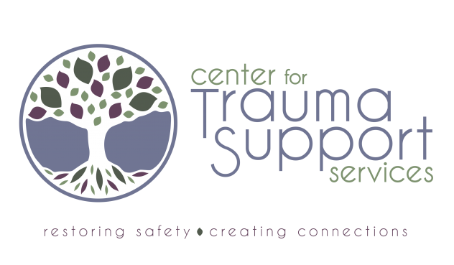

Slide 7
References
Blackstock, C. (2011). The emergence of the breath of life theory. Journal of Social Work Values and Ethics, 8(1), 1-16.
Bohren, M. A., Hofmeyr, G. J., Sakala, C., Fukuzawa, R. K., & Cuthbert, A. (2017). Continuous support for women during childbirth. Cochrane Database of Systematic Reviews, (7).
brown, adrienne marie. Emergent Strategy: Shaping Change, Changing Worlds. Chico, CA: AK Press, 2017.
Dundek, L. H. (2006). Establishment of a Somali doula program at a large metropolitan hospital. The Journal of perinatal & neonatal nursing, 20(2), 128-137.
Ginwright, S. (2018). The future of healing: Shifting from trauma-informed care to healing centered engagement. Medium. Retrieved from https://medium. com/@ ginwright/the-future-of- healing-shifting-from-trauma-informed-care-to-healing-centered- engagement-634f557ce69c.
Lederach, J. P.. (2005). The moral imagination: The art and soul of building peace. In On mass and movement: The theory of the critical yeast. Oxford University Press. doi: 10.1093/0195174542.003.0009
Leitch, L. (2017). Action steps using ACEs and trauma-informed care: a resilience model. Health & Justice 5:5. DOI 10.1186/s40352-017-0050-5
Porges, S.W. (2011) The Polyvagal Theory: Neurophysiological Foundations of Emotions, Attachment, Communication, Self-regulation. New York: W.W. Norton & Company, Inc.

