Slide 1
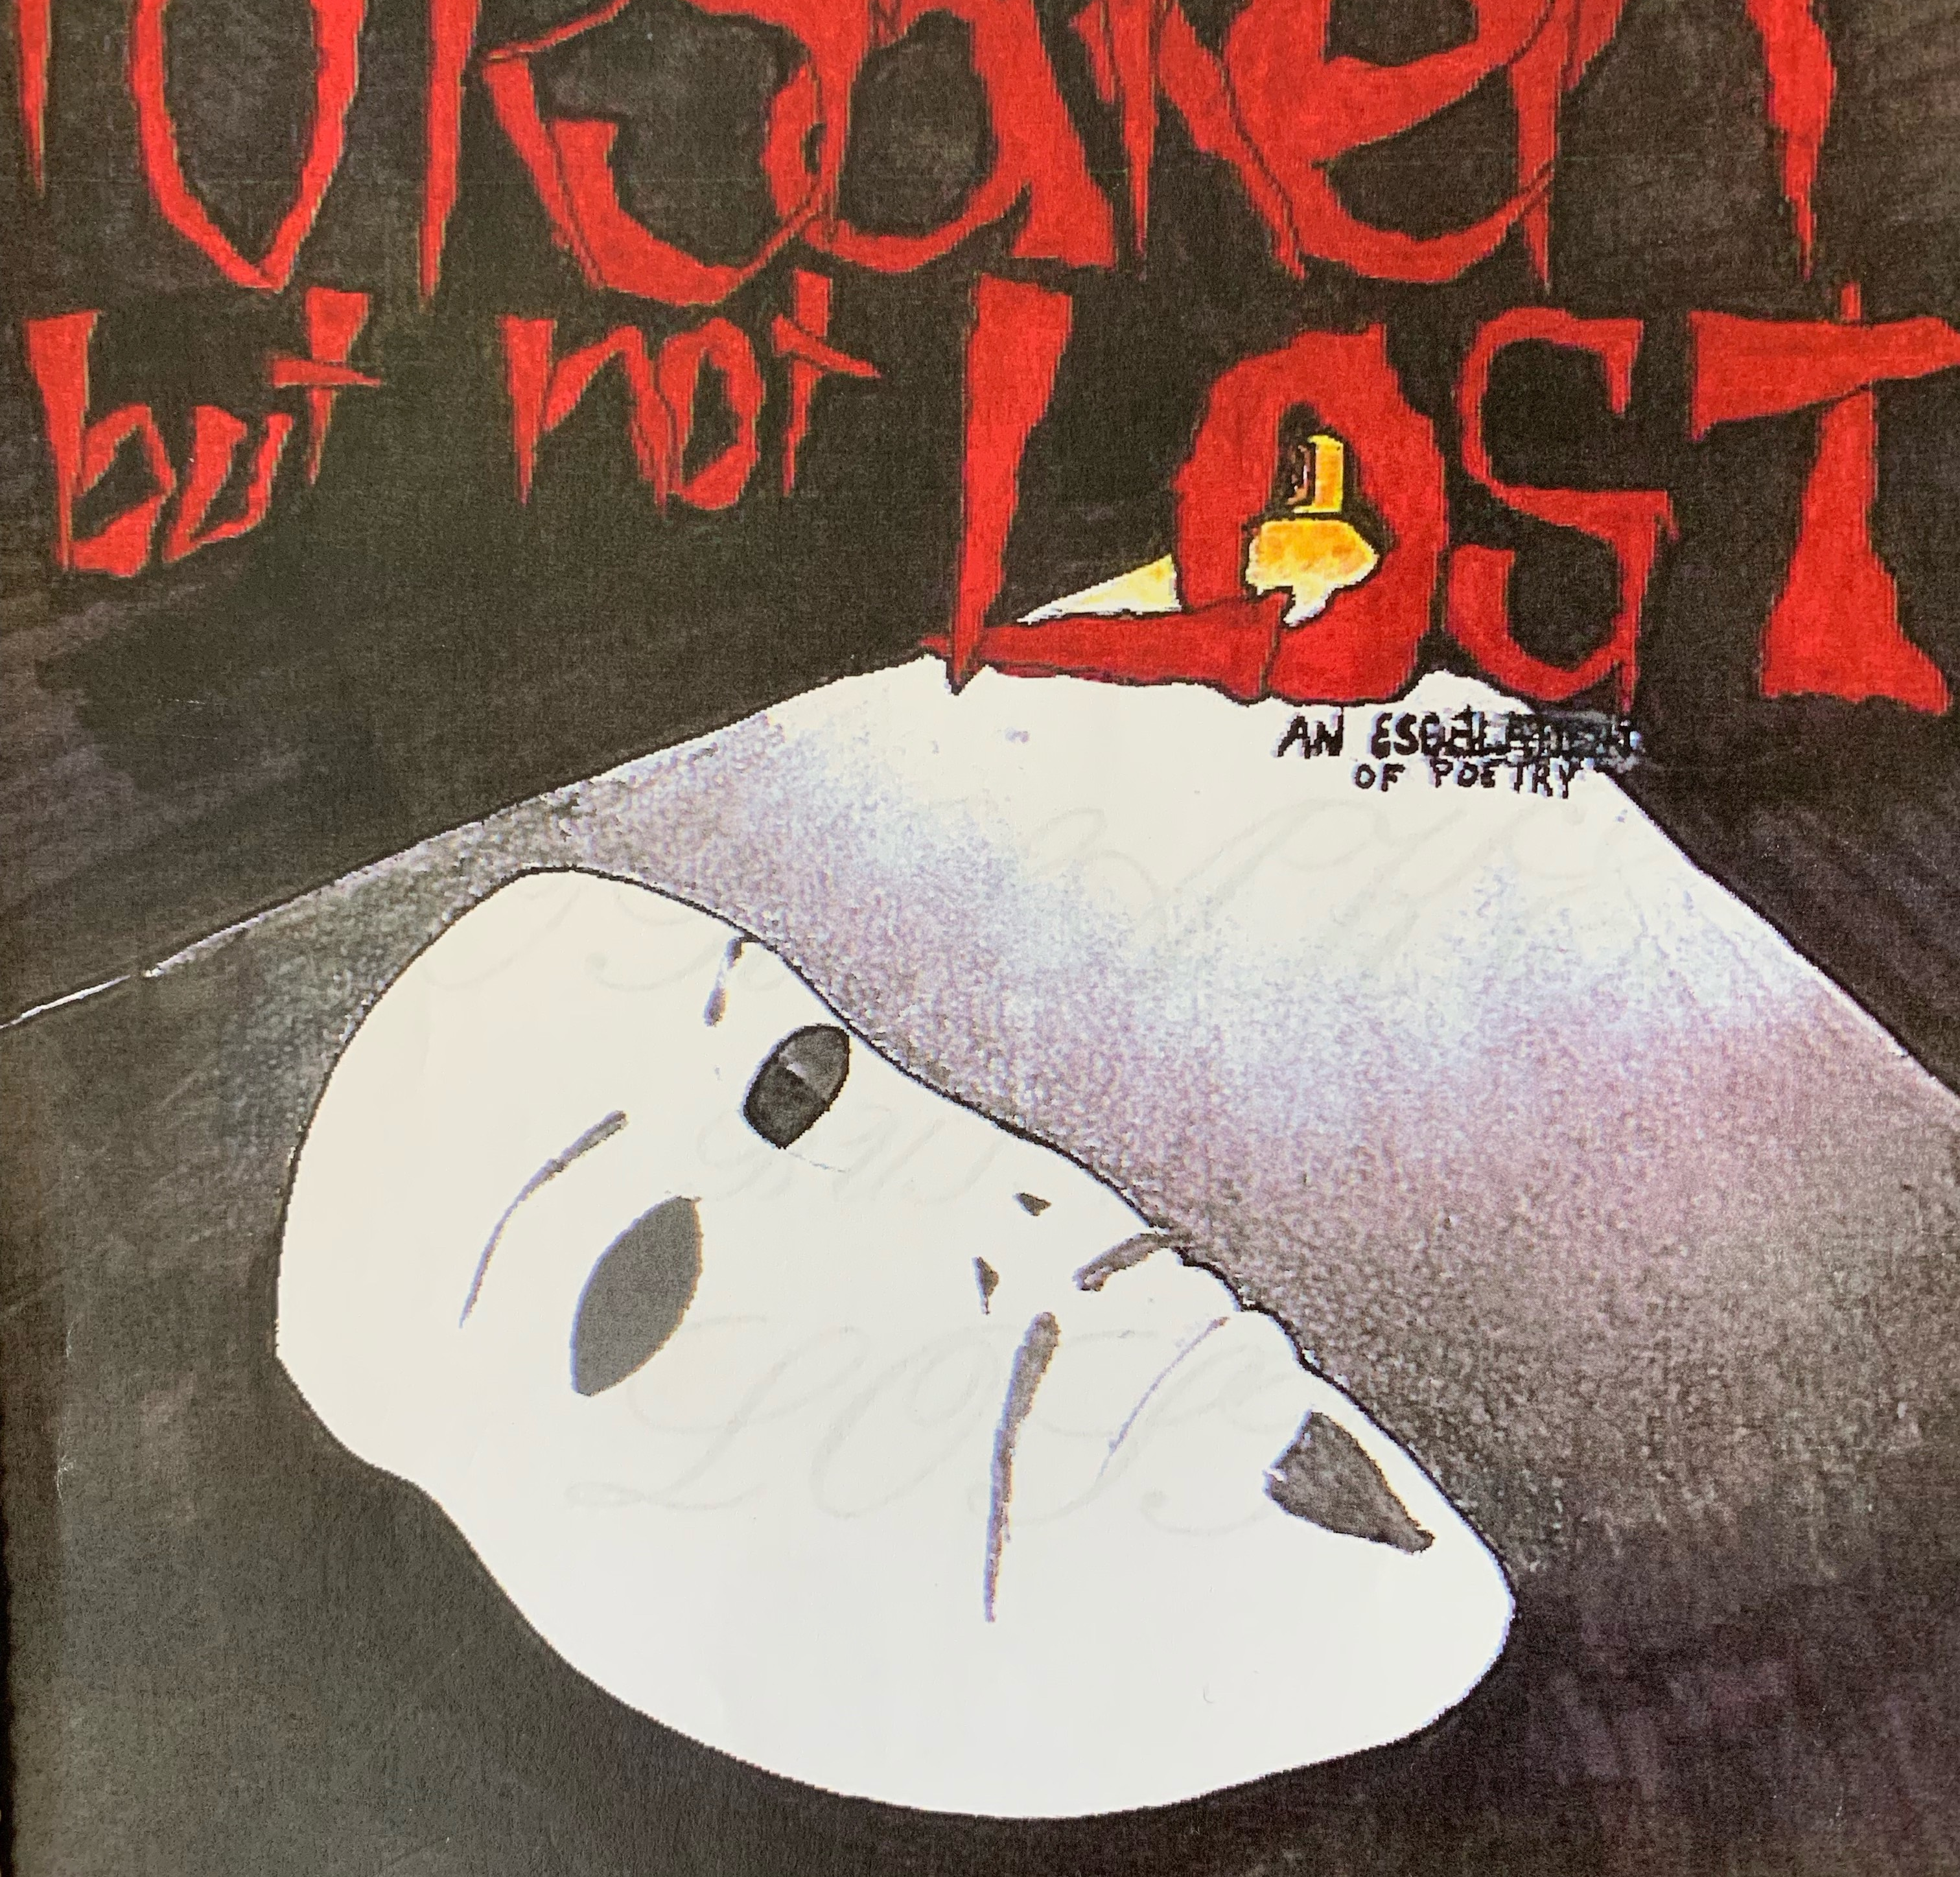
Prelude
A Powerful Name
Why Declaration?
Ladder of Darkness to Light a Poem by Declaration found in Forsaken but not Forgotten. Light of hope publishing.
Forsaken but not Lost

Slide 2
Presentation Overview
Creating a Restorative Context in Prison
Conflict and Conflict Transformation
The “A Ha” of Restorative Justice
Restorative Values
Restorative Communication
Other Applications

Slide 3
Mission Statement
Common Good Atlanta provides incarcerated people with broad, democratic access to higher education so they can develop a better understanding of both themselves and the societal forces at work around them.

Slide 5
Creating a restorative context
Humanity
Literature
Voice
Liberation

Slide 6
Creating a Restorative Context
Humanity

Slide 7
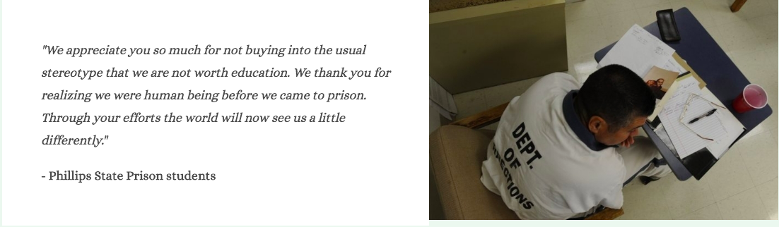
Creating A Restorative Context
”My Teachers Kill Monsters”
Humanity

Slide 8
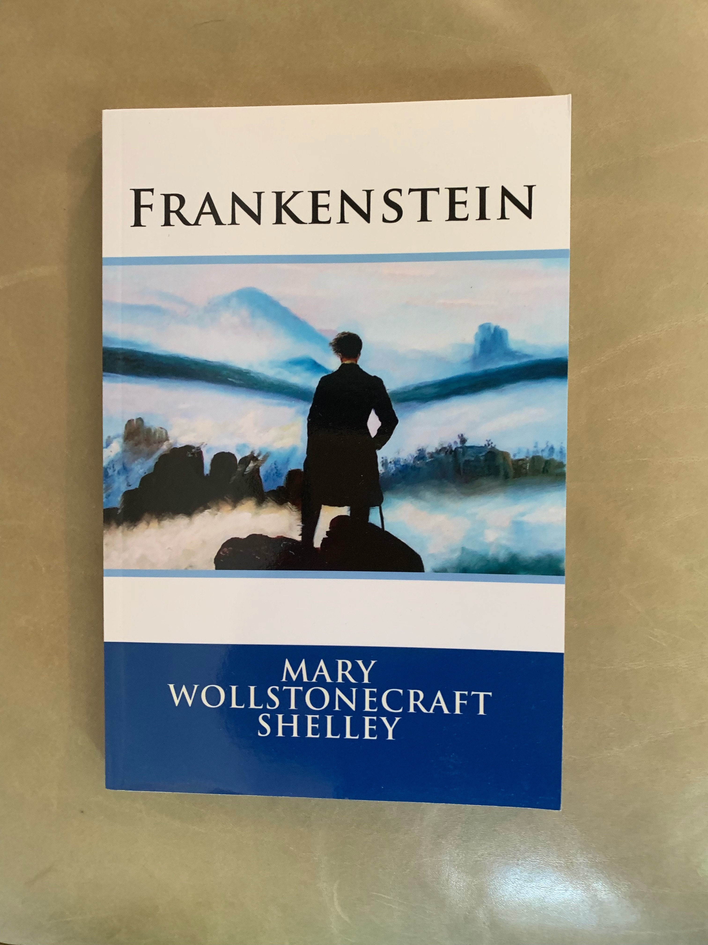
Creating a Restorative Context
Literature
\

Slide 9
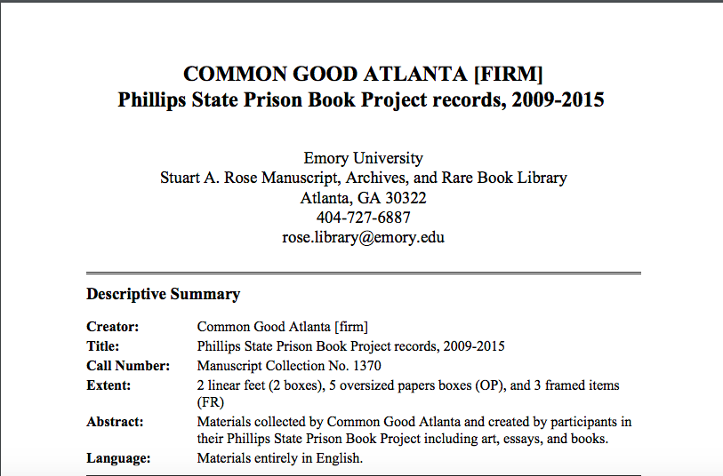
Creating a Restorative Context
Voice
  Voice
    Emory Archives

Slide 10
Creating a Restorative Context
Liberation
Need Quote

Slide 11
Creating a Restorative Context
Critical Theory and Beyond Banking Education
-Tarwater, Charles. "The Mind Oppressed: Recidivism as a Learned Behavior." Wake Forest Journal of Law & Policy 6, no. 2 (2016): 357-69.

Slide 12
Conflict and Conflict Transformation

Slide 13
Voice and Bureaucracy
Change is in the air
Power given and power taken
How do we exercise what we leaned
  Its like you gave us a tool but we turned it into a bomb

Slide 14
Resolving a Fracture
In order for us to move beyond where we were we had to have a dialogue
I stopped coming to class until everyone agreed to talk

Slide 15
Resolving a Fracture
Our egos had to broken down in order to break barriers
  We had to swallow our egos and pride
Recognized our own aggression ( I could only see Sarah Crying)
We became the oppressors and by our coming back together we became our liberation.

Slide 16
Healing from Conflict
Overview of RJ and RP in context outside of prison
Finding a collective voice

Slide 17
Creating the PSP Identity Statement
Common Good Atlanta is a diverse group of passionate, ambitious students that are capable of renaming the world. As scholars we work to break through stereotypes and constraints, by growing and expressing ourselves academically. By working through rigorous academic challenges in a creative and scholarly manner, we have transformed and challenged ourselves through humanizing experiences, which in some instances has saved our lives. The results of our work is demonstrated by a body of academic achievements that now stand archived in prominent institutions of higher learning and in several journals and periodicals."

Slide 18
What the Statement Meant
Allowed me to openly admit things
We have a voice. We are represented by our own words
We remembered that we had helped each other

Slide 19
Restorative Values
Hope
Humanity
Understanding
Trust
Foy
Respect
Commitment
Compassion
Restorative Pride

Slide 20
Restorative Values and Circle
Beyond the words
  Allowed us to put things out their that needed to be said
  We were surprised by who said what
  Safe place to feel like a human

Slide 21
Restorative Communication
Active Listening
Non Violent Communication
IIRP principals

Slide 22
Using RP in Dorm
“I went all Desmond Tutu on him”
“It cant be like it is in here”
The end was the same but the feelings were not

Slide 23
When the Shoe is on the Other Foot

