Slide 1
Restorative practices in catholic dialogue schools: how do we do that in Flanders?
Katrien Bressers, pedagogical counselor
16 may 2019, IIRP-congres, Kortrijk

Slide 2
What will you learn today?
Who are we?
Why restorative practices in Flemisch catholic schools?
How do we do it? How do schools it?

Slide 3
It is either positive or negative;

Slide 4
either it enriches or it impoverishes;

Slide 5
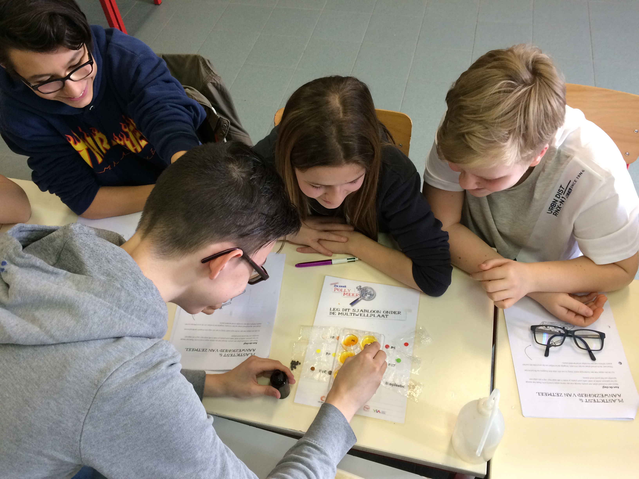
either it enables a person to grow or it lessens, even corrupts him.

Slide 6
The mission of schools is to develop a sense of truth, of what is good and beautiful.

Slide 7
And this occurs through a rich path
made up of
many ingredients.

Slide 8
This is why there are so many subjects — because development is the result of different elements that act together and stimulate intelligence, knowledge, the emotions, the body, and so on.”

Slide 9
“If something is true, it is good and beautiful;
if it is beautiful; it is good and true;
if it is good, it is true and it is beautiful.

Slide 10
And together, these elements enable us
to grow and help us to love life,
even when we are not well,
even in the midst of many problems.

Slide 11
True education
enables us to love life and opens us
to the fullness of life.” Pope Francis

Slide 12

Contents
Education in Flanders
The Office of Katholiek Onderwijs Vlaanderen
The Catholic Dialogue School – our pedagogical project

Slide 13
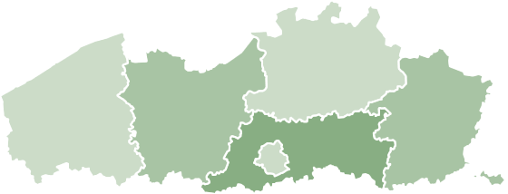
Education in Flanders

Slide 14
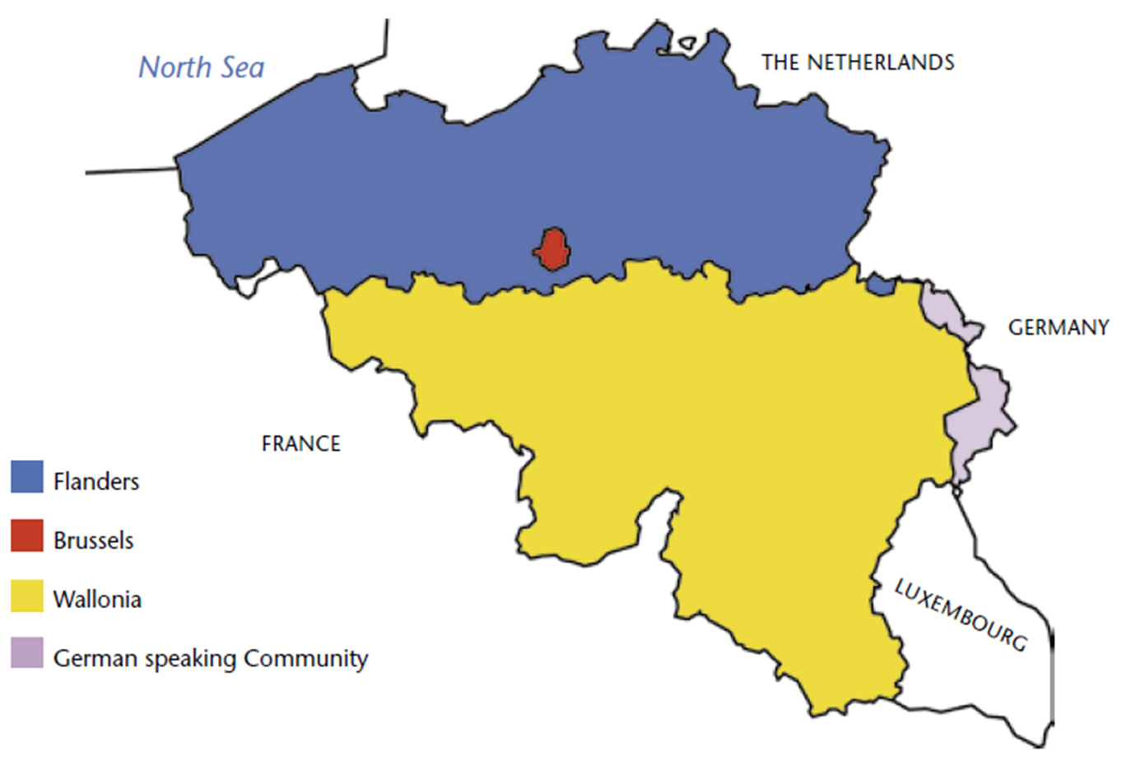
Notes:
Figuur komt uit: “Education in the Flemish Community of Belgium” van ond.vlaanderen.be

Slide 15
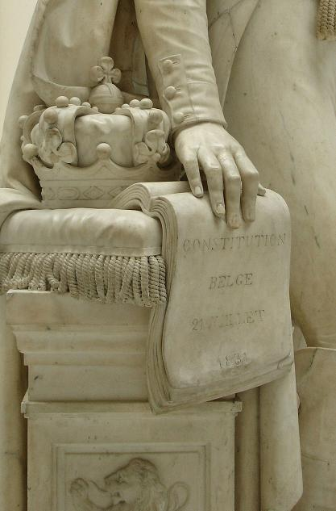
Constitution: freedom of education
Every person has a right to organize education and establish schools for his or her purpose
  If you find enough parents
  If you comply to certain conditions
  The school is run by a school board
Parents must find a school of their choice within a reasonable distance
Schools have a high degree
of autonomy

Slide 16




Educational networks
Representative associations of governing bodies/ school boards
3 educational networks:
  Schools of the Flemish Community
  (public schools)
  Schools run by municipalities, provinces
  (public schools)
  Privately run schools, most of them Catholic
  (publicly funded)

Slide 17

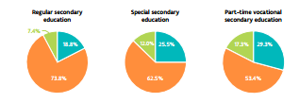
‘Market share’ of the educational networks

Slide 18
Catholic Education
1 419 primary schools (62 %)
659 secondary schools (75 %)
191 schools for special education
99 boarding schools
44 centres for adult education
7 schools for higher education
1 university
Notes:
Educational network: umbrella organisation
63% of all primary and nursery schools in Flanders
75% of all secondary schools in Flanders
Other school are organised by
- local authorities (Municipal authorities)
- and by the Flemish government.
SLIDE KOMT LETTERLIJK UIT MARCS PRESENTATIE. Nog aan te passen. Cijfergegevens nog te updaten.

Slide 19

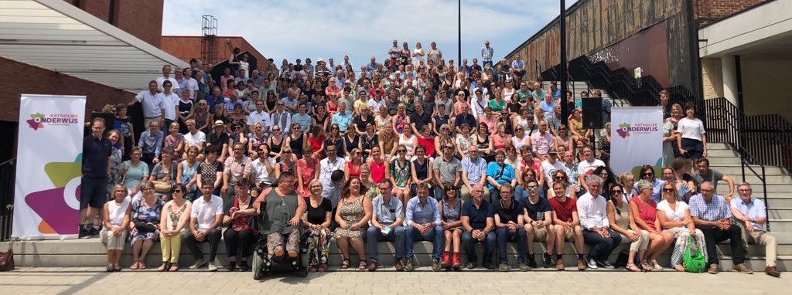

Slide 20
Spirituality – passion - inspiration
Innovation ‘with care’
Sustainability – young - fresh
Tradition - ground

Slide 21

Our mission
OUR MISSION
Our organization unites, on behalf of the Episcopal Conference, the Catholic schools, centers, boarding schools, colleges and universities. As a Catholic Education Office it supports Catholic education in Flanders and Brussels. The Catholic Education Office is tasked with the religious and pedagogical vision on Catholic education as well as with its vision on management and forward planning.
We speak for our members and we represent them at the government, at the Church and in society. By offering qualitative and inspiring service, together we are building up the rich Catholic-pedagogical tradition in Flanders and Brussels.

Slide 22
General objectives
We choose an integrated support of administrations and their schools, centers and boarding schools. This support focuses on each of the following dimensions of education: ideology, pedagogy, didactics, administration and organization as well as administration and logistics, and forward planning. We are developing a Flanders broad vision as well as a Flanders broad knowhow. We attend to effective school advisory service.

Slide 23
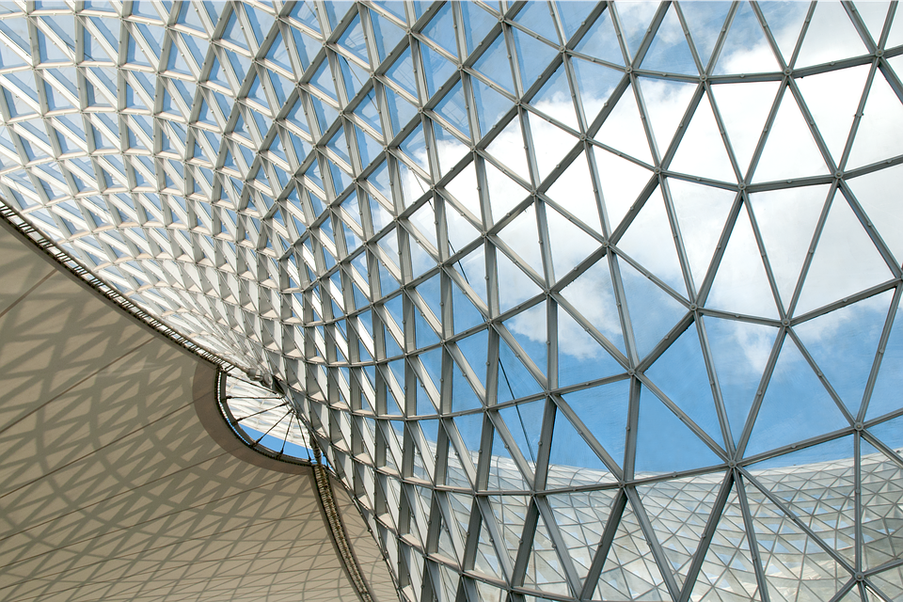
Fivefold thematic structure
Governance & organisation
Staff
Pupils/students
Curriculum & education
Identity & quality
  (including teacher training and professionalisation)

Slide 24
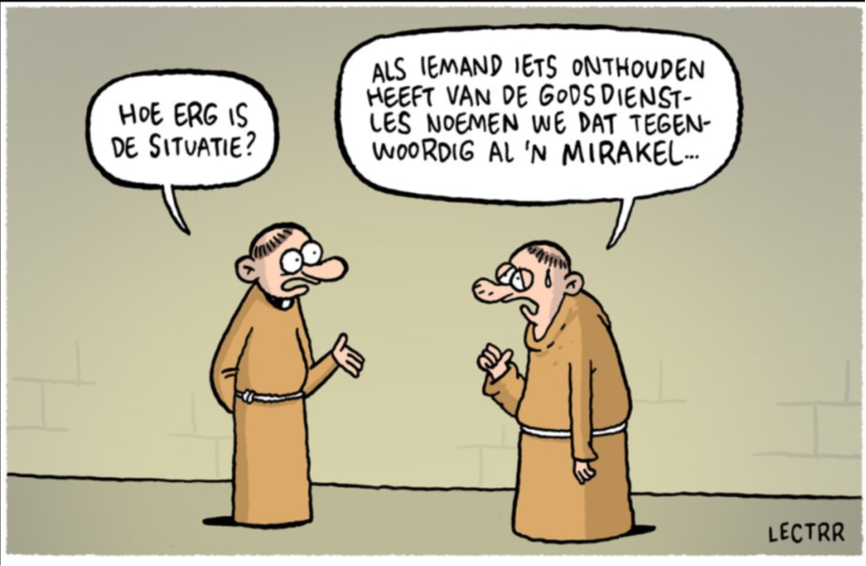
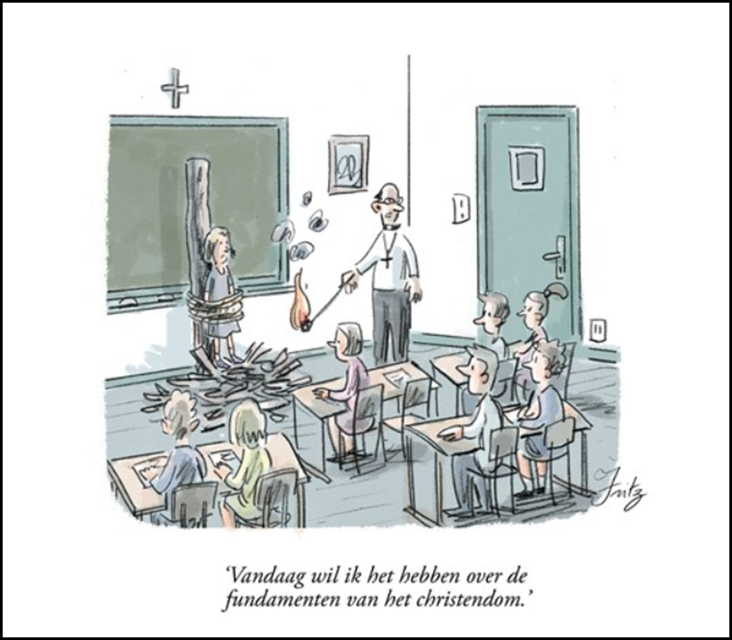

The Catholic Dialogue School

Slide 25
General objectives
By way of critically-constructively interacting with our strongly changed and changing society, we present the concept of the Catholic Dialogue School as a hall mark for Catholic education and at the same time we want it to frame the way we operate.

Slide 26
6. A Project for Catholic Education in a Post-Christian and Post-Secular Context
Recognising and respecting the plurality present in the class room
The opportunity for identity construction offered by the dialogue with the other - learning from plurality and difference…
  A pedagogical opportunity…
  … challenging both Christians and non-Christians to foster more reflexive identities in dialogue with each other

Slide 27
In two ways catholic:
  Background world view, informing the concept of dialogue
    A Christian anthropological view
    Christian revelation: God is dialogue
  Bringing the Christian voice into the dialogue
The ‘catholic dialogue school’
  A new mission text: 5 paragraphs

Slide 28
The catholic dialogue school
At the crosroads of education, Church and society, the catholic dialogue school warmly welcomes everyone, whatever his or her religious or ideological background may be.
Pupils, parents, members of staff, administrators, all of them and without exception are invited to participate in its educational project.
Proceeding from its Christian inspiration the catholic dialogue school wants to challenge and empower everyone to these ends.

Slide 29
As a school it is convinced that quality education is more than just training and instruction. Education generates free persons, competent and standing by each other, people for whom living and living together is meaningful and of great significance.
Within the school, learning to learn, learning to work and learning to live (together) go along. Education in its broadest sense empowers children, youngsters and adults to cope with the ever more complex world of today and tomorrow. They learn to discover this world and acquire the skills to immerse themselves in this world with commitment, a critical state of mind and creativity.
This school is an inclusive school. It cares for the unique talents of every pupil, with special attention to those who experience difficulties.

Slide 30
As a catholic school it is proceeding from the fundamental experience that both the human being and the world are a gift and an assignment all at once. As embedded in a network of relations with fellow human beings, with society and with the world, human freedom is a given freedom and incites responsibility.
Trusting that the deepest mystery of reality is love, the school considers this love – as the Bible tells us and after the example of Jesus – as a guideline for educating, for living and living together.
The Christian hope originating from this love and from the belief in the resurrection, directs the school in its goals and overall functioning.

Slide 31
Given this view on humankind and on the world, in times of religious plurality, the catholic dialogue school invites everybody to go into dialogue with each other in search of the full meaning of being human. Therefore it brings together Christians, Muslims, Jews, people from other beliefs and non-believers, and all other people who want to find significance in living and living together.
In conversation with each other one learns to form one’s own identity, through discovering it, reflecting on it, and deepening it.
Instructed by its own mission, the school itself, in words and praxis, brings the Christian voice into this conversation in a contemporary and challenging way, while in additionally creating room for those who do not get a chance to enter into the conversation.

Slide 32
Making school in this way requires a persisting effort from everyone and offers room for growth and diversity.
Throughout the dialogue the catholic dialogue school enriches itself and is also called to recontextualise its Christian inspiration in the contemporary context.
Proceeding from the tradition to which the school belongs and in dialogue with its environment, the catholic dialogue school intends to be a training ground for living (together) in a world that is characterized by diversity and difference.
Critically-creatively learning to get along with what is familiar and what is different, with what unites and what distinguishes, enables people to contribute to an open, meaningful, tolerant and enduring society, where everyone has got a place – a world of which God dreams too.

Slide 33
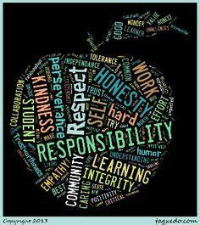
“How to create a climate of Connection and restorative practices in Catholic dialogue schools in Flanders”

Slide 34
PART ONE: training and professionalisation for pedagogical counselors

Slide 35
1 pedagogical supervision plan for the governement: provide broad and rich educational opportunities
Strategic goal: Introduce and support the concept of connection and restorative practices in catholic schools
Pedagogical counselors know the vision of Catholic education Flanders about connection in schools. They know restorative practices.
Pedagogical counselors have to support schools and pupil guidance centers to pay attention to connection and restorative work for all children and students.

Slide 36
GOALS FOR PEDAGOGICAL COUNSELORS
Knowing what a connecting classroom and school climate is.
Get acquainted with ingredients that support a connecting classroom and school culture.
See the link between the curriculum and a connecting classroom and school culture

Slide 37
How to realize the goals for pedagogical counselors?
Organisation of a 3-day professionalization and training for pedagogical counselors
They learn about connection, restorative practices, non-violent communication, new authority….

Slide 38
PART TWO: training and professionalisation for schools (headmasters, teachers…)

Slide 39
PROJECT for schools: “Ingredients for a climate of connection in Catholic dialogue schools”
WHY?
Schools observe that the order and disciplinary policies are reaching their limits. That pupils fall out of the boat in different schools. The question is how to build a school in which an order and disciplinary policy is set up in a different way and starts from the needs of the pupil than from sanctioning elements. This retraining project seeks to provide an answer.

Slide 40
PROJECT: “Ingredients for connection in Catholic dialogue schools”
Content:
During this periodic training, existing frameworks such as policy, pedagogical vision and the educational project of the school will be assessed against all principles on which a “connected” school is committed. Logically, this policy, education project and pedagogical vision are evolving through targeted steps and interventions at school to a vision and policy on creating a connecting school. Connecting school is the framework to which all this is tested.
In the region, the pedagogical counselors support schools to implement and embed the vision of a binding school climate. In the long term, in cooperation with the schools, PB also evolves into a regional learning network.
Identity development and creating connection go hand in hand. A school that wants to make a work of her Catholic identity and deepens it, does so through the principles of bound school climate. A Catholic dialogue school is by definition bound.

Slide 41
PROJECT: “Ingredients for connection in Catholic dialogue schools”
The first part (2 or 3 ½ day sessions) (pedagogical counselor)
The participants:
Get acquainted with existing frameworks and vision texts from Catholic education Flanders on creating connecting in schools, restorative practices, non-violent communication and new authority;
Acquiring insight into these ingredients and working from there to connecting in their own school
Go to work yourself and critically view the own school policy: what is already bound? What could be better? What does the team need? Timetable?

Slide 42
PROJECT: “Ingredients for connection in Catholic dialogue schools
The second part (2 à 3 sessions)
The participants:
Train the methodology of pro-active circles so that they can get to work on the classroom floor
Target group: Primary education teacher Teams
Provider: Catholic Education Flanders

Slide 43
OUR PROJECT GOALS FOR SCHOOLS
Knowing what a connecting classroom and school climate is.
Get acquainted with ingredients that support a connecting classroom and school culture.
See the link between the curriculum and a connecting classroom and school culture

Slide 44
HOW we START?
INDIVIDUAL SCHOOL
WHAT ARE OUR NEEDS? EDUCATIONAL PROJECT / VISION
CONNECTION
RELATIONSHIP WITH LEARNING

Slide 45
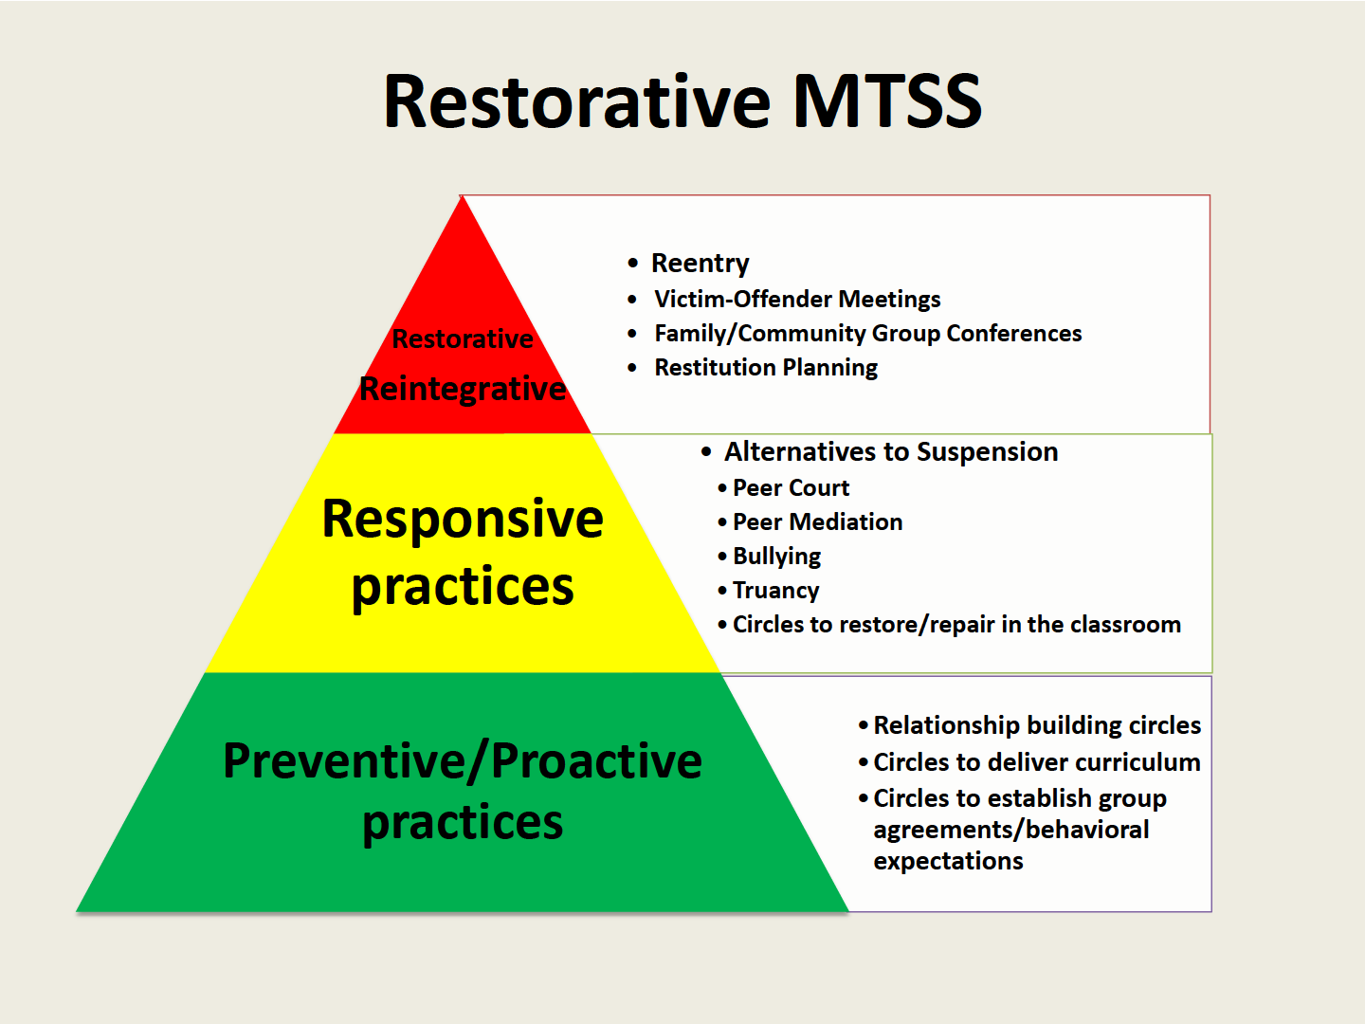
THE IMPORTANCE OF RELATIONSHIPS & CONNECTION in Catholic dialogue schools

Slide 46
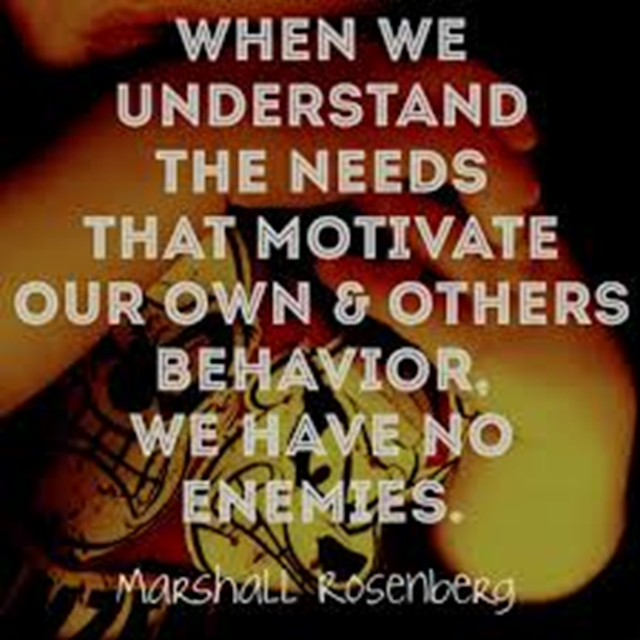

Slide 47
Key question:
How can we create a living environment in which we can learn optimally?
Answer:
Works from connection, from the personal relationship, works from well-being
But HOW do you do that?

Slide 48
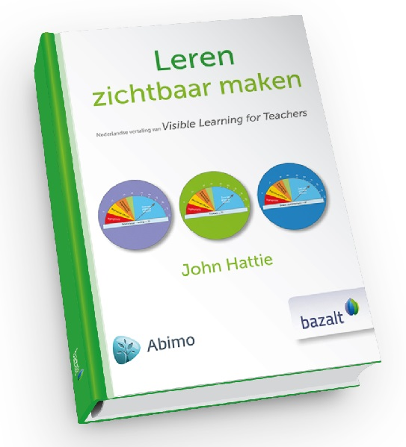
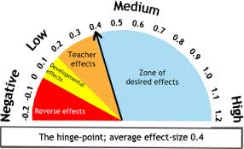
Effective learning (John Hattie)
Notes:
Wat weten de PB’ers
Update Wat heeft Hattie gedaan? Hoe moeten we ze juist interpreteren? Effect groepjes van 15 studenten als onderzoeken die hetzelfde nagaan van kleuters. Allemaal samengegooid. 1 parameters bedenkt soms een hele hoop andere parameters, bv. feedback.

Slide 49
Hattie: Impact on learning performance
SOME STRONG IMPACT SCORES:
Expectations of the teacher (d = 1,62)
Relationship teacher-pupil (d = 0,52)
Give Feedback (d = 0,70)
Behavior in the classroom (d = 0,62)
No labeling (d = 0,61)
Teacher's credibility
In the pupil's eyes (d = 0.90)
Pupils ' expectations (d = 1.44)
Definitive exclusion of pupils (d = -0.62)

Slide 50
What means CONNECTDNESS in a catholic dialogue school?

Slide 51
VISION TEXT “Connection in catholic schools”
Everyone (pupils, staff, parents) is valued for who he is, for what he does
Within the own possibilities
Within agreed frameworks
Basic needs: feeling safe, having input, being able to enter into relationships
Ask for a policy

Slide 52
What does investing in school relationships mean?
Pupils positively connected to school/teachers
School takes teachers, children, parents seriously, (partly) responsible
Positively confirm the desired behavior

Slide 53
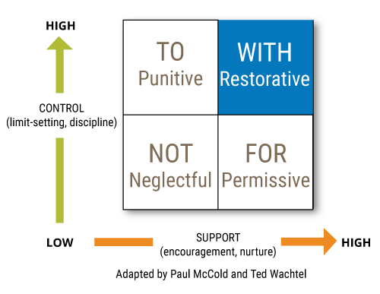
SOCIAL DISCIPLIN MATRIX

Slide 54

Working towards connection in our schools?
→ PROACTIVE
We build a school where everyone feels welcome and at home
We bet on non-violent communication and on expressing feelings and needs
NO POWER
We use workmethods and techniques as pro-active circles frequently practised with student and teachers, headmasters
Which pedagogical style best applies to leadership and classroom management
To handle conflicts and tensions by rebuilding the relationships?
Central setting and strengthening of relationships
-> REACTIVE
A RESPONSE policy from need and relationship
Attention to recovery: recovery focused dealing with conflict
How do we organise vigilant care and an internal network for school support?
Notes:
Een school die werk wil maken van een verbindend schoolklimaat, voert een proactief beleid op sociaal-pedagogisch terrein. De school houdt rekening met alle belanghebbenden. De uitgangspunten betreffende stu-ring en ondersteuning van de leerlingen worden expliciet geformuleerd. Gedragingen worden concreet omschreven en de consequenties wanneer het fout loopt op dit gebied, worden aan iedereen uitgelegd en breed ge-communiceerd.
Een verbindend schoolklimaat kan enkel succesvol tot stand komen indien directie en personeelsleden ook werk maken van de communicatie op school, meer bepaald van verbindende communicatie . Verbindende communicatie heeft als doel het bevestigen en verstevigen van relaties. Het is een mededeling aan de ander over zijn gedrag of zijn houding en het effect daarvan op een ander. I.c. zal men in een verbindend schoolklimaat het gedrag van een leerling eerst bespreken en duiden, voor men aan sanctioneren begint. Directie en personeel zullen zichzelf steeds afvragen welk gedrag men gezien heeft, over welke grens de leerling is gegaan en wat dat dat gedrag met het directie-of personeelslid doet. Verbindende communicatie is duidelijk, niet oordelend en respectvol en ondersteunend. Investeren in verbindende communicatie maakt dat eventuele conflicten bespreekbaar gemaakt kunnen worden zonder dat de relatie verstoord wordt.
Onaanvaardbaar leerlingengedrag zal men ook eerst proberen aan te pakken door te werken aan relaties. Men kiest in een verbindend schoolklimaat expliciet voor het herstelgericht benaderen van conflicten (zie punten 3 en 4).
Een school die verbindend werkt, zal daar op haar eigen manier invulling aan geven, afhankelijk van omstandigheden als leerlingenpopulatie, onderwijsklimaat, didactische werkvormen, hiërarchie, kortom: de schoolcultuur. Het is daarom belangrijk om deze goed in kaart te brengen. Vervolgens is het zaak daar niet star, maar flexibel mee om te gaan om op tijd aanpassingen te doen die het ideaal van een verbindend schoolklimaat benaderen.
Relaties staan centraal in een verbindend schoolklimaat. De school richt zich steeds op het bouwen, behouden en versterken van die relaties omdat zij de basis zijn voor een gemotiveerd en productief leerproces op school en in de klas.

Slide 55
How does the teacher make the difference?
Wellbeing of the pupils is important:
Focus on his/her satisfaction
Involvement in learning and living in class, classroom, school
Academic Self Concept
Consciously working on positive social relationships (in class, playground,...)
Pedagogical environment (Forms of work, class management, rules and communication)
Conversation circles: Practicing formulating feelings, thoughts and needs
Self-control and nonviolent communication
TEAM:
Reflect together
Support each other as a resource = SUPPORT NETWORK

Slide 56


Slide 57

PRIMARY SCHOOL OLSENE

Slide 58
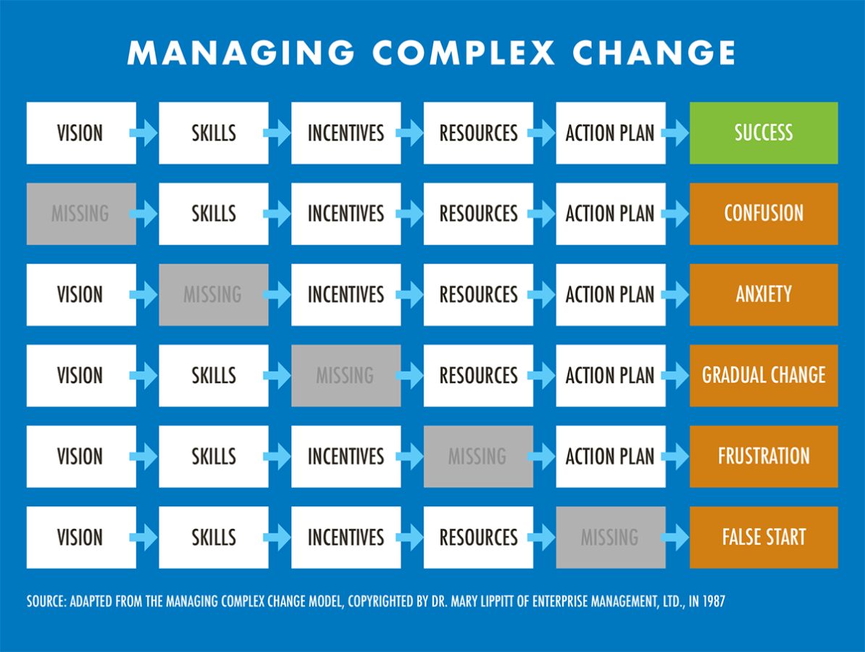

Slide 59
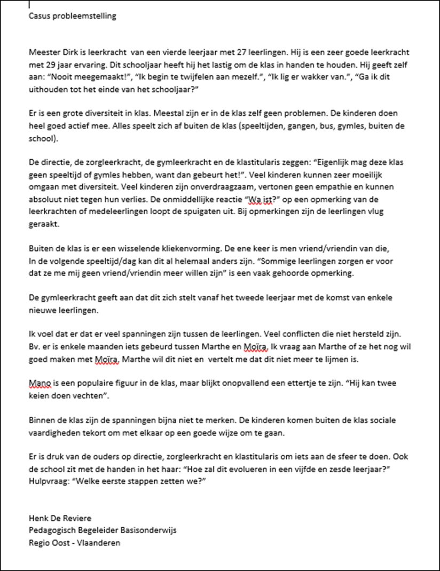

Slide 61
OTHERS WAYS OF SUPPORTING SCHOOLS
We go to schools to organise formal restorative conferences to avoid the exclusion of pupils/students (50 à 60 schools in Flanders every year)
We support schools to organise restorative talks with parents when they have complaints

Slide 62
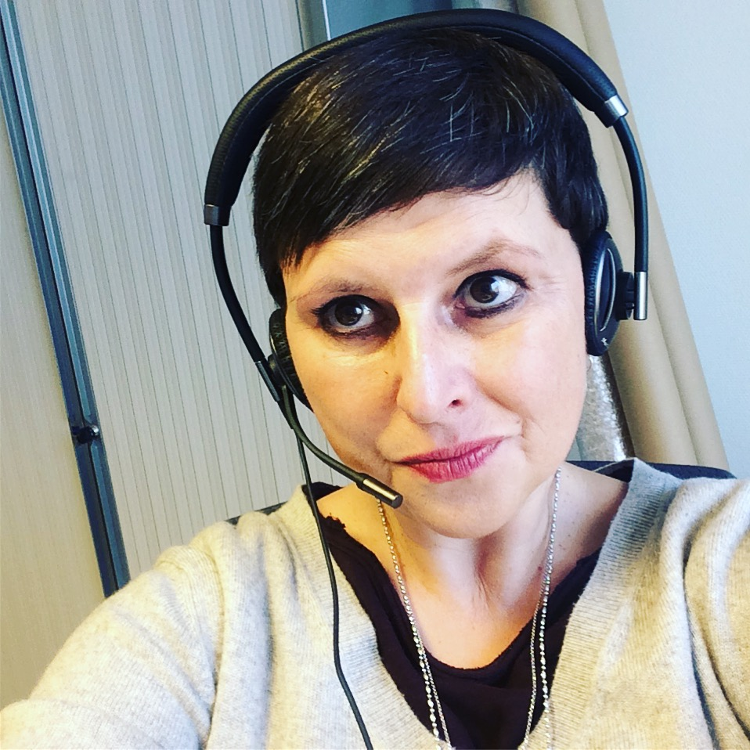
Who am I?
Katrien Bressers
Pedagogical advisor
Moderator restorative practices
Leader of the project “How to create a climate of connection”
Katrien.bressers@katholiekonderwijs.vlaanderen

