Slide 1
Restorative Pedagogy in Higher Education
Nicola Preston
International Institute for Restorative Practices Graduate School, USA
University of Northampton, UK

Slide 2
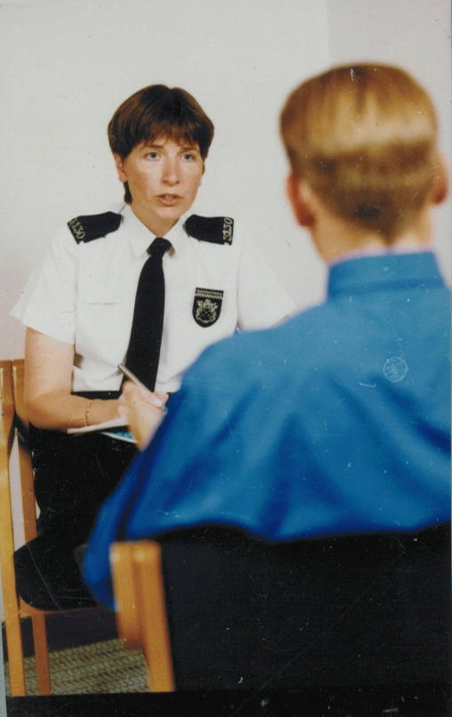
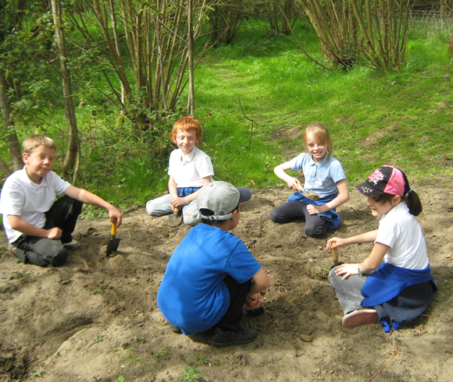
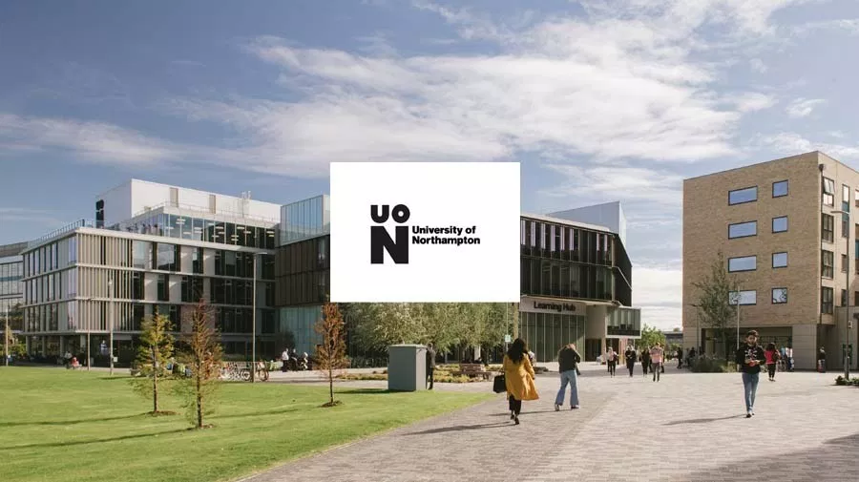
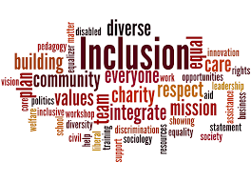
My Background

Slide 3
Higher Education (HE) and Relationships
“Helping people achieve their aspirations and unlock their potential are surely two of the key missions of higher education”.
Spier, 2019
“academic and pastoral responsibilities cannot be easily separated as academic problems almost always have a non-academic cause”.
Hughes, Panjwani, Tulcidas and Byrom, 2018

Slide 4
Relationships Matter
“In place of the received wisdom of the importance to students of choice and flexibility, is the finding that it is a sense of belonging that is critical to both retention and success.
It is the human side of higher education that comes first – finding friends, feeling confident and above all, feeling a part of your course of study and the institution – that is the necessary starting point for academic success”.
Thomas, 2012

Slide 5
Student Retention and Success
“In the UK only 1 in 12 students, or 8%, leave HE during their first year of study, but between 33% and 42% of students think about withdrawing from HE”.
Thomas, 2012
“Growing national and global diversity makes it more important than ever for all of us to understand people who are different than ourselves."
“Institutions of higher education need to prepare students for effective participation in a rapidly changing world”.

Slide 6
University of Northampton, UK
Enhancing Student Success Plan
Enhancing Student Success (ESS) is a four year, institution-wide plan seeking to enhance the undergraduate student experience. It comprises 2 separate projects – the First Year Experience (FYE) project, launched in September 2015 and a new project entitled Continuing Student Success which is looking at the ongoing-programme experience of our levels 5 and 6 students (Years 2 & 3).
Institute of Learning and Teaching, University of Northampton, 2019

Slide 7
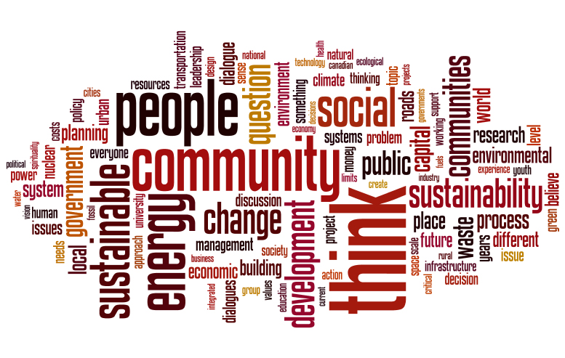
Learning Enhancement and Innovation Fund 2018-2019
University of Northampton
The Institute of Learning and Teaching (ILT) Learning Enhancement and Innovation fund 2018-19 has funded 11 projects. All the projects started in November 2018, and will be completed in July 2019.

Slide 8
Aims and Objectives
Restorative practices facilitate a space where all voices are valued and collaboration and participation are encouraged. Traditionally associated with conflict and harm, more recent development has been in the development of relational pedagogy.
Aim:
To engage undergraduate students in the development of a relational model of teaching and learning.
Objectives
To use restorative processes to build relationships and establish shared learning norms
To investigate student perceptions of the co-created learning environment that values respect, equal voice and relationship
To evaluate through student feedback, the restorative framework as an explicit approach to develop a relational model of learning.
The ‘project’ has received University ethical approval

Slide 9
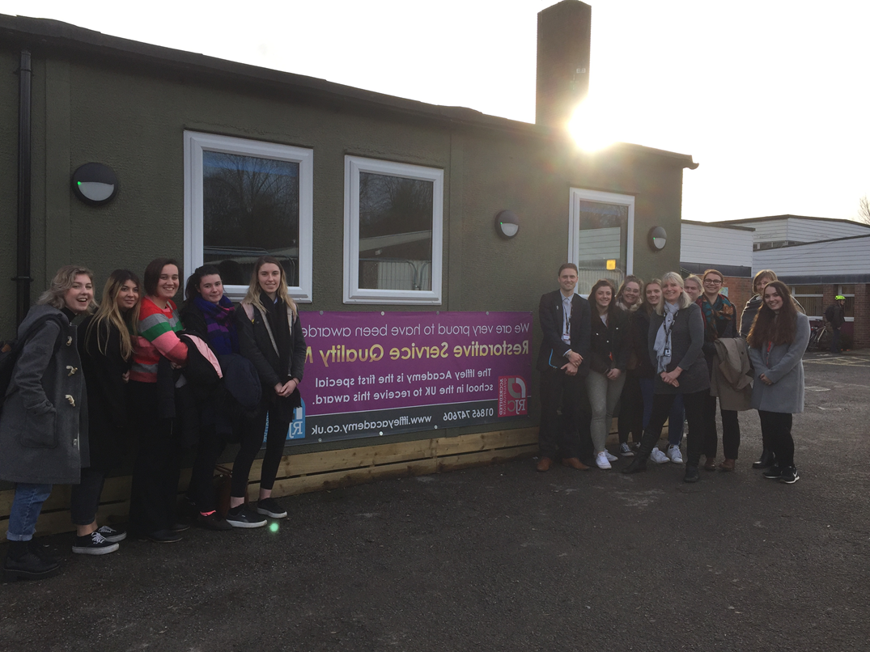
Restorative Pedagogy

Slide 10
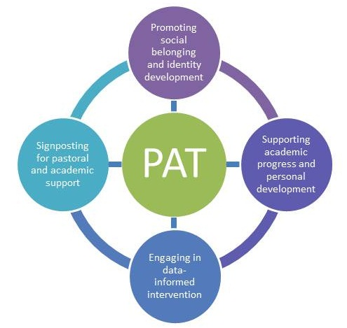
Personal Academic Tutoring (PAT)
“Personal Academic Tutoring is integral to the University of Northampton’s holistic approach to supporting student success”.
Institute for Learning and Teaching, University of Northampton
RELATIONSHIPS
RELATIONSHIPS
RELATIONSHIPS
©Institute for Learning and Teaching, University of Northampton

Slide 11
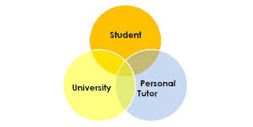
Proactive Restorative Practices
“The PAT serves as a central figure in a student’s university experience”.
Institute of Learning and Teaching, University of Northampton, 2019

Slide 12
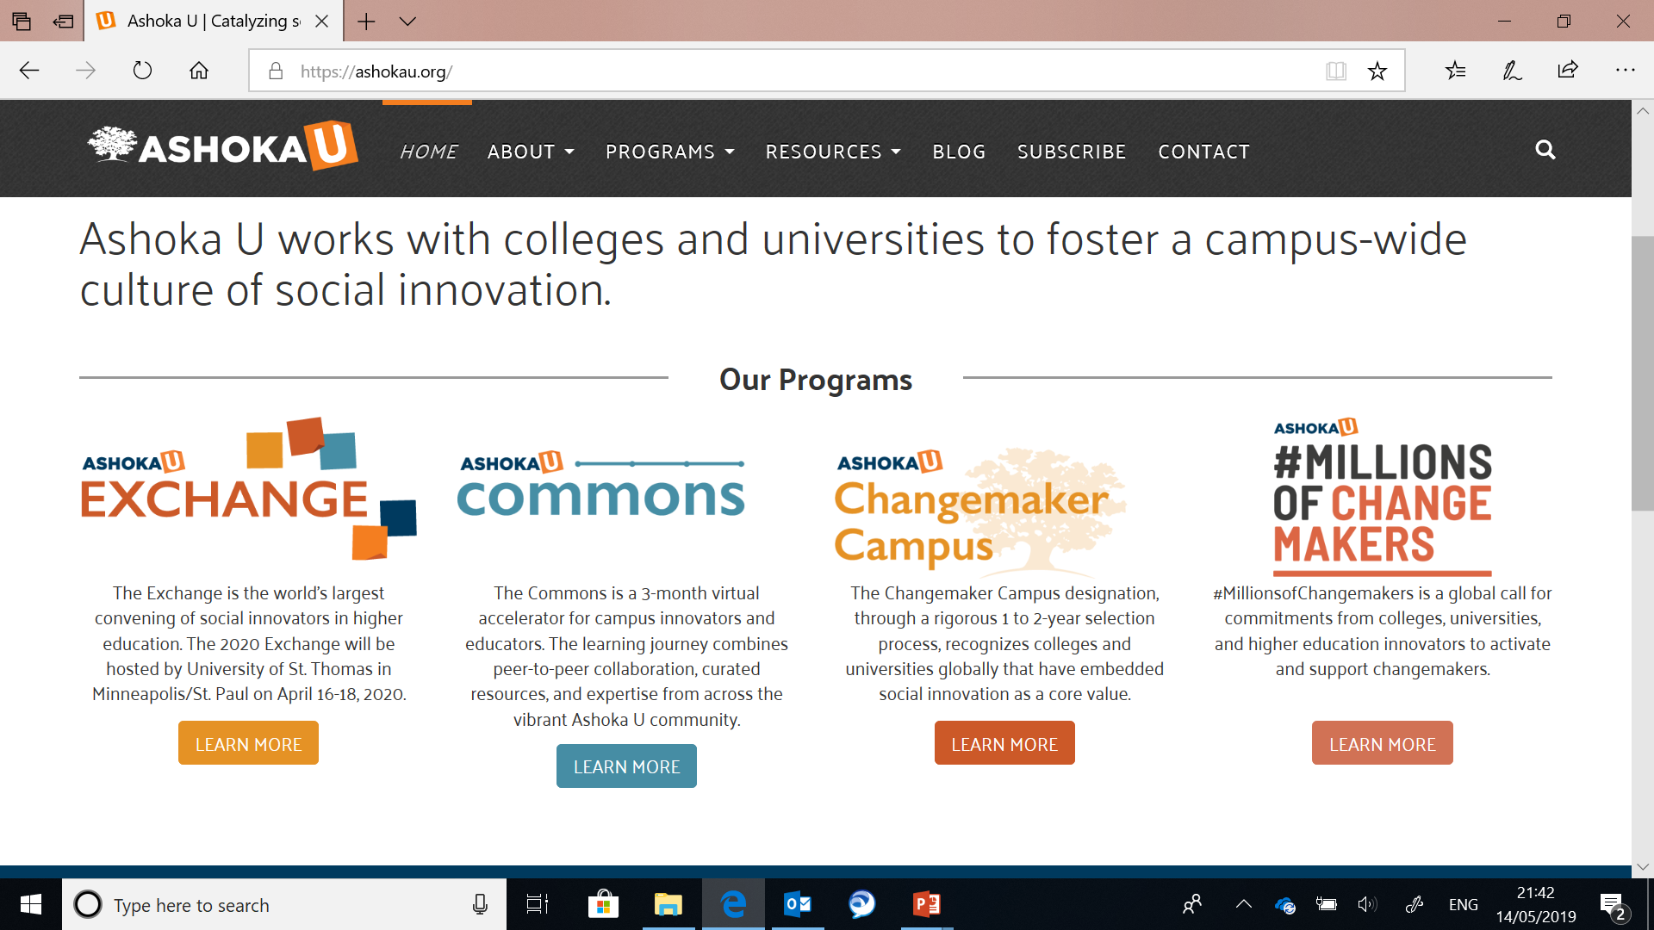

Slide 13
“Currently approximately 45 colleges and universities globally are recognized as Changemaker Campuses.
Changemaker Campuses are the global leaders in social innovation and changemaking in higher education and represent a vision of what education and universities can be”.
Changemaker Campus is a community of leaders and institutions who work collectively to make social innovation and changemaking the new norm in higher education and beyond. These institutions collaborate with each other and Ashoka to advance social innovation and changemaking across higher education

Slide 14
Restorative Practices Continuum
Informal Formal
affective
statements
affective
questions
small impromptu
conference
group
or circle
formal
conference
Proactive Reactive

Slide 15
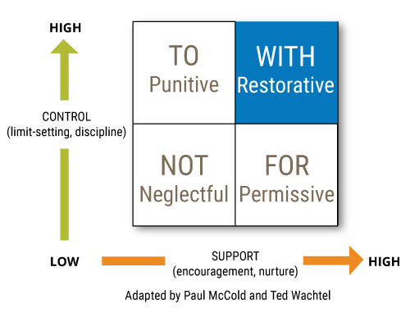
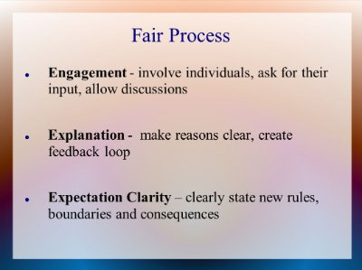
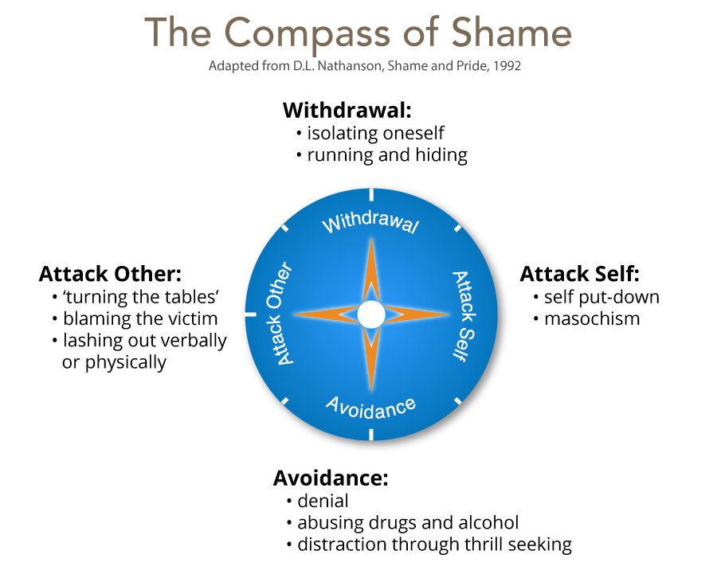
The IIRP Explicit Restorative Framework
The Social Discipline Window
Adapted by Ted Wachtel & Paul McCold (2000) from Glaser, 1969.
Fair Process
Kim, W, & Mauborgne, R. (2003)
Affect Script Psychology
Tomkins, (1962)
Compass of Shame
Nathanson (1992)
Re-integrative shaming
Braithwaite (1989)
https://www.iirp.edu/defining-restorative/what-we-do/defining-restorative/
© IIRP

Slide 16
The Restorative Questions
they seek to build an understanding rather than to blame.
the person asking is likely to be seen as objective and respectful.
they actually allow the person to tell their story.
they are more likely to promote responsibility.
they can be applied in every situation.
they are thinking questions, yet are likely to get 'feeling' responses.
the questions are neutral and non-judgemental.
they are about the wrongdoer’s behaviour and it’s effect upon others.
they are open questions which require an answer.
they take everyone from the past (what happened) to the future (repairing harm).
they require people to reflect on who has been affected.

Slide 17
Narrative Approaches
Hollingsworth and Dybdahl identify eight key principles within the narrative approach that they state increase the potential for the learning that can come from conversation:
The restorative questions
(1) Develop trust. Listen non-judgmentally.
(2) Initially scaffold or structure conversations and set norms, if necessary.
(3) Encourage talk about topics that are controversial and difficult.
(4) Allow emergent purposes for the conversation to develop.
(5) Value different discourse styles.
(6) Specifically articulate the learning that occurs in conversation.
(7) Examine assumptions.
(8) Pay attention to issues of power-in-relationship.
(Hollingsworth and Dybdahl in Clandinin, 2007, pp 79-80)
Neutral and non-judgemental
Seek to build understanding rather than to blame
They are objective and respectful
They allow the person to tell their story
They are thinking questions that elicit feeling responses
They take people from past to the future
They allow for the free expression of emotion
They separate the ‘act’ from the ‘actor’
© IIRP

Slide 18
References
Braithwaite, J. (1989). Crime shame and re-integration. Cambridge University press.
Hughes, G. Panjwani, M. Tulcidas, P. and Byrom,N. (2018). Student mental health: the role and experiences of academics. Available from http://www.studentminds.org.uk/uploads/3/7/8/4/3784584/180129_student_mental_health__the_role_and_experience_of_academics__student_minds_pdf.pdf
Kim, W, & Mauborgne, R. (2003). Fair Process: Managing in the Knowledge Economy, Harvard Business Review, 81, 1, pp. 127-136, Business Source Premier, EBSCOhost, [Accessed17 February 2018].
Nathanson, D. (1992). Shame and pride: affect, sex and the birth of self. W.W. Norton and Company.
Spier, (2019) Supporting students leaving care. Higher Education Policy Institute. Available from: https://www.hepi.ac.uk/2019/05/10/supporting-students-leaving-care/
Thomas, L. (2012) Building student engagement and belonging in Higher Education at a time of change: a summary of findings and recommendations from the What Works? Student Retention & Success programme. Available from https://www.heacademy.ac.uk/system/files/what_works_final_report.pdf
Wachtel, T., & McCold, P. (2000). Restorative justice in everyday life. In J. Braithwaite and H. Strang (Eds.), Restorative Justice in Civil Society (pp. 117-125). New York: Cambridge University Press.

Slide 19
Nicola Preston
International Institute for Restorative Practices Graduate School, USA
University of Northampton, UK
nicolapreston@iirp.edu
nicola.preston2@northampton.ac.uk
Twitter: @NicolaPreston9

