Slide 1
Trauma-Informed and Restorative Approaches to Workforce and School Connect
Jessica K. Camp Ph.D., L.M.S.W.
Tracy Hall Ph.D., M.P.H.
Brian Frick, M.A.

Slide 2
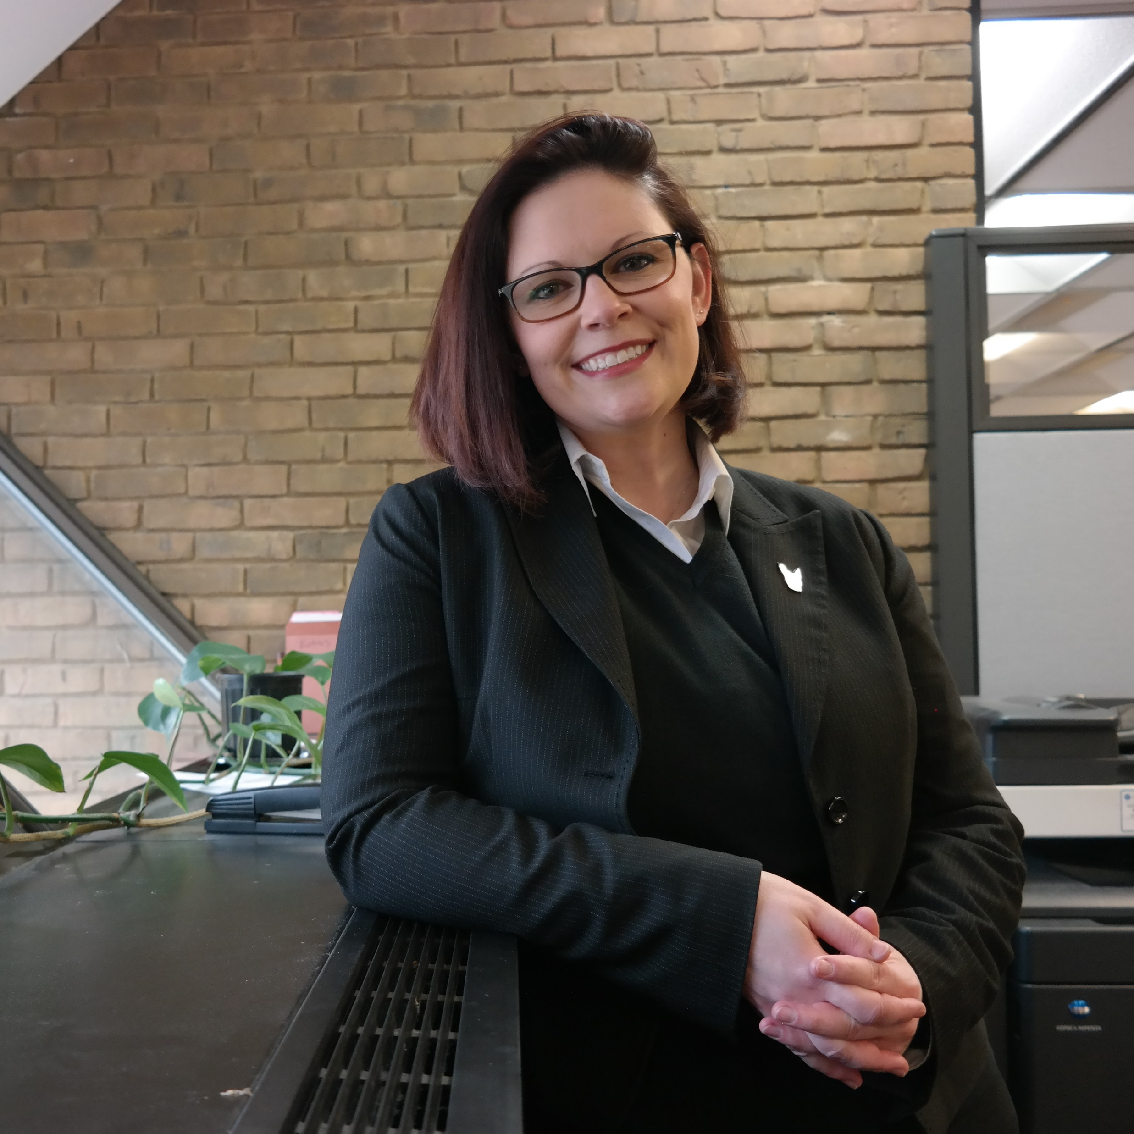
Jessica K. Camp, PhD, MSW
Assistant professor of social work at the University of Michigan-Dearborn
Former CMH therapist and substance use counselor
Research poverty and social inequality
Work to challenge systemic forces that create barriers to well-being
Notes:
Jessica: Key highlights☺.

Slide 3
Tracy S. Hall, PhD, MPA
Executive Director/Office of Metropolitan Impact
Lecturer – Public Administration Masters Program
Operating Partner – Public Allies Metro Detroit
30+ years experience in the public sector:
½ Washington, DC-based, and
½ Detroit, Michigan-based.
Committed to positive social transformation through unending cycles of best practices research & praxis
https://umdearborn.edu/business-community/office-metropolitan-impact
Notes:
TRACY (1 minute max):
Good Morning – we’d like to share a little bit about ourselves before we get into the content of our presentation!
Tracy Hall – I spent the first half of my career in Washington, DC – serving a member of Congress; lobbying for a wide variety of clients; and as a political appointee at the State and Agriculture Departments.
The 2nd half of my career has been spent in SE Michigan in the nonprofit sector and now at University of Michigan-Dearborn – where I’ve both taught in the Masters of Public Administration program and helped establish the Office of Metropolitan Impact – which is committed to deploying the University’s resources on behalf of SE Michigan
NEXT SLIDE

Slide 4
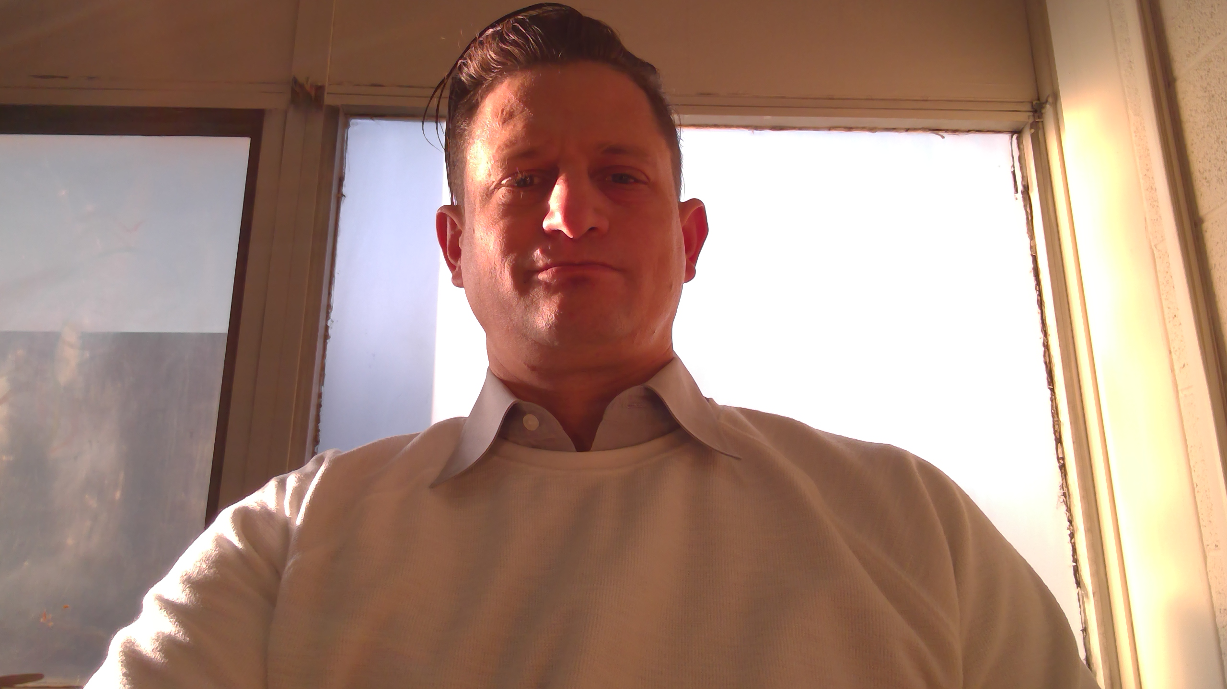
Brian P. Frick M.A.
Jobs for Michigan’s Graduates –Specialist
Trauma Informed Care – National Trainer for Jobs for America’s Graduates
Motivational and Inspirational Speaker
20+ years working in education
Working and specializing in Trauma
Community Activist
Mission: To recreate our Villaging System to bring about positive change across our nation

Slide 5
Public Allies Metro Detroit
(est. 2013)
5- and 10-month stipended capacity-building service experiences with 150-300+ hours of leadership development, training and coaching
Targeting homegrown, “Opportunity Youth” – unconnected to work and/or post-secondary education – convicted that everyone can lead!
Mission: to create a just and equitable society with the diverse leadership to sustain it.
Notes:
How this organically-evolving partnership got started:
OMI launched Public Allies Metro Detroit – the 23rd affiliate of a national AmeriCorps service program.
We’re launching our 6th cohort of roughly 35 individuals in the 10-month apprenticeship program and will host up to 40 in the 5-month pre-apprenticeship program over the course of 2018-2019.

Slide 6
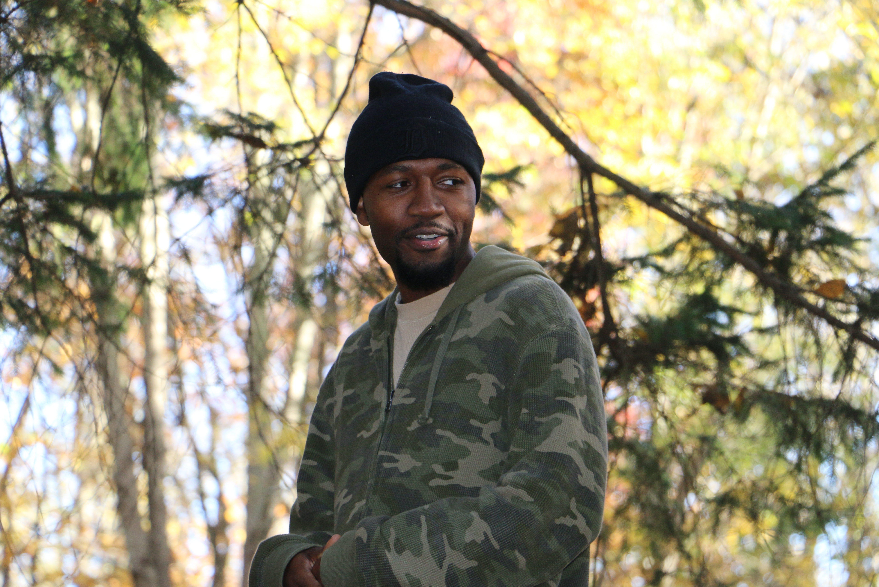
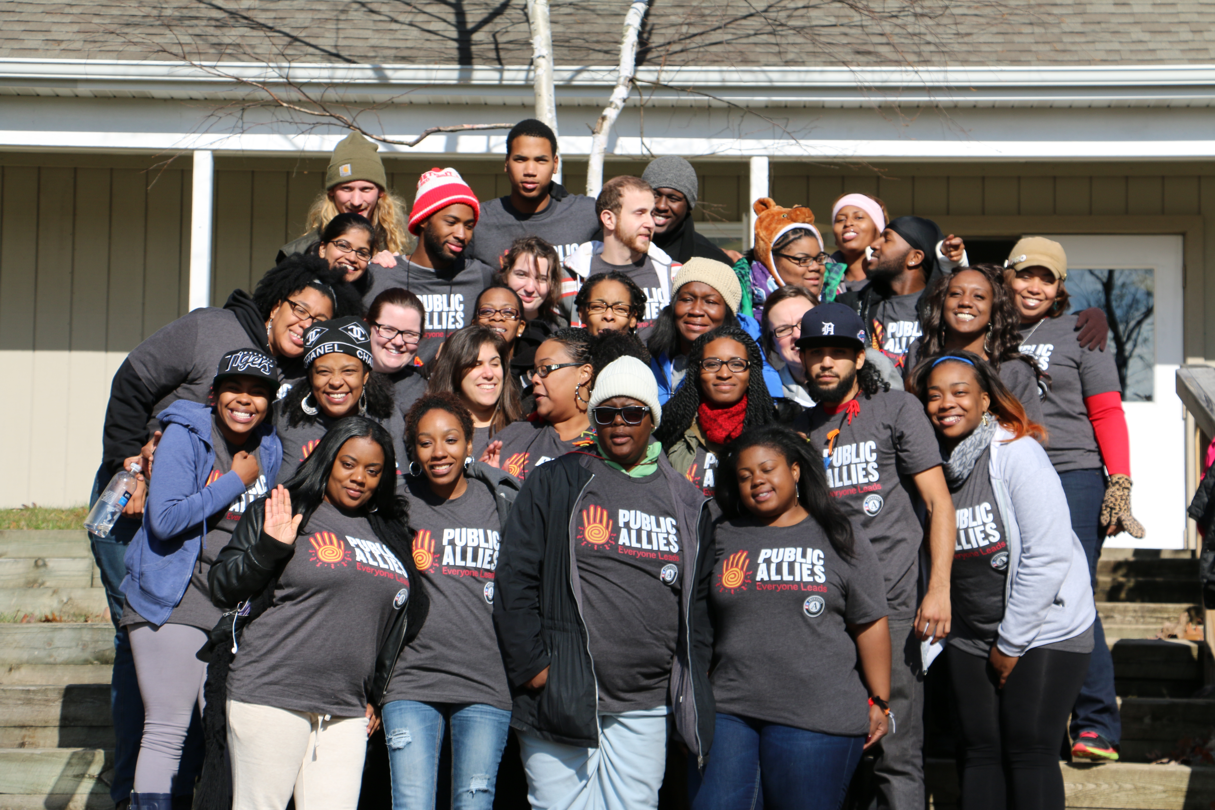
Notes:
To be clear – our PA program is different than most other national service programs:
HS Diploma or GED; citizen; no violent criminal background;
Seeking leaders from community to lead community-building and activism
Nontraditional folks are welcome, re-entering citizens, LGBTQ?, young parents, etc.
60% are OY
61% are non-degreed
83%+ are of color
77% are 17-24 years old
60% female
Audacious goal of changing the face of leadership in Detroit over the next 10-20 years

Slide 7
Detroit’s Workforce Development Board
Notes:
Through our Public Allies work, we were invited to join Detroit’s WFD Board Youth Committee – and became co-conveners of the DOYC several years ago – and became advocating on behalf of the unique needs of this population – roughly 25,000 young adults within our city’s limits, with another 50,000 or so in the inner rim suburbs.
Note: GDYT adjacent to the left – we’ll come back to it in a few minutes.

Slide 8
Detroit Opportunity Youth Collaborative
Opportunity Youth = young adults ages 16-24 who are neither in-school nor working (with or without a high school credential).
DOYC Goal: To develop a sustainable system of pathways into postsecondary credentials and careers in order to improve educational attainment and employment outcomes for opportunity youth, ultimately leading to higher graduation rates, increased economic self-sufficiency, and clearer opportunities for formerly disconnected youth to contribute to a vibrant and growing community.
Notes:
UM Dearborn was asked to help co-convene the DOYC with Detroit’s WFD agency, DESC.
We began traveling twice a year to Aspen Institute’s Opportunity Youth Incentive Fund Convenings – and learned more that resonated with us about OY – especially ideas about TIC, ACEs and related challenges that our members are facing.
All of this additional Youth-focused work resulted in a contract with a U.S. Dept. of Labor-funded Jobs for Michigan’s Graduates project within one of Detroit’s most challenged high schools – Osborn High School – where we met Brian Frick, who is presenting with us this morning.
Our model of engagement was the following (next slide).

Slide 9
Notes:
We began by asking the students what THEY wanted – and developed programming based on their desires.
But, along the way, as we partnered ever more closely with Brian and other JMG teachers, we realized we were seeing the same patterns

Slide 10
BUT, as our collaborative work has deepened over the past 6 years, we have been increasingly faced with how best to support our youth in ways that built on their resiliency and helped them cope with and address their trauma, as well as their poverty/inequality.
Notes:
This led to a serendipitous and fortuitous partnership with Dr. Camp, whose research intersects with our desire to develop best practices that are evidence-based!

Slide 11
Trauma
Trauma exposure is growing among youth today
Society is becoming increasingly disconnected
Youth of color in under resourced areas are more likely to report an exposure to trauma, report more frequent exposures to trauma, and have fewer pathways to recovery after a traumatic event
Notes:
Jessica – Slides 11-20

Slide 12
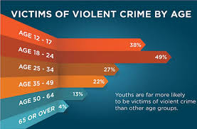
Thinking Outside the Box
Usually think of trauma as abuse and neglect but trauma exposure includes:
Environmental disasters and displacement
Witnessing violence done to others, ie. School shootings
Community violence
Poverty, hunger, intergenerational barriers to well-being
Social exclusion, racism, sexism… etc.

Slide 13
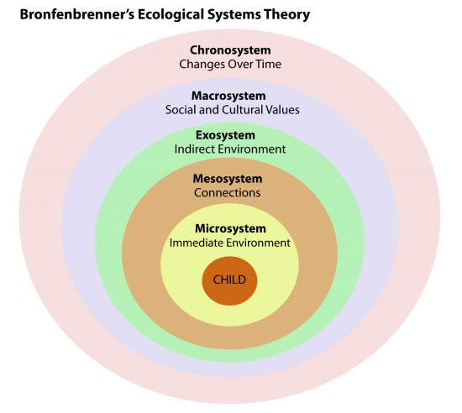
SAMHSA
17 arenas of trauma that range from individual experiences and exposure to macro-level experiences
Majority of currently identified trauma occurs at the micro, or individual, level. (9/17)
5/17 at the mezzo- level, and 3/ 17 at the macro-level

Slide 14
Trauma Defined
“An event, series of events, or set of circumstances that is experienced by an individual as physically or emotionally harmful or life threatening and that has lasting adverse effects on the individual's functioning and mental, physical, social, emotional, or spiritual well-being.” SAMHSA, 2016
Individuals who experience trauma become more sensitive to future threats.
Threats can be actual experiences of harm or perceived threats of harm, ie. triggering of past trauma is perceived but the individual is still experiencing the event as an active experience of harm.
Trauma rewires and restructures the brain for children and adults.

Slide 15
The Brain Model

Slide 16
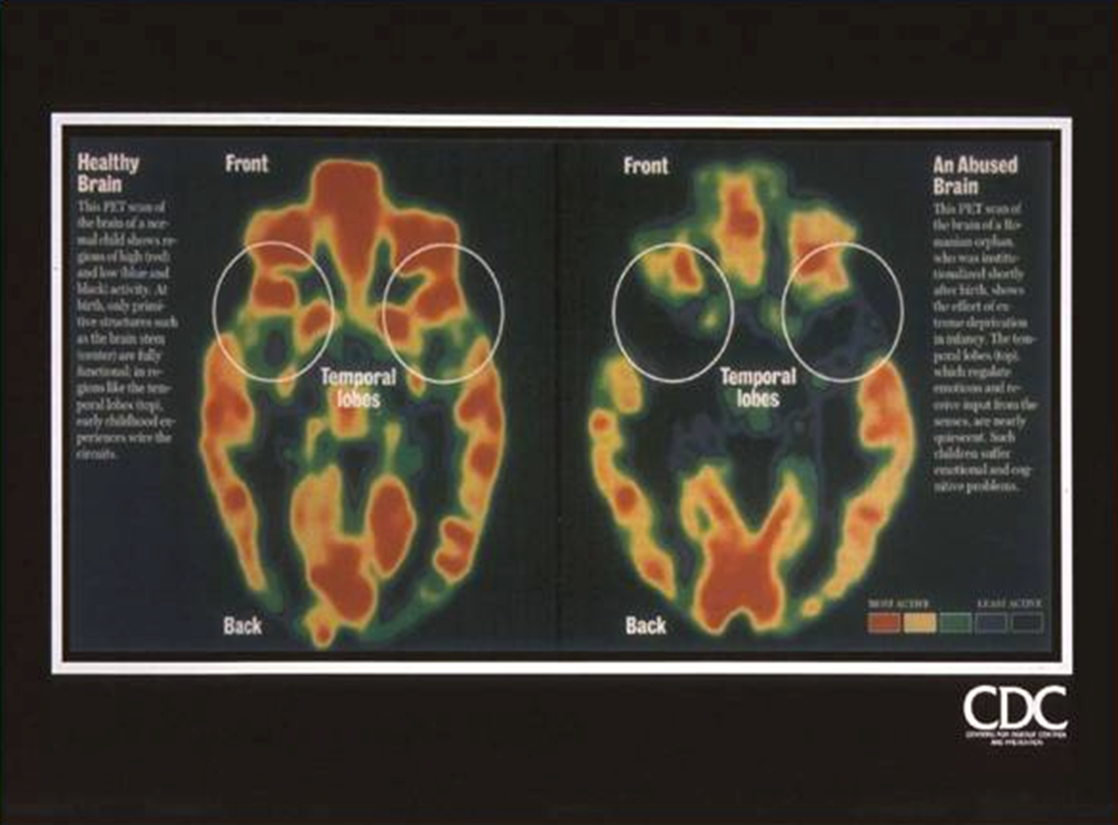
Trauma and the Brain

Slide 17
Redefining Trauma
Trauma is a force or experience that creates disconnection internally and externally. Trauma can be intentional or unintentional, be caused at any level of the ecological system, and have consequences at any level of the ecological system.
Poverty and inequality is a measure to which an individual or group currently and historically experienced trauma and to what degree they have the ability to access pathways to recovery and well-being.

Slide 18
Trauma Causes Disconnection from Life Opportunity
Students with 4 or more ACEs had 1.79 times the odds of chronic absenteeism.
Chronically absent students are 4 times the odds more likely of dropping out of high school.
High school drop outs live, on average, seven years less than college graduates.
Youth exposed to trauma have 2.34 times the odds of experiencing high school drop out
Youth exposed to trauma have 1.56 times the odds of experiencing poverty.

Slide 19
What do we do?

Slide 20
Trauma Informed Care + Restorative Practices
Model that combines the evidenced-based and best practices models of trauma-informed care with restorative practices.
Increase awareness of the impact of trauma and create systems that restore safety and belonging.

Slide 21
Healing Centered Restorative Engagement
Focused on what we are trying to do- heal, not on the perceived injury to the youth.
Argues for both a clinical and political understanding of the impact of trauma. Understands healing as both a process of therapy and social action.
Culturally grounded- healing should be experienced collectively as the restoration of identity and belonging.
Strengths focused- Remain committed to the healing we want to accomplish. Focus on the restoration of well-being.
Supports providers who are exposed to secondary trauma and may need to engage in their own work. “Adulthood is not always a trauma-free destination”- Shawn Ginwright 2017
Healing is demonstrated by a re-engagement with experience, knowledge, skills, curiosity, civic responsibility, and service to others.

Slide 22
Helping Students Understand Trauma?
Trauma is created very similar to how a slinky works
It builds through our actions
When it occurs in is contained within our bodies
Animals are experts at COPING with Trauma
We are starting to see how trauma affects us physically, emotionally, and Educationally

Slide 23
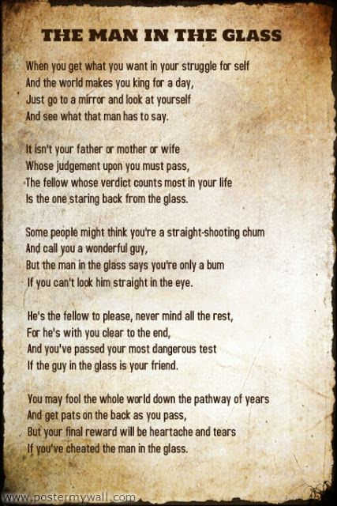
Trauma Informed Care & Restorative Practices in the Classroom in the School
Helping students deal with the Toxic Stresses in their lives starts with Understanding self.

Slide 24
Helping Learn to Respond rather than React
Event
Little to no control
Initial Emotion Result
Little to no control
---STOP
Breathe
Behavioral/Cognitive
React
-VS.
Respond

Slide 25
Next Steps
Healing Centered Restorative Engagement
Working to build strong, long-term partnerships with:
University of Michigan-Dearborn’s Office of Metropolitan Impact (UM-D/OMI)
Detroit Public Schools Community District (DPSCD)
Detroit Employment Solutions Corporation (DESC) – the city’s workforce development system
Jobs for America’s/Michigan’s Graduates – supporting those in-school and out-of-school youth who are at highest risk of unconnection/disconnection
Notes:
Tracy – summarizing where we’re going from here:
Fundraising for research & implementation
Research – JMG data analysis – UM grad student assistance
Model dissemination
Learning Community / Community of Practice – transparent collaboration
Anticipated academic and popular press publishing

Slide 26
Notes:
It’s now your turn to ask questions that you haven’t yet had a chance to ask …..

Slide 27
Contact Us
We would LOVE to hear from you!
Tracy S. Hall, PhD, MPA
#313-583-6379
tshall@umich.edu
Jessica K. Camp, PhD, MSW
313-593-5099
#jkcamp@umich.edu
Brian Frick, MA/Counseling
#313.296.5645
Bfrick@detempsol.org

