Slide 1
True Justice for Youth::
Non-Punitive Measures of Prevention, Enrichment, Support and Restoration for Disadvantaged, Racial/Ethnic Minority and Immigrant Students
Dr. Magda A. Cabrero

Slide 2
From Dean of Students to Restorative Justice Facilitator
My work, research, blog
Punitive
Impersonal
Incremental matrix
In-School-Suspension for attendance issues
More preventive & restorative
Student Stories

Slide 3
MY BLOG:
https://truejustice4youth.org
True Justice for Young Offenders: My Experiences Facilitating Restorative Justice Circles
https://www.truejustice4youth.org/blog/true-justice-for-young-offenders-my-experiences-with-restorative-justice-circles
True Justice for Borderlands Children: Latino/a Children’s Experiences, Voices & Perspectives
https://www.truejustice4youth.org/blog/true-justice-for-borderlands-children-latino-a-children-s-experiences-voices-perspectives
True Justice for Invisible Children: A Dream Deferred & The Dreamkeepers of African American Children
https://www.truejustice4youth.org/blog/true-justice-for-invisible-children
Book Review of African American Childhoods: Historical Perspectives from Slavery to Civil Rights
https://www.truejustice4youth.org/blog/book-review-of-african-american-childhoods-historical-perspectives-from-slavery-to-civil-rights
Borderlands Latino/a Children: Other People’s Children
https://www.truejustice4youth.org/blog/borderlands-latino-children-other-people-s-children

Slide 4
Preventive, Restorative Discipline
Discipline with Dignity:
Respects Funds of Knowledge
Not shameful
Circle of Support, Circle of “Cariño” (affection, caring):
Mentoring, Zone of Proximal Development
“This child could have been my own”
Inclusiveness, center
Facilitates Child’s Voice:
Voice of the child – listened, facilitated
Characteristics, life stories
Center of curriculum
Speech functions
Cognitive Development
Expressive
Facilitates Child’s Agency:
Empowerment
Equal stakeholder
Active, non-reactive
Safe; no need for self-defensiveness
Frontal lobe & decision-making
Accountability, behavioral agreements
Restoration and involvement based on uniqueness
Hopeful
Growth spurt
Considers social identity issues of the traditionally marginalized child

Slide 5
Punitive Discipline
Less Dignity
Shameful
Abuse of authority
Less funds of knowledge, less dignity
Criminalizes “other people’s children”
No Circle of Cariño,
No real support
No mentoring or community
Association of violence with discipline
Misbehavior increases negative feedback
Cumulative
Increasing exclusiveness, “other people’s children”
No safety, lack of trust in the system
Less Voice
Impersonal, incremental matrix
No listening to child’s story
Monologue, sentence by judge, one way, non-transactional
Less expressive, does not develop expression ability
Less Agency
Disempowers
External locus of control, done to students
“Don’t get caught” mentality
No cognitive development
Uniqueness of how to contribute lacking
Not more altruistic
Assumptions, “I am going to teach you a lesson”!
Reactive, defensive, not active
No consideration of social identity issues

Slide 6
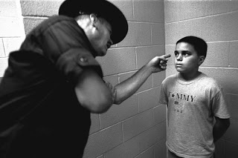
Punished Youth: Other People’s Children
I am going to teach
YOU
a lesson!

Slide 7
In-School-Suspension Data 2016-17
Demographics of my school in Fairfax County Public Schools, Virginia, USA
Hispanic: 50%
Black: 6.79%
White: 18.57
Asian: 20.71%
Other: 3.62
Free or Reduced: 55.97%
Gender: 53.16 % Male & 46.84% Female
Freshmen: 29.39%
The most frequent punisher (48%)? (1/5 APs, female, White)
The Least Frequent Punishers: The two Latino APs
Highest Grade Level: 9th Graders – 40%
Highest Gender: Males – 69%
Highest for ESOL: ESOL 1 (double every other)
ISS Distribution:
Latino/a: 67%
Black: 13%
Multiracial: 12%
White (Middle Eastern): 8%
White (No Middle Eastern): 4%
ASIAN: 4%
ISS more than three times:
H: 53%
B: 27%
MULTI - 12%
W (Middle Eastern): 8%
W (Non-Middle-Eastern): 0
Asian: 0

Slide 8
Social Identity Issues
“…that part of the individual self-concept which derives from his knowledge of his membership of a social group (or groups) together with the value and emotional significance attached to that membership” (H. Tajfel & J. Turner)
Multiple identities, dual, triple; hyphenated (“I am not American”), borderlands
Marginalization: the other (often the most personal and familiar) is less
Invisible and marginal in dominant curriculum & literary practices
Subtracting schools (E. Valenzuela); low expectations
Not expressive; powerless and voiceless despite heroic stories; often ignore own histories

Slide 9
Ethnic Identity vs. Racial Identification- Impact identity, sense of self-worth
Labels
Positionalities: Cultural straddlers, noncompliant believers, or cultural mainstreamers (Carter, 2005); acting white
Oppositionality, prefer to fail than to be disempowered
Need to explore identities, positionalities, deconstruct injustices in society and literature, reconstruct a stronger identity

Slide 10
African American Children
“Children’s nihilated identity: culturally, linguistically and racially” (J. King)
No true self-consciousness vs. revelation of the other world (W.E.B. DuBois)
Two warring souls: An American and a Negro, but at the margin (W.E.B. DuBois)
“It is a peculiar sensation, this double-consciousness, this sense of always looking at one’s self through the eyes of others, of measuring one’s soul by the tape of a world that looks on in amused contempt and pity. One ever feels his twoness –an American, a Negro,; two warring souls, two thoughts, two unreconciled strivings, two warring ideals in one dark body, whose dogged strength alone keeps it from being torn asunder. The history of the American Negro is the history of this strife –this longing to attain self-conscious manhood, to merge his double self into a better and truer self…” (p. 3) (W.E.B.DuBois)
Well-documented history of implicit and explicit discrimination
More sophisticated forms of historic exploration & support systems than Latinos

Slide 11
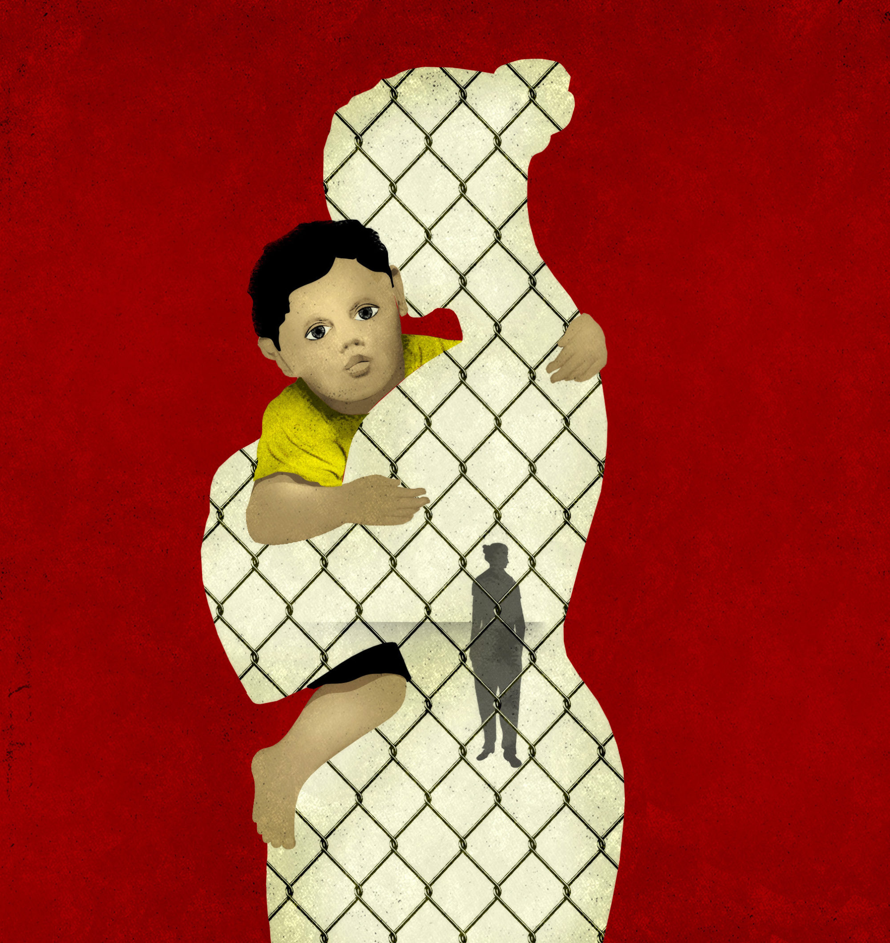
Latino Children
Ethnicity has been racialized
Order of immigration: 1st, 1.5, 2nd (history knowledge)
Consonant acculturation vs dissonant acculturation
Role reversal, limited communication with parents
Limited bilingual, fluent bilingual (Diglossia); females and males
Language and order of immigration
Downward assimilation or eventual academic disengagement
Selective acculturation: original language and culture, and English and American culture

Slide 12
Positive Sense of Identity: Challenging Task
Positive sense of identity, one of the most challenging tasks:
“Language inconsistency at home and school, a perceived gap in the status of their parents and the quality of their environment and those of the larger society, and the dangers and attractions of barrio streets create an ambiguity in their ethnic identity. Parents and older siblings are often unable to effectively guide youngsters in ways to reconcile the contrasting cultural worlds, and this results in an uneven adoption of acculturative strategies”. (J.D. Vigil, p. 41)
My incarcerated student (My Blog “Freedom Readers: What I lost and gained from my literary correspondence with my incarcerated student”):
2nd generation
Limited language and cultural knowledge
Divorced parents
Lack of father involvement
Dissonant acculturation between mother & son
Poor, unsafe neighborhood
Lack of protection and safety
ADHD’s needs neglected by home and school

Slide 14
Marginalized Sense of Identity
African Americans
Hostile and derisive depiction by the media 19th & 20th centuries (African American Childhoods)
The Invisible Children: School Integration in American society (Ray C. Rist)
My Blog: “True Justice for Invisible Children: A Dream Deferred and the Dreamkeepers of African American Children.”
Other People’s Children (Lisa Delpit)
My Latino Students:
“I was born here but I am not Americanized, I guess. How white people live like, like they live in those big houses. They have everything they want like picture perfect lives”.
“I identify as a ‘hispano’ or ‘latino’ since both for me mean the same. People identify me as ‘bruto’ (brute), ‘maleante’ (criminal), gangster and all of those labels. But I don’t care. I am who I am and don’t care about what anyone says about me. I also identify as a worker since when I like to accomplish something I do a good job”.
“My dad is different from Americans. Being Latino in the United States you experience racism. I like being Hispanic but people already assume that I don’t speak English; but I like being Hispanic; our class makes me feel better about being Hispanic. It makes me feel more proud all the different countries in our class. I have gone through a lot of identity crises. I have gone a lot through it. I felt ashamed because I heard things about being Hispanic. Tenth grade was when I thought about it for the most time. You start thinking about who you are and one of the things you are is Hispanic and I have gone a lot through that. […]. I know I am Hispanic and can’t do anything about it. I am in eleventh grade. My parents are the nicest people I know. And I know many Hispanic people that aren’t like that.”
Interest and identification in marginalized literary topics

Slide 15
Social Identity Exploration
Culturally Responsive Pedagogy:
Linguistic identity exploration
Cultural identity exploration
Borderlands literary topics
Connection to roots, family and community
Cultural gender exploration
Voices
Agency
Classroom culture
Literary Topics:
Language
Roots
Borderlands experiences
Marginal experiences and positionalities
Voices
Cultural gender roles
Critical theory
Linguistic Identity Exploration:
Ebonics
Black English
African American Vernacular English (AAVE)
African American Language
English monolingualism
Spanglish
Spanish/English bilingualism (diglossia).
Cultural Exploration:
National identity
Panethnic identity
Roots
Positive and negative cultural characteristics
Identification vs. identity
Labels
Reader/Writer Identity:
Resistant reader; semi-resistant reader; non-resistant
Resistant writer; semi-resistant writer; non-resistant writer

Slide 16
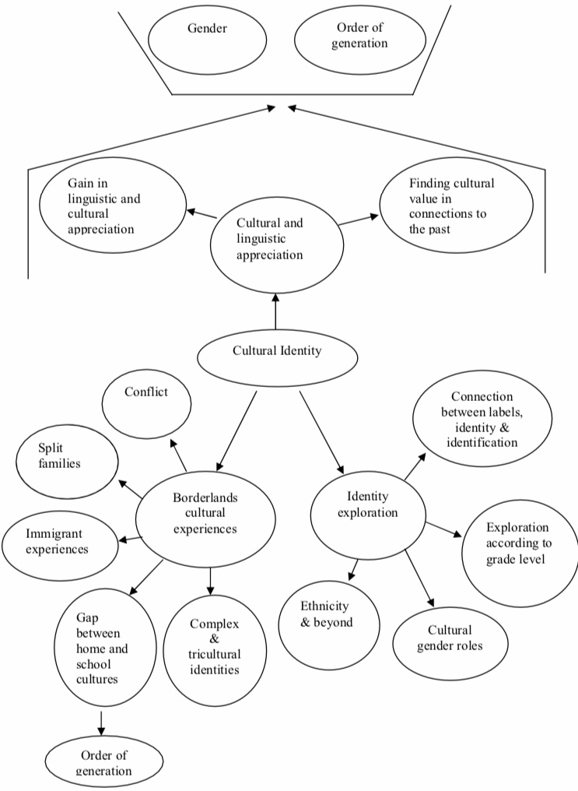
Cultural Identity Exploration
(My dissertation, page 93)

Slide 17
What Do Circles Mean
To You?

Slide 18
Third Space: Circle of Cariño
A space for co-constructing what is mutually meaningful
“We need to learn how to care for the world of human-made objects and their arrangement. What if we had to start from scratch? How much of the human-made world could we thirty people recreate?” (N. Noddings)
Equal stakeholders, with equal responsibility, agency, voice in a supporting community (My Blog)
Familism, communal values, circular
Oral tradition for book reading & discussion; Circle-Sustained Reading, library visits
Personalized, identity-related book club circles: exploration of stories, histories, funds of knowledge, social identity, labels, critical literary theory
Mentoring/Welcoming/Inclusive Programs: – Ladies of Honor, Men of Honor, S.T.A.R. (Student Training in Accountability & Responsibility), Check & Connect Mentoring, New Jags (for recent immigrants), Attendance Restorative Circles (handouts)

Slide 19
Third Space: Circles of Cariño
Engaging schools, “sense of belonging”, connectivity and safety
Caring/empathetic teachers – more impact on hard enough students (L.J. Dance)
Lots of dialogue, story telling, deep listening, cognitive coaching (facilitating the thinking and decision making processes)
Restorative Justice Discipline: In the safety of the circle, explore what has been done, who has been impacted and how, and how to repair the harm (classroom example)
“Our class has so much connectivity. I like how we change seats often and get to sit next to different people. It is like a community. We are all weird. I felt that Rafael [who had been incarcerated] was like my brother”.

Slide 20
Circle of Cariño

Slide 21
Student Voices: Tales of Heroism!

Slide 22
“When I was a little girl I had to take care of my brother. My older brother was our father and mother in one person. But when he died I did not know how to make my life function. But since my older brother used to take care of us I had to start taking care of my little brother. I was a mess when my oldest brother died but I had to put myself together for my little brother. I had to comfort him during the first months and later when my parents were not at home. I used to be the one to cook for him and used to help him in his homework. Taking care of my brother meant everything for me. And it is still my obligation but I don’t feel forced. I do it because I love my brother and want the best for him. Now he tells me I am like the mother we did not have. He is my priority. Now I cook only during the weekdays. On the weekends I rest”.

Slide 23
“For two years I lived in El Salvador with my aunt. During those years I spent fun time with my cousins. […] The movie “Under the Same Moon” made me think about my own past. I remember how much I missed my mother. And I used to think like the child in the movie. I thought that she did not love me, but when I grew up I realized that she did. Even though I lived with my aunt and used to see my oldest sister, it was not the same as having my mother with me. The idea of leaving my whole life in El Salvador caused me a lot of fear. I did not know how things were going to be here. When I used to live in El Salvador I did not have to attend school but I was told that when I came to the United States I would have to go since that was the law in the United States.
I felt terribly since I did not want to leave my cousins and could not bring my toys in my suitcase. When the day arrived I felt really badly. When I arrived to the airport my stomach started to hurt. I was so afraid that I lost my appetite […]. Then the time came to get into the airplane. I started to cry. All of my relatives hugged me and told me goodbye. I got into the plane with my uncle and cousins. In the airplane I slept several hours. Finally the airplane landed. There were my mother, brother and sister waiting for me”.

Slide 24
“My parents tell me that from the age of one more or less I used to travel to El Salvador. I never went with my parents. I traveled with my grandparents, my uncles and aunts. My mother tells me that […] I always used to come back speaking with the accents of the children from there. I used to come back as an entirely new person…each time that I go back to El Salvador I cry while I go towards the airport and take the plane to go there. I feel that I will miss my loved ones in the United States….but when I come back the same thing happens to me, I come sobbing because I feel that I leave who I really am there. Even though I was not born in El Salvador, I feel I am from El Salvador. It is in my blood, it runs through my veins. I feel, like India Maria (comedian) says, ‘I am neither from here, nor from there.’ Inside of me there is always a voice that wants to come out. I understand the importance of being bilingual and bicultural in this country but in reality almost always only English is the language that is used. The only places where I feel that I can allow that second person to come out are in Spanish class and in my home. I wish I could change that in one way or another.”

Slide 25
“I have become introverted. I was expressive before but I have changed. My father was deported; can no longer enter here. Now I cry a lot and I am sad and pretend to be happy when I don’t want anyone to know what happened. Now you know something about me and I hope you will understand why I don’t speak much in your classroom.”

Slide 26
“When I saw this movie (Under the Same Moon) for the first time I started to cry because I went through something similar. When my father came to the United States it was very sad for me and hard not to see him every day. But through the years he could save money to bring me to the United States. And for him that was really hard since he had to work night and day to make money to be able to bring us.
That is why I appreciate all he does for me and my siblings. I don’t plan to get in trouble because he does not deserve that I fail him that way.”

Slide 27
Curriculum
Stories of heroism: More visibility, validation and exploration
Reflects funds of knowledge
“Because English class is not interesting, but in your class we read things that have to do with us.”
“…school-driven definitions of literacy need to be reexamined in light of adolescents’ authentic literacy practices” (p. 178). (M. Leslie, 2001).
Broader understanding of literacy - oral and written expressions of African American dialect (G. Ladson-Billings)
Bridges dominant and non-dominant literary text
Library’s list (S.C. Athanases; E. Moje)
Marginalization and demarginalization
More expressive
Facilitates identity exploration
Deconstruction and positionality exploration using critical literacy theory
Agency instead of victim mentality

Slide 28
Nicolas (trying to leave gang life): “After much search for a book that he enjoyed and after jointly deciding that he did not like reading fiction -- Nicolas insisted he disliked reading throughout the school year -- I found him one about Latin American history which included Aztec and Mayan history. In an essay that was the longest of any of my students and by far his best in the year, Nicolas wrote a detailed account of the history of his ancestors based on that book. Nicolas expressed how much he liked ancient history, particularly his Aztec and Mayan histories: “I want to learn about Mayans and Aztecs. I feel connected because it is my culture; I am Mexican, Mayans love art. American history is boring, not enough background or ancient history. I like to read about what people are capable of doing; genocide and all of that. Some people break down and cry about it, but it happens. Not me. People make decisions that affect the whole world” (May 24, 2010). At the time of that conversation, Nicolas was taking Advanced Placement World History, which he considered his favorite class”. (My dissertation, p. 153 & 154)
WRITING ENTRIES BECAME INCREMENTAL IN LENGTH AND DEPTH IN MY CLASS!

Slide 29
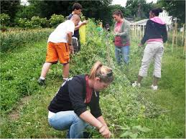
Agency
Empower, equal stakeholders in community & in discipline
School agents facilitate student agency
Connection between personal, historical, cultural, linguistic strengths and more authentic involvement
Critical Theory & Critical Literacy focus on agency, not victimzation
School programs require community service and involvement
“I want to learn to write and read more in Spanish next year. Latin culture is strong, I want to read more, write more, those accents”.
Gang Member: Visited Maya civilization, out of gang life, child psychologist
Incarcerated Child: Three year-correspondence of empowering poems in Spanish; graduation; second fastest to leave Boys’ Home; moved out of neighborhood

Slide 30
Justice High School’s S.T.A.R.
(Student Training in Accountability & Responsibility)
Lobby at the House of Delegates in Richmond, Virginia
January, 2019

Slide 31
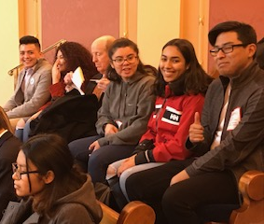
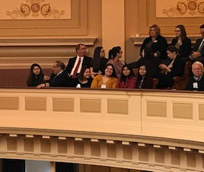
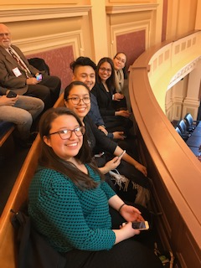
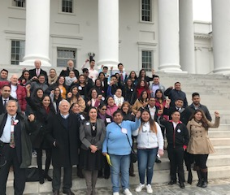
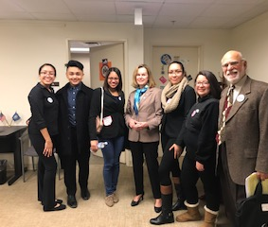

Slide 32
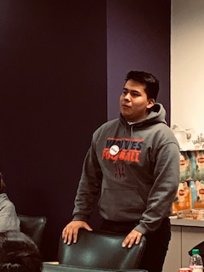
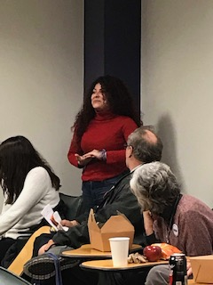
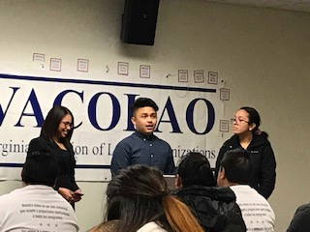
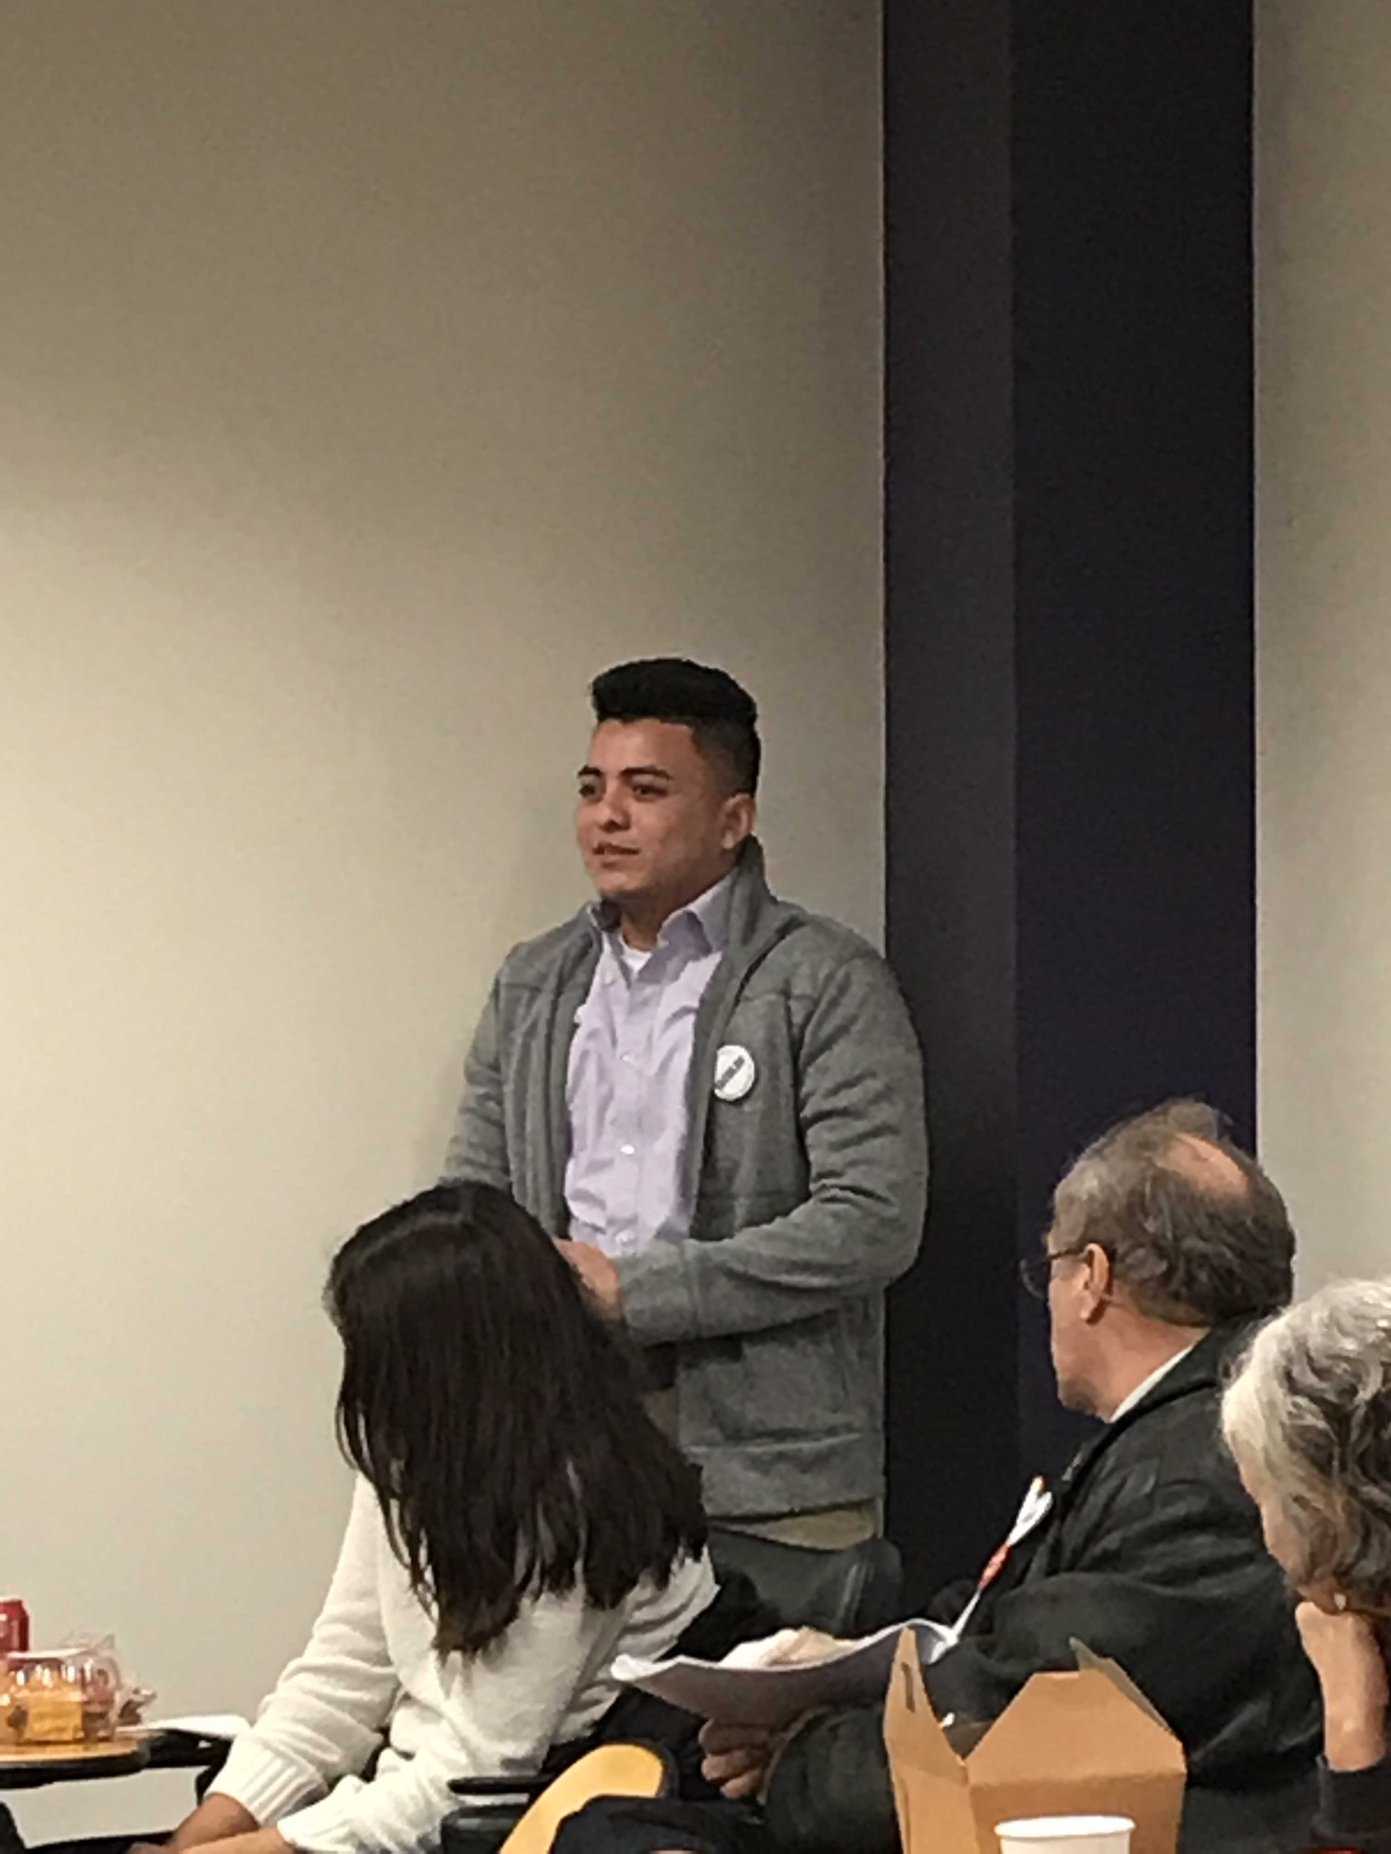
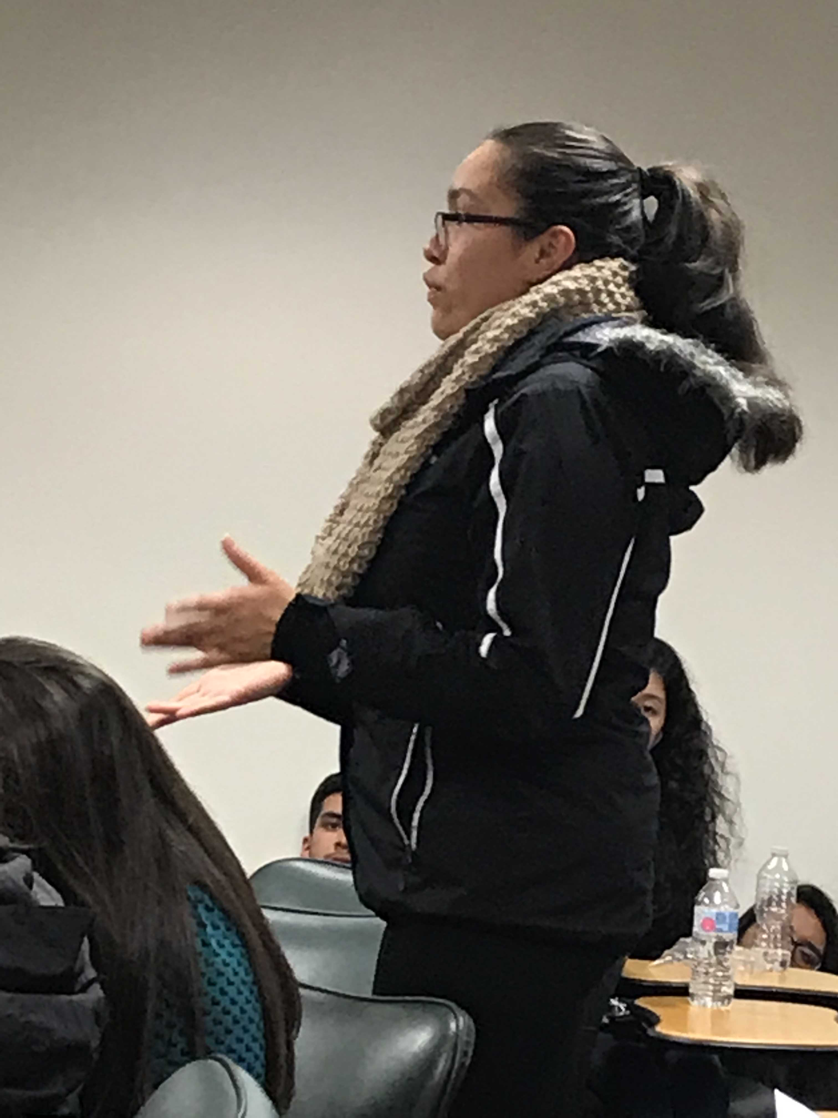

Slide 33
S.T.A.R. Students’ Training On
How to Lobby
by Giancarla Rojas
January, 2019

Slide 34
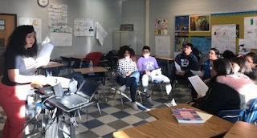
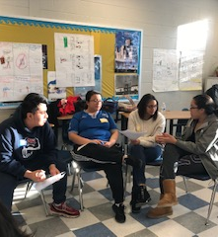
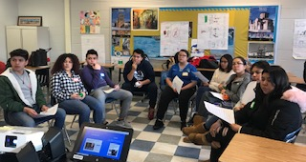

Slide 35
S.T.A.R. Members Speak About Impact of their Community Service

Slide 36
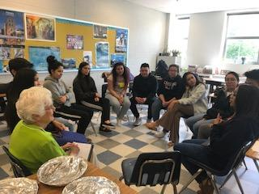

Slide 37
True Discipline
Prevention, enrichment, intervention, support, restoration (not punishment)
Reinforceable behavior agreements for accountability (3 samples in handouts)
Third space; Circle of Cariño in Zone of Proximal Development
Voice, development of speech functions
Curriculum demarginalizes, bridges, reflects, encourages expression
Identity Exploration
Critical Literary Theory
Agency in community involvement and how to repair

Slide 38
True Discipline
No assumptions, teaches a better way: explanation, practice, repetition and evaluation like academic instruction
Challenges to grow rather than threats or rewards
Rules broken an opportunity to build community
Growth spur, more altruistic
Higher form of dignity and identity
Empathy and compassion, “cariño”
Other people’s children/young offenders could have been our own

Slide 39
Ladies of Honor
Falls Church High School
Fairfax County, Virginia
May, 2017

Slide 41
Handouts With Non-Punitive Resources
Restorative Justice: #1 Unhelpful Punishment; #2 Criteria for Restorative Justice in Schools Referral (Created by Fairfax County Public Schools, Virginia, USA)
School Engagement: #1 School Engagement Survey; #2 STAR Community Service Agreement
Resilience, Endurance & Student Literacy: #1 Resilience & Endurance Literature for Youth; #2 Ladies of Honor Library Topics
Mentoring: #1 Check & Connect Mentor Training (Created by Fairfax County Public Schools, Virginia, USA); #2 Check & Connect Permission Form; #3 About Me, Connecting with Your Mentee; #4 For Mentors at Schools
Ladies of Honor: #1 Ladies of Honor Program; #2 Referral for Ladies of Honor & Men of Honor; #3 What is it to Be a Lady of Honor?

Slide 42
Handouts With Non-Punitive Resources
New Jags Program (Program for Recent Immigrant Students)
Ladies of Honor & New Jags Data
S.T.A.R. (Student Training in Accountability & Responsibility): #1 STAR Description; #2 STAR Questionnaire for Student Involvement; #3 STAR Questionnaire for Beginning, Middle & End of the School Year
Cultural Proficiency (Created by Fairfax County Public Schools, Virginia, USA): #1 Cultural Proficiency; #2 Cultural Proficiency Continuum
Behavior Contracts: #1 Behavior Contract Explanation & Sample 1; Behavior Contract Sample 2; Behavior Contract Sample 3
Attendance Circles

Slide 43
REFERENCES
Athanases, S.Z. (1998). Diverse learners, diverse texts: Exploring identity and difference through literary encounters. Journal of Literacy Research, 30, 273-296.
Cabrero, M. (2011). Using borderlands literature to increase interest in literacy in the heritage language: Teacher research with Latino/a teenage students (Doctoral Dissertation).
Carter, P. L. (2005). Keepin’ it real. New York: Oxford University Press, Inc.
Curwin, R. (2018). Discipline with Dignity: How to build responsibility, relationships, and respect in your classroom (4th Ed.). Alexandria, VA: ASCD.
Dance, L.J. (2002). Tough fronts: The impact of street culture on schooling. New York, London: Routledge Falmer.
Delpit, L. (1995). Other people’s children: Cultural conflict in the classroom. New York: The New Press.
Dubois, W.E.B. (1989). The souls of Black folk. New York: Penguin.
King, J.E. (2006). If justice is our objective: Diaspora literacy, heritage knowledge, and the praxis of critical studying’ for human freedom. In A.F. Ball (Ed.), With more deliberate speed: Achieving equity and excellence in education realizing the full potential of Brown v. Board of Education (pp. 337-360). Massachusetts: Blackwell Publishing Malden.
King, W. (2005). African American Childhoods: Historical perspectives from slavery to civil rights. New York: Palgrave MacMillan.
Ladson-Billings, G. (1994). The dreamkeepers: Successful teachers of African American children. San Francisco: Jossey-Bass Publishers.
Leslie, M. (2001). Exploring the links between critical literacy and developmental reading. Journal of Adolescent & Adult Literacy, 45(3), 180-189.

Slide 44
Leslie, M. (2008). Access and resistance to dominant forms of discourse: Critical literacy and “at-risk” high school students. Literacy Research & Instruction, 47, 174-194.
Moje, E. (2000). “To be part of the story.” The literacy practices of gangsta adolescents. Teachers College Record, 102 (3), 651-690.
Ogbu, J. & Simmons, H.D. (1998). Voluntary and involuntary minorities: A cultural-ecological theory of school performance with some implications for education. Anthropology and Education Quarterly, 29(2): 155-88.
Phinney, J.S. (1989). Stages of ethnic identity in minority group adolescents. Journal of Early Adolescents, 9, 34-49.
Phinney, J.S. (1993). A three-stage model of ethnic identity development in adolescence. In M.E. Bernal & G.P. Knight (Eds.), Ethnic identity formation and transmission among Hispanics and other minorities. Albany: State University of New York Press.
Rios, V. (2011). Punished: Policing the Lives of Black and Latino boys (New perspectives in crime, deviance, and law). New York: NYU Press.
Rist, R.C. (1978). The invisible children: School integration in American society. Cambridge, Mass.: Harvard University Press.
Rodriguez, R. ( ). Hunger of memory: The education of Richard Rodriguez. New York: Bantam
Tajfel, H., & Turner, J. (1986). The social identity theory of intergroup behavior. In S. Worchel & W.G. Austin (Eds.), Psychology of Intergroup Relations (pp. 7- 24). Chicago, Illinois: Nelson.
Valenzuela, A. (1999). Subtracting schooling. Albany, NY: State University of NY Press.
Vigil, J.D. (1988). Barrio gangs: Street life and identity in Southern California. Austin, TX: University of Texas Press.

Slide 45
magda.cabrero@truejustice4youth.org

